Slide 1

Data Science and Machine Learning in Finance: Problem set 1
Hadi Movaghari
2022-2023

Slide 2

Question 1
Consider the following joint probability distribution:
(1.1) Compute the marginal distributions for X and Y.
With these in hand, compute E[X] and E[Y ].
$E\left[X\right]=\sum_{x}{x.P(X=x)}=\left(0×0.4\right)+\left(1×0.2\right)+\left(2×0.4\right)=1$ $E\left[Y\right]=\sum_{y}{y.P(Y=y)}=\left(−5×0.4\right)+\left(2×0.35\right)+\left(8×0.25\right)=$0.7
X y | 0 | +1 | +2
-5 | 10% | 20% | 10%
+2 | 20% | 0% | 15%
+8 | 10% | 0% | 15%
Marginal distribution of X
X | 0 | +1 | +2
P(X=x) | 0.4 | 0.2 | 0.4
Marginal distribution of Y
Y | -5 | +2 | +8
P(Y=y) | 0.4 | 0.35 | 0.25
Data Science & Machine Learning in Finance: Problem set 1
University of Glasgow
2022-2023

Slide 3
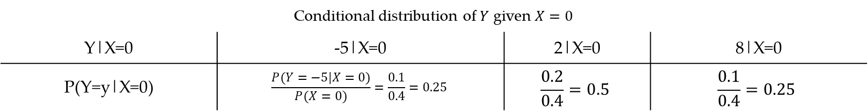

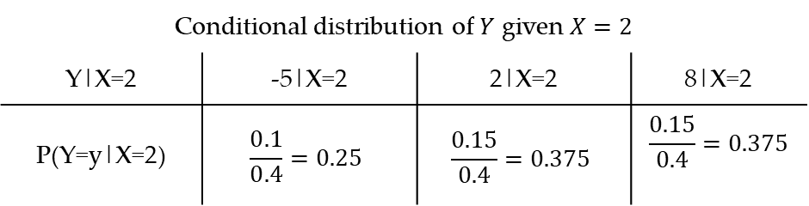
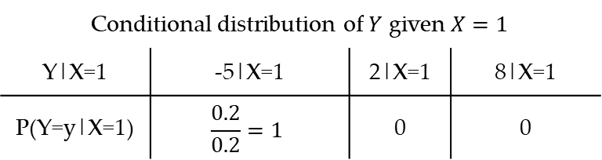
Question 1 (Cont’d)
(1.2) Compute the conditional distribution of $Y$ given $X$:
If we fix variable $X$ on a specific value, for example $X=0$, then using marginal distribution of $X$ and joint probability distribution of $X$ and $Y$, we have:
Similarly, conditional distribution of $Y$ given other values of $X$ are:
Conditional distribution of $Y$ given $X=0$
Y|X=0 | -5|X=0 | 2|X=0 | 8|X=0
P(Y=y|X=0) | $$\frac{P(Y=−5|X=0)}{P(X=0)}=\frac{0.1}{0.4}=0.25$$ | $$\frac{0.2}{0.4}=0.5$$ | $$\frac{0.1}{0.4}=0.25$$
Conditional distribution of $Y$ given $X=2$
Y|X=2 | -5|X=2 | 2|X=2 | 8|X=2
P(Y=y|X=2) | $$\frac{0.1}{0.4}=0.25$$ | $$\frac{0.15}{0.4}=0.375$$ | $$\frac{0.15}{0.4}=0.375$$
Conditional distribution of $Y$ given $X=1$
Y|X=1 | -5|X=1 | 2|X=1 | 8|X=1
P(Y=y|X=1) | $$\frac{0.2}{0.2}=1$$ | 0 | 0
Data Science & Machine Learning in Finance: Problem set 1
University of Glasgow
2022-2023

Slide 4

Question 1 (Cont’d)
(1.3) Compute the conditional expectation of E(Y | X = x) for all three values of X.
By definition:
$$E\left[Y | X=x\right]=\sum_{y}{y.P(Y|X=x)}$$
Thus, using three previous conditional distributions, we have:
$E\left[Y | X=0\right]=\left(−5×0.25\right)+\left(2×0.5\right)+\left(8×0.25\right)=1.75$
$E\left[Y | X=1\right]=\left(−5×1\right)+\left(2×0\right)+\left(8×0\right)=−5$
$E\left[Y | X=2\right]=\left(−5×0.25\right)+\left(2×0.375\right)+\left(8×0.375\right)=2.5$
Data Science & Machine Learning in Finance: Problem set 1
University of Glasgow
2022-2023

Slide 5
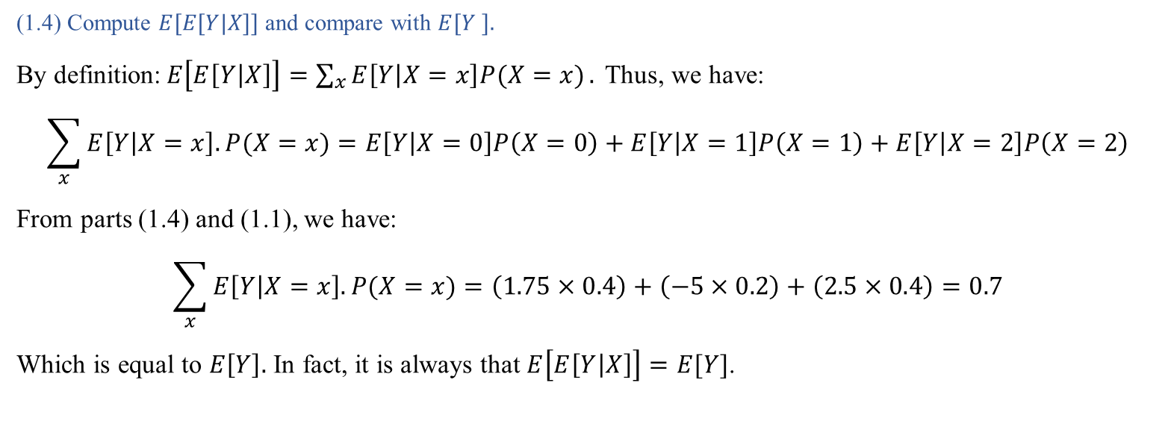
Question 1 (Cont’d)
(1.4) Compute $E[E[Y|X]]$ and compare with $E[Y ].$
By definition:$E\left[E\left[Y | X\right]\right]=\sum_{x}{E\left[Y | X=x\right]P(X=x)}.$ Thus, we have:
$$\sum_{x}{E\left[Y | X=x\right].P(X=x)}=E\left[Y | X=0\right]P\left(X=0\right)+E\left[Y | X=1\right]P\left(X=1\right)+E\left[Y | X=2\right]P\left(X=2\right)$$
From parts (1.4) and (1.1), we have:
$$\sum_{x}{E\left[Y | X=x\right].P(X=x)}=\left(1.75×0.4\right)+\left(−5×0.2\right)+\left(2.5×0.4\right)=0.7$$
Which is equal to $E\left[Y\right].$ In fact, it is always that $E\left[E\left[Y | X\right]\right]=E[Y]$.
Data Science & Machine Learning in Finance: Problem set 1
University of Glasgow
2022-2023

Slide 6
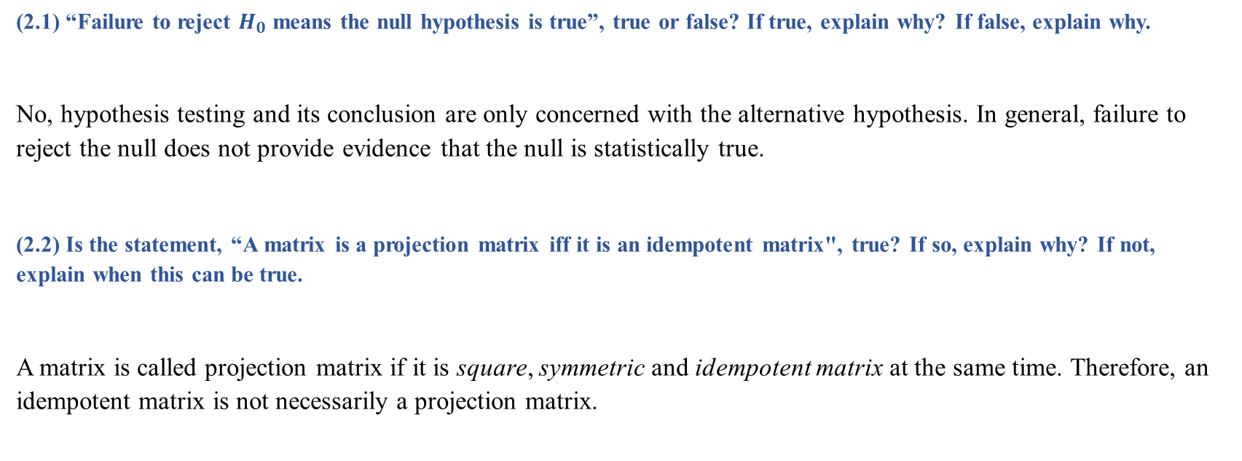
Question 2
(2.1) “Failure to reject $H_{0}$ means the null hypothesis is true”, true or false? If true, explain why? If false, explain why.
No, hypothesis testing and its conclusion are only concerned with the alternative hypothesis. In general, failure to reject the null does not provide evidence that the null is statistically true.
(2.2) Is the statement, “A matrix is a projection matrix iff it is an idempotent matrix", true? If so, explain why? If not, explain when this can be true.
A matrix is called projection matrix if it is square, symmetric and idempotent matrix at the same time. Therefore, an idempotent matrix is not necessarily a projection matrix.
Data Science & Machine Learning in Finance: Problem set 1
University of Glasgow
2022-2023

Slide 7
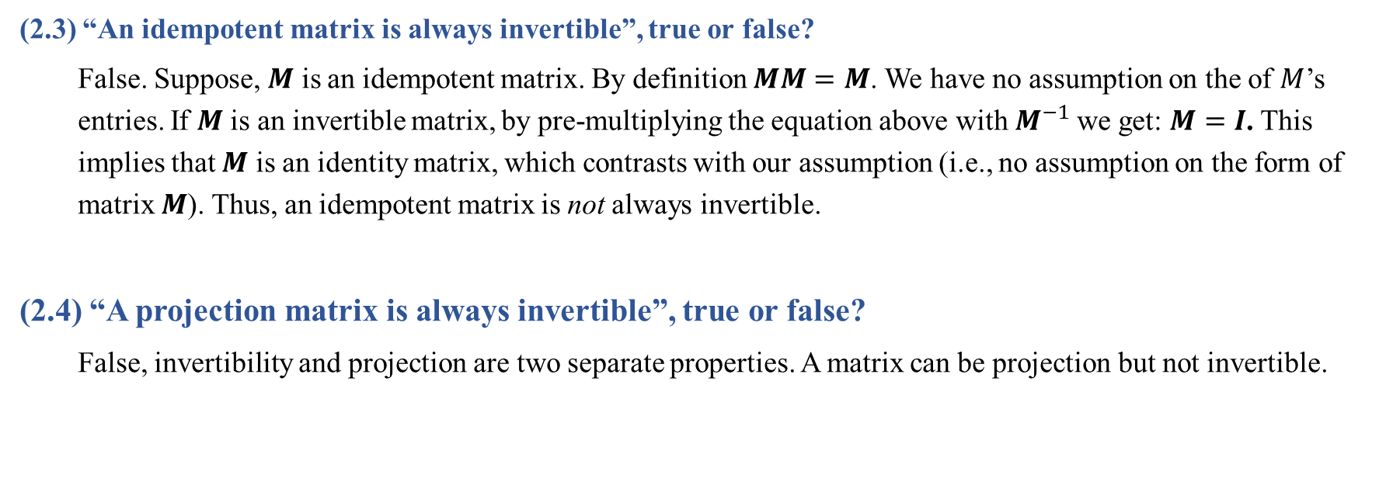
Question 2 (Cont’d)
(2.3) “An idempotent matrix is always invertible”, true or false?
False. Suppose, $M$ is an idempotent matrix. By definition $MM=M$. We have no assumption on the of $M$’s entries. If $M$ is an invertible matrix, by pre-multiplying the equation above with $M^{−1}$we get: $M=I$. This implies that $M$ is an identity matrix, which contrasts with our assumption (i.e., no assumption on the form of matrix $M$). Thus, an idempotent matrix is not always invertible.
(2.4) “A projection matrix is always invertible”, true or false?
False, invertibility and projection are two separate properties. A matrix can be projection but not invertible.
Data Science & Machine Learning in Finance: Problem set 1
University of Glasgow
2022-2023

Slide 8
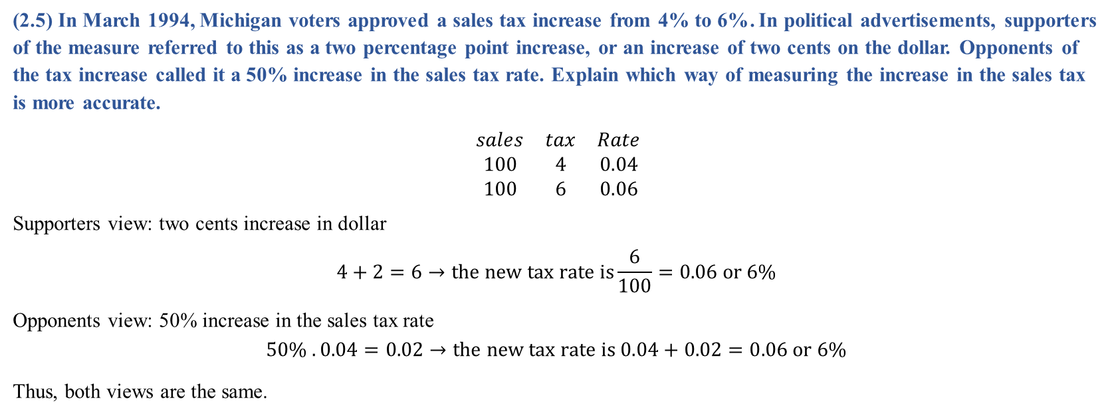
Question 2 (Cont’d)
(2.5) In March 1994, Michigan voters approved a sales tax increase from 4% to 6%. In political advertisements, supporters of the measure referred to this as a two percentage point increase, or an increase of two cents on the dollar. Opponents of the tax increase called it a 50% increase in the sales tax rate. Explain which way of measuring the increase in the sales tax is more accurate.
$$\begin{matrix}sales & tax & Rate \\ 100 & 4 & 0.04 \\ 100 & 6 & 0.06\end{matrix}$$
Supporters view: two cents increase in dollar
$$4+2=6→the new tax rate is\frac{6}{100}=0.06 or 6\%$$
Opponents view: 50% increase in the sales tax rate
$$50\% . 0.04=0.02→the new tax rate is 0.04+0.02=0.06 or 6\%$$
Thus, both views are the same.
Data Science & Machine Learning in Finance: Problem set 1
University of Glasgow
2022-2023

Slide 9
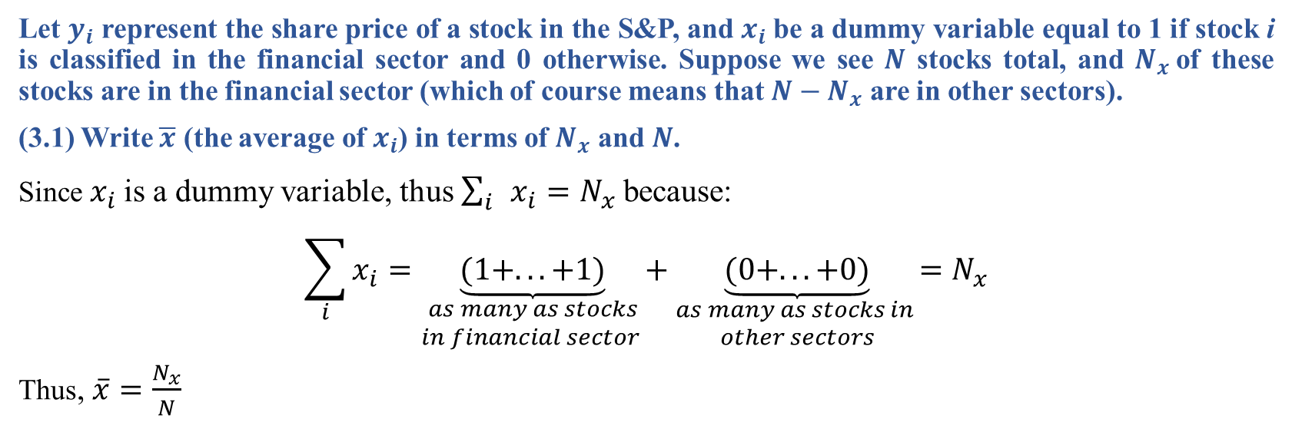
Question 3
Let $y_{i}$ represent the share price of a stock in the S&P, and $x_{i}$be a dummy variable equal to 1 if stock i is classified in the financial sector and 0 otherwise. Suppose we see $N$ stocks total, and $N_{x}$of these stocks are in the financial sector (which of course means that $N−N_{x}$ are in other sectors).
(3.1) Write $\overline{x}$ (the average of $x_{i}$) in terms of $N_{x}$ and $N$.
Since $x_{i}$is a dummy variable, thus $\sum_{i}{x_{i}}=N_{x}$because:
$$\sum_{i}{x_{i}}=\underset{\begin{aligned}as many as stocks \\ in financial sector \end{aligned}}{\underbrace{(1+...+1)}}+\underset{\begin{aligned}as many as stocks in \\ other sectors\end{aligned}}{\underbrace{(0+...+0)}}=N_{x}$$
Thus, $\overline{x}=\frac{N_{x}}{N}$
Data Science & Machine Learning in Finance: Problem set 1
University of Glasgow
2022-2023

Slide 10
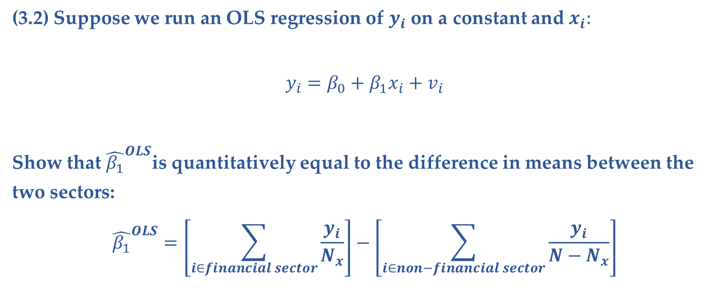
Question 3 (Cont’d)
(3.2) Suppose we run an OLS regression of $y_{i}$ on a constant and $x_{i}:$
$$y_{i}=β_{0}+β_{1}x_{i}+v_{i}$$
Show that ${\hat{β_{1}}}^{OLS}$is quantitatively equal to the difference in means between the two sectors:
$${\hat{β_{1}}}^{OLS}=\left[\sum_{i∈financial sector}{\frac{y_{i}}{N_{x}}}\right]−\left[\sum_{i∈non−financial sector}{\frac{y_{i}}{{N−N}_{x}}}\right]$$
Data Science & Machine Learning in Finance: Problem set 1
University of Glasgow
2022-2023

Slide 11
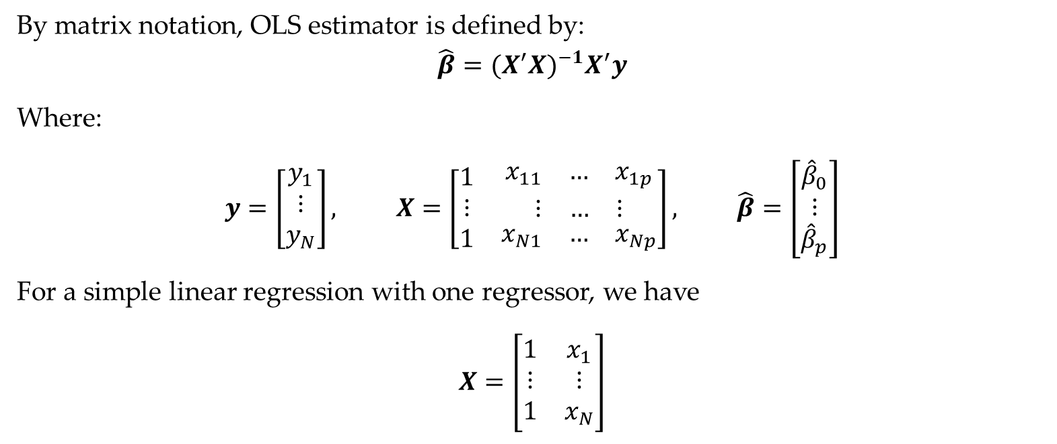
Question 3 (Cont’d)
By matrix notation, OLS estimator is defined by:
$$\hat{β}={(X^{′}X)}^{−1}X^{′}y$$
Where:
$$y=\left[\begin{matrix}y_{1} \\ ⋮ \\ y_{N}\end{matrix}\right], X=\left[\begin{matrix}1 & \begin{matrix}x_{11} & … & x_{1p}\end{matrix} \\ ⋮ & \begin{matrix}⋮ & … & ⋮\end{matrix} \\ 1 & \begin{matrix}x_{N1} & … & x_{Np}\end{matrix}\end{matrix}\right], \hat{β}=\left[\begin{matrix}{\hat{β}}_{0} \\ ⋮ \\ {\hat{β}}_{p}\end{matrix}\right]$$
For a simple linear regression with one regressor, we have
$$X=\left[\begin{matrix}1 & x_{1} \\ ⋮ & ⋮ \\ 1 & x_{N}\end{matrix}\right]$$
Data Science & Machine Learning in Finance: Problem set 1
University of Glasgow
2022-2023

Slide 12

Question 3 (Cont’d)
For this matrix $X$, we have
$$X^{′}X=\left[\begin{matrix}1 & … & 1 \\ x_{1} & … & x_{N}\end{matrix}\right]\left[\begin{matrix}1 & x_{1} \\ ⋮ & ⋮ \\ 1 & x_{N}\end{matrix}\right]=\left[\begin{matrix}N & \sum_{i=1}^{N}{x_{i}} \\ \sum_{i=1}^{N}{x_{i}} & \sum_{i=1}^{N}{x_{i}^{2}}\end{matrix}\right], ({X^{′}X)}^{−1}=\frac{1}{\left(N\sum_{i=1}^{N}{x_{i}^{2}}\right)− {(\sum_{i=1}^{N}{x_{i}})}^{2}}\left[\begin{matrix}\sum_{i=1}^{N}{x_{i}^{2}} & −\sum_{i=1}^{n}{x_{i}} \\ −\sum_{i=1}^{n}{x_{i}} & N\end{matrix}\right]$$
$$X^{′}y=\left[\begin{matrix}1 & … & 1 \\ x_{1} & … & x_{N}\end{matrix}\right]\left[\begin{matrix}y_{1} \\ ⋮ \\ y_{N}\end{matrix}\right]=\left[\begin{matrix}\sum_{i=1}^{N}{y_{i}} \\ \sum_{i=1}^{N}{x_{i}y_{i}}\end{matrix}\right]$$
Data Science & Machine Learning in Finance: Problem set 1
University of Glasgow
2022-2023

Slide 13
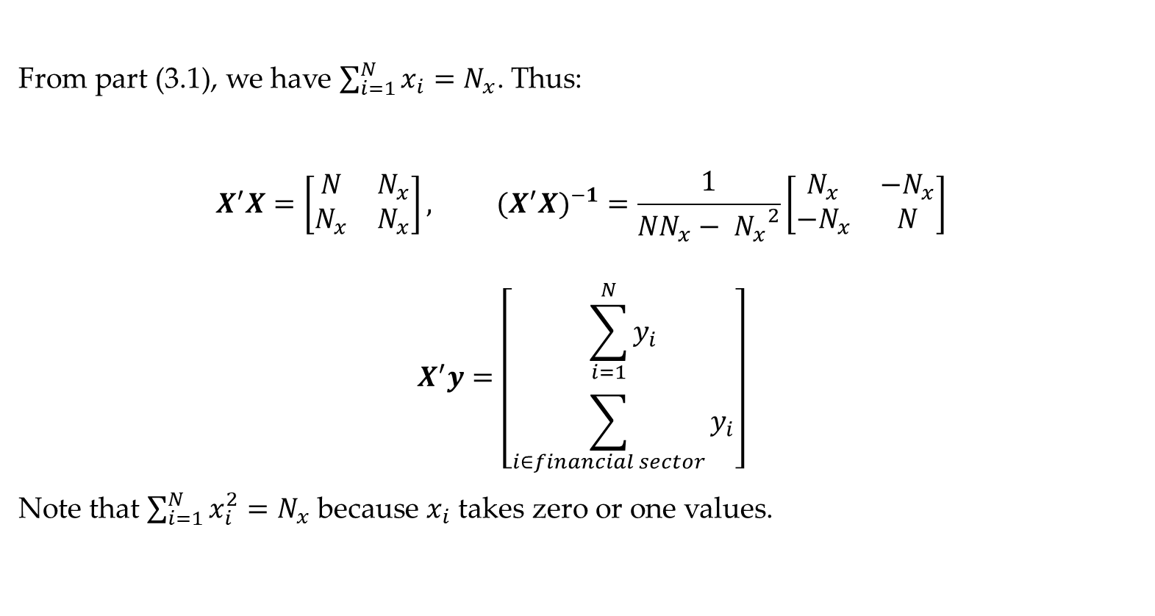
Question 3 (Cont’d)
From part (3.1), we have $\sum_{i=1}^{N}{x_{i}=N_{x}}$. Thus:
$$X^{′}X=\left[\begin{matrix}N & N_{x} \\ N_{x} & N_{x}\end{matrix}\right], ({X^{′}X)}^{−1}=\frac{1}{NN_{x}− {N_{x}}^{2}}\left[\begin{matrix}N_{x} & −N_{x} \\ −N_{x} & N\end{matrix}\right]$$
$$X^{′}y=\left[\begin{matrix}\sum_{i=1}^{N}{y_{i}} \\ \sum_{i∈financial sector}{y_{i}}\end{matrix}\right]$$
Note that $\sum_{i=1}^{N}{x_{i}^{2}=N_{x}}$ because $x_{i}$ takes zero or one values.
Data Science & Machine Learning in Finance: Problem set 1
University of Glasgow
2022-2023

Slide 14
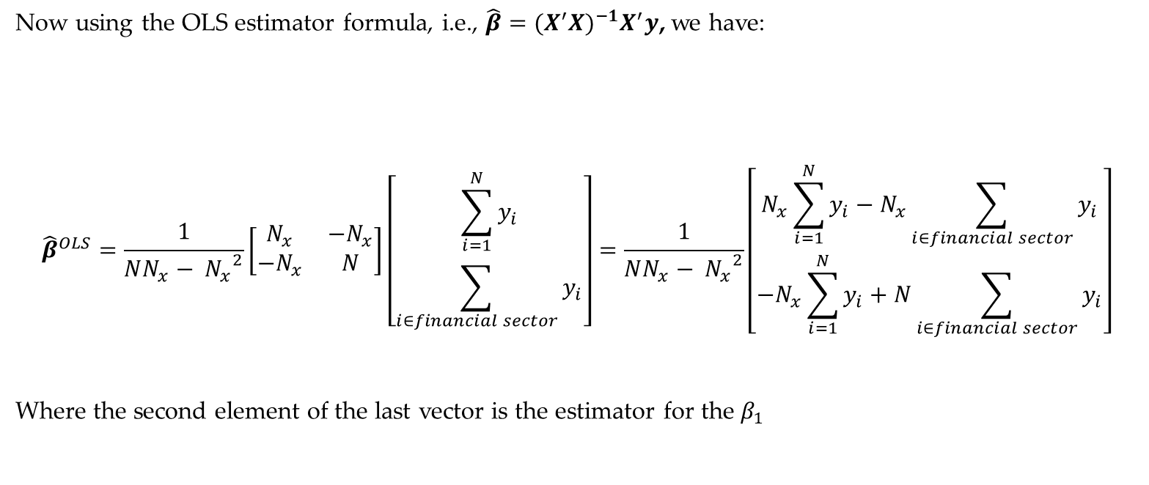
Question 3 (Cont’d)
Now using the OLS estimator formula, i.e., $\hat{β}={(X^{′}X)}^{−1}X^{′}y$, we have:
$${\hat{β}}^{OLS}=\frac{1}{NN_{x}− {N_{x}}^{2}}\left[\begin{matrix}N_{x} & −N_{x} \\ −N_{x} & N\end{matrix}\right]\left[\begin{matrix}\sum_{i=1}^{N}{y_{i}} \\ \sum_{i∈financial sector}{y_{i}}\end{matrix}\right]=\frac{1}{NN_{x}− {N_{x}}^{2}}\left[\begin{matrix}N_{x}\sum_{i=1}^{N}{y_{i}}−N_{x}\sum_{i∈financial sector}{y_{i}} \\ {−N}_{x}\sum_{i=1}^{N}{y_{i}}+N\sum_{i∈financial sector}{y_{i}}\end{matrix}\right]$$
Where the second element of the last vector is the estimator for the $β_{1}$
Data Science & Machine Learning in Finance: Problem set 1
University of Glasgow
2022-2023

Slide 15
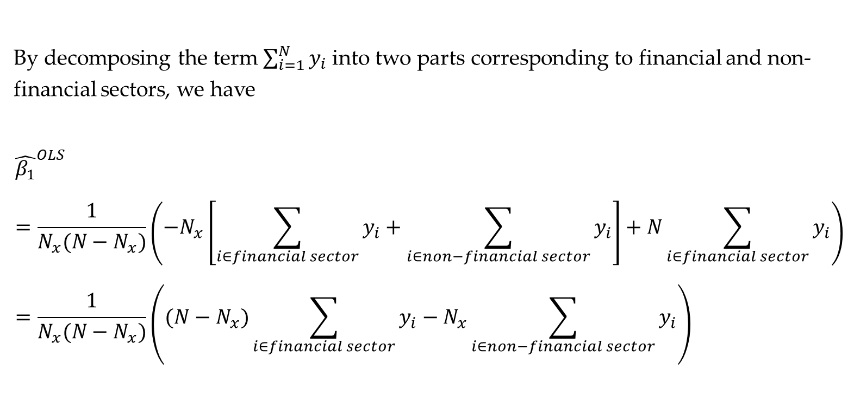
Question 3 (Cont’d)
By decomposing the term $\sum_{i=1}^{N}{y_{i}}$ into two parts corresponding to financial and non-financial sectors, we have
$${\hat{β_{1}}}^{OLS}=\frac{1}{N_{x}(N−N_{x})}\left({−N}_{x}\left[\sum_{i∈financial sector}{y_{i}}+\sum_{i∈non−financial sector}{y_{i}}\right]+N\sum_{i∈financial sector}{y_{i}}\right)=\frac{1}{N_{x}(N−N_{x})}\left({(N−N}_{x})\sum_{i∈financial sector}{y_{i}}−N_{x}\sum_{i∈non−financial sector}{y_{i}}\right)$$
Data Science & Machine Learning in Finance: Problem set 1
University of Glasgow
2022-2023

Slide 16

Question 3 (Cont’d)
Multiplying by term $\frac{1}{N_{x}(N−N_{x})}$ gives:
$${\hat{β_{1}}}^{OLS}=\sum_{i∈financial sector}{\frac{y_{i}}{N_{x}}}−\sum_{i∈non−financial sector}{\frac{y_{i}}{N−N_{x}}}$$
Data Science & Machine Learning in Finance: Problem set 1
University of Glasgow
2022-2023

Slide 17
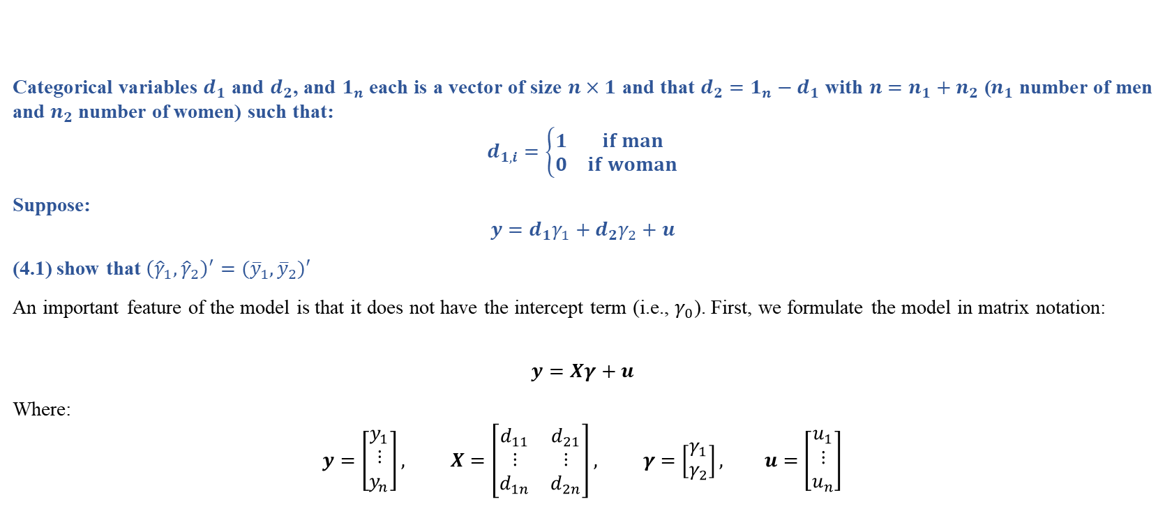
Question 4
Categorical variables $d_{1}$ and $d_{2}$, and $1_{n}$ each is a vector of size $n×1$ and that $d_{2}=1_{n}−d_{1}$ with $n=n_{1}+n_{2}$ ($n_{1}$ number of men and $n_{2}$ number of women) such that:
$$d_{1,i}=\left\{\begin{matrix}1 & if man \\ 0 & if woman\end{matrix}\right.$$
Suppose:
$$y=d_{1}γ_{1}+d_{2}γ_{2}+u$$
(4.1) show that ${\left({\hat{γ}}_{1},{\hat{γ}}_{2}\right)}^{′}=({\overline{y}}_{1},{\overline{y}}_{2})′$
An important feature of the model is that it does not have the intercept term (i.e., $γ_{0}$). First, we formulate the model in matrix notation:
$$y=Xγ+u$$
Where:
$$y=\left[\begin{matrix}y_{1} \\ ⋮ \\ y_{n}\end{matrix}\right], X=\left[\begin{matrix}d_{11} & d_{21} \\ ⋮ & ⋮ \\ d_{1n} & d_{2n}\end{matrix}\right], γ=\left[\begin{matrix}γ_{1} \\ γ_{2}\end{matrix}\right], u=\left[\begin{matrix}u_{1} \\ ⋮ \\ u_{n}\end{matrix}\right]$$
Data Science & Machine Learning in Finance: Problem set 1
University of Glasgow
2022-2023

Slide 18
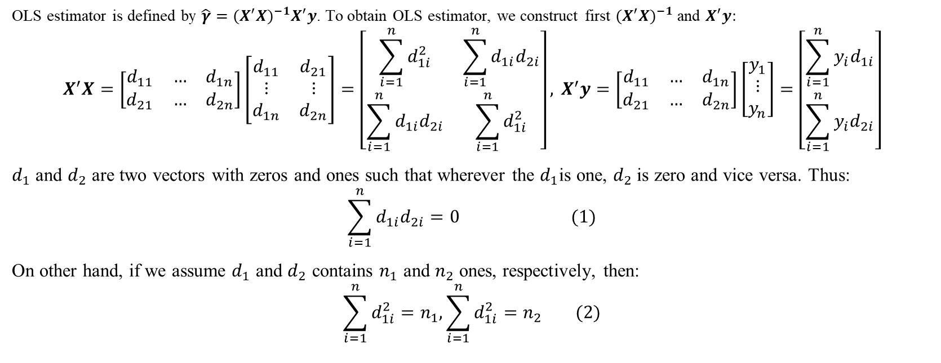
Question 4 (Cont’d)
OLS estimator is defined by $\hat{γ}={(X^{′}X)}^{−1}X^{′}y$. To obtain OLS estimator, we construct first ${(X^{′}X)}^{−1}$ and $X^{′}y:$
$$X^{′}X=\left[\begin{matrix}d_{11} & … & d_{1n} \\ d_{21} & … & d_{2n}\end{matrix}\right]\left[\begin{matrix}d_{11} & d_{21} \\ ⋮ & ⋮ \\ d_{1n} & d_{2n}\end{matrix}\right]=\left[\begin{matrix}\sum_{i=1}^{n}{d_{1i}^{2}} & \sum_{i=1}^{n}{d_{1i}d_{2i}} \\ \sum_{i=1}^{n}{d_{1i}d_{2i}} & \sum_{i=1}^{n}{d_{1i}^{2}}\end{matrix}\right],{ X}^{′}y=\left[\begin{matrix}d_{11} & … & d_{1n} \\ d_{21} & … & d_{2n}\end{matrix}\right]\left[\begin{matrix}y_{1} \\ ⋮ \\ y_{n}\end{matrix}\right]=\left[\begin{matrix}\sum_{i=1}^{n}{y_{i}d_{1i}} \\ \sum_{i=1}^{n}{y_{i}d_{2i}}\end{matrix}\right]$$
$d_{1}$ and $d_{2}$ are two vectors with zeros and ones such that wherever the $d_{1}$is one, $d_{2}$is zero and vice versa. Thus:
$$\sum_{i=1}^{n}{d_{1i}d_{2i}}=0 (1)$$
On other hand, if we assume $d_{1}$ and $d_{2}$ contains $n_{1}$ and $n_{2}$ ones, respectively, then:
$$\sum_{i=1}^{n}{d_{1i}^{2}}=n_{1},\sum_{i=1}^{n}{d_{1i}^{2}}=n_{2} (2)$$
Data Science & Machine Learning in Finance: Problem set 1
University of Glasgow
2022-2023

Slide 19
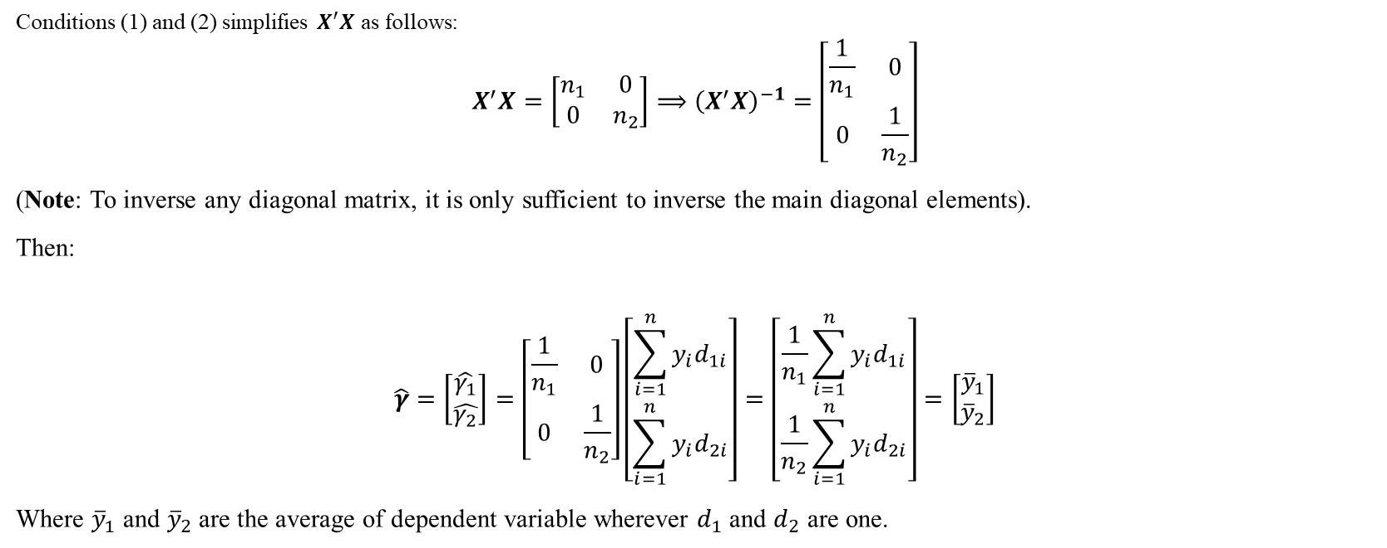
Question 4 (Cont’d)
Conditions (1) and (2) simplifies $X^{′}X$ as follows:
$$X^{′}X=\left[\begin{matrix}n_{1} & 0 \\ 0 & n_{2}\end{matrix}\right]⟹{\left(X^{′}X\right)}^{−1}=\left[\begin{matrix}\frac{1}{n_{1}} & 0 \\ 0 & \frac{1}{n_{2}}\end{matrix}\right]$$
(Note: To inverse any diagonal matrix, it is only sufficient to inverse the main diagonal elements).
Then:
$$\hat{γ}=\left[\begin{matrix}\hat{γ_{1}} \\ \hat{γ_{2}}\end{matrix}\right]=\left[\begin{matrix}\frac{1}{n_{1}} & 0 \\ 0 & \frac{1}{n_{2}}\end{matrix}\right]\left[\begin{matrix}\sum_{i=1}^{n}{y_{i}d_{1i}} \\ \sum_{i=1}^{n}{y_{i}d_{2i}}\end{matrix}\right]=\left[\begin{matrix}\frac{1}{n_{1}}\sum_{i=1}^{n}{y_{i}d_{1i}} \\ \frac{1}{n_{2}}\sum_{i=1}^{n}{y_{i}d_{2i}}\end{matrix}\right]=\left[\begin{matrix}{\overline{y}}_{1} \\ {\overline{y}}_{2}\end{matrix}\right]$$
Where ${\overline{y}}_{1}$ and ${\overline{y}}_{2}$ are the average of dependent variable wherever $d_{1}$ and $d_{2}$ are one.
Data Science & Machine Learning in Finance: Problem set 1
University of Glasgow
2022-2023

Slide 20
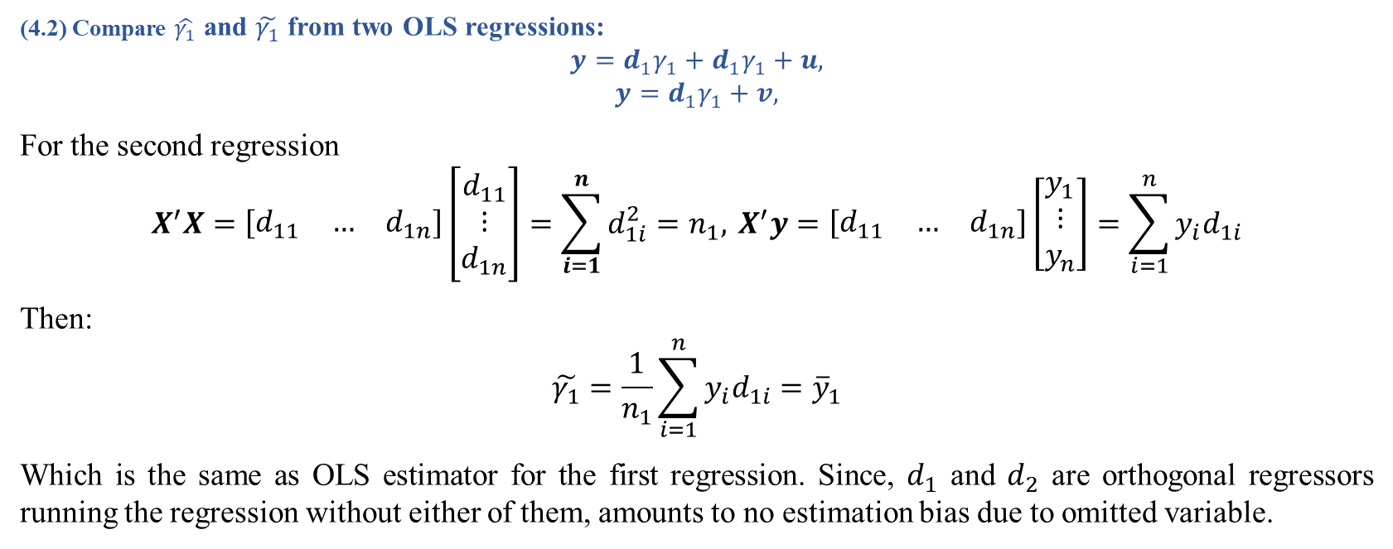
Question 4 (Cont’d)
(4.2) Compare $\hat{γ_{1}}$ and $\tilde{γ_{1}}$ from two OLS regressions:
$$y=d_{1}γ_{1}+d_{1}γ_{1}+u,$$
$$y=d_{1}γ_{1}+v,$$
For the second regression
$$X^{′}X=\left[\begin{matrix}d_{11} & … & d_{1n}\end{matrix}\right]\left[\begin{matrix}d_{11} \\ ⋮ \\ d_{1n}\end{matrix}\right]=\sum_{i=1}^{n}{d_{1i}^{2}}=n_{1},{ X}^{′}y=\left[\begin{matrix}d_{11} & … & d_{1n}\end{matrix}\right]\left[\begin{matrix}y_{1} \\ ⋮ \\ y_{n}\end{matrix}\right]=\sum_{i=1}^{n}{y_{i}d_{1i}}$$
Then:
$$\tilde{γ_{1}}=\frac{1}{n_{1}}\sum_{i=1}^{n}{y_{i}d_{1i}}={\overline{y}}_{1}$$
Which is the same as OLS estimator for the first regression. Since, $d_{1}$ and $d_{2}$ are orthogonal regressors running the regression without either of them, amounts to no estimation bias due to omitted variable.
Data Science & Machine Learning in Finance: Problem set 1
University of Glasgow
2022-2023

Slide 21
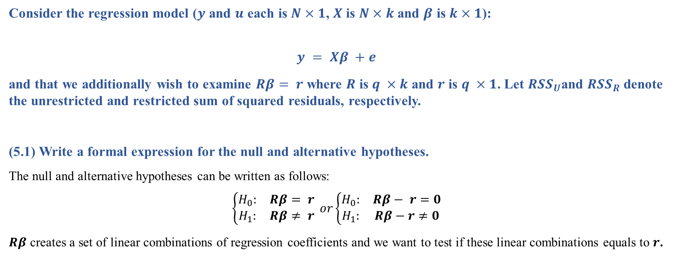
Question 5
Consider the regression model ($y$ and $u$ each is $N×1$, $X$ is $N×k$ and $β$ is $k×1$):
$$y = Xβ +e$$
and that we additionally wish to examine $Rβ= r$where $R$ is $q ×k$ and $r$ is $q ×1$. Let ${RSS}_{U}$and ${RSS}_{R}$denote the unrestricted and restricted sum of squared residuals, respectively.
(5.1) Write a formal expression for the null and alternative hypotheses.
The null and alternative hypotheses can be written as follows:
$$\left\{\begin{matrix}H_{0}: & Rβ= r \\ H_{1}: & Rβ≠ r\end{matrix}\right. or\left\{\begin{matrix}H_{0}: & Rβ− r=0 \\ H_{1}: & Rβ−r≠0\end{matrix}\right.$$
$Rβ$ creates a set of linear combinations of regression coefficients and we want to test if these linear combinations equals to $r$.
Data Science & Machine Learning in Finance: Problem set 1
University of Glasgow
2022-2023

Slide 22
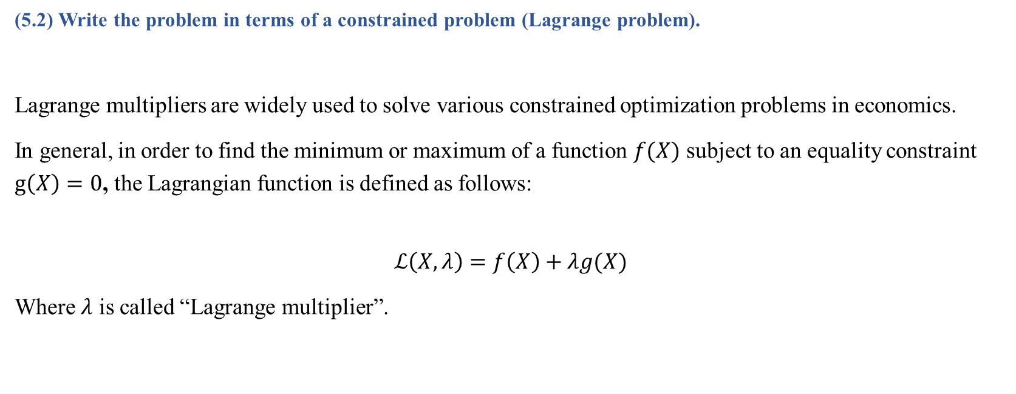
Question 5 (Cont’d)
(5.2) Write the problem in terms of a constrained problem (Lagrange problem).
Lagrange multipliers are widely used to solve various constrained optimization problems in economics.
In general, in order to find the minimum or maximum of a function $f(X)$ subject to an equality constraint $g\left(X\right)=0$, the Lagrangian function is defined as follows:
$$ℒ\left(X,λ\right)=f\left(X\right)+λg(X)$$
Where $λ$ is called “Lagrange multiplier”.
Data Science & Machine Learning in Finance: Problem set 1
University of Glasgow
2022-2023

Slide 23
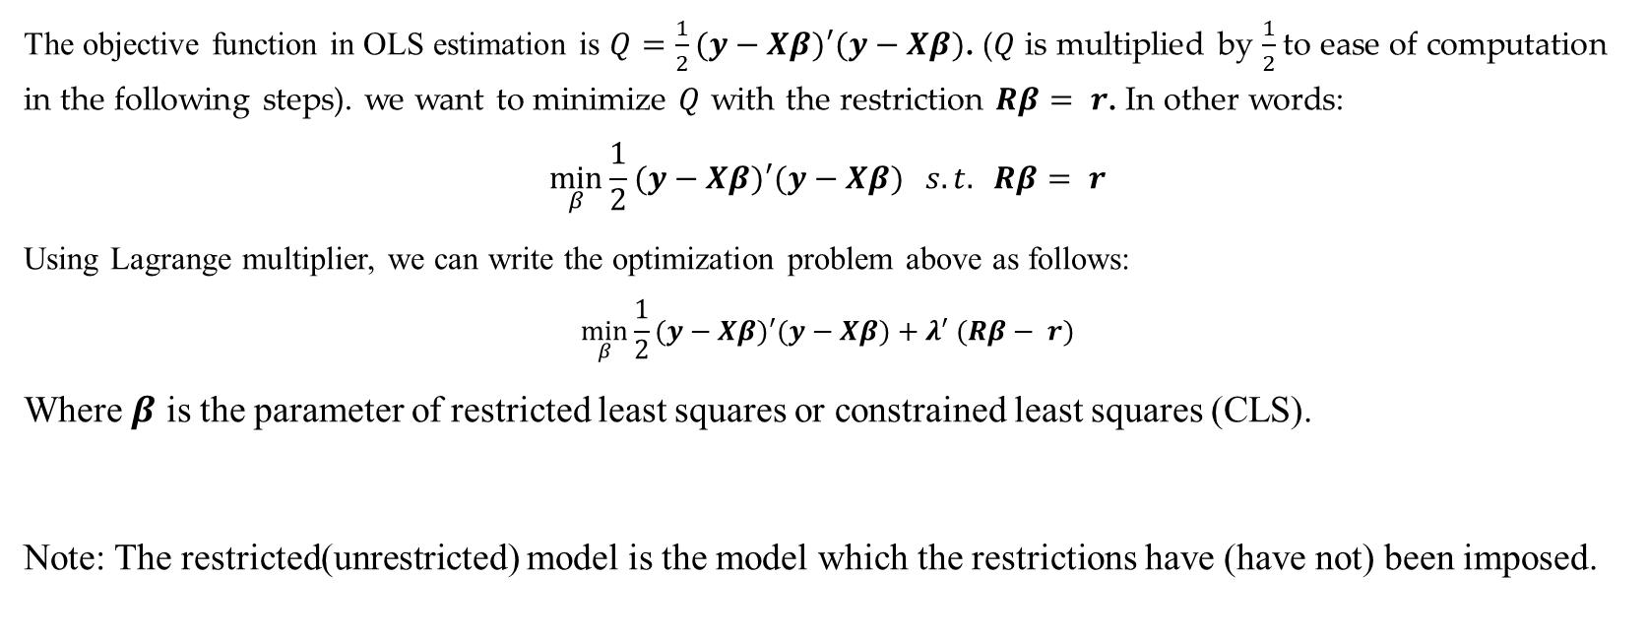
Question 5 (Cont’d)
The objective function in OLS estimation is $Q=\frac{1}{2}(y−Xβ)′(y−Xβ)$. ($Q$ is multiplied by $\frac{1}{2}$to ease of computation in the following steps). we want to minimize $Q$ with the restriction $Rβ= r$. In other words:
$$\min_{β}{\frac{1}{2}(y−Xβ)′(y−Xβ) } s.t. Rβ= r$$
Using Lagrange multiplier, we can write the optimization problem above as follows:
$$\min_{β}{\frac{1}{2}(y−Xβ)′(y−Xβ)}+λ′ (Rβ− r)$$
Where $β$ is the parameter of restricted least squares or constrained least squares (CLS).
Note: The restricted(unrestricted) model is the model which the restrictions have (have not) been imposed.
Data Science & Machine Learning in Finance: Problem set 1
University of Glasgow
2022-2023

Slide 24
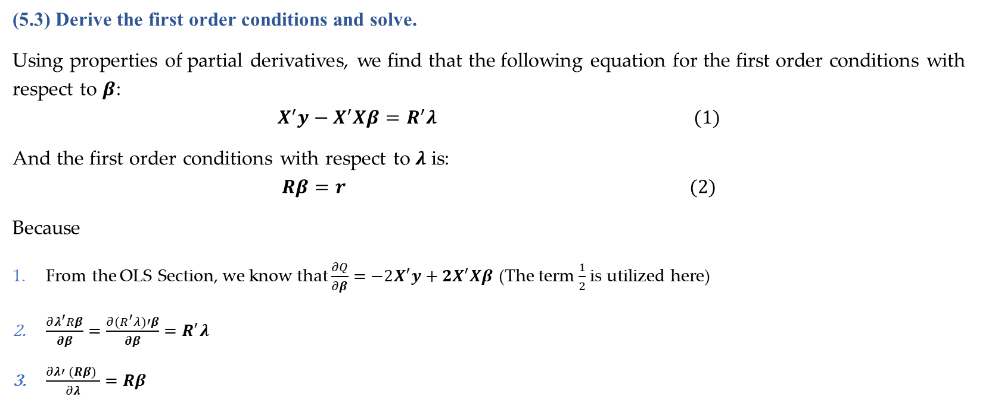
Question 5 (Cont’d)
(5.3) Derive the first order conditions and solve.
Using properties of partial derivatives, we find that the following equation for the first order conditions with respect to $β$:
$$X^{′}y−X^{′}Xβ=R^{′}λ (1)$$
And the first order conditions with respect to $λ$ is:
$$Rβ=r (2)$$
Because
From the OLS Section, we know that $\frac{∂Q}{∂β}=−2X^{′}y+2X^{′}Xβ$ (The term $\frac{1}{2}$ is utilized here)
$\frac{∂λ^{′}Rβ}{∂β}=\frac{∂(R^{′}λ)′β}{∂β}=R^{′}λ$
$\frac{∂λ′ (Rβ) }{∂λ}=Rβ$
Data Science & Machine Learning in Finance: Problem set 1
University of Glasgow
2022-2023

Slide 25
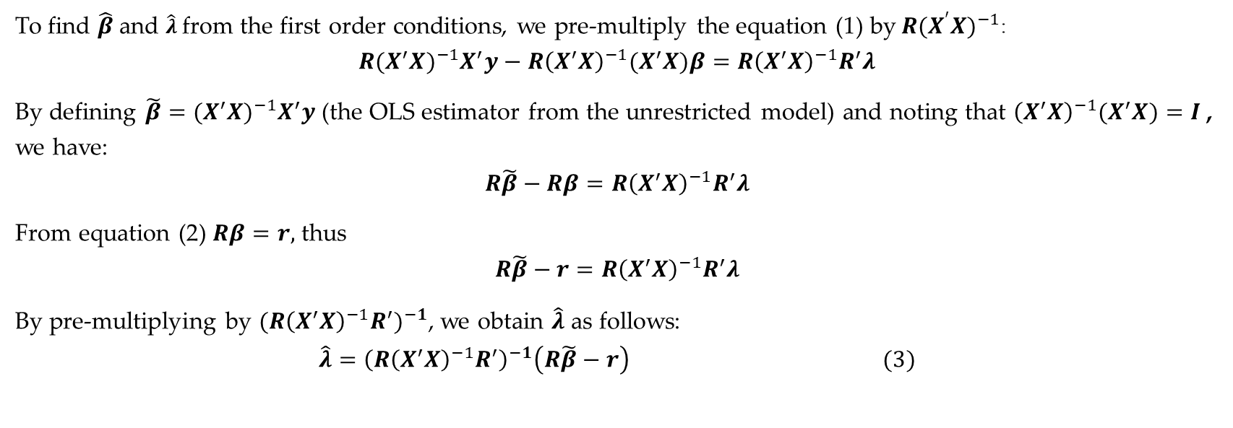
Question 5 (Cont’d)
To find $\hat{β}$ and $\hat{λ}$ from the first order conditions, we pre-multiply the equation (1) by$R{(X^{′}X)}^{−1}$:
$${R{(X^{′}X)}^{−1}X}^{′}y−{R{\left(X^{′}X\right)}^{−1}(X}^{′}X)β=R{\left(X^{′}X\right)}^{−1}R^{′}λ$$
By defining ${\tilde{β}={(X^{′}X)}^{−1}X}^{′}y$ (the OLS estimator from the unrestricted model) and noting that ${{\left(X^{′}X\right)}^{−1}(X}^{′}X)=I$ , we have:
$$R\tilde{β}−Rβ=R{\left(X^{′}X\right)}^{−1}R^{′}λ$$
From equation (2) $Rβ=r,$ thus
$$R\tilde{β}−r=R{\left(X^{′}X\right)}^{−1}R^{′}λ$$
By pre-multiplying by ${(R{\left(X^{′}X\right)}^{−1}R^{′})}^{−1}$, we obtain $\hat{λ}$ as follows:
$$\hat{λ}={\left(R{\left(X^{′}X\right)}^{−1}R^{′}\right)}^{−1}\left(R\tilde{β}−r\right) (3)$$
Data Science & Machine Learning in Finance: Problem set 1
University of Glasgow
2022-2023

Slide 26
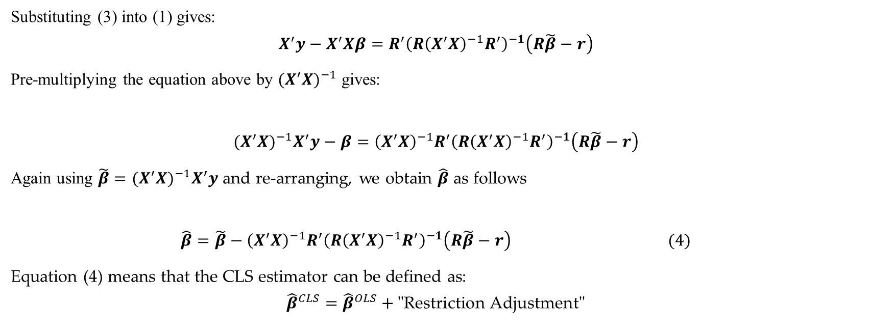
Question 5 (Cont’d)
Substituting (3) into (1) gives:
$$X^{′}y−X^{′}Xβ=R^{′}{\left(R{\left(X^{′}X\right)}^{−1}R^{′}\right)}^{−1}\left(R\tilde{β}−r\right)$$
Pre-multiplying the equation above by ${(X^{′}X)}^{−1}$ gives:
$${(X^{′}X)}^{−1}X^{′}y−β={\left(X^{′}X\right)}^{−1}R^{′}{\left(R{\left(X^{′}X\right)}^{−1}R^{′}\right)}^{−1}\left(R\tilde{β}−r\right)$$
Again using ${\tilde{β}={(X^{′}X)}^{−1}X}^{′}y$ and re-arranging, we obtain $\hat{β}$ as follows
$$\hat{β}=\tilde{β}−{\left(X^{′}X\right)}^{−1}R^{′}{\left(R{\left(X^{′}X\right)}^{−1}R^{′}\right)}^{−1}\left(R\tilde{β}−r\right) (4)$$
Equation (4) means that the CLS estimator can be defined as:
$${\hat{β}}^{CLS}={\hat{β}}^{OLS}+\text{"}\text{Restriction} \text{Adjustment}\text{"}$$
Data Science & Machine Learning in Finance: Problem set 1
University of Glasgow
2022-2023

Slide 27
Question 5 (Cont’d)
(5.4) What the value of Lagrange multiplier? Interpret the Lagrange multiplier. What is the sign?
The Lagrange multiplier is a vector with non-negative elements which measures whether constraint is binding or slack.
The interpretation of the Lagrange multiplier depends on economic meaning of each variable. In general, however, this links the constraint to the sum of squared residuals.
Data Science & Machine Learning in Finance: Problem set 1
University of Glasgow
2022-2023

Slide 28
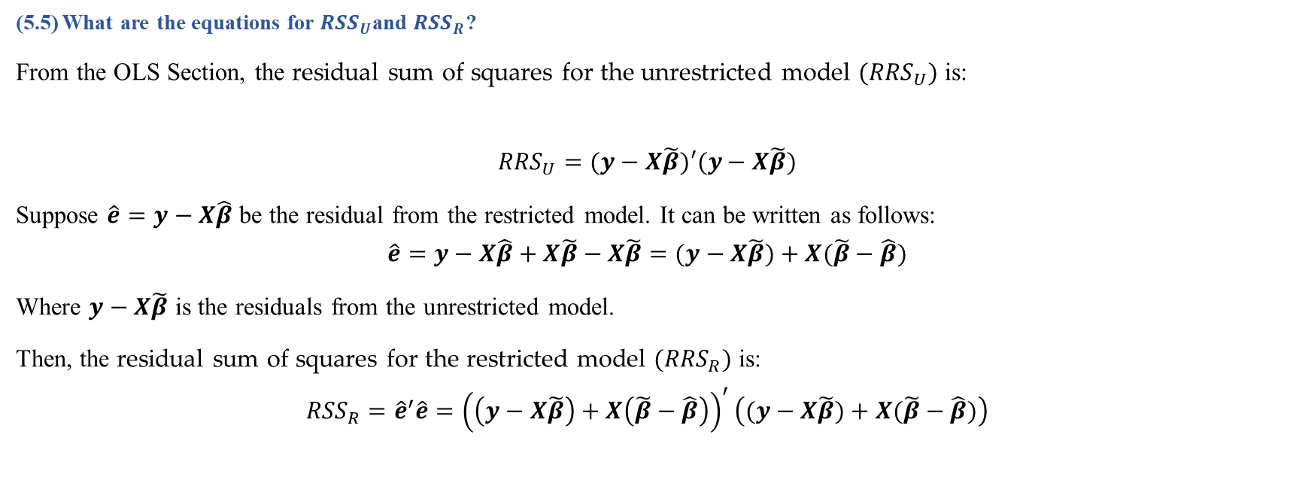
Question 5 (Cont’d)
(5.5) What are the equations for ${RSS}_{U}$and ${RSS}_{R}$?
From the OLS Section, the residual sum of squares for the unrestricted model $({RRS}_{U})$ is:
$${RRS}_{U}=(y−X\tilde{β})′(y−X\tilde{β})$$
Suppose $\hat{e}=y−X\hat{β}$ be the residual from the restricted model. It can be written as follows:
$$\hat{e}=y−X\hat{β}+X\tilde{β}−X\tilde{β}=(y−X\tilde{β})+X(\tilde{β}−\hat{β})$$
Where $y−X\tilde{β}$ is the residuals from the unrestricted model.
Then, the residual sum of squares for the restricted model $({RRS}_{R})$ is:
$${RSS}_{R}={\hat{e}}^{′}\hat{e}={\left(\left(y−X\tilde{β}\right)+X\left(\tilde{β}−\hat{β}\right)\right)}^{′}\left((y−X\tilde{β})+X(\tilde{β}−\hat{β})\right)$$
Data Science & Machine Learning in Finance: Problem set 1
University of Glasgow
2022-2023

Slide 29

Question 5 (Cont’d)
It can be simplified as follows:
$${RSS}_{R}={\left(y−X\tilde{β}\right)}^{′}\left(y−X\tilde{β}\right)+{\left(\tilde{β}−\hat{β}\right)}^{′}X^{′}X\left(\tilde{β}−\hat{β}\right)$$
Note that two other terms are zero:
${\left(y−X\tilde{β}\right)}^{′}X\left(\tilde{β}−\hat{β}\right)=0,$
${\left(\tilde{β}−\hat{β}\right)}^{′}X′\left(y−X\tilde{β}\right)=0$.
Because $\tilde{β}={(X^{′}X)}^{−1}X^{′}y$ from the unrestricted model and $X′\left(y−X\tilde{β}\right)=0$.
Data Science & Machine Learning in Finance: Problem set 1
University of Glasgow
2022-2023

Slide 30
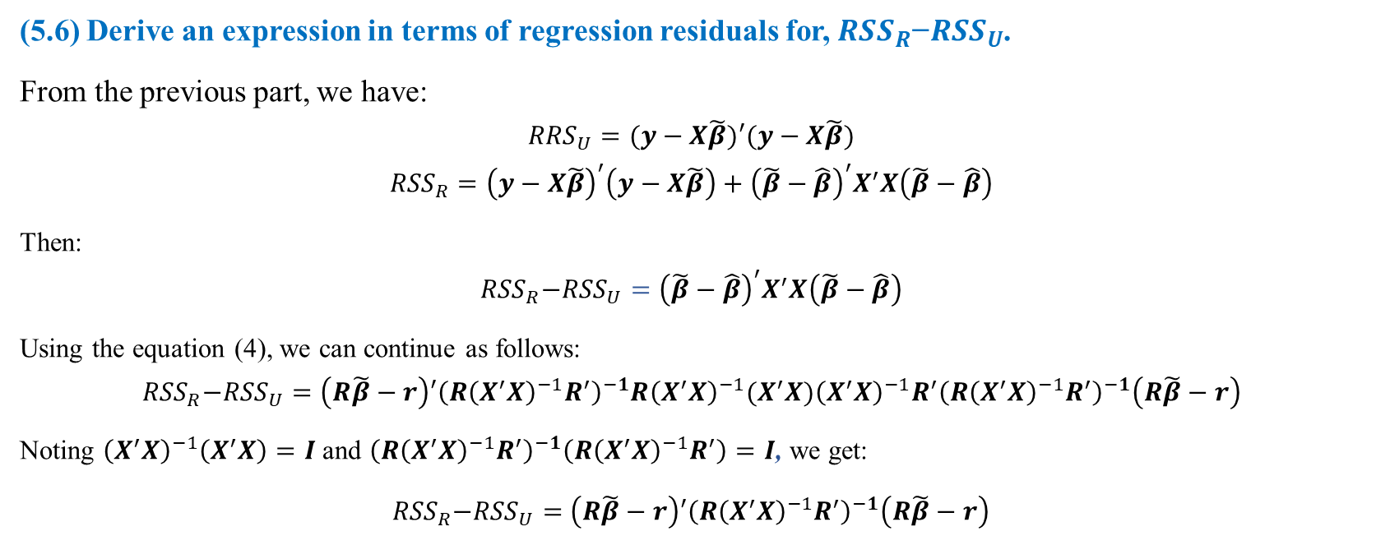
Question 5 (Cont’d)
(5.6) Derive an expression in terms of regression residuals for, ${{RSS}_{R}\text{−}RSS}_{U}$.
From the previous part, we have:
$${RRS}_{U}=(y−X\tilde{β})′(y−X\tilde{β})$$
$${RSS}_{R}={\left(y−X\tilde{β}\right)}^{′}\left(y−X\tilde{β}\right)+{\left(\tilde{β}−\hat{β}\right)}^{′}X^{′}X\left(\tilde{β}−\hat{β}\right)$$
Then:
$${{RSS}_{R}\text{−}RSS}_{U}={\left(\tilde{β}−\hat{β}\right)}^{′}X^{′}X\left(\tilde{β}−\hat{β}\right)$$
Using the equation (4), we can continue as follows:
$${{RSS}_{R}\text{−}RSS}_{U}=\left(R\tilde{β}−r\right)′{\left(R{\left(X^{′}X\right)}^{−1}R^{′}\right)}^{−1}{R\left(X^{′}X\right)}^{−1}(X^{′}X){\left(X^{′}X\right)}^{−1}R^{′}{\left(R{\left(X^{′}X\right)}^{−1}R^{′}\right)}^{−1}\left(R\tilde{β}−r\right)$$
Noting ${\left(X^{′}X\right)}^{−1}\left(X^{′}X\right)=I$ and ${\left(R{\left(X^{′}X\right)}^{−1}R^{′}\right)}^{−1}\left(R{\left(X^{′}X\right)}^{−1}R^{′}\right)=I$, we get:
${{RSS}_{R}\text{−}RSS}_{U}=$ $\left(R\tilde{β}−r\right)′{\left(R{\left(X^{′}X\right)}^{−1}R^{′}\right)}^{−1}\left(R\tilde{β}−r\right)$
Data Science & Machine Learning in Finance: Problem set 1
University of Glasgow
2022-2023

Slide 31
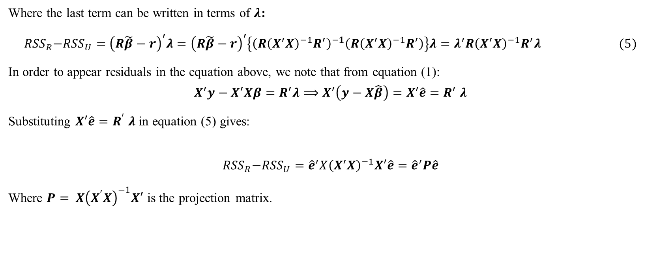
Question 5 (Cont’d)
Where the last term can be written in terms of $λ$:
${{RSS}_{R}\text{−}RSS}_{U}=$ ${\left(R\tilde{β}−r\right)}^{′}λ={\left(R\tilde{β}−r\right)}^{′}\left\{{\left(R{\left(X^{′}X\right)}^{−1}R^{′}\right)}^{−1}\left(R{\left(X^{′}X\right)}^{−1}R^{′}\right)\right\}λ=λ^{′}R{\left(X^{′}X\right)}^{−1}R^{′}λ (5)$
In order to appear residuals in the equation above, we note that from equation (1):
$$X^{′}y−X^{′}Xβ=R^{′}λ⟹X^{′}\left(y−X\hat{β}\right)=X′\hat{e}{=R}^{′}λ$$
Substituting $X′\hat{e}{=R}^{′}λ$ in equation (5) gives:
$${{RSS}_{R}\text{−}RSS}_{U}={\hat{e}}^{′}X{\left(X^{′}X\right)}^{−1}X′\hat{e}={\hat{e}}^{′}P\hat{e}$$
Where $P= X{\left(X^{′}X\right)}^{−1}X′$ is the projection matrix.
Data Science & Machine Learning in Finance: Problem set 1
University of Glasgow
2022-2023

Slide 32
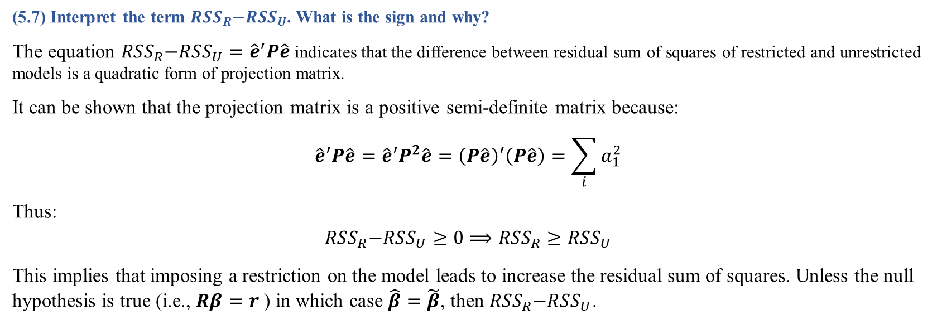
Question 5 (Cont’d)
(5.7) Interpret the term ${{RSS}_{R}\text{−}RSS}_{U}$. What is the sign and why?
The equation ${{RSS}_{R}\text{−}RSS}_{U}={\hat{e}}^{′}P\hat{e}$ indicates that the difference between residual sum of squares of restricted and unrestricted models is a quadratic form of projection matrix.
It can be shown that the projection matrix is a positive semi-definite matrix because:
$${\hat{e}}^{′}P\hat{e}={\hat{e}}^{′}P^{2}\hat{e}={\left(P\hat{e}\right)}^{′}\left(P\hat{e}\right)=\sum_{i}{a_{1}^{2}}$$
Thus:
$${{RSS}_{R}\text{−}RSS}_{U}≥0⟹{RSS}_{R}≥{RSS}_{U}$$
This implies that imposing a restriction on the model leads to increase the residual sum of squares. Unless the null hypothesis is true (i.e., $Rβ=r$) in which case $\hat{β}=\tilde{β}$, then ${{RSS}_{R}\text{−}RSS}_{U}$.
Data Science & Machine Learning in Finance: Problem set 1
University of Glasgow
2022-2023

Slide 33
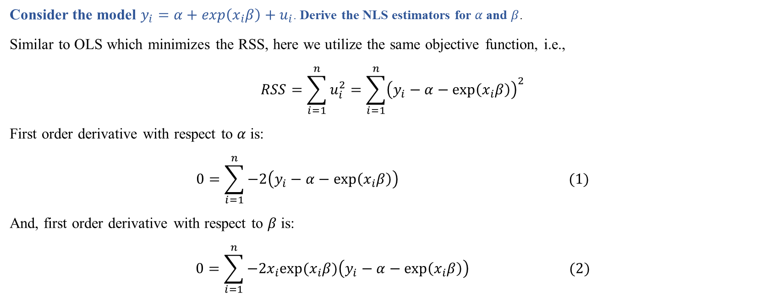
Question 6
Consider the model $y_{i}=α+exp\left(x_{i}β\right)+u_{i}$. Derive the NLS estimators for $α$ and $β$.
Similar to OLS which minimizes the RSS, here we utilize the same objective function, i.e.,
$$RSS=\sum_{i=1}^{n}{u_{i}^{2}}=\sum_{i=1}^{n}{{\left(y_{i}−α−exp\left(x_{i}β\right)\right)}^{2}}$$
First order derivative with respect to $α$ is:
$$0=\sum_{i=1}^{n}{−2\left(y_{i}−α−exp\left(x_{i}β\right)\right)} (1)$$
And, first order derivative with respect to $β$ is:
$$0=\sum_{i=1}^{n}{−2x_{i}exp⁡(x_{i}β)\left(y_{i}−α−exp\left(x_{i}β\right)\right)} (2)$$
Data Science & Machine Learning in Finance: Problem set 1
University of Glasgow
2022-2023

Slide 34
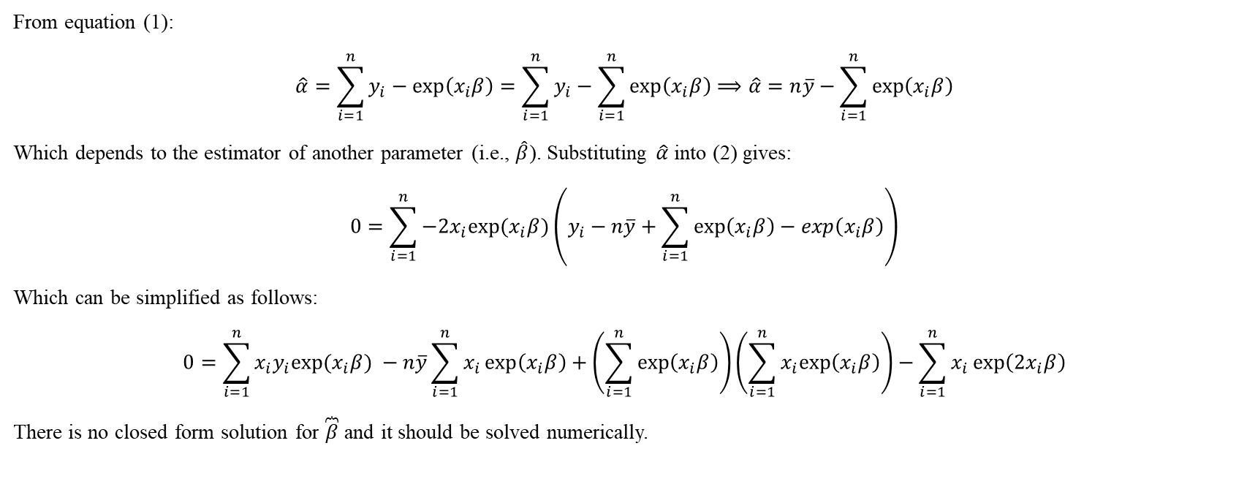
Question 6
From equation (1):
$$\hat{α}=\sum_{i=1}^{n}{y_{i}−exp\left(x_{i}β\right)}=\sum_{i=1}^{n}{y_{i}}−\sum_{i=1}^{n}{exp\left(x_{i}β\right)}⟹\hat{α}=n\overline{y}−\sum_{i=1}^{n}{exp\left(x_{i}β\right)}$$
Which depends to the estimator of another parameter (i.e., $\hat{β}$). Substituting $\hat{α}$ into (2) gives:
$$0=\sum_{i=1}^{n}{−2x_{i}exp⁡(x_{i}β)\left(y_{i}−n\overline{y}+\sum_{i=1}^{n}{exp\left(x_{i}β\right)}−exp\left(x_{i}β\right)\right)}$$
Which can be simplified as follows:
$$0=\sum_{i=1}^{n}{x_{i}y_{i}exp⁡(x_{i}β) }−n\overline{y}\sum_{i=1}^{n}{x_{i}\exp\left(x_{i}β\right)}+\left(\sum_{i=1}^{n}{exp\left(x_{i}β\right)}\right)\left(\sum_{i=1}^{n}{x_{i}exp\left(x_{i}β\right)}\right)−\sum_{i=1}^{n}{x_{i}\exp\left(2x_{i}β\right)}$$
There is no closed form solution for $\overbrace{β}$ and it should be solved numerically.
Data Science & Machine Learning in Finance: Problem set 1
University of Glasgow
2022-2023

