Slide 1

Data Science & Machine Learning in Finance: Introduction
Hadi Movaghari
2022-2023

Slide 2
Outline
Section 1: Fundamentals
Section 2: Popular statistical distribution in finance
Section 3: Point estimation
Section 4: Hypothesis testing
Data Science & Machine Learning in Finance: Introduction
University of Glasgow
2022-2023

Slide 3
Section 1
Fundamentals

Slide 4
Outcome
Potential results of a trial is known as outcome or event.
Example:
CEO Change in the company A in the next fiscal year,
R&D expenditure in company A in the next year
The amount of money held by Company A at the end of this fiscal year
Data Science & Machine Learning in Finance: Introduction
University of Glasgow
2022-2023

Slide 5
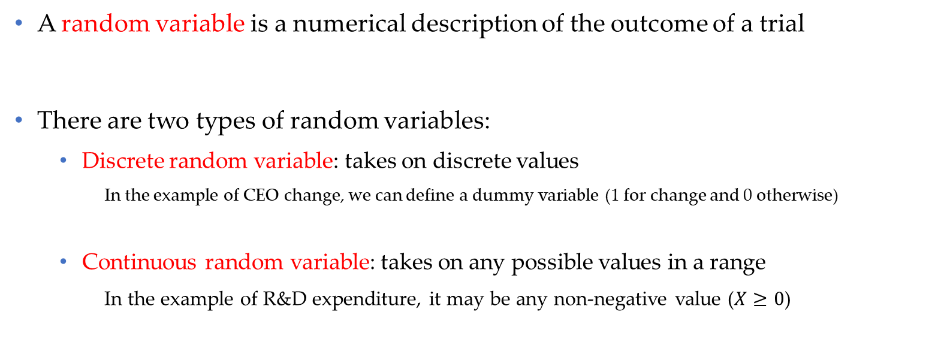
Random variable (r.v.)
A random variable is a numerical description of the outcome of a trial
There are two types of random variables:
Discrete random variable: takes on discrete values
In the example of CEO change, we can define a dummy variable (1 for change and 0 otherwise)
Continuous random variable: takes on any possible values in a range
In the example of R&D expenditure, it may be any non-negative value ($X≥0$)
Data Science & Machine Learning in Finance: Introduction
University of Glasgow
2022-2023

Slide 6
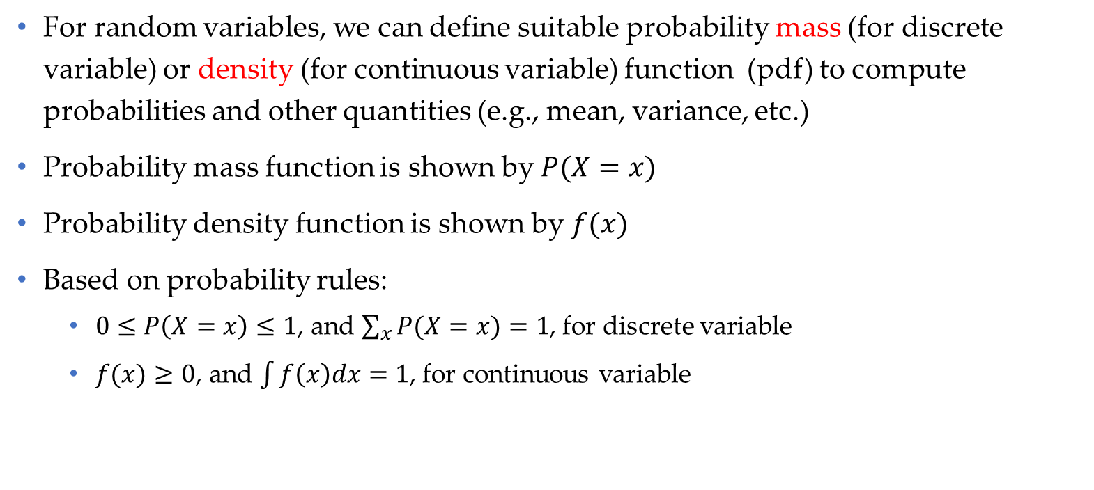
Probability function
For random variables, we can define suitable probability mass (for discrete variable) or density (for continuous variable) function (pdf) to compute probabilities and other quantities (e.g., mean, variance, etc.)
Probability mass function is shown by $P(X=x)$
Probability density function is shown by $f(x)$
Based on probability rules:
$0≤P\left(X=x\right)≤1$, and $\sum_{x}{P(X=x)}=1$, for discrete variable
$f(x)≥0$, and $\int{f\left(x\right)dx}=1$, for continuous variable
Data Science & Machine Learning in Finance: Introduction
University of Glasgow
2022-2023

Slide 7
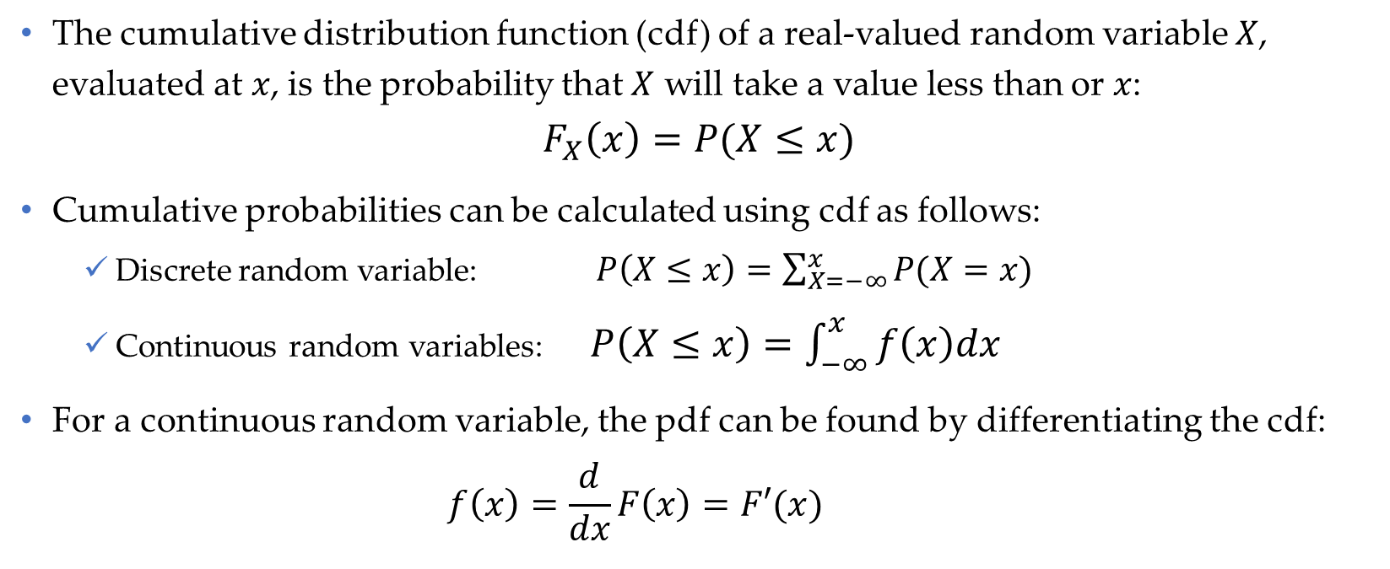
Cumulative distribution function (cdf)
The cumulative distribution function (cdf) of a real-valued random variable $X$, evaluated at $x$, is the probability that $X$ will take a value less than or $x$:
$$F_{X}\left(x\right)=P(X≤x)$$
Cumulative probabilities can be calculated using cdf as follows:
Discrete random variable: $P\left(X≤x\right)=\sum_{X=−∞}^{x}{P(X=x)}$
Continuous random variables: $P\left(X≤x\right)=\int_{−∞}^{x}{f\left(x\right)dx}$
For a continuous random variable, the pdf can be found by differentiating the cdf:
$$f\left(x\right)=\frac{d}{dx}F\left(x\right)=F′(x)$$
Data Science & Machine Learning in Finance: Introduction
University of Glasgow
2022-2023

Slide 8
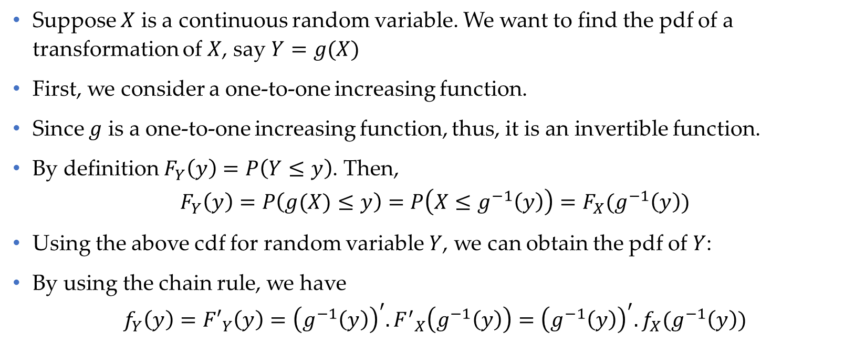
pdf for a transformation of continuous r.v.
Suppose $X$ is a continuous random variable. We want to find the pdf of a transformation of $X$, say $Y=g(X)$
First, we consider a one-to-one increasing function.
Since $g$ is a one-to-one increasing function, thus, it is an invertible function.
By definition $F_{Y}\left(y\right)=P\left(Y≤y\right)$. Then,
$$F_{Y}\left(y\right)=P\left(g(X)≤y\right)=P\left(X≤g^{−1}\left(y\right)\right)=F_{X}(g^{−1}\left(y\right))$$
Using the above cdf for random variable $Y$, we can obtain the pdf of $Y$:
By using the chain rule, we have
$$f_{Y}\left(y\right)={F′}_{Y}\left(y\right)={\left(g^{−1}\left(y\right)\right)}^{′}. {F^{′}}_{X}\left(g^{−1}\left(y\right)\right)={\left(g^{−1}\left(y\right)\right)}^{′}.f_{X}(g^{−1}\left(y\right))$$
Data Science & Machine Learning in Finance: Introduction
University of Glasgow
2022-2023

Slide 9

pdf for a transformation of continuous r.v. (Cont’d)
For any arbitrary transformation of $X$, we can show that:
$$f_{Y}\left(y\right)={F′}_{Y}\left(y\right)={\left(g^{−1}\left(y\right)\right)}^{′}. {F^{′}}_{X}\left(g^{−1}\left(y\right)\right)=f_{X}(g^{−1}\left(y\right))\left|{\left(g^{−1}\left(y\right)\right)}^{′}\right|$$
Data Science & Machine Learning in Finance: Introduction
University of Glasgow
2022-2023

Slide 10
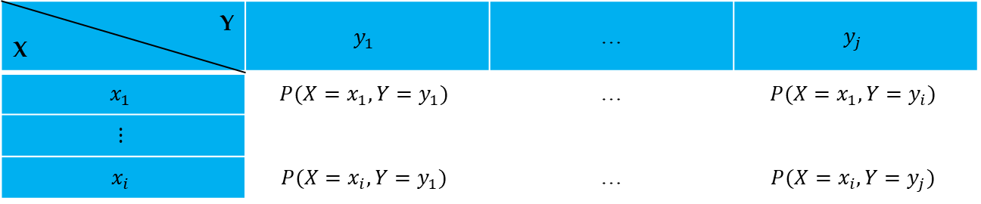

Joint density (probability) function
Similar to density function for a random variable, we can define a density or probability function for two random variables.
Joint probability function for two discrete variables is denoted by a two-way table as follows:
Probability rules hold here too, such as: $\sum_{x}{\sum_{y}{P(X=x,Y=y)}}=1$, etc.
Example: See Problem Set 1, Question 1.
Y X | $$y_{1}$$ | … | $$y_{j}$$
$$x_{1}$$ | $$P(X=x_{1},Y=y_{1})$$ | … | $$P(X=x_{1},Y=y_{i})$$
$$⋮$$
$$x_{i}$$ | $$P(X=x_{i},Y=y_{1})$$ | … | $$P(X=x_{i},Y=y_{j})$$
Data Science & Machine Learning in Finance: Introduction
University of Glasgow
2022-2023

Slide 11

Independent r.vs
$$f_{X,Y}\left(x,y\right)=f_{X}(x).f_{Y}\left(y\right)$$
Data Science & Machine Learning in Finance: Introduction
University of Glasgow
2022-2023

Slide 12
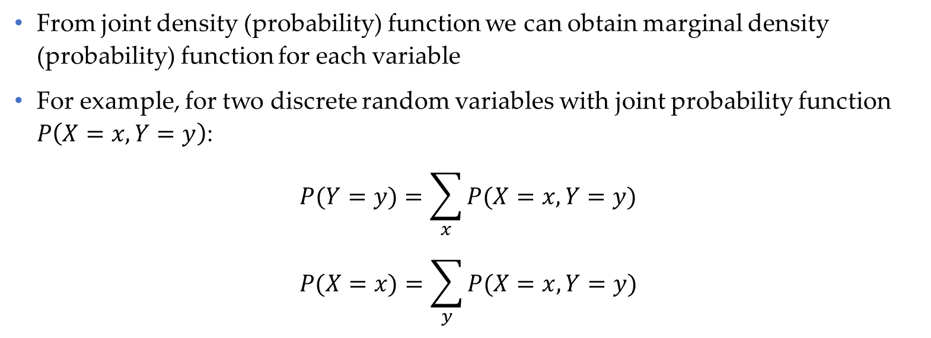
Marginal density (probability) function
From joint density (probability) function we can obtain marginal density (probability) function for each variable
For example, for two discrete random variables with joint probability function $P\left(X=x, Y=y\right)$:
$$P(Y=y)=\sum_{x}{P(X=x, Y=y)}$$
$$P(X=x)=\sum_{y}{P(X=x, Y=y)}$$
Data Science & Machine Learning in Finance: Introduction
University of Glasgow
2022-2023

Slide 13
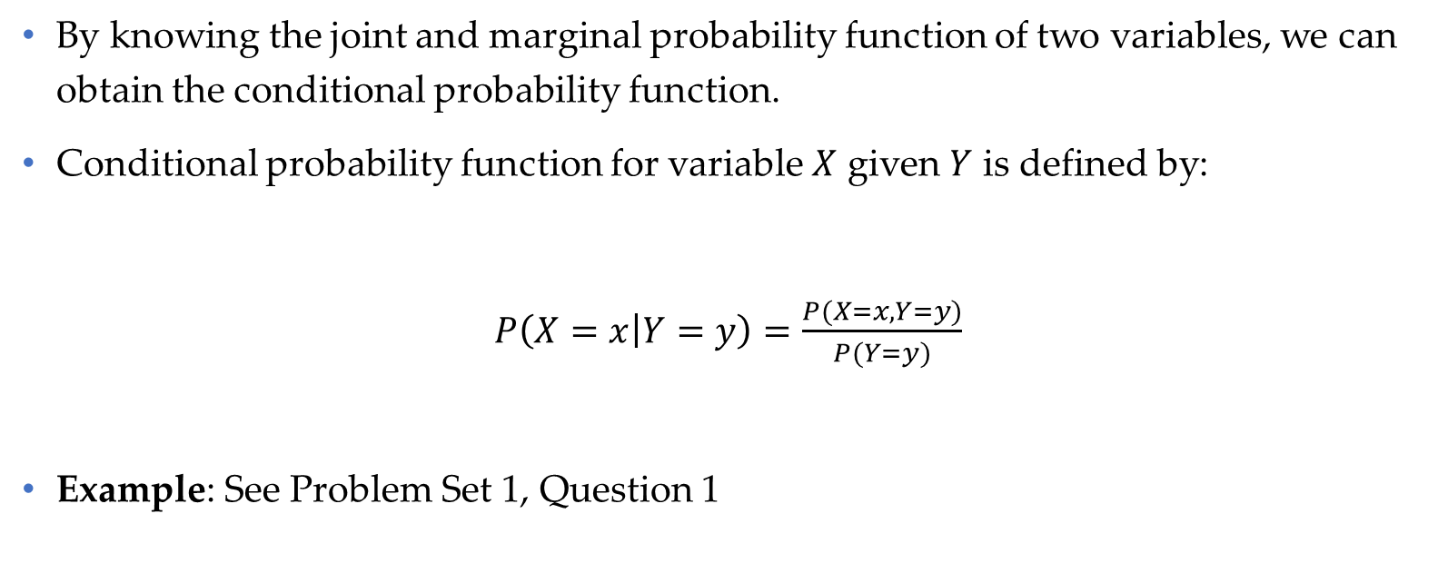
Conditional probability function
By knowing the joint and marginal probability function of two variables, we can obtain the conditional probability function.
Conditional probability function for variable $X$ given $Y$ is defined by:
$P\left(X=x | Y=y\right)=\frac{P(X=x, Y=y)}{P(Y=y)}$
Example: See Problem Set 1, Question 1
Data Science & Machine Learning in Finance: Introduction
University of Glasgow
2022-2023

Slide 14
Conditional probability function: Example
Suppose we have 2 red and 3 blue marbles in a bag.
What is the probability of drawing a red marble?
What is the probability of drawing a red marble in the second attempt?
In the first question, the chance of drawing a red marble is 2 in 5.
But after taking one out the chance changes!
If the first marble is blue, the chance of drawing a red marble is 2 in 4.
If the first marble is red, the chance of drawing another red marble is 1 in 4
Data Science & Machine Learning in Finance: Introduction
University of Glasgow
2022-2023

Slide 15
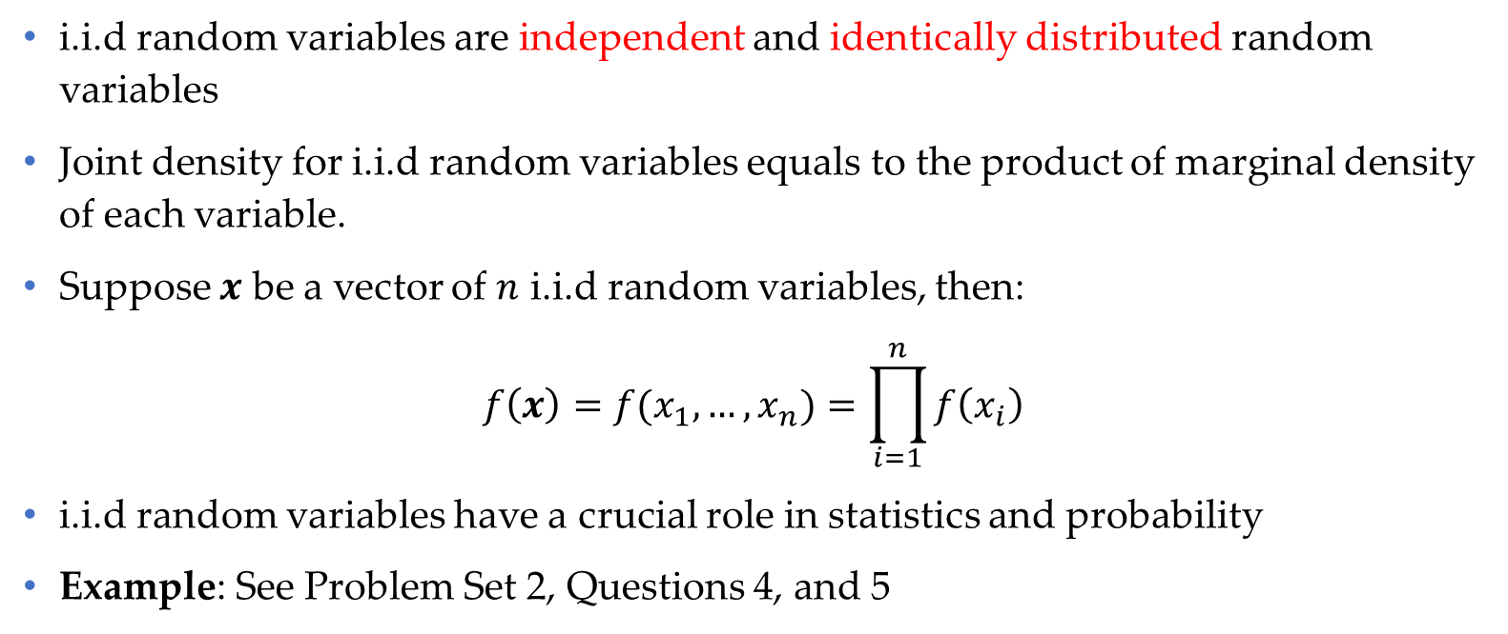
Joint density for i.i.d random variables
i.i.d random variables are independent and identically distributed random variables
Joint density for i.i.d random variables equals to the product of marginal density of each variable.
Suppose $x$ be a vector of $n$ i.i.d random variables, then:
$$f\left(x\right)=f(x_{1},…,x_{n})=\prod_{i=1}^{n}{f\left(x_{i}\right)}$$
i.i.d random variables have a crucial role in statistics and probability
Example: See Problem Set 2, Questions 4, and 5
Data Science & Machine Learning in Finance: Introduction
University of Glasgow
2022-2023

Slide 16

Mathematical expectation
For discrete random variables
$$E\left(X\right)=\sum{x}.P\left(X=x\right)$$
For continuous random variables
$$E\left(X\right)=\int{x.f\left(x\right)dx}$$
Example: See Problem Set 1, Question 1.
Data Science & Machine Learning in Finance: Introduction
University of Glasgow
2022-2023

Slide 17
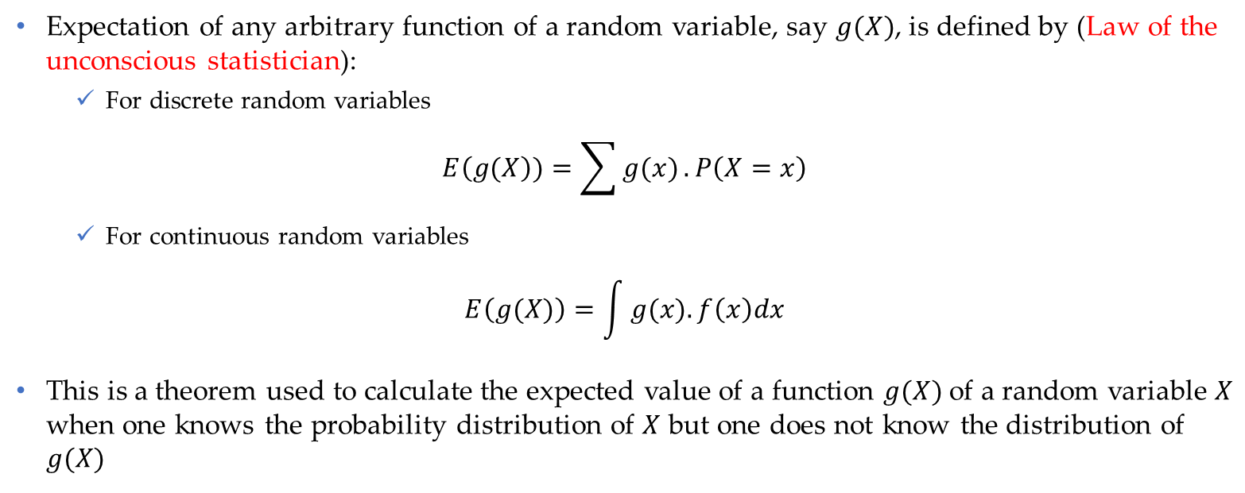
Mathematical expectation (Cont’d)
Expectation of any arbitrary function of a random variable, say $g(X)$, is defined by (Law of the unconscious statistician):
For discrete random variables
$$E\left(g(X\right))=\sum{g(x)}.P\left(X=x\right)$$
For continuous random variables
$$E\left(g(X)\right)=\int{g(x).f\left(x\right)dx}$$
This is a theorem used to calculate the expected value of a function $g(X)$of a random variable $X$ when one knows the probability distribution of $X$ but one does not know the distribution of $g(X)$
Data Science & Machine Learning in Finance: Introduction
University of Glasgow
2022-2023

Slide 18
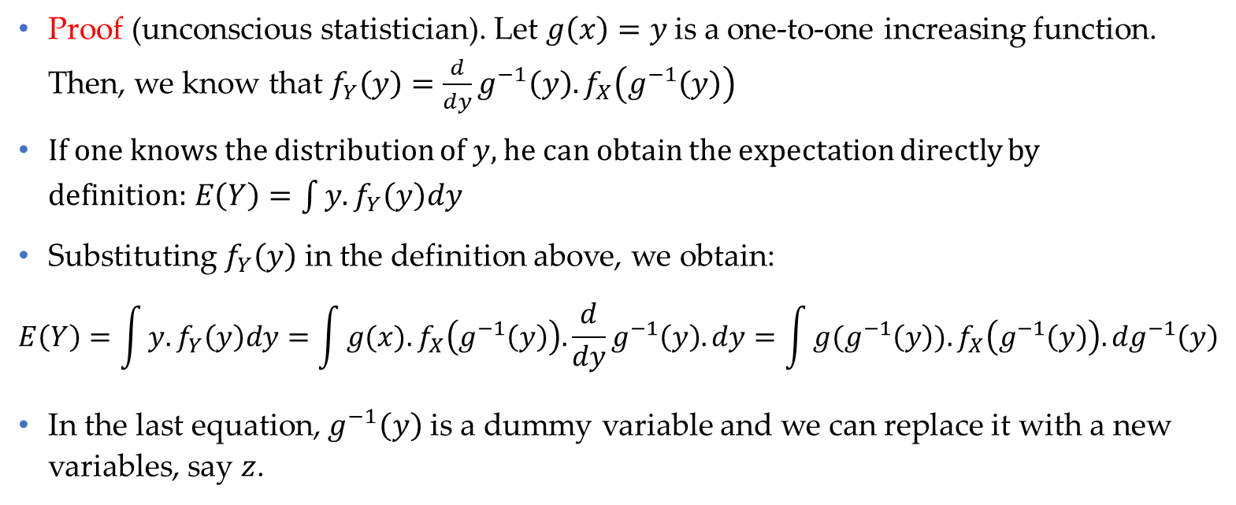
Mathematical expectation (Cont’d)
Proof (unconscious statistician). Let $g\left(x\right)=y$is a one-to-one increasing function. Then, we know that $f_{Y}\left(y\right)=\frac{d}{dy}g^{−1}\left(y\right).f_{X}\left(g^{−1}\left(y\right)\right)$
If one knows the distribution of $y$, he can obtain the expectation directly by definition:$E\left(Y\right)=\int{y. f_{Y}\left(y\right)dy}$
Substituting $f_{Y}\left(y\right)$ in the definition above, we obtain:
$$E\left(Y\right)=\int{y. f_{Y}\left(y\right)dy}=\int{g(x).f_{X}\left(g^{−1}\left(y\right)\right).\frac{d}{dy}g^{−1}\left(y\right). dy}=\int{g(g^{−1}\left(y\right)).f_{X}\left(g^{−1}\left(y\right)\right).{dg}^{−1}\left(y\right)}$$
In the last equation, $g^{−1}\left(y\right)$ is a dummy variable and we can replace it with a new variables, say $z$.
Data Science & Machine Learning in Finance: Introduction
University of Glasgow
2022-2023

Slide 19
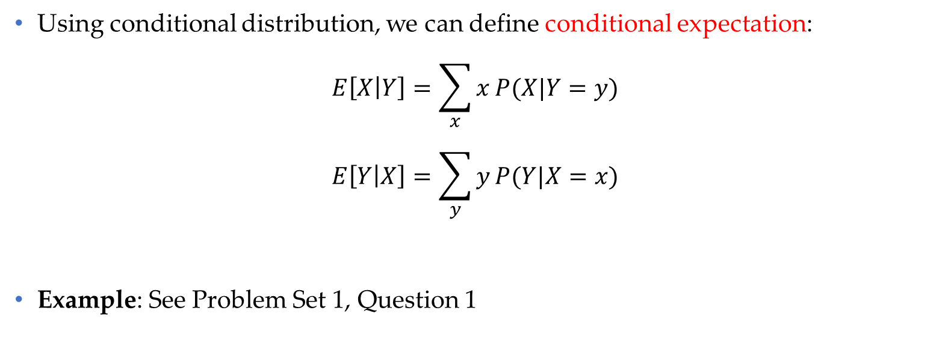
Conditional expectation
Using conditional distribution, we can define conditional expectation:
$$E\left[X | Y\right]=\sum_{x}{x}P(X|Y=y)$$
$$E\left[Y | X\right]=\sum_{y}{y}P(Y|X=x)$$
Example: See Problem Set 1, Question 1
Data Science & Machine Learning in Finance: Introduction
University of Glasgow
2022-2023

Slide 20
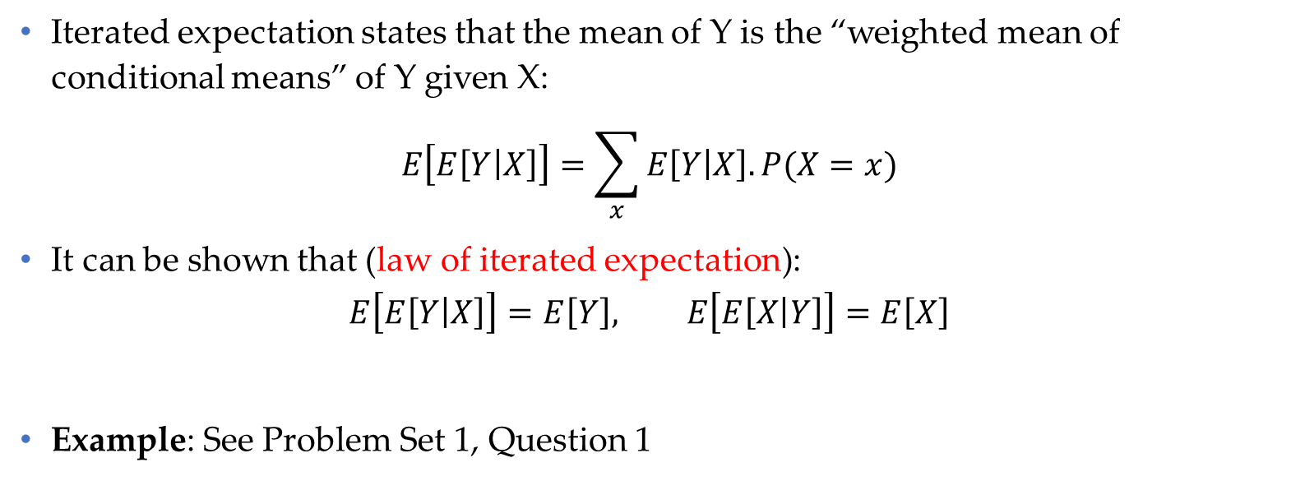
Iterated expectation
Iterated expectation states that the mean of Y is the “weighted mean of conditional means” of Y given X:
$$E\left[E\left[Y | X\right]\right]=\sum_{x}{E\left[Y | X\right].P(X=x)}$$
It can be shown that (law of iterated expectation):
$$E\left[E\left[Y | X\right]\right]=E\left[Y\right], E\left[E\left[X | Y\right]\right]=E\left[X\right]$$
Example: See Problem Set 1, Question 1
Data Science & Machine Learning in Finance: Introduction
University of Glasgow
2022-2023

Slide 21

Iterated expectation (Cont’d)
Proof of law of iterated expectation
$$\begin{matrix}E\left[E\left[Y | X\right]\right] & = & \sum_{x}{E\left[Y | X\right].P(X=x)} \\ & = & \sum_{x}{\left(\sum_{y}{yP(Y|X=x)}\right)P(X=x)} \\ & = & \sum_{x}{\sum_{y}{y\frac{P(Y=y, X=x)}{P(X=x)}}P(X=x)}\end{matrix}$$
The last line is given by conditional probability function
$$\begin{matrix}E\left[E\left[Y | X\right]\right] & = & \sum_{x}{\sum_{y}{y}P(Y=y, X=x)} \\ & = & \sum_{y}{y\sum_{x}{P(Y=y, X=x)}} \\ & = & \sum_{x}{yP(Y=x)}\end{matrix}$$
Data Science & Machine Learning in Finance: Introduction
University of Glasgow
2022-2023

Slide 22

Variance of a r.v.
Variance of a r.v.
$$Var\left(X\right)=E{\left(X−E(X)\right)}^{2}$$
It can be shown that:
$$Var\left(X\right)=E{\left(X^{2}\right)−E}^{2}(X)$$
Data Science & Machine Learning in Finance: Introduction
University of Glasgow
2022-2023

Slide 23
Section 2
Popular statistical distribution in finance

Slide 24
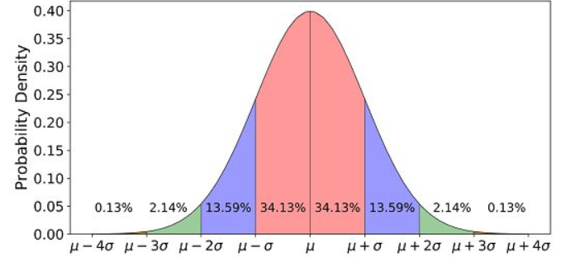
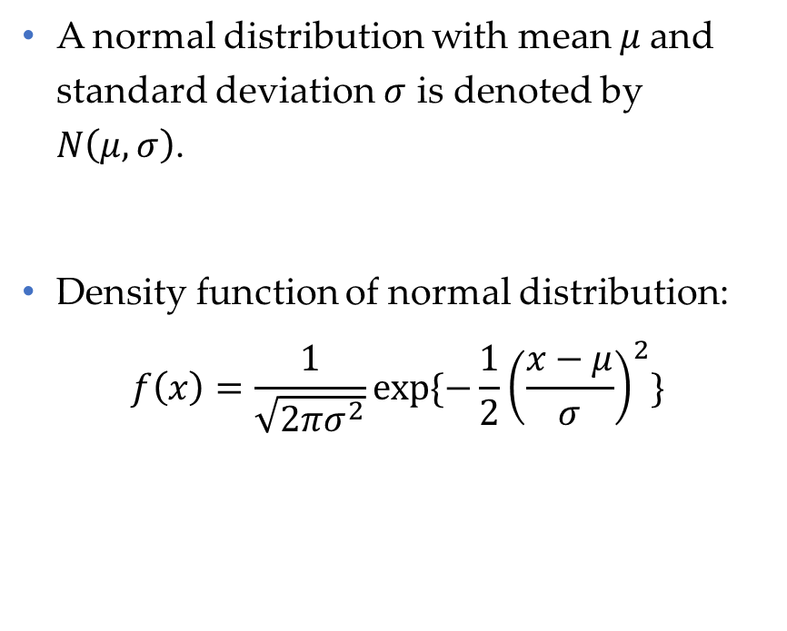
Normal distribution
A normal distribution with mean $μ$and standard deviation $σ$ is denoted by $N\left(μ, σ\right)$.
Density function of normal distribution:
$$f\left(x\right)=\frac{1}{\sqrt{2πσ^{2}}}exp⁡\{−\frac{1}{2}{\left(\frac{x−μ}{σ}\right)}^{2}\}$$
Data Science & Machine Learning in Finance: Introduction
University of Glasgow
2022-2023

Slide 25
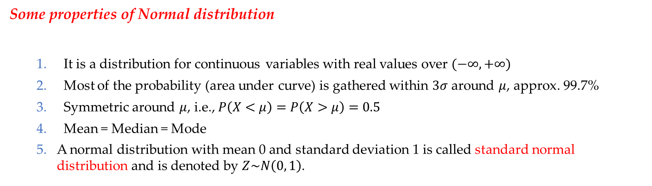
Normal distribution (Cont’d)
Some properties of Normal distribution
It is a distribution for continuous variables with real values over $(−∞, +∞)$
Most of the probability (area under curve) is gathered within $3σ$ around $μ$, approx. 99.7%
Symmetric around $μ$, i.e., $P\left(X<μ\right)=P\left(X>μ\right)=0.5$
Mean = Median = Mode
A normal distribution with mean 0 and standard deviation 1 is called standard normal distribution and is denoted by $Z\sim N\left(0, 1\right)$.
Data Science & Machine Learning in Finance: Introduction
University of Glasgow
2022-2023

Slide 26
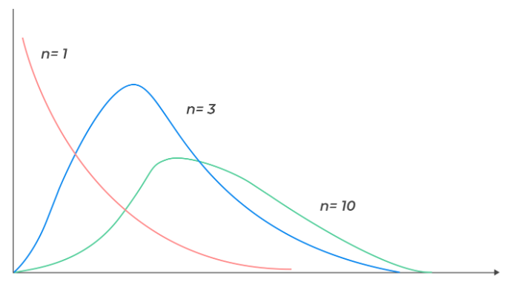
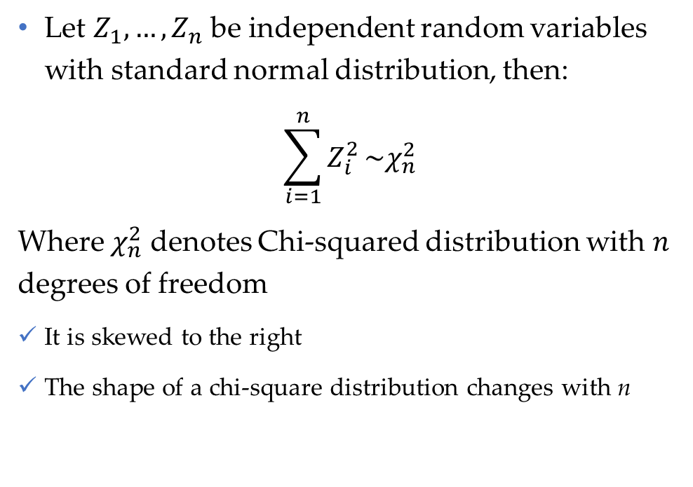
Chi-square distribution
Let $Z_{1},…,Z_{n}$ be independent random variables with standard normal distribution, then:
$$\sum_{i=1}^{n}{Z_{i}^{2}}\sim χ_{n}^{2}$$
Where $χ_{n}^{2}$ denotes Chi-squared distribution with $n$ degrees of freedom
It is skewed to the right
The shape of a chi-square distribution changes with n
Data Science & Machine Learning in Finance: Introduction
University of Glasgow
2022-2023

Slide 27
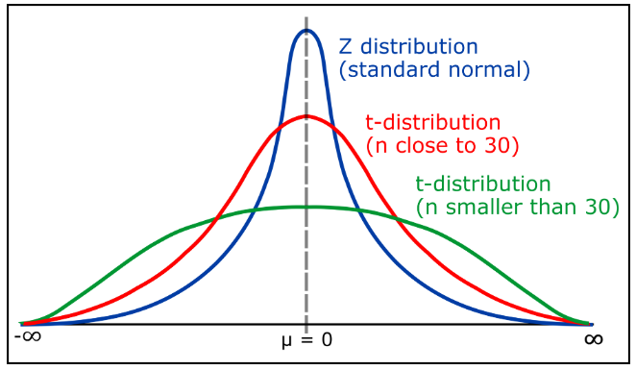
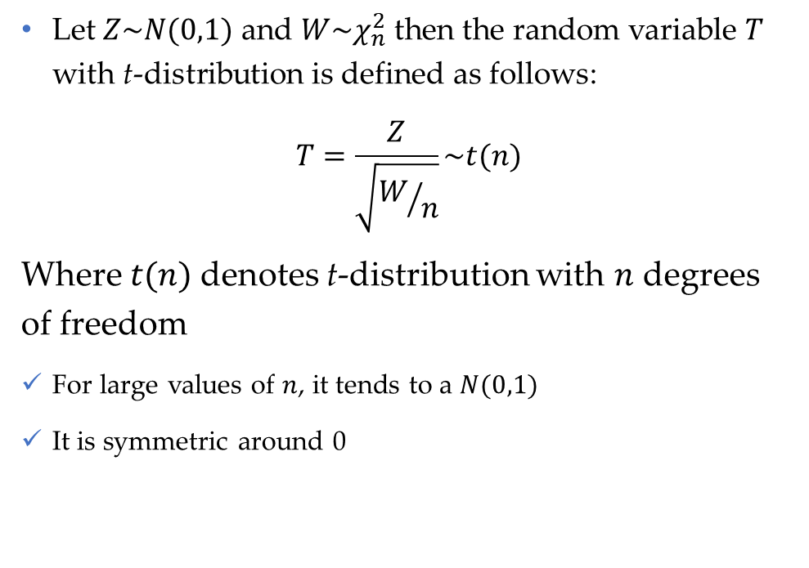
t-distribution
Let $Z\sim N(0,1)$ and $W\sim χ_{n}^{2}$ then the random variable $T$ with t-distribution is defined as follows:
$$T=\frac{Z}{\sqrt{W/n}}\sim t(n)$$
Where $t(n)$denotes t-distribution with $n$ degrees of freedom
For large values of $n$, it tends to a $N(0,1)$
It is symmetric around 0
Data Science & Machine Learning in Finance: Introduction
University of Glasgow
2022-2023

Slide 28
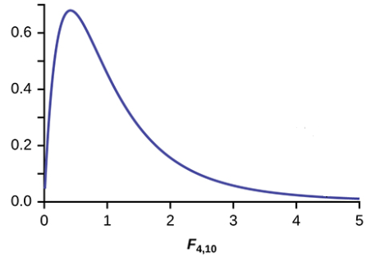
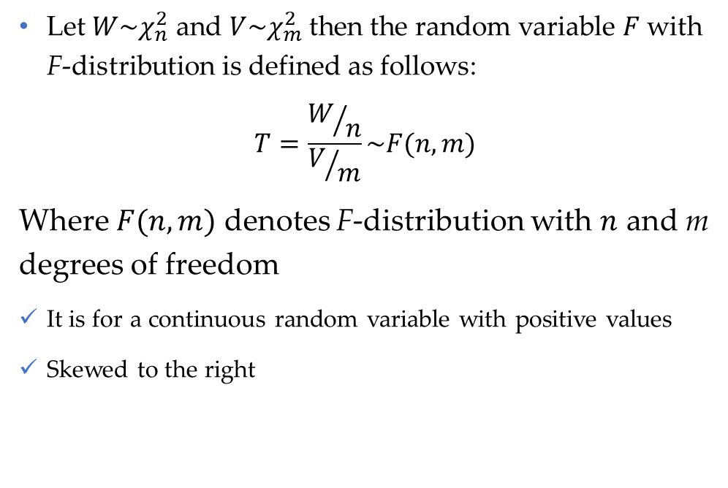
F-distribution
Let $W\sim χ_{n}^{2}$ and $V\sim χ_{m}^{2}$ then the random variable $F$ with F-distribution is defined as follows:
$$T=\frac{W/n}{V/m}\sim F(n,m)$$
Where $F(n,m)$ denotes F-distribution with $n$ and m degrees of freedom
It is for a continuous random variable with positive values
Skewed to the right
Data Science & Machine Learning in Finance: Introduction
University of Glasgow
2022-2023

Slide 29
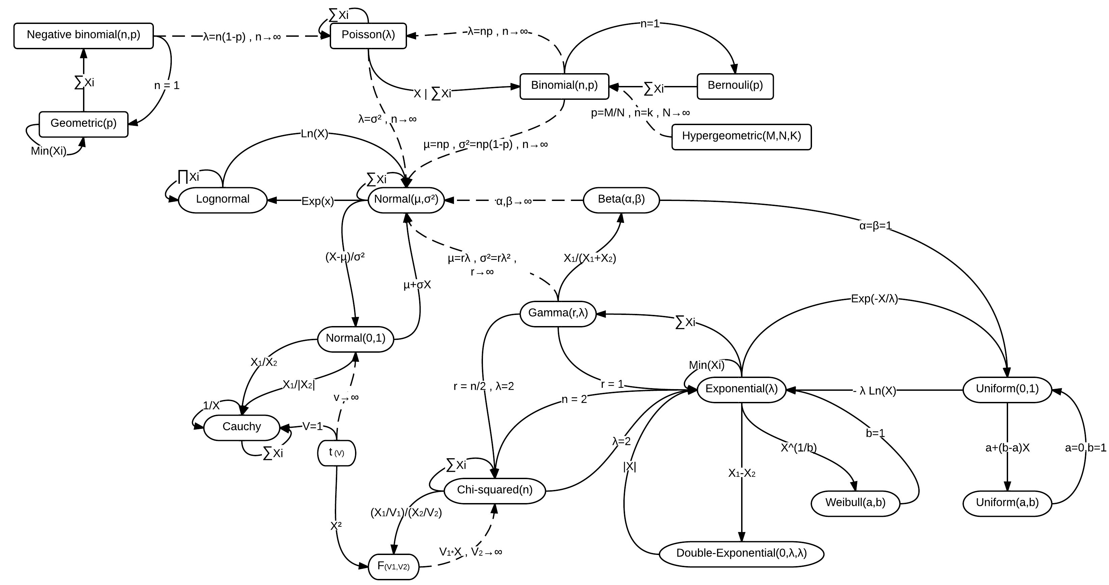
Relationship between statistical distributions
Source: Wikipedia

Slide 30
Applications of continuous distributions in Finance
Normal, Chi-square, t and F--- Almost in all domain of finance
Lognormal --- especially in asset pricing
Cong, L. W., Li, Y., & Wang, N. (2021). Tokenomics: Dynamic adoption and valuation. The Review of Financial Studies, 34(3), 1105-1155.
Stein, E. M., & Stein, J. C. (1991). Stock price distributions with stochastic volatility: an analytic approach. The review of financial studies, 4(4), 727-752.
Beta and its extension --- especially for return prediction
Higbee, J. D., & McDonald, J. B. (2021). A comparison of the GB2 and skewed generalized log-t distributions with an application in finance. Journal of Econometrics.
McDonald, J. B., & Xu, Y. J. (1995). A generalization of the beta distribution with applications. Journal of Econometrics, 66(1-2), 133-152.
Data Science & Machine Learning in Finance: Introduction
University of Glasgow
2022-2023

Slide 31
Applications of discrete distributions in Finance
Poisson --- especially in insurance
Cohn, J. B., Liu, Z., & Wardlaw, M. I. (2022). Count (and count-like) data in finance. Journal of Financial Economics, 146(2), 529-551.
Han, L., Lutz, C., Sand, B., & Stacey, D. (2021). The effects of a targeted financial constraint on the housing market. Review of Financial Studies, 34(8), 3742-3788.
Sunder, J., Sunder, S. V., & Zhang, J. (2017). Pilot CEOs and corporate innovation. Journal of Financial Economics, 123(1), 209-224.
Negative binomial
Tang, X., Shi, J., Han, J., Shu, A., & Xiao, F. (2021). Culturally diverse board and corporate innovation. Accounting & Finance, 61(4), 5655-5679.
Data Science & Machine Learning in Finance: Introduction
University of Glasgow
2022-2023

Slide 32
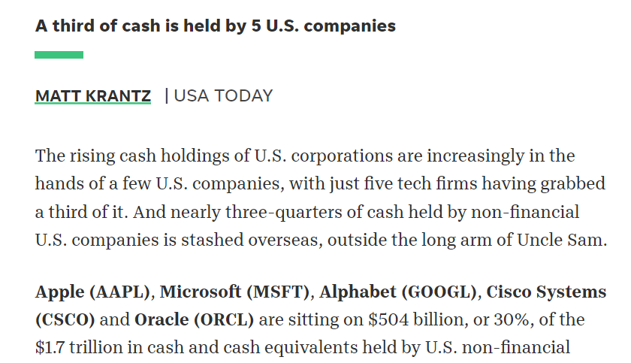
Assessing statistical distributions in practice
Histogram is the main instrument to examine the statistical distribution of a variable
Example:
We expect a highly skewed distribution on the right side for corporate cash holdings in the USA
Because a third of cash is held by five U.S. companies including Apple, Microsoft, Alphabet, Cisco Systems, and Oracle
Source:
Krantz, M. (2017). A third of cash is held by 5 US companies. USA Today. https://www, usatoday.
Data Science & Machine Learning in Finance: Introduction
University of Glasgow
2022-2023

Slide 33
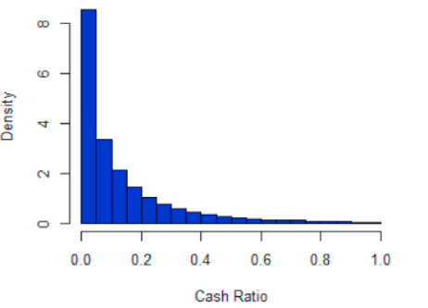
Assessing statistical distributions in practice (Cont’d)
Histogram of US firms cash ratio
over 1980-2017
Source:
Elyasiani and Movaghari (2022)
Data Science & Machine Learning in Finance: Introduction
University of Glasgow
2022-2023

Slide 34
Section 3
Point estimation

Slide 35
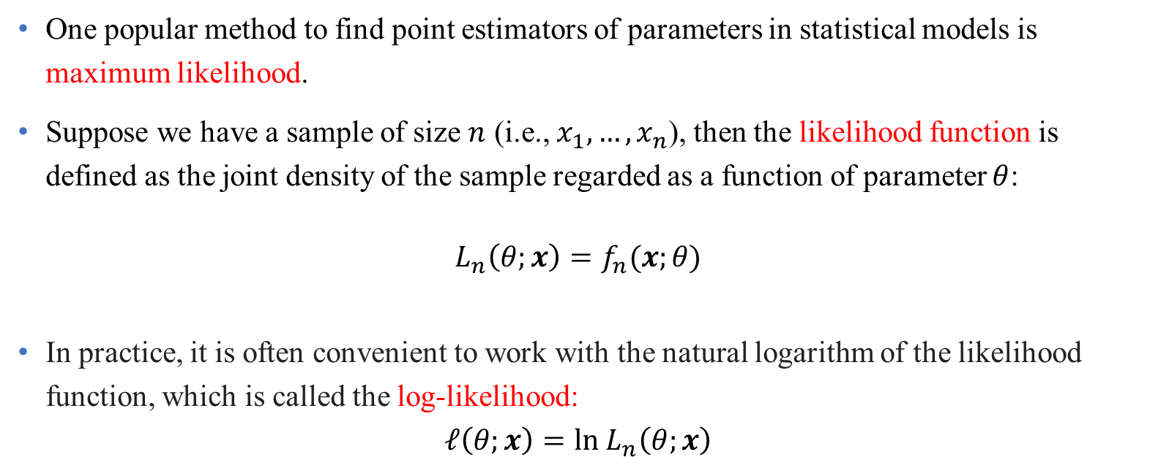
Maximum likelihood estimator (MLE)
One popular method to find point estimators of parameters in statistical models is maximum likelihood.
Suppose we have a sample of size $n$ (i.e., $x_{1},…,x_{n}$), then the likelihood function is defined as the joint density of the sample regarded as a function of parameter $θ$:
$$L_{n}\left(θ;x\right)=f_{n}(x;θ)$$
In practice, it is often convenient to work with the natural logarithm of the likelihood function, which is called the log-likelihood:
$$ℓ\left(θ;x\right)=ln L_{n}\left(θ;x\right)$$
Data Science & Machine Learning in Finance: Introduction
University of Glasgow
2022-2023

Slide 36
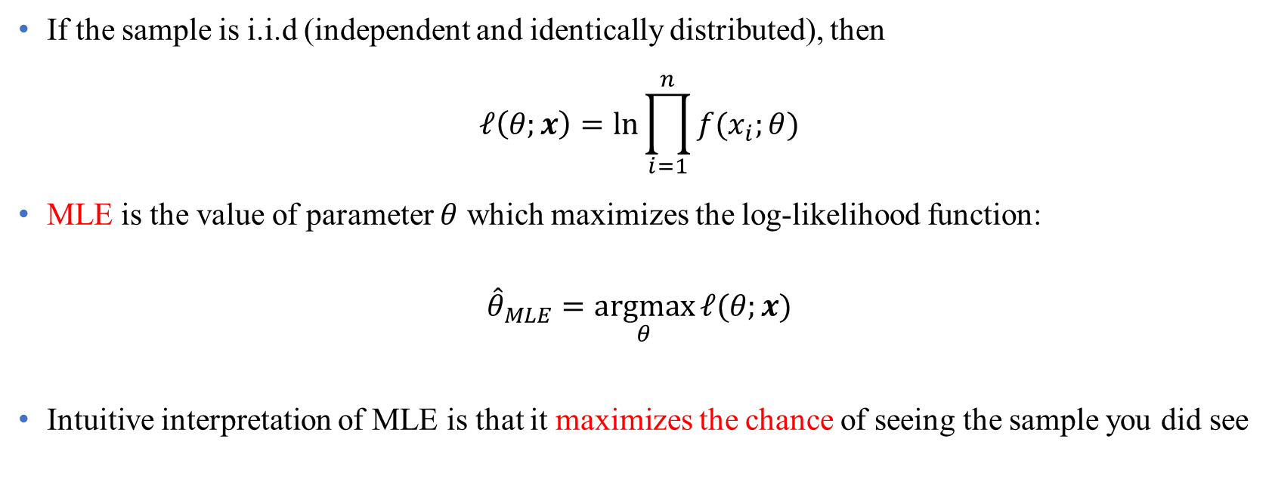
Maximum likelihood estimator (MLE) (Cont’d)
If the sample is i.i.d (independent and identically distributed), then
$$ℓ\left(θ;x\right)=ln\prod_{i=1}^{n}{f(x_{i};θ)}$$
MLE is the value of parameter $θ$ which maximizes the log-likelihood function:
$${\hat{θ}}_{MLE}=\underset{θ}{argmax}{ℓ(θ;x)}$$
Intuitive interpretation of MLE is that it maximizes the chance of seeing the sample you did see
Data Science & Machine Learning in Finance: Introduction
University of Glasgow
2022-2023

Slide 37
Maximum likelihood estimator (MLE) (Cont’d)
Example: See Problem Set 2, Question 4 & 5.
In some cases, there is no a closed form solution for MLE. In this situation iterative methods (e.g., expectation-maximization (EM) algorithm) is used.
McLachlan, G. J., & Krishnan, T. (2007). The EM algorithm and extensions. John Wiley & Sons.
Data Science & Machine Learning in Finance: Introduction
University of Glasgow
2022-2023

Slide 38
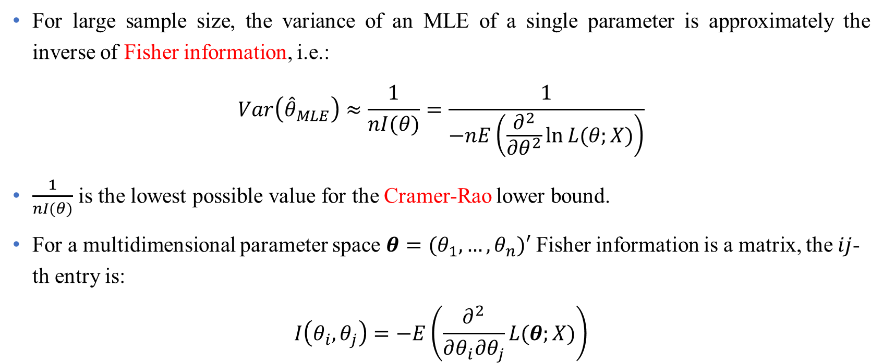
Variance of MLEs
For large sample size, the variance of an MLE of a single parameter is approximately the inverse of Fisher information, i.e.:
$$Var\left({\hat{θ}}_{MLE}\right)≈\frac{1}{nI(θ)}=\frac{1}{−nE\left(\frac{∂^{2}}{∂θ^{2}}\ln{L(θ;X)}\right)}$$
$\frac{1}{nI(θ)}$ is the lowest possible value for the Cramer-Rao lower bound.
For a multidimensional parameter space $θ=(θ_{1},…,θ_{n})′$ Fisher information is a matrix, the $ij$-th entry is:
$$I\left(θ_{i},θ_{j}\right)=−E\left(\frac{∂^{2}}{∂θ_{i}∂θ_{j}}L(θ;X)\right)$$
Data Science & Machine Learning in Finance: Introduction
University of Glasgow
2022-2023

Slide 39
Fisher Information
Fisher information provides a way to measure:
The amount of information that a random variable contains about parameter θ of the random variable's probability distribution
Data Science & Machine Learning in Finance: Introduction
University of Glasgow
2022-2023

Slide 40
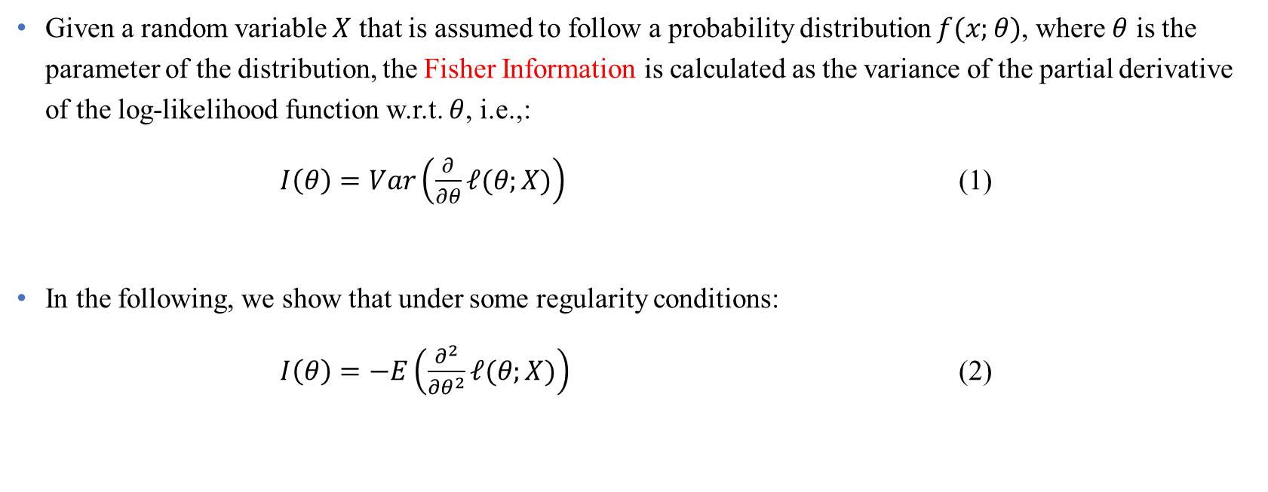
Fisher Information (Cont’d)
Given a random variable $X$ that is assumed to follow a probability distribution $f(x;θ)$, where $θ$ is the parameter of the distribution, the Fisher Information is calculated as the variance of the partial derivative of the log-likelihood function w.r.t. $θ$, i.e.,:
$I\left(θ\right)=Var\left(\frac{∂}{∂θ}ℓ(θ;X)\right)$ (1)
In the following, we show that under some regularity conditions:
$I\left(θ\right)=−E\left(\frac{∂^{2}}{∂θ^{2}}ℓ(θ;X)\right)$ (2)
Data Science & Machine Learning in Finance: Introduction
University of Glasgow
2022-2023

Slide 41
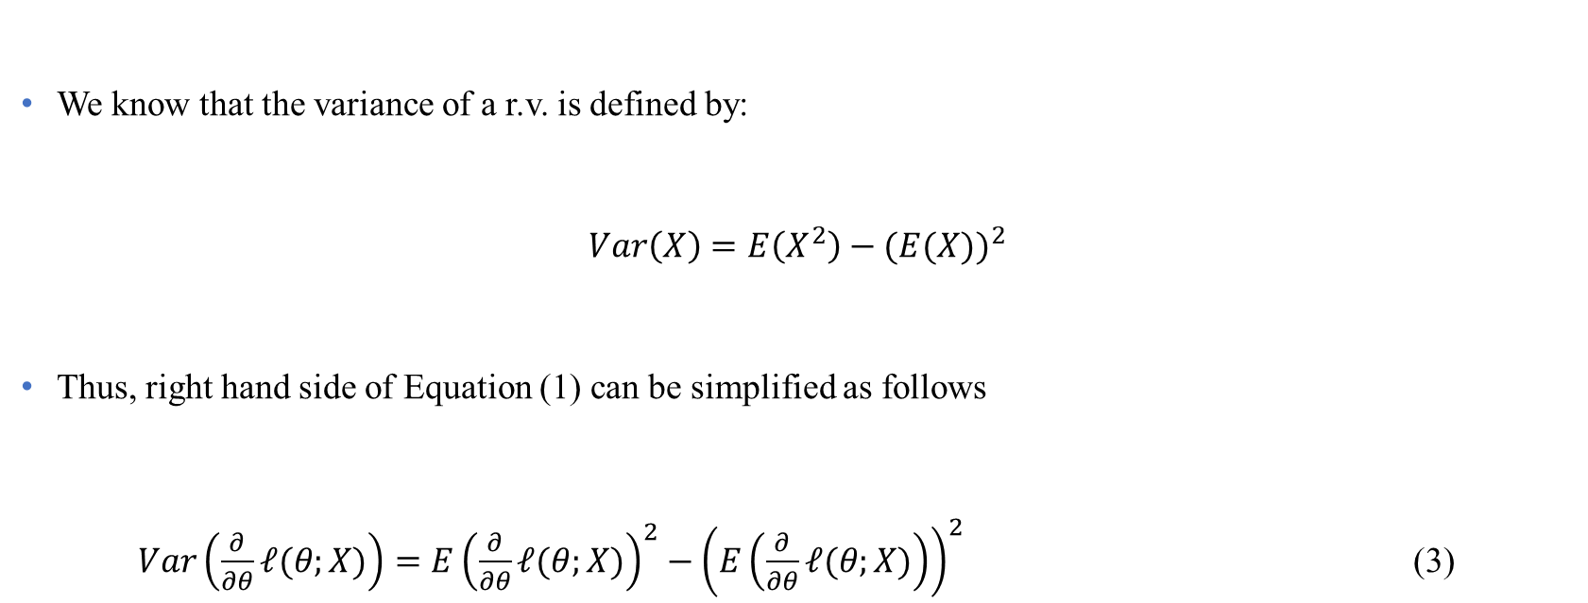
Fisher Information (Cont’d)
We know that the variance of a r.v. is defined by:
$Var\left(X\right)=E\left(X^{2}\right)−{(E(X))}^{2}$
Thus, right hand side of Equation (1) can be simplified as follows
$Var\left(\frac{∂}{∂θ}ℓ(θ;X)\right)=E{\left(\frac{∂}{∂θ}ℓ(θ;X)\right)}^{2}−{\left(E\left(\frac{∂}{∂θ}ℓ(θ;X)\right)\right)}^{2}$ (3)
Data Science & Machine Learning in Finance: Introduction
University of Glasgow
2022-2023

Slide 42
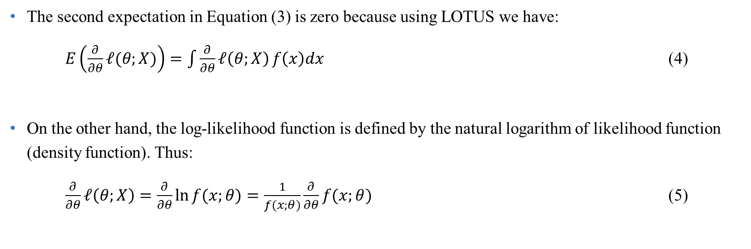
Fisher Information (Cont’d)
The second expectation in Equation (3) is zero because using LOTUS we have:
$E\left(\frac{∂}{∂θ}ℓ(θ;X)\right)=\int{\frac{∂}{∂θ}ℓ\left(θ;X\right)}f\left(x\right)dx$ (4)
On the other hand, the log-likelihood function is defined by the natural logarithm of likelihood function (density function). Thus:
$\frac{∂}{∂θ}ℓ\left(θ;X\right)=\frac{∂}{∂θ}\ln{f(x;θ)}=\frac{1}{f(x;θ)}\frac{∂}{∂θ}f(x;θ)$ (5)
Data Science & Machine Learning in Finance: Introduction
University of Glasgow
2022-2023

Slide 43
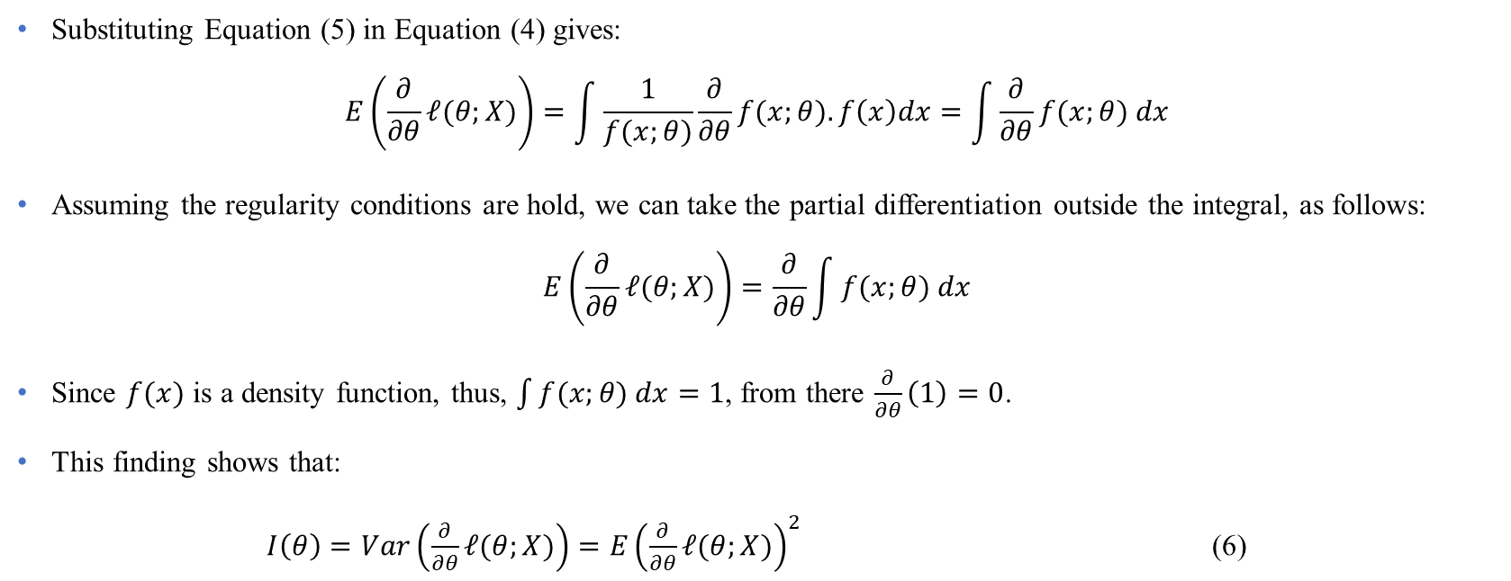
Fisher Information (Cont’d)
Substituting Equation (5) in Equation (4) gives:
$$E\left(\frac{∂}{∂θ}ℓ(θ;X)\right)=\int{\frac{1}{f(x;θ)}\frac{∂}{∂θ}f(x;θ).f\left(x\right)dx}=\int{\frac{∂}{∂θ}f(x;θ) dx}$$
Assuming the regularity conditions are hold, we can take the partial differentiation outside the integral, as follows:
$$E\left(\frac{∂}{∂θ}ℓ(θ;X)\right)=\frac{∂}{∂θ}\int{f(x;θ) dx}$$
Since $f(x)$ is a density function, thus, $\int{f(x;θ) dx}=1$, from there $\frac{∂}{∂θ}\left(1\right)=0$.
This finding shows that:
$I\left(θ\right)=Var\left(\frac{∂}{∂θ}ℓ(θ;X)\right)=E{\left(\frac{∂}{∂θ}ℓ(θ;X)\right)}^{2}$ (6)
Data Science & Machine Learning in Finance: Introduction
University of Glasgow
2022-2023

Slide 44
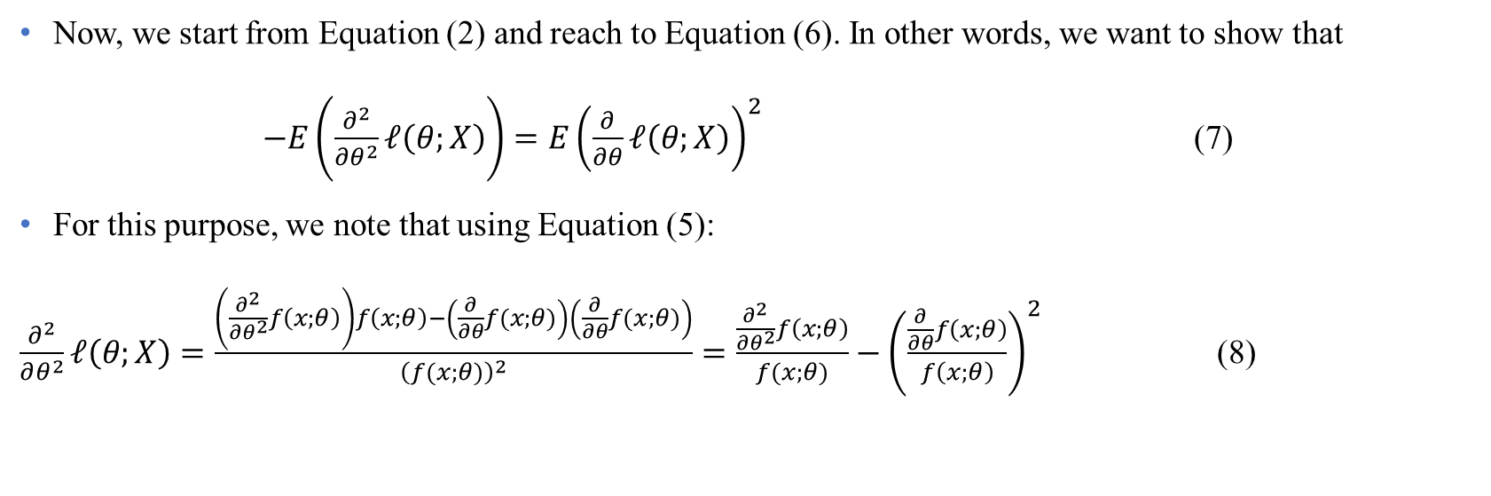
Fisher Information (Cont’d)
Now, we start from Equation (2) and reach to Equation (6). In other words, we want to show that
$−E\left(\frac{∂^{2}}{∂θ^{2}}ℓ\left(θ;X\right)\right)=E{\left(\frac{∂}{∂θ}ℓ\left(θ;X\right)\right)}^{2}$ (7)
For this purpose, we note that using Equation (5):
$\frac{∂^{2}}{∂θ^{2}}ℓ\left(θ;X\right)=\frac{\left(\frac{∂^{2}}{∂θ^{2}}f\left(x;θ\right)\right)f\left(x;θ\right)−\left(\frac{∂}{∂θ}f(x;θ)\right)\left(\frac{∂}{∂θ}f(x;θ)\right)}{{\left(f(x;θ)\right)}^{2}}=\frac{\frac{∂^{2}}{∂θ^{2}}f\left(x;θ\right)}{f(x;θ)}−{\left(\frac{\frac{∂}{∂θ}f\left(x;θ\right)}{f\left(x;θ\right)}\right)}^{2}$ (8)
Data Science & Machine Learning in Finance: Introduction
University of Glasgow
2022-2023

Slide 45
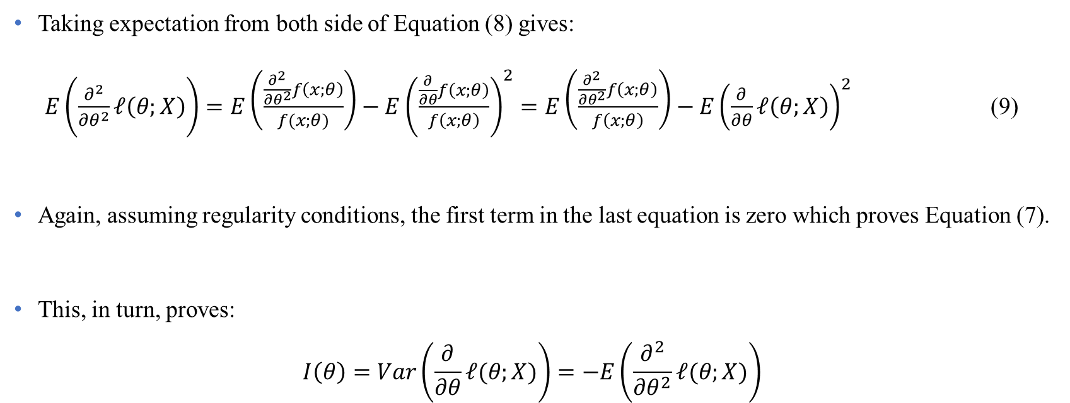
Fisher Information (Cont’d)
Taking expectation from both side of Equation (8) gives:
$E\left(\frac{∂^{2}}{∂θ^{2}}ℓ\left(θ;X\right)\right)=E\left(\frac{\frac{∂^{2}}{∂θ^{2}}f\left(x;θ\right)}{f(x;θ)}\right)−E{\left(\frac{\frac{∂}{∂θ}f\left(x;θ\right)}{f\left(x;θ\right)}\right)}^{2}=E\left(\frac{\frac{∂^{2}}{∂θ^{2}}f\left(x;θ\right)}{f\left(x;θ\right)}\right)−E{\left(\frac{∂}{∂θ}ℓ\left(θ;X\right)\right)}^{2}$ (9)
Again, assuming regularity conditions, the first term in the last equation is zero which proves Equation (7).
This, in turn, proves:
$$I\left(θ\right)=Var\left(\frac{∂}{∂θ}ℓ(θ;X)\right)=−E\left(\frac{∂^{2}}{∂θ^{2}}ℓ(θ;X)\right)$$
Data Science & Machine Learning in Finance: Introduction
University of Glasgow
2022-2023

Slide 46
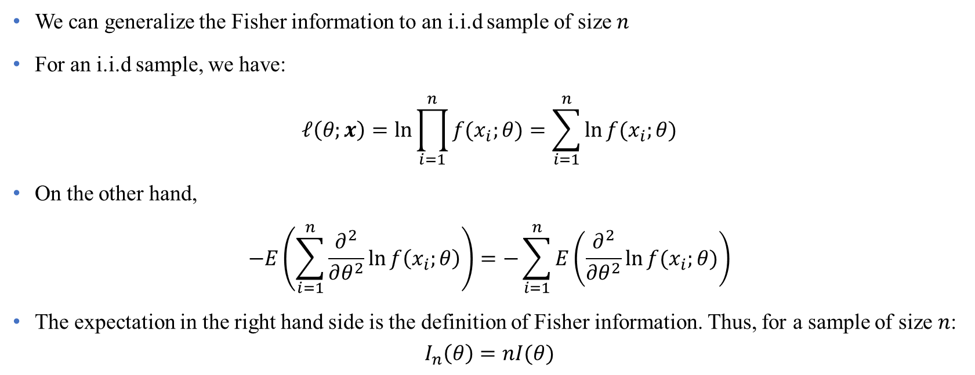
Fisher Information for i.i.d sample
We can generalize the Fisher information to an i.i.d sample of size $n$
For an i.i.d sample, we have:
$$ℓ\left(θ;x\right)=\ln{\prod_{i=1}^{n}{f(x_{i};θ)}}=\sum_{i=1}^{n}{\ln{f(x_{i};θ)}}$$
On the other hand,
$$−E\left(\sum_{i=1}^{n}{\frac{∂^{2}}{∂θ^{2}}\ln{f\left(x_{i};θ\right)}}\right)=−\sum_{i=1}^{n}{E\left(\frac{∂^{2}}{∂θ^{2}}\ln{f(x_{i};θ)}\right)}$$
The expectation in the right hand side is the definition of Fisher information. Thus, for a sample of size $n$:
$$I_{n}\left(θ\right)=nI(θ)$$
Data Science & Machine Learning in Finance: Introduction
University of Glasgow
2022-2023

Slide 47
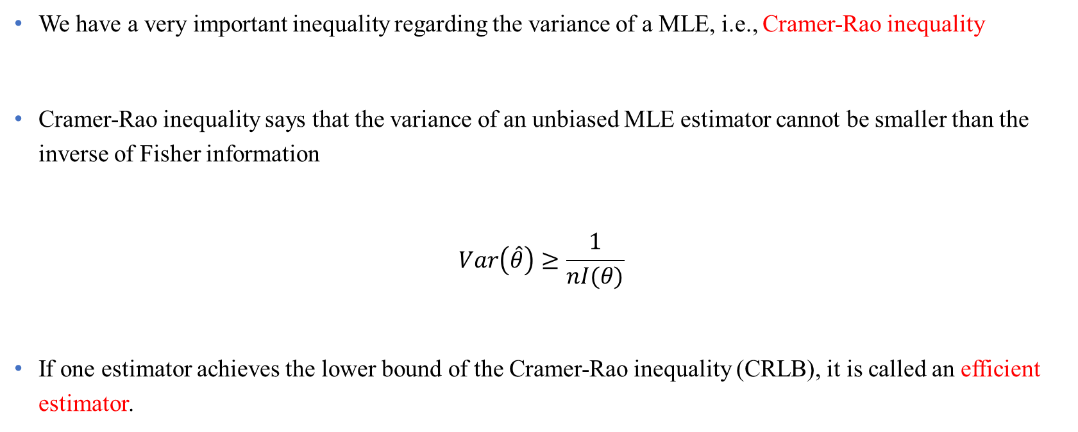
Cramer-Rao inequality
We have a very important inequality regarding the variance of a MLE, i.e., Cramer-Rao inequality
Cramer-Rao inequality says that the variance of an unbiased MLE estimator cannot be smaller than the inverse of Fisher information
$$Var\left(\hat{θ}\right)≥\frac{1}{nI(θ)}$$
If one estimator achieves the lower bound of the Cramer-Rao inequality (CRLB), it is called an efficient estimator.
Data Science & Machine Learning in Finance: Introduction
University of Glasgow
2022-2023

Slide 48
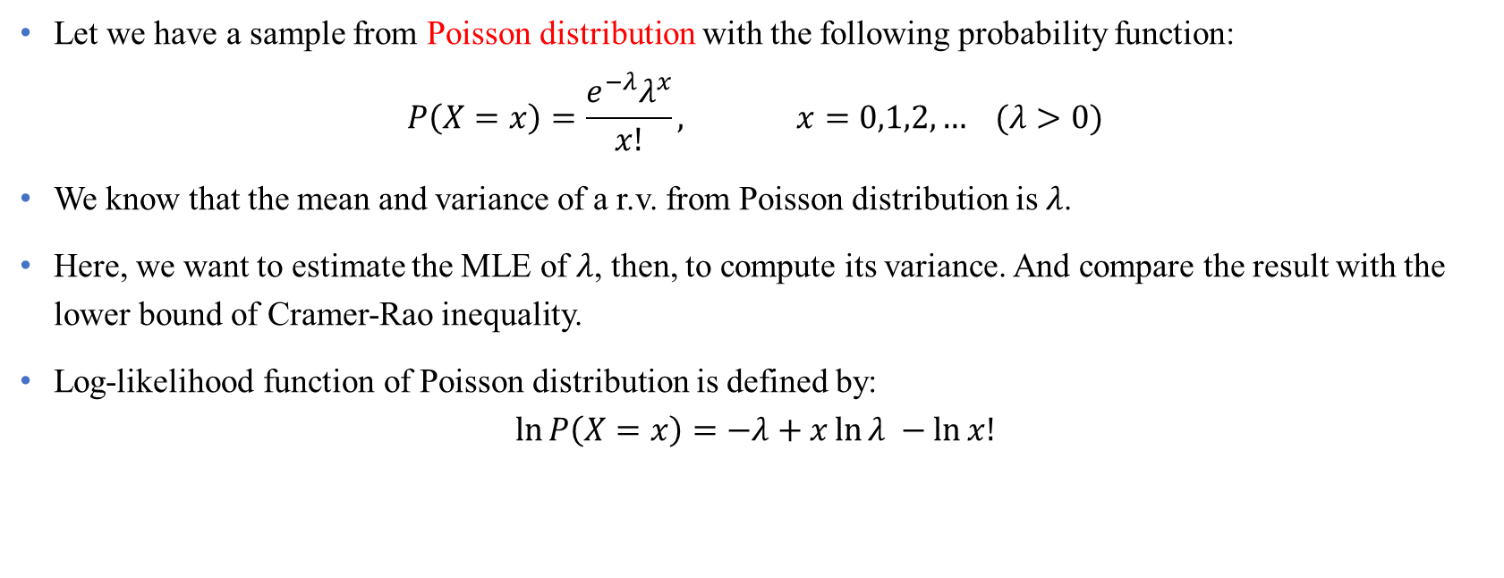
Example
Let we have a sample from Poisson distribution with the following probability function:
$$P\left(X=x\right)=\frac{e^{−λ}λ^{x}}{x!}, x=0,1,2,… (λ>0)$$
We know that the mean and variance of a r.v. from Poisson distribution is $λ$.
Here, we want to estimate the MLE of $λ$, then, to compute its variance. And compare the result with the lower bound of Cramer-Rao inequality.
Log-likelihood function of Poisson distribution is defined by:
$$\ln{P\left(X=x\right)}=−λ+x\ln{λ} −\ln{x!}$$
Data Science & Machine Learning in Finance: Introduction
University of Glasgow
2022-2023

Slide 49
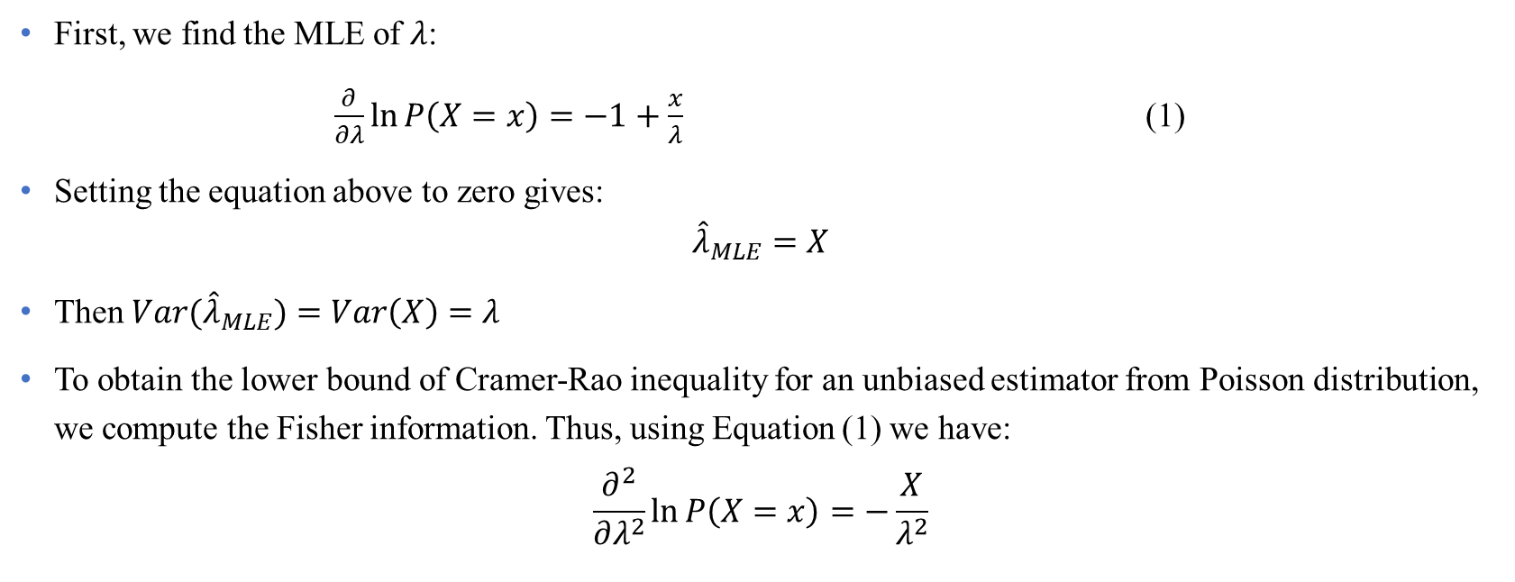
Example (Cont’d)
First, we find the MLE of $λ$:
$\frac{∂}{∂λ}\ln{P\left(X=x\right)}=−1+\frac{x}{λ}$ (1)
Setting the equation above to zero gives:
$${\hat{λ}}_{MLE}=X$$
Then ${Var(\hat{λ}}_{MLE})=Var\left(X\right)=λ$
To obtain the lower bound of Cramer-Rao inequality for an unbiased estimator from Poisson distribution, we compute the Fisher information. Thus, using Equation (1) we have:
$$\frac{∂^{2}}{∂λ^{2}}\ln{P\left(X=x\right)}=−\frac{X}{λ^{2}}$$
Data Science & Machine Learning in Finance: Introduction
University of Glasgow
2022-2023

Slide 50
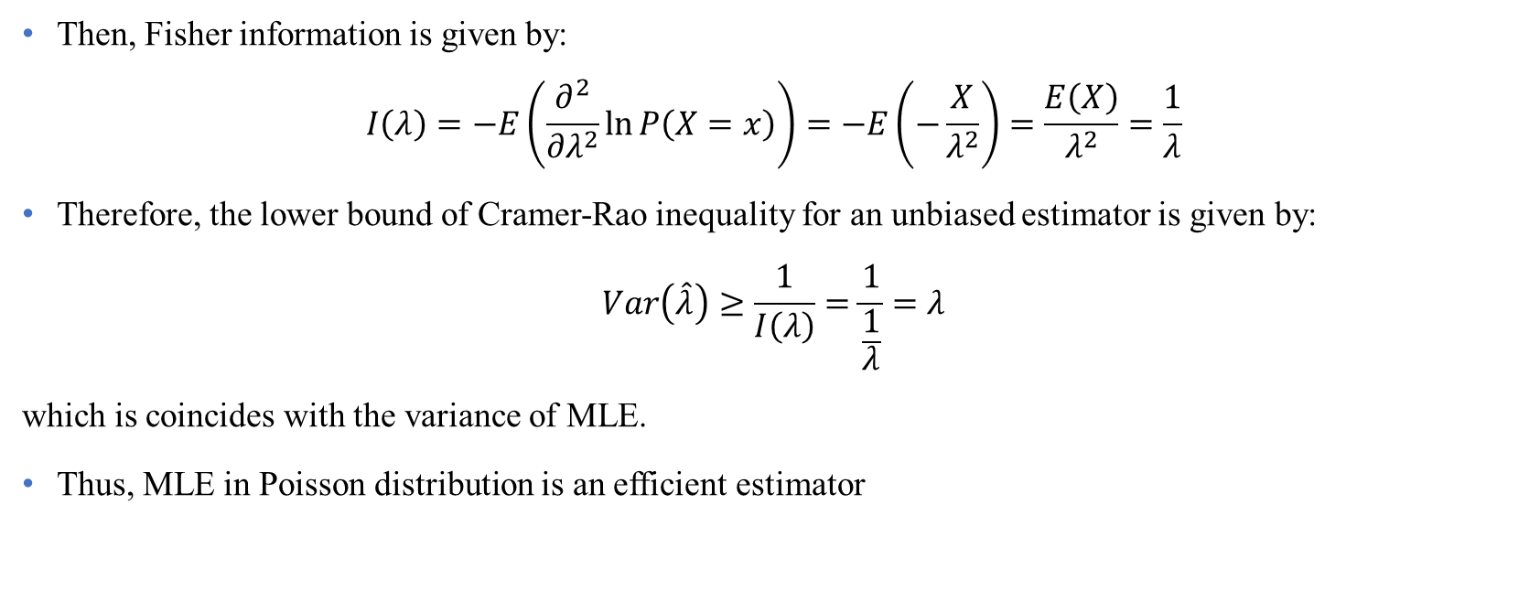
Example (Cont’d)
Then, Fisher information is given by:
$$I\left(λ\right)=−E\left(\frac{∂^{2}}{∂λ^{2}}\ln{P\left(X=x\right)}\right)=−E\left(−\frac{X}{λ^{2}}\right)=\frac{E\left(X\right)}{λ^{2}}=\frac{1}{λ}$$
Therefore, the lower bound of Cramer-Rao inequality for an unbiased estimator is given by:
$$Var\left(\hat{λ}\right)≥\frac{1}{I\left(λ\right)}=\frac{1}{\frac{1}{λ}}=λ$$
which is coincides with the variance of MLE.
Thus, MLE in Poisson distribution is an efficient estimator
Data Science & Machine Learning in Finance: Introduction
University of Glasgow
2022-2023

Slide 51
Applications of Fisher information in Statistics
Three applications of Fisher information in Statistics are:
Hypothesis testing and constructing confidence intervals
Defining Jeffreys’s prior in Bayesian statistics
Measure model complexity in the minimum description length (MLD)
Ly, A., Marsman, M., Verhagen, J., Grasman, R. P., & Wagenmakers, E. J. (2017). A tutorial on Fisher information. Journal of Mathematical Psychology, 80, 40-55.
Data Science & Machine Learning in Finance: Introduction
University of Glasgow
2022-2023

Slide 52
Section 4
Hypothesis testing

Slide 53
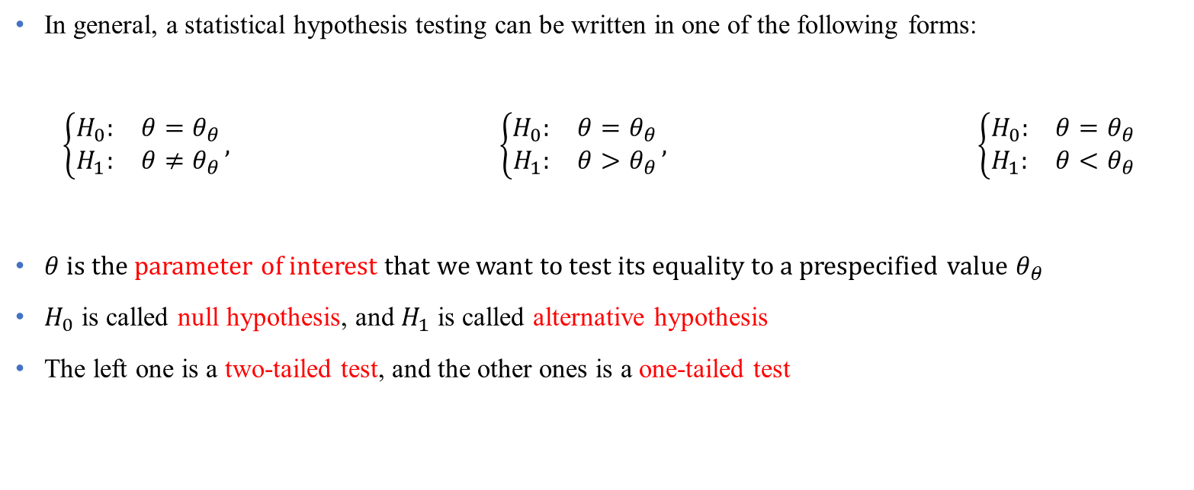
Null and alternative hypothesis
In general, a statistical hypothesis testing can be written in one of the following forms:
$$\left\{\begin{matrix}H_{0}: & θ=θ_{θ} \\ H_{1}: & θ≠θ_{θ}\end{matrix}\right., \left\{\begin{matrix}H_{0}: & θ=θ_{θ} \\ H_{1}: & θ>θ_{θ}\end{matrix}\right., \left\{\begin{matrix}H_{0}: & θ=θ_{θ} \\ H_{1}: & θ<θ_{θ}\end{matrix}\right.$$
$θ$ is the parameter of interest that we want to test its equality to a prespecified value $θ_{θ}$
$H_{0}$ is called null hypothesis, and $H_{1}$ is called alternative hypothesis
The left one is a two-tailed test, and the other ones is a one-tailed test
Data Science & Machine Learning in Finance: Introduction
University of Glasgow
2022-2023

Slide 54
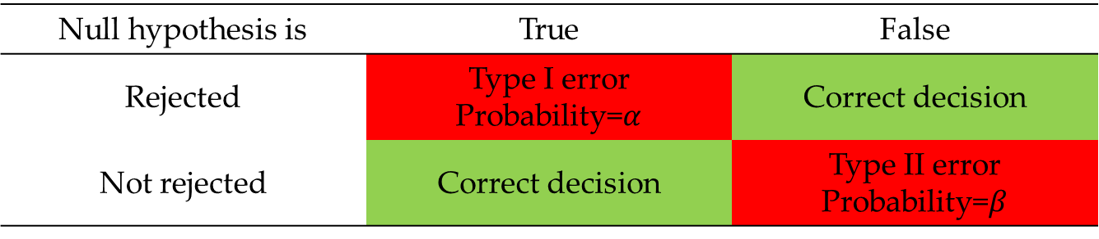
Type I & II errors
In hypothesis testing, we face two types of errors
Example: See Problem Set 2, Question 2.
Null hypothesis is | True | False
Rejected | Type I error Probability=$α$ | Correct decision
Not rejected | Correct decision | Type II error Probability=$β$
Data Science & Machine Learning in Finance: Introduction
University of Glasgow
2022-2023

Slide 55
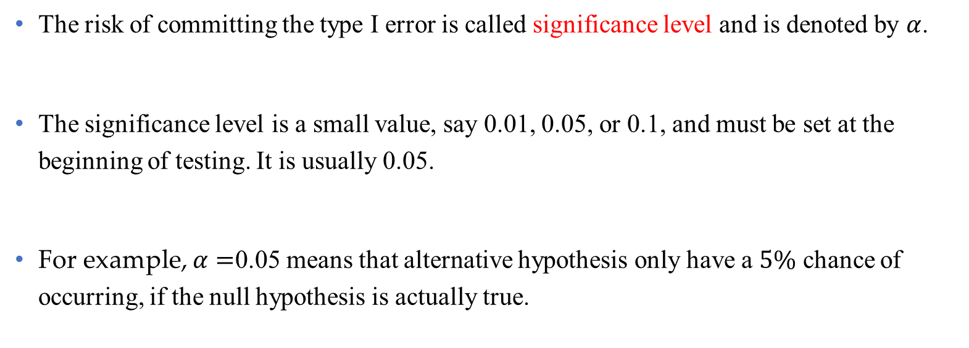
Significant level
The risk of committing the type I error is called significance level and is denoted by $α$.
The significance level is a small value, say 0.01, 0.05, or 0.1, and must be set at the beginning of testing. It is usually 0.05.
For example, $α=$0.05 means that alternative hypothesis only have a $5\%$ chance of occurring, if the null hypothesis is actually true.
Data Science & Machine Learning in Finance: Introduction
University of Glasgow
2022-2023

Slide 56
What is p-value?
P-value is a data-driven value for hypothesis testing
p-value > 0.05 indicates strong evidence for the null hypothesis.
p-value < 0.05 indicates strong evidence against the null hypothesis
Example: See Problem Set 2, Question 2.
Data Science & Machine Learning in Finance: Introduction
University of Glasgow
2022-2023

Slide 57
Recent criticism of p-value
Demidenko, E. (2016). The p-value you can’t buy. The American Statistician, 70(1), 33-38.
Wasserstein, R. L., & Lazar, N. A. (2016). The ASA statement on p-values: context, process, and purpose. The American Statistician, 70(2), 129-133.
Wasserstein, R. L., Schirm, A. L., & Lazar, N. A. (2019). Moving to a world beyond “p< 0.05”. The American Statistician, 73(sup1), 1-19.
Data Science & Machine Learning in Finance: Introduction
University of Glasgow
2022-2023

Slide 58
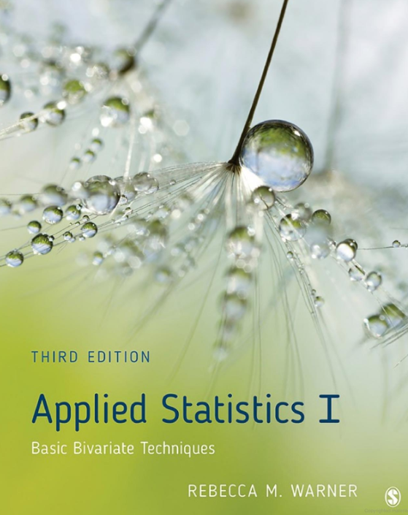
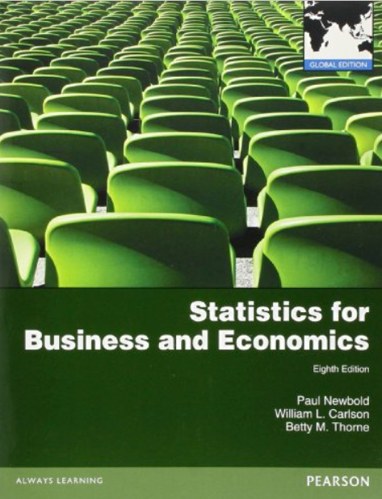
Bibliography
Papoulis, A., & Pillai, S. U. (1990). Random variables, and stochastic processes. McGraw-Hill, New York.
Applied statistics I: basic bivariate techniques,
by Warner, Rebecca M,
https://go.exlibris.link/TzYSCMHg
Statistics for business and economics
by Newbold, Paul; Carlson, William L; Thorne, Betty
https://go.exlibris.link/xTZ52RQS
Data Science & Machine Learning in Finance: Introduction
University of Glasgow
2022-2023

