Slide 1

Data Science & Machine Learning in Finance: Introduction
Hadi Movaghari
2022-2023

Slide 2
Outline
Section 1: Fundamentals
Section 2: Popular statistical distribution in finance
Section 3: Point estimation
Section 4: Hypothesis testing
Data Science & Machine Learning in Finance: Introduction
University of Glasgow
2022-2023

Slide 3
Section 1
Fundamentals

Slide 4
Outcome
Potential results of a trial is known as outcome or event.
Example:
CEO Change in the company A in the next fiscal year,
R&D expenditure in company A in the next year
Data Science & Machine Learning in Finance: Introduction
University of Glasgow
2022-2023

Slide 5
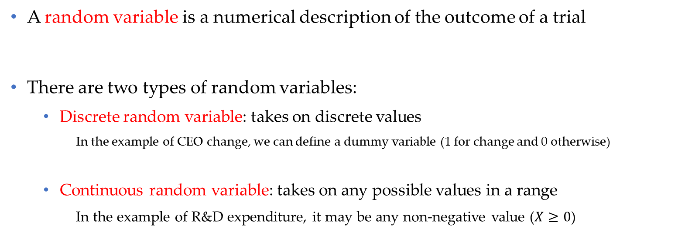
Random variable
A random variable is a numerical description of the outcome of a trial
There are two types of random variables:
Discrete random variable: takes on discrete values
In the example of CEO change, we can define a dummy variable (1 for change and 0 otherwise)
Continuous random variable: takes on any possible values in a range
In the example of R&D expenditure, it may be any non-negative value ($X≥0$)
Data Science & Machine Learning in Finance: Introduction
University of Glasgow
2022-2023

Slide 6
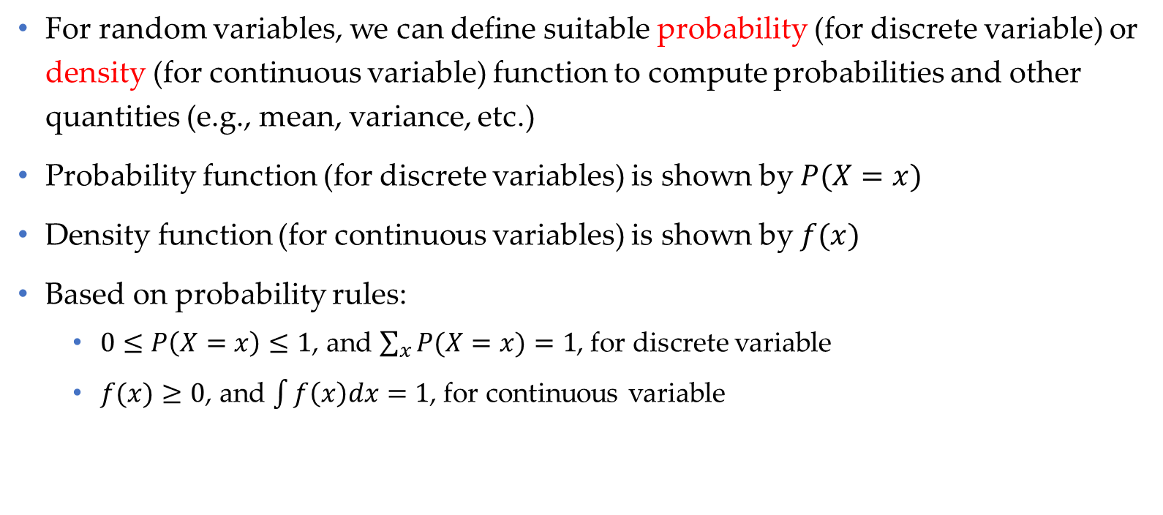
Density (probability) function
For random variables, we can define suitable probability (for discrete variable) or density (for continuous variable) function to compute probabilities and other quantities (e.g., mean, variance, etc.)
Probability function (for discrete variables) is shown by $P(X=x)$
Density function (for continuous variables) is shown by $f(x)$
Based on probability rules:
$0≤P\left(X=x\right)≤1$, and $\sum_{x}{P(X=x)}=1$, for discrete variable
$f(x)≥0$, and $\int{f\left(x\right)dx}=1$, for continuous variable
Data Science & Machine Learning in Finance: Introduction
University of Glasgow
2022-2023

Slide 7
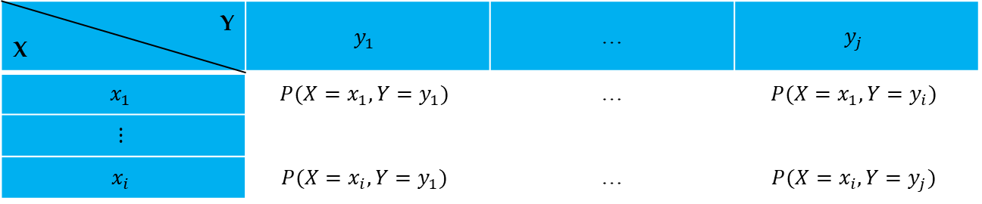

Joint density (probability) function
Similar to density function for a random variable, we can define a density or probability function for two random variables.
Joint probability function for two discrete variables is denoted by a two-way table as follows:
Probability rules hold here too, such as: $\sum_{x}{\sum_{y}{P(X=x,Y=y)}}=1$, etc.
Example: See Problem Set 1, Question 1.
Y X | $$y_{1}$$ | … | $$y_{j}$$
$$x_{1}$$ | $$P(X=x_{1},Y=y_{1})$$ | … | $$P(X=x_{1},Y=y_{i})$$
$$⋮$$
$$x_{i}$$ | $$P(X=x_{i},Y=y_{1})$$ | … | $$P(X=x_{i},Y=y_{j})$$
Data Science & Machine Learning in Finance: Introduction
University of Glasgow
2022-2023

Slide 8
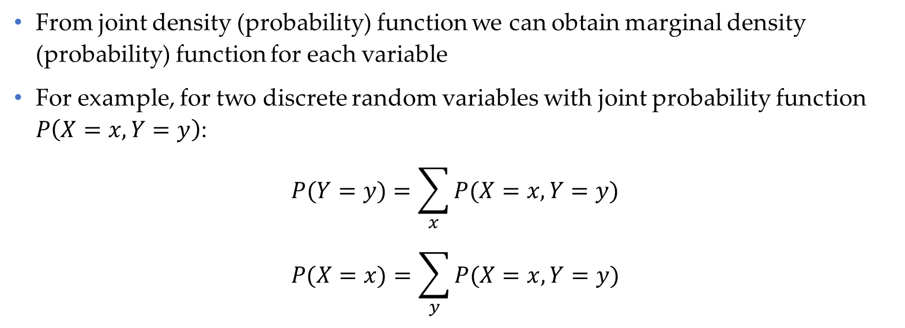
Marginal density (probability) function
From joint density (probability) function we can obtain marginal density (probability) function for each variable
For example, for two discrete random variables with joint probability function $P\left(X=x, Y=y\right)$:
$$P(Y=y)=\sum_{x}{P(X=x, Y=y)}$$
$$P(X=x)=\sum_{y}{P(X=x, Y=y)}$$
Data Science & Machine Learning in Finance: Introduction
University of Glasgow
2022-2023

Slide 9
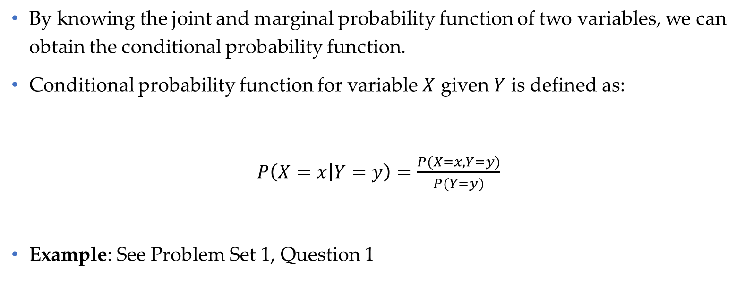
Conditional probability function
By knowing the joint and marginal probability function of two variables, we can obtain the conditional probability function.
Conditional probability function for variable $X$ given $Y$ is defined as:
$P\left(X=x | Y=y\right)=\frac{P(X=x, Y=y)}{P(Y=y)}$
Example: See Problem Set 1, Question 1
Data Science & Machine Learning in Finance: Introduction
University of Glasgow
2022-2023

Slide 10
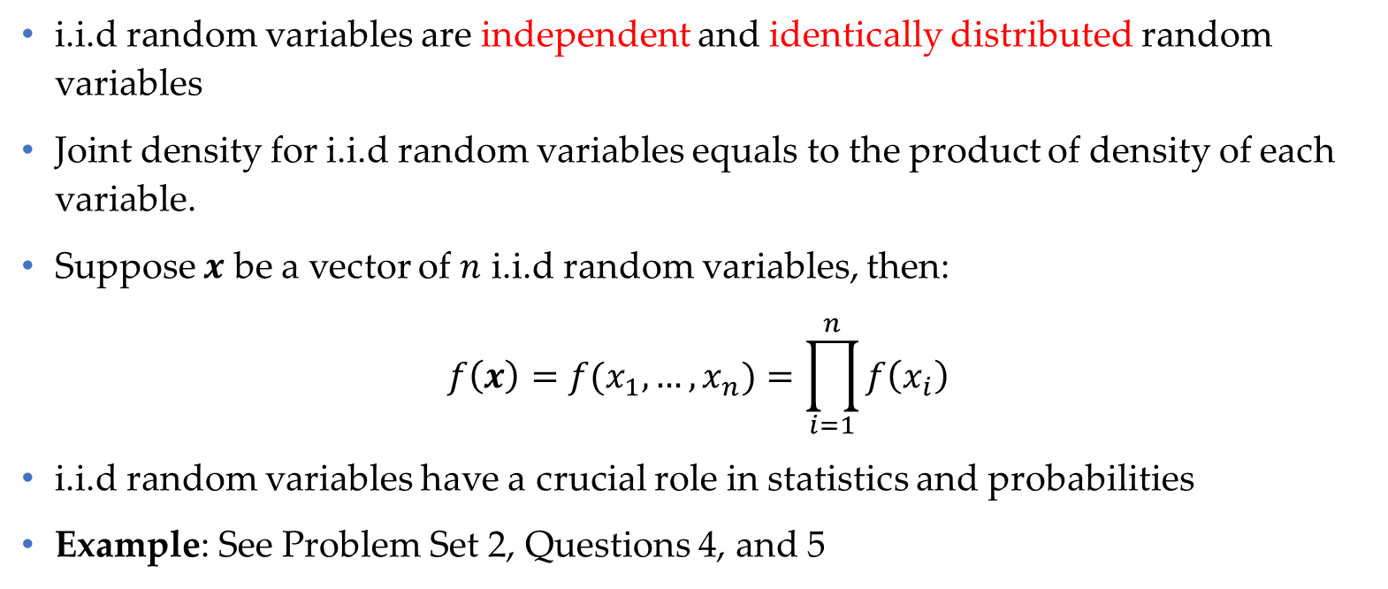
Joint density for i.i.d random variables
i.i.d random variables are independent and identically distributed random variables
Joint density for i.i.d random variables equals to the product of density of each variable.
Suppose $x$ be a vector of $n$ i.i.d random variables, then:
$$f\left(x\right)=f(x_{1},…,x_{n})=\prod_{i=1}^{n}{f\left(x_{i}\right)}$$
i.i.d random variables have a crucial role in statistics and probabilities
Example: See Problem Set 2, Questions 4, and 5
Data Science & Machine Learning in Finance: Introduction
University of Glasgow
2022-2023

Slide 11

Mathematical expectation
For discrete random variables
$$E\left(X\right)=\sum{x}.P\left(X=x\right)$$
For continuous random variables
$$E\left(X\right)=\int{x.f\left(x\right)dx}$$
Example: See Problem Set 1, Question 1.
Data Science & Machine Learning in Finance: Introduction
University of Glasgow
2022-2023

Slide 12

Conditional expectation
Using conditional distribution, we can define conditional expectation:
$$E\left[X | Y\right]=\sum_{x}{x}P(X|Y=y)$$
$$E\left[Y | X\right]=\sum_{y}{y}P(Y|X=x)$$
Example: See Problem Set 1, Question 1
Data Science & Machine Learning in Finance: Introduction
University of Glasgow
2022-2023

Slide 13
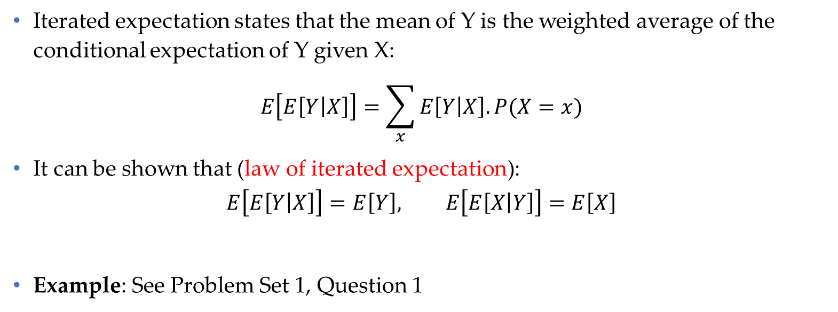
Iterated expectation
Iterated expectation states that the mean of Y is the weighted average of the conditional expectation of Y given X:
$$E\left[E\left[Y | X\right]\right]=\sum_{x}{E\left[Y | X\right].P(X=x)}$$
It can be shown that (law of iterated expectation):
$$E\left[E\left[Y | X\right]\right]=E\left[Y\right], E\left[E\left[X | Y\right]\right]=E\left[X\right]$$
Example: See Problem Set 1, Question 1
Data Science & Machine Learning in Finance: Introduction
University of Glasgow
2022-2023

Slide 14
Section 2
Popular statistical distribution in finance

Slide 15
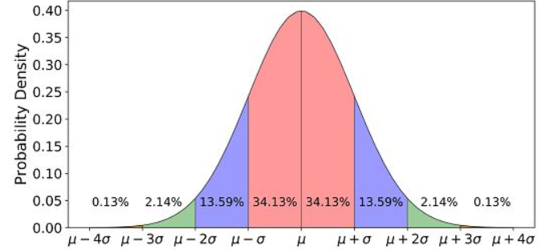
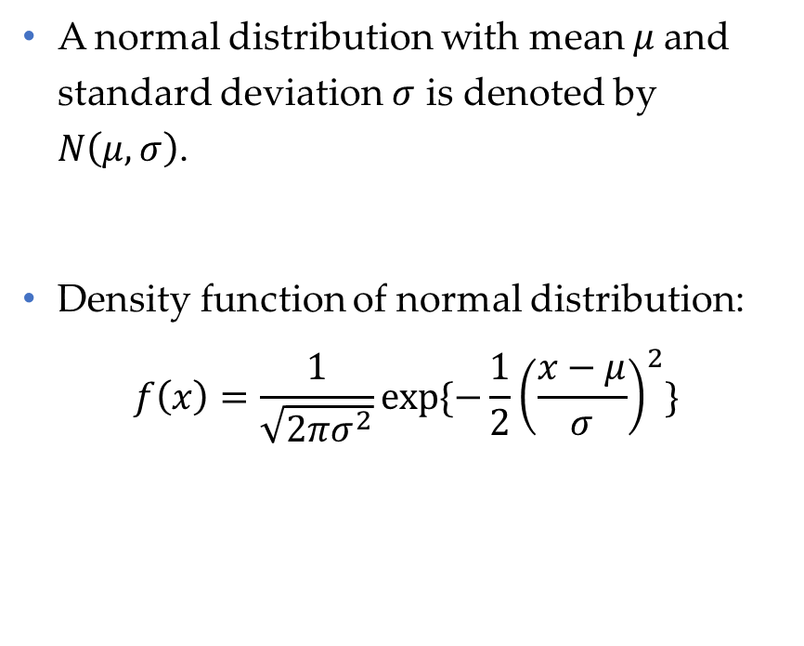
Normal distribution
A normal distribution with mean $μ$and standard deviation $σ$ is denoted by $N\left(μ, σ\right)$.
Density function of normal distribution:
$$f\left(x\right)=\frac{1}{\sqrt{2πσ^{2}}}exp⁡\{−\frac{1}{2}{\left(\frac{x−μ}{σ}\right)}^{2}\}$$
Data Science & Machine Learning in Finance: Introduction
University of Glasgow
2022-2023

Slide 16
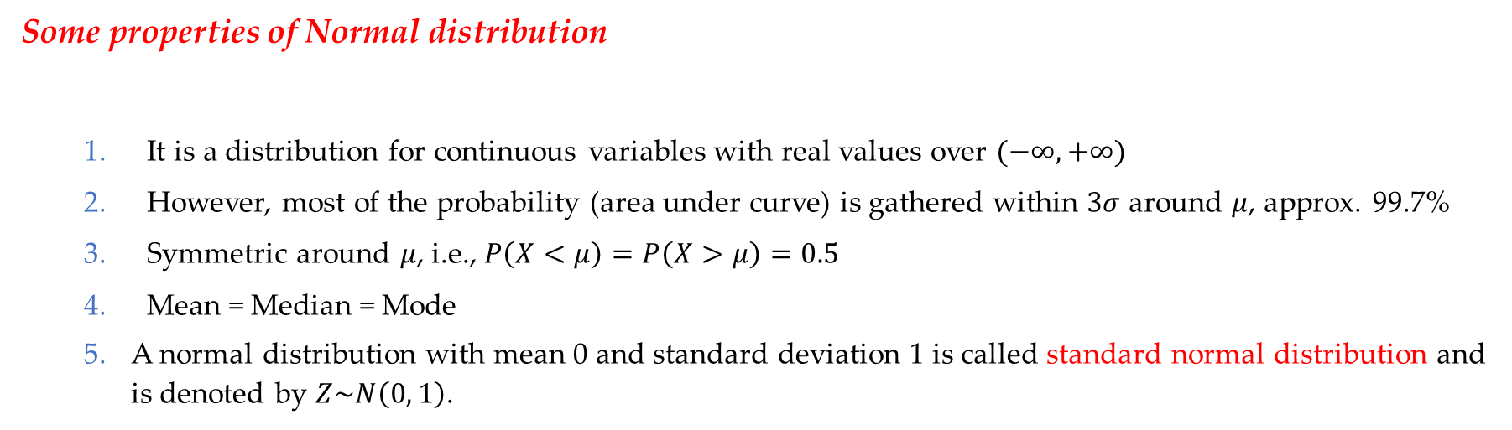
Normal distribution (Cont’d)
Some properties of Normal distribution
It is a distribution for continuous variables with real values over $(−∞, +∞)$
However, most of the probability (area under curve) is gathered within $3σ$ around $μ$, approx. 99.7%
Symmetric around $μ$, i.e., $P\left(X<μ\right)=P\left(X>μ\right)=0.5$
Mean = Median = Mode
A normal distribution with mean 0 and standard deviation 1 is called standard normal distribution and is denoted by $Z\sim N\left(0, 1\right)$.
Data Science & Machine Learning in Finance: Introduction
University of Glasgow
2022-2023

Slide 17
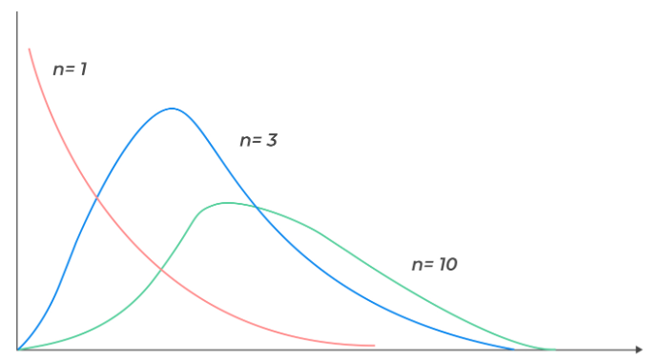
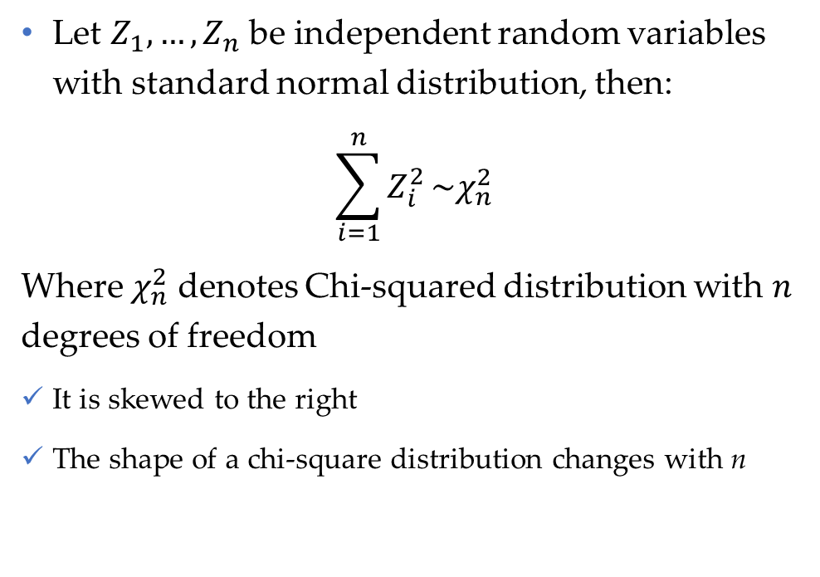
Chi-square distribution
Let $Z_{1},…,Z_{n}$ be independent random variables with standard normal distribution, then:
$$\sum_{i=1}^{n}{Z_{i}^{2}}\sim χ_{n}^{2}$$
Where $χ_{n}^{2}$ denotes Chi-squared distribution with $n$ degrees of freedom
It is skewed to the right
The shape of a chi-square distribution changes with n
Data Science & Machine Learning in Finance: Introduction
University of Glasgow
2022-2023

Slide 18
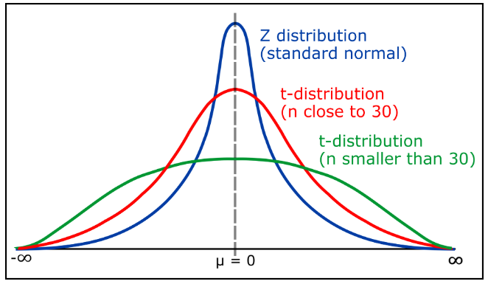
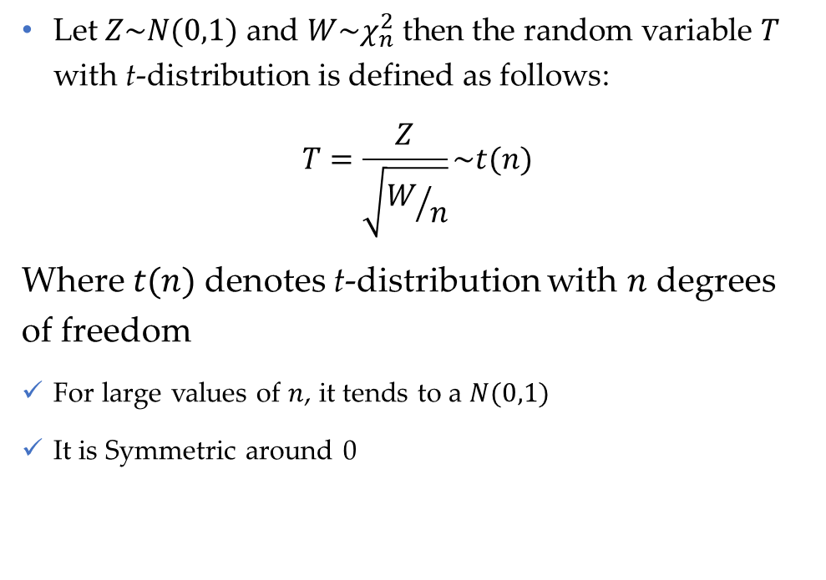
t-distribution
Let $Z\sim N(0,1)$ and $W\sim χ_{n}^{2}$ then the random variable $T$ with t-distribution is defined as follows:
$$T=\frac{Z}{\sqrt{W/n}}\sim t(n)$$
Where $t(n)$denotes t-distribution with $n$ degrees of freedom
For large values of $n$, it tends to a $N(0,1)$
It is Symmetric around 0
Data Science & Machine Learning in Finance: Introduction
University of Glasgow
2022-2023

Slide 19
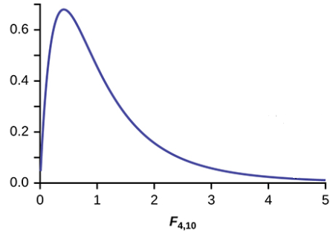
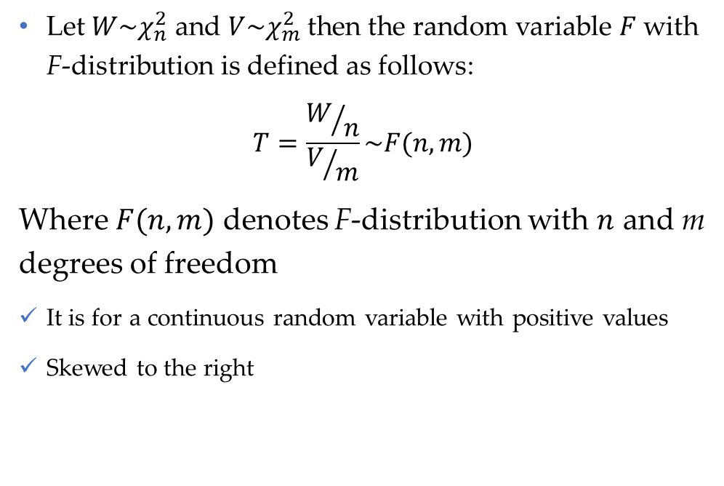
F-distribution
Let $W\sim χ_{n}^{2}$ and $V\sim χ_{m}^{2}$ then the random variable $F$ with F-distribution is defined as follows:
$$T=\frac{W/n}{V/m}\sim F(n,m)$$
Where $F(n,m)$ denotes F-distribution with $n$ and m degrees of freedom
It is for a continuous random variable with positive values
Skewed to the right
Data Science & Machine Learning in Finance: Introduction
University of Glasgow
2022-2023

Slide 20
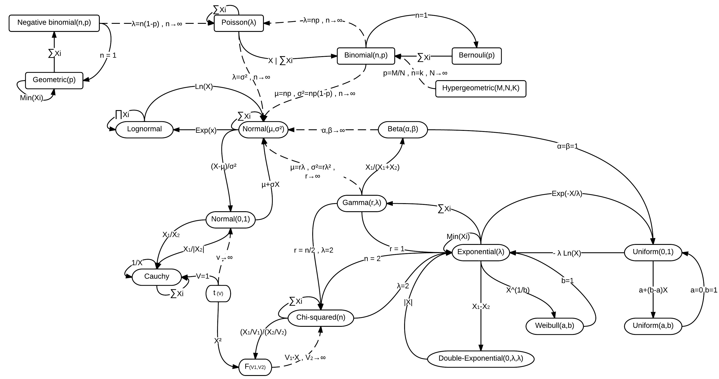
Relationship between statistical distributions
Source: Wikipedia

Slide 21
Applications of continuous distributions in Finance
Normal, Chi-square, t and F--- Almost in all domain of finance
Lognormal --- especially in asset pricing
Cong, L. W., Li, Y., & Wang, N. (2021). Tokenomics: Dynamic adoption and valuation. The Review of Financial Studies, 34(3), 1105-1155.
Stein, E. M., & Stein, J. C. (1991). Stock price distributions with stochastic volatility: an analytic approach. The review of financial studies, 4(4), 727-752.
Beta and its extension --- especially for return prediction
Higbee, J. D., & McDonald, J. B. (2021). A comparison of the GB2 and skewed generalized log-t distributions with an application in finance. Journal of Econometrics.
McDonald, J. B., & Xu, Y. J. (1995). A generalization of the beta distribution with applications. Journal of Econometrics, 66(1-2), 133-152.
Data Science & Machine Learning in Finance: Introduction
University of Glasgow
2022-2023

Slide 22
Applications of discrete distributions in Finance
Poisson --- especially in insurance
Cohn, J. B., Liu, Z., & Wardlaw, M. I. (2022). Count (and count-like) data in finance. Journal of Financial Economics, 146(2), 529-551.
Han, L., Lutz, C., Sand, B., & Stacey, D. (2021). The effects of a targeted financial constraint on the housing market. Review of Financial Studies, 34(8), 3742-3788.
Sunder, J., Sunder, S. V., & Zhang, J. (2017). Pilot CEOs and corporate innovation. Journal of Financial Economics, 123(1), 209-224.
Negative binomial
Tang, X., Shi, J., Han, J., Shu, A., & Xiao, F. (2021). Culturally diverse board and corporate innovation. Accounting & Finance, 61(4), 5655-5679.
Data Science & Machine Learning in Finance: Introduction
University of Glasgow
2022-2023

Slide 23
Section 3
Point estimation

Slide 24
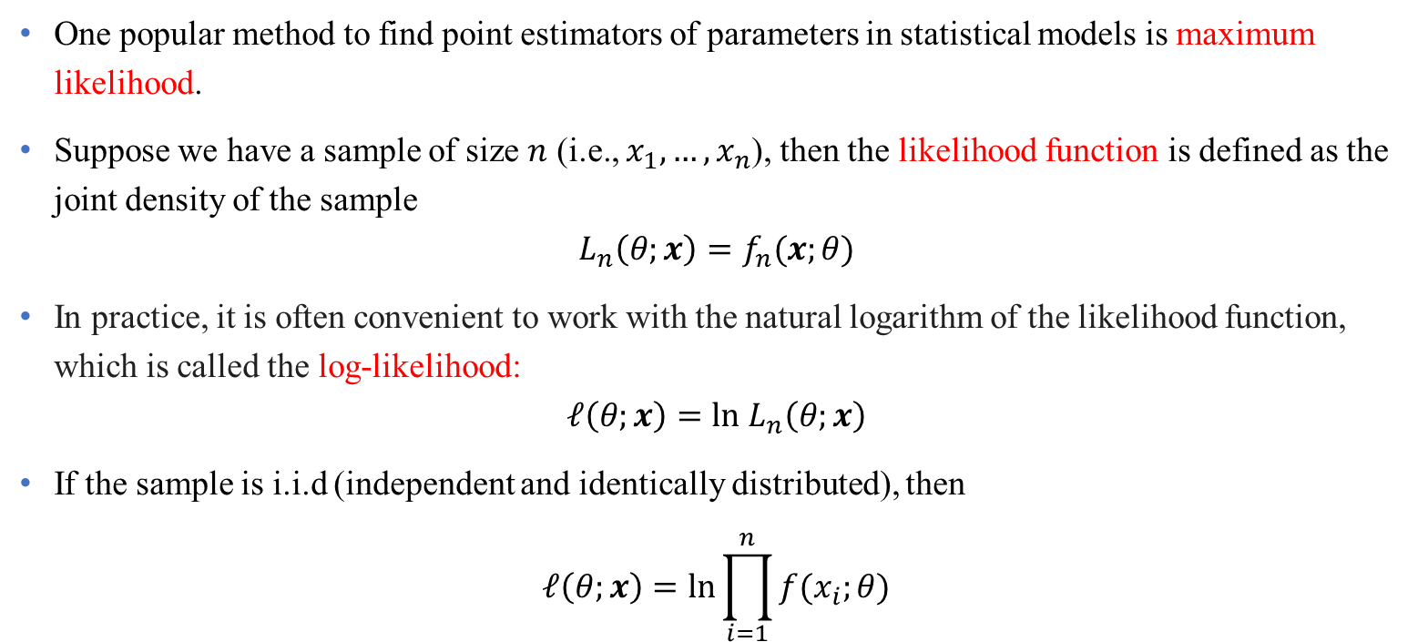
Maximum likelihood estimator (MLE)
One popular method to find point estimators of parameters in statistical models is maximum likelihood.
Suppose we have a sample of size $n$ (i.e., $x_{1},…,x_{n}$), then the likelihood function is defined as the joint density of the sample
$$L_{n}\left(θ;x\right)=f_{n}(x;θ)$$
In practice, it is often convenient to work with the natural logarithm of the likelihood function, which is called the log-likelihood:
$$ℓ\left(θ;x\right)=ln L_{n}\left(θ;x\right)$$
If the sample is i.i.d (independent and identically distributed), then
$$ℓ\left(θ;x\right)=ln\prod_{i=1}^{n}{f(x_{i};θ)}$$
Data Science & Machine Learning in Finance: Introduction
University of Glasgow
2022-2023

Slide 25
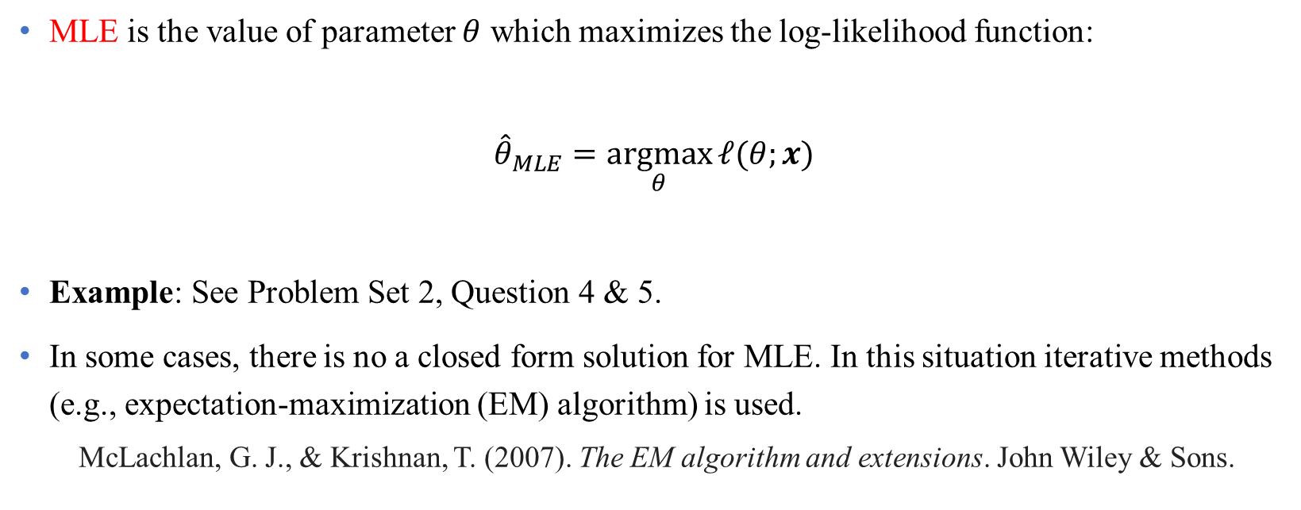
Maximum likelihood estimator (MLE) (Cont’d)
MLE is the value of parameter $θ$ which maximizes the log-likelihood function:
$${\hat{θ}}_{MLE}=\underset{θ}{argmax}{ℓ(θ;x)}$$
Example: See Problem Set 2, Question 4 & 5.
In some cases, there is no a closed form solution for MLE. In this situation iterative methods (e.g., expectation-maximization (EM) algorithm) is used.
McLachlan, G. J., & Krishnan, T. (2007). The EM algorithm and extensions. John Wiley & Sons.
Data Science & Machine Learning in Finance: Introduction
University of Glasgow
2022-2023

Slide 26
Section 4
Hypothesis testing

Slide 27
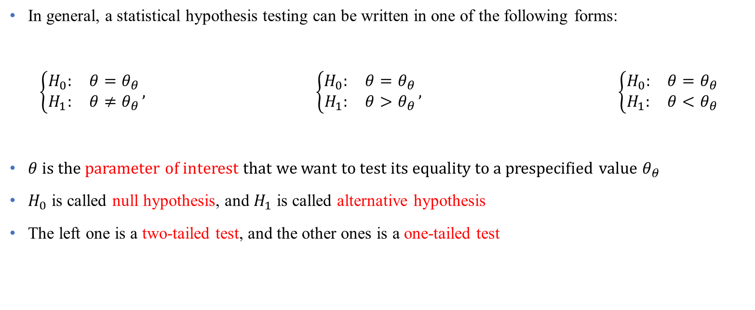
Null and alternative hypothesis
In general, a statistical hypothesis testing can be written in one of the following forms:
$$\left\{\begin{matrix}H_{0}: & θ=θ_{θ} \\ H_{1}: & θ≠θ_{θ}\end{matrix}\right., \left\{\begin{matrix}H_{0}: & θ=θ_{θ} \\ H_{1}: & θ>θ_{θ}\end{matrix}\right., \left\{\begin{matrix}H_{0}: & θ=θ_{θ} \\ H_{1}: & θ<θ_{θ}\end{matrix}\right.$$
$θ$ is the parameter of interest that we want to test its equality to a prespecified value $θ_{θ}$
$H_{0}$ is called null hypothesis, and $H_{1}$ is called alternative hypothesis
The left one is a two-tailed test, and the other ones is a one-tailed test
Data Science & Machine Learning in Finance: Introduction
University of Glasgow
2022-2023

Slide 28
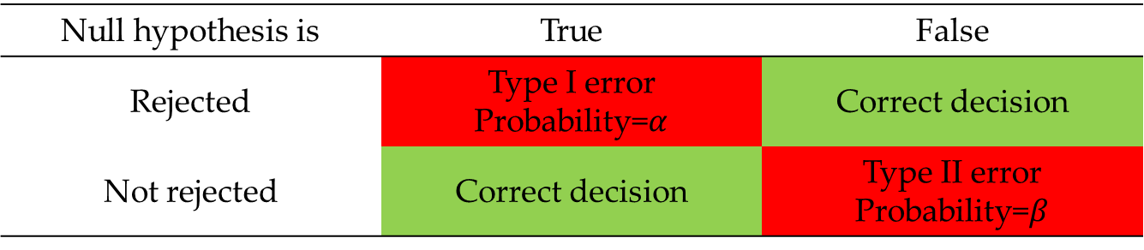
Type I and Type II errors
In hypothesis testing, we face two types of errors
Example: See Problem Set 2, Question 2.
Null hypothesis is | True | False
Rejected | Type I error Probability=$α$ | Correct decision
Not rejected | Correct decision | Type II error Probability=$β$
Data Science & Machine Learning in Finance: Introduction
University of Glasgow
2022-2023

Slide 29
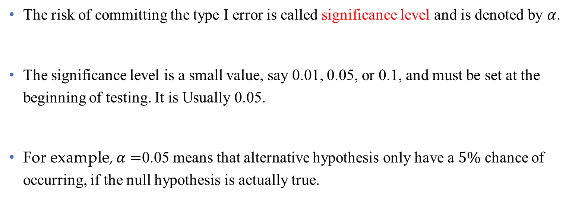
Significant level
The risk of committing the type I error is called significance level and is denoted by $α$.
The significance level is a small value, say 0.01, 0.05, or 0.1, and must be set at the beginning of testing. It is Usually 0.05.
For example, $α=$0.05 means that alternative hypothesis only have a $5\%$ chance of occurring, if the null hypothesis is actually true.
Data Science & Machine Learning in Finance: Introduction
University of Glasgow
2022-2023

Slide 30
What is p-value?
P-value is a data-driven value for hypothesis testing
p-value > 0.05 indicates strong evidence for the null hypothesis.
p-value < 0.05 indicates strong evidence against the null hypothesis
Example: See Problem Set 2, Question 2.
Data Science & Machine Learning in Finance: Introduction
University of Glasgow
2022-2023

Slide 31
Recent criticism of p-value
Demidenko, E. (2016). The p-value you can’t buy. The American Statistician, 70(1), 33-38.
Wasserstein, R. L., & Lazar, N. A. (2016). The ASA statement on p-values: context, process, and purpose. The American Statistician, 70(2), 129-133.
Wasserstein, R. L., Schirm, A. L., & Lazar, N. A. (2019). Moving to a world beyond “p< 0.05”. The American Statistician, 73(sup1), 1-19.
Data Science & Machine Learning in Finance: Introduction
University of Glasgow
2022-2023

Slide 32
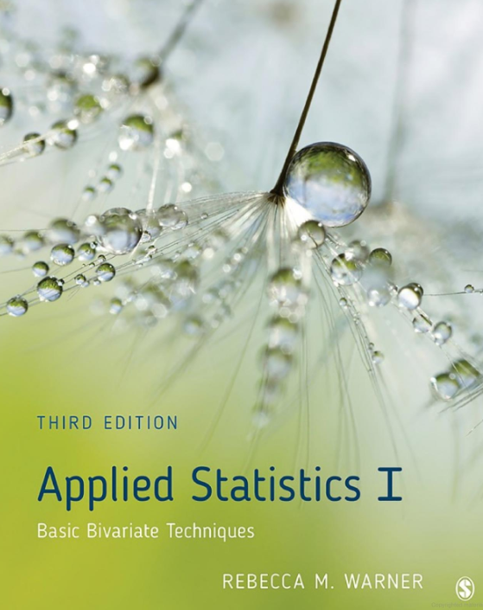
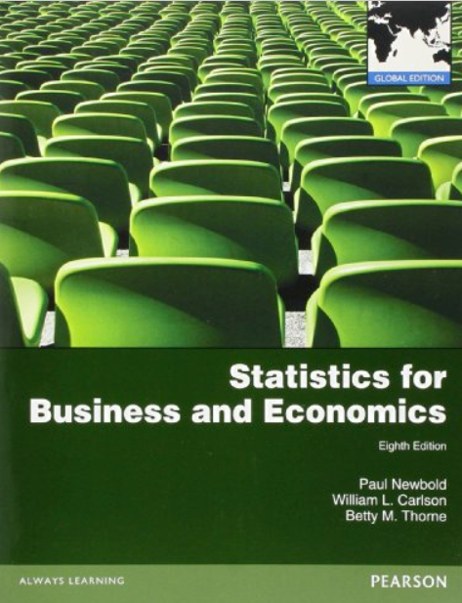
Bibliography
Applied statistics I: basic bivariate techniques,
by Warner, Rebecca M,
https://go.exlibris.link/TzYSCMHg
Statistics for business and economics
by Newbold, Paul; Carlson, William L; Thorne, Betty
https://go.exlibris.link/xTZ52RQS
Data Science & Machine Learning in Finance: Introduction
University of Glasgow
2022-2023

