Slide 1
Feature selection
Feature | P_Value | AUC | MRMR_Count | Normalized_P_Value | Normalized_AUC | Normalized_MRMR_Count | Composite_Score
CX | 0.003104722 | 0.622379986 | 20 | 0.002458376 | 1 | 1 | 0.999508325
BL | 0.01986081 | 0.596391143 | 20 | 0.019225328 | 0.901379089 | 1 | 0.95670657
BY | 0.036531422 | 0.586544963 | 20 | 0.035906748 | 0.864015394 | 1 | 0.938424808
EL | 0.098165599 | 0.568458418 | 19 | 0.097580887 | 0.795381655 | 0.95 | 0.878636485
AP | 0.086709557 | 0.570909398 | 18 | 0.086117417 | 0.804682489 | 0.9 | 0.864649512
EY | 0.125062577 | 0.562880325 | 18 | 0.124495304 | 0.77421424 | 0.9 | 0.844786635
EZ | 0.215747091 | 0.549780257 | 19 | 0.215238613 | 0.724502886 | 0.95 | 0.826753432
BS | 0.070128785 | 0.574966193 | 14 | 0.069525894 | 0.820076972 | 0.7 | 0.79412561
BF | 0.263346316 | 0.546315078 | 18 | 0.2628687 | 0.711353432 | 0.9 | 0.791967633
E | 0.382465541 | 0.46382691 | 20 | 0.382065157 | 0.398332264 | 1 | 0.682919874
HF | 0.353136756 | 0.461544963 | 19 | 0.352717356 | 0.389672867 | 0.95 | 0.665325676
CT | 0.132417945 | 0.562288709 | 9 | 0.131855441 | 0.771969211 | 0.45 | 0.662416596
AU | 0.190699881 | 0.445824882 | 17 | 0.190175164 | 0.330019243 | 0.85 | 0.633972665
CA | 0.0308983 | 0.410665991 | 18 | 0.030269974 | 0.196600385 | 0.9 | 0.632586159
HP | 0.753829943 | 0.513015551 | 16 | 0.753670337 | 0.584990378 | 0.8 | 0.603262084

Slide 2
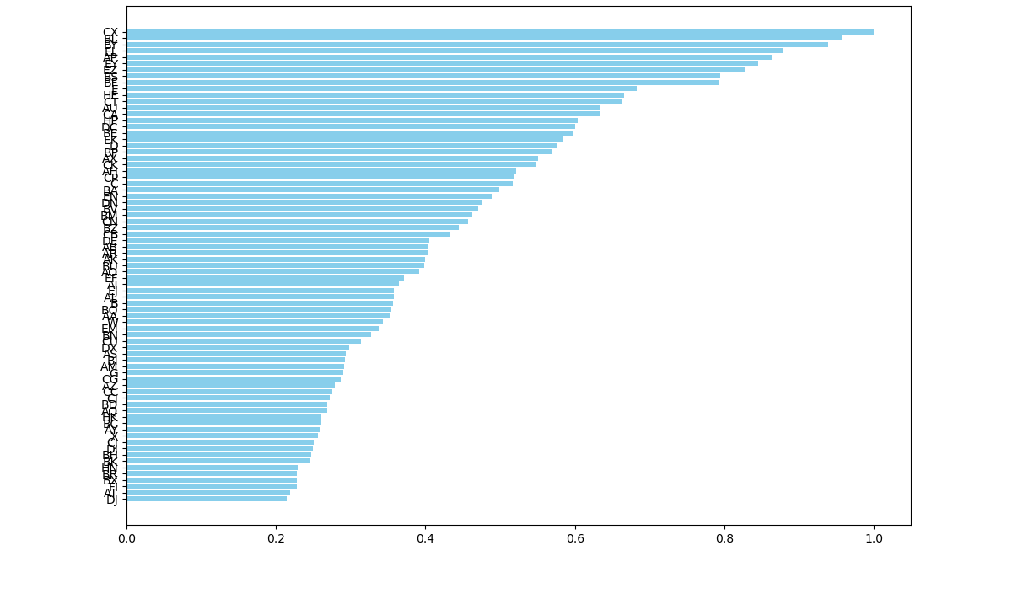
Feature selection

Slide 3
Model evaluation
Classifier | AUC (95% CI) | Sensitivity (95% CI) | Specificity (95% CI) | PPV (95% CI) | NPV (95% CI)
RandomForest | 0.59 (0.53, 0.66) | 0.95 (0.93, 0.98) | 0.09 (0.05, 0.13) | 0.73 (0.67, 0.78) | 0.54 (0.48, 0.61)
SVM | 0.52 (0.45, 0.58) | 0.90 (0.86, 0.94) | 0.03 (0.01, 0.05) | 0.70 (0.64, 0.76) | 0.03 (0.01, 0.05)
LogisticRegression | 0.57 (0.51, 0.63) | 0.95 (0.92, 0.98) | 0.08 (0.04, 0.11) | 0.72 (0.67, 0.78) | 0.35 (0.29, 0.41)
NaiveBayes | 0.61 (0.55, 0.67) | 0.80 (0.75, 0.85) | 0.28 (0.22, 0.33) | 0.74 (0.68, 0.79) | 0.36 (0.30, 0.42)

Slide 4
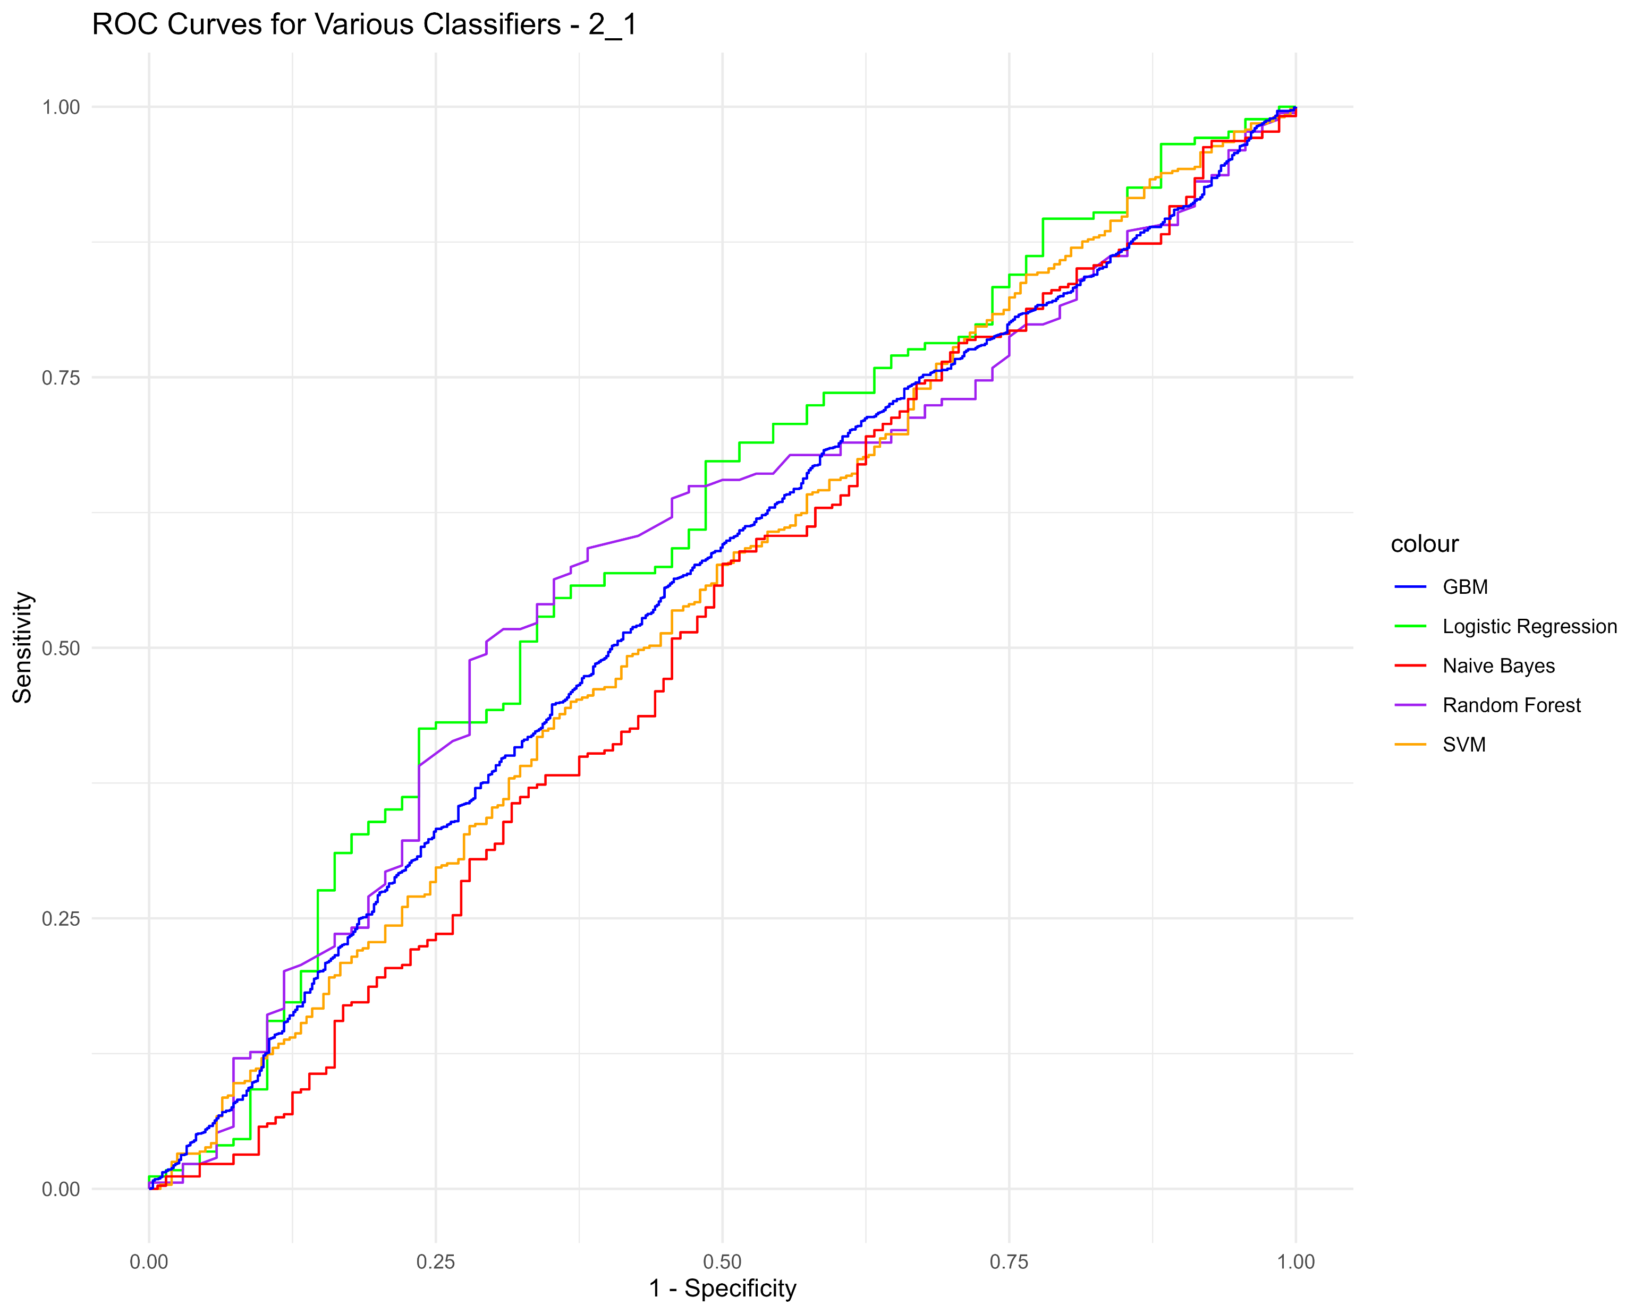
TumorTexture (2_1)
Model | AUC | Sensitivity | Specificity | PPV | NPV
Logistic_Regression | 0.60 (0.52-0.68) | 0.65 (0.52-0.75) | 0.55 (0.47-0.62) | 0.36 (0.28-0.44) | 0.80 (0.73-0.87)
Random_Forest | 0.58 (0.50-0.66) | 0.71 (0.60-0.81) | 0.51 (0.43-0.58) | 0.36 (0.28-0.44) | 0.81 (0.74-0.88)
SVM | 0.55 (0.50-0.59) | 0.63 (0.56-0.70) | 0.45 (0.41-0.49) | 0.31 (0.27-0.36) | 0.76 (0.71-0.81)
Naive_Bayes | 0.52 (0.46-0.58) | 0.50 (0.41-0.58) | 0.58 (0.52-0.63) | 0.31 (0.25-0.38) | 0.75 (0.69-0.80)
GBM | 0.56 (0.53-0.58) | 0.54 (0.50-0.58) | 0.56 (0.54-0.59) | 0.33 (0.30-0.36) | 0.76 (0.73-0.78)

Slide 5
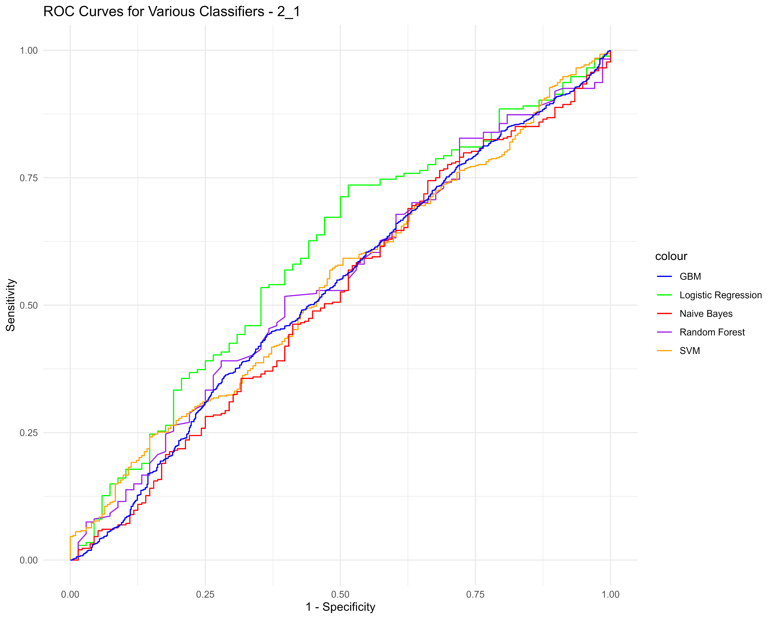
TumorTexturePreprocessing (2_1)
Model | AUC | Sensitivity | Specificity | PPV | NPV
Logistic_Regression | 0.60 (0.52-0.68) | 0.49 (0.37-0.60) | 0.73 (0.67-0.80) | 0.42 (0.31-0.52) | 0.78 (0.72-0.84)
Random_Forest | 0.55 (0.47-0.63) | 0.60 (0.48-0.72) | 0.52 (0.44-0.59) | 0.33 (0.24-0.42) | 0.77 (0.69-0.84)
SVM | 0.54 (0.50-0.59) | 0.15 (0.10-0.20) | 0.76 (0.72-0.80) | 0.19 (0.13-0.26) | 0.69 (0.65-0.73)
Naive_Bayes | 0.52 (0.46-0.58) | 0.34 (0.26-0.41) | 0.74 (0.70-0.79) | 0.34 (0.26-0.42) | 0.74 (0.70-0.79)
GBM | 0.53 (0.51-0.56) | 0.64 (0.60-0.67) | 0.44 (0.42-0.47) | 0.31 (0.28-0.33) | 0.76 (0.73-0.78)

Slide 6
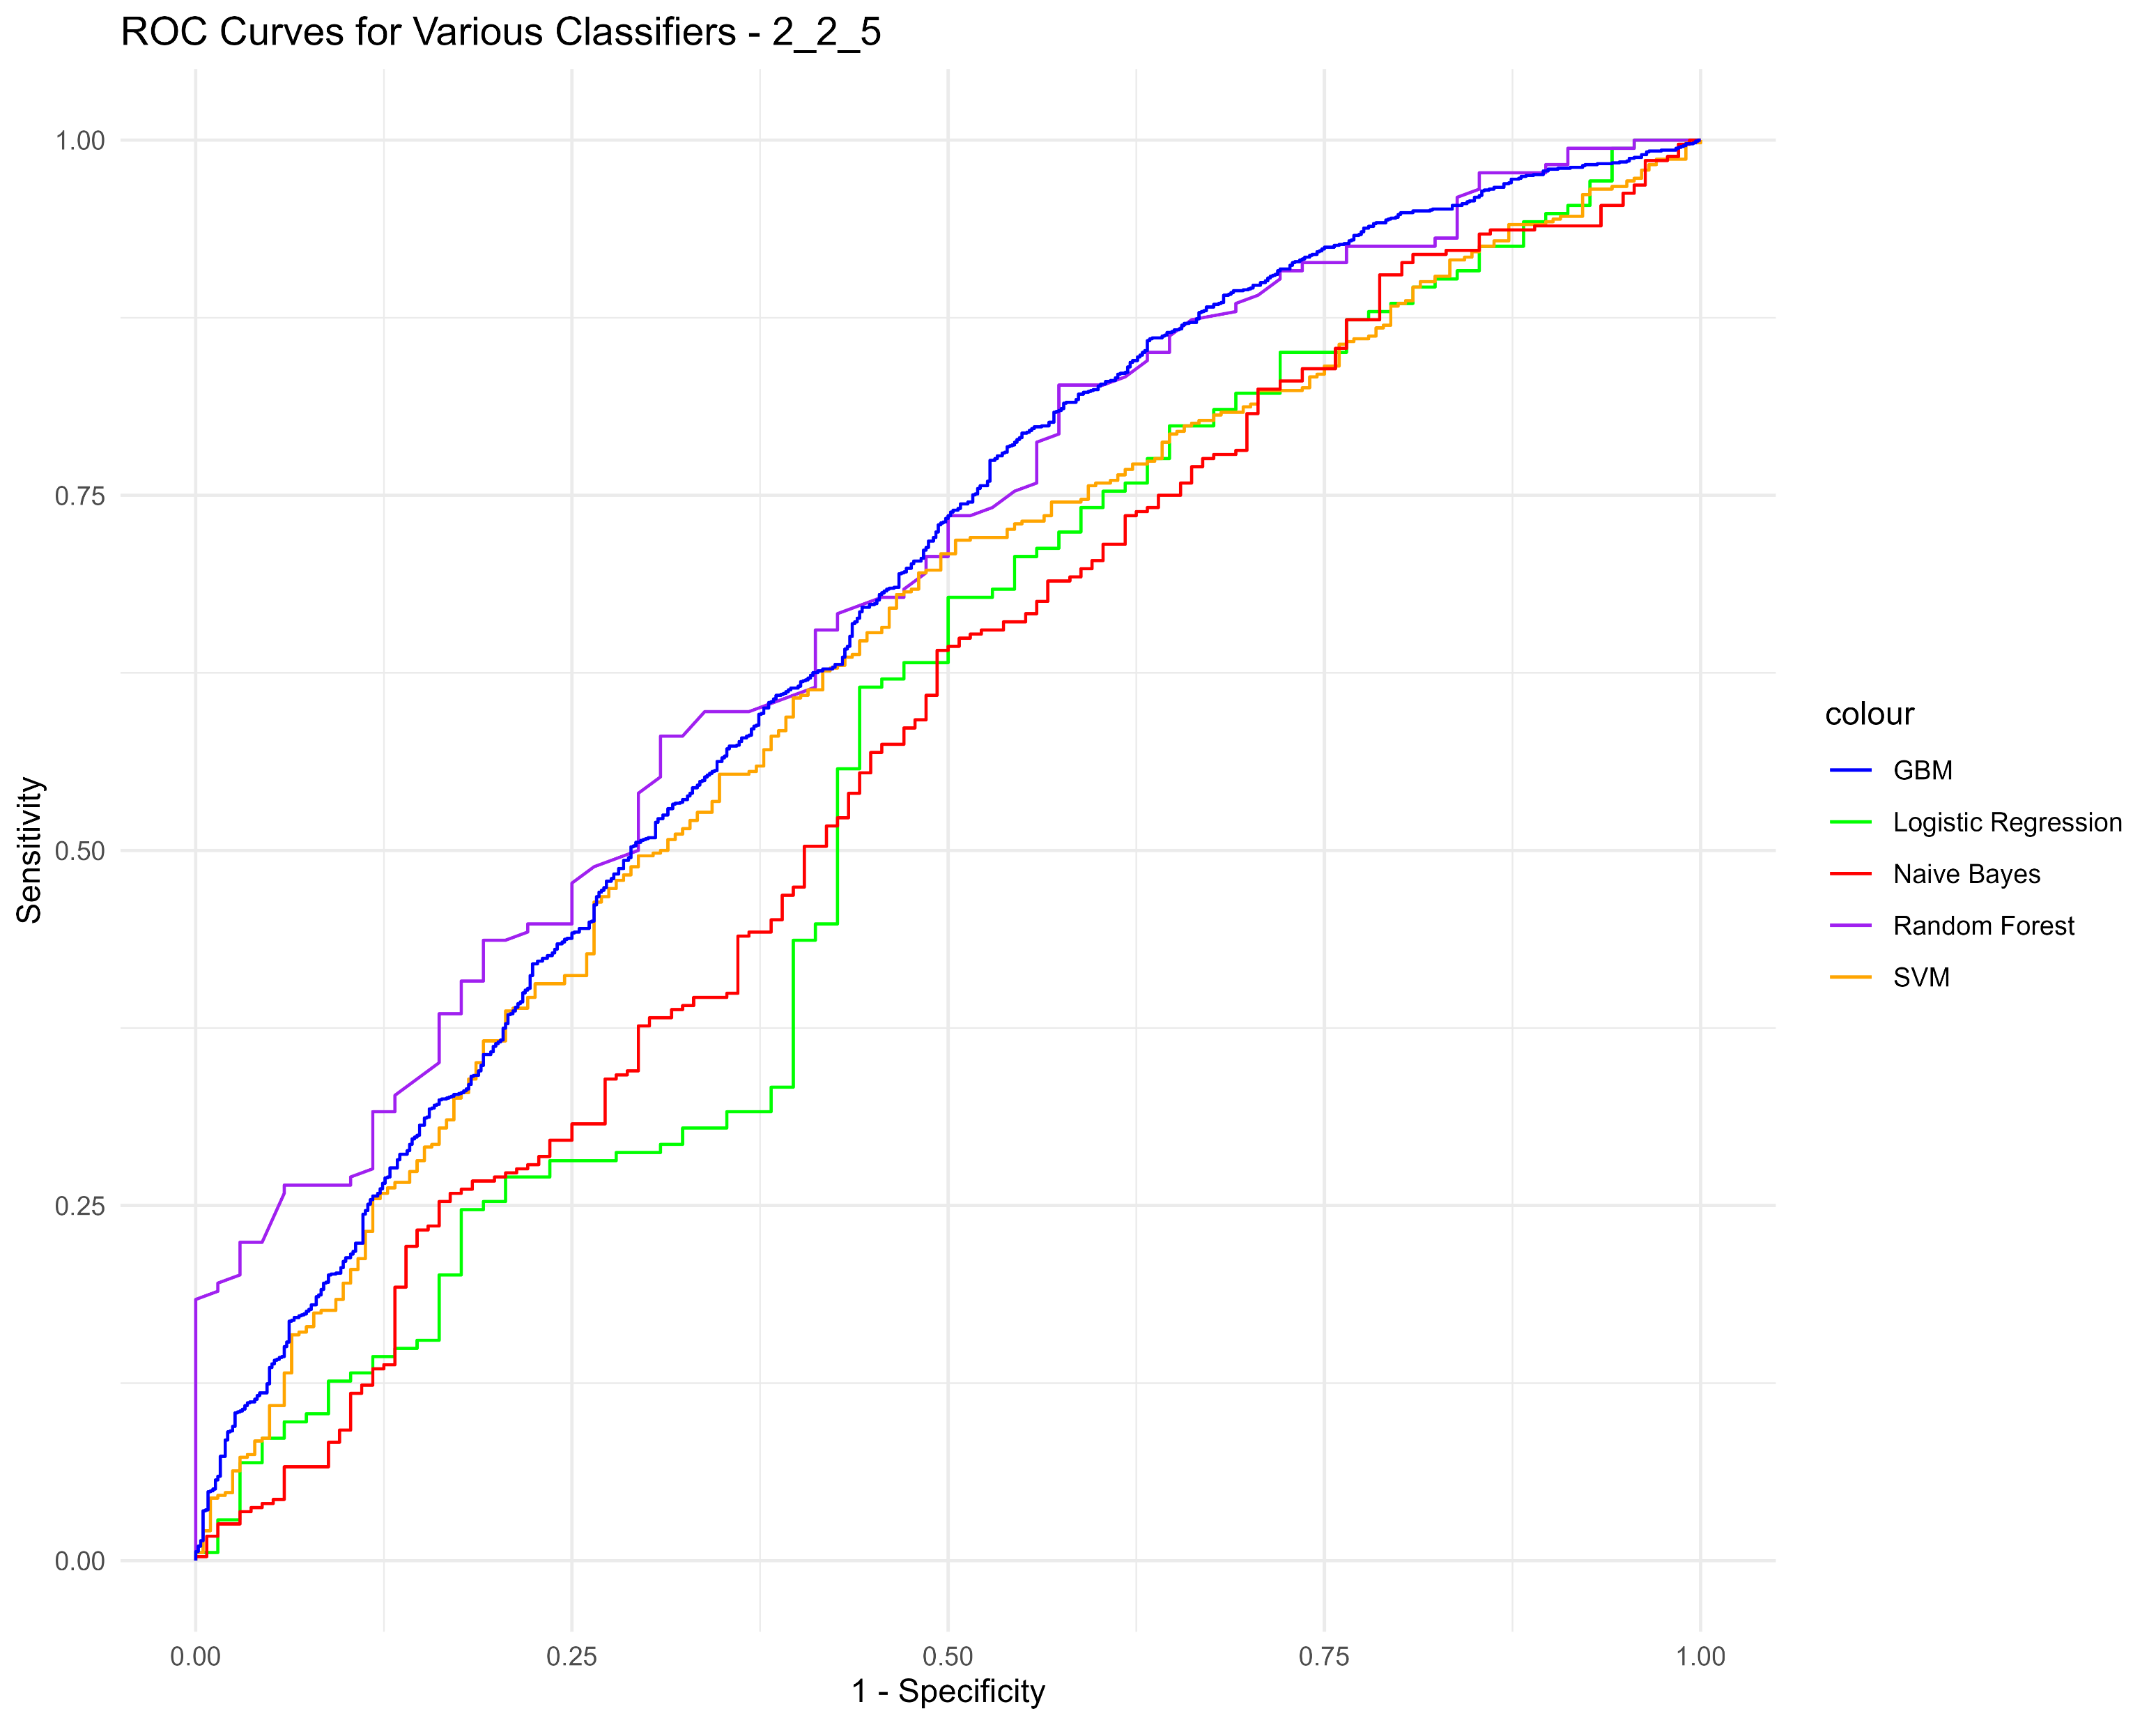
TumorBoundaryTexture (2_2_5)
Model | AUC | Sensitivity | Specificity | PPV | NPV
Logistic_Regression | 0.56 (0.48-0.65) | 0.50 (0.38-0.62) | 0.68 (0.61-0.75) | 0.38 (0.28-0.48) | 0.78 (0.71-0.84)
Random_Forest | 0.68 (0.61-0.75) | 0.69 (0.58-0.79) | 0.58 (0.51-0.65) | 0.39 (0.31-0.48) | 0.83 (0.75-0.89)
SVM | 0.63 (0.58-0.67) | 0.52 (0.45-0.59) | 0.70 (0.66-0.74) | 0.40 (0.34-0.46) | 0.79 (0.75-0.82)
Naive_Bayes | 0.57 (0.51-0.63) | 0.51 (0.42-0.59) | 0.64 (0.59-0.69) | 0.36 (0.29-0.42) | 0.77 (0.72-0.82)
GBM | 0.66 (0.64-0.69) | 0.47 (0.44-0.51) | 0.77 (0.75-0.80) | 0.45 (0.41-0.49) | 0.79 (0.77-0.81)

Slide 7
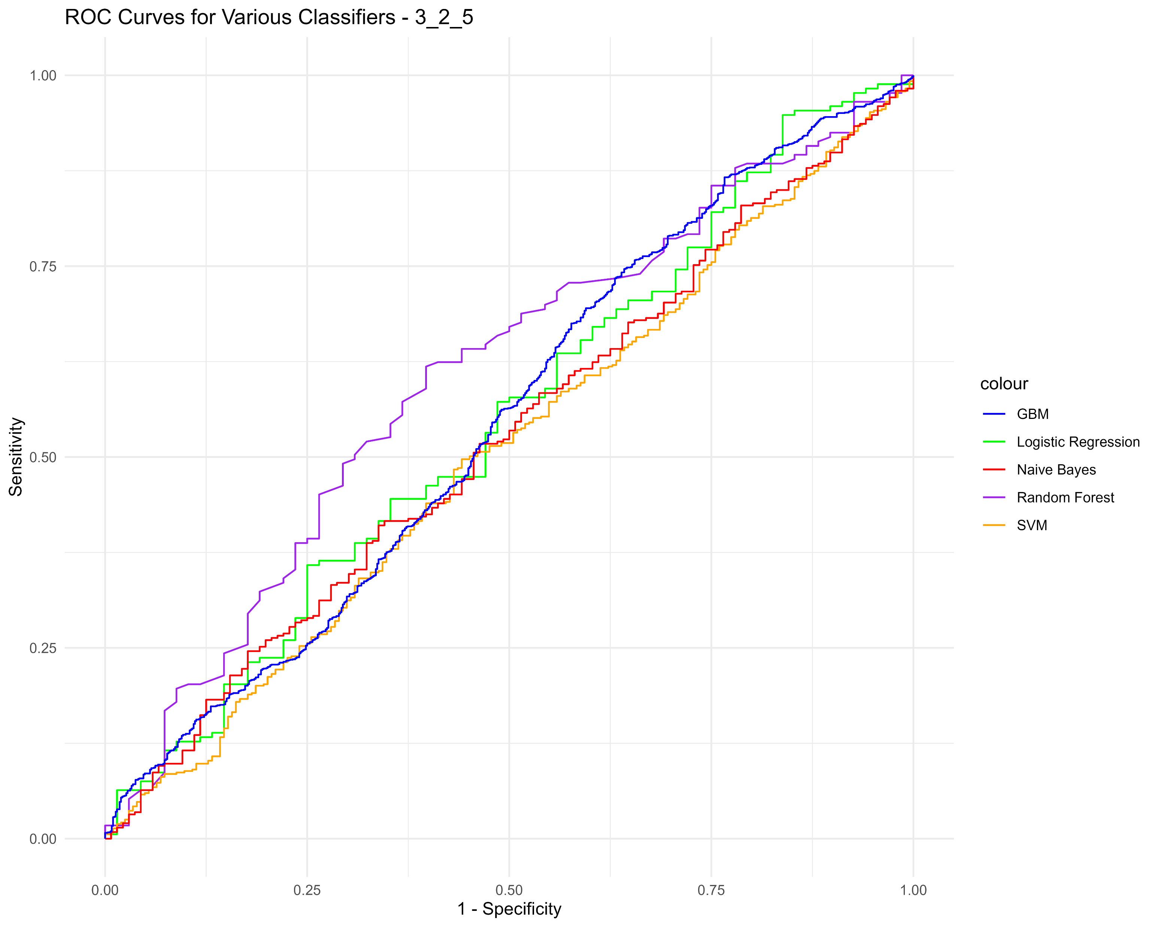
TumorBoundaryTexturePreprocessing (3_2_5)
Model | AUC | Sensitivity | Specificity | PPV | NPV
Logistic_Regression | 0.55 (0.47-0.63) | 0.84 (0.74-0.93) | 0.05 (0.02-0.08) | 0.26 (0.20-0.32) | 0.45 (0.24-0.67)
Random_Forest | 0.60 (0.53-0.68) | 0.61 (0.49-0.72) | 0.62 (0.55-0.69) | 0.38 (0.29-0.47) | 0.80 (0.73-0.86)
SVM | 0.51 (0.46-0.55) | 0.56 (0.49-0.63) | 0.50 (0.46-0.54) | 0.30 (0.26-0.36) | 0.74 (0.70-0.78)
Naive_Bayes | 0.52 (0.47-0.58) | 0.66 (0.58-0.74) | 0.41 (0.36-0.47) | 0.31 (0.26-0.36) | 0.75 (0.69-0.81)
GBM | 0.55 (0.52-0.57) | 0.36 (0.32-0.40) | 0.75 (0.72-0.77) | 0.36 (0.32-0.40) | 0.75 (0.73-0.77)

Slide 8
TumorBoundaryTexturePreprocessing (3_2_5)
Model | AUC | Sensitivity | Specificity | PPV | NPV
Logistic_Regression | 0.55 (0.47-0.63) | 0.84 (0.74-0.93) | 0.05 (0.02-0.08) | 0.26 (0.20-0.32) | 0.45 (0.24-0.67)
Random_Forest | 0.60 (0.53-0.68) | 0.61 (0.49-0.72) | 0.62 (0.55-0.69) | 0.38 (0.29-0.47) | 0.80 (0.73-0.86)
SVM | 0.51 (0.46-0.55) | 0.56 (0.49-0.63) | 0.50 (0.46-0.54) | 0.30 (0.26-0.36) | 0.74 (0.70-0.78)
Naive_Bayes | 0.52 (0.47-0.58) | 0.66 (0.58-0.74) | 0.41 (0.36-0.47) | 0.31 (0.26-0.36) | 0.75 (0.69-0.81)
GBM | 0.55 (0.52-0.57) | 0.36 (0.32-0.40) | 0.75 (0.72-0.77) | 0.36 (0.32-0.40) | 0.75 (0.73-0.77)

