Slide 1
MMRd imaging study

Slide 2
Tumor features
Top 20 features
Feature | P_Value | AUC | MRMR_Count (out of 5) | Composite_Score
CX | 0.003105 | 0.62238 | 5 | 0.999508
BL | 0.019861 | 0.596391 | 4 | 0.876707
BY | 0.036531 | 0.586545 | 4 | 0.858425
EY | 0.125063 | 0.56288 | 4 | 0.804787
BS | 0.070129 | 0.574966 | 3 | 0.754126
AP | 0.08671 | 0.570909 | 3 | 0.74465
EZ | 0.215747 | 0.54978 | 3 | 0.686753
EL | 0.098166 | 0.568458 | 2 | 0.658636
CT | 0.132418 | 0.562289 | 2 | 0.642417
CK | 0.164458 | 0.557556 | 2 | 0.62882
E | 0.382466 | 0.463827 | 4 | 0.60292
DC | 0.000648 | 0.358857 | 5 | 0.6
C | 0.065217 | 0.576318 | 1 | 0.597161
BF | 0.263346 | 0.546315 | 2 | 0.591968
EK | 0.089755 | 0.570233 | 1 | 0.583014
AR | 0.348457 | 0.538793 | 2 | 0.563517
BE | 0.630434 | 0.519946 | 3 | 0.558477
EN | 0.163119 | 0.557514 | 1 | 0.549024
BA | 0.188897 | 0.554344 | 1 | 0.539054

Slide 3
Tumor model evaluation
Classifier | AUC (95% CI) | Sensitivity (95% CI) | Specificity (95% CI) | PPV (95% CI) | NPV (95% CI)
RandomForest | 0.59 (0.53, 0.66) | 0.95 (0.93, 0.98) | 0.09 (0.05, 0.13) | 0.73 (0.67, 0.78) | 0.54 (0.48, 0.61)
SVM | 0.52 (0.45, 0.58) | 0.90 (0.86, 0.94) | 0.03 (0.01, 0.05) | 0.70 (0.64, 0.76) | 0.03 (0.01, 0.05)
LogisticRegression | 0.57 (0.51, 0.63) | 0.95 (0.92, 0.98) | 0.08 (0.04, 0.11) | 0.72 (0.67, 0.78) | 0.35 (0.29, 0.41)
NaiveBayes | 0.61 (0.55, 0.67) | 0.80 (0.75, 0.85) | 0.28 (0.22, 0.33) | 0.74 (0.68, 0.79) | 0.36 (0.30, 0.42)

Slide 4
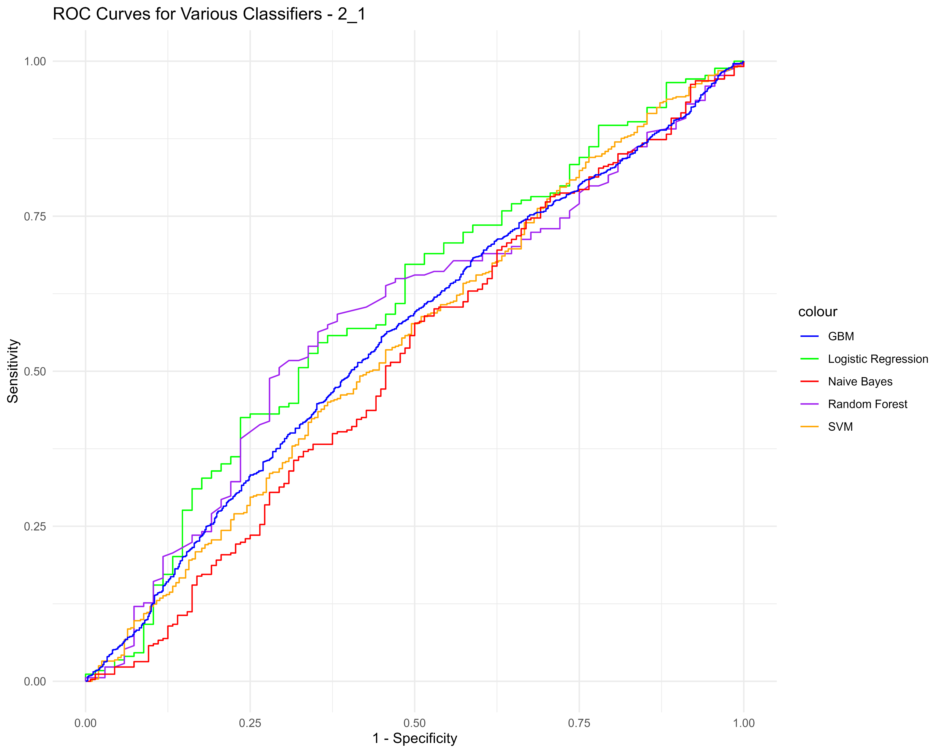
TumorTexture (2_1)
Model | AUC | Sensitivity | Specificity | PPV | NPV
Logistic_Regression | 0.60 (0.52-0.68) | 0.65 (0.52-0.75) | 0.55 (0.47-0.62) | 0.36 (0.28-0.44) | 0.80 (0.73-0.87)
Random_Forest | 0.58 (0.50-0.66) | 0.71 (0.60-0.81) | 0.51 (0.43-0.58) | 0.36 (0.28-0.44) | 0.81 (0.74-0.88)
SVM | 0.55 (0.50-0.59) | 0.63 (0.56-0.70) | 0.45 (0.41-0.49) | 0.31 (0.27-0.36) | 0.76 (0.71-0.81)
Naive_Bayes | 0.52 (0.46-0.58) | 0.50 (0.41-0.58) | 0.58 (0.52-0.63) | 0.31 (0.25-0.38) | 0.75 (0.69-0.80)
GBM | 0.56 (0.53-0.58) | 0.54 (0.50-0.58) | 0.56 (0.54-0.59) | 0.33 (0.30-0.36) | 0.76 (0.73-0.78)

Slide 5
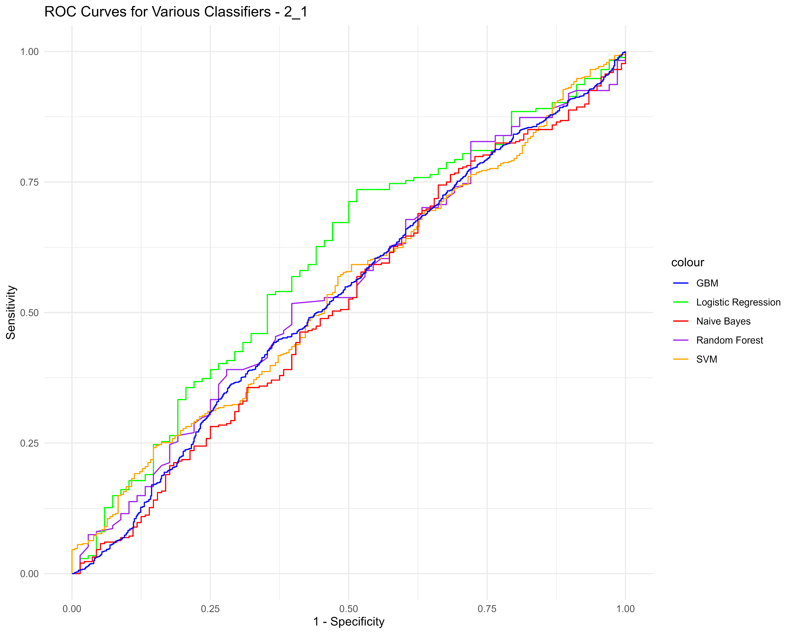
TumorTexturePreprocessing (2_1)
Model | AUC | Sensitivity | Specificity | PPV | NPV
Logistic_Regression | 0.60 (0.52-0.68) | 0.49 (0.37-0.60) | 0.73 (0.67-0.80) | 0.42 (0.31-0.52) | 0.78 (0.72-0.84)
Random_Forest | 0.55 (0.47-0.63) | 0.60 (0.48-0.72) | 0.52 (0.44-0.59) | 0.33 (0.24-0.42) | 0.77 (0.69-0.84)
SVM | 0.54 (0.50-0.59) | 0.15 (0.10-0.20) | 0.76 (0.72-0.80) | 0.19 (0.13-0.26) | 0.69 (0.65-0.73)
Naive_Bayes | 0.52 (0.46-0.58) | 0.34 (0.26-0.41) | 0.74 (0.70-0.79) | 0.34 (0.26-0.42) | 0.74 (0.70-0.79)
GBM | 0.53 (0.51-0.56) | 0.64 (0.60-0.67) | 0.44 (0.42-0.47) | 0.31 (0.28-0.33) | 0.76 (0.73-0.78)

Slide 6
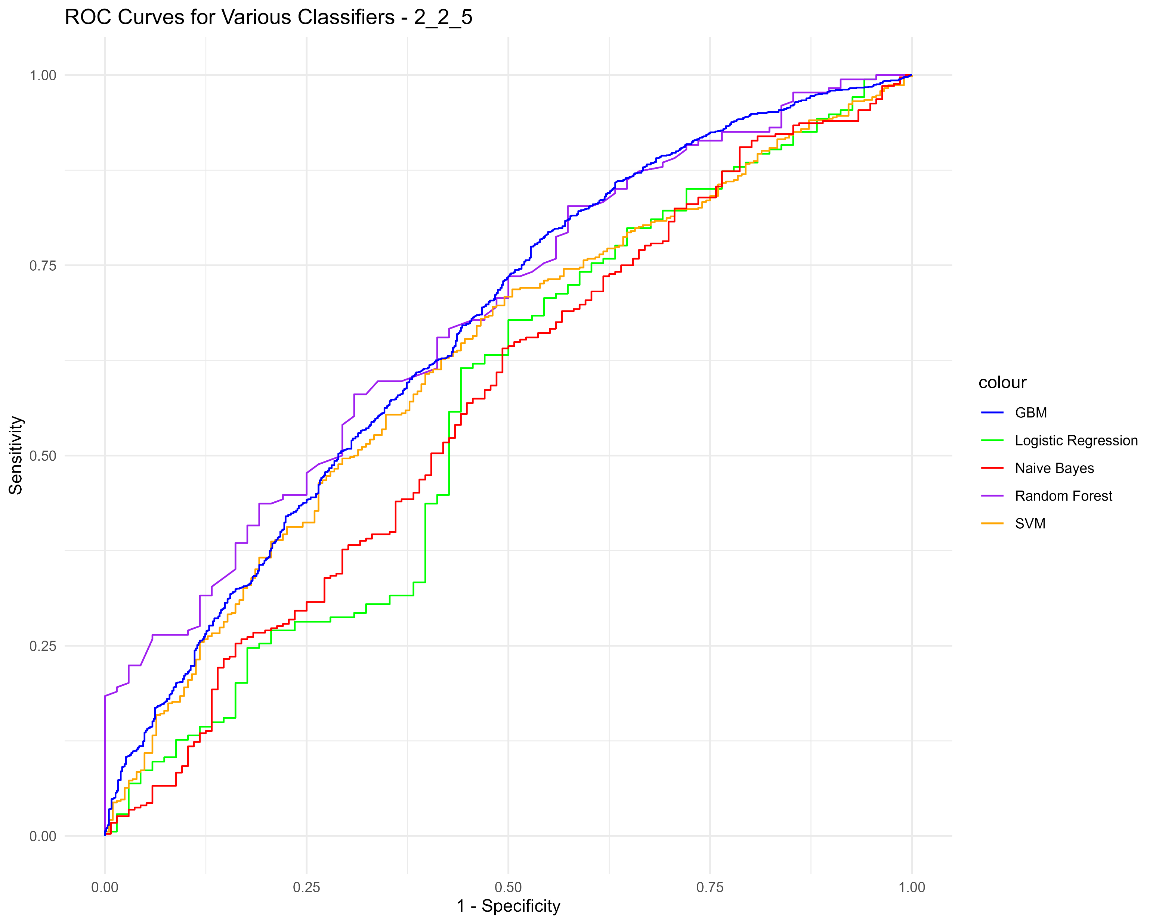
TumorBoundaryTexture (2_2_5)
Model | AUC | Sensitivity | Specificity | PPV | NPV
Logistic_Regression | 0.56 (0.48-0.65) | 0.50 (0.38-0.62) | 0.68 (0.61-0.75) | 0.38 (0.28-0.48) | 0.78 (0.71-0.84)
Random_Forest | 0.68 (0.61-0.75) | 0.69 (0.58-0.79) | 0.58 (0.51-0.65) | 0.39 (0.31-0.48) | 0.83 (0.75-0.89)
SVM | 0.63 (0.58-0.67) | 0.52 (0.45-0.59) | 0.70 (0.66-0.74) | 0.40 (0.34-0.46) | 0.79 (0.75-0.82)
Naive_Bayes | 0.57 (0.51-0.63) | 0.51 (0.42-0.59) | 0.64 (0.59-0.69) | 0.36 (0.29-0.42) | 0.77 (0.72-0.82)
GBM | 0.66 (0.64-0.69) | 0.47 (0.44-0.51) | 0.77 (0.75-0.80) | 0.45 (0.41-0.49) | 0.79 (0.77-0.81)

Slide 7
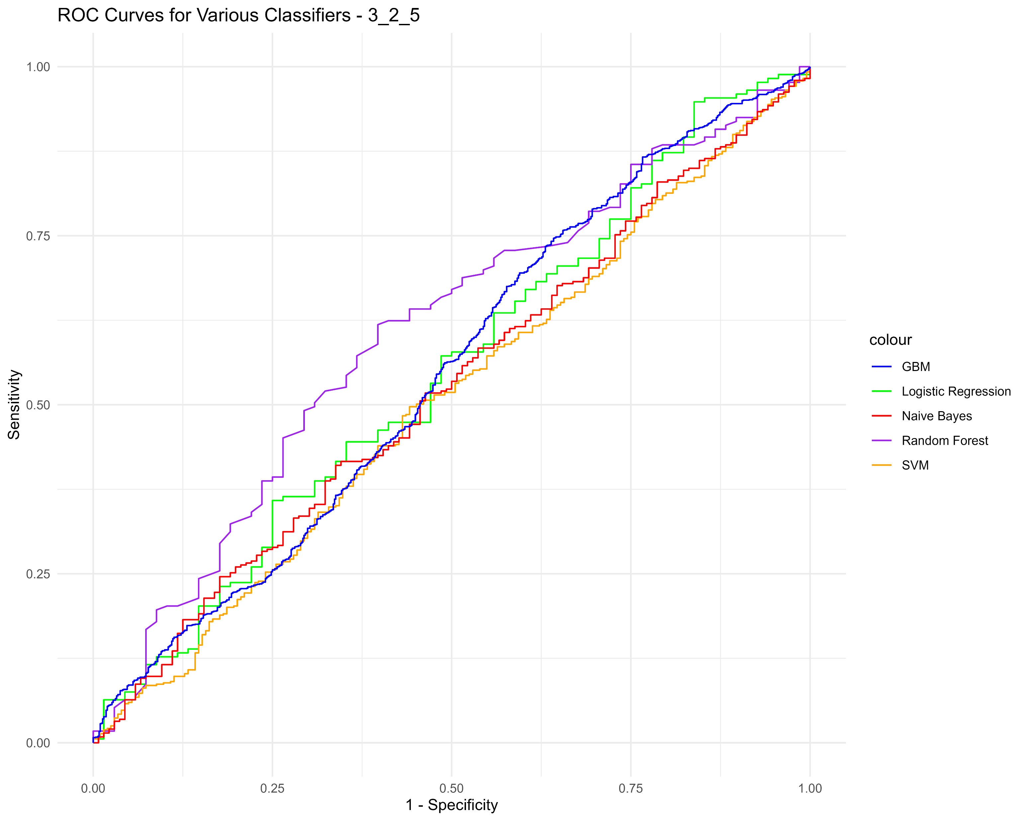
TumorBoundaryTexturePreprocessing (3_2_5)
Model | AUC | Sensitivity | Specificity | PPV | NPV
Logistic_Regression | 0.55 (0.47-0.63) | 0.84 (0.74-0.93) | 0.05 (0.02-0.08) | 0.26 (0.20-0.32) | 0.45 (0.24-0.67)
Random_Forest | 0.60 (0.53-0.68) | 0.61 (0.49-0.72) | 0.62 (0.55-0.69) | 0.38 (0.29-0.47) | 0.80 (0.73-0.86)
SVM | 0.51 (0.46-0.55) | 0.56 (0.49-0.63) | 0.50 (0.46-0.54) | 0.30 (0.26-0.36) | 0.74 (0.70-0.78)
Naive_Bayes | 0.52 (0.47-0.58) | 0.66 (0.58-0.74) | 0.41 (0.36-0.47) | 0.31 (0.26-0.36) | 0.75 (0.69-0.81)
GBM | 0.55 (0.52-0.57) | 0.36 (0.32-0.40) | 0.75 (0.72-0.77) | 0.36 (0.32-0.40) | 0.75 (0.73-0.77)

Slide 8
TumorBoundaryTexturePreprocessing (3_2_5)
Model | AUC | Sensitivity | Specificity | PPV | NPV
Logistic_Regression | 0.55 (0.47-0.63) | 0.84 (0.74-0.93) | 0.05 (0.02-0.08) | 0.26 (0.20-0.32) | 0.45 (0.24-0.67)
Random_Forest | 0.60 (0.53-0.68) | 0.61 (0.49-0.72) | 0.62 (0.55-0.69) | 0.38 (0.29-0.47) | 0.80 (0.73-0.86)
SVM | 0.51 (0.46-0.55) | 0.56 (0.49-0.63) | 0.50 (0.46-0.54) | 0.30 (0.26-0.36) | 0.74 (0.70-0.78)
Naive_Bayes | 0.52 (0.47-0.58) | 0.66 (0.58-0.74) | 0.41 (0.36-0.47) | 0.31 (0.26-0.36) | 0.75 (0.69-0.81)
GBM | 0.55 (0.52-0.57) | 0.36 (0.32-0.40) | 0.75 (0.72-0.77) | 0.36 (0.32-0.40) | 0.75 (0.73-0.77)

