Slide 1
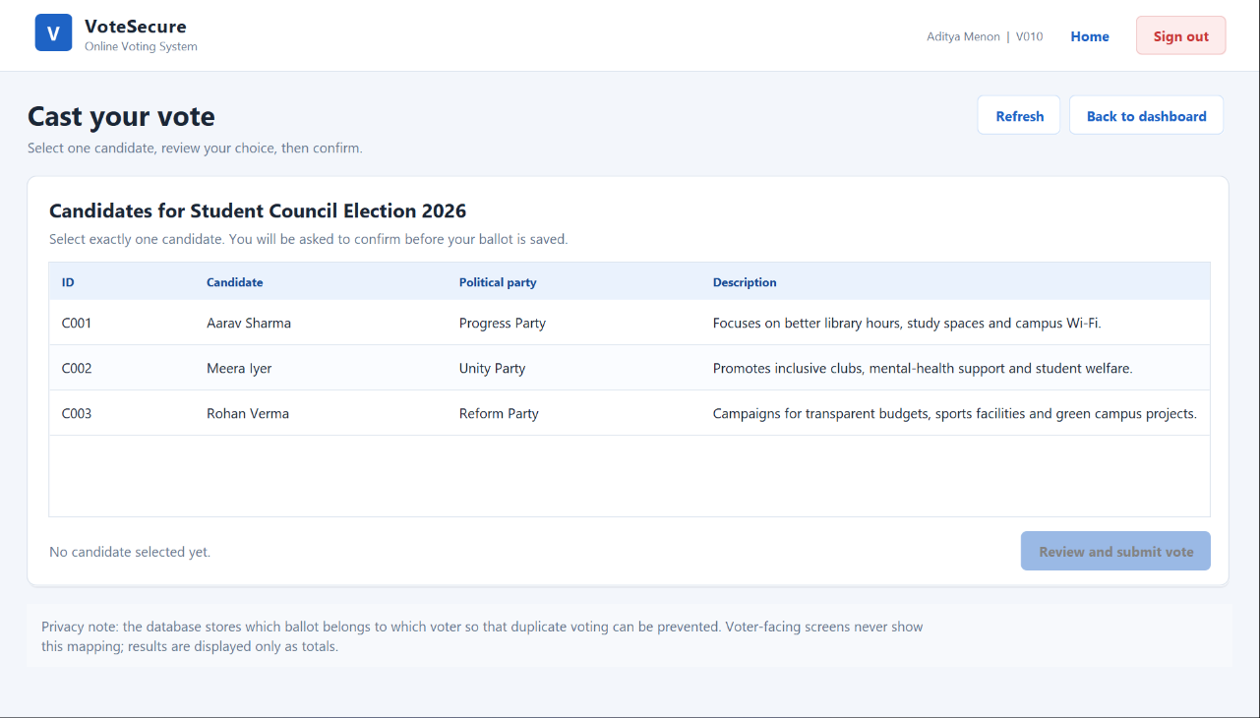
SEMESTER 3 · OBJECT-ORIENTED PROGRAMMING IN JAVA
VoteSecure
Online Voting System
A local Java desktop application that registers voters, enforces one ballot per voter and exports auditable results.
Candidate listing — live desktop capture
Java 17 · Swing · SQLite · JDBC · JUnit 5
Academic local prototype — not a production election platform

Slide 2
THE PROBLEM
Paper and spreadsheets do not enforce the rules
The gap is not counting speed — it is trust: who is eligible, when voting is open, and whether a ballot is unique.
Paper and spreadsheets
VoteSecure’s rules
WHAT GOES WRONG
WHAT THE APPLICATION ENFORCES
Duplicate or fictitious entries go unnoticed
Eligibility is informal and easy to dispute
Manual counting is slow and cannot be repeated
No consistent report, tie rule or zero-vote handling
Unique IDs; PINs stored only as salted hashes
One ballot per voter, checked in service and DB
Voting only while start ≤ now < end
Config freezes after the first vote
Scope: one election on one computer, with an administrator and an eligible-voter roll. Production Internet voting is out of scope.

Slide 3
ARCHITECTURE
A layered design keeps rules out of the UI
Each layer depends only on the one below it. The Swing screens never execute SQL, and the services never paint a pixel.
ui 12 Swing screens · theme · dialogs · table models
OOP in practice
Encapsulation — private fields and guarded constructors; Election owns the window rule.
Abstraction — repository interfaces hide SQL behind a small contract.
Inheritance — every expected failure extends VoteSecureException.
Polymorphism — services depend on interfaces, never on Jdbc* classes.
service VotingManager · ElectionService · ResultsService · AdminService
repository 5 interfaces + JDBC implementations · all SQL lives here
database DatabaseManager · connections · schema · demonstration seed
model · exception · util domain objects · failure types · PBKDF2 · validation
AppContext wires the object graph once; screens call services, and only the repositories execute SQL.

Slide 4
VOTING WORKFLOW
A ballot passes six enforced checks
Start is inclusive; the end instant is already closed. Any failure rolls back the database transaction.
1
2
3
4
5
6
Sign in
Eligibility
Window
Duplicate
Transaction
Receipt
Voter ID and PIN checked against the PBKDF2 hash.
The administrator-set eligible flag must be on.
start ≤ now < end, evaluated with the injected Clock.
Service check first, then UNIQUE(election, voter) in SQLite.
Insert the ballot and mark the voter; commit or roll back together.
Timestamp shown; the chosen candidate is not repeated.
Failure path: a specific checked exception is shown, the transaction rolls back, and no ballot is stored.

Slide 5
SECURITY AND INTEGRITY
Integrity and credentials are defended in depth
Three independent layers must agree before a ballot is trusted — and no layer stores a raw credential.
Credentials
Database
Process
PBKDF2-HMAC-SHA256 hashing
120,000 iterations, 16-byte salt
Constant-time verification
No plain-text credentials
PINs never logged or shown
PreparedStatement for all SQL
Foreign keys ON per connection
UNIQUE(election_id, voter_id)
Transactional insert + rollback
Generic user-facing errors
Freeze after the first ballot
Voter results hidden while open
Admin live view labelled PREVIEW
Duplicate checked twice
Reports contain aggregates only
Threat model: a local academic prototype. Ballot secrecy against full database access is not claimed.

Slide 6
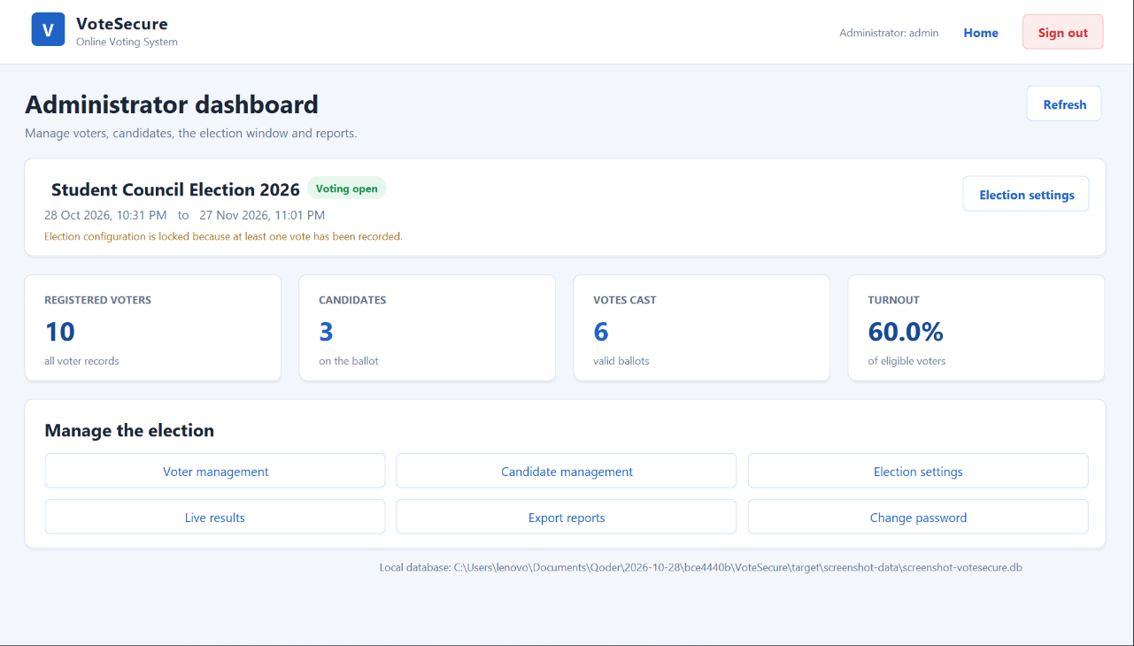
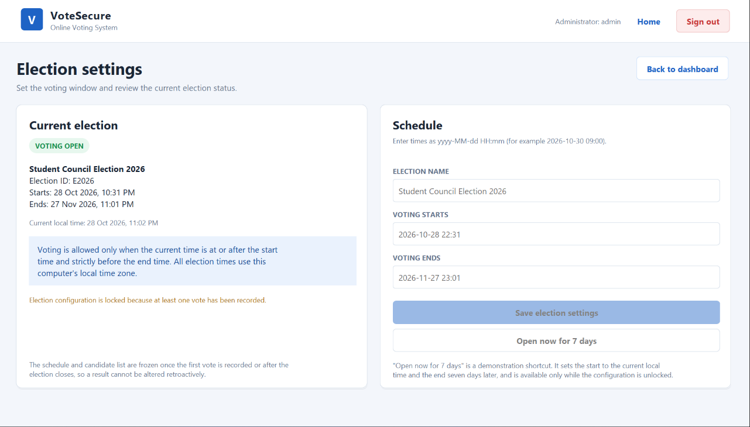
ADMINISTRATOR
Administrator workspace
Voters, ballot, schedule, results and reports in one signed-in session.
Administrator dashboard — counts, window and election status
Election settings — configuration locked after the first ballot
Register and search voters
Add or edit candidates
Export TXT and CSV reports
Once a ballot exists, the schedule and candidate list are frozen; the screen states the reason.

Slide 7
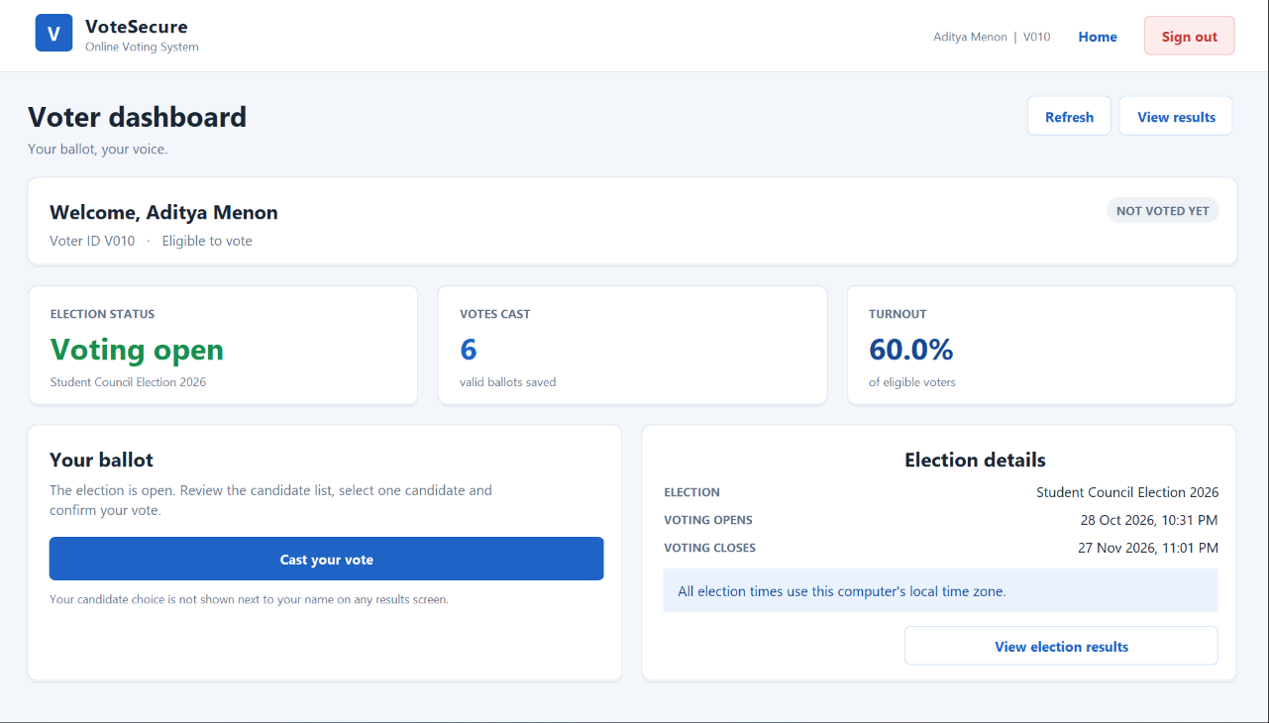
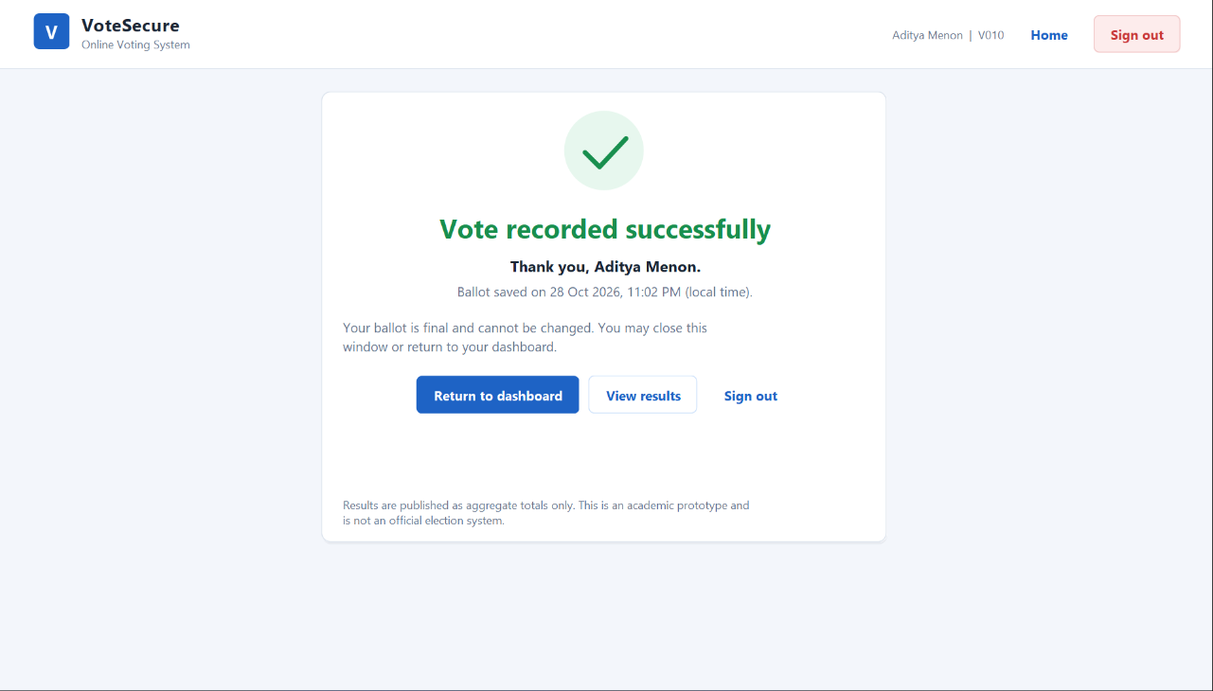
VOTER EXPERIENCE
Voter journey: sign in, choose, confirm
The receipt proves the ballot was saved without repeating the voter’s choice on screen.
Signed in as Aditya Menon (V010)
No candidate selected; submit is disabled
Ballot time shown; choice omitted
Dashboard
Ballot
Success receipt
Election window, status and whether this voter has already voted.
Exactly one candidate; submit stays disabled until a row is selected.
Timestamp only. The selected candidate is deliberately omitted.
Eligible voters only; a repeat attempt is rejected by the service and by the database constraint.

Slide 8
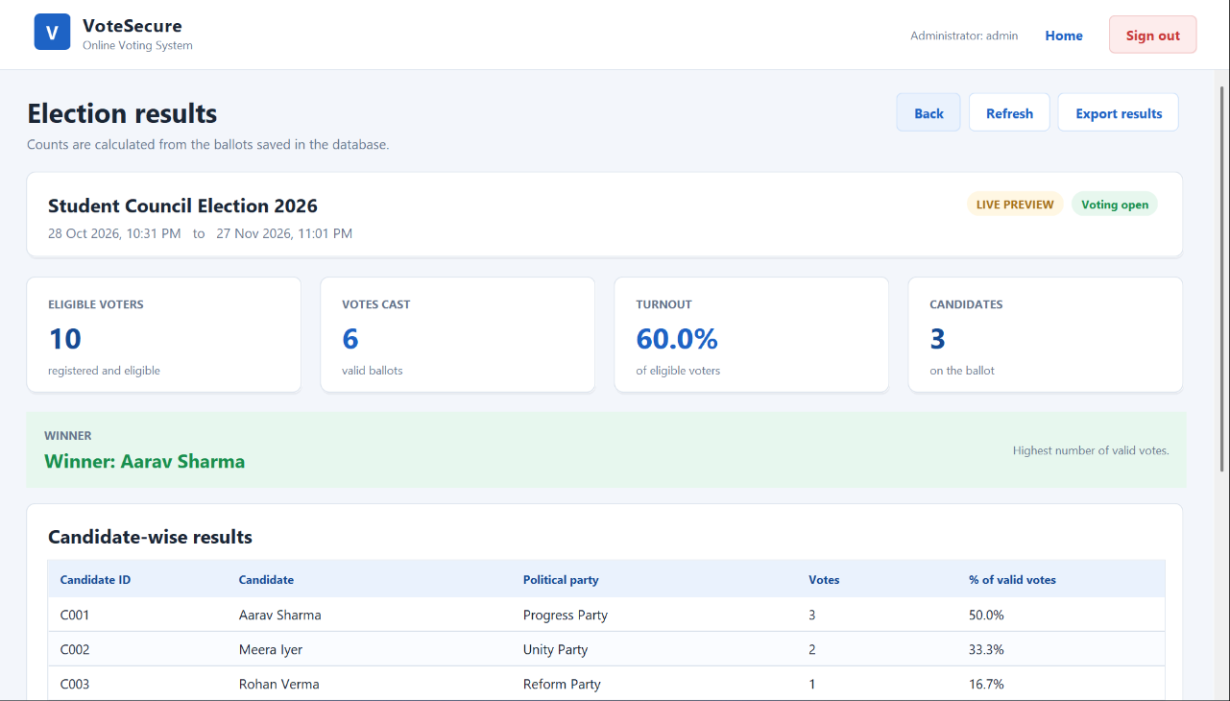
RESULTS · SAMPLE DEMONSTRATION DATA
Results are computed from saved ballots
Counts, percentages and turnout come from ResultsService — never from hard-coded UI values.
ELIGIBLE VOTERS
SAMPLE BALLOTS
10
6
TURNOUT
WINNER
60.0%
Aarav Sharma
Ties are reported explicitly; zero ballots yield 0.0% without division by zero. The administrator can export the same figures as TXT or CSV.
Administrator results — LIVE PREVIEW while voting is open
Sample demonstration database: 10 voters, 3 candidates and 6 ballots. A normal first launch contains zero votes.

Slide 9
VERIFICATION AND LIMITS
59/59
Known limits
Ballot secrecy cannot be guaranteed against full database access.
Local files are protected only by operating-system permissions.
Demonstration credentials are for assessment, not a real election.
No cryptographic receipts or independent audit trail.
automated tests passed
0 failures · 0 errors · 0 skipped · Maven BUILD SUCCESS
Thank you
VoteSecure · academic local prototype · Semester 3 Object-Oriented Programming

