Slide 1

Customer Behavior Analysis
3.9K customers | $59.76 average purchase | 3.75 rating

Slide 2
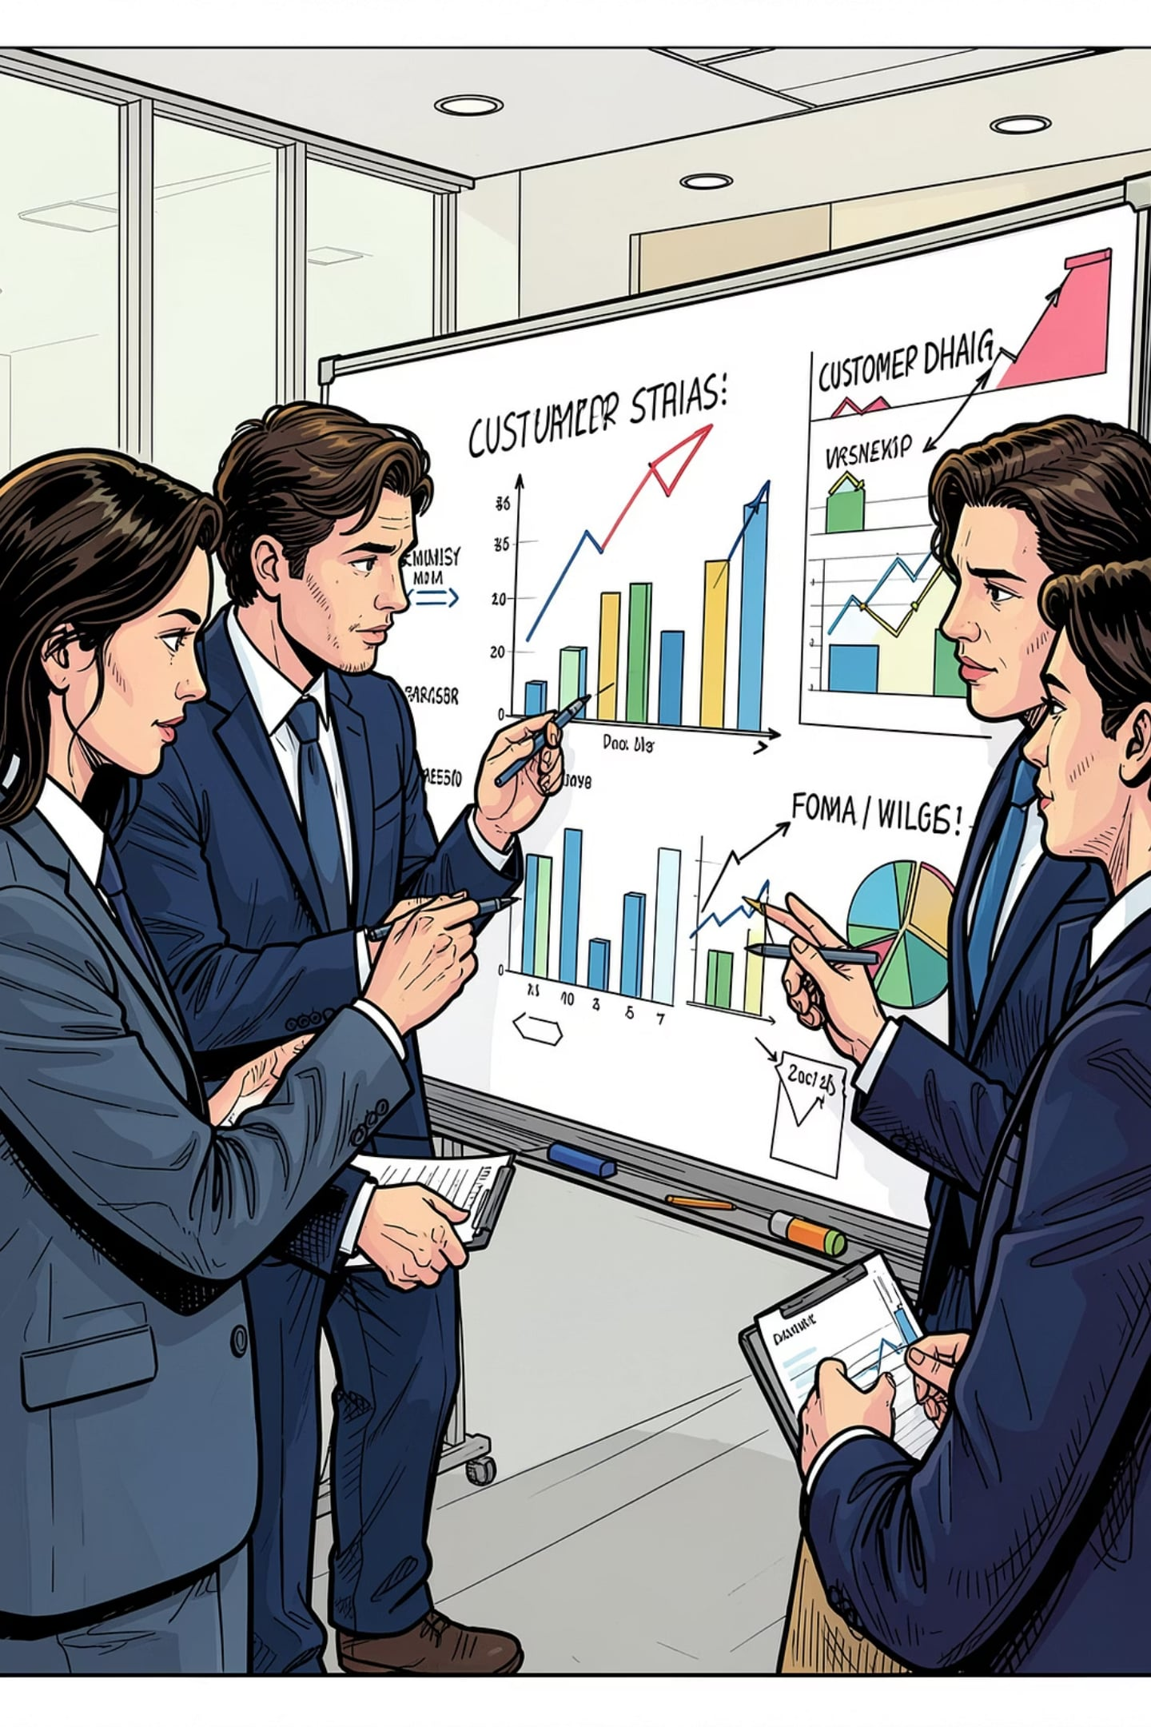
Dataset Highlights
A structured customer dataset with 3,900 rows and 18 columns, covering customer demographics, purchase details, and shopping behavior.
Rows
Columns
3,900 records
18 fields
Missing Values
37 in Review Rating
Customer Demographics
Purchase Details
Age, gender, and other profile attributes
Order value, product information, and transaction data
Shopping Behavior
Frequency, preferences, and engagement patterns

Slide 3




Data Preparation Process
Data Loading
EDA (Exploratory Data Analysis)
Data Cleaning
Imported dataset using pandas
Handled missing values (37 in Review Rating), imputed using median by category
Used df.info() and .describe() for summary statistics
Data Engineering
Data Engineering with PostgreSQL
Created age_group and purchase_frequency_days columns, standardized to snake_case, verified data consistency
Connected Python to PostgreSQL and loaded cleaned DataFrame into database

Slide 4
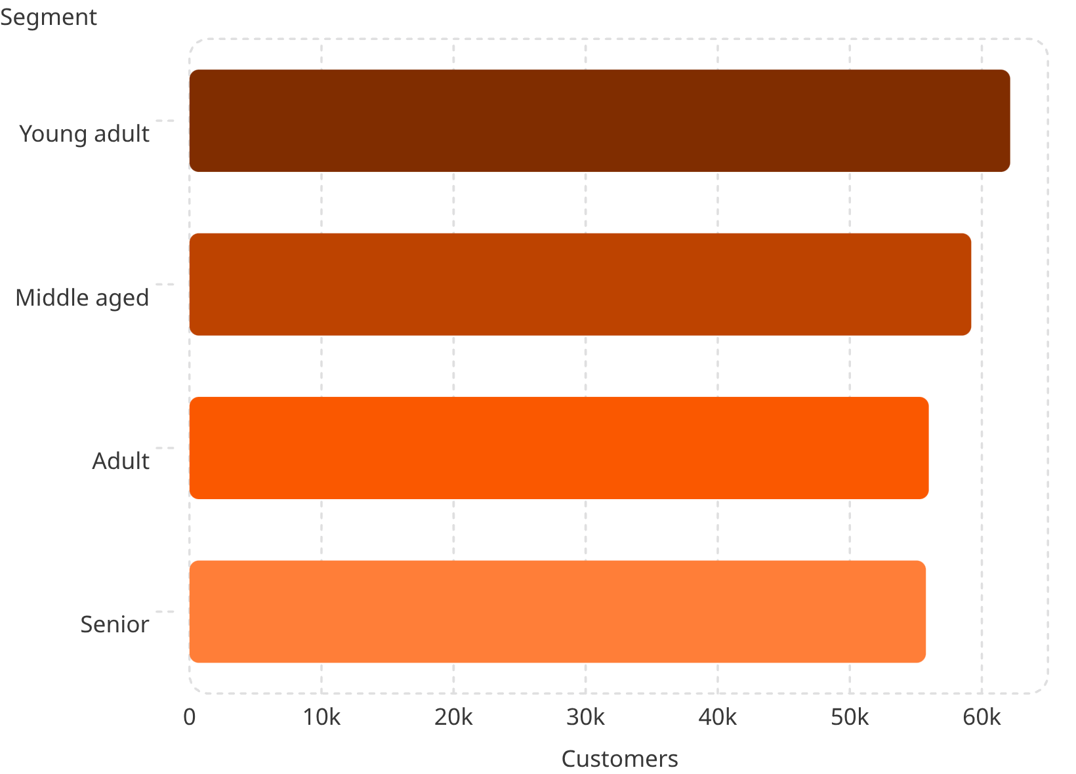
Who Are They? The Demographic Landscape
Segment Highlights
Young adults represent the largest number of customers

Slide 5

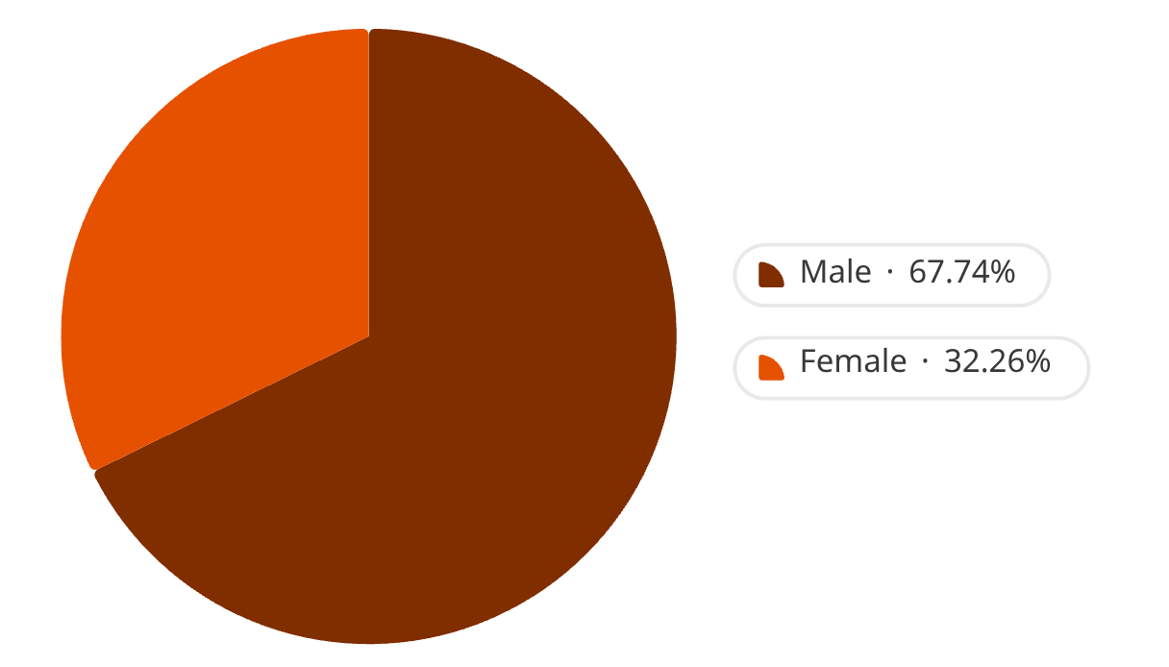
Revenue by Gender
Female 75191
Male 157890
Male customers generate significantly higher total revenue ($157,890) compared to female customers ($75,191).

Slide 6
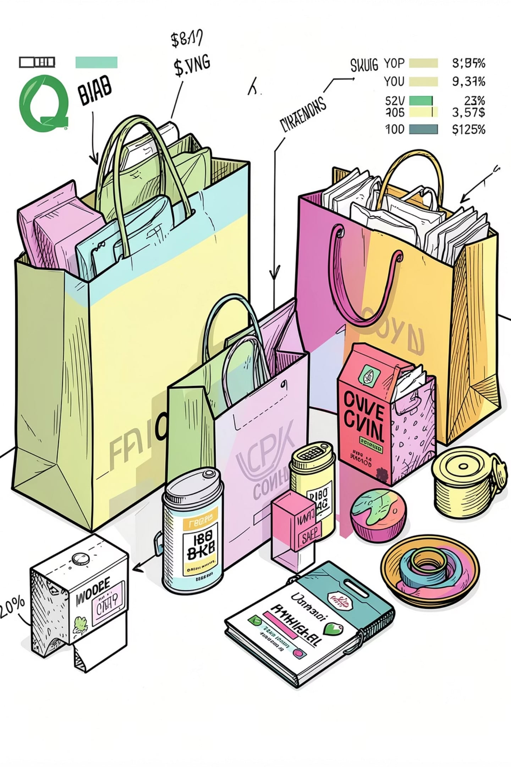
The Purchase Pulse
Repeat behavior is the strongest signal of customer health. Our analysis reveals a powerful concentration of value in a small but critical group.
42%
82%
Repeat Purchase Rate
Revenue from Champions
Nearly half of all transactions come from returning customers
A small elite segment drives the vast majority of total revenue
3.9K
Unique Customers
Total addressable base across all segments and tiers

Slide 7
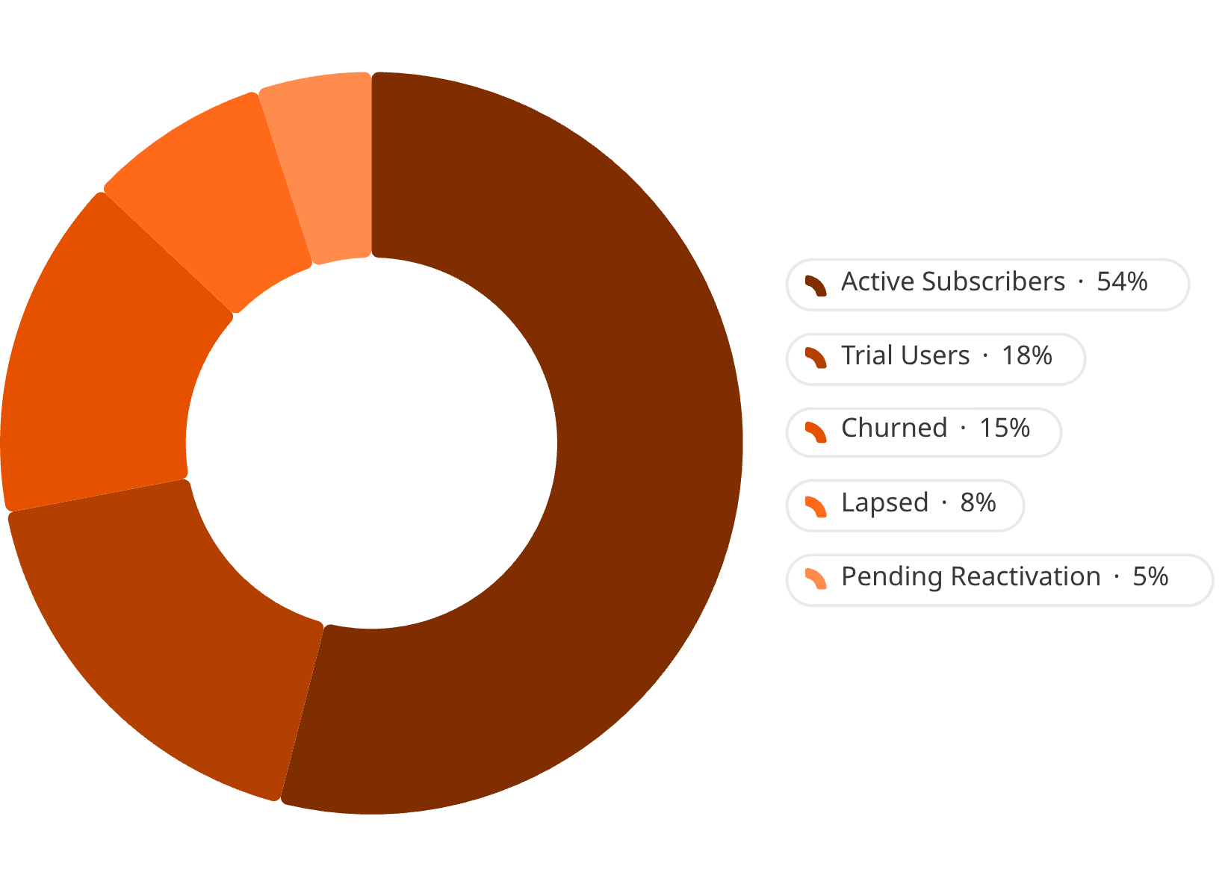

Subscription Dynamics
Subscription status is a direct proxy for customer intent. Active subscribers demonstrate significantly higher Average Order Value (AOV) compared to trial and churned users — making retention the highest-leverage growth lever.
Key Finding: Active subscribers make up 71% of the base, while non-subscribers account for 29%.

Slide 8
Top 5 Products by Rating
Item Purchased
Average Product Rating
Gloves
3.86
Sandals
3.84
Boots
3.82
Hat
3.80
Skirt
3.78
Footwear and accessories dominate the top-rated products, with Gloves leading at 3.86 average rating.

Slide 9

Shipping Type Comparison
Shipping Type
Average Purchase Amount
Standard
58.46
Express
60.48
Express shipping customers spend slightly more ($60.48) compared to standard shipping customers ($58.46), suggesting premium service preference correlates with higher spending.

Slide 10
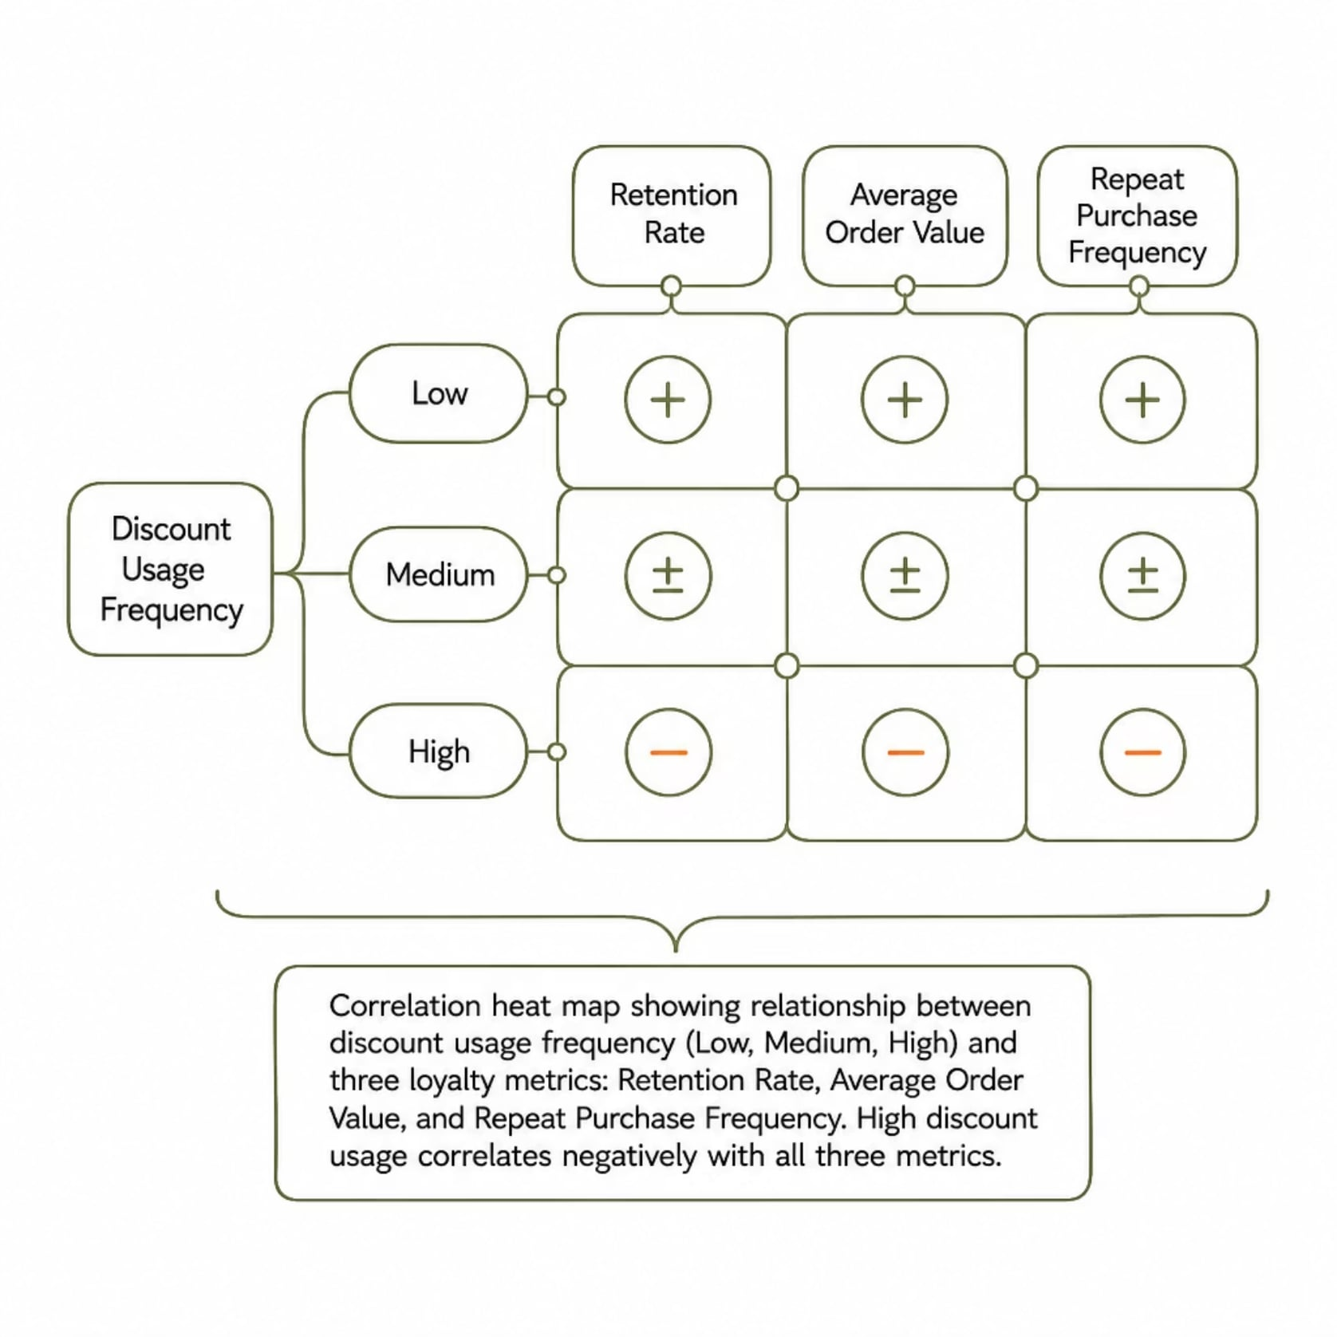
Behavioral Drivers: The Discount Effect
Promo Sensitivity at a Glance
40.2% of all transactions involve a promotional code or discount. While promos drive short-term volume, heavy discount users show measurably lower long-term loyalty scores.
High promo users: lower AOV over time
Full-price buyers: 3x higher retention at 6 months
Strategic discounting can convert without eroding value

Slide 11
Subscribers vs. Non-Subscribers
Subscription Status
Total Customers
Avg Spend
Total Revenue
Yes
1053
59.49
62645.00
No
2847
59.87
170436.00
While non-subscribers have higher average spend ($59.87), subscribers represent a smaller but engaged segment. Non-subscribers drive 73% of total revenue due to their larger population.

Slide 12
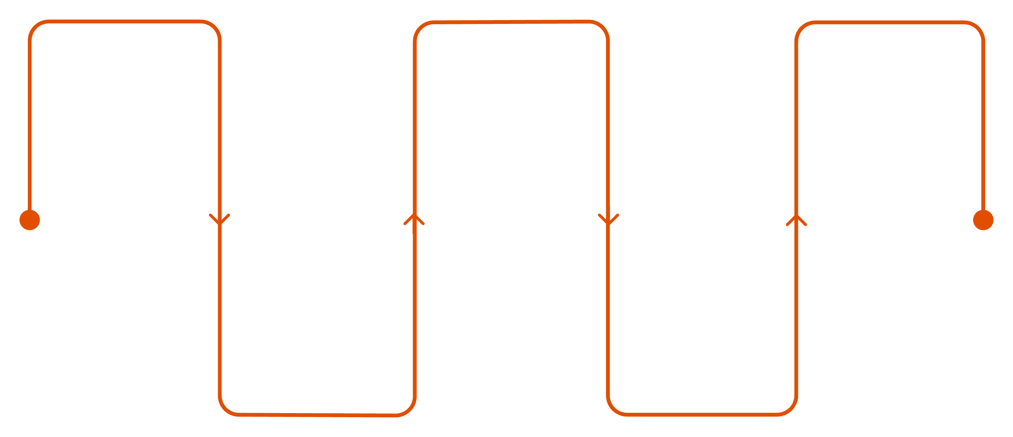
The Customer Journey Map
Every touchpoint is an opportunity — or a risk. Mapping the full path from awareness to advocacy reveals the critical moments that determine long-term customer value.
Awareness
First Purchase
Advocacy
First brand contact
Conversion event
Referrals and loyalty
Consideration
Retention
Browse and compare options
Repeat engagement
The highest-impact intervention points are at First Purchase → Retention and Retention → Advocacy — where targeted engagement programs yield the greatest ROI.

Slide 13
Discount-Dependent Products
Item Purchased
Discount Rate (%)
Hat
50.00
Sneakers
49.66
Coat
49.07
Sweater
48.17
Pants
47.37
Hat is the most discount-dependent product with 50% of purchases involving a discount, suggesting price sensitivity in this category.

Slide 14
Conclusion: From Insights to Impact
This analysis surfaces a clear path to higher retention, smarter marketing spend, and stronger customer lifetime value. The data is ready — execution is the next step.
Key Discoveries
Call to Action
3.9K customers in the dashboard
$59.76 average purchase amount
3.75 average rating
71% subscription rate
Implement the new behavioral segmentation framework by next quarter. Priority actions:
Launch Champion retention pilot program
Redesign promo strategy for targeted segments
Audit high-return product categories
Set up automated re-engagement triggers

