Slide 1

KESTREL
Launch in one message. Spot the rug before it bites.
A Telegram launcher and risk scanner for Ascend on Elysium
ASCEND BUILDER INCUBATOR · NOVEMBER 2026 · RYAN HADI
Notes:
Kestrel: one Telegram message launches a coin on Ascend, and every Ascend launch gets a plain-language risk card. I'm Ryan Hadi, and this is our application to the Ascend Builder Incubator.

Slide 2

KESTREL // the pitch in one line
02
Kestrel brings Ascend more launches, and safer ones.
01 · LAUNCHER
02 · SCANNER
03 · BUILDER FEE
A coin from one Telegram message. No code, no dev buy.
A plain-language risk card for every Ascend coin, not only ours.
Our only revenue, capped by Ascend, paid on trades that also pay Ascend.
Notes:
The whole pitch in one line. Kestrel is two products and one business model: a launcher, a scanner, and a builder fee that only pays when Ascend also earns.

Slide 3

DAY ONE // elysium mainnet
03
40
coins launched on Ascend in about one hour. Creators showed up on day one.
Source: Kestrel reader · 40 most recent Ascend launches · Nov 9, 2026, ~03:40 UTC
Notes:
Real numbers from mainnet day one, read by Kestrel's own reader. 40 coins launched on Ascend in about an hour. Creators showed up on day one.

Slide 4

DAY ONE // elysium mainnet
04
0
of them came through a builder app. The builder lane on Ascend is open.
Source: builderFee = 0 on all 40 Launched events
Notes:
And none of those 40 came through a builder app. Every launch carried a builder fee of zero. Elysium has other launch partners, but on Ascend the builder lane is empty. Kestrel is built to fill it.

Slide 5
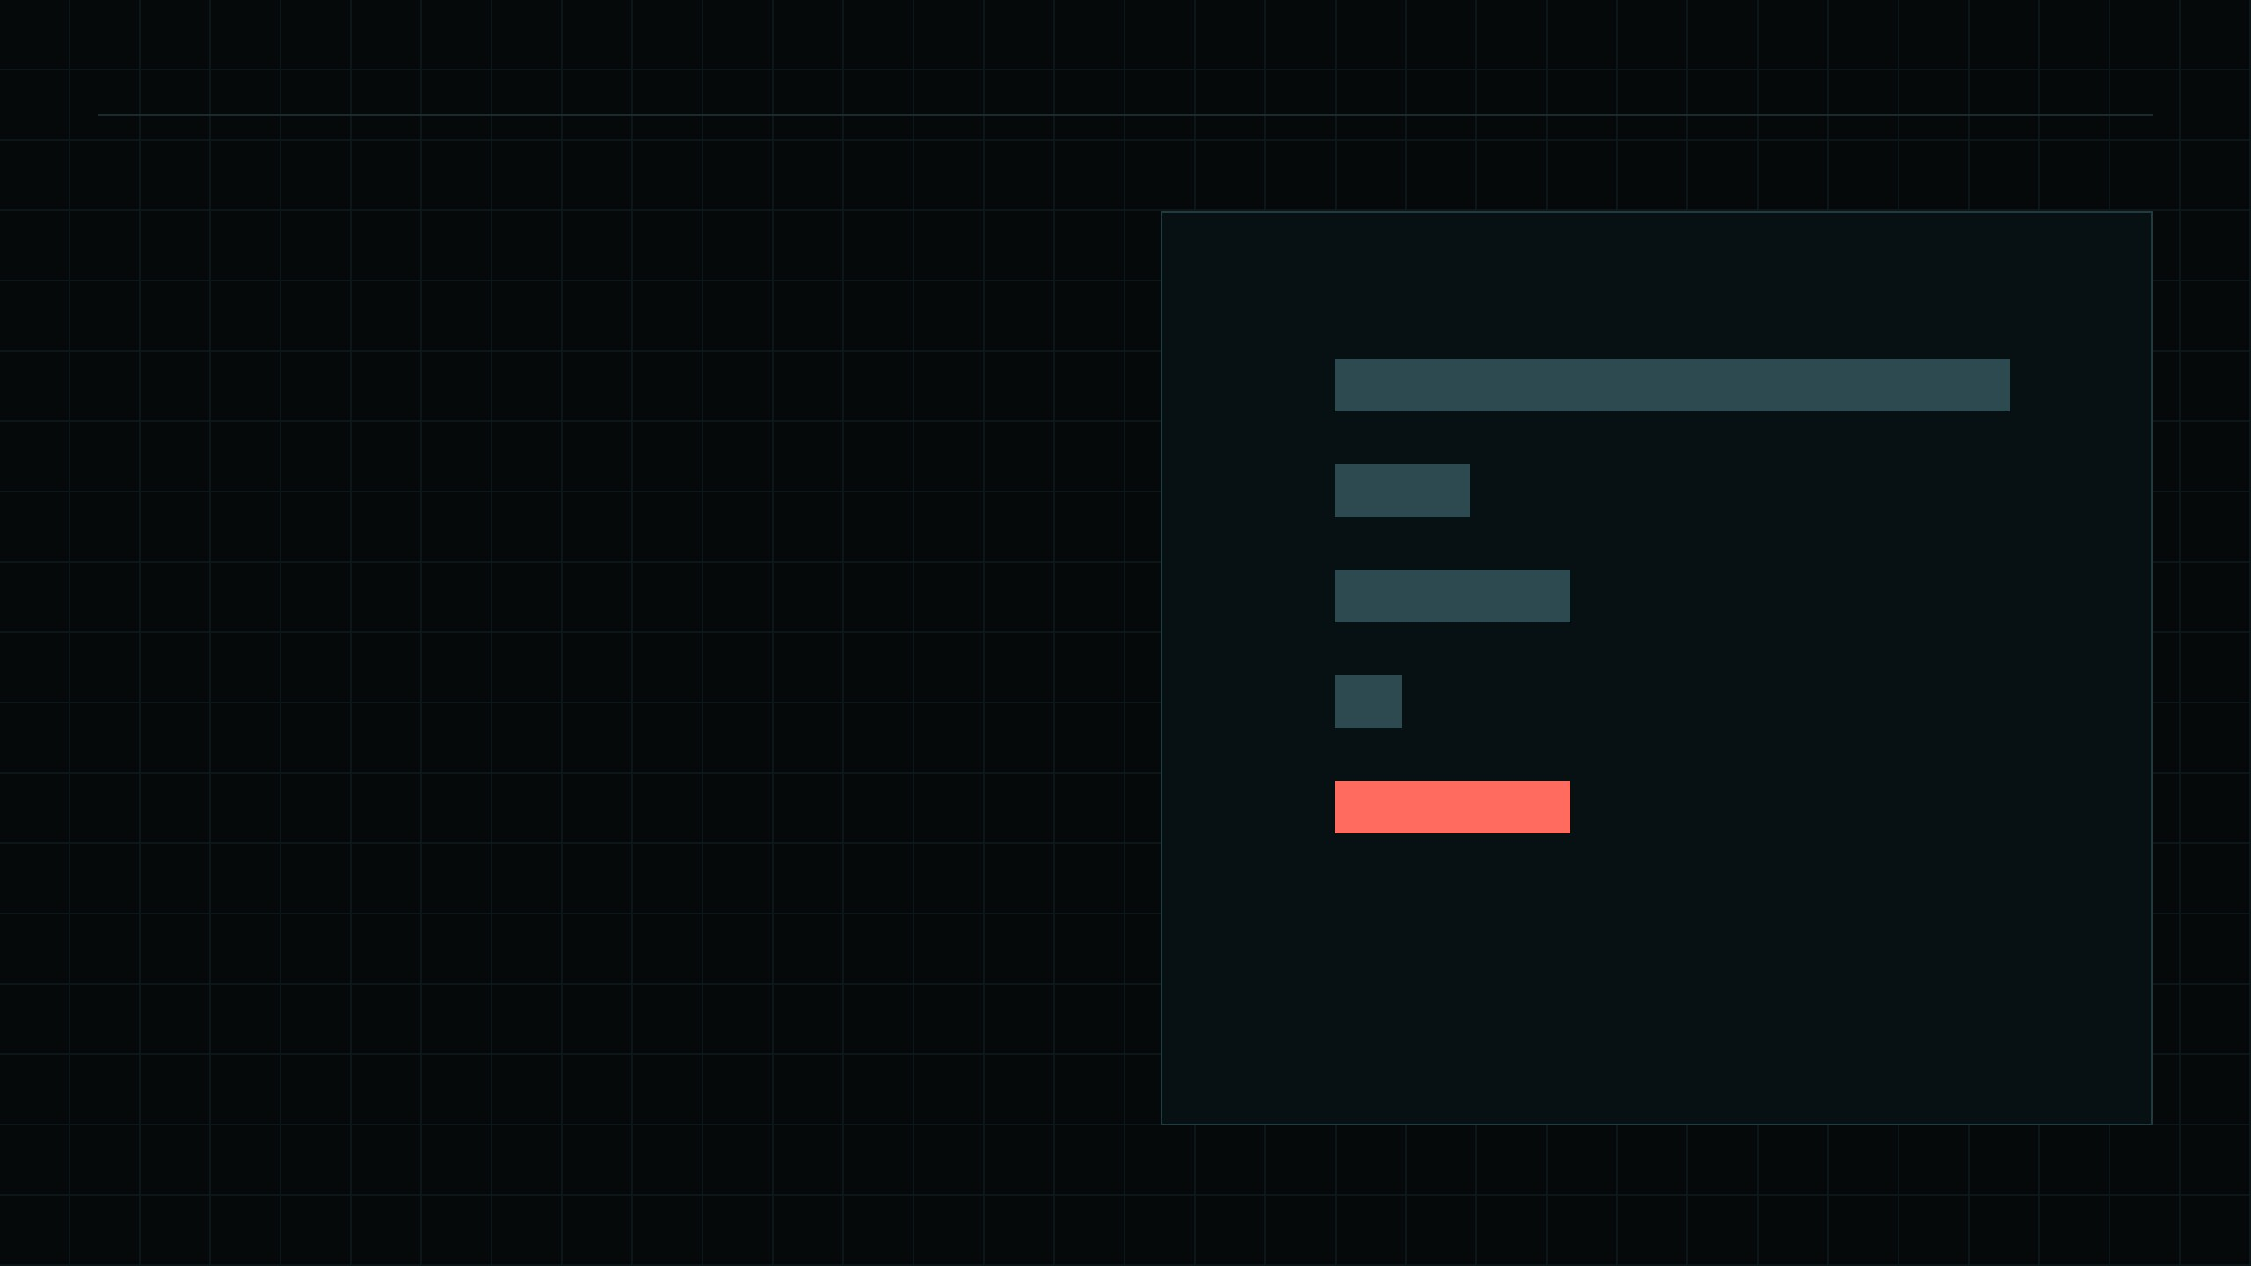
05 // what buyers can't see
source: Launched events · last 40
One in six coins charges 10% on every buy and sell.
LAUNCHES BY CREATOR FEE
1%
20
2%
4
The fee is set in a contract event most traders never open. A wallet shows the price, not the toll.
3%
7
5%
2
10%
7
11 / 40
13 / 40
opted out of community takeover
included a dev buy
fee = creator fee tier · charged on buys and sells
Notes:
The risk is real too. Seven of the 40 coins charge the maximum 10% fee on every buy and sell. Eleven opted out of community takeover, and thirteen included a dev buy. All of it is on-chain, none of it is visible in a wallet or a chart.

Slide 6

THE PROBLEM
06
Launching is hard. Reading a launch is harder.
CREATORS GIVE UP HALFWAY
TRADERS BUY BLIND
Wallets, pair assets and fee settings stand between a community and its coin.
Fees, dev buys and takeover opt-outs are all on-chain, but written in code.
Notes:
Both sides of the market have a problem. Creators give up halfway through a launch. Traders cannot read what the chain already tells them.

Slide 7
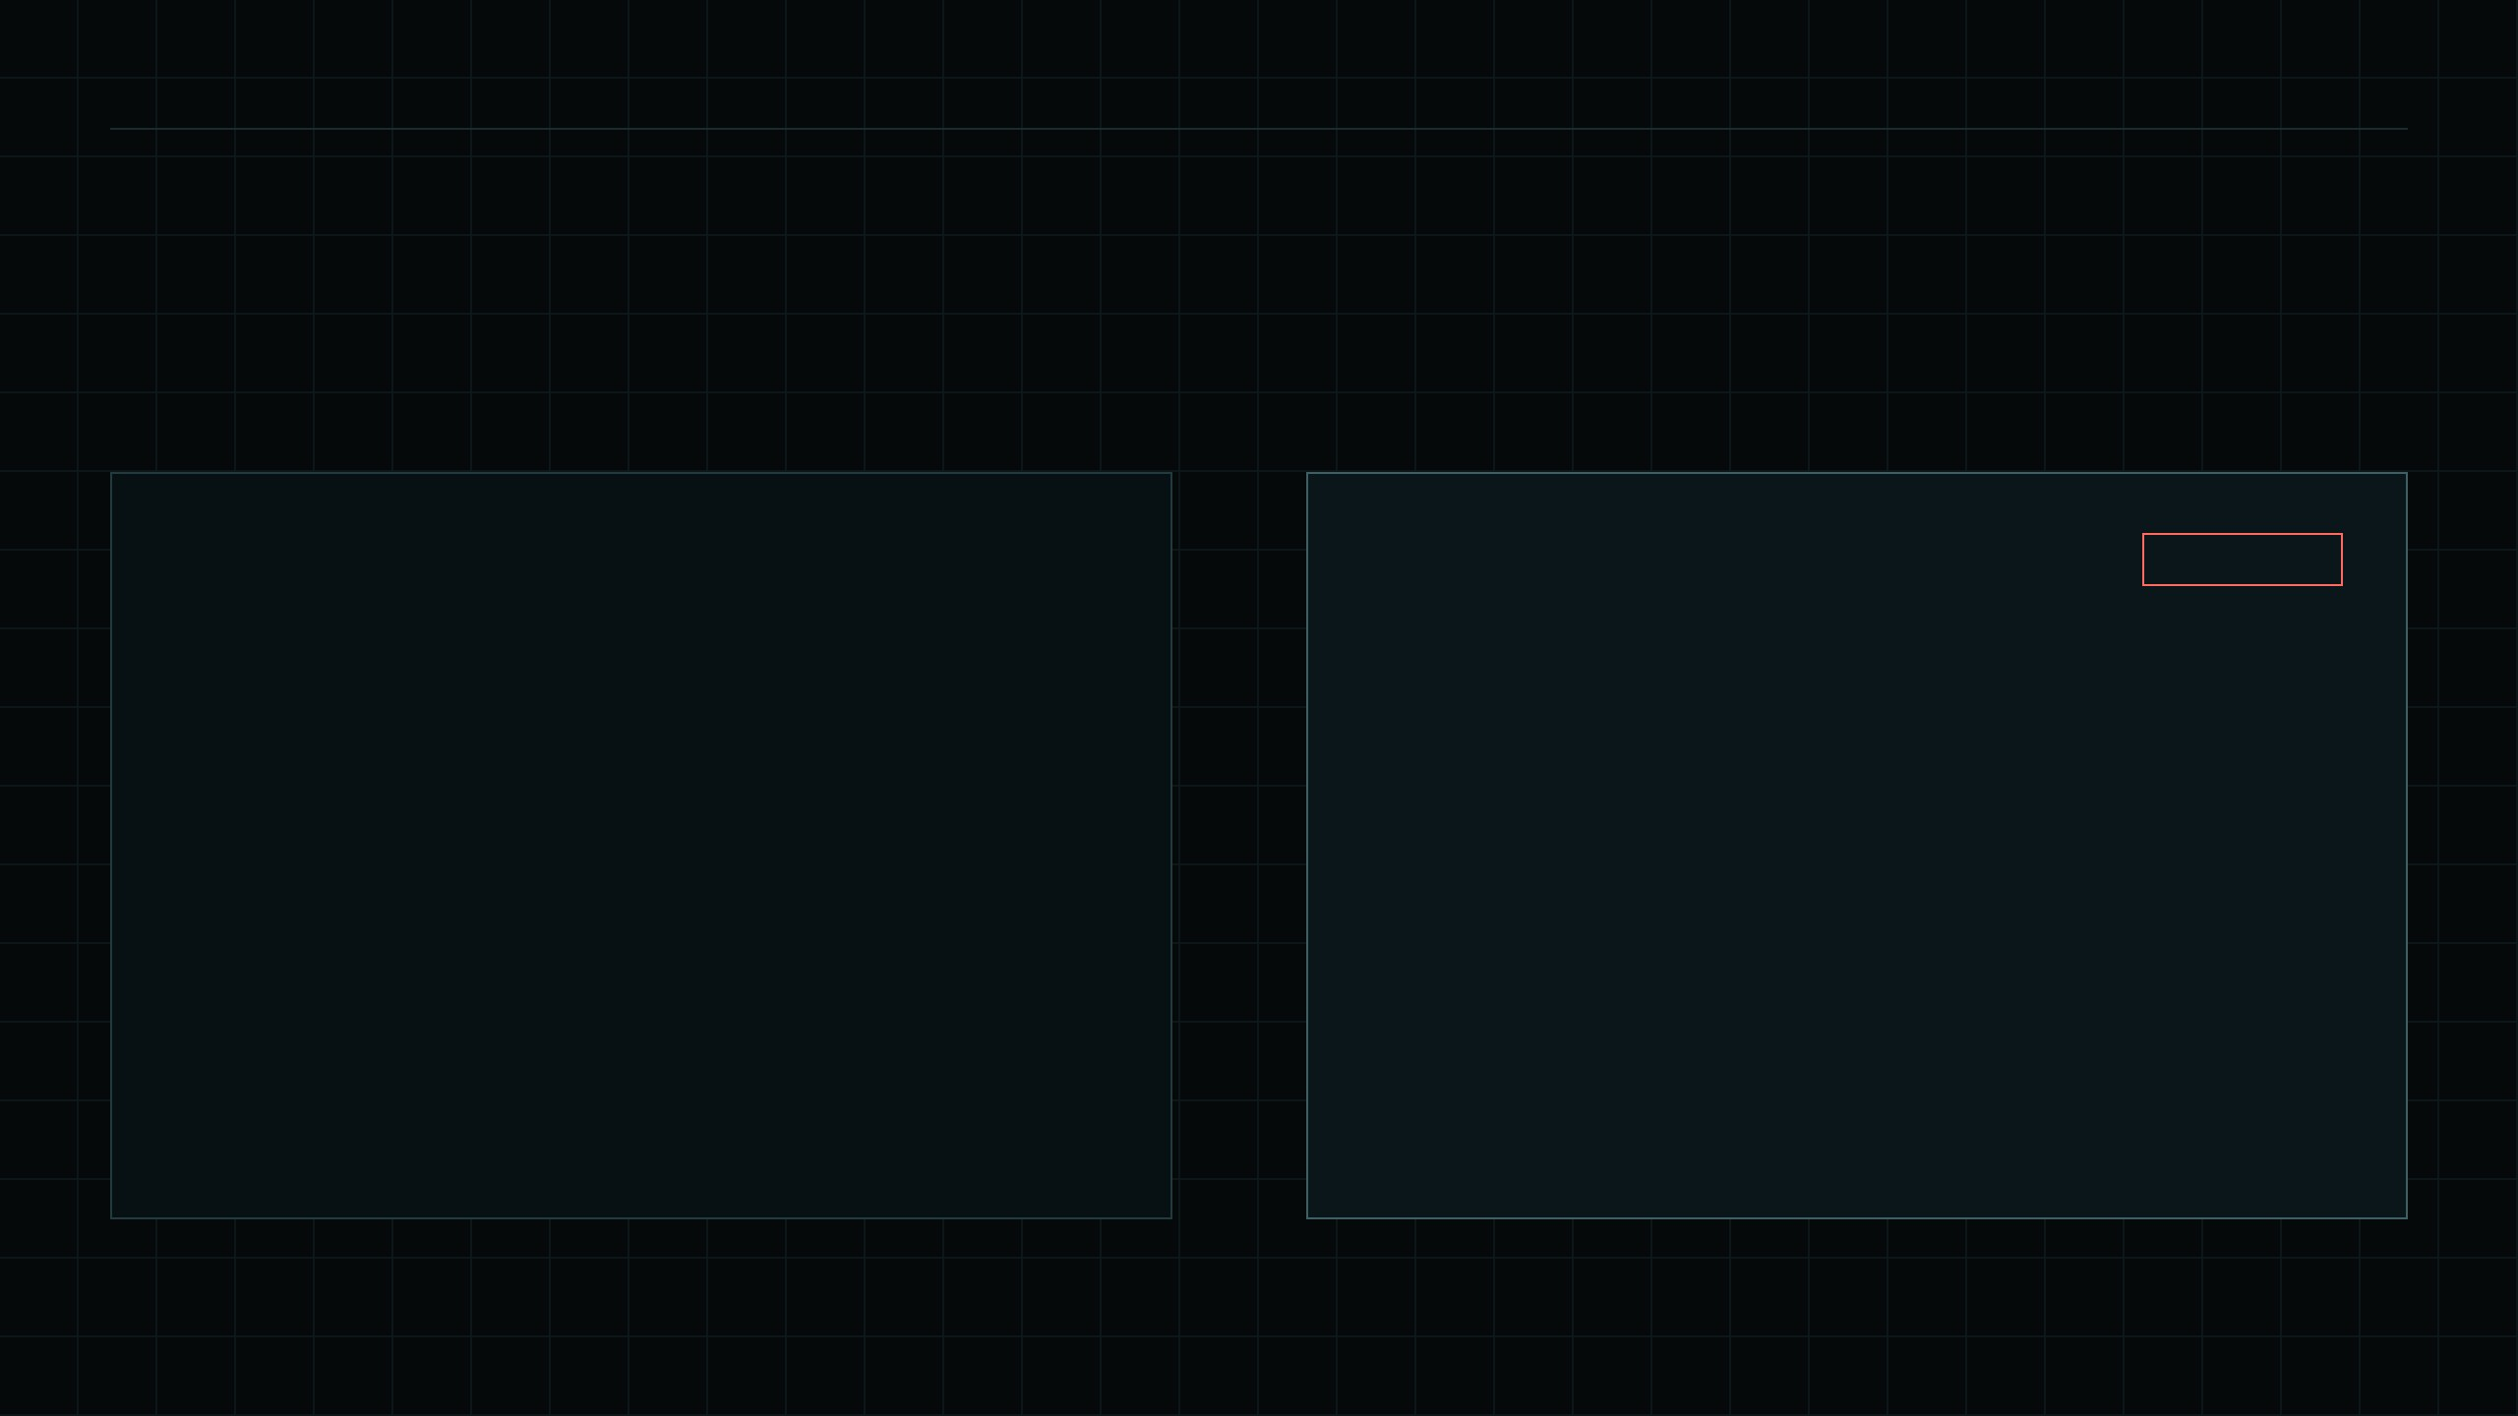
07 // the core idea
raw event → risk card
We turn launch events into sentences.
WHAT THE CHAIN SAYS
WHAT KESTREL SAYS
HIGH RISK
Launched(
poolId, token, creator, quote,
supplySeeded,
devBuyTokens = 2.06e25,
fee = 100000,
builderFee = 0
)
Expensive to trade: 10% fee on every buy and sell.
→
Creator holds 2.06% of supply from the dev buy.
Notes:
This is the core idea. On the left is what a launch actually looks like on-chain. On the right is the same launch after Kestrel reads it: two plain sentences a trader understands in seconds.

Slide 8
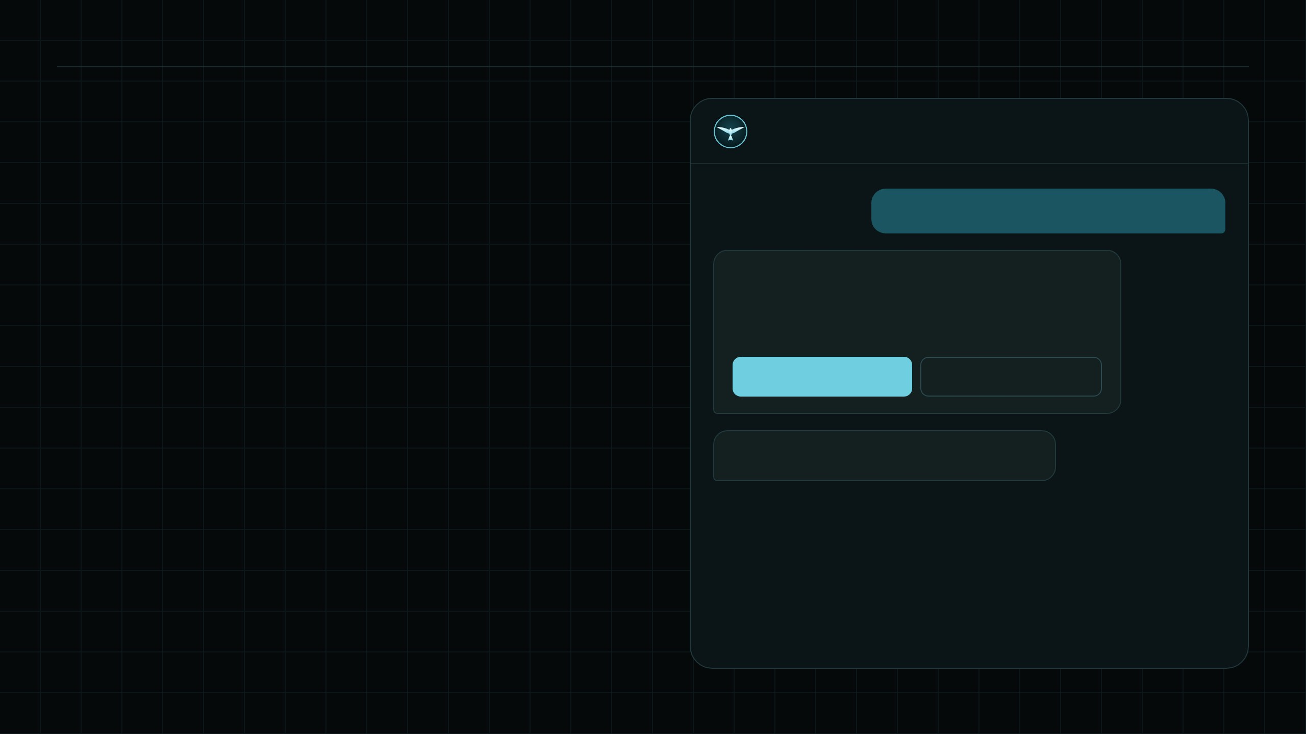
08 // product · launcher
telegram
Launch: one message, safe defaults.
Kestrel
bot
/launch KOPI "Kopi Nusantara" fee=2
Confirm launch
› set your wallet once
Kopi Nusantara ($KOPI)
Pair USDC · Fee 2% · Dev buy none
› no code, no gas from the creator
Launch
Cancel
› no dev buy by default
› creator fees go to the creator's wallet
› simulated before anything is sent
● $KOPI is live on Ascend · 0x7a3f…c91e
example coin · illustrative
Notes:
The launcher. A creator sets their wallet once, sends one message, checks a confirmation card and taps once. Safe defaults: no dev buy, creator fees straight to the creator's wallet, and every launch is simulated against Ascend's contracts before it is sent. Example coin is illustrative.

Slide 9
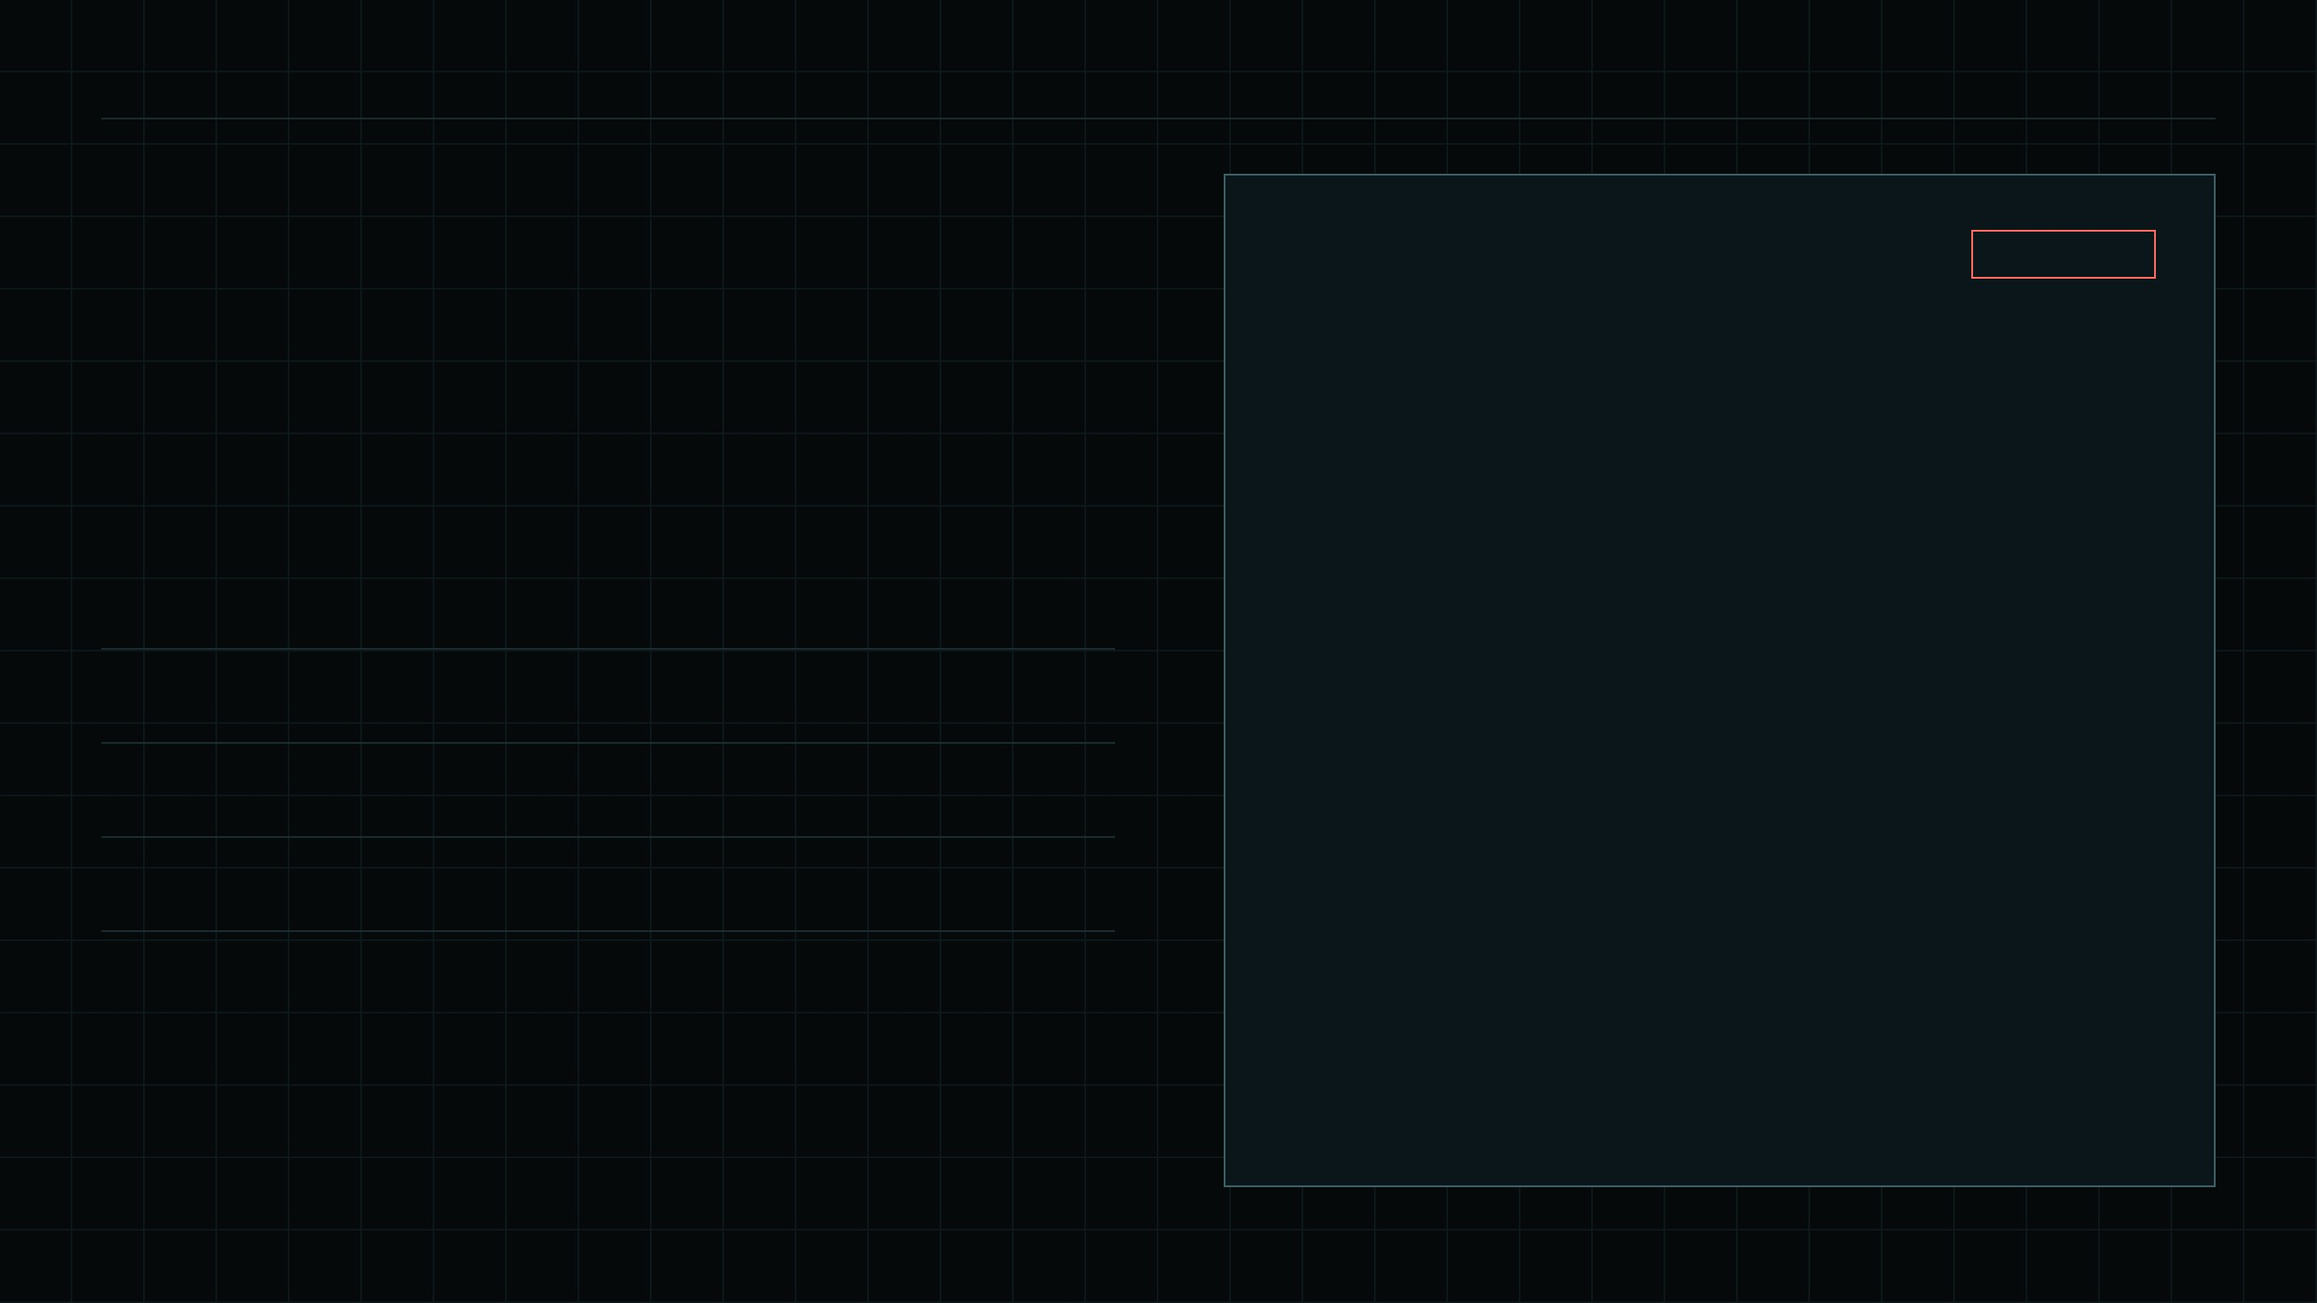
09 // product · scanner
web + telegram
Scan: every Ascend coin gets a card before anyone buys.
0x6666…6666 · 12m · HYPE pair
HIGH RISK
Hyper Moon $HYPE
▲ Ticker copies a well-known asset. Likely a copycat.
▲ Creator holds 18% of supply from the dev buy.
TICKER
FEE
DEV BUY
TAKEOVER
RISK
▲ Expensive to trade: 8% fee on every buy and sell.
8%
18%
off
HIGH
$HYPE
▲ No community takeover if the creator leaves.
3%
3.5%
on
MEDIUM
$GPIX
2.5%
0%
on
LOW
$KOPI
example coins from the live site
rule-based: every flag maps to an on-chain field
Notes:
The scanner reads every Ascend launch, not only the ones Kestrel makes, and gives each a risk level with reasons. Rules are transparent: every flag maps to a field on-chain. The coins shown are the example coins from the live site.

Slide 10

HOW IT COMPOUNDS
10
Every launch feeds the next one.
01
02
03
04
Launch →
Scan →
Trade →
Earn ↺
One message brings a creator and their community.
Every coin gets a card, so buyers trust the platform.
Buyers trade with the facts in hand.
Fees reach the creator, who comes back to launch again.
Notes:
The flywheel. Easier launches bring more coins. Risk cards give buyers confidence. Trades pay creators, Ascend and Kestrel. Good creators bring their communities back for the next launch.

Slide 11
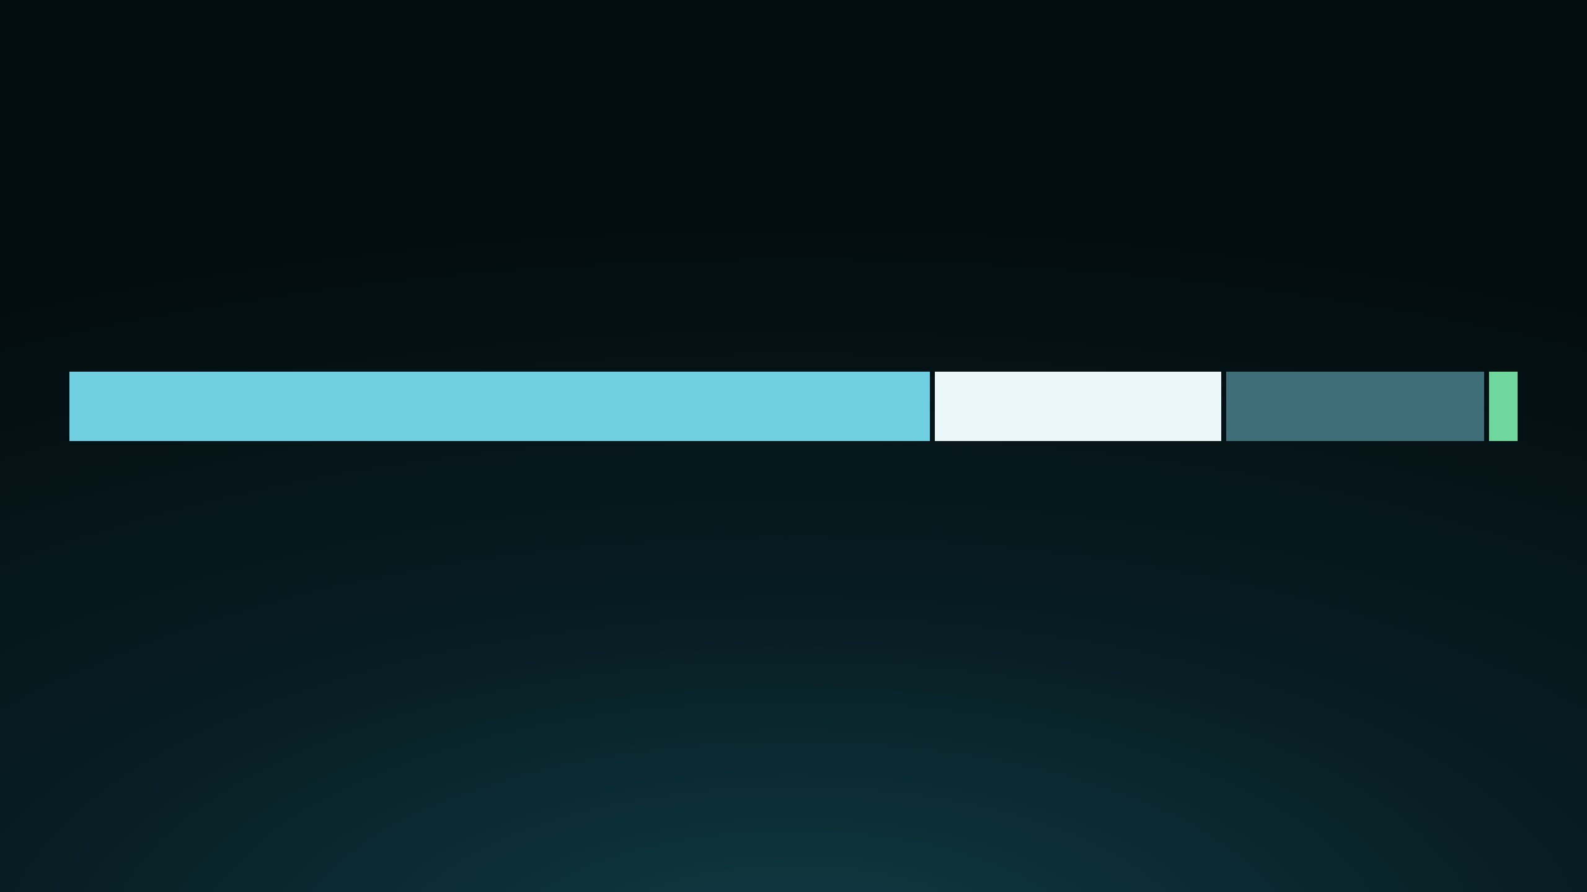
BUSINESS MODEL
11
Kestrel earns only when Ascend earns.
ONE $1,000 TRADE ON A KESTREL COIN · 2% CREATOR FEE + 0.5% BUILDER FEE
$15
$5
$4.50
$0.50
to the creator
to Kestrel (builder fee)
to Ascend protocol
buys back the coin
At $1M traded on Kestrel coins: $15k to creators, $4.5k to Ascend, $5k to Kestrel. The builder fee is capped on-chain by Ascend's multisig, at most 1%.
Shares from Ascend's fee table, $40k–$1M market cap band · per-$1M figures illustrative
Notes:
Fee shares follow Ascend's published fee table for a coin between 40 thousand and 1 million dollars market cap. Kestrel never touches user funds. Its only revenue is the builder fee, which Ascend caps on-chain. More Kestrel volume means more Ascend revenue. Per-million figures are illustrative.

Slide 12
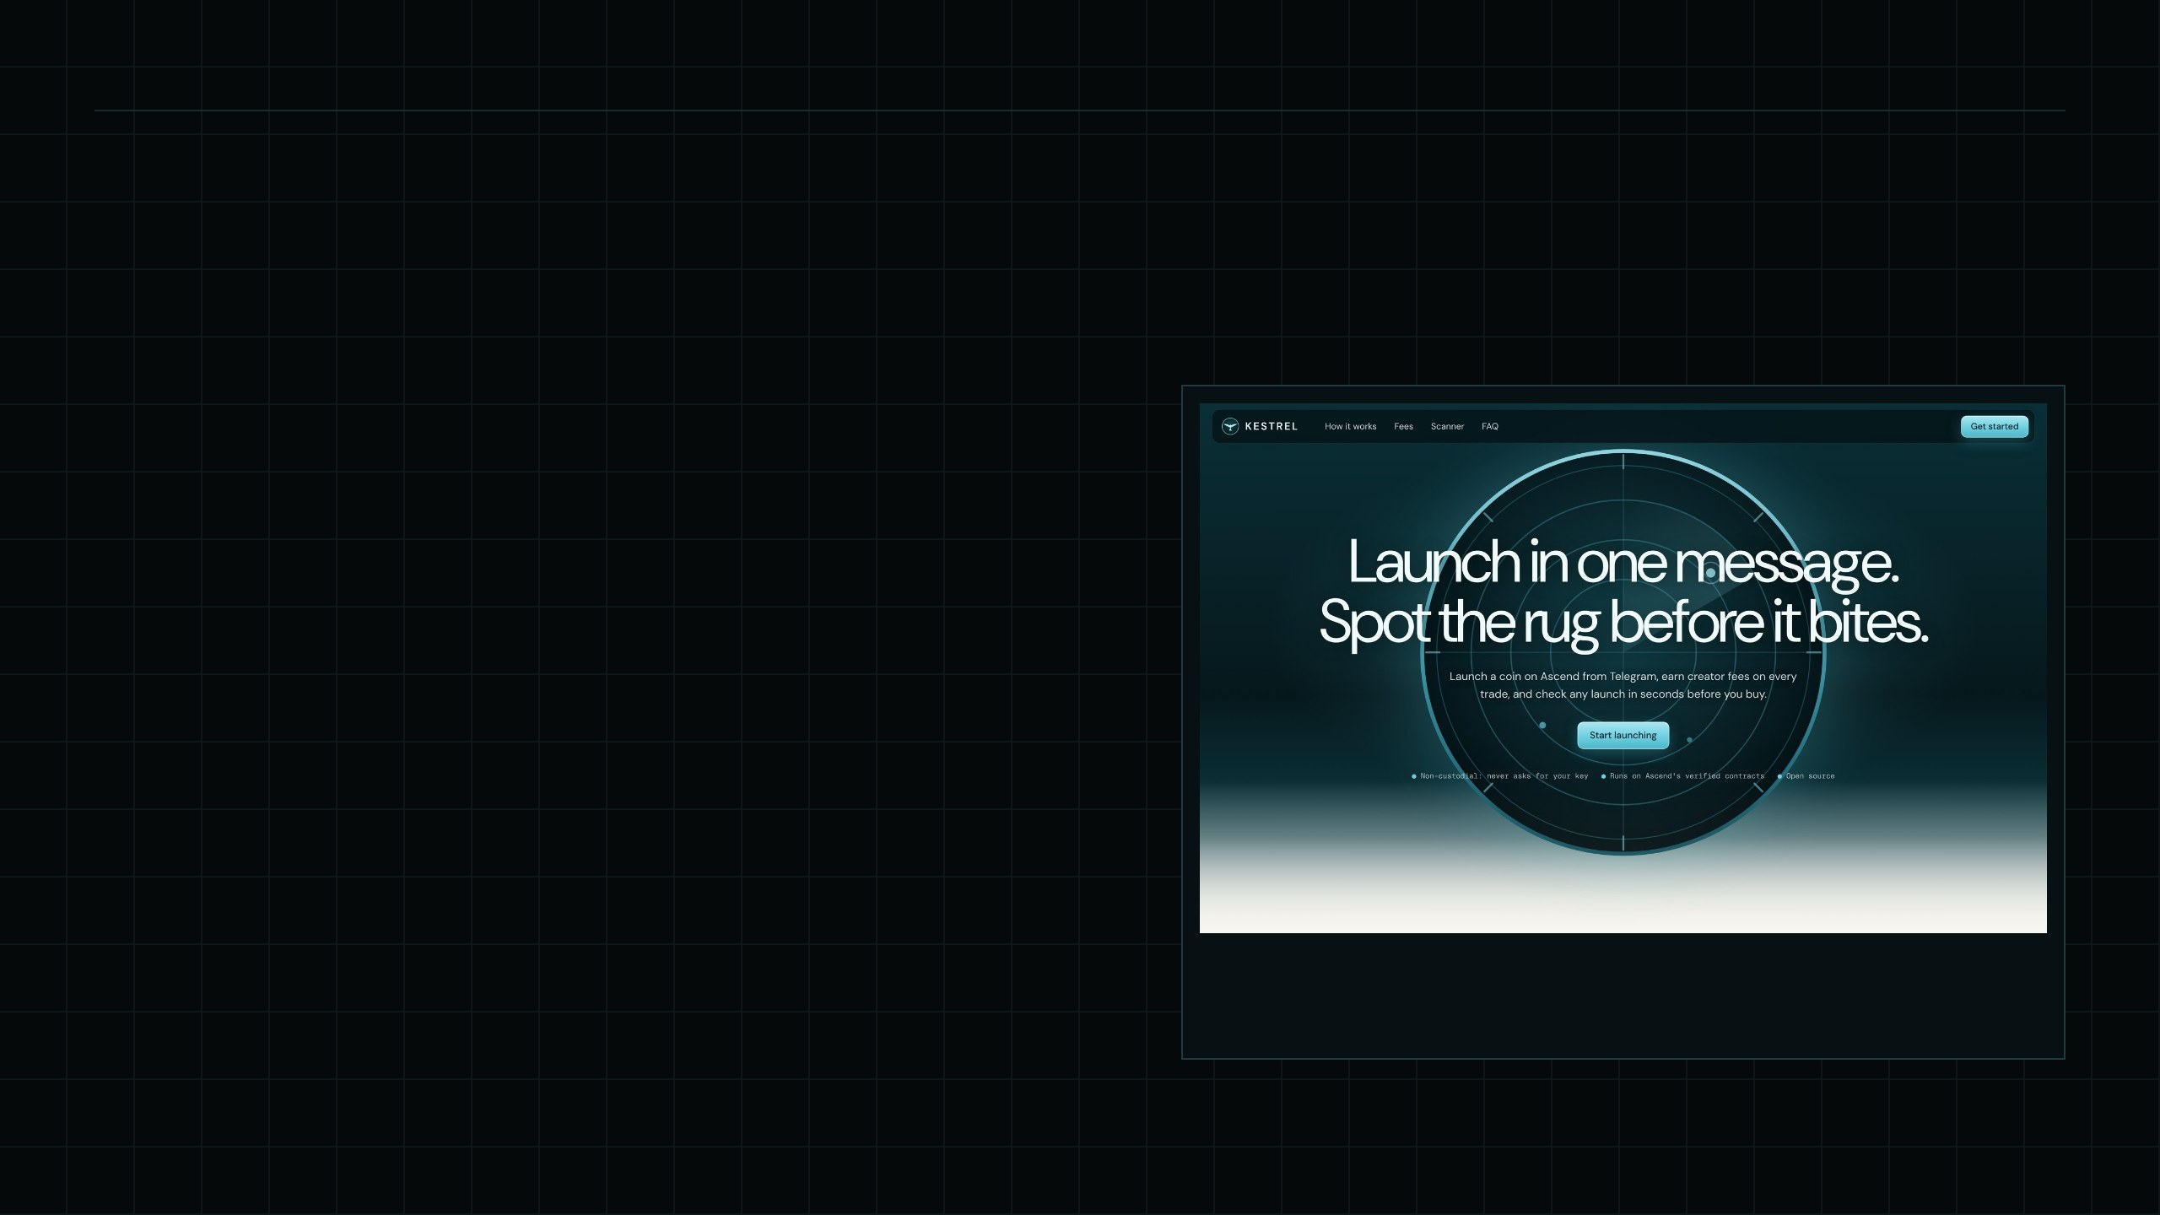
12 // where we are
no users yet · everything below is checkable
Built, and checked against mainnet.
✓
scanner
live on Elysium mainnet, public RPC
✓
launch flow
launchChecked simulated on Ascend's mainnet contracts, USDC and HYPE pairs
✓
addresses
simulated outputs match predict()
✓
telegram bot
/launch /scan /new, channel alerts, English and Bahasa Indonesia
✓
tests
15 / 15 passing: calldata, risk rules, rate limits, escaping
○
live launches
wait on builder approval and a funded gas wallet
hadijayyy.github.io/kestrel
live scanner on Elysium mainnet
Notes:
No users yet, and I say so. What exists is real: the scanner reads mainnet today, and the launch transaction was simulated against Ascend's live contracts with outputs matching predict. Live launches wait on builder approval and a funded gas wallet.

Slide 13
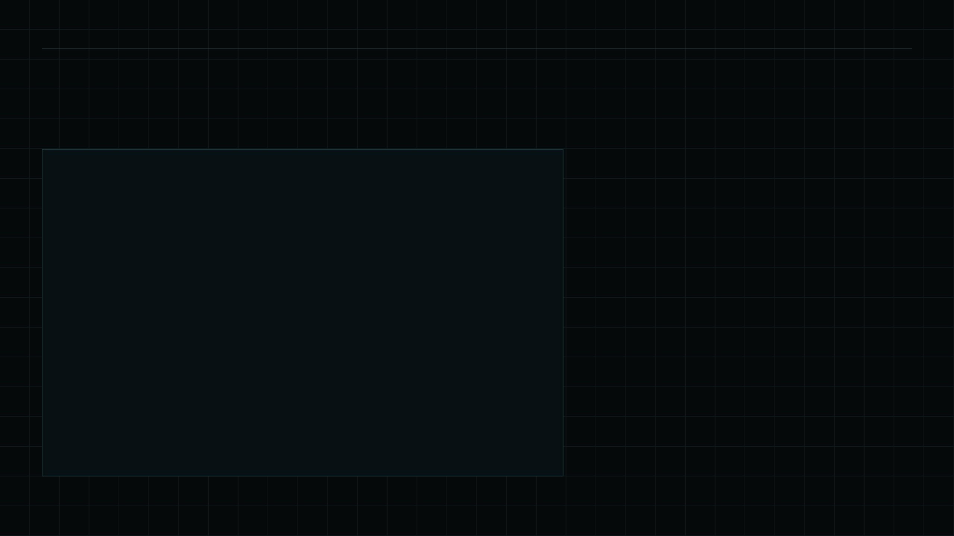
13 // risk controls
bot/config.js
Safe by default, in code.
KNOWN RISKS
KESTREL DEFAULTS
Spam launches
custody
none
# no keys asked
Rate limits and the copycat filter.
simulate
always
# before every send
Hot wallet
dry_run
on
# until switched off
It pays gas only and holds a minimal balance.
rate_limit
1/user/day
# + global hourly cap
No audit yet
copycats
blocked
# tickers, hidden chars
A launch-flow review is the first line of the budget.
builder_fee
≤ 1%
# clamped to Ascend's cap
scoring
rules
# each flag = on-chain field
Notes:
Safety is in the code, not in a promise. The main risks are spam launches hurting Ascend's reputation, a hot-wallet compromise, and dependence on one RPC. The controls on the left address them. There is no audit yet; a review of the launch flow is the first line in the budget.

Slide 14

FIRST 90 DAYS
14
Milestones you can check on-chain.
DAY
DAY
DAY
30
60
90
Live on mainnet
Builder fee on
More launch types
Bot live with /scan and alerts. First 25 coins launched through Kestrel.
Approved builder fee live. 150 launches. 1,000-member alert channel.
Holder Rewards and Buyback options. 500 launches. Public fee dashboard.
Measured by Kestrel's builder address on-chain · depends on builder approval and a reliable Elysium RPC
Notes:
Each milestone is verifiable on-chain through Kestrel's builder address, so Ascend can check progress without trusting my reporting. Everything after day 30 depends on builder approval.

Slide 15

TEAM
15
FOUNDER · INDONESIA (GMT+7)
Ryan Hadi
Shipped on launch day
Scanner, bot and site ran against Elysium mainnet on its first day.
Close to the users
AI automation specialist. I build data pipelines, LLM agents and bots for businesses. Kestrel applies the same skills to on-chain data: event ingestion, automated analysis and chat interfaces.
Native to the Indonesian and Southeast Asian Telegram communities Kestrel targets.
Open source
All code is public, so reviewers can check every claim.
hadijayyy.github.io
Notes:
Solo founder today. I build automation for businesses: data pipelines, LLM agents and chat bots. Kestrel applies the same skills to on-chain data. The incubator support goes to the two areas where a solo founder needs leverage most: security review and community growth.

Slide 16

THE ASK
16
$15k
PROPOSED USE OF $15,000
Security review of the launch flow
$4,000
SEA community growth
$4,000
+ builder approval
Runway, 3 months (partial)
$4,000
Builder approval
A builderFeeCap for Kestrel's address, so launches carry the builder fee.
Infrastructure, RPC and launch gas
$3,000
Indexer access
Partner access to Ascend's indexer for scanner and alert volume.
Distribution
A mention in Ascend's ecosystem pages and announcements.
Notes:
The money matters less than builder approval. Without a builder fee cap, Kestrel cannot earn, and every milestone after day 30 depends on it. The fifteen thousand dollars is a proposed split; I'm open to adjusting it with the Ascend team.

Slide 17

KESTREL
Launch in one message. Spot the rug before it bites.
site
hadijayyy.github.io/kestrel
code
github.com/hadijayyy/hadijayyy.github.io
founder
Ryan Hadi
Kestrel is an independent app built on Ascend's public contracts and is not affiliated with Ascend or Kinetiq. Data from Elysium mainnet, Nov 9, 2026. Per-$1M figures are illustrative.
Notes:
Thank you. The scanner is live on mainnet at the website, and all the code is public.

