Slide 1





Data Visualization
Hadi Kachmar
12 Jan 2021
data preprocessing
visualization

Slide 2


Project overview
This project will be based on the wasabi dataset.
There will be 2 types of visualization
Bubble map
Funnel chart
The Bubble Map Visualisation will show the distribution of artists according to their genre.
The funnel chart will show the number of artists belong to a specific genre in order for a chosen country
data preprocessing
visualization

Slide 3
Data pre processing
The first step was to choose the main dataset column that the work will be based on.
The columns are [genres, location.country, id_artist_deezer]
TASK 1
TASK 2
TASK 3
TASK 4
Data pre-processing
visualisation

Slide 4
Second step
The genres need some work, there is a lot of genres so we need to cluster it.
The best way to do that is to add a new column called sub_genres, to subclass the genres.
Note: For the missing value I fill it with string called missing values.
TASK 1
TASK 2
TASK 3
TASK 4
Data pre-processing
visualisation

Slide 5
Third step
The bubble map visualization will be based on the continents, not the countries.
So a column needs to be added for the continents depending on the location.country column.
Note: For the missing value I fill it with string called missing values.
TASK 1
TASK 2
TASK 3
TASK 4
Data pre-processing
visualisation

Slide 6
Final step
Once the continent column is added, the latitude and longitude need to be added for each continent map to identify each continent on the map.
Note: for the missing data value in the continent column I added lat and longitude of the Southern ocean to be shown there.
TASK 1
TASK 2
TASK 3
TASK 4
Data pre-processing
visualisation

Slide 7
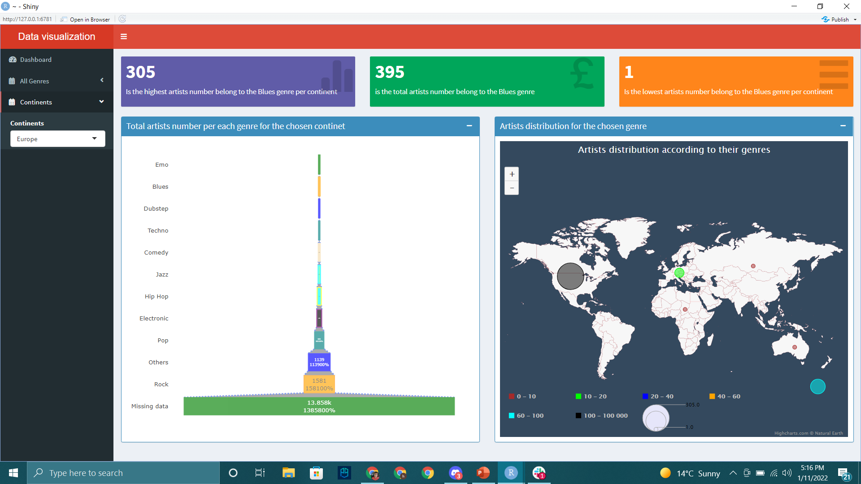
Full visualization
The visualization dashboard will look like that.
Dashboard
BubbleMap
Funnel chart
Tooltips
Data pre-processing
Visualization

Slide 8
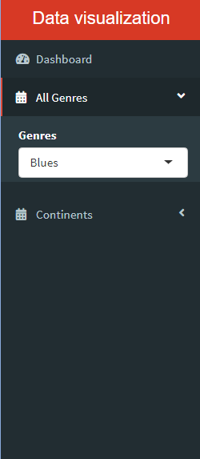
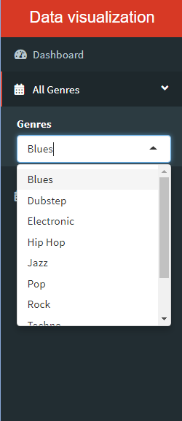
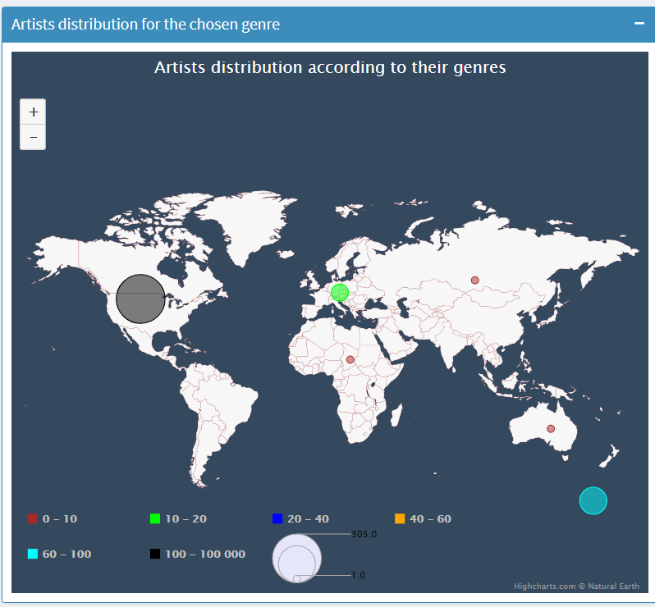
Bubble map visualization
The user will be able to choose any genre from the genres dropdownbutton, and the changes will appear on the map.
The color palettes are pressable, the user can toggle it and the changes will appear on the map.
Dashboard
BubbleMap
Funnel chart
Tooltips
Data pre-processing
Visualization

Slide 9

Funnel chart visualization
The user will be able to choose any continent from the continent dropdown button, and the changes will appear on the funnel chart.
Dashboard
BubbleMap
Funnel chart
Tooltips
Data pre-processing
Visualization

Slide 10
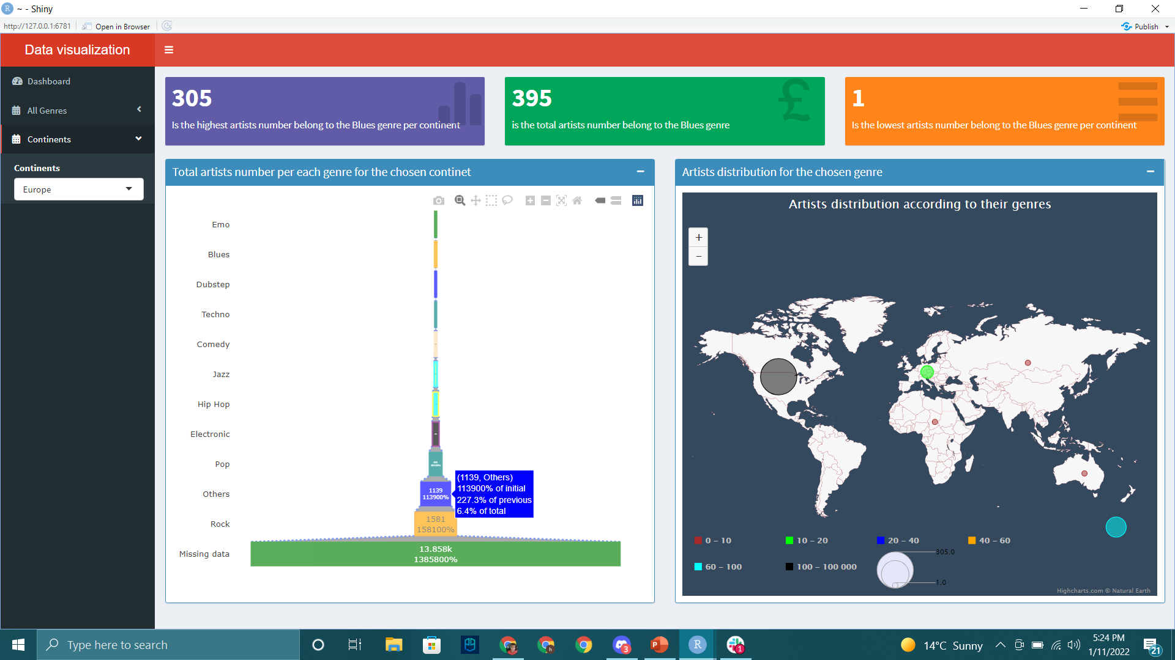

Tooltips
Once the user hover on the bubble map bubble, and on the funnel chart items, a tooltip will appear show extra information about the data as shown in the pictures
Dashboard
BubbleMap
Funnel chart
Tooltips
Data pre-processing
Visualization

Slide 11

THANKS!
Data pre-processing
visualisation

