Slide 1

COVID-19 Detector X
Using Image classification in machine learning
Supervisor : Dr. Mohamad Chaitou
Student: Hadi Jaber

Slide 2
OVERVIEW
Description
Goals
NVIDIA Jetson Nano Implementation
Main Page
One Image Test
Multi Images Test
Settings Tab
Pneumonia Images Test
Scanner and Future Updates
Conclusion

Slide 3
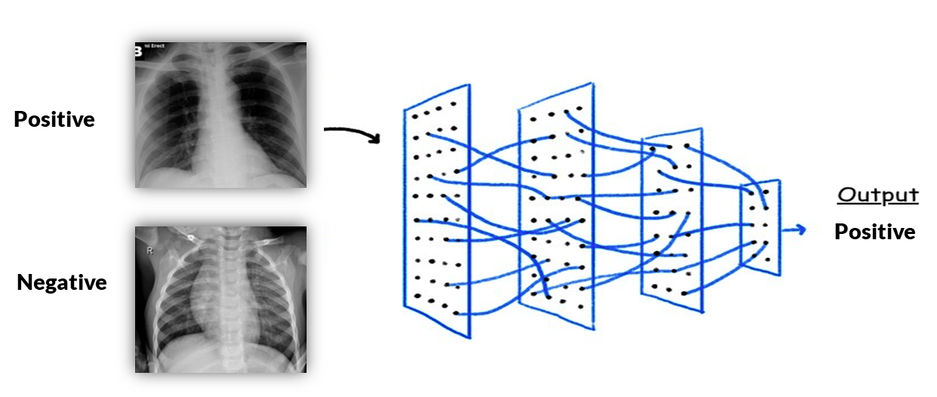
Description
The reverse transcription polymerase chain reaction (RT-PCR) test kits are in limited supply, there exists a need to explore alternative means of identifying and prioritizing suspected cases of COVID-19. The average time to get (RT-PCR) test result is about 2 days. Moreover, large scale implementation of the COVID-19 tests which are extremely expensive cannot be afforded by many of the developing & underdeveloped countries hence if we can have some parallel diagnosis/testing procedures using Artificial Intelligence & Machine Learning and leveraging the historical data, it will be extremely helpful. This can also help in the process to select the ones to be tested primarily.

Slide 4
Goals
Build a machine learning model that can detect COVID-19 from the XRAY images of chest.
Convert this model to TensorFlow lite to optimize the size and the speed of it.
Implement the final model in the NVIDIA Jetson Nano.
Build a GUI using Python Tkinter to easier the testing of images.
Do some tests on our program to make sure we have fast results with good accuracy.

Slide 5
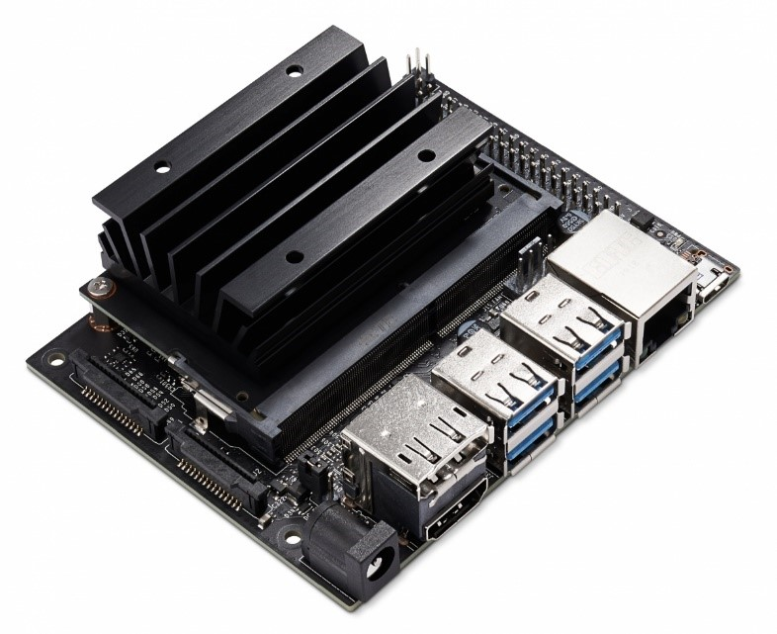
NVIDIA Jetson Nano Implementation
What is the NVIDIA Jetson Nano ?
NVIDIA® Jetson Nano™ Developer Kit is a small, powerful computer that lets you run multiple neural networks in parallel for applications like image classification, object detection, segmentation, and speech processing. All in an easy-to-use platform that runs in as little as 5 watts.

Slide 6
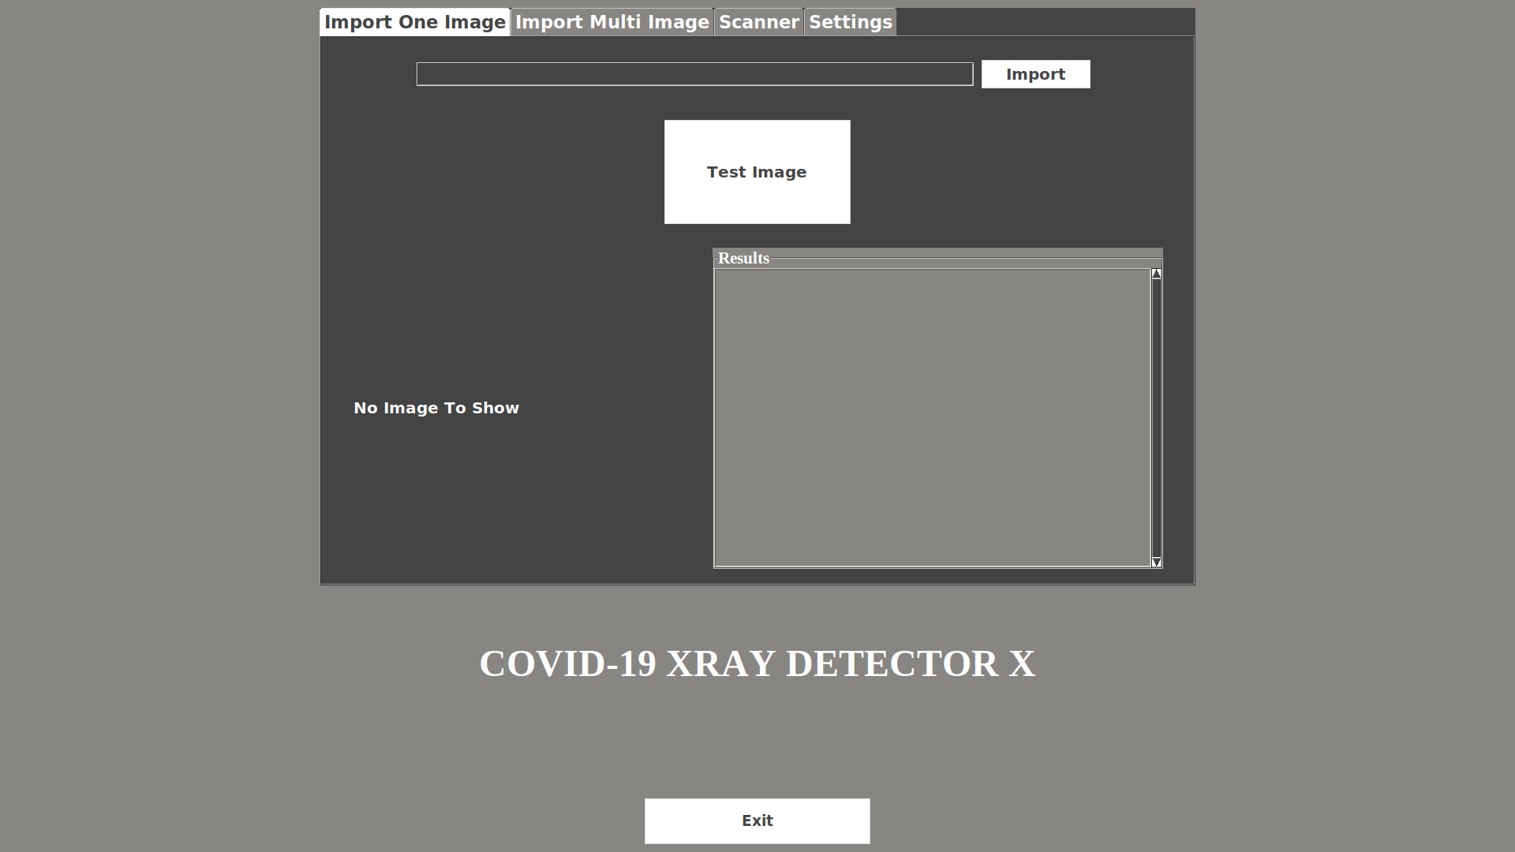
Main Page
On startup the program run automatically and the main page appear.
We used Tkinter to build the graphical user interface in python, it contain a menu with 3 tabs and exit button.

Slide 7
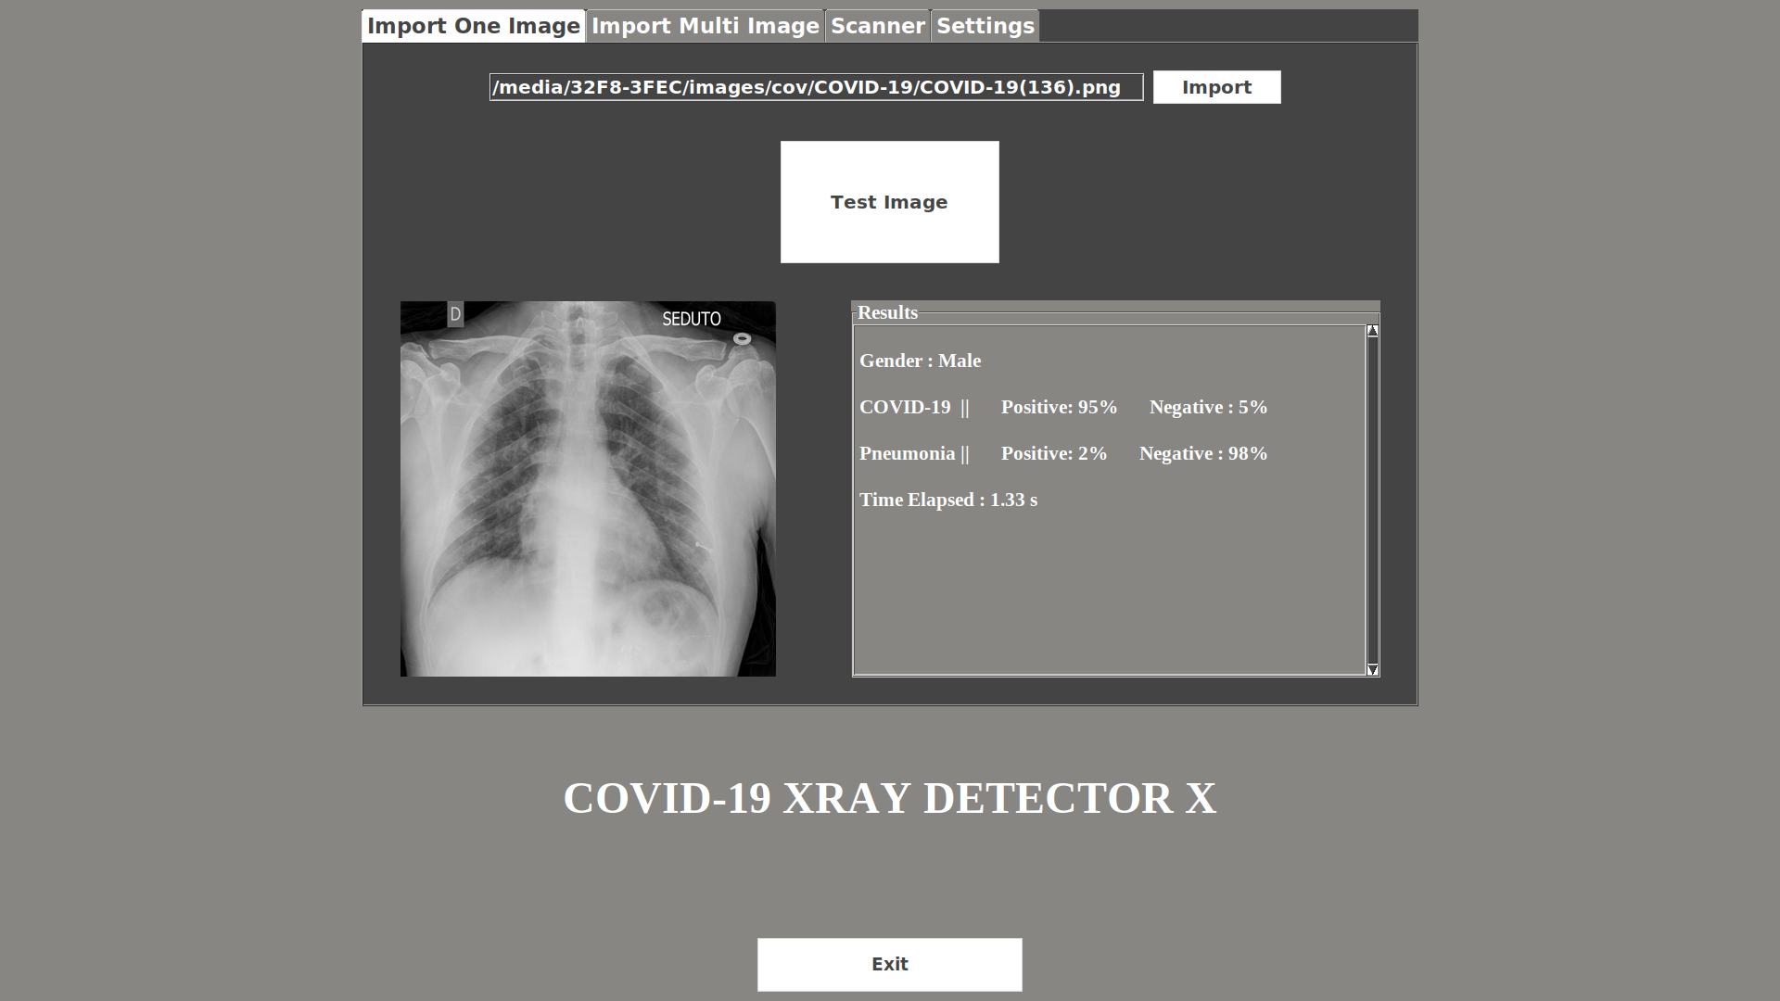
One Image Test
You can import just one image and press Test Image to show the result. The result that will be see is :
Gender of patient
Covid-19 test result ( Positive and Negative)
Pneumonia test result ( Positive and Negative)
Time elapsed of testing

Slide 8
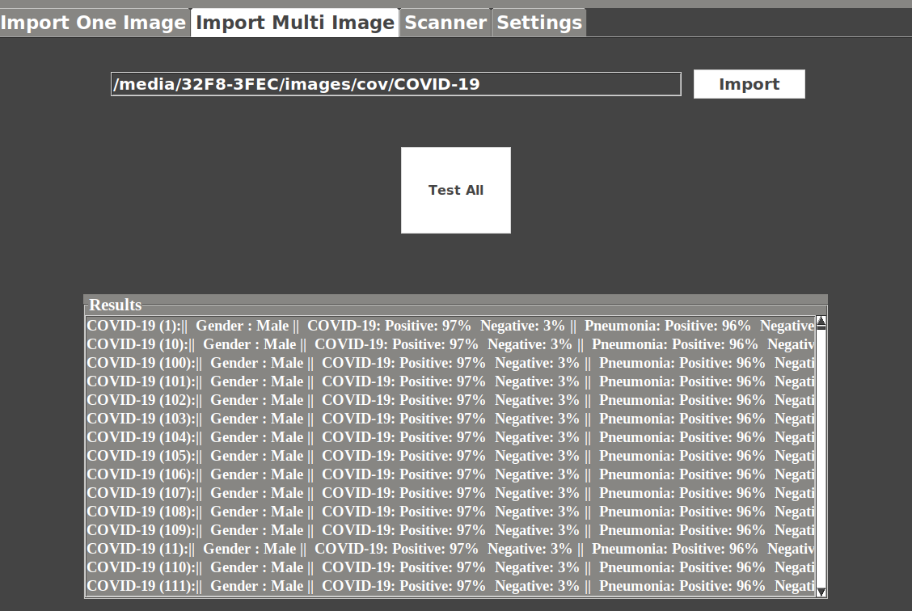
Multi Images Test
Choose the directory that contain many images and press Test All to show the results of all images in the choosed directory.
Test
Give the software 867 Positive images and 1311 Negative images. (Tested on COVID-19 model)
Accuracy : 99.5%
Detection Rate : 98.9%
Time : 16.61 minutes

Slide 9
Pneumonia Images Test
Give the software 2000 chest x-ray images of pneumonia. (Tested on Pneumonia model)
Accuracy : 98.4%
Detection Rate : 99.1%
Time : 7.6 minutes

Slide 10
Scanner and Future Updates
In the future we will try to connect our software in NVIDIA Jetson Nano with scanner for x-ray, this can help us to get the results faster, the scanner can send the data of the x-ray image directly to NVIDIA Jetson Nano then get the results in less than one second. Moreover, we can connect this device to the scanner in airports not just in hospital, we know that in airports, each traveler when he pass from the scanner can knowing his result.

Slide 11
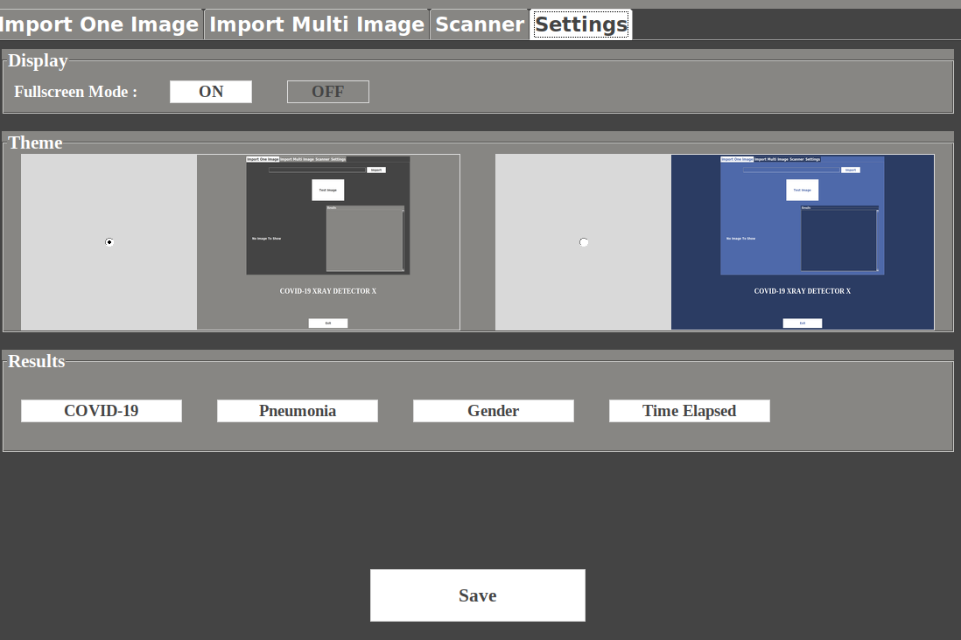
Settings Tab

Slide 12
Conclusion
After finishing this project, we got accurate and impressive results. Of course we can not give up PCR testing completely and adopt this device as an alternative, but these results will enable us to reduce the number of these tests significantly, so that many countries adopt PCR tests for all people in cities, villages, hospitals and especially airports, and as we know that this examination is expensive and requires quarantine for about 72 hours and then this test must be re-examined again to confirm the result once and for all. But using this device we will be able to know the negative results more accurately through the x-ray image of the chest which can be obtained in only 10 minutes without any costs.

