Slide 1
A DATA ANALYTICS PROJECT
Budget vs Success
Does spending more on a movie actually buy a better one?
Abdulhadi Kirkici
Fatih Ridvan Kizik
Numrah Khan
Yash Tiwari
DATA AVENGERS

Slide 2
ORIGIN
Why we picked this topic
We looked at a few ideas first: global job market trends, a comparison of LLM tools. Budget vs success kept winning the argument, because it's one of the few questions where everyone already has a take, but almost nobody has checked it against real numbers.
The assumption everyone makes: spend more on cast, effects, and marketing, and you get a bigger hit and a better movie. We wanted to find out whether that's actually true, or just something the industry tells itself.
WHY IT FITS THIS COURSE
—
Four real public datasets, a genuine ingestion and merge problem
—
Numeric and categorical fields together, so correlation, EDA, and feature engineering all apply
—
A clean regression target (revenue) and a clean classification target (hit or flop)
02

Slide 3
THE QUESTION
Problem statement
Every year, studios put heavy money into productions, betting that a bigger budget means a bigger audience and better reviews. That's not always what happens. Some of the most expensive films ever made have flopped, and some films made on a shoestring budget have gone on to become genuine cultural moments.
So the question is straightforward. Does spending more actually lead to better outcomes? We looked at this through real data: how production budgets relate to box office earnings, audience ratings, and critic scores across thousands of films, and whether the answer changes by genre or by era.
Four datasets, one merge. We pulled The Movies Dataset, TMDB 5000, Rotten Tomatoes, and IMDb from Kaggle and merged them into one working file. Beyond correlation, we trained regression and classification models to see whether revenue or a hit/flop outcome can be predicted before a film is even released.
03

Slide 4
WHO DID WHAT
The team
01
02
03
04
Abdulhadi Kirkici
Fatih Ridvan Kizik
Numrah Khan
Yash Tiwari
DATA ENGINEERING
ANALYSIS & MODELING
PLANNING & SCRUM
DATA SOURCING & DOCUMENTATION
Set up the repository, pulled and merged the datasets, built the cleaning pipeline.
Ran the exploratory analysis, trained the regression and classification models.
Managed the timeline, wrote the problem analysis and system design.
Sourced and checked the data, wrote the final report, built this deck.
04

Slide 5
METHOD
How we built it
1
2
3
4
5
6
Collect
Clean & merge
Explore
Engineer
Model
Report
4 Kaggle datasets
Joined on IMDb ID
Correlations, ROI, trends
Genre, tier, decade
Regression + classification
Dashboard + write-up
Built with Python, scikit-learn, Streamlit, and tracked end to end on GitHub.
05

Slide 6
METHOD, IN FULL
System workflow
1
2
3
4
5
Data collection
→
Raw storage
→
Cleaning & merging
→
Processed dataset
→
Exploratory analysis
Kaggle CSV / TSV downloads
Kept in Data/raw
Handle missing values, merge on IMDb ID
5,381 films, ready for analysis
Budget, revenue, ratings, ROI, trends
6
7
8
9
10
Feature engineering
→
ML modeling
→
Model evaluation
→
Dashboard & visualization
→
Reporting & maintenance
Genre, budget tier, decade, encodings
Regression and classification
R-squared, MAE, accuracy, AUC-ROC
Streamlit app and exported charts
Final report, GitHub commits
Ten stages, raw downloads to a maintained GitHub repository. Notebooks 01 through 08 correspond to steps 3 through 10.
06

Slide 7
RAW MATERIAL
The data we used
The Movies Dataset
TMDB 5000
Rotten Tomatoes
IMDb Dataset
Budget, revenue, genre
Cast, crew, popularity
Tomatometer, audience score
Rating, vote count, runtime
45,466 → 5,381 usable
4,803 rows
81.3% coverage
99.96% coverage
5,381
$17M
$30M
4,294 / 1,074
films after merge, 20 columns
median budget ($1 to $380M)
median revenue ($1 to $2.79B)
train / test split
07

Slide 8
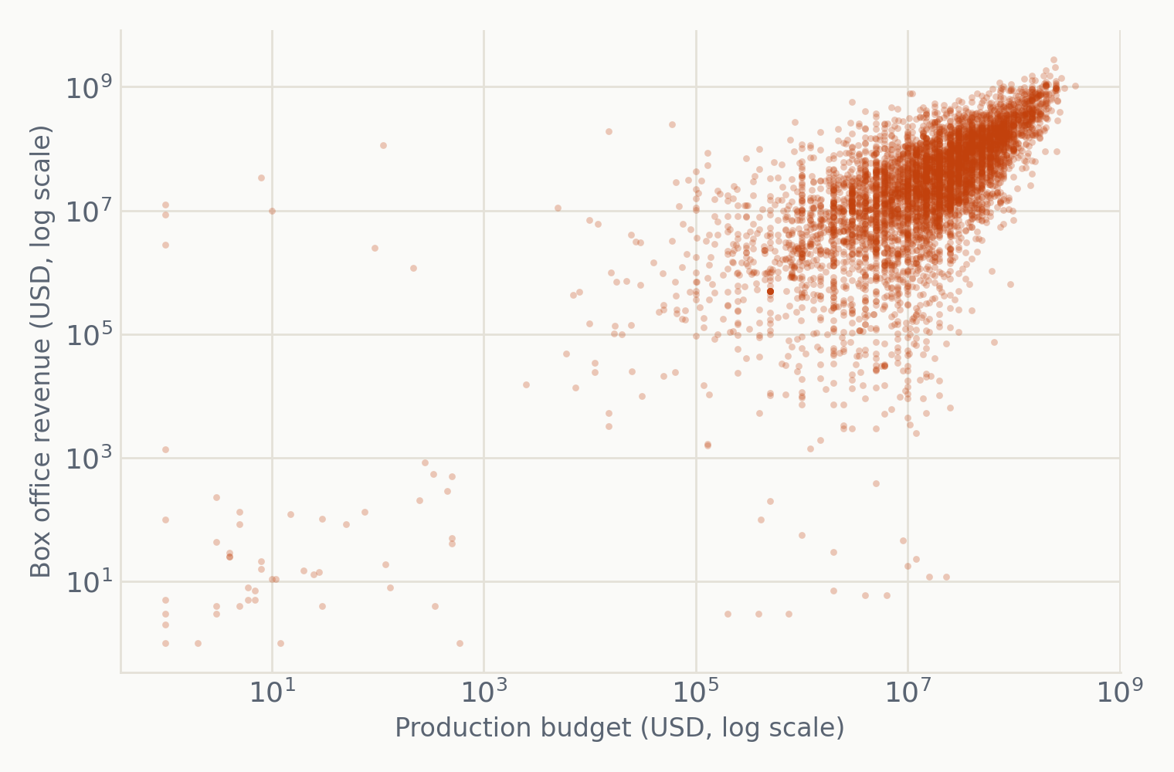
FINDING ONE
Budget predicts reach, not quality
r = 0.70
Budget vs box office revenue
A strong link. Budget alone explains around half of the spread in revenue.
r = -0.06
Budget vs IMDb rating
Practically nothing. Spending more does not make audiences rate it higher.
r = -0.18
Budget vs Tomatometer
A weak negative tilt, bigger films skew slightly lower with critics.
Each point is one film, plotted on a log scale since budgets and revenues span orders of magnitude.
08

Slide 9
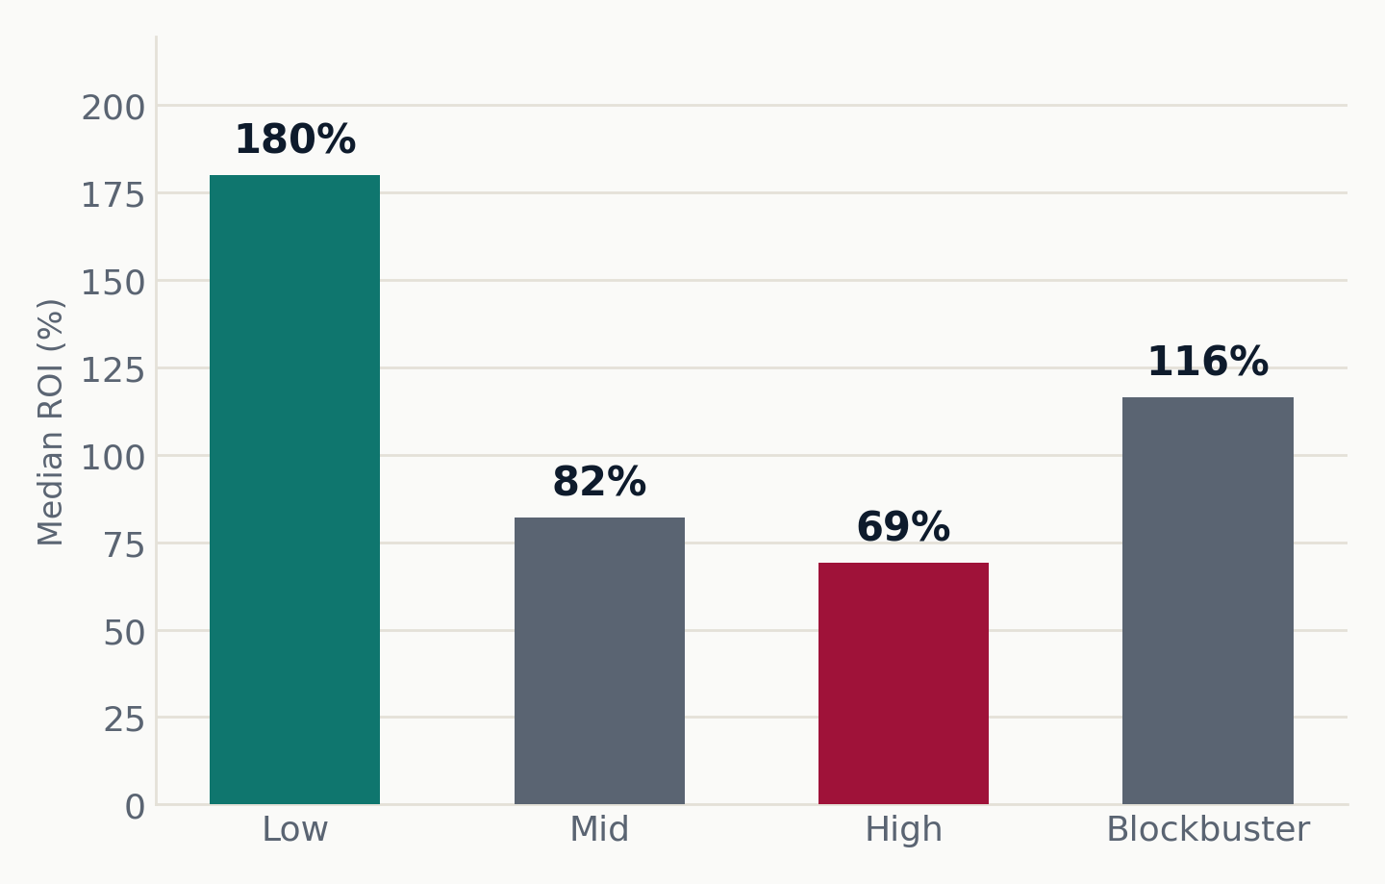
FINDING TWO
Smaller budgets often pay off better
Low-budget films return 180% on the median dollar. High-budget films return 69%. Blockbusters claw some of it back at 116%, but the clear winner on return is the smallest tier, not the biggest.
09

Slide 10
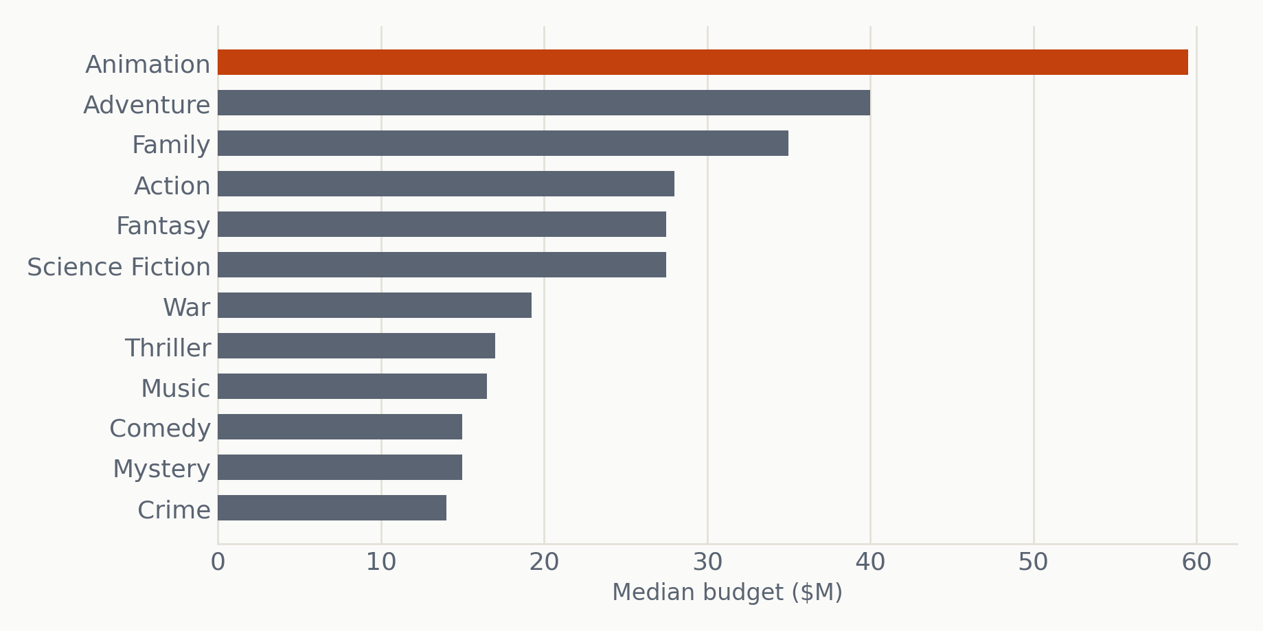
CONTEXT
Where the money goes, by genre
Animation and Adventure carry the highest median budgets, mostly visual-effects cost. Genres absent from this list, like horror, tend to sit in the low-budget tier, and post the strongest returns on the previous slide.
10

Slide 11
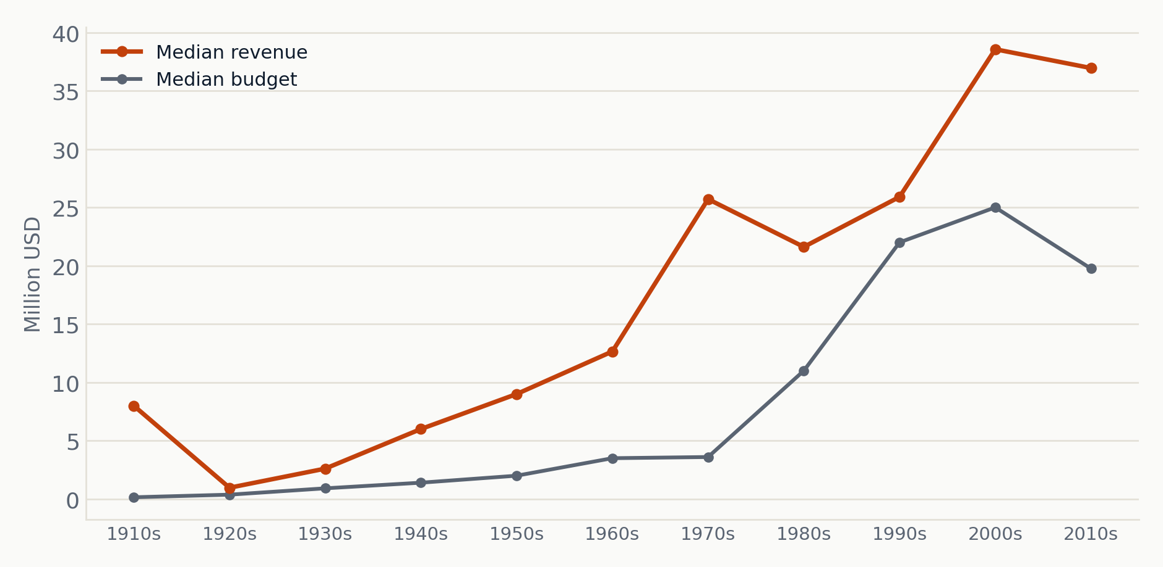
CONTEXT
A century of rising budgets and revenue
Revenue has stayed above budget in every decade since the 1910s, so the industry has been profitable on a median basis throughout. The gap narrows slightly in the 2010s as streaming starts to cut into theatrical revenue.
11

Slide 12
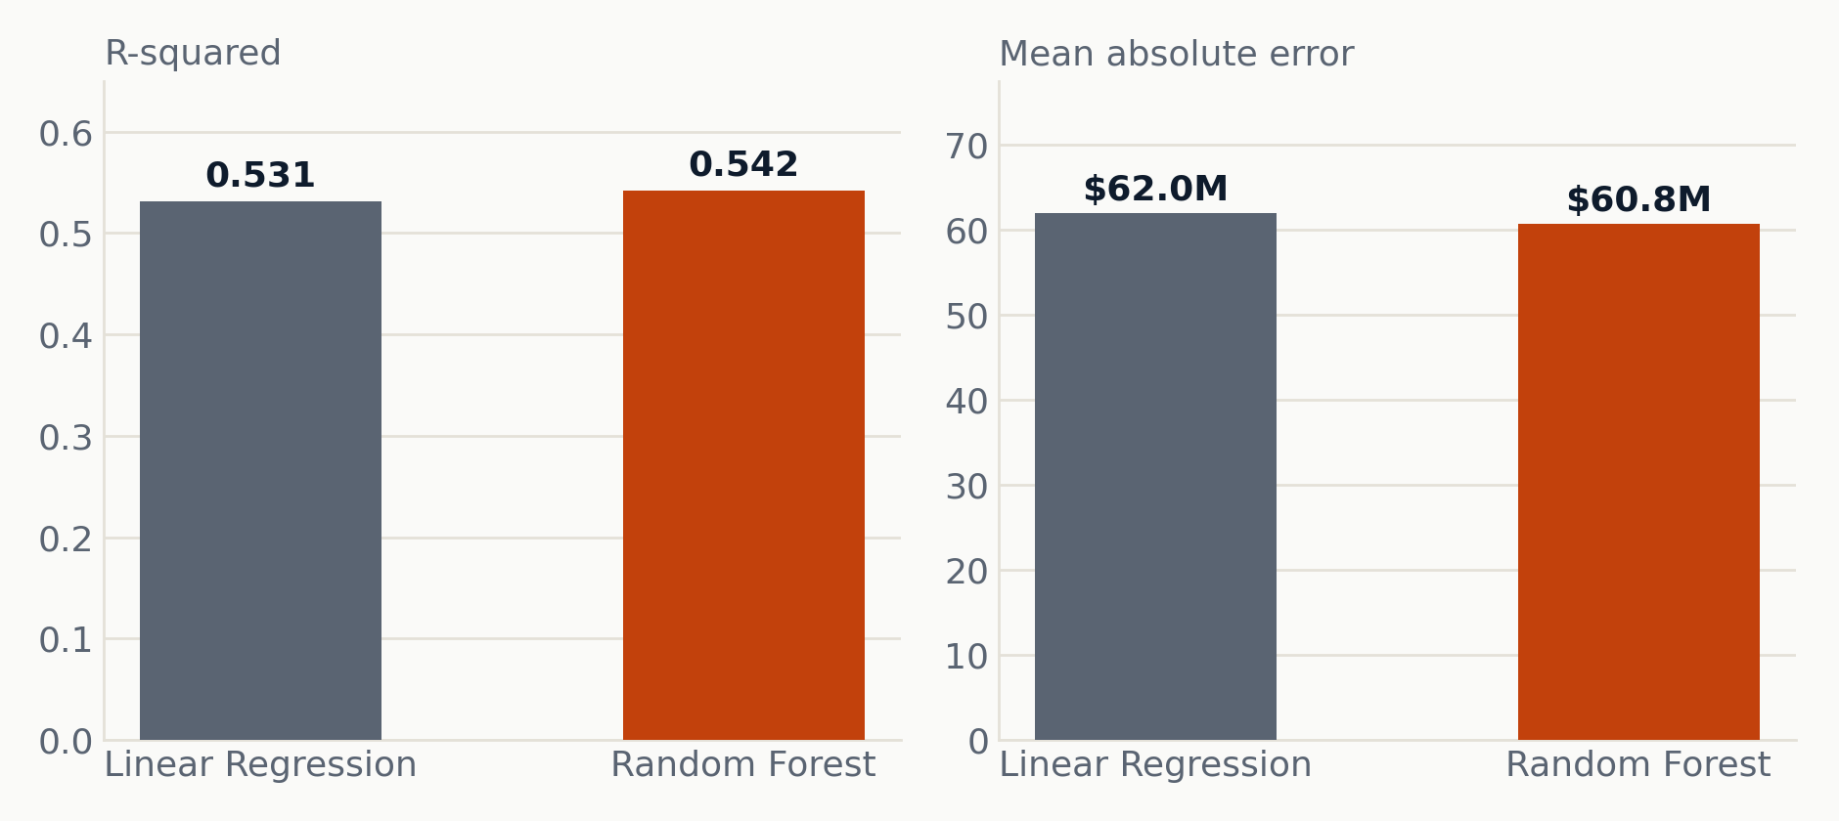
PREDICTION, PART ONE
Can revenue be predicted before release?
Model
MAE
RMSE
R² (test)
CV R²
Linear Regression
$62.0M
$123.5M
0.531
0.536 ± 0.047
Random Forest
$60.8M
$122.1M
0.542
0.498 ± 0.078
Inputs: budget, runtime, release year, genre, and decade: five features, all known before a film comes out.
Reading the result: Random Forest edges ahead on this one test split, but Linear Regression wins on five-fold cross-validation with lower variance, so the simpler model actually generalizes better. Either way, an R-squared near 0.54 leaves the rest to marketing, cast, timing, and word of mouth.
12

Slide 13
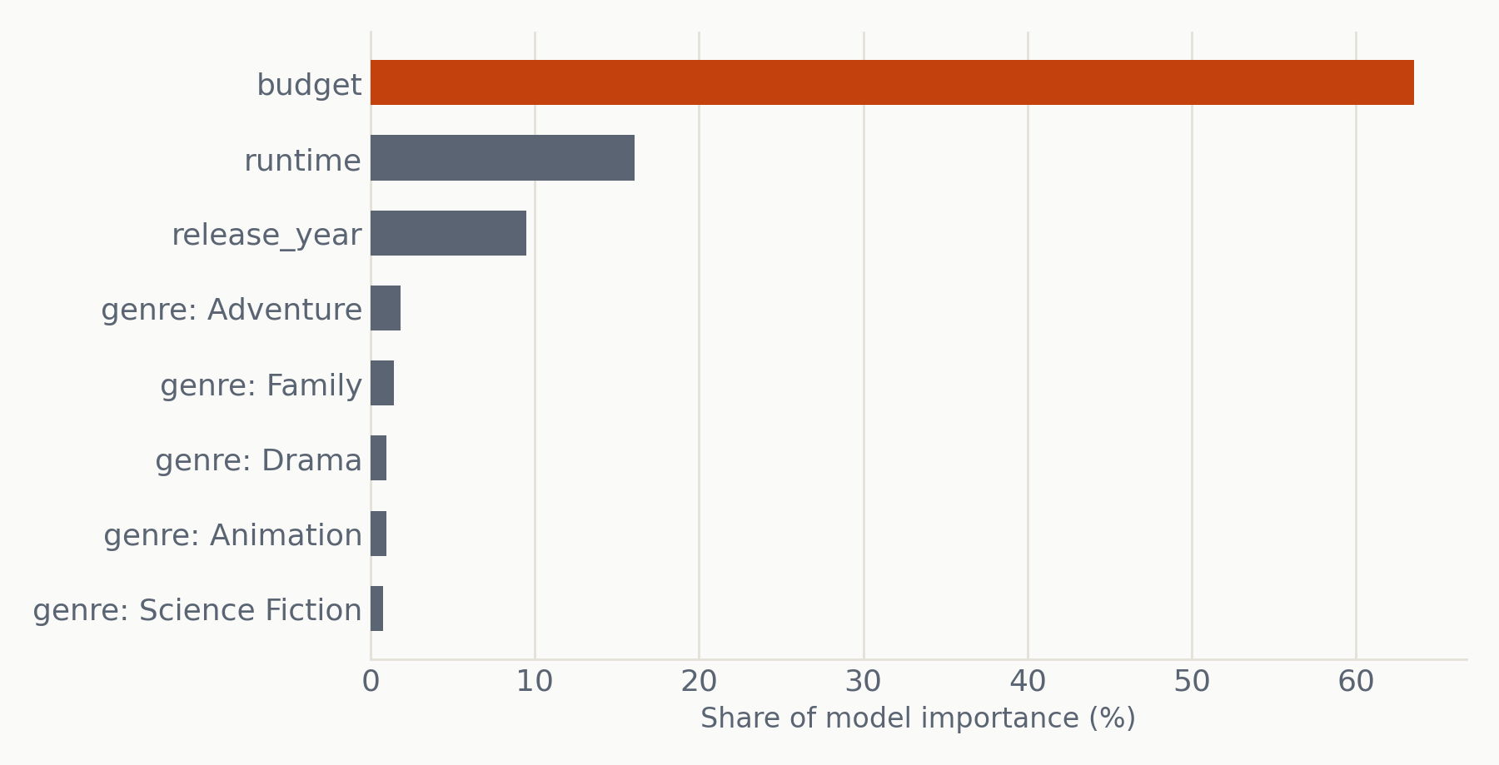
PREDICTION, PART ONE
What the model actually leans on
Budget alone carries 63.6% of the predictive weight. Runtime adds 16.1% and release year 9.5%. All genres and decades combined add roughly 10.8%. The story is almost entirely about how much money went in.
13

Slide 14
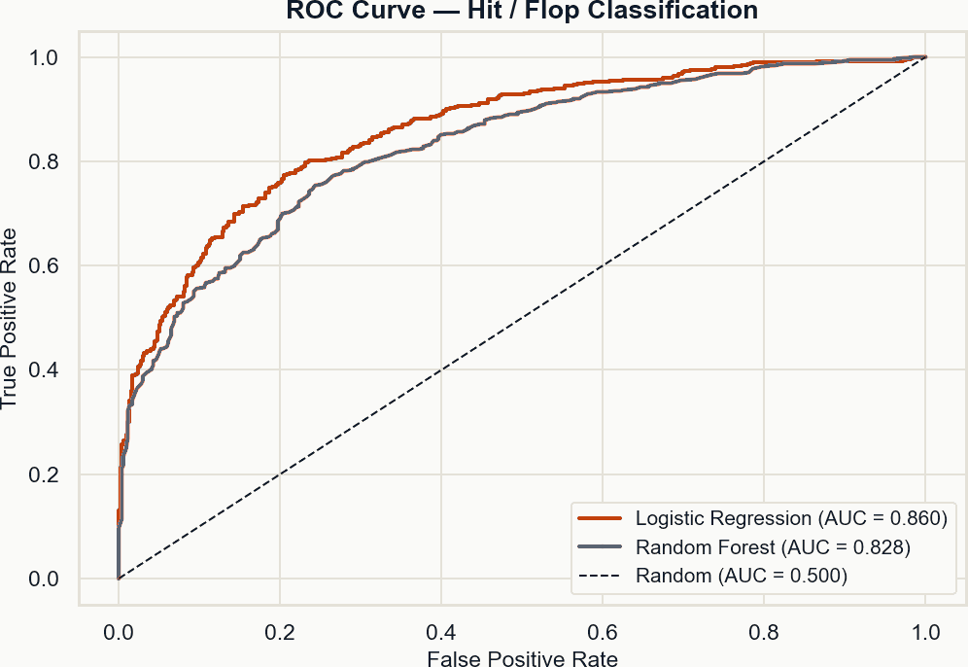
PREDICTION, PART TWO
A simpler question: hit, or flop?
AUC 0.860
Logistic Regression, on a held-out test set
77.3%
accuracy, Logistic Regression
0.750
F1 score
47.2%
share of Random Forest's decision that comes from budget alone
The $30M median revenue is the hit/flop line. Applying that same threshold to the regression model's own predictions gives comparable accuracy, so one regression model can do both jobs.
14

Slide 15
PROCESS
How we got here
Tracked on JIRA, May 3 to June 28
DA-12
Finalize project direction
Numrah
DA-13
Identify and download datasets
Hadi
DA-14
Clean, standardize, and merge data
Hadi
DA-15
Analyze budget vs revenue and ratings
Fatih, Yash
DA-16
Feature engineering and modeling
Fatih, Hadi
DA-17
Evaluate model performance
Hadi, Fatih
DA-18
Build charts, exports, dashboard
Yash
DA-19
Write the system design document
Numrah
DA-20
Final report and presentation
Yash
DA-21
Track project work, team updates
Numrah
15
All 10 epics and 50+ subtasks were closed out before this presentation.

Slide 16
PROCESS, IN FULL
Project Gantt chart
W1
W2
W3
W4
W5
W6
W7
W8
W9
DA-12
Finalize project direction
DA-13
Identify & download datasets
DA-14
Clean, standardize, merge data
DA-15
Analyze budget vs revenue/ratings
DA-16
Feature engineering & modeling
DA-17
Evaluate model performance
DA-18
Build charts, exports, dashboard
DA-19
System design document
DA-20
Final report & presentation
DA-21
Track project work, team updates
Bars group into three phases: setup/sourcing (amber), analysis/modeling (teal), reporting (wine). Tracking ran all nine weeks.
16

Slide 17
HONESTY CHECK
Where the model falls short
LIMITATIONS
ITERATIONS WE MADE
—
Only films with reported budget and revenue are included, a bias toward mainstream productions
—
Compared Linear Regression against Random Forest on a single split and on five-fold cross-validation
—
Marketing spend, cast, director track record, and release timing are missing, part of the 46% unexplained variance
—
Added a full classification variant, hit or flop, using the same five pre-release features
—
Rotten Tomatoes coverage is 81.3%, so about one in five films has no critic score
—
Used log-log scaling on every budget and revenue chart, since raw values span $1 to $2.79 billion
—
The model underpredicts extreme blockbusters; a log-transformed target would help
—
Built budget tiers from quartile cuts to compare groups beyond a single correlation number
Budget explains the part of revenue we can measure. What's left, marketing spend, cast, timing, and word of mouth, is real, but it needs richer data than what we had.
17

Slide 18
BACK TO THE QUESTION
So, does budget drive success?
Does budget predict revenue?
Does budget predict ratings?
Yes
No
r = 0.70, the strongest single signal we found
r = -0.06, essentially no relationship
Does a bigger budget mean better ROI?
Can revenue be predicted pre-release?
No
Partly
Low tier returns 180%, high tier returns 69%
R-squared of 0.54, about half explained
Budget buys reach, not quality. It is the strongest single signal for how big an audience a film will pull in, but it tells us almost nothing about whether people will actually like what they see.
18

Slide 19
Thank you
Data Avengers, Data Analytics
github.com/hadikrkc/Data-Avengers-DA-60
Full code, notebooks, reports, and the live dashboard

