Slide 1



Chatbot basé sur la reconnaissance visuelle
Elaboré par :
Hadil AFFES
Encadrant professionnel: Mr. Hedi MANAI
Encadrante académique: Mme. Zouhour BEN AZOUZ
Année universitaire: 2021 - 2022
Mesdames et monsieurs les membres du jury.
Je tiens tout d’abord a vous remercier pour l’interet que vous avez voulu porter à mon travail en acceptant de faire partie du jury.
Je remercie tout particulierement Mme Zouhour et Mr Hedi pour leurs confiances et leurs conseils sans lesquelles ce projet n’aurait pas pu s’aboutir.
C’est un honneur pour moi d’avoir discuter et presenter mon projet l’intitulé….. avec vous
Notes:
Mesdames et monsieurs les membres du jury.
Je tiens tout d’abord a vous remercier pour l’interet que vous avez voulu porter à mon travail en acceptant de faire partie du jury.
Je remercie tout particulierement Mme Zouhour et Mr Hedi pour leurs confiances et leurs conseils sans lesquelles ce projet n’aurait pas pu s’aboutir.
C’est un honneur

Slide 2
Plan
Etude préalable
01
Solution proposée
02
Conception
03
Etude théorique
04
Réalisation
05
Conclusion &
perspectives
06
Pour ce faire nous avons choisi le chemin suivant:
Nous allons commencer par une Etude préalable qui sera suivi par la solution proposée puis la conception et l’architecture du projet
Ensuite l’etude theorique 5ement la realisation et les resultats obtenus. Cette presentation sera cloturer par une conclusion et perspectives
Notes:
The plan of our presentation is as follows :
First an intro to the project context followed by Camera Pose Estimation: State of the Art
Third we present the proposed solution . Then we have the training set generation
Fifth the implementation and we finish by the conclusion and perspectives

Slide 3






Solution proposée
conception
Etude théorique
Etude
préalable
Réalisation
Conclusion & perspectives
Réponse automatique
Introduction
Conception
Réseaux Sociaux
Chatbot visuel
Reconnaissance d’images
Notes:
Fraud costs the car insurance industry a lot of money. . It can take on many forms.
According to a study in 2015 the loss can reach 150 Millions per year.
Customers can collude with mechanic to rise components prices and take a portion in return. Furthermore the expert may be involved in the scam. As he provides a final report containing the details of the damaged parts with their prices and the total repair amount, he can collude with the customer to make the price higher. In return he can receive a portion of the final refund.
Hence the need of a system that detects fraud.
Deep learning, a revolutionary technique of artificial intelligence is reshaping several fields. For instance, the insurance sector is one of them.
To further improve the localization of damaged parts, we can estimate the camera pose of the captured car accident photos and use deep learning techniques for this purpose.
// detection of fraud in insurance sector hence the purpose of unfrauded : explanation of unfrauded
No info explicite de la position 3d
Sujet a la pointe de la rech hence we reviewed the state of art techniques

Slide 4

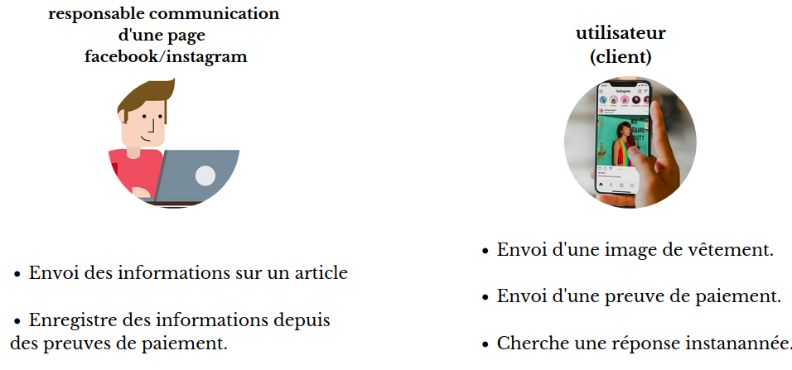

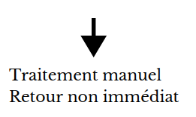
Solution proposée
conception
conception
Etude théorique
Etude
préalable
Camera Pose Estimation
State of the Art
Proposed Solution
Réalisation
Conclusion/
perspectives
Conclusion & perspectives
Problématique
24h 24
7J 7
Notes:
Unfrauded the solution made by NGS uses deep learning techniques to estimate the repair cost of damaged cars. A key module to this application is the automatic identification of damaged parts from car accident photos.
Damage position estimation of the existence solution does not have explicit information on the 3D position of the part whereas the cost estimation depends on the damage identification with respect to a coordinate system linked to the car hence the importance of the integration of an explicit 3D information. In fact, the actual system can not detect parts when given a picture taken from an angle where we cannot see all the parts. Given the angle of the camera can help identify that this picture lacks some parts.
In addition, to save a precise history of the damage location, the 3D model localization is the best choice . And the 3D information we need is the camera pose from a single image. Camera pose estimation is a topic at the cutting edge of study. Popular research are targeting this problematic that’s why we have made a state-of-the-art study of deep learning camera pose estimation techniques.
Recovering the camera-to-world translation and orientation from an image is one of the fundamental problems in computer vision.

Slide 5
Solution proposée
conception
Etude théorique
Etude
préalable
Réalisation
Conclusion & perspectives
Organisme d’acceuil
• Tunisian Cloud est une entreprise tunisienne fondée en 2014.
• Spécialiée dans le cloud computing, la sécurité informatique et l’intégration.
• Fournit une variété de solutions logicielles.
Insurance
Notes:
In this context, the startup NGS (Next generation Solution), our host organization, offers software solutions for the automatic detection of fraud. It is a Tunisian startup founded in June and provides a variety of software solutions. Specifically for insurance sector.

Slide 6

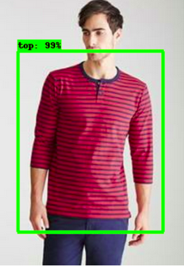


Etude préalable
conception
conception
Etude théorique
Solution
proposée
Réalisation
Conclusion & perspectives
Solution proposée
Chatbot visuel
Disponibilité 24h/24
Recherche des articles similaires
Basé 100%
sur les images
Reconnaissance automatique
de texte
Plateforme CBOT

Slide 7
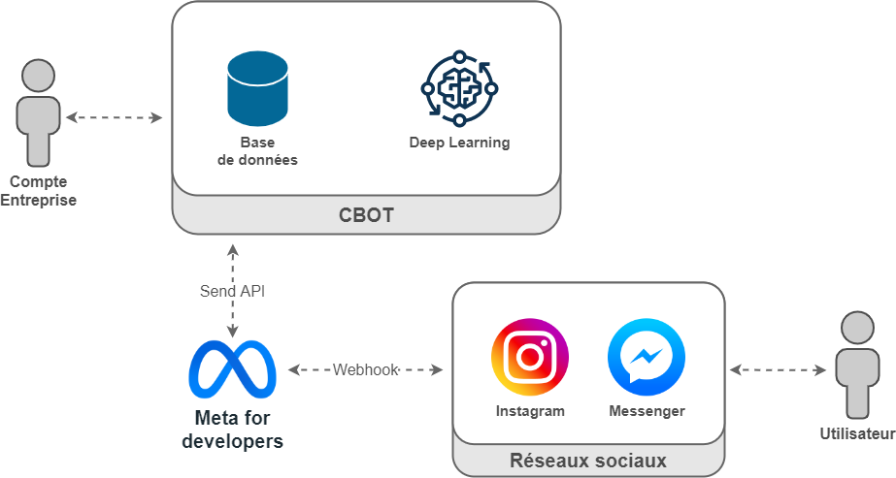
Etude préalable
Solution proposée
Etude théorique
Conception
Réalisation
Conclusion & perspectives
Architecture globale du système
Entreprise
Notes:
Since we have made a study of the existent deep learning techniques, first we need to define what is an absolute camera pose:
Given an image Ic, captured by a camera C, an absolute pose estimator E aims to predict the 3D pose orientation and location of C with respect to a reference 3D coordinate frame.
The translation(location) of C with respect to the origin is specified by a vector x ∈ R 3 . The orientation of C can be represented using a rotation matrix (M), a quaternion (q) or Euler angles (A)

Slide 8
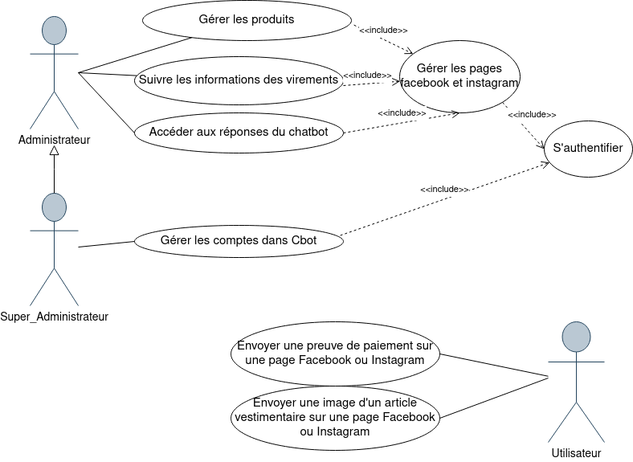
Etude préalable
Solution proposée
Etude théorique
Conception
Réalisation
Conclusion & perspectives
Diagramme de cas d’utilisation général
Notes:
Since we have made a study of the existent deep learning techniques, first we need to define what is an absolute camera pose:
Given an image Ic, captured by a camera C, an absolute pose estimator E aims to predict the 3D pose orientation and location of C with respect to a reference 3D coordinate frame.
The translation(location) of C with respect to the origin is specified by a vector x ∈ R 3 . The orientation of C can be represented using a rotation matrix (M), a quaternion (q) or Euler angles (A)

Slide 9
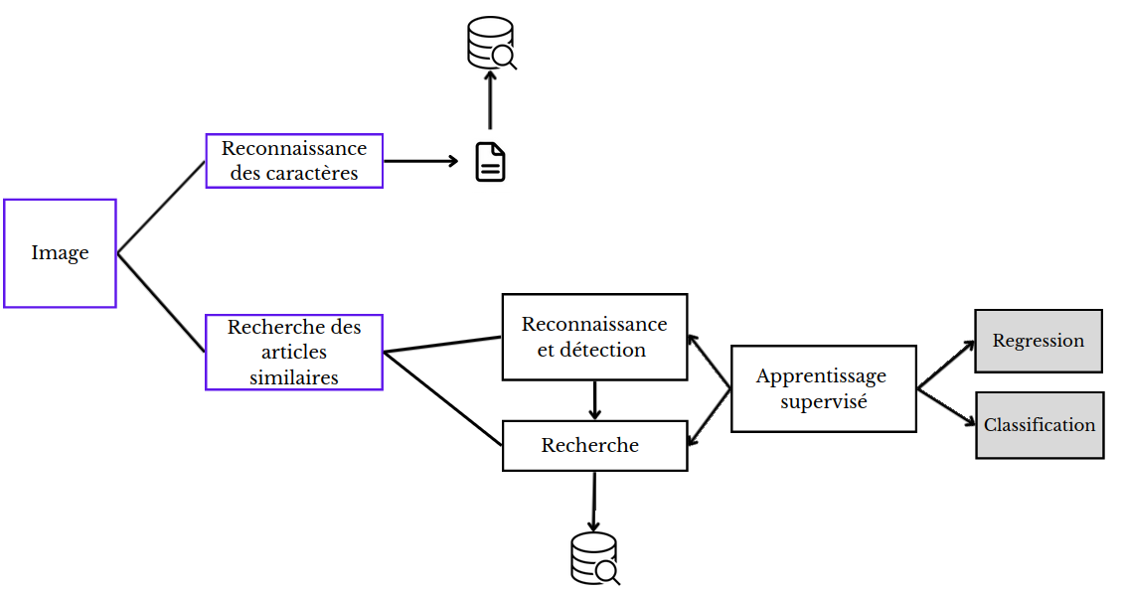

Etude préalable
Solution proposée
Etude théorique
Conception
Réalisation
Conclusion & perspectives
Architecture de la solution proposée
Chatbot visuel
intelligent
Notes:
Since we have made a study of the existent deep learning techniques, first we need to define what is an absolute camera pose:
Given an image Ic, captured by a camera C, an absolute pose estimator E aims to predict the 3D pose orientation and location of C with respect to a reference 3D coordinate frame.
The translation(location) of C with respect to the origin is specified by a vector x ∈ R 3 . The orientation of C can be represented using a rotation matrix (M), a quaternion (q) or Euler angles (A)

Slide 10
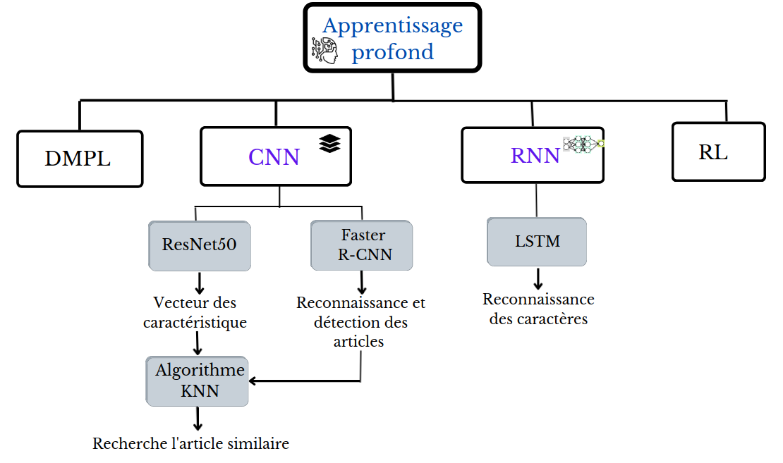
Etude préalable
Solution proposée
Conception
Etude théorique
Réalisation
Conclusion & perspectives
Les techniques de l’apprentissage profond
Notes:
Since we have made a study of the existent deep learning techniques, first we need to define what is an absolute camera pose:
Given an image Ic, captured by a camera C, an absolute pose estimator E aims to predict the 3D pose orientation and location of C with respect to a reference 3D coordinate frame.
The translation(location) of C with respect to the origin is specified by a vector x ∈ R 3 . The orientation of C can be represented using a rotation matrix (M), a quaternion (q) or Euler angles (A)

Slide 11
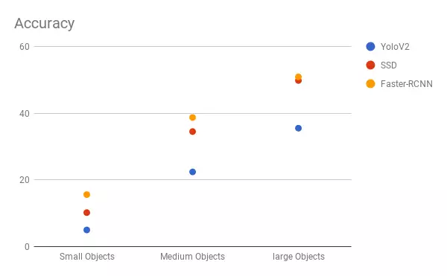

Etude préalable
Solution proposée
Conception
Etude théorique
Réalisation
Conclusion & perspectives
Reconnaissance et recherche des articles similaires (1/3)
Reconnaissance d’un
article vestimentaire
YOLO
RCNN
Réseau de détection d'objets
Rapide
SSD
Performant
Faster R-CNN
Caractérisé par RPN
(propose des régions)
Notes:
Since we have made a study of the existent deep learning techniques, first we need to define what is an absolute camera pose:
Given an image Ic, captured by a camera C, an absolute pose estimator E aims to predict the 3D pose orientation and location of C with respect to a reference 3D coordinate frame.
The translation(location) of C with respect to the origin is specified by a vector x ∈ R 3 . The orientation of C can be represented using a rotation matrix (M), a quaternion (q) or Euler angles (A)

Slide 12
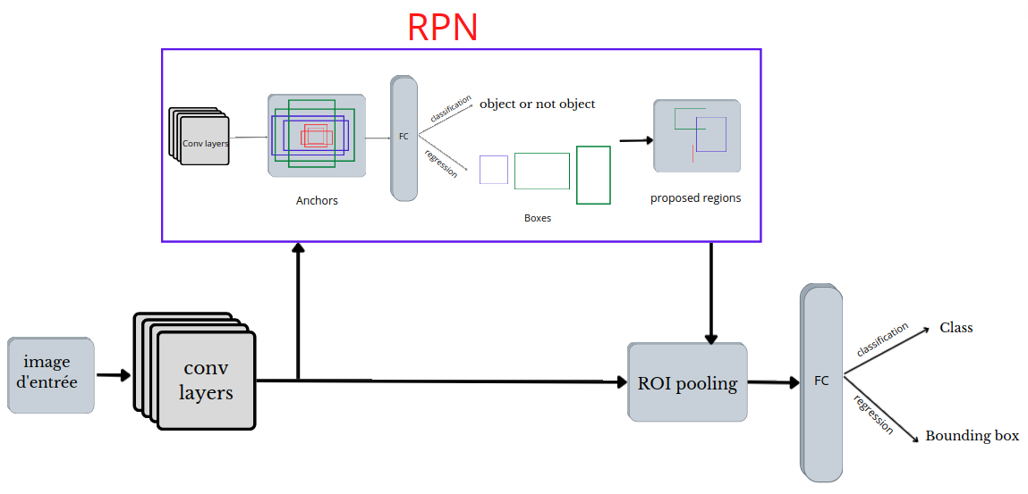
Etude préalable
Solution proposée
Conception
Etude théorique
Réalisation
Conclusion & perspectives
Reconnaissance et recherche des articles similaires (2/3)
Reconnaissance d’un article vestimentaire
Architecture Faster R-CNN
Notes:
Since we have made a study of the existent deep learning techniques, first we need to define what is an absolute camera pose:
Given an image Ic, captured by a camera C, an absolute pose estimator E aims to predict the 3D pose orientation and location of C with respect to a reference 3D coordinate frame.
The translation(location) of C with respect to the origin is specified by a vector x ∈ R 3 . The orientation of C can be represented using a rotation matrix (M), a quaternion (q) or Euler angles (A)

Slide 13
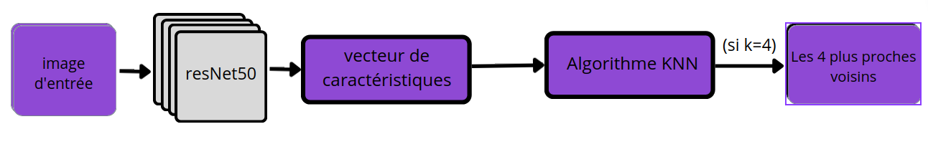
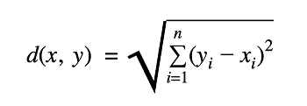
Etude préalable
Solution proposée
Conception
Etude théorique
Réalisation
Conclusion & perspectives
Reconnaissance et recherche des articles similaires (3/3)
Recherche des articles les plus similaires
Algorithme KNN
Distance
euclidienne
Notes:
Since we have made a study of the existent deep learning techniques, first we need to define what is an absolute camera pose:
Given an image Ic, captured by a camera C, an absolute pose estimator E aims to predict the 3D pose orientation and location of C with respect to a reference 3D coordinate frame.
The translation(location) of C with respect to the origin is specified by a vector x ∈ R 3 . The orientation of C can be represented using a rotation matrix (M), a quaternion (q) or Euler angles (A)

Slide 14
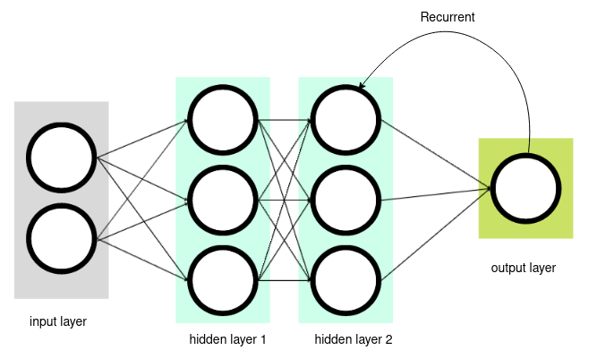
Etude préalable
Solution proposée
Conception
Etude théorique
Réalisation
Conclusion & perspectives
Reconnaissance des caractères (1/3)
Architecture de RNN (Recurent Neural Network)
Notes:
Since we have made a study of the existent deep learning techniques, first we need to define what is an absolute camera pose:
Given an image Ic, captured by a camera C, an absolute pose estimator E aims to predict the 3D pose orientation and location of C with respect to a reference 3D coordinate frame.
The translation(location) of C with respect to the origin is specified by a vector x ∈ R 3 . The orientation of C can be represented using a rotation matrix (M), a quaternion (q) or Euler angles (A)

Slide 15
Etude préalable
Solution proposée
Conception
Etude théorique
Réalisation
Conclusion & perspectives
Reconnaissance des caractères (2/3)
OCR (Reconnaissance optique des caractères)
Réseau LSTM
Outil tesseract
OCR
Extraction des données
Image => texte
Notes:
Since we have made a study of the existent deep learning techniques, first we need to define what is an absolute camera pose:
Given an image Ic, captured by a camera C, an absolute pose estimator E aims to predict the 3D pose orientation and location of C with respect to a reference 3D coordinate frame.
The translation(location) of C with respect to the origin is specified by a vector x ∈ R 3 . The orientation of C can be represented using a rotation matrix (M), a quaternion (q) or Euler angles (A)

Slide 16
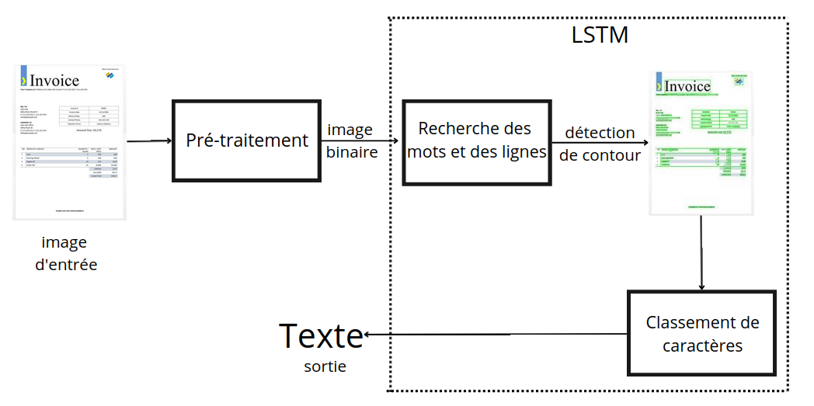
Etude préalable
Solution proposée
Conception
Etude théorique
Réalisation
Conclusion & perspectives
Reconnaissance des caractères
Reconnaissance des caractères (3/3)
Processus d’extraction de données depuis une image
Notes:
Since we have made a study of the existent deep learning techniques, first we need to define what is an absolute camera pose:
Given an image Ic, captured by a camera C, an absolute pose estimator E aims to predict the 3D pose orientation and location of C with respect to a reference 3D coordinate frame.
The translation(location) of C with respect to the origin is specified by a vector x ∈ R 3 . The orientation of C can be represented using a rotation matrix (M), a quaternion (q) or Euler angles (A)

Slide 17






Etude préalable
Solution proposée
Conception
Etude théorique
Réalisation
Conclusion & perspectives
Choix technolgiques
Notes:
Since we have made a study of the existent deep learning techniques, first we need to define what is an absolute camera pose:
Given an image Ic, captured by a camera C, an absolute pose estimator E aims to predict the 3D pose orientation and location of C with respect to a reference 3D coordinate frame.
The translation(location) of C with respect to the origin is specified by a vector x ∈ R 3 . The orientation of C can be represented using a rotation matrix (M), a quaternion (q) or Euler angles (A)

Slide 18

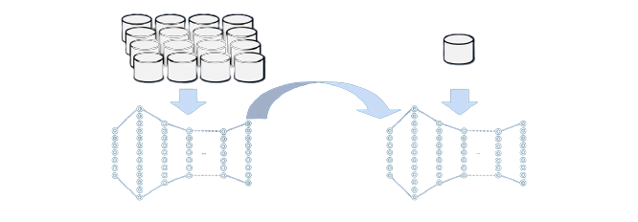
Etude préalable
Solution proposée
Conception
Etude théorique
Réalisation
Conclusion & perspectives
Apprentissage par transfert
Pretrained model
Less training time
Small dataset
Notes:
Since we have made a study of the existent deep learning techniques, first we need to define what is an absolute camera pose:
Given an image Ic, captured by a camera C, an absolute pose estimator E aims to predict the 3D pose orientation and location of C with respect to a reference 3D coordinate frame.
The translation(location) of C with respect to the origin is specified by a vector x ∈ R 3 . The orientation of C can be represented using a rotation matrix (M), a quaternion (q) or Euler angles (A)

Slide 19
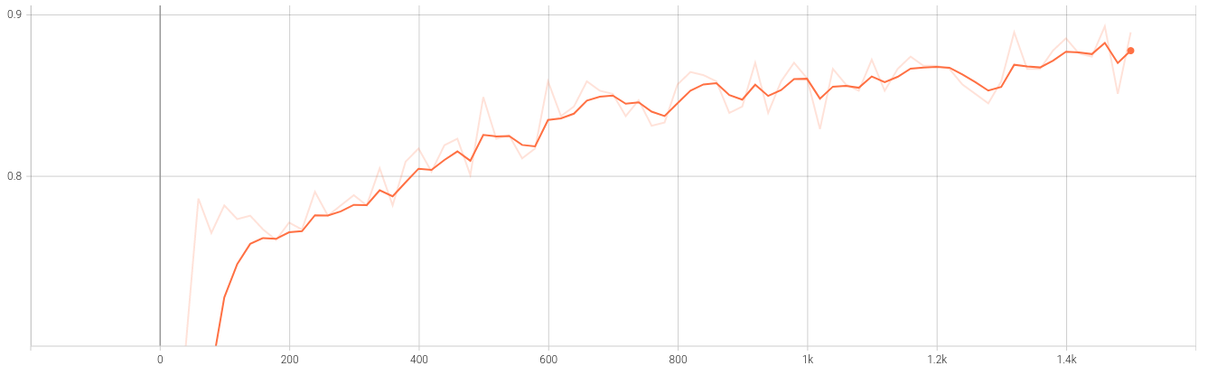
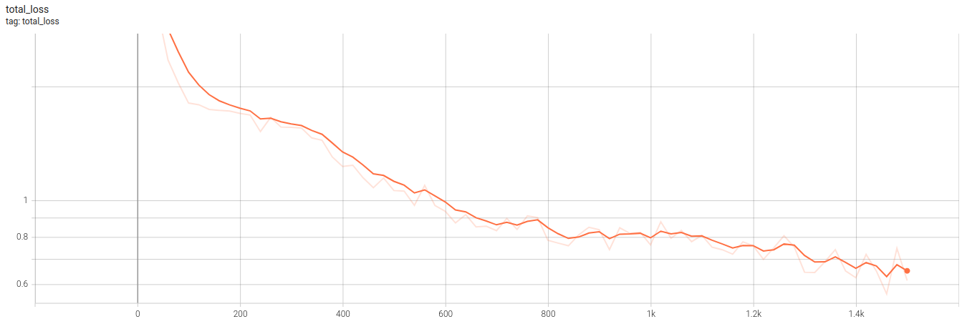
Etude préalable
Solution proposée
Conception
Etude théorique
Réalisation
Conclusion & perspectives
Résultats du modèle Faster R-CNN
Performance et précision du modèle
==> atteint 80%
Performance et précision du modèle
==> atteint 80%
Performance et précision du modèle
==> atteint 80%
La décroissance de la perte
au cours de l’apprentissage
0.65
Notes:
Since we have made a study of the existent deep learning techniques, first we need to define what is an absolute camera pose:
Given an image Ic, captured by a camera C, an absolute pose estimator E aims to predict the 3D pose orientation and location of C with respect to a reference 3D coordinate frame.
The translation(location) of C with respect to the origin is specified by a vector x ∈ R 3 . The orientation of C can be represented using a rotation matrix (M), a quaternion (q) or Euler angles (A)

Slide 20
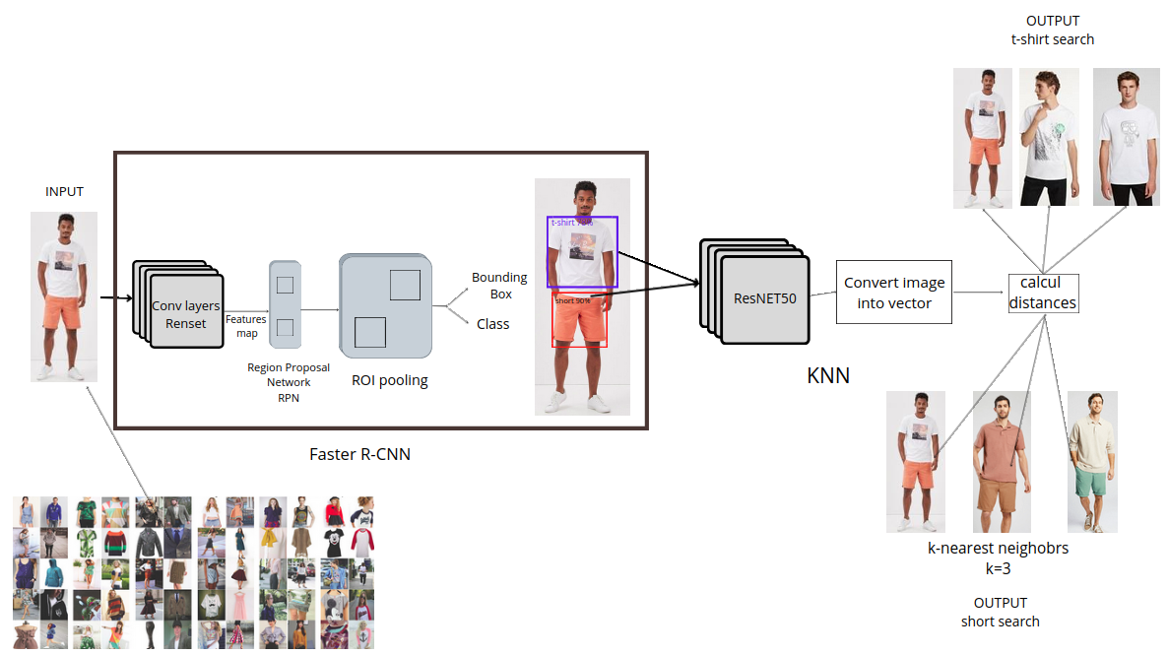
Etude préalable
Solution proposée
Conception
Etude théorique
Réalisation
Conclusion & perspectives
Exemple de résultats de la recherche d’articles vestimentaires
DeepFashion2
Notes:
Since we have made a study of the existent deep learning techniques, first we need to define what is an absolute camera pose:
Given an image Ic, captured by a camera C, an absolute pose estimator E aims to predict the 3D pose orientation and location of C with respect to a reference 3D coordinate frame.
The translation(location) of C with respect to the origin is specified by a vector x ∈ R 3 . The orientation of C can be represented using a rotation matrix (M), a quaternion (q) or Euler angles (A)

Slide 21
Conclusion & perspectives
Notes:
Since we have made a study of the existent deep learning techniques, first we need to define what is an absolute camera pose:
Given an image Ic, captured by a camera C, an absolute pose estimator E aims to predict the 3D pose orientation and location of C with respect to a reference 3D coordinate frame.
The translation(location) of C with respect to the origin is specified by a vector x ∈ R 3 . The orientation of C can be represented using a rotation matrix (M), a quaternion (q) or Euler angles (A)

Slide 22
Etude préalable
Solution proposée
Conception
Etude théorique
Réalisation
Conclusion & perspectives
Notes:
Since we have made a study of the existent deep learning techniques, first we need to define what is an absolute camera pose:
Given an image Ic, captured by a camera C, an absolute pose estimator E aims to predict the 3D pose orientation and location of C with respect to a reference 3D coordinate frame.
The translation(location) of C with respect to the origin is specified by a vector x ∈ R 3 . The orientation of C can be represented using a rotation matrix (M), a quaternion (q) or Euler angles (A)

Slide 23


Etude préalable
Solution proposée
Conception
Etude théorique
Réalisation
Introduction
Training Set Generation
Conclusion & perspectives
Conclusion
Envoi des réponses
automatiques
Notre solution peut
etre utilisée pour
d’autre types d’objets
Detecter et prédicter
des articles
et leurs classes
Rechercher
les produits
similaires
Extraction des données
depuis des images
Une image vaut mille mots
Notes:
Our project is elaborated within "Next Gen Solution". It aims to make a system to estimate the absolute camera pose of a single image. In this report, we have presented the deep learning state-of-the art techniques of absolute camera pose estimation and we have concluded that DSAC++ is the most suitable technique for our application. Moreover, we presented our system architecture and described the process of generating the Training set using Carla simulator. In addition, we trained our model Using transfer learning.
Finally we discussed the results that are acceptable and we proposed some possible enhancements such as increasing the dataset and the number of training iterations.

Slide 24

Etude préalable
Solution proposée
Conception
Etude théorique
Réalisation
Introduction
Training Set Generation
Conclusion & perspectives
Perspectives
Entrainer les modèle
avec des plus grands
ensembles de données
Réseau
siamois
Ecriture
manuscrite
Notes:
Our project is elaborated within "Next Gen Solution". It aims to make a system to estimate the absolute camera pose of a single image. In this report, we have presented the deep learning state-of-the art techniques of absolute camera pose estimation and we have concluded that DSAC++ is the most suitable technique for our application. Moreover, we presented our system architecture and described the process of generating the Training set using Carla simulator. In addition, we trained our model Using transfer learning.
Finally we discussed the results that are acceptable and we proposed some possible enhancements such as increasing the dataset and the number of training iterations.

Slide 25
Merci de votre attention

