Slide 1
InPress
Computer Science 4ZP6 Capstone Project
Abdul Hadi Muhammad
Wenbo Liu
Justin Kan
McMaster University Computing and Software Department

Slide 2

The Problem
Lack of interaction between Instructors and Students
Learning Pitfalls
Hardware Constraints
Communication barriers

Slide 3

The Solution
Web-Based Application (Compatible on most internet enabled devices)
Real-time interaction and feedback from students
No extra physical hardware required
Open Source (Free!)
Notes:
“For the students, from the students"
To create a web-based application
Student can interact with instructor without bring any additional device
Student also can review the in class activities after class
Decrease the distance between student’s thought and instructor’s
Two main modules:
Instructor
Student
Technology used
Python
Django
Javascript
PostgresSQL
Basic Hardware

Slide 4
Implementation
“For the students, from the students"
To create a web-based application
Student can interact with instructor without bring any additional device
Student also can review the in class activities after class
Decrease the distance between student’s thought and instructor’s
Two main modules:
Instructor
Student
Technology used
Python
Django
Javascript
PostgresSQL
Basic Hardware
Notes:
“For the students, from the students"
To create a web-based application
Student can interact with instructor without bring any additional device
Student also can review the in class activities after class
Decrease the distance between student’s thought and instructor’s
Two main modules:
Instructor
Student
Technology used
Python
Django
Javascript
PostgresSQL
Basic Hardware

Slide 5

Instructor
Create Questions in seconds
LaTex Supported
Real-Time Data Analysis
Notes:
Create Courses and Student Accounts
Create Assessments
Add Short Answer and Multiple Choice questions
Update question status
Collect and analysis students’ answer

Slide 6
Database Schema
Students
Student Number
Enrollment
Student Answer
Answer
AssessmentData
QuestionNo QuestionData ChoiceA…ChoiceE QuestionType QuestionAnswer
Courses
Name Code
Assessment
Name PostDate Post
Notes:
Create Courses and Student Accounts
Create Assessments
Add Short Answer and Multiple Choice questions
Update question status
Collect and analysis students’ answer

Slide 7
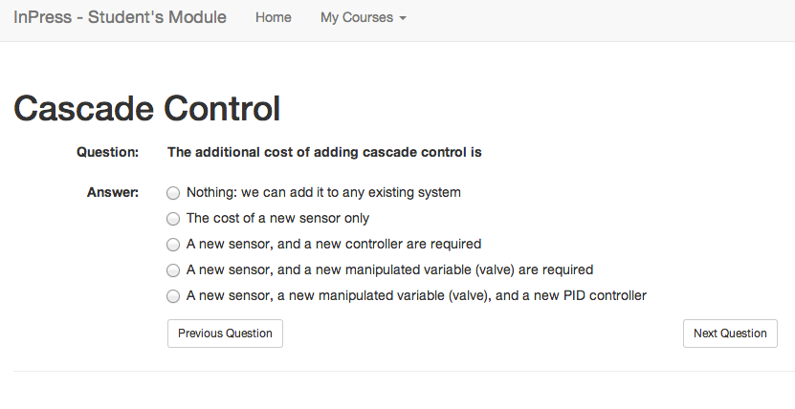

Student view
Visit course page
Answer questions with classmates together
Review questions and answers after class
Student data structure
Student number
Student answer

Slide 8
Student Answer Analysis
Student’s answer will be keeping update
Instructor can see the answer summary
How many answered
Which answer been most answered
…

Slide 9
Field Test

Slide 10
The Next Steps
Portability for different environment
Open Source
Security
Installation kit
Localization

Slide 11
Conclusion

Slide 12

Question Time

