Slide 1
Topics
Differential and linear cryptanalysis
AES
Wide trail strategy

Slide 2
Linear and Differential Cryptanalysis
Most important tools to analyze symmetric ciphers
Used to analyze block ciphers, hash functions and stream ciphers
Statistical methods
New designs must resist these attacks

Slide 3






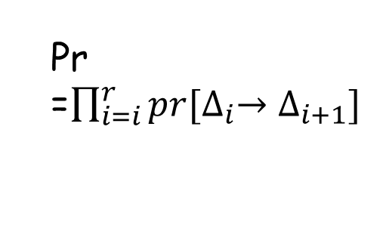
Diff./Linear characteristic
Characteristic/trail/path
State
$$P=$$
$X_{0}\underset{→}{F_{K_{0}}}X_{1}⋯$ $X_{r−1}\underset{→}{F_{K_{r−1}}}X_{r}\underset{→}{F_{K_{r}}}X_{r+1}$
$$=C$$
Pr =$\prod_{i=i}^{r}{pr[∆_{i}→∆_{i+1}]}$
$$X_{0}⊕{X′}_{0}=∆_{0}$$
$∆_{0}\underset{→}{F_{K_{0}}}∆_{1}⋯$ $∆_{r−1}\underset{→}{F_{K_{r}}}∆_{r}$
Diff.
r-round distinguisher, pr > 2^{-n}
Linear
$Γ_{0}\underset{→}{F_{K_{0}}}Γ_{1}⋯$ $Γ_{r−1}\underset{→}{F_{K_{r}}}Γ_{r}$
r-round distinguisher, |bias| > 2^{-n/2}

Slide 4






Generic diff./linear analysis
Prepend/Append some rounds
K_{r+1}
Diff.
$$X_{0}⊕{X′}_{0}=∆_{0}$$
$∆_{0}\underset{→}{F_{K_{0}}}∆_{1}⋯$ $∆_{r−1}\underset{→}{F_{K_{r}}}∆_{r}$
$$F^{−1}$$
$$C, C′$$
Distinguisher pr > 2^{-n}
Key recovery
K_{r+1}
$Γ_{0}\underset{→}{F_{K_{0}}}Γ_{1}⋯$ $Γ_{r−1}\underset{→}{F_{K_{r}}}Γ_{r}$
$$F^{−1}$$
$$C$$
Linear
Distinguisher
|Bias| > 2^{-n/2}
Key recovery

Slide 5
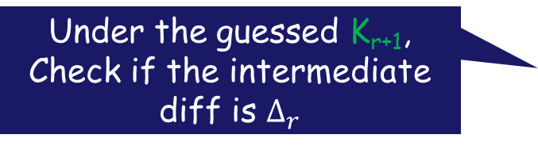
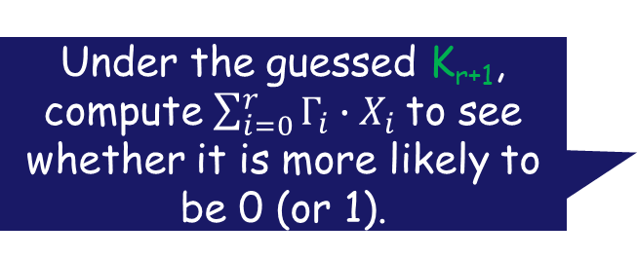
Key recovery
Prepend/Append some rounds
K_{r+1}
Under the guessed K_{r+1}, Check if the intermediate diff is $∆_{r}$
Diff.
$$X_{0}⊕{X′}_{0}=∆_{0}$$
$∆_{0}\underset{→}{F_{K_{0}}}∆_{1}⋯$ $∆_{r−1}\underset{→}{F_{K_{r}}}∆_{r}$
$$F^{−1}$$
$$C, C′$$
Distinguisher pr > 2^{-n}
Key recovery
Under the guessed K_{r+1}, compute $\sum_{i=0}^{r}{Γ_{i}∙X_{i}}$to see whether it is more likely to be 0 (or 1).
K_{r+1}
$Γ_{0}\underset{→}{F_{K_{0}}}Γ_{1}⋯$ $Γ_{r−1}\underset{→}{F_{K_{r}}}Γ_{r}$
$$F^{−1}$$
$$C$$
Linear
Distinguisher
|Bias| > 2^{-n/2}
Key recovery

Slide 6


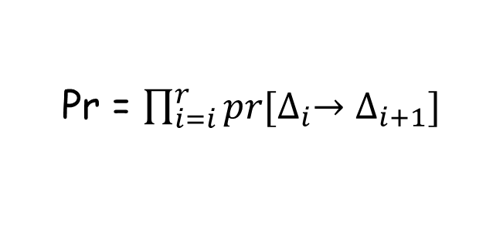
Differential prob.
state transition:
$X_{0}\underset{→}{F_{K_{0}}}X_{1}⋯$ $X_{r−1}\underset{→}{F_{K_{r−1}}}X_{r}$
diff. transition:
$∆_{0}\underset{→}{F_{K_{0}}}∆_{1}⋯$ $∆_{r−1}\underset{→}{F_{K_{r}}}∆_{r}$
Probability of the diff. trail:
Pr = $\prod_{i=i}^{r}{pr[∆_{i}→∆_{i+1}]}$
Assume subkeys are random and independent.
Notes:
Markov ciphers, 有时候这个假设不成立，相关性也是一个研究点

Slide 7
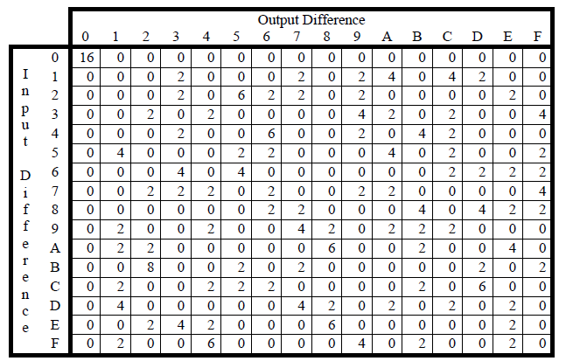
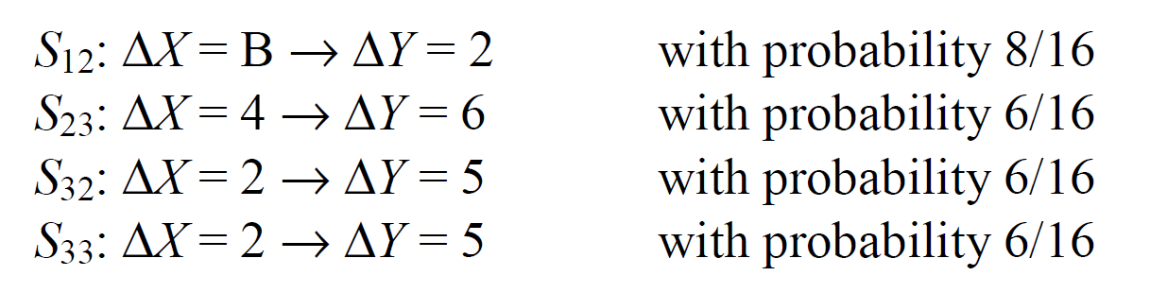







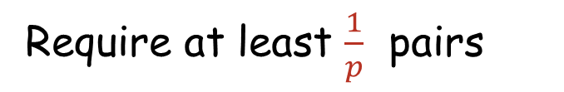








Example: probability of diff. trail
$$P$$
$⊕k_{0}$
$$S$$
$$S$$
$$S$$
$$S$$
$⊕k_{1}$
$$S$$
$$S$$
$$S$$
$$S$$
$⊕k_{2}$
$$S$$
$$S$$
$$S$$
$$S$$
$⊕k_{3}$
$$F_{k_{4}}$$
$p=1728/2^{16}$
Require at least $\frac{1}{p}$ pairs
$$C$$

Slide 8
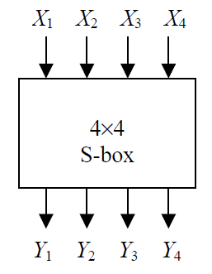

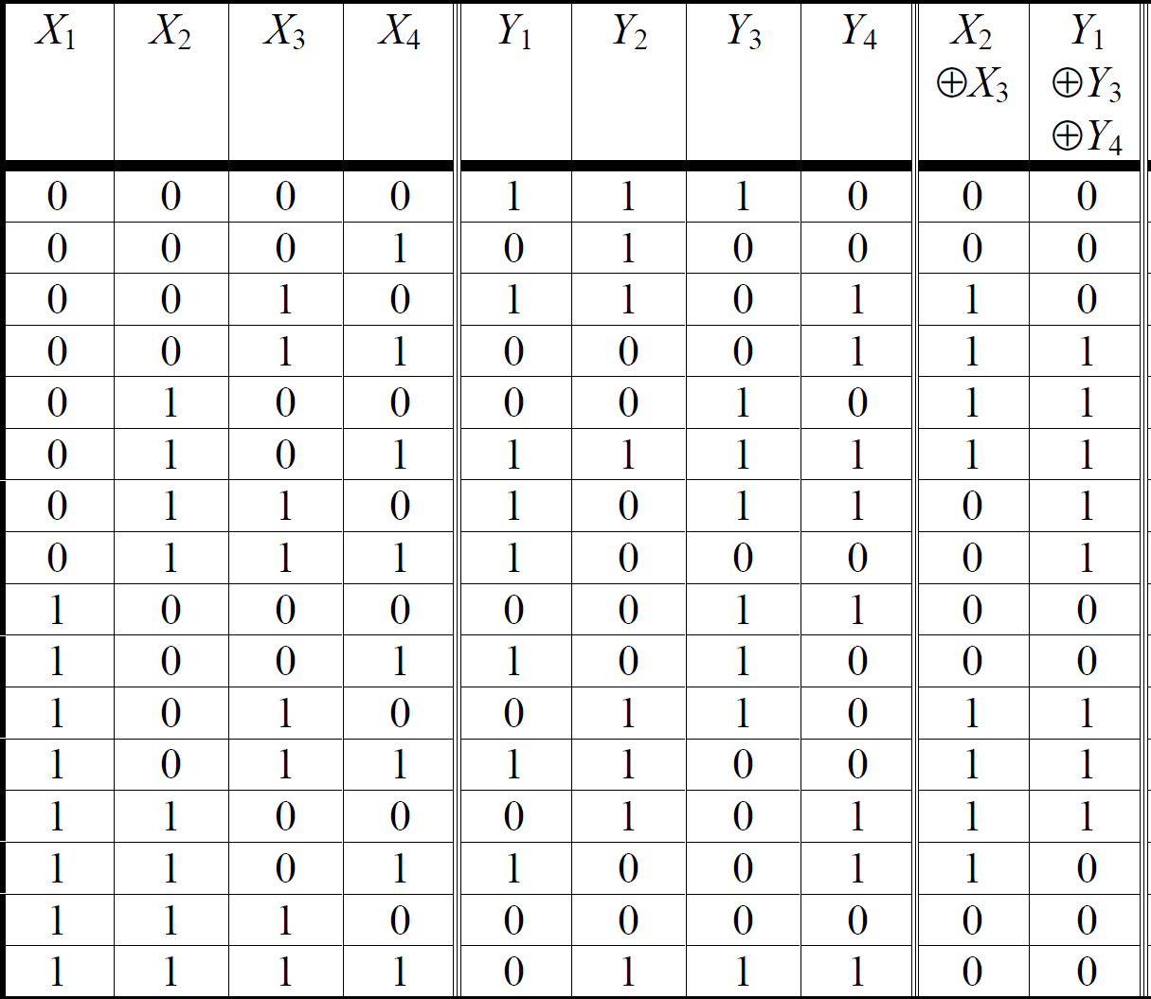
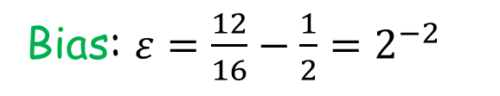
Linear bias
S-box:
Linear approximation of S-boxes:
It holds true for 12 out of 16 cases.
Bias: $ε=\frac{12}{16}−\frac{1}{2}=2^{−2}$
It is possibly negative.

Slide 9
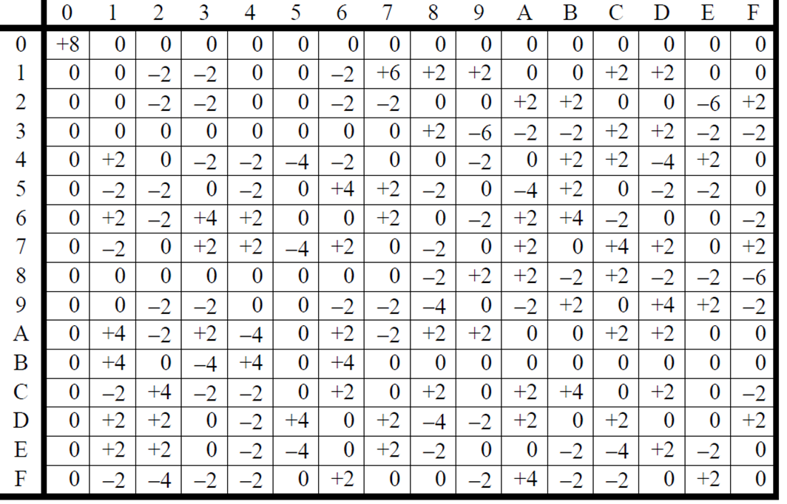
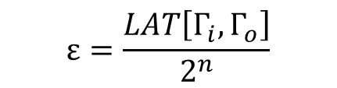



Linear bias
Linear Approximation Table (LAT) :
$$LAT\left[Γ_{i},Γ_{o}\right]=\#\{X∈\{0,1\}^{n}|Γ_{i}⋅X{⊕Γ}_{O}⋅Y=0\}−2^{n−1}$$
$$=\frac{ \#\{X∈\{0,1\}^{n}|Γ_{i}⋅X{⊕Γ}_{O}⋅Y=0\}−\#\{X∈\{0,1\}^{n}|Γ_{i}⋅X{⊕Γ}_{O}⋅Y=1\}}{2}$$
Output mask $Γ_{o}$
Approximation:
Input mask $Γ_{i}$
$$Γ_{i}⋅X{⊕Γ}_{O}⋅Y=0$$
Inner product
$$ε=\frac{LAT\left[Γ_{i},Γ_{o}\right]}{2^{n}}$$

Slide 10
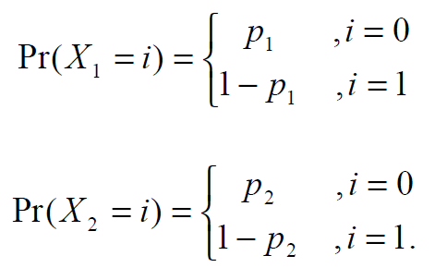

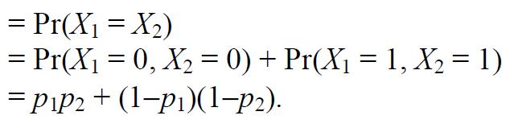



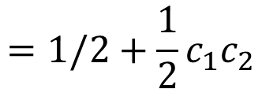
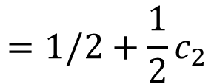
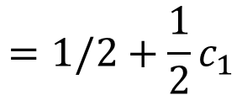
Linear bias of a trail
Piling-up Lemma: assume $X_{1},X_{2}$ are random variables
$$=1/2+{\frac{1}{2}c}_{1}$$
Let
then
$$=1/2+{\frac{1}{2}c}_{2}$$
$$=1/2+{\frac{1}{2}c}_{1}c_{2}$$
Product of correlations! Can be extended to the case with k random variables

Slide 11
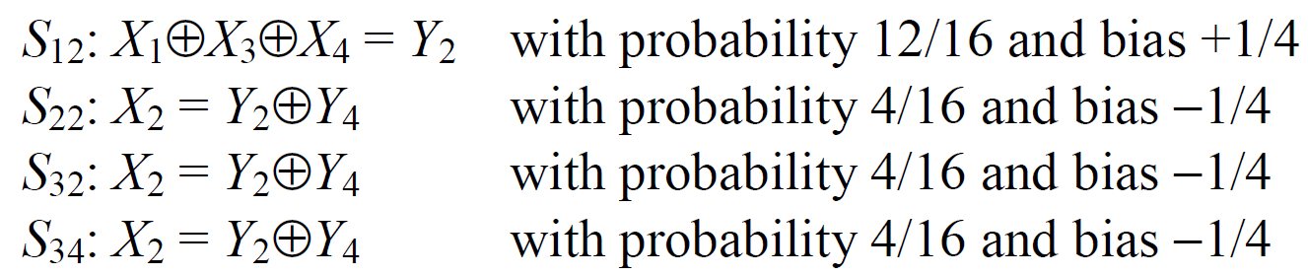

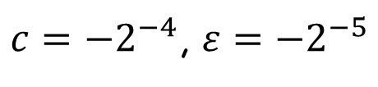






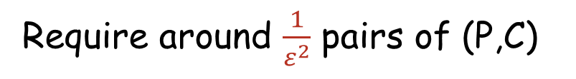







Example: correlation of linear trail
$$P$$
$⊕k_{0}$
$$S$$
$$S$$
$$S$$
$$S$$
$⊕k_{1}$
$$S$$
$$S$$
$$S$$
$$S$$
$⊕k_{2}$
$$S$$
$$S$$
$$S$$
$$S$$
$⊕k_{3}$
$c={−2}^{−4}$, $ε={−2}^{−5}$
$$F_{k_{4}}$$
Require around $\frac{1}{ε^{2}}$ pairs of (P,C)
$$C$$

Slide 12
How to design a block cipher with resistance against DC/LC?
Notes:
To do: more about linear analysis, piling-up lemma
Prepare some home works:

Slide 13

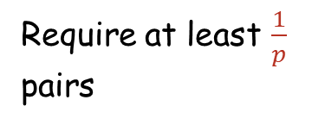
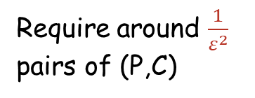





$$P$$
$$P$$
$⊕k_{0}$
$⊕k_{0}$
$$S$$
$$S$$
$$S$$
$$S$$
$$S$$
$$S$$
$$S$$
$$S$$
$⊕k_{1}$
$⊕k_{1}$
$$S$$
$$S$$
$$S$$
$$S$$
$$S$$
$$S$$
$$S$$
$$S$$
$⊕k_{2}$
$⊕k_{2}$
$$S$$
$$S$$
$$S$$
$$S$$
$$S$$
$$S$$
$$S$$
$$S$$
$⊕k_{3}$
$⊕k_{3}$
$$F_{k_{4}}$$
$$F_{k_{4}}$$
Require at least $\frac{1}{p}$ pairs
Require around $\frac{1}{ε^{2}}$ pairs of (P,C)
$$C$$
$$C$$

Slide 14
The probability of any trail is sufficiently small.

Slide 15
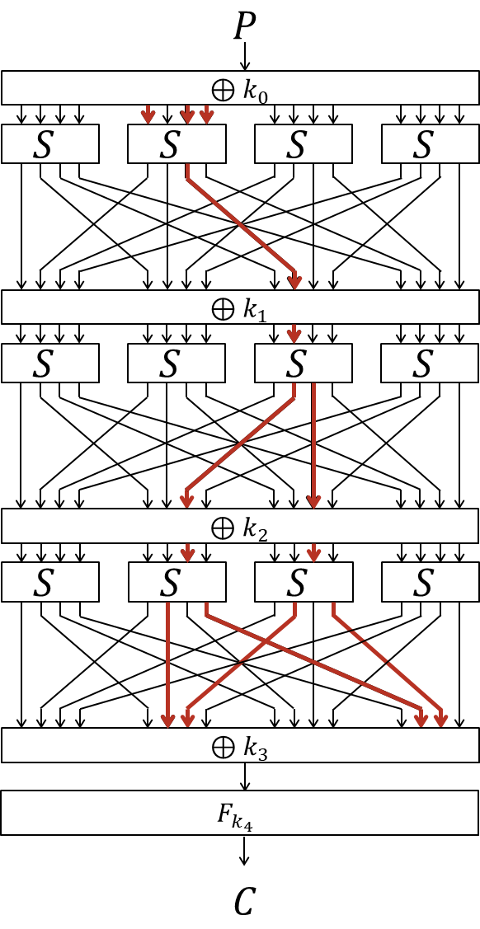
What affect the probability?
S-box
DDT/LAT determines the prob. for each S-box.
Activate as many S-boxes as possible
Active S-box
Input diff. (output mask) is non-zero
Choose S-boxes with good diff./linear property.
Design a linear layer with strong diffusion.

Slide 16
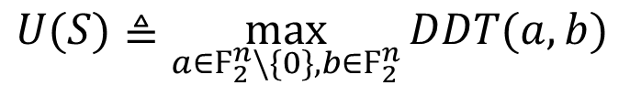
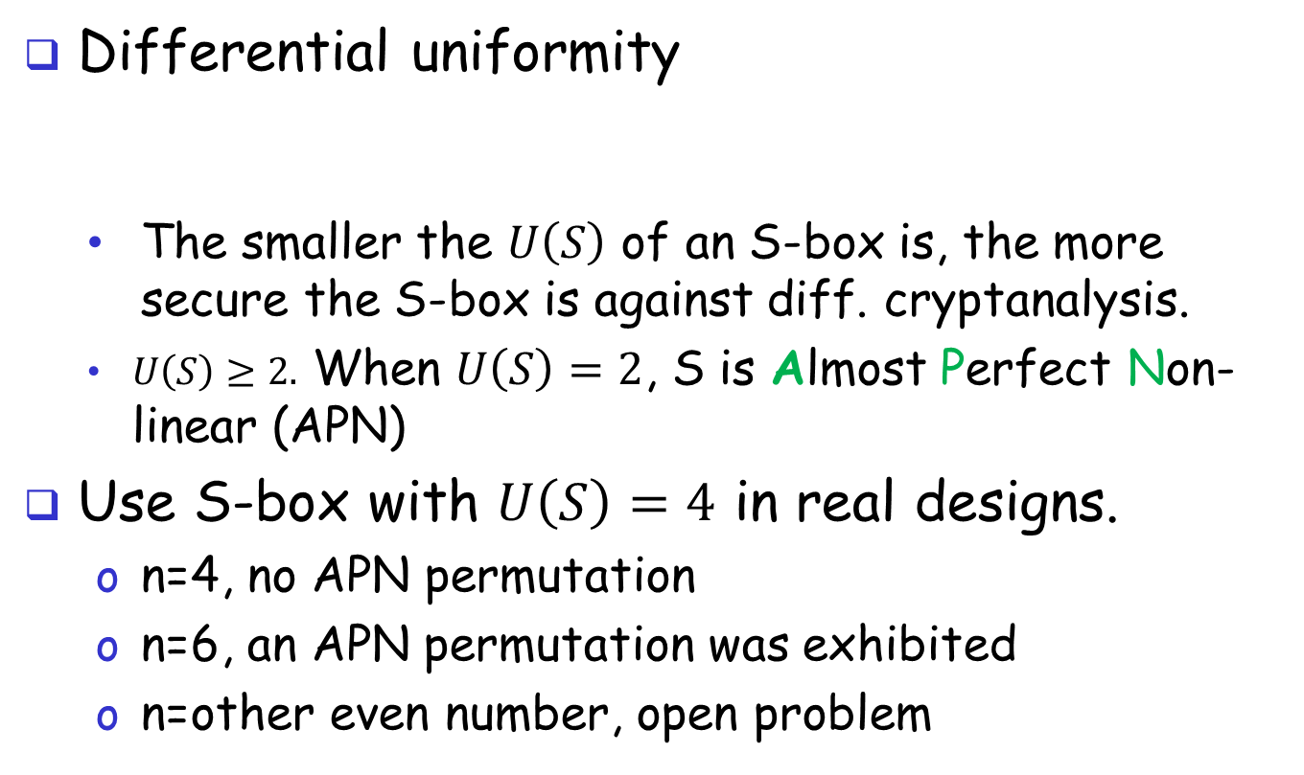
S-box
Differential uniformity
The smaller the $U\left(S\right)$ of an S-box is, the more secure the S-box is against diff. cryptanalysis.
$U\left(S\right)≥2.$ When $U\left(S\right)=2$, S is Almost Perfect Non-linear (APN)
Use S-box with $U\left(S\right)=4$ in real designs.
n=4, no APN permutation
n=6, an APN permutation was exhibited
n=other even number, open problem
$$U(S)≜\max_{a∈Ϝ_{2}^{n}\backslash \{0\},b{∈Ϝ}_{2}^{n}}{DDT(a,b)}$$
Notes:
N=4, no APN permutation. It was conjectured for a long time that no APN permutation could exist on Fn2 if n is even, until Dillon exhibited an APN permutation on F62.

Slide 17
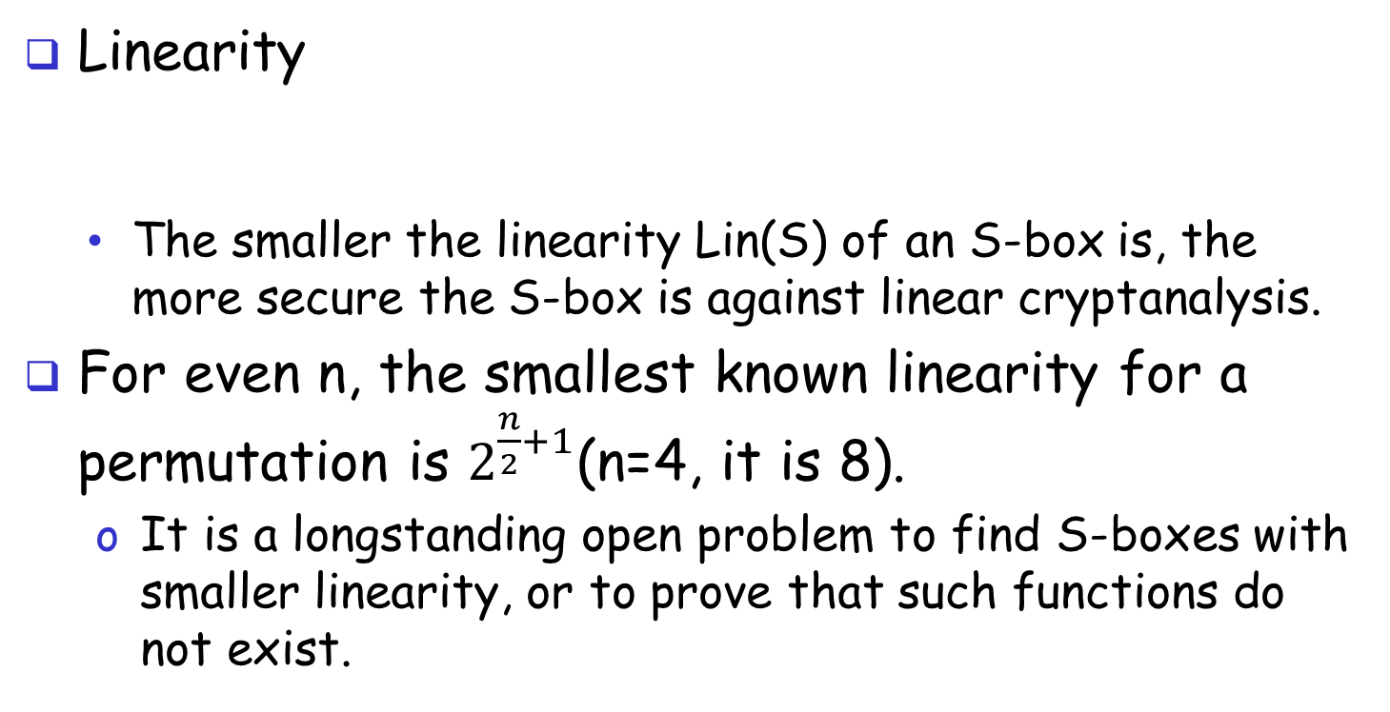
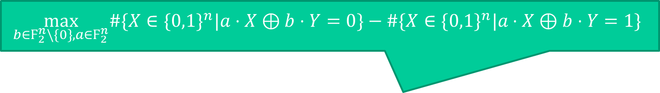
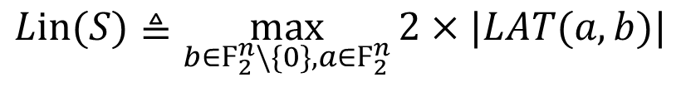
S-box
$$\max_{b∈Ϝ_{2}^{n}\backslash \{0\},a{∈Ϝ}_{2}^{n}}\#\{X∈\{0,1\}^{n}|a⋅X⊕b⋅Y=0\}−\#\{X∈\{0,1\}^{n}|a⋅X⊕b⋅Y=1\}$$
Linearity
The smaller the linearity Lin(S) of an S-box is, the more secure the S-box is against linear cryptanalysis.
For even n, the smallest known linearity for a permutation is $2^{\frac{n}{2}+1}$(n=4, it is 8).
It is a longstanding open problem to find S-boxes with smaller linearity, or to prove that such functions do not exist.
$$Lin(S)≜\max_{b∈Ϝ_{2}^{n}\backslash \{0\},a{∈Ϝ}_{2}^{n}}{2×|LAT(a,b)|}$$
Notes:
It is a longstanding open problem to find S-boxes with smaller linearity, or to prove that such functions do not exist.
Correspond to “correlation” (instead of bias)

Slide 18

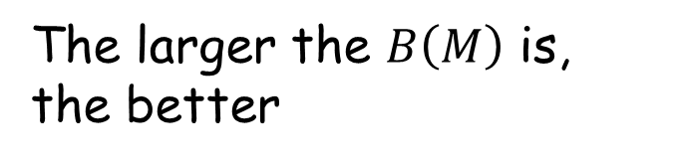
Linear Layer
$$P$$
$⊕k_{0}$
$$S$$
$$S$$
$$S$$
$$S$$
“1->2”
An active S-box leads to multiple active S-boxes in the neighboring rounds
$⊕k_{1}$
$$S$$
$$S$$
$$S$$
$$S$$
$⊕k_{2}$
$$S$$
$$S$$
$$S$$
$$S$$
Branch number of linear layer M
$$B\left(M\right)=\min_{X≠0}{(w_{H}\left(X\right)+w_{H}(M∙X))}$$
$⊕k_{3}$
$$F_{k_{4}}$$
The larger the $B\left(M\right)$ is, the better
$$C$$

Slide 19
AES

Slide 20
The AES process
1997: NIST publishes request for proposal
1998: 15 submissions.
1999: NIST chooses 5 finalists
2000: NIST chooses Rijndael as AES (designed in Belgium)

Slide 21
AES
The most widely used symmetric cipher today
128-bit block size, three supported key sizes: 128, 192, 256
Efficient in software and hardware
An SPN cipher
S
S
S
S
P
S
S
S
S
P
SPN Structure

Slide 22
AES
Key size | #Rounds
128 | 10
192 | 12
256 | 14
k₁
k₂
k_{n}
S₁
S₁
S₁
S₂
S₂
S₂
S₃
S₃
S₃
⋯
⨁
input
⨁
output
⨁
⋯
⋯
⋯
S₈
S₈
S₈
subs.
layer
perm.
layer

Slide 23
Notation
Input block: 16 bytes
0 | 4 | 8 | 12
1 | 5 | 9 | 13
2 | 6 | 10 | 14
3 | 7 | 11 | 15
=
S_{0,0} | S_{0,1} | S_{0,2} | S_{0,3}
S_{1,0} | S_{1,1} | S_{1,2} | S_{1,3}
S_{2,0} | S_{2,1} | S_{2,2} | S_{2,3}
S_{3,0} | S_{3,1} | S_{3,2} | S_{3,3}
0
1
2
3
4
5
6
7
8
9
10
11
12
13
14
15

Slide 24
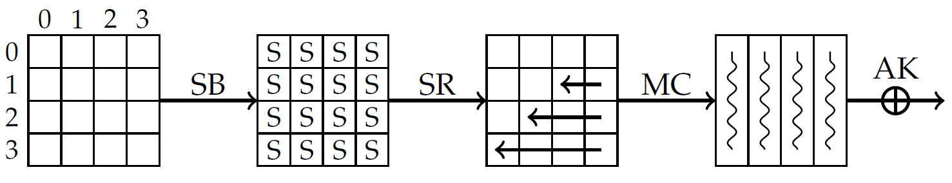
Round Function
Four steps
SubBytes (SB)
ShiftRows (SR)
MixColumns (MC)
AddRoundKey (AK)

Slide 25
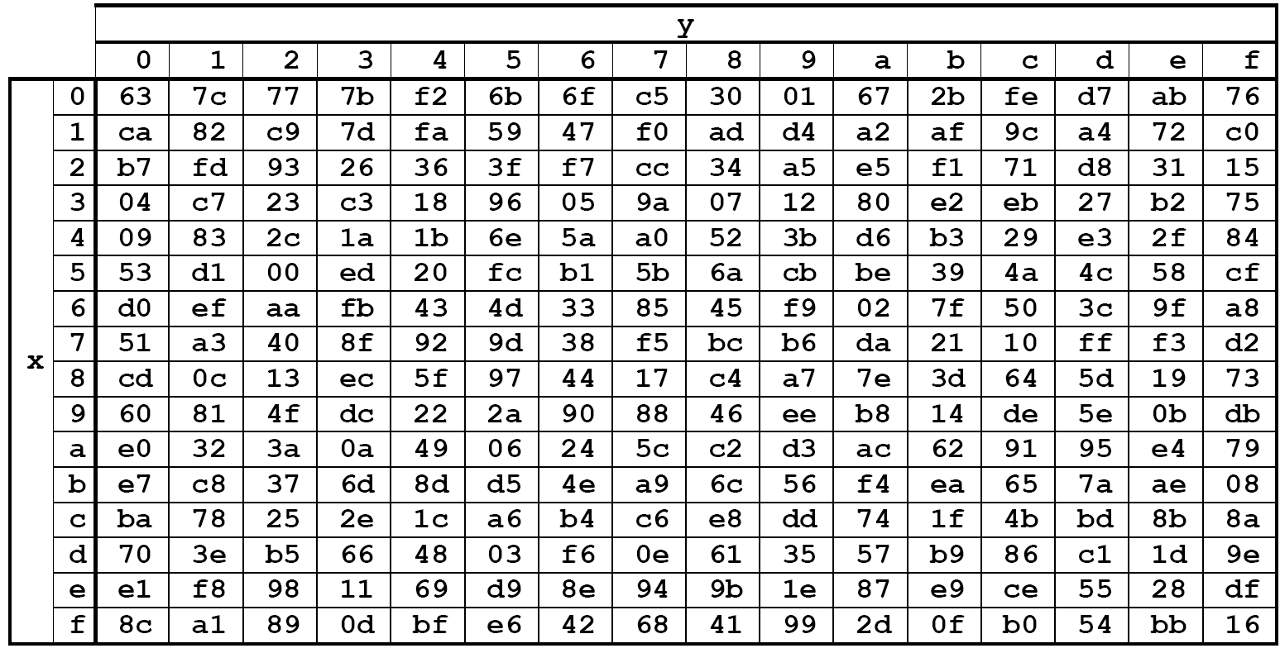
SubBytes (SB)
Apply the same S-box to each byte of the internal state.
00 | 44 | 88 | CC
11 | 55 | 99 | DD
22 | 66 | AA | EE
33 | 77 | BB | FF
55

Slide 26
ShiftRows (SR)
Shift Row i to the left by i positions.
S_{0,0}
S_{0,1}
S_{0,2}
S_{0,3}
S_{1,0}
S_{1,0}
S_{1,1}
S_{1,2}
S_{1,3}
S_{2,0}
S_{2,1}
S_{2,0}
S_{2,1}
S_{2,2}
S_{2,3}
S_{3,0}
S_{3,1}
S_{3,2}
S_{3,0}
S_{3,1}
S_{3,2}
S_{3,3}

Slide 27
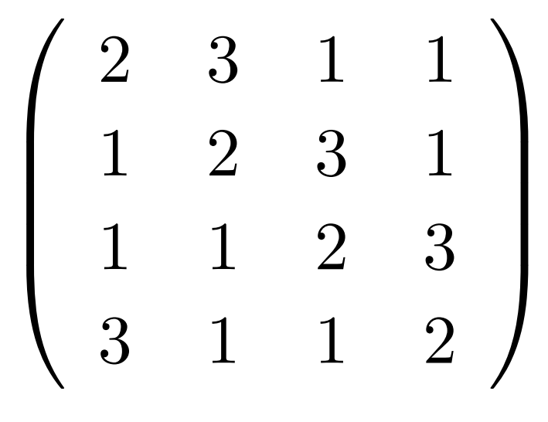
MixColumns (MC)
A multiplication of each column with a matrix over GF(2⁸).
S’_{0,c} = ({02} • S_{0,c}) ⊕ ({03} • S_{1,c}) ⊕ S_{2,c} ⊕ S_{3,c}
S’_{1,c} = S_{0,c} ⊕ ({02} • S_{1,c}) ⊕ ({03} • S_{2,c}) ⊕ S_{3,c}
S’_{2,c} = S_{0,c} ⊕ S_{1,c} ⊕ ({02} • S_{2,c} ) ⊕ ({03} • S_{3,c})
S’_{3,c} = ({03} • S_{0,c}) ⊕ S_{1,c} ⊕ S_{2,c} ⊕ ({02} • S_{3,c}
MixColumns()
S_{0,1}
S’_{0,1}
S_{0,0} | S_{0,1} | S_{0,2} | S_{0,3}
S_{1,0} | S_{1,1} | S_{1,2} | S_{1,3}
S_{2,0} | S_{2,1} | S_{2,2} | S_{2,3}
S_{3,0} | S_{3,1} | S_{3,2} | S_{3,3}
S’_{0,0} | S’_{0,1} | S’_{0,2} | S’_{0,3}
S’_{1,0} | S’_{1,1} | S’_{1,2} | S’_{1,3}
S’_{2,0} | S’_{2,1} | S’_{2,2} | S’_{2,3}
S’_{3,0} | S’_{3,1} | S’_{3,2} | S’_{3,3}
S_{1,1}
S’_{1,1}
S_{2,1}
S’_{2,1}
S_{3,1}
S’_{3,1}

Slide 28
AddRoundKey (AK)
Xor a sbukey byte to each byte of the state
XOR
S_{0,1}
S_{0,0} | S_{0,1} | S_{0,2} | S_{0,3}
S_{1,0} | S_{1,1} | S_{1,2} | S_{1,3}
S_{2,0} | S_{2,1} | S_{2,2} | S_{2,3}
S_{3,0} | S_{3,1} | S_{3,2} | S_{3,3}
S_{1,1}
S’_{0,1}
K_{0,1}
S_{2,1}
S’_{0,0} | S’_{0,1} | S’_{0,2} | S’_{0,3}
S’_{1,0} | S’_{1,1} | S’_{1,2} | S’_{1,3}
S’_{2,0} | S’_{2,1} | S’_{2,2} | S’_{2,3}
S’_{3,0} | S’_{3,1} | S’_{3,2} | S’_{3,3}
K_{0,0} | K_{0,1} | K_{0,2} | K_{0,3}
K_{1,0} | K_{1,1} | K_{1,2} | K_{1,3}
K_{2,0} | K_{2,1} | K_{2,2} | K_{2,3}
K_{3,0} | K_{3,1} | K_{3,2} | K_{3,3}
S’_{1,1}
K_{1,1}
S_{3,1}
S’_{2,1}
K_{2,1}
S’_{3,1}
K_{3,1}

Slide 29
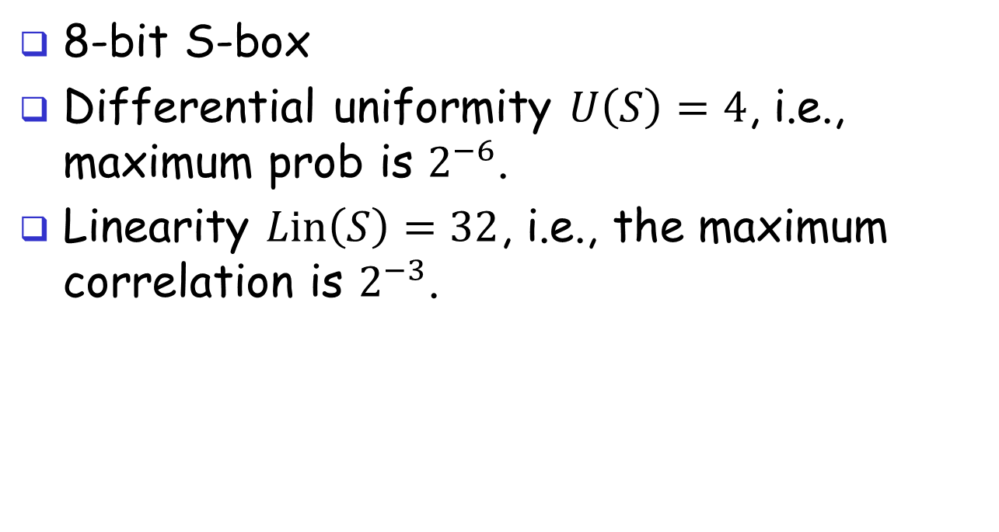
AES’s S-box
8-bit S-box
Differential uniformity $U\left(S\right)=4$, i.e., maximum prob is $2^{−6}$.
Linearity $Lin\left(S\right)=32$, i.e., the maximum correlation is $2^{−3}$.

Slide 30
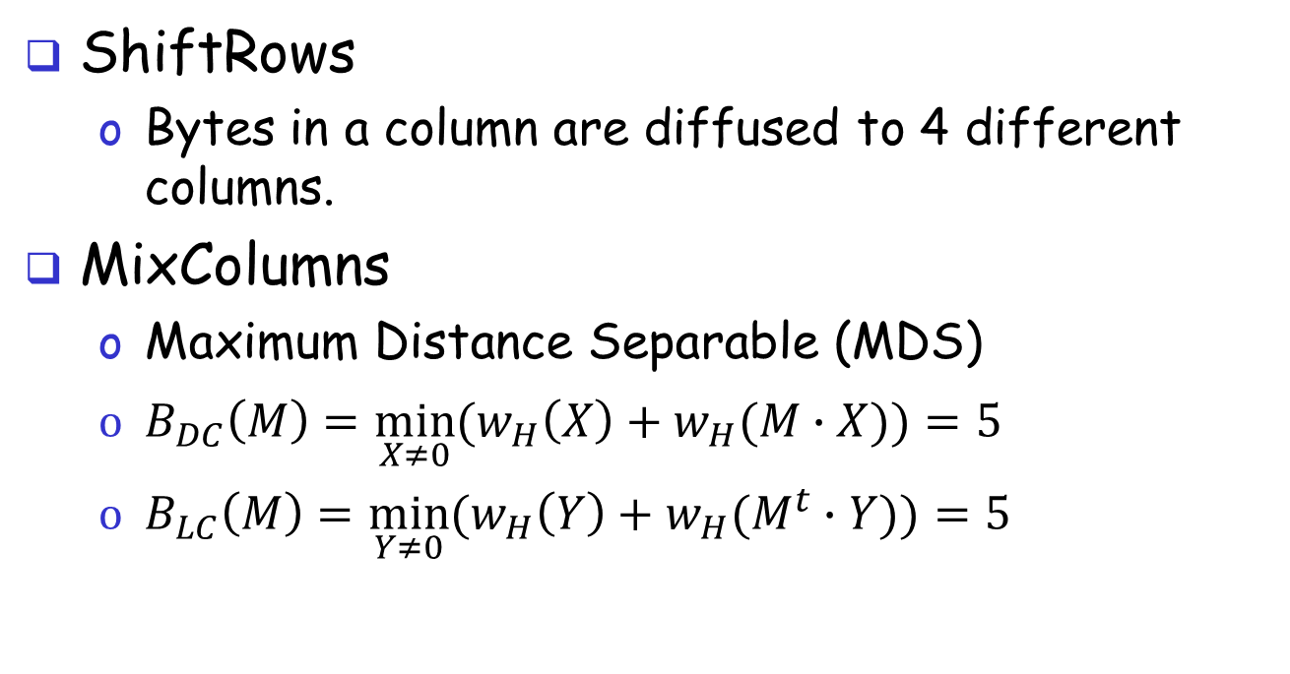
AES’s Linear Layer
ShiftRows
Bytes in a column are diffused to 4 different columns.
MixColumns
$\text{Maximum} \text{Distance} \text{Separable}\text{ (}\text{MDS}\text{)}$
$B_{DC}\left(M\right)=\min_{X≠0}{(w_{H}\left(X\right)+w_{H}(M∙X))}=5$
$B_{LC}\left(M\right)=\min_{Y≠0}{(w_{H}\left(Y\right)+w_{H}(M^{t}∙Y))}=5$

Slide 31
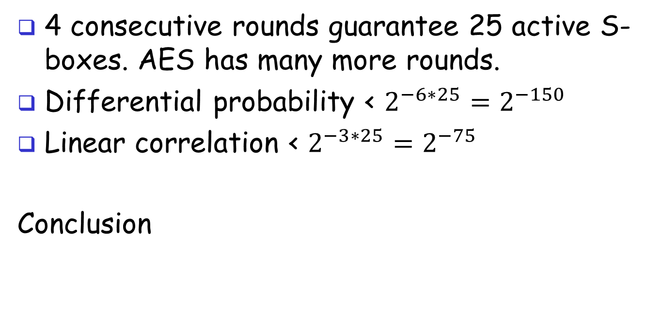
Wide trail strategy
4 consecutive rounds guarantee 25 active S-boxes. AES has many more rounds.
Differential probability < $2^{−6∗25}=2^{−150}$
Linear correlation < $2^{−3∗25}=2^{−75}$
Conclusion
The probability/correlation of any diff./linear trail of AES is sufficiently small to resist DC/LC!

Slide 32
Round 1
Col 0
Col 3
Col 2
Col 1
Round 2
Round 3
Round 4
Notes:
强调异或密钥可忽略；S盒操作也可以不管。只关系活跃S盒的数目。

Slide 33
Notes:
SB作用于字节，SR只改变字节的位置，因而两者可交换。

Slide 34
Layer of super S-box
L = SR◦ MC◦SR
Layer of super S-box
Notes:
每一个大方框看成一个超级S盒，作用于列，包含：S-box，MC和S-box的运算。

Slide 35
Lemma: The column weight (the number of active columns) of the input and the output is at least 5.

Slide 36
The are at least 5 active super S-boxes.

Slide 37
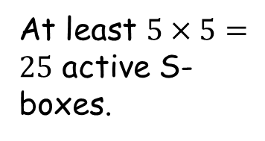
The are at least 5 active S-boxes in each active Super S-box.
At least $5×5=25$ active S-boxes.

Slide 38
Lesson and summary
Linear layers play an important role.
Resistance against DC/LC can be obtained via wide trail strategy.
The wide trail strategy opens a door to designs of block ciphers
AES is a milestone.

Slide 39
So many attacks…
prob. rational interpol.
higher-order d.c.
probabilistic interpol.
yo-yo
rational interpol.
boomerang
integrals
MITM
TMTO
interpolation attacks
zero-correlation
truncated d.c.
sliding
l.c. with multiple approximations
differential crypt.
impossible d.c.
linear crypt.
complementation props.
linear factors

Slide 40
Reference and Acknowledgement
Howard M. Heys: A Tutorial on Linear and
Differential Cryptanalysis. Cryptologia 26(3): 189-221 (2002)
Joan Daemen, Vincent Rijmen: The Design of Rijndael: AES - The Advanced Encryption Standard. Information Security and Cryptography, Springer 2002, ISBN 3-540-42580-2
李小千，抵抗差分分析、线性分析的分组密码设计—— AES为例，2013
Notes:
Howard M. Heys: A Tutorial on Linear and Differential Cryptanalysis. Cryptologia 26(3): 189-221 (2002)

