Slide 1
Topics
Intro of FEAL cipher
Differential cryptanalysis
Linear cryptanalysis

Slide 2
FEAL

Slide 3
FEAL
Fast data Encryption ALgorithm
Invented, promoted by NTT in 1987
Japanese telecommunications monopoly
Designed as replacement for DES
And to be fast and efficient
With modest security
Original version (FEAL-4) found to be weak
Many “improved” versions followed
All are flawed to some degree
Notes:
FEAL大体介绍

Slide 4
A. Shimizu and S. Miyaguchi, Fast data encipherment algorithm FEAL, Eurocrypt '87
FEAL-4
Bert den Boer, Cryptanalysis of F.E.A.L., EUROCRYPT 1988: 293–299 (100–10000 chosen plaintexts)
Sean Murphy, The Cryptanalysis of FEAL-4 with 20 Chosen Plaintexts. J. Cryptology 2(3): 145–154 (1990)
FEAL-8
Shoji Miyaguchi: The FEAL-8 Cryptosystem and a Call for Attack. CRYPTO 1989: 624–627
FEAL-N/NX
Eli Biham, Adi Shamir: Differential Cryptanalysis of Feal and N-Hash. EUROCRYPT 1991: 1–16
Mitsuru Matsui, Atsuhiro Yamagishi: A New Method for Known Plaintext Attack of FEAL Cipher. EUROCRYPT 1992: 81–91
Notes:
版本史

Slide 5
FEAL-4
Here, we consider FEAL-4
Important in history of cryptanalysis
Differential crypytanalysis developed to attack FEAL-4
Powerful method to analyze block ciphers
We present differential and linear attacks on FEAL-4
Notes:
本节考虑FEAL-4，以此为例展示DC/LC

Slide 6
Differential and Linear Attacks
Differential and linear attacks are usually only of theoretical interest
Large chosen (known) plaintext requirement
FEAL-4 is an exception
Both differential and linear attacks on FEAL-4 are practical
So these attacks fit theme of the book
And introduce important cryptanalysis methods
Notes:
DC/LC,统计类分析方法，data complexity较大

Slide 7
FEAL-4 Cipher
FEAL-4 is a 4-round Feistel cipher with a 64-bit block and 64-bit key
Several different (but equivalent) ways to describe the cipher
1st description for differential attack
64-bit key → six 32-bit subkeys
Round function F maps 32 bits to 32 bits
Notes:
FEAL-4介绍

Slide 8
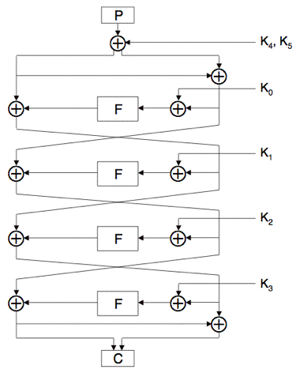
FEAL-4 Cipher
Plaintext: P
Ciphertext: C
Round function: F
32-bit subkeys:
K₀,K₁,…,K₅
XOR: ⊕
Very simple cipher!
Notes:
结构

Slide 9
FEAL-4 Round Function
Define
G₀(a,b) = (a + b (mod 256)) <<< 2
G₁(a,b) = (a + b + 1 (mod 256)) <<< 2
Where “<<<” is left cyclic shift (rotation)
Then F(x₀,x₁,x₂,x₃) = (y₀,y₁,y₂,y₃) where
y₁ = G₁(x₀ ⊕ x₁, x₂ ⊕ x₃) y₀ = G₀(x₀, y₁)
y₂ = G₁(y₁, x₂ ⊕ x₃) y₃ = G₁(y₂, x₃)
Notes:
轮函数

Slide 10
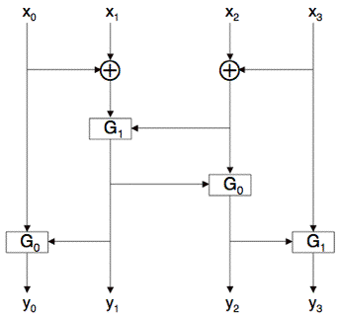
FEAL-4 Round Function
Schematic of FEAL-4 round function
Note the XORs
By considering differences, the cipher is simplified

Slide 11
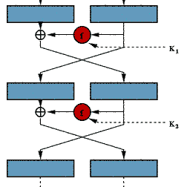
Block Cipher
x
S
S
S
S
k
P
S
S
S
S
P
E_{k}(x)
Feistel Structure
SPN Structure

Slide 12
Differential Attack
Chosen plaintext attack
First published by Biham and Shamir*
Don Coppersmith revealed that the designer of DES already known this attack
Differ. attack against DES need 2⁴⁷ (< 2 ⁵⁶) plaintexts**
*Biham, E. and A. Shamir. Differential Cryptanalysis of DES-like Cryptosystems. CRYPTO '90. 1990.
**Biham, E. and A. Shamir. Differential Cryptanalysis of the Full 16-round DES. CRYPTO '92. 1992.

Slide 13
Generic method cryptanalysis against iterated ciphers
X
X
1. None-random characteristics of round functions
2. None-random characteristics of Ciphers (distinguishers)
3. Recover key
f₁
X
E_{k}
=
X
f_{n}
X
X

Slide 14
Differential probability
Note:
Other operators can be used to define “difference”.
f

Slide 15
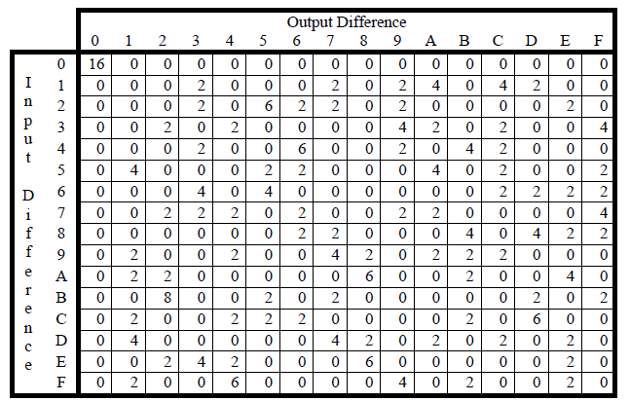

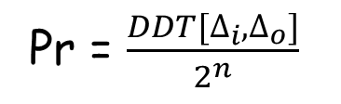
Differential property of non-linear operations (1)
Eg. S-box
$\#\{x∈\{0,1\}^{n}|S\left(x\right)⨁S\left(x⨁Δ_{i}\right)=Δ_{o}$}
Pr = $\frac{DDT[∆_{i},∆_{o}]}{2^{n}}$
Difference Distribution Table
When $∆_{i}≠0$, pr < 1.
When $∆_{i}=0$, same inputs-> same output.

Slide 16
Differential property of non-linear operations (2)
modular addition
a + b (mod 2^{n})
not efficient to build a DDT when n is large, eg. n = 16
There are other ways to study differential properties of addition.
For simplicity, we don’t involve them in the following slides.

Slide 17








Differential property of linear operations
Suppose L is linear
$L\left(x_{1}⊕ x_{2}\right)=L(x_{1})⊕L(x_{2})$
$$x_{1}$$
L
$$y_{1}=L(x_{1})$$
$$x_{2}$$
L
$$y_{2}=L(x_{2})$$
$$∆_{i}=x_{1}⊕ x_{2}$$
$$∆_{o}=y_{1}⊕ y_{2}$$
$$∆_{o}=L(∆_{i})$$
Differences propagate deterministically.

Slide 18
Steps of Differential Attack
1. Analyze DP of non-linear operations
2. Find r-round differential trail with high DP
3. Recover the (r+1)^{th} round key

Slide 19
FEAL-4 Differential Attack
A chosen plaintext attack
Two plaintexts, specified difference
Difference is known as a characteristic
For example if X is the characteristic,
P₀ ⊕ P₁ = X
Note, we can choose P₀ at random and let
P₁ = P₀ ⊕ X
Are there any useful characteristics?

Slide 20
FEAL-4 Round Function

Slide 21
FEAL-4 Differential Attack
Note: A₀ ⊕ A₁ = 0 implies F(A₀) = F(A₁)
Easy to show that if
A₀ ⊕ A₁ = 0x80800000
then for round function F we have
F(A₀) ⊕ F(A₁) = 0x02000000
And it holds with probability 1
Differential attack is based on this

Slide 22
Calculate the probability
Note: A₀ ⊕ A₁ = 0 implies F(A₀) = F(A₁)
80
80
00
00
G₀(a,b) = (a + b (mod 256)) <<< 2
0
0
0
0
The difference of y₀ is 0x02. Why?
80
0
0
02
0
0
0
Notes:
当我们将One-round differential 扩展到多轮时，轮密钥未知，该怎么做？

Slide 23
The impact of xoring subkeys
Treat them as constants
When subkeys are added linearly, they do not change differences.
Ignore them

Slide 24
FEAL-4 Differential Attack
Choose plaintext P₀ and P₁ so that
P₀ ⊕ P₁ = 0x8080000080800000
Given corresponding C₀ and C₁
Let P′ = P₀ ⊕ P₁ and C′ = C₀ ⊕ C₁
Consider difference P′ as it passes thru cipher
Under “⊕” subkeys drop out of cipher

Slide 25
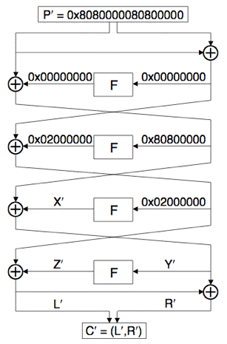
FEAL-4 Differential Attack
Characteristic for P′ gets us half way thru
then work backwards from C′
Try to meet in middle
Note differences L′,R′ are known

Slide 26
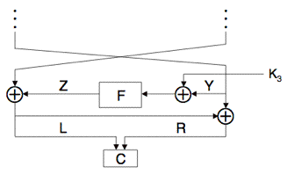
FEAL-4 Differential Attack
We know the output diff. of F
Z′ = 0x02000000 ⊕ L′
We know the inputs of F
Y₀=L₀⊕R ₀, Y₁=L₁⊕R₁
Guess K₃ and compute putative Z₀, Z₁
Note: Z_{i} = F(Y_{i} ⊕ K₃)
Compare true Z′ to putative Z′

Slide 27
FEAL-4 Differential Attack
Using 4 chosen plaintext pairs plaintexts
Work is of order 2³²
Expect one K₃ to survive
Good divide and conquer strategy
But it is possible to do better!
Can reduce work to about 2¹⁷
Relies on structure of F function
See next slide…
Notes:
4 chosen plaintexts
See the original paper
Sean Murphy, The Cryptanalysis of FEAL-4 with 20 Chosen Plaintexts. J. Cryptology 2(3): 145–154 (1990)

Slide 28
FEAL-4 Round Function
k₀
⊕
k₁
⊕
k₂
⊕
k₃
⊕
x₀,x₁,x₂,x₃ are known.
Goal:
Recover k₀,k₁,k₂,k₃
Differences of y₀,y₁,y₂,y₃ are known.

Slide 29
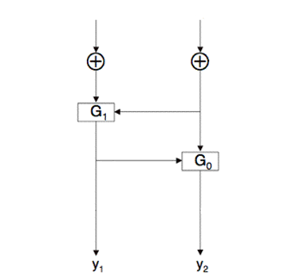
FEAL-4 Round Function
x₀+x₁
x₂+x₃
k₀⊕k₁
⊕
⊕
k₂⊕k₃
Recover 16 bits of K₃ with time = 2¹⁶

Slide 30
FEAL-4 Differential Attack
For 32-bit word A=(a₀,a₁,a₂,a₃), define
M(A) = (z, a₀ ⊕ a₁, a₂ ⊕ a₃, z)
where z is all-zero byte
For all possible A=(z,a₀,a₁,z), compute
Q₀ = F(M(Y₀) ⊕ A) and Q₁ = F(M(Y₁) ⊕ A)
Can be used to find 16 bits of K₃

Slide 31
FEAL-4 Differential Attack
For all possible A=(z,a₀,a₁,z), compute
Q₀ = F(M(Y₀) ⊕ A) and Q₁ = F(M(Y₁) ⊕ A)
When A = M(K₃) by defn of F, we have
⟨Q₀ ⊕ Q₁⟩_{8…23} = ⟨Z′⟩_{8…23}
where ⟨X⟩_{i…j} is bits i thru j of X
Can recover K₃ with about 2¹⁷ work

Slide 32
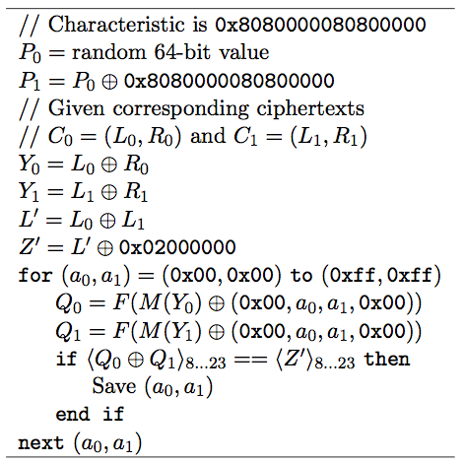
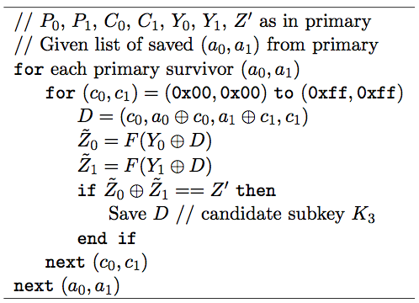
FEAL-4 Differential Attack
Primary for K₃
Secondary for K₃
Assuming only one chosen plaintext pair

Slide 33
FEAL-4 Differential Attack
Once K₃ is known, can successively recover K₂,K₁,K₀ and finally K₄,K₅
Attack is similar in each case
Some require different characteristics
There are a few subtle points

Slide 34
Differential Attacks
In FEAL-4, differential for K₃ holds with probability 1
In most differential attacks, probability is << 1, which
Increases chosen plaintext requirement
Increases work factor
Differential cryptanalysis seldom practical
Crucial work: Search for high-probability diff. characteristics

Slide 35
Linear Attack
Discovered by Mitsuru Matsui
First applied to FEAL *
The attack on DES requires 2⁴³ known plaintexts **
* Matsui, M. and Yamagishi, A. "A new method for known plaintext attack of FEAL cipher". EUROCRYPT 1992.
**Matsui, M. "Linear cryptanalysis method for DES cipher" . EUROCRYPT 1993.

Slide 36
Linear attack tries to find the linear approximations:
and then guess the value of the key

Slide 37
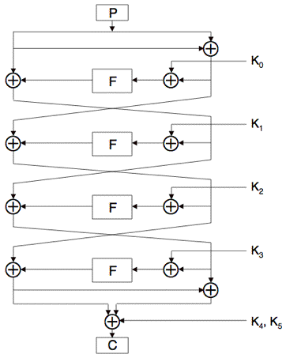
FEAL-4 Linear Attack
Consider equivalent form of FEAL-4
Known plaintext attack…

Slide 38
FEAL-4 Linear Attack
Let X be 32-bit word, X = (x₀,x₁,…,x₃₁)
Define S_{i,j}(X) = x_{i} ⊕ x_{j} and S_{i}(X) = x_{i}
Also extends to sum of more than 2 bits
Attack uses fact that for bytes a and b,
S₇(a ⊕ b) = S₇(a + b (mod 256))
Recall G₀(a,b) = (a + b (mod 256)) <<< 2,
so that S₅G₀(a,b) = S₇(a ⊕ b)
Also, S₅G₁(a,b) = S₇(a ⊕ b) ⊕ 1 as
LSB
G₁(a,b) = (a + b + 1 (mod 256)) <<< 2

Slide 39
FEAL-4 Linear Attack
Have S₅G₀(a,b) = S₇(a ⊕ b)
And S₅G₁(a,b) = S₇(a ⊕ b) ⊕ 1
Let Y = F(X), where X,Y are 32-bit words
Then it can be shown that
S₁₃(Y) = S_{7,15,23,31}(X) ⊕ 1
S₅(Y) = S₁₅(Y) ⊕ S₇(X)
S₁₅(Y) = S₂₁(Y) ⊕ S_{23,31}(X)
S₂₃(Y) = S₂₉(Y) ⊕ S₃₁(X) ⊕ 1
Linear relations between X and Y that hold with prob. = 1.

Slide 40








S₅G₀(a,b) = S₇(a ⊕ b)
S₅G₁(a,b) = S₇(a ⊕ b) ⊕ 1
$$x_{0}⋯x_{7}$$
$$x_{8}⋯x_{15}$$
$$x_{16}⋯x_{23}$$
$$x_{24}⋯x_{31}$$
S₁₃(Y) = S_{7,15,23,31}(X) ⊕ 1
S₅(Y) = S₁₅(Y) ⊕ S₇(X)
S₁₅(Y) = S₂₁(Y) ⊕ S_{23,31}(X)
S₂₃(Y) = S₂₉(Y) ⊕ S₃₁(X) ⊕ 1
S₁₃(Y) = S_{7,15,23,31}(X) ⊕ 1
S_{5,15}(Y) = S₇(X)
S_{15,21}(Y) = S_{23,31}(X)
S_{23,29}(Y) = S₃₁(X) ⊕ 1
$$y_{0}⋯y_{7}$$
$$y_{8}⋯y_{15}$$
$$y_{16}⋯y_{23}$$
$$y_{24}⋯y_{31}$$

Slide 41
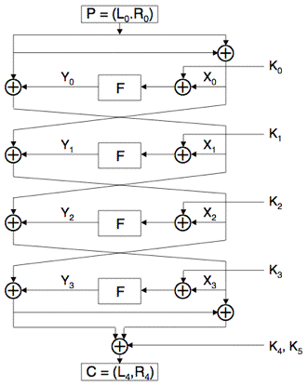
FEAL-4 Linear Attack
Label FEAL-4 intermediate steps
Use formulas on previous slide…

Slide 42

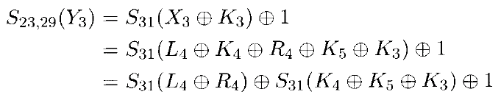
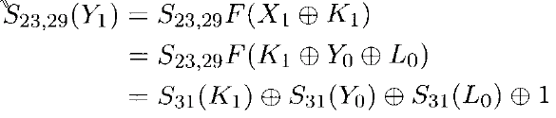

Start from some ciphertext bits

Slide 43
FEAL-4 Linear Attack
It can be shown that
a = S_{23,29}(L₀ ⊕ R₀ ⊕ L₄) ⊕ S₃₁(L₀ ⊕ L₄ ⊕ R₄)
⊕ S₃₁F(L₀ ⊕ R₀ ⊕ K₀)
Where a = S₃₁(K₁⊕K₃⊕K₄⊕K₅) ⊕ S_{23,29}(K₄)
Treat a as unknown, but constant
Exhaust over all choices for K₀
Test all known plaintext/ciphertext pairs
If a is not constant, putative K₀ is incorrect
All items are known except K₀
Unknown but constant

Slide 44
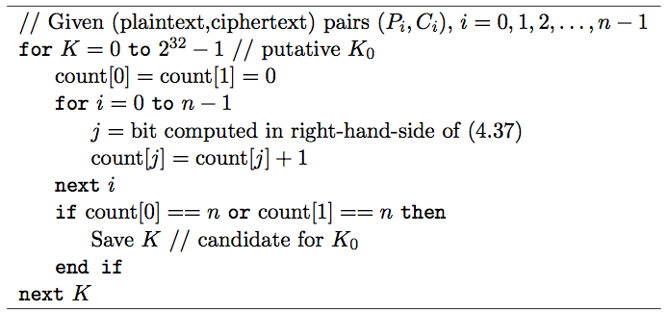
FEAL-4 Linear Attack
Linear attack to find K₀

Slide 45
FEAL-4 Linear Attack
Possible to improve on linear attack of previous slide
Exhaust for 12 bits of K₀ first, then…
Work is much less than 2³² (see text)
Can extend this attack to recover other subkeys
How about linear approximations with prob. << 1?

Slide 46
Confusion and Diffusion
Modern block ciphers employ both confusion and diffusion
FEAL-4 is a Feistel cipher
With round function F(X ⊕ K_{i})
Diffusion: shift bytes in F and bits in G₀,G₁
Confusion: XOR of K_{i} and addition
FEAL-4: diffusion and confusion are weak

Slide 47
FEAL-4 Conclusion
Weak block cipher
Important in modern cryptanalysis
Many variants in FEAL cipher family
All broken
Differential cryptanalysis developed for FEAL
Good example to illustrate both linear and differential attacks

Slide 48
Linear and Differential Attacks
Important tools to analyze ciphers
Used in block cipher design
Seldom practical methods of attack for block ciphers
Will see again with hash functions
In particular, differential attacks
Application to ciphers stronger than FEAL-4

Slide 49






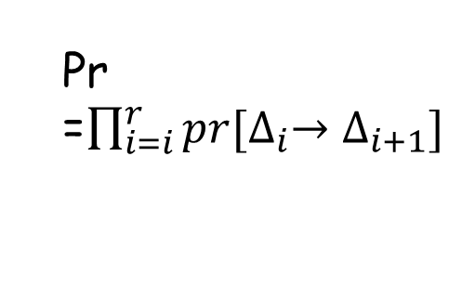
Diff./Linear characteristic
Characteristic/trail/path
State
$$P=$$
$X_{0}\underset{→}{F_{K_{0}}}X_{1}⋯$ $X_{r−1}\underset{→}{F_{K_{r−1}}}X_{r}\underset{→}{F_{K_{r}}}X_{r+1}$
$$=C$$
Diff.
Pr =$\prod_{i=i}^{r}{pr[∆_{i}→∆_{i+1}]}$
$$P⊕P^{′}=∆_{0}$$
$∆_{0}\underset{→}{F_{K_{0}}}∆_{1}⋯$ $∆_{r−1}\underset{→}{F_{K_{r}}}∆_{r}$
r-round distinguisher, pr > 2^{-n}
Linear
$Γ_{0}\underset{→}{F_{K_{0}}}Γ_{1}⋯$ $Γ_{r−1}\underset{→}{F_{K_{r}}}Γ_{r}$
Introduce later
r-round distinguisher, bias > 2^{-n/2}

Slide 50







Generic diff./linear analysis
Prepend/Append some rounds
K_{r+1}
Diff.
$$P⊕P^{′}=∆_{0}$$
$∆_{0}\underset{→}{F_{K_{0}}}∆_{1}⋯$ $∆_{r−1}\underset{→}{F_{K_{r}}}∆_{r}$
$$F^{−1}$$
$$C, C′$$
Distinguisher pr > 2^{-n}
Key recovery
K_{r+1}
Linear
$$P$$
$Γ_{0}\underset{→}{F_{K_{0}}}Γ_{1}⋯$ $Γ_{r−1}\underset{→}{F_{K_{r}}}Γ_{r}$
$$F^{−1}$$
$$C$$
Distinguisher
Bias > 2^{-n/2}
Key recovery

Slide 51



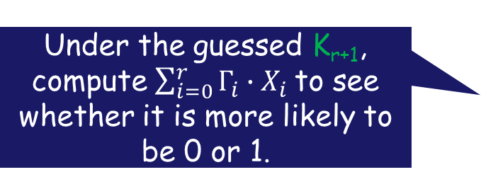


Key recovery
Under the guessed K_{r+1}, Check if the intermediate diff is $∆_{r}$
K_{r+1}
Diff.
$$P⊕P^{′}=∆_{0}$$
$∆_{0}\underset{→}{F_{K_{0}}}∆_{1}⋯$ $∆_{r−1}\underset{→}{F_{K_{r}}}∆_{r}$
$$C, C′$$
$$F^{−1}$$
Distinguisher pr > 2^{-n}
Key recovery
Under the guessed K_{r+1}, compute $\sum_{i=0}^{r}{Γ_{i}∙X_{i}}$to see whether it is more likely to be 0 or 1.
K_{r+1}
Linear
$$P$$
$Γ_{0}\underset{→}{F_{K_{0}}}Γ_{1}⋯$ $Γ_{r−1}\underset{→}{F_{K_{r}}}Γ_{r}$
$$F^{−1}$$
$$C$$
Distinguisher
Correlation c > 2^{-n/2}
Key recovery

Slide 52


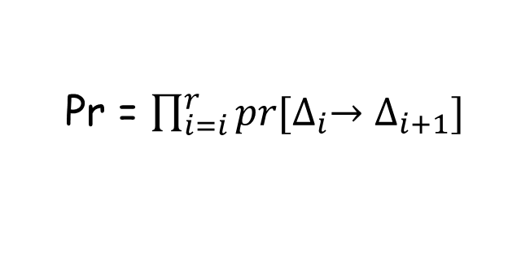
Differential prob.
state transition:
$X_{0}\underset{→}{F_{K_{0}}}X_{1}⋯$ $X_{r−1}\underset{→}{F_{K_{r−1}}}X_{r}$
diff. transition:
$∆_{0}\underset{→}{F_{K_{0}}}∆_{1}⋯$ $∆_{r−1}\underset{→}{F_{K_{r}}}∆_{r}$
Probability of the diff. trail:
Pr = $\prod_{i=i}^{r}{pr[∆_{i}→∆_{i+1}]}$
Assume subkeys are random and independent.
Notes:
Markov ciphers, 有时候这个假设不成立，相关性也是一个研究点

Slide 53

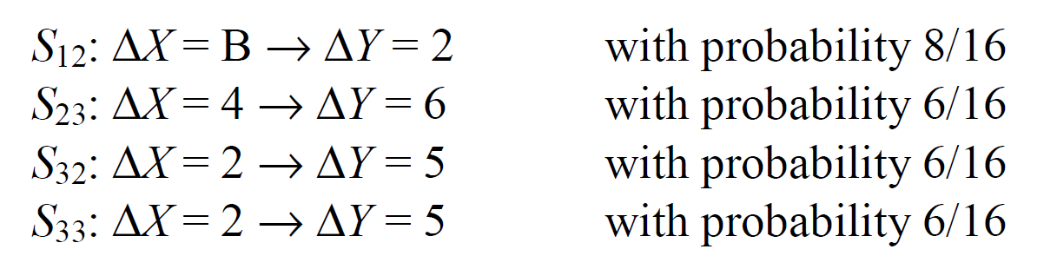















$$P$$
$⊕k_{0}$
$$S$$
$$S$$
$$S$$
$$S$$
$⊕k_{1}$
$$S$$
$$S$$
$$S$$
$$S$$
$⊕k_{2}$
$$S$$
$$S$$
$$S$$
$$S$$
$p=1728/2^{16}$
$⊕k_{3}$
$$F_{k_{4}}$$
$$C$$

Slide 54
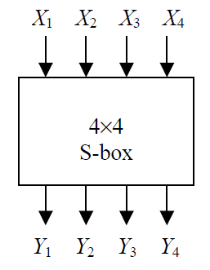

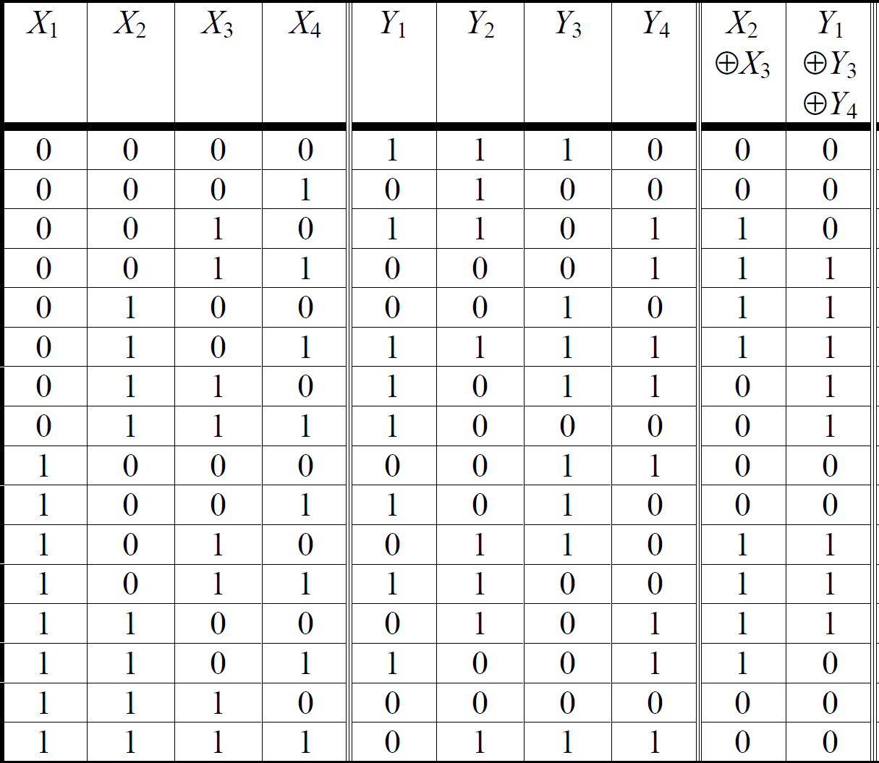
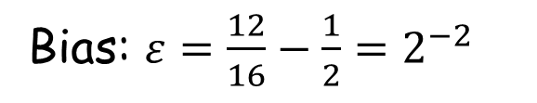
Linear bias
S-box:
Linear approximation of S-boxes:
It holds true for 12 out of 16 cases.
Bias: $ε=\frac{12}{16}−\frac{1}{2}=2^{−2}$
It is possibly negative.

Slide 55
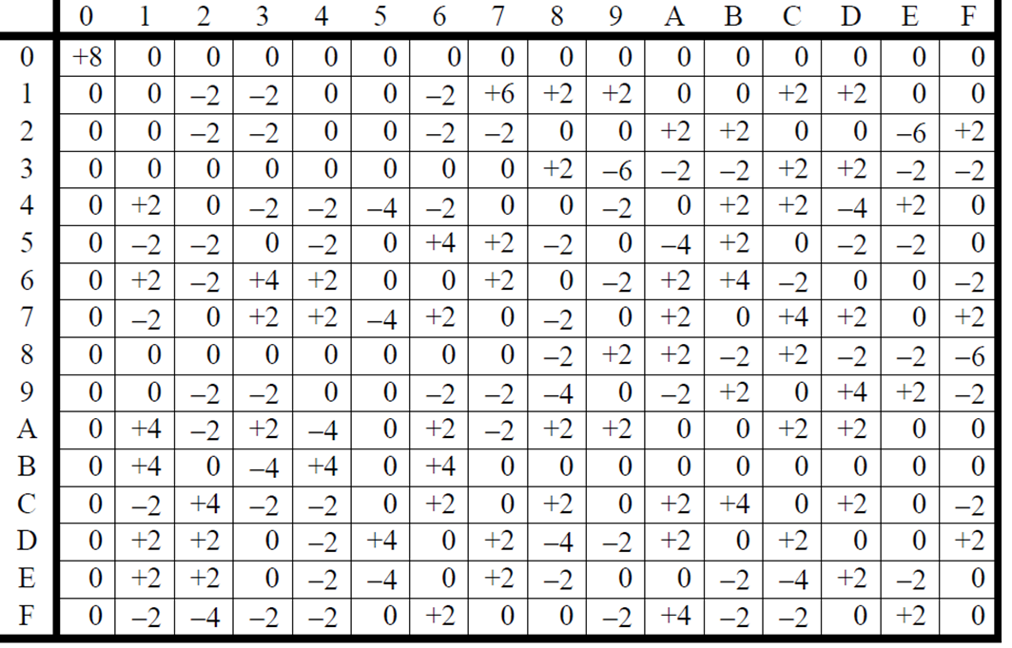
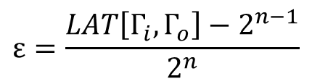



Linear bias
S-box:
Linear Approximation Table (LAT) :
Output mask $Γ_{o}$
Approximation:
Input mask $Γ_{i}$
$$Γ_{i}⋅X{⊕Γ}_{O}⋅Y=0$$
$$ε=\frac{LAT\left[Γ_{i},Γ_{o}\right]−2^{n−1}}{2^{n}}$$

Slide 56
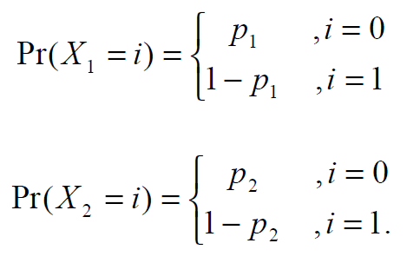

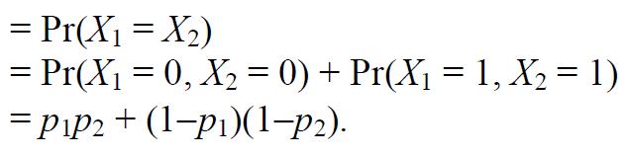



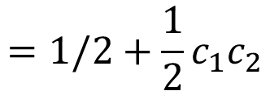
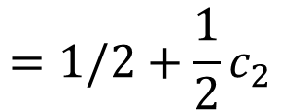
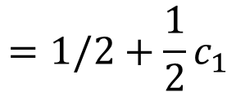
Linear bias of a trail
Piling-up Lemma: assume $X_{1},X_{2}$ are random variables
$$=1/2+{\frac{1}{2}c}_{1}$$
Let
then
$$=1/2+{\frac{1}{2}c}_{2}$$
$$=1/2+{\frac{1}{2}c}_{1}c_{2}$$
Product of correlations! Can be extended to the case with k random varialbes

Slide 57
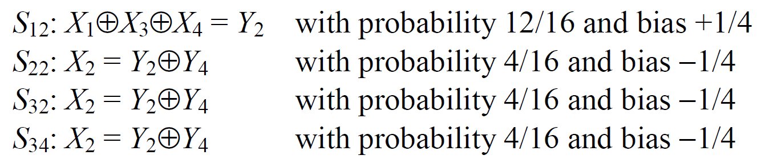

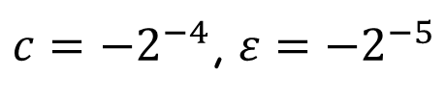






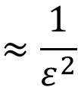







$$P$$
$⊕k_{0}$
$$S$$
$$S$$
$$S$$
$$S$$
$⊕k_{1}$
$$S$$
$$S$$
$$S$$
$$S$$
$⊕k_{2}$
$$S$$
$$S$$
$$S$$
$$S$$
$c={−2}^{−4}$, $ε={−2}^{−5}$
$⊕k_{3}$
$$F_{k_{4}}$$
$$≈\frac{1}{ε^{2}}$$
Data
$$C$$

Slide 58
Let’s recap
The FEAL block cipher
Differential attack on FEAL
Linear attack on FEAL
Generic differential/linear cryptanalysis
Notes:
To do: more about linear analysis, piling-up lemma
Prepare some home works:

Slide 59
Home work
FEAL-4的攻击都利用了LSB线性的特点。如果基于模加设计类似FEAL 但抗差分和线性的分组密码，有什么办法和策略可以提升安全性？

