Slide 1
MD4 and Collision Attacks
2021.04.14

Slide 2
MD4
Message Digest 4
Invented by Rivest, ca 1990
Weaknesses found by 1992
Rivest proposed improved version (MD5), 1992
Dobbertin found 1st MD4 collision in 1998
Clever and efficient attack
Nonlinear equation solving and differential

Slide 3
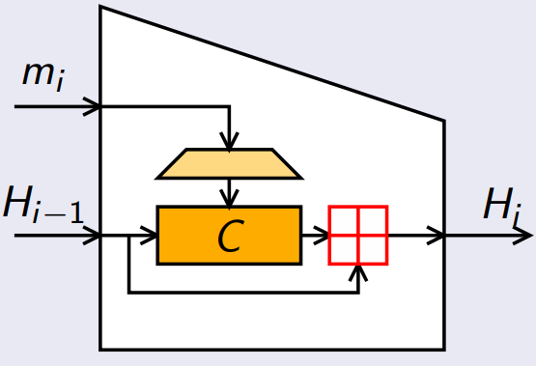
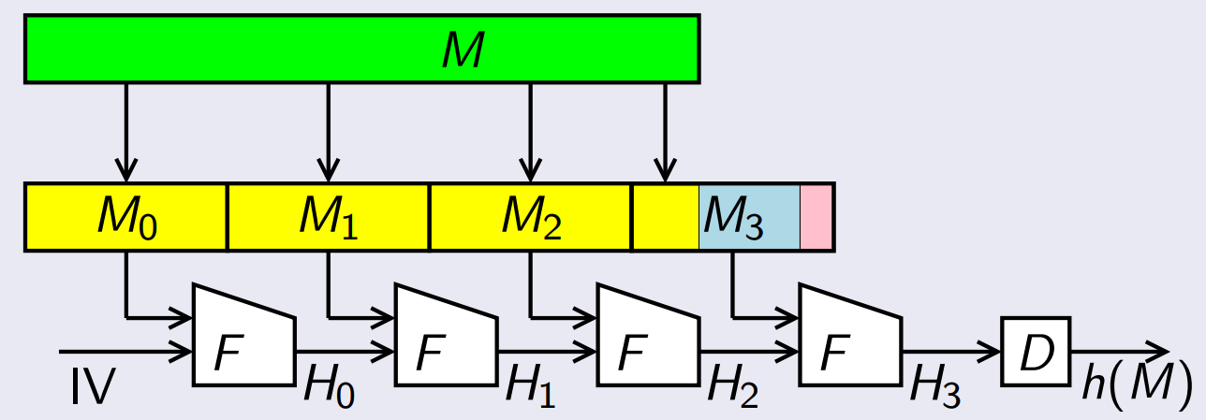
MD4
Merkle-Damgård
Block size: 512 bits
Internal state: 128 bits
Designed to be fast

Slide 4
MD4 - padding
Assumes 32-bit words
Let M be message to hash
Pad M so length is 448 (mod 512)
Single “1” bit followed by “0” bits
At least one bit of padding, at most 512
Length before padding (64 bits) is appended
What if padding with 0*?

Slide 5
MD4 - padding
After padding message is a multiple of the 512-bit block size
Also a multiple of 32-bit word size
Let N be number of 32-bit words
Then N is a multiple of 16
For each message block M = (M₀,M₁,…,M₁₆₋₁)
Each M_{i} is a 32-bit word

Slide 6
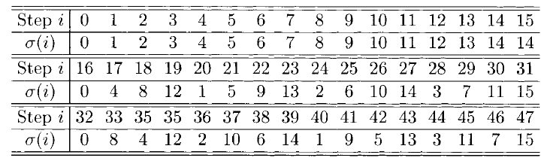

MD4 – message expansion
For each 512-bit message block $M$
$M=(M_{0},…,M_{15})⟼(m_{0},…,m_{47})$ where
$$m_{i}=M_{σ(i)}$$

Slide 7
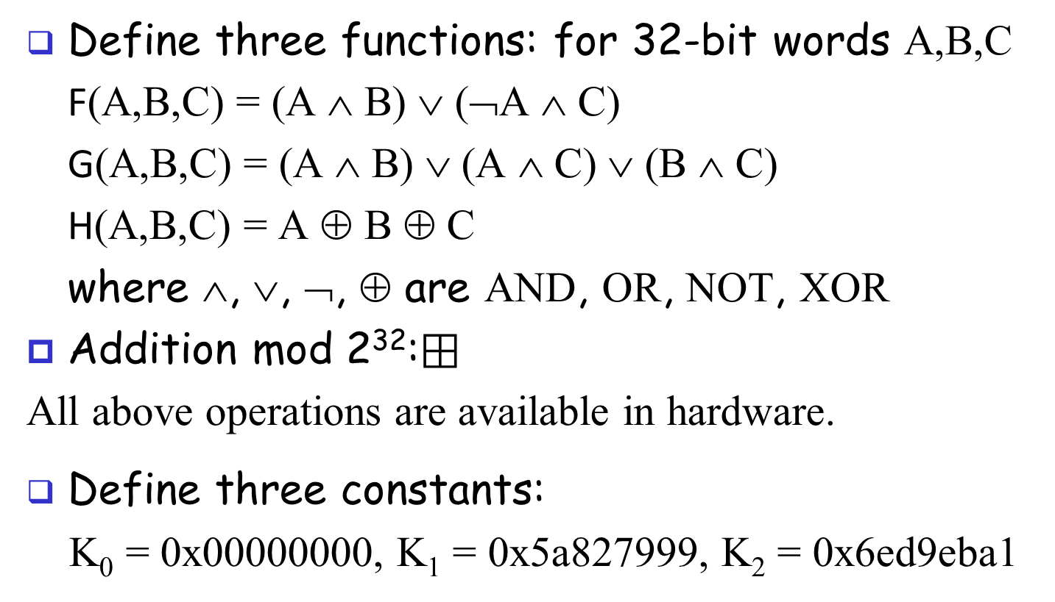
MD4 - components
Define three functions: for 32-bit words A,B,C
F(A,B,C) = (A ∧ B) ∨ (¬A ∧ C)
G(A,B,C) = (A ∧ B) ∨ (A ∧ C) ∨ (B ∧ C)
H(A,B,C) = A ⊕ B ⊕ C
where ∧, ∨, ¬, ⊕ are AND, OR, NOT, XOR
Addition mod 2³²:$⊞$
All above operations are available in hardware.
Define three constants:
K₀ = 0x00000000, K₁ = 0x5a827999, K₂ = 0x6ed9eba1

Slide 8
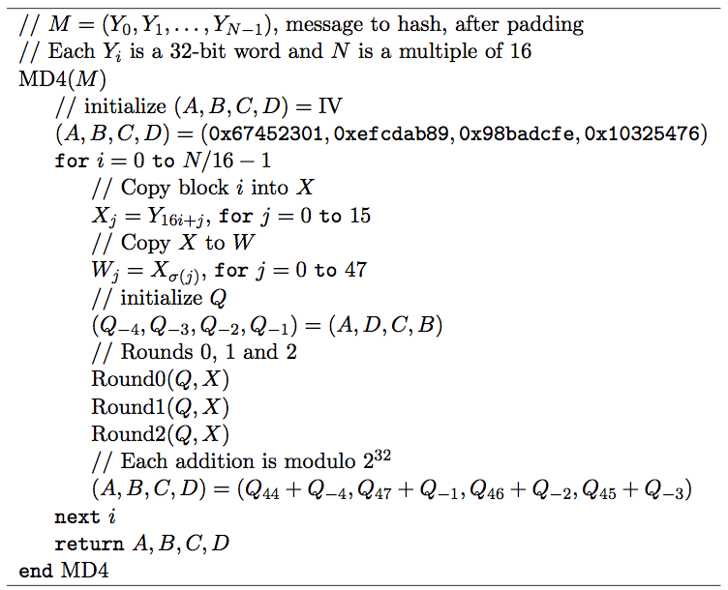
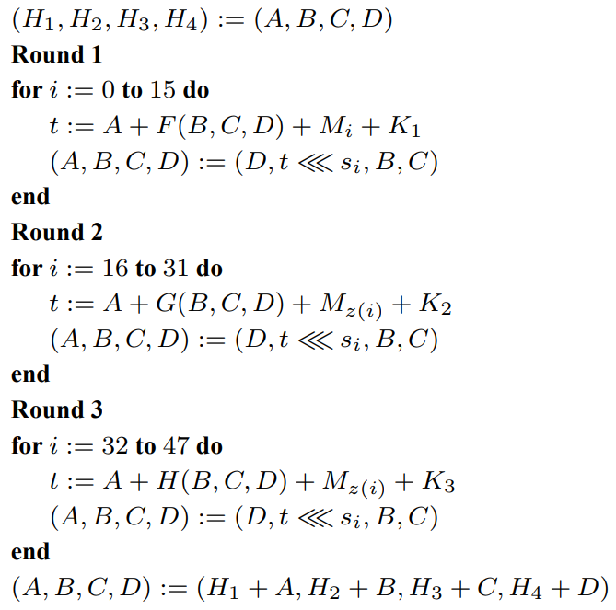
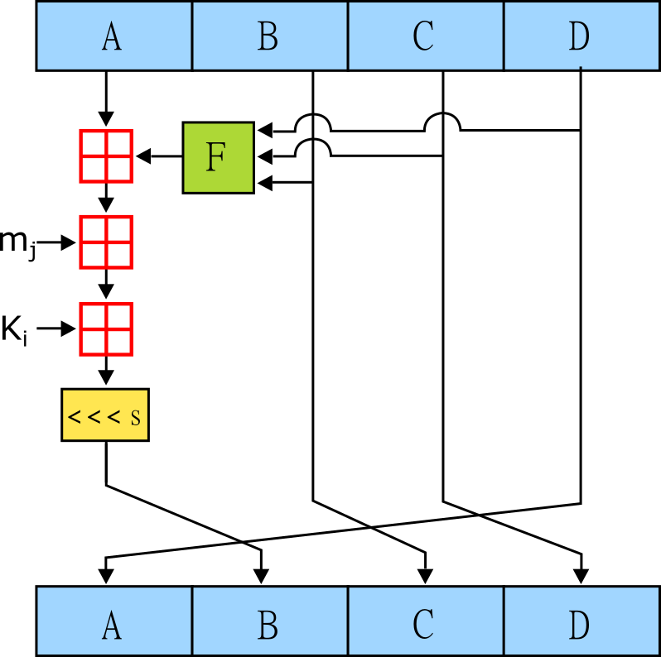



Slide 9
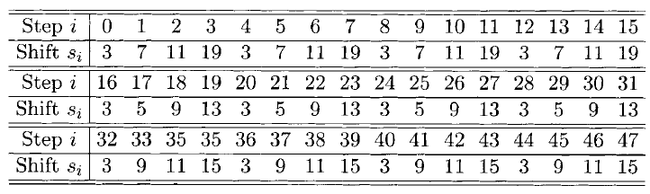
S for each round

Slide 10
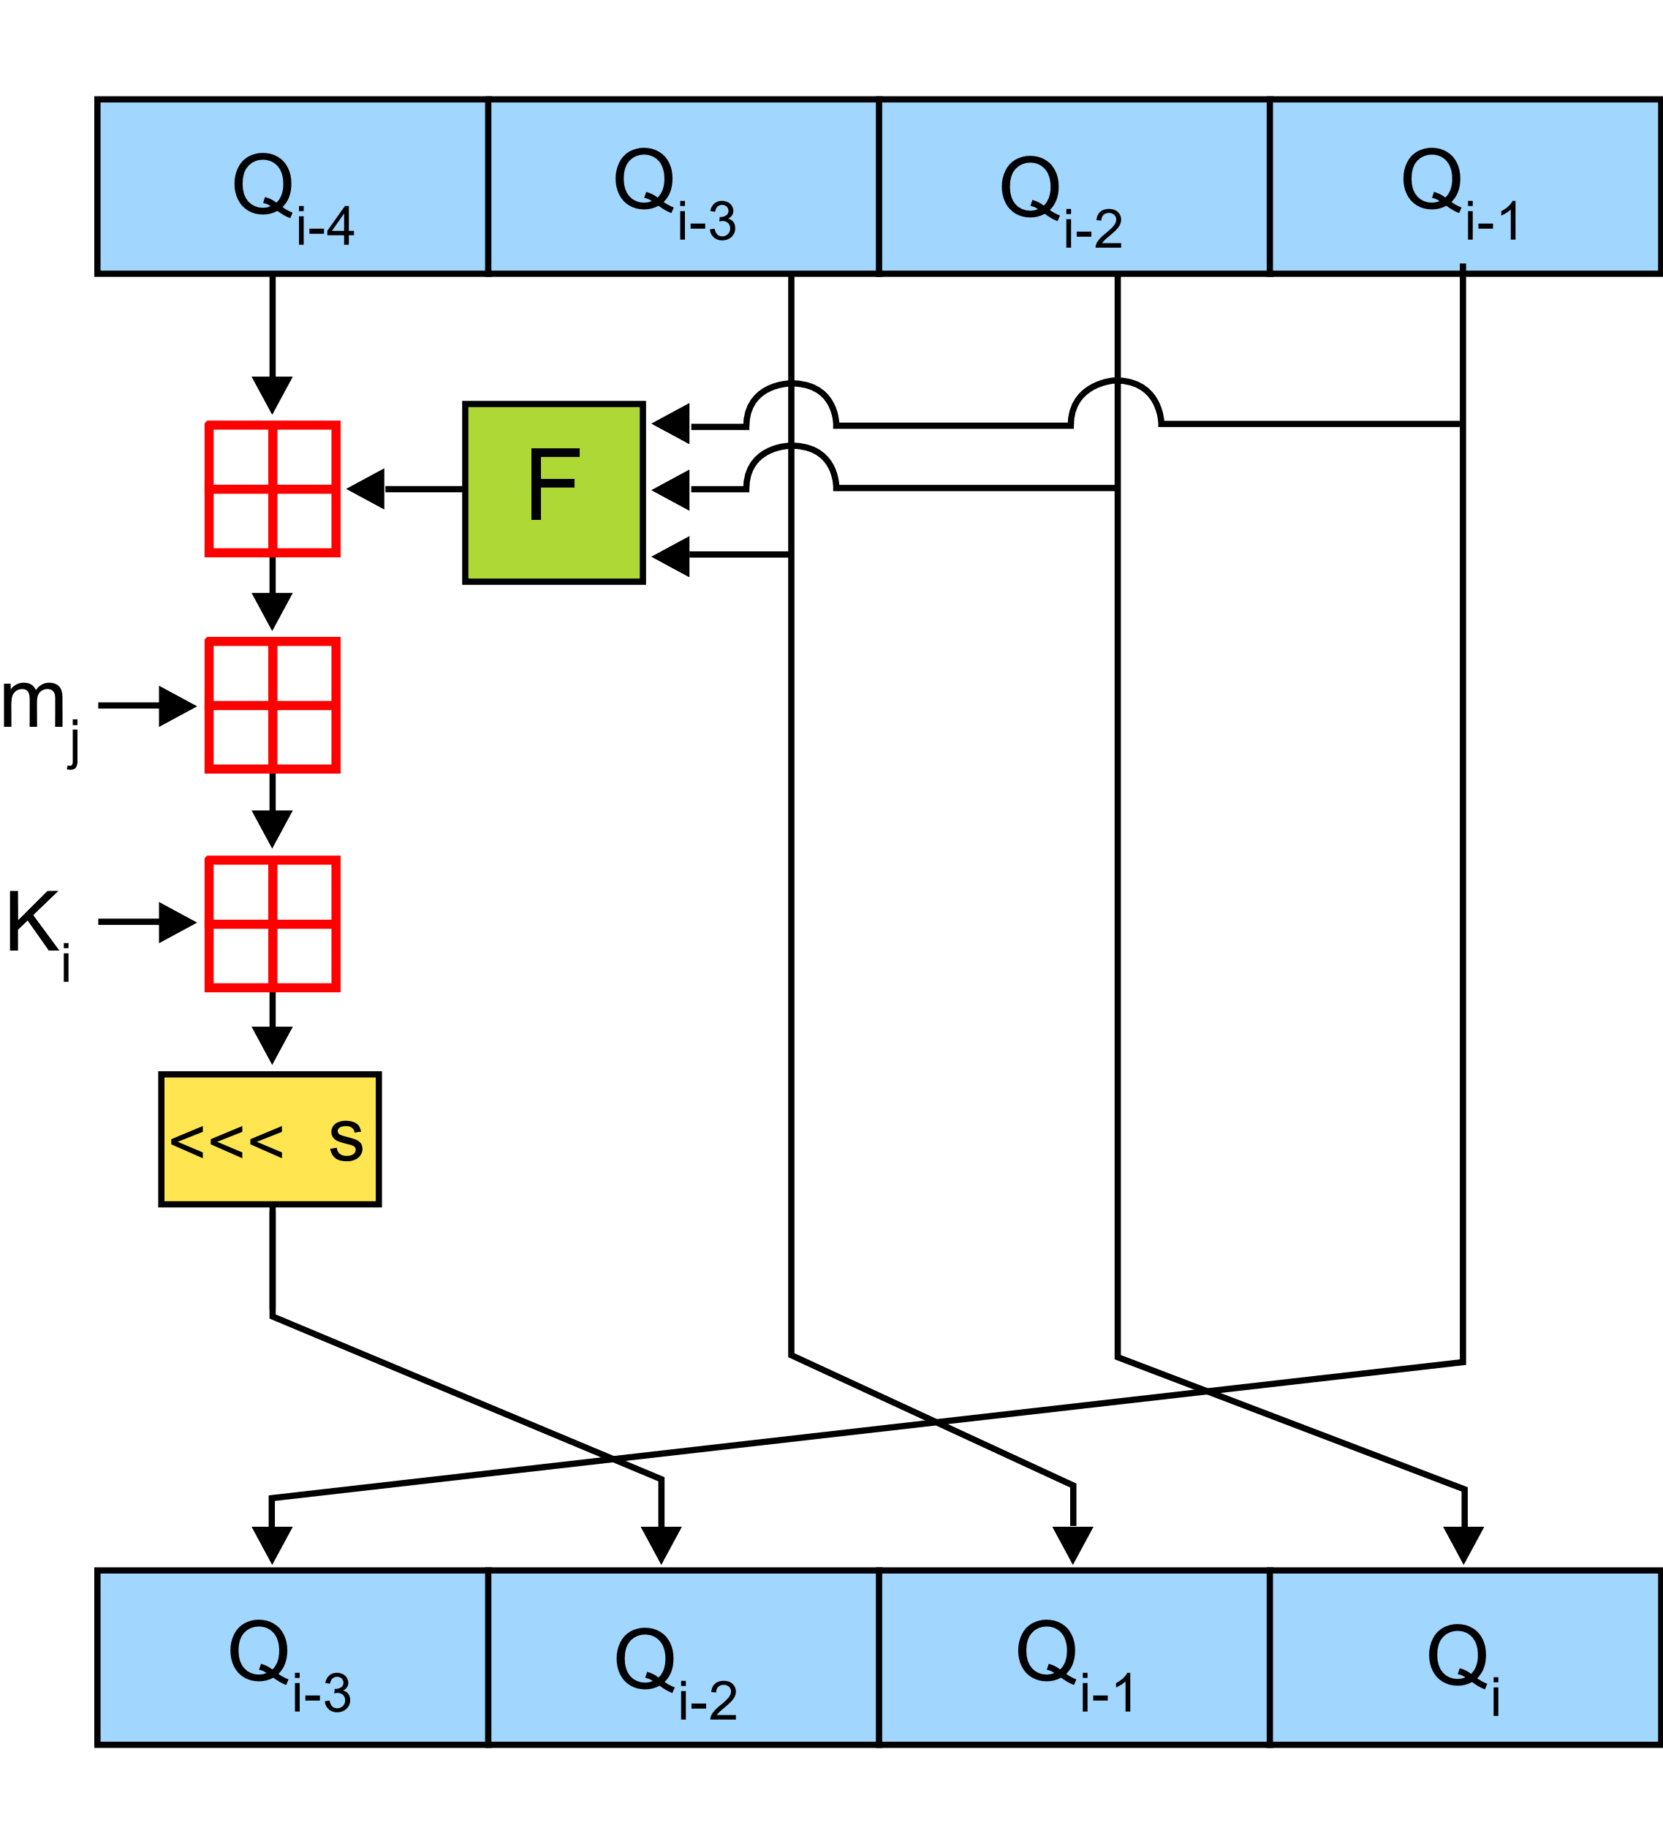

MD4: One Step
Where

Slide 11
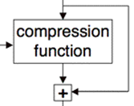

Notation
IV
M
Let MD4_{i…j}(A,B,C,D,M) be steps i thru j
“Initial value” (A,B,C,D) at step i, message M
Note that MD4_{0…47}(IV,M) ≠ h(M)
Due to padding and final transformation
Let f(IV,M) = (Q₄₄,Q₄₇,Q₄₆,Q₄₅) + IV
Where “+” is addition mod 2³², per 32-bit word
Then f is the MD4 compression function

Slide 12
Collision attack on MD4
Dobbertin’s attack strategy
Only word 12 differs
Apply differential analysis (natural)

Slide 13
If condition A holds, then a differential from step 19-35 ends with zero difference, with prob = 2⁻²²
If part of state/message words from step 12-19 are chosen in a certain way, condition A holds with high prob.
For the undetermined message words, choose a value so that the internal state for step 12 can be reach with given IV.
Critical

Slide 14
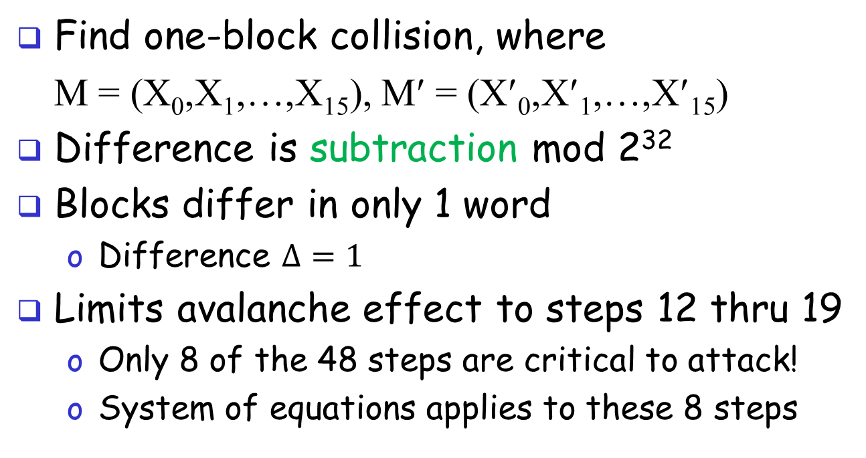
MD4 Attack: Motivation
Find one-block collision, where
M = (X₀,X₁,…,X₁₅), M′ = (X′₀,X′₁,…,X′₁₅)
Difference is subtraction mod 2³²
Blocks differ in only 1 word
Difference $Δ=1$
Limits avalanche effect to steps 12 thru 19
Only 8 of the 48 steps are critical to attack!
System of equations applies to these 8 steps

Slide 15
More Notation
Spse (Q_{j},Q_{j−1},Q_{j−2},Q_{j−3}) = MD4_{0…j}(IV,M)
and (Q′_{j},Q′_{j−1},Q′_{j−2},Q′_{j−3}) = MD4_{0…j}(IV,M′)
Define
Δ_{j} = (Q_{j} − Q′_{j}, Q_{j−1} − Q′_{j−1}, Q_{j−2} − Q′_{j−2}, Q_{j−3} − Q′_{j−3} )
where subtraction is modulo 2³²
Let ±2^{n} denote ±2^{n} mod 2³², for example,
2²⁵ = 0x02000000 and −2⁵ = 0xffffffe0

Slide 16
MD4 Attack
All arithmetic is modulo 2³²
Denote M = (X₀,X₁,…,X₁₅)
Define M′ by X′_{i} = X_{i} for i ≠12 and
X′₁₂ = X₁₂ + 1
Word X₁₂ last appears in step 35
So, if Δ₃₅ = (0,0,0,0) we have a collision
Goal is to find pair M and M′ with Δ₃₅ = 0

Slide 17
MD4 Attack
Analyze attack in three phases
Show: Δ₁₉ = (2²⁵,−2⁵,0,0) implies probability at least 1/2³⁰ that the Δ₃₅ condition holds
Uses differential cryptanalysis
“Backup” to step 12: We can start at step 12 and have Δ₁₉ condition hold
By solving system of nonlinear equations
“Backup” to step 0: And find collision

Slide 18
X₀
0
Find X_{j} for remaining j
X₁₂
12
Find (Q₈,Q₉,Q₁₀,Q₁₁)
and X_{j} for j = 0,4,8,12,13,14,15
By solving system of nonlinear equations
X₁₂
19
Δ₁₉ = (2²⁵,−2⁵,0,0)
p ≥ 1/2³⁰
X₁₂
35
Δ₃₅ = (0,0,0,0)
47

Slide 19
MD4 Attack
In each phase of attack, some words of M are determined
When completed, have M and M′
Where M ≠ M′ but h(M) = h(M′)
Equation solving step is tricky part
Nonlinear system of equations
Must be able to solve efficiently

Slide 20
Steps 19 to 35
Differential phase of the attack
Suppose M and M′ as given above
Only differ in word 12
Assume that Δ₁₉ = (2²⁵,−2⁵,0,0)
And G(Q₁₉,Q₁₈,Q₁₇) = G(Q′₁₉,Q′₁₈,Q′₁₇)
Then we compute probabilities of “Δ” conditions at steps 19 thru 35

Slide 21
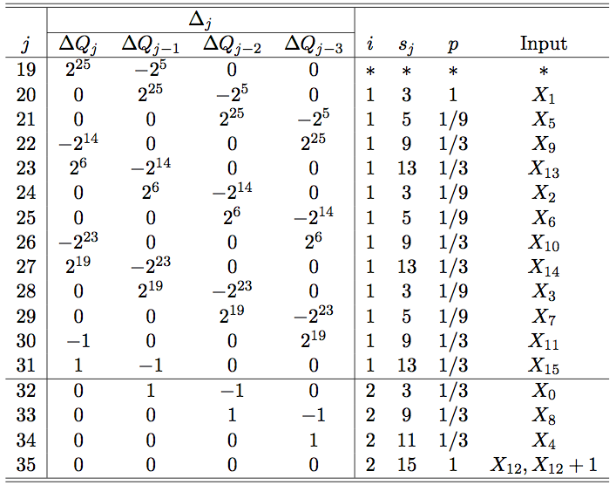
Steps 19 to 35
G
H
Differential and probabilities

Slide 22
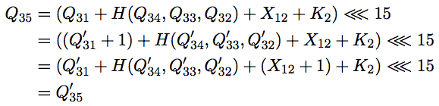
Steps 19 thru 35
For example, consider Δ₃₅
Spse j = 34 holds: Then Δ₃₄ = (0,0,0,1) and
Implies Δ₃₅ = (0,0,0,0) with probability 1
As summarized in j = 35 row of table

Slide 23
Steps 12 to 19
Analyze steps 12 to 19, find conditions that ensure Δ₁₉ = (2²⁵,−2⁵,0,0)
And G(Q₁₉,Q₁₈,Q₁₇) = G(Q′₁₉,Q′₁₈,Q′₁₇), as required in differential phase
Step 12 to 19—equation solving phase
This is most complex part of attack
Last phase, steps 0 to 11, is easy

Slide 24
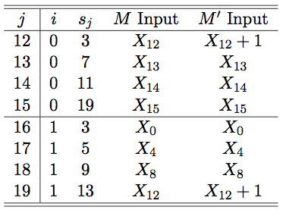
Steps 12 to 19
Info for steps 12 to 19 given here
If i = 0, function F, if i = 1, function G
F
G

Slide 25
Steps 12 to 19
To apply differential phase, must have
Δ₁₉ = (2²⁵,−2⁵,0,0) which states that
Q₁₉ = Q′₁₉ + 2²⁵
Q₁₈ + 2⁵ = Q′₁₈
Q₁₇ = Q′₁₇
Q₁₆ = Q′₁₆
Derive equations for steps 12 to 19…

Slide 26
Step 12
At step 12 we have
Q₁₂ = (Q₈ + F(Q₁₁,Q₁₀,Q₉) + X₁₂) <<< 3
Q′₁₂ =(Q′₈ + F(Q′₁₁,Q′₁₀,Q′₉) + X′₁₂) <<< 3
Since X′₁₂ = X₁₂ + 1 and
(Q₈,Q₉,Q₁₀,Q₁₁) = (Q′₈,Q′₉,Q′₁₀,Q′₁₁)
it follows that
(Q′₁₂ <<< 29) − (Q₁₂ <<< 29) = 1

Slide 27
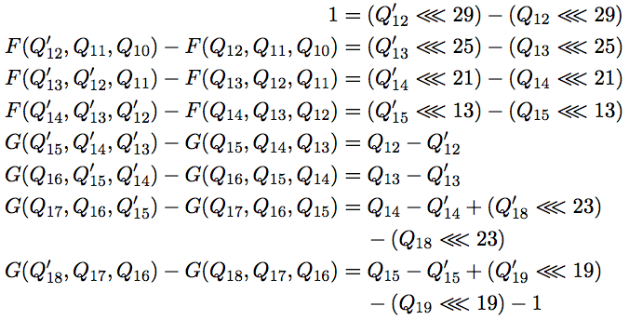
Steps 12 to 19
Similar analysis for remaining steps yields system of equations:

Slide 28
Steps 12 to 19
To solve this system must find
so that all equations hold
Given such a solution, we determine
X_{j} for j = 13,14,15,0,4,8,12
so that we begin at step 12 and arrive at step 19 with Δ₁₉ condition satisfied

Slide 29
Steps 12 to 19
This phase reduces to solving (nonlinear) system of equations
Can manipulate the equations so that
Choose (Q₁₄,Q₁₅,Q₁₆,Q₁₇,Q₁₈,Q₁₉) arbitrary
Which determines (Q₁₀,Q₁₃,Q′₁₃ ,Q′₁₄ ,Q′₁₅)
See textbook for details
Result is 3 equations must be satisfied (next slide)

Slide 30

Steps 12 to 19
Three conditions must be satisfied:
First 2 are “check” equations
Third is “admissible” condition
Naïve algorithm: choose six Q_{j}, yields five Q_{j},Q′_{j} until 3 equations satisfied
How much work is this?

Slide 31
Continuous Approximation
Each equation holds with prob 1/2³²
Appears that 2⁹⁶ iterations required
Since three 32-bit check equations
Birthday attack on MD4 is only 2⁶⁴ work!
Dobbertin has a clever solution
A “continuous approximation”
Small changes, converge to a solution

Slide 32
Continuous Approximation
Generate random Q_{i} values until first check equation is satisfied
Random one-bit modifications to Q_{i}
Save if 1st check equation still holds and 2nd check equation is “closer” to holding
Else try different random modifications
Modifications converge to solution
Then 2 check equations satisfied
Repeat until admissible condition holds

Slide 33
Continuous Approximation
Why does continuous approx work?
Small change to arguments of F (or G) yield small change in function value
What is the work factor?
Not easy to determine analytically
Easy to determine empirically
Efficient, and only once per collision

Slide 34
Steps 0 to 11
At this point, we have (Q₈,Q₉,Q₁₀,Q₁₁) and
MD4_{12…47}(Q₈,Q₉,Q₁₀,Q₁₁,X) = MD4_{12…47}(Q₈,Q₉,Q₁₀,Q₁₁,X′)
To finish, we must have
MD4_{0…11}(IV,X) = MD4_{0…11}(IV,X′) = (Q₈,Q₉,Q₁₀,Q₁₁)
Recall, X₁₂ is only difference between M, M′
Also, X₁₂ first appears in step 12
Have already found X_{j} for j = 0,4,8,12,13,14,15
Free to choose X_{j} for j = 1,2,3,5,6,7,9,10,11 so that MD4_{0…11} equation holds — very easy!

Slide 35
All Together Now
Attack proceeds as follows…
Steps 12 to 19: Find (Q₈,Q₉,Q₁₀,Q₁₁) and X_{j} for j = 0,4,8,12,13,14,15
Steps 0 to 11: Find X_{j} for remaining j
Steps 19 to 35: Check Δ₃₅ = (0,0,0,0)
If so, have found a collision!
If not, goto 2.

Slide 36
Meaningful Collision
MD4 collisions exist where M and M′ have meaning
Attack is so efficient, possible to find meaningful collisions
Let “∗” represent a “random” byte
Inserted for “security” purposes
Can find collisions on next slide…

Slide 37
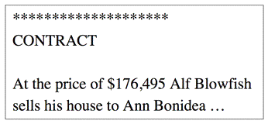
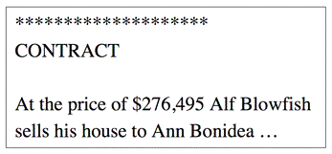
Meaningful Collision
Different contracts, same hash value

Slide 38
MD4 Conclusions
MD4 weaknesses exposed early
Never widely used
But took long time to find a collision
Dobbertin’s attack
Clever equation solving phase
Also includes differential phase
Seconds to find a collision

Slide 39
Latter attacks on MD4
Collision
In 2004, a very efficient collision attack by Wang et. al;
Improved later by Sasaki et al. a few microseconds.
Preimage:
In 2008, the preimage resistance of MD4 was also broken by Gaetan Leurent, with complexity 2¹⁰².

Slide 40
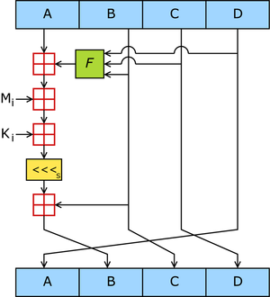
MD5
Block size 512 bits, digest size 128 bits
64 steps
Collision attack 2¹⁸

Slide 41
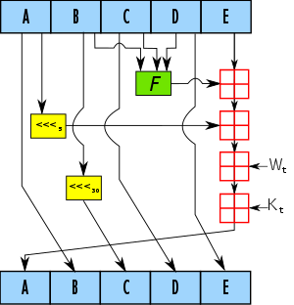
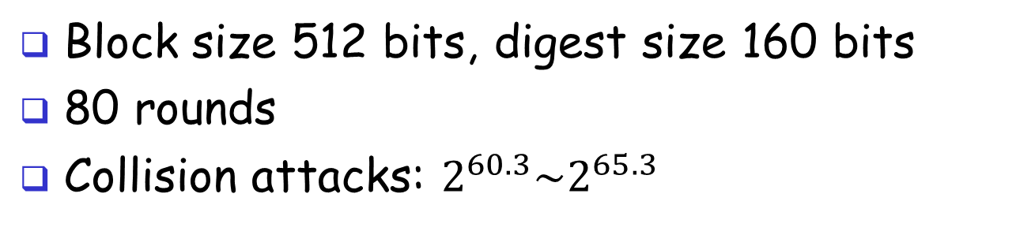
SHA-1
Block size 512 bits, digest size 160 bits
80 rounds
Collision attacks: $2^{60.3}\sim 2^{65.3}$

Slide 42
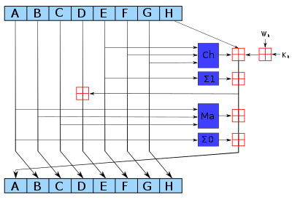
SHA-2
Block size 256/512 bits, digest size 224, 256, 384 and 512 bits
64/80 rounds

