Slide 1
Topics
A short intro of block ciphers
Meet-in-the-middle attack
Application to Feistel
Time-memory trade-off attack
2021.03.10

Slide 2
Block Ciphers

Slide 3
What’s a block cipher?
Part II
Part I
x
E_{k} : X → X bijective for all k
Key schedule Algorithm
k
Round function
E_{k}(x)

Slide 4
(Iterated) Block Cipher
Plaintext and ciphertext “units” are fixed sized blocks
Typical block sizes: 64 to 256 bits
Ciphertext obtained from plaintext by iterating a round function
Input to round function consists of key and the output of previous round

Slide 5
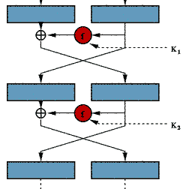
Feistel Cipher
Example: DES
Feistel network
Notes:
Two main structures for designing block ciphers, mainly for the encryption part, not the key schedule part

Slide 6
Feistel Cipher
Feistel cipher refers to a type of block cipher design, not a specific cipher
Split plaintext block into left and right halves: Plaintext = (L₀,R₀)
For each round i=1,2,...,n, compute
L_{i}= R_{i−1}
R_{i}= L_{i−1} ⊕ f(R_{i−1},K_{i})
where f is round function and K_{i} is subkey
Ciphertext = (L_{n},R_{n})
Notes:
Feistel has variants

Slide 7
Feistel Cipher
Decryption: Ciphertext = (L_{n},R_{n})
For each round i=n,n−1,…,1, compute
R_{i−1} = L_{i}
L_{i−1} = R_{i} ⊕ F(R_{i−1},K_{i})
where F is round function and K_{i} is subkey
Plaintext = (L₀,R₀)
Formula “works” for any function F
But only secure for certain functions F

Slide 8
SP network
S
S
S
S
P
Example: AES
S
S
S
S
P
SPN network
Notes:
Other: Lai-massey construction

Slide 9
So many attacks…
prob. rational interpol.
higher-order d.c.
probabilistic interpol.
yo-yo
rational interpol.
boomerang
integrals
MITM
TMTO
interpolation attacks
truncated d.c.
sliding
l.c. with multiple approximations
differential crypt.
impossible d.c.
linear crypt.
complementation props.
linear factors

Slide 10
Deffie&Hellman’s MitM Attack

Slide 11


Home work
Consider two ciphers, Cipher A and Cipher B, and suppose that Cipher A has a 64-bit key, while Cipher B has a 128-bit key. Alice prefers Cipher A, while Bob wants the additional security provided by a 128-bit key, so he insists on Cipher B. As a compromise, Alice proposes that they use Cipher A, but they encrypt each message twice, using two independent64-bit keys. Assuming that no shortcut attack is available for either cipher, is Alice’s approach sound?
$$K_{1}$$
$$K_{2}$$
64
64
plaintext
Cipher A
Cipher A
ciphertext
Notes:
讨论一下作业中同学们的思路

Slide 12
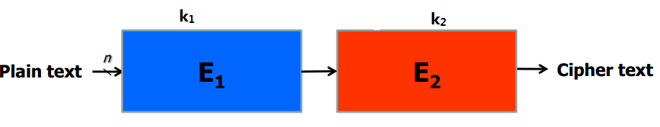



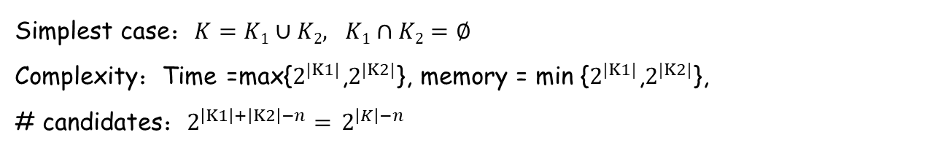
Meet-in-the-Middle Attack
Proposed by Diffie and Hellman for analyzing m-DES in 1977
u
v
Simplest case：$K=K1∪K2, K1∩K2=∅$
Complexity：Time =max{$2^{|K1|}$,$2^{|K2|}$}, memory = min {$2^{|K1|}$,$2^{|K2|}$},
# candidates：$2^{\left|K1\right|+\left|K2\right|−n}=$ $2^{\left|K\right|−n}$
Given a pair（P,C）
For all possible K1，compute u=E₁(P,K₁)，store u in table L
For all possible K2，compute v=E¹₂（C,K₂）, look up table L to find a match. If a match is found, i.e., u=v，the corresponding (K₁, K₂) is a candidate.
Test all candidates（K₁,K₂）
$$2^{|K_{1}|}$$
$$2^{|K_{2}|}$$
$$2^{\left|K\right|−n}$$
Notes:
$2^{\left|K\right|−n}$特别解释一下，为什么是减去n

Slide 13
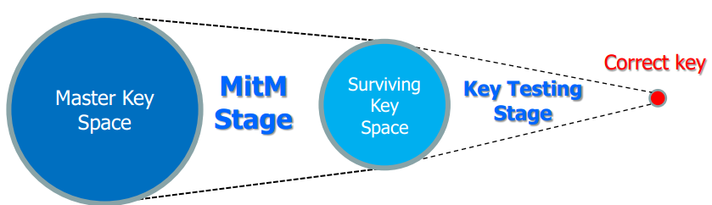
Meet-in-the-Middle Attack
Proposed by Diffie and Hellman for analyzing m-DES in 1977
u
v

Slide 14
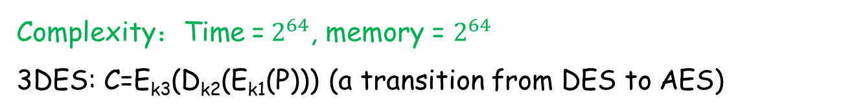
Home work
Consider two ciphers, Cipher A and Cipher B, and suppose that Cipher A has a 64-bit key, while Cipher B has a 128-bit key. Alice prefers Cipher A, while Bob wants the additional security provided by a 128-bit key, so he insists on Cipher B. As a compromise, Alice proposes that they use Cipher A, but they encrypt each message twice, using two independent64-bit keys. Assuming that no shortcut attack is available for either cipher, is Alice’s approach sound?
$$K_{1}$$
$$K_{2}$$
64
64
plaintext
Cipher A
Cipher A
ciphertext
Complexity：Time =$2^{64}$, memory = $2^{64}$
3DES: C=E_{k3}(D_{k2}(E_{k1}(P))) (a transition from DES to AES)
Notes:
一个成功的攻击，其T,M,D需要满足什么条件？
银行系统中之前就用3DES （1999）

Slide 15
Complexities for a successful attack
Data D < 2^{n}
Sometimes D >= 2^{n} is acceptable
Time T < 2^^{k-1}
Memory M < 2^^{k}

Slide 16
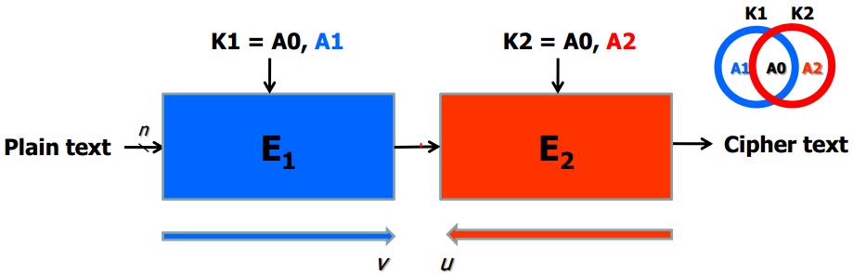

MitM
K1,K2不能完全独立的情形，即 3-subset MitM
猜测A0,然后进行简单的中间相遇
MitM的时间复杂度：max{$2^{|A1|}$,$2^{|A2|}$}$×2^{|A0|}$, 存储复杂度： min {$2^{|A1|}$,$2^{|A2|}$},
筛选出的密钥量：$2^{\left|K1\right|+\left|K2\right|−n}=$ $2^{\left|K\right|−n}$
Notes:
考虑一般化一点的情形：不是将一个算法连续用两次，K1,K2不能完全独立

Slide 17
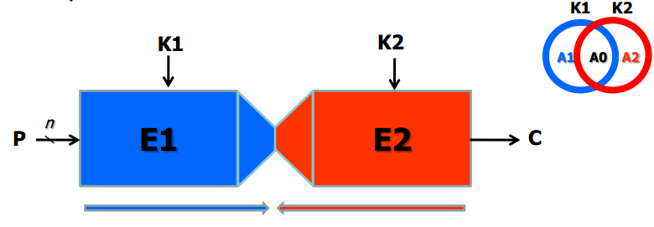
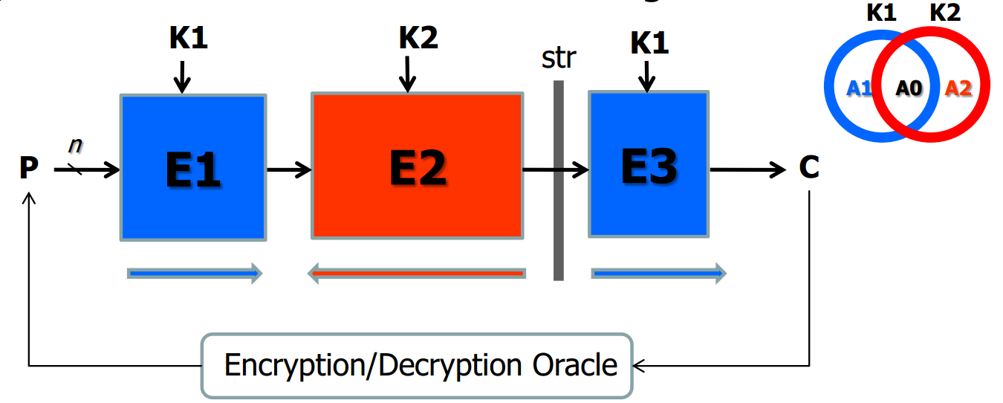
MitM
部分匹配(partial matching),则需要多一点的明密文对
Splice-and-cut, 已知明文攻击变成选择明文/密文攻击

Slide 18
Limitation
前面的MitM攻击依赖简单的密钥扩展算法，密钥扩展简单，则划分独立密钥比特集可行
例如对KTANTAN， GOST , LED 的MitM攻击
对于密钥扩展复杂的密码，MitM攻击难以操作
很自然的考虑：
对于密钥扩展复杂的密码，如何进行MitM攻击？
这类密码抗MitM攻击的安全性如何？

Slide 19
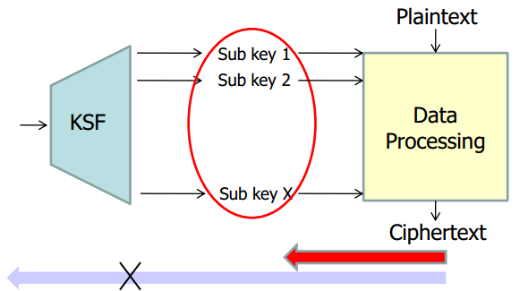
All SubKeys Recovery(ASR) Attack
扩展MitM,使其应用于更多密码的分析
恢复master key => 所有子密钥
避开密钥扩展算法是否复杂的问题
Master key

Slide 20
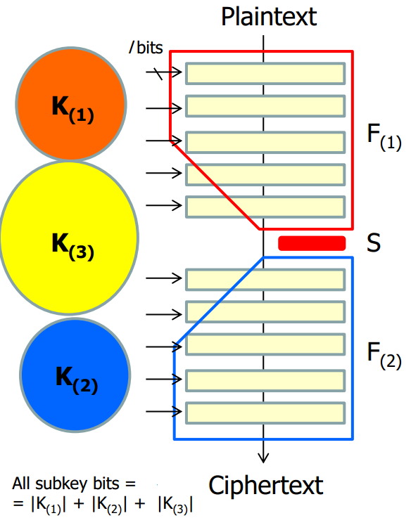

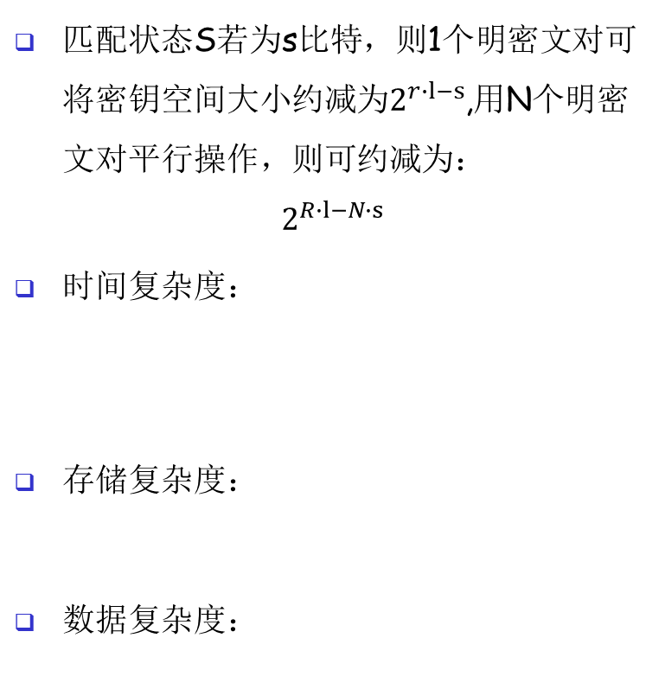



All SubKeys Recovery(ASR) Attack
匹配状态S若为s比特，则1个明密文对可将密钥空间大小约减为$2^{r∙l−s}$,用N个明密文对平行操作，则可约减为：
$$2^{R∙l−N∙s}$$
时间复杂度：
存储复杂度：
数据复杂度：
MitM stage
Key testing
$$R∙l$$
$$max(N,(R∙l−N∙s)/n)$$
$l 为$轮密钥的长度
Notes:
轮密钥当成相互独立，目标恢复R轮的轮密钥

Slide 21
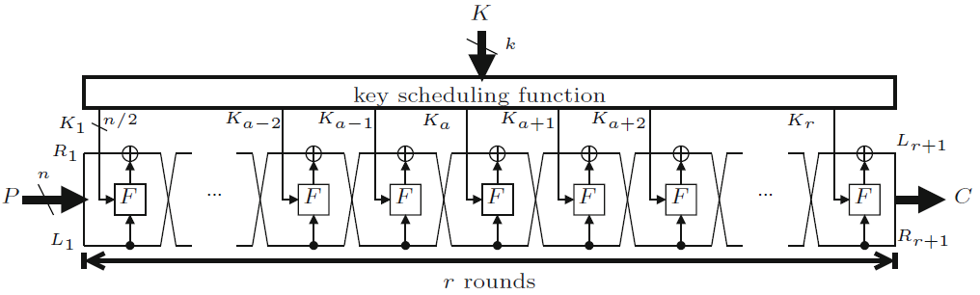
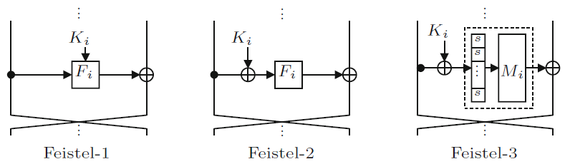
Feistel Scheme
Feistel 密码
考虑的轮函数结构
Feistel-1[2n]表示密钥长度是分组长度的2倍
Notes:
应用于Feistel结构，利用一点点密码算法的细节

Slide 22
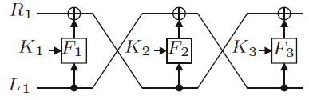
Simple attack on Feistel-1
Feistel-1[n]
Feistel-1[2n],密钥长度更长了，允许在Feistel-1[n]的基础上前后各加2轮，可攻击7轮
Notes:
多猜一轮，就要猜等同于密钥长度的子密钥了。多一轮就是多猜测n/2。可不可以少于n/2?

Slide 23
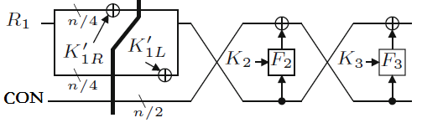


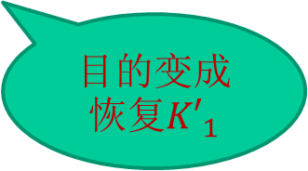
Improved attack on Feistel-1
Improved attack on feistel-1[n]
固定L₁为某一个常数，L₁=CON, 则 ,
利用splice-and-cut的技巧，可以增加一轮，即4轮
前后各加2轮，可攻击8轮的Feistel-1[2n]
2^{n/4} 的数据复杂度
K₄
F₄
目的变成恢复${K′}_{1}$

Slide 24
Feistel-2 and Feistel-3
利用轮函数的细节，提升攻击效果
可攻击5轮的feistel-2[n]
可攻击9轮的feistel-2[2n]
可攻击7轮Feistel-3[n]
可攻击11轮的Feilstel-3[2n]
更多细节，参考下面的文献
1. Isobe, T., Shibutani, K.: All subkeys recovery attack on block ciphers: Extending meet-in-the-middle approach. SAC 2012
2.Isobe, T., Shibutani, K.: Generic Key Recovery Attack on Feistel Scheme. ASIACRYPT 2013

Slide 25
Lessons Learnt
前向计算和后向计算覆盖的轮数越多越好
前向计算和后向计算用到的子密钥比特数不能超过主密钥的比特数
基于Feistel结构设计的算法，轮数不能比这里攻击的少，或接近这里攻击的轮数。

Slide 26
Hellman’s TMTO Attack

Slide 27
Popcnt
Before we consider Hellman’s attack, consider simpler Time-Memory Trade-Off
“Population count” or popcnt
Let x be a 32-bit integer
Define popcnt(x) = number of 1’s in binary expansion of x
How to compute popcnt(x) efficiently?

Slide 28
Simple Popcnt
Most obvious thing to do is
popcnt(x) // assuming x is 32-bit value
t = 0
for i = 0 to 31
t = t + ((x >> i) & 1)
next i
return t
end popcnt
Is this the most efficient method?

Slide 29
More Efficient Popcnt
Pre-compute popcnt for all 256 bytes
Store pre-computed values in a table
Given x, lookup its bytes in this table
Sum these values to find popcnt(x)
Note that pre-computation is done once
Each popcnt now requires 4 steps, not 32

Slide 30
More Efficient Popcnt
Initialize: table[i] = popcnt(i) for i = 0,1,…,255
popcnt(x) // assuming x is 32-bit word
p = table[ x & 0xff ]
+ table[ (x >> 8) & 0xff ]
+ table[ (x >> 16) & 0xff ]
+ table[ (x >> 24) & 0xff ]
return p
end popcnt

Slide 31
TMTO Basics
Pre-computation
One-time work
Results stored in a table
Pre-computation results used to make each subsequent computation faster
Try to balance “memory” and “time”
In general, larger pre-computation requires more initial work and larger “memory” but then each computation takes less “time”

Slide 32
Block Cipher Notation
Consider a block cipher
C = E(P, K)
where
P is plaintext block of size n
C is ciphertext block of size n
K is key of size k

Slide 33
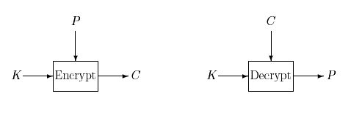
Block Cipher as Black Box
For TMTO, treat block cipher as black box
Details of crypto algorithm not important

Slide 34
Hellman’s TMTO Attack
Chosen plaintext attack: choose P and obtain C, where C = E(P, K)
Want to find the key K
Two “obvious” approaches
Exhaustive key search
“Memory” is 0, but “time” of 2^{k-1} for each attack
Pre-compute C = E(P, K) for all keys K
Given C, simply look up key K in the table
“Memory” of 2^{k} but “time” of 0 for each attack
TMTO lies between 1. and 2.
Notes:
0是有争议的

Slide 35
Chain of Encryptions
Assume block length n and key length k are equal: n = k
Then a chain of encryptions is
SP = K₀ = Starting Point
K₁ = E(P, SP)
K₂ = E(P, K₁)
:
:
EP = K_{t} = E(P, K_{t−1}) = End Point

Slide 36
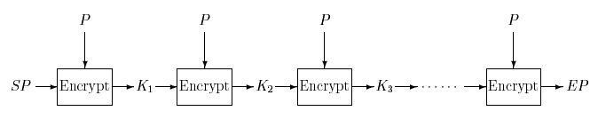
Encryption Chain
Ciphertext used as key at next iteration
Same (chosen) plaintext P used at each iteration
Notes:
用图表示这个过程

Slide 37
Pre-computation
Pre-compute m encryption chains, each of length t +1
Save only the start and end points
(SP₀, EP₀)
(SP₁, EP₁)
:
(SP_{m-1}, EP_{m-1})
EP₀
SP₀
EP₁
SP₁
EP_{m-1}
SP_{m-1}

Slide 38
TMTO Attack
Memory: Pre-compute encryption chains and save (SP_{i}, EP_{i}) for i = 0,1,…,m−1
This is one-time work
Must be sorted on EP_{i}
To attack a particular unknown key K
For the same chosen P used to find chains, we know C where C = E(P, K) and K is unknown key
Time: Compute the chain (maximum of t steps)
X₀ = C, X₁ = E(P, X₀), X₂ = E(P, X₁),…

Slide 39
TMTO Attack
Consider the computed chain
X₀ = C, X₁ = E(P, X₀), X₂ = E(P, X₁), …
Suppose for some i we find X_{i} = EP_{j}
EP_{j}
SP_{j}
C
K
Since C = E(P, K) key K should lie before ciphertext C in chain!

Slide 40
TMTO Attack
Summary of attack phase: we compute chain
X₀ = C, X₁ = E(P, X₀), X₂ = E(P, X₁),…
If for some i we find X_{i} = EP_{j}
Then reconstruct chain from SP_{j}
Y₀ = SP_{j}, Y₁ = E(P,Y₀), Y₂ = E(P,Y₁),…
Find C = Y_{t−i} = E(P, Y_{t−i−1}) (always?)
Then K = Y_{t−i−1} (always?)

Slide 41
Trudy’s Perfect World
Suppose block cipher has k = 56
That is, the key length is 56 bits
Spse we find m = 2²⁸ chains each of length t = 2²⁸ and no chains overlap (unrealistic)
Memory: 2²⁸ pairs (SP_{j}, EP_{i})
Time: about 2²⁸ (per attack)
Start at C, find some EP_{j} in about 2²⁷ steps
Find K with about 2²⁷ more steps
Attack never fails!

Slide 42
Trudy’s Perfect World
No chains overlap
Every ciphertext C is in one chain
SP₀
EP₀
C
EP₁
SP₁
K
EP₂
SP₂

Slide 43
The Real World
Chains are not so well-behaved!
Chains can cycle and merge
K
C
EP
SP
Chain beginning at C goes to EP
But chain from SP to EP does not give K
Is this Trudy’s nightmare?

Slide 44
Real-World TMTO Issues
Merging chains, cycles, false alarms, etc.
Pre-computation is lots of work
Must attack many times to amortize cost
Success is not assured
Probability depends on initial work
What if block size not equal key length?
This is easy to deal with
What is the probability of success?
This is not so easy to compute…

Slide 45
To Reduce Merging
Compute chain as F(E(P, K_{i−1})) where F permutes the bits
Chains computed using different functions can intersect, but they will not merge
SP₀
F₀ chain
EP₁
SP₁
F₁ chain
EP₀

Slide 46
Hellman’s TMTO in Practice
Let
m = random starting points for each F
t = encryptions in each chain
r = number of “tables”, i.e., random functions F
Then mtr = total pre-computed chain elements
Pre-computation is about mtr work
Each TMTO attack requires
About mr “memory” and about tr “time”
If we choose m = t = r = 2^{k/3} then probability of success is at least 0.55

Slide 47
Success Probability
Throw n balls into m urns
What is expected number of urns that have at least one ball?
This is classic “occupancy” problem
See Feller, Intro. to Probability Theory
Why is this relevant to TMTO attack?
“Urns” correspond to keys
“Balls” correspond to constructing chains

Slide 48
Success Probability
Using occupancy problem approach
Assuming k-bit key and m,t,r defined as previously discussed
Then, approximately,
P(success) = 1 − e^{−mtr/2k}
An upper bound can be given that is slightly “better”

Slide 49
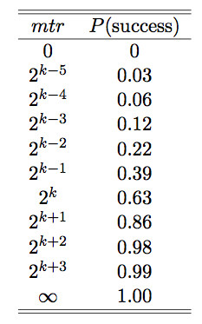
Success Probability
Success probability
P(success) = = 1 − e^{−mtr/2k}

Slide 50
TMTO: The Bottom Line
Attack is feasible against DES
Pre-computation is about 2⁵⁶ work
Each attack requires about
2³⁷ “memory” and 2³⁷ “time”
Attack not particular to DES
No fancy math is required!
Lesson: Clever algorithms can break crypto!

Slide 51
Reference
M. Hellman, A cryptanalytic time-memory tradeoff, IEEE transactions on Information Theory, Vol. 26, 1980, pp. 401–406.

Slide 52

Rainbow table
Oechslin, P. (2003). "Making a Faster Cryptanalytic Time-Memory Trade-Off". Advances in Cryptology - CRYPTO 2003. LNCS. 2729. pp. 617–630.
Later Oechslin devised a competing method with a slight speed-up, called Rainbow Table. The Rainbow Table attack seems to be better known, presumably due to its colorful name.
—— I found in a paper
Notes:
取个好名字的好处！

Slide 53
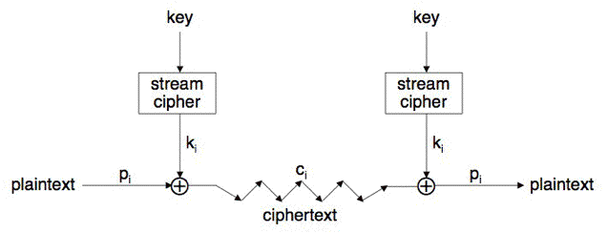
Stream Cipher
Generic view of stream cipher

Slide 54
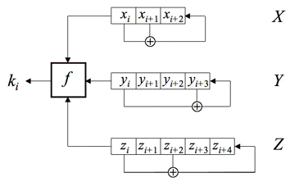
LFSR-based Stream Cipher
For example
Initialization: load key and IV, iterate a great number of rounds without outputting anything
Goal: Recover the state, so that
Forward: Predict the following key streams
Backward: recover the key

Slide 55
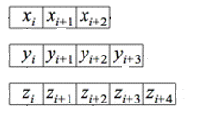






LFSR-based Stream Cipher
$$G$$
$$k_{i},…,k_{i+s}$$
State S of s bits
A keystream of s bits
Compared to block ciphers, multiple data can be used for stream ciphers
$$k_{i},…,k_{i+s}$$
$$k_{i+1},…,k_{i+1+s}$$
$$k_{i+2},…,k_{i+2+s}$$
$$…$$

Slide 56
LFSR-based Stream Cipher
$$G$$
$$k_{i},…,k_{i+s}$$
State S of s bits
A keystream of s bits
TMTO attack: T = M = D = 2^{s/2}
Require that s >= 2k
How can we design stream ciphers with s >= 2k
(A seminar topic)

Slide 57
Dedicated to Resource-constrained Environment
Lightweight stream ciphers
Storage is most expensive
Cost overview
Rule of Thumb:
NOT: 0.67 GE
NOR: 1 GE
AND: 1.33 GE
OR: 1.33
XOR: 2.67
Registers/Flipflops:
6 − 12 GE per bit

Slide 58
Research Lines of TMTO
TMTO algorithms
including use of multiple data
investigation of theoretical issues
TMTO applications
To invert oneway functions
identify a target oneway function
For more info., refer to:
Alex Biryukov, Adi Shamir: Cryptanalytic Time/Memory/Data Tradeoffs for Stream Ciphers. ASIACRYPT 2000: 1-13
Jin Hong, Palash Sarkar: New Applications of Time Memory Data Tradeoffs. ASIACRYPT 2005: 353-372
Notes:
Applicable to block ciphers, stream ciphers, hash functions and asymmetric algorithms

Slide 59
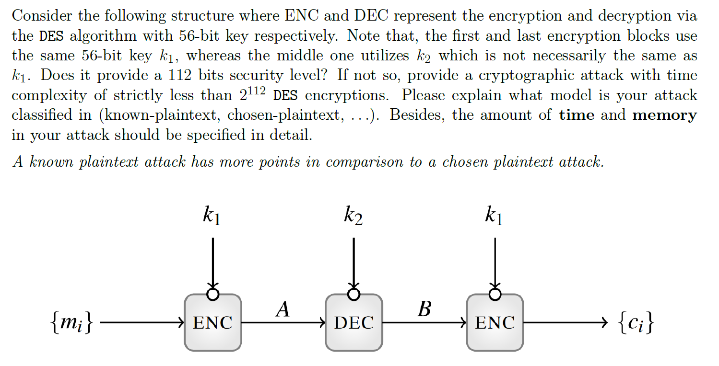
Home work (1)

Slide 60
Home work (2)
Describe a different application of TMTO attack
On what target cipher
How it works
Complexities and the impact to the target cipher
This would be a good reference.
Jin Hong, Palash Sarkar: New Applications of Time Memory Data Tradeoffs. ASIACRYPT 2005: 353-372

Slide 61
作业模板
两个作业模板（latex，word）
交作业方式
可以按模板来，也可以手写拍照，或自己的格式（必须包含姓名、学号、作业布置时间）
星期二之前将作业发到指定邮箱：wangchao0edu@gmail.com

