Slide 1
Introduction
Intro <number>

Slide 2
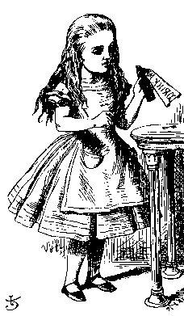
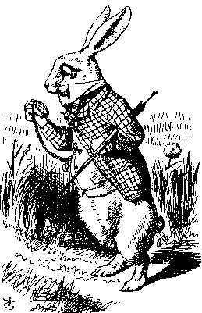
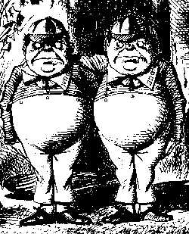
Good Guys and Bad Guys
Alice and Bob are the good guys
Trudy is the bad guy
Trudy is our generic “intruder”
Intro <number>

Slide 3
Good Guys and Bad Guys
Alice and Bob want to communicate securely
  Typically, over a network
Alice or Bob might also want to store their data securely
Trudy wants to read Alice and Bob’s secrets
Or Trudy might have other devious plans…
  Impersonation.
  Cause confusion, denial of service, etc.
Intro <number>

Slide 4
Crypto
Cryptology ⎯ The art and science of making and breaking “secret codes”
Cryptography ⎯ making “secret codes”
Cryptanalysis ⎯ breaking “secret codes”
Crypto ⎯ all of the above (and more)
Intro <number>

Slide 5
How to Speak Crypto
A cipher or cryptosystem is used to encrypt the plaintext
The result of encryption is ciphertext
We decrypt ciphertext to recover plaintext
A key is used to configure a cryptosystem
A symmetric key cryptosystem uses the same key to encrypt as to decrypt
A public key cryptosystem uses a public key to encrypt and a private key to decrypt
  Private key can be used to sign and public key used to verify signature (more on this later…)
Intro <number>

Slide 6
Crypto
Underlying assumption
  The system is completely known to Trudy
  Only the key is secret
Also known as Kerckhoffs Principle [Ker83]
  Crypto algorithms are not secret
Why do we make this assumption?
  Experience has shown that secret algorithms are often weak when exposed
  Secret algorithms never remain secret
  Better to find weaknesses beforehand
Intro <number>
Notes:
In some cases, details of an unknown cryptographic cipher may be found by analyzing the inputs and outputs of a black-box implementation. Notable examples include Bletchley Park’s breaking the Lorenz cipher during World War II without ever acquiring a cipher machine [5] and the disclosure of the DST cipher used in cryptographic Radio Frequency Identification (RFID) tokens from Texas Instruments [4]. In both cases, researchers started with a rough understanding of the cipher’s structure and were able to fill in the missing details through cryptanalysis of the cipher output for known keys and inputs. This black-box approach requires some prior understanding of the structure of a cipher and is only applicable to ciphers with statistical weaknesses. The output of a sound cipher should not be statistically biased and therefore should not leak information about its structure.
Other ciphers have been disclosed through disassembly of their software implementation. Such implementations can either be found in computer software or as microcode on an embedded micro-controller. Ciphers found through software disassembly include the A5/1 and A5/2 algorithms that secure GSM cell phone communication [1] and the Hitag2 and Keeloq algorithms used in car remote controls [3]. The cryptography on the RFID tags we analyzed is not known to be available in software or in a micro-code implementation; tags and reader chips implement the cipher entirely in hardware.
In this paper, we focus on revealing proprietary cryptography from its silicon implementation alone. Reverse-engineering silicon is possible even when very little is known about a cipher and no software implementation exists. The idea of reverse-engineering hardware is not new. Hardware analysis is frequently applied in industry, government, and the military for spying, security assessments, and protection of intellectual property. Such reverse-engineering, however, is usually considered prohibitively expensive for typical attackers, because of the high prices charged by professionals offering this service. The key contribution of this work is demonstrating that reverse-engineering silicon is cheap and that it can be mostly automated. This is the first published work to describe the details of reverse-engineering a cryptographic function from its silicon implementation. We describe a mostly automated process that can be used to cheaply determine the functionality of previously unknown cipher implementations.

Slide 7

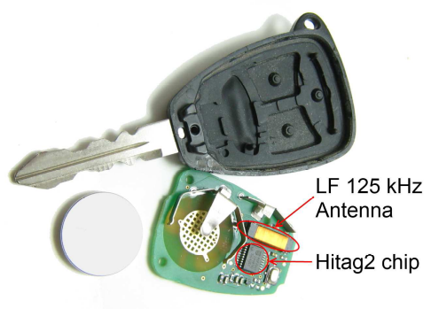
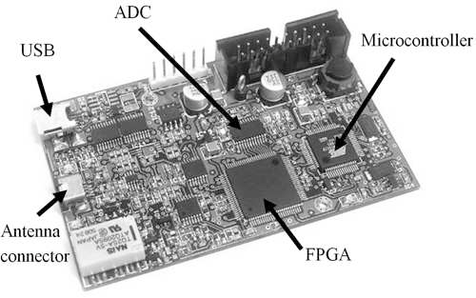


Example
The Hitag2 algorithm was introduced in the ‘90s and used in vehicle immobilizers
The algorithm was disclosed through disassembly of their software implementation.
Broke in 6 minutes.
Roel Verdult, Flavio D. Garcia, Josep Balasch: Gone in 360 Seconds: Hijacking with Hitag2. USENIX Security Symposium 2012: 237-252
Intro <number>
Notes:
基于LFSR的流密码，被许多汽车制造商用于汽车防盗

Slide 8
Crypto as a Black Box
key
key
P_{i}
C_{i}
P_{i}
plaintext
encrypt
decrypt
plaintext
ciphertext
Note P_{i} is i^{th} “unit” of plaintext
And C_{i} is corresponding ciphertext
“Unit” may be bit, letter, block of bits, etc.
Intro <number>

Slide 9
Crypto as a Gray Box
key
key
P_{i}
C_{i}
P_{i}
plaintext
encrypt
decrypt
plaintext
ciphertext
The encryption/decryption leaks so called side channel information, like timing information, power consumption, and radiations.
Not covered in this course.
Intro <number>

Slide 10
Who Knows What?
Alice
key
Trudy
key
Bob
P_{i}
C_{i}
P_{i}
plaintext
encrypt
decrypt
plaintext
ciphertext
Trudy knows the ciphertext
Trudy knows the cipher and how it works
Trudy might know a little more
Trudy does not know the key
Intro <number>

Slide 11
Taxonomy of Cryptography
Symmetric Key
  Same key for encryption as for decryption
  Stream ciphers and block ciphers
  Authenticated encryption and MAC
  Hash algorithms (keyless)
Public Key
  Two keys, one for encryption (public), and one for decryption (private)
  Digital signatures ⎯ nothing comparable in symmetric key crypto
Intro <number>

Slide 12
Goals of Cryptography
Confidentiality
  Given ciphertext C, the attacker has no idea about the corresponding plaintext.
  The attacker has no idea about the key.
  Encryption schemes: block ciphers, streams ciphers, AE, public key encryptions
Intro <number>
Notes:
The fundamental goal of an attacker is to violate one or several of these security .
身份鉴别：Make sure the person is the one she/he claims. 是由方案而非单一的算法来实现。

Slide 13
Goals of Cryptography
Authenticity
  Make sure the message comes from the right person.
  MAC, digital signature
Integrity
  Make sure data has not been altered in an unauthorized manner
  Hash algorithms, MAC
And more ..
Intro <number>
Notes:
The fundamental goal of an attacker is to violate one or several of these security .
身份鉴别：Make sure the person is the one she/he claims. 是由方案而非单一的算法来实现。

Slide 14
Cryptanalysis
This course focused on cryptanalysis
Trudy wants to recover key or plaintext
The fundamental goal of Trudy is to violate one or several of these security, or to violate the properties required for these security.
Example: collision attacks on hash algorithms
Intro <number>

Slide 15
Exhaustive Key Search
How can Trudy attack a cipher?
She can simply try all possible keys and test each to see if it is correct
  Exhaustive key search
To prevent an exhaustive key search, a cryptosystem must have a large keyspace
  Must be too many keys for Trudy to try them all in any reasonable amount of time
Intro <number>

Slide 16
Beyond Exhaustive Search
A large keyspace is necessary for security
But a large keyspace is not sufficient
Shortcut attacks might exist
We’ll see many examples of shortcut attacks
In cryptography we can (almost) never prove that no shortcut attack exists
This makes cryptography interesting…
Intro <number>

Slide 17
Models of Attack
Ciphertext only — always an option
Known plaintext — possible in many cases
Chosen plaintext
  “Lunchtime attack”
  Protocols might encrypt chosen text
Adaptively chosen plaintext
Related key
Forward search (public key crypto only)
Intro <number>

Slide 18
Definition of Secure
A cryptosystem is secure if the best known attack is to try all possible keys
Cryptosystem is insecure if any shortcut attack is known
By this definition, an insecure system might be harder to break than a secure system!
Intro <number>

Slide 19
Definition of Secure
Why do we define secure this way?
The size of the keyspace is the “advertised” level of security
If an attack requires less work, then false advertising
A cipher must be secure (by our definition) and have a “large” keyspace
  Too big for an exhaustive key search
Intro <number>

Slide 20
Theoretical Cryptanalysis
Spse that a cipher has a 100 bit key
  Then keyspace is of size 2¹⁰⁰
On average, for exhaustive search Trudy tests 2¹⁰⁰/2 = 2⁹⁹ keys
Spse Trudy can test 2³⁰ keys/second
  Then she can find the key in about 37.4 trillion years (37.4×10¹²)
Intro <number>

Slide 21
Theoretical Cryptanalysis
Spse that a cipher has a 100 bit key
  Then keyspace is of size 2¹⁰⁰
Spse there is a shortcut attack with “work” equal to testing about 2⁸⁰ keys
If Trudy can test 2³⁰ per second
  Then she finds key in 36 million years
  Better than 37 trillion, but not practical
Intro <number>

Slide 22
Applied Cryptanalysis
In this class, we mainly focus on attacks that produce plaintext
  Not interested in attacks that just show a theoretical weakness in a cipher
We call this applied cryptanalysis
Why applied cryptanalysis?
  Because it’s a lot more fun…
  And it’s a good place to start
Intro <number>

