Slide 1



Hospital Readmission Analysis
DATA ANALYSIS DIPLOMA
An exploratory, statistical, and predictive modeling study of patient and hospitalization factors behind readmission
Presented by : Hadeer hussen Atia
Notes:
1

Slide 2
Abstract
The Question This Project Answers
PROBLEM / QUESTION
4,996
Patients Analyzed
Can a patient's demographics and hospitalization details (age, diagnosis, procedures, length of stay, comorbidity burden, and discharge destination) predict whether they will be readmitted?
8
Features Per Patient
Hypothesis not supported.
VERDICT:
18.8%
Baseline Readmission Rate
Every bivariate test came back non-significant, and out-of-sample model performance (AUC ≈ 0.47) sits at chance level, none of the measured features carry real predictive signal.
~0.47
Best Held-out AUC
(Chance = 0.50)

Slide 3
INTRODUCTION
Why Readmission, and How We Studied It
1
Clean & explore
Structure, distributions, and data quality checks
Unplanned hospital readmissions are one of the most closely watched quality and cost metrics in healthcare, they signal whether a patient's condition, treatment, and discharge plan actually held. Identifying which factors drive readmission is the first step toward reducing it.
2
Test relationships
Statistical hypothesis tests, feature by feature
3
Model & predict
Logistic regression and random forest classifiers
4
Segment patients
PCA + K-Means clustering as an alternate lens

Slide 4
INITIAL HYPOTHESIS
What We Expected Going In
Before testing, the working expectation was that clinical burden would show up in the readmission rate, formalized as a null and alternative hypothesis.
H₀ — NULL HYPOTHESIS
H₁ — ALTERNATIVE HYPOTHESIS
There is no association between
patient / hospitalization features and readmission. Age, gender, diagnosis, procedures, length of stay, comorbidity score, and discharge destination are all independent of the outcome.
Older age, more procedures, longer hospital stays, and higher comorbidity scores raise readmission risk, and this risk also varies by diagnosis and discharge destination.
Tested using: Shapiro–Wilk · t-tests · Chi-square · Logistic Regression · Random Forest

Slide 5
THE DATASET
4,996 Patients, 8 Features
4,996
8
312.6 KB
0
rows (patients)
columns
in-memory size
missing values
Column | Type | Meaning
age | Numeric | Patient age, 18–89 years
gender | Categorical | Male / Female
primary_diagnosis | Categorical | Admitting diagnosis, 5 categories (Kidney Disease, Diabetes, COPD, Hypertension, Heart Disease)
num_procedures | Numeric | Number of procedures performed during the stay, 0–9
days_in_hospital | Numeric | Length of hospital stay in days, 1–14
comorbidity_score | Numeric | Composite score of coexisting conditions, 0–4
discharge_to | Categorical | Discharge destination: Home, Home Health Care, Rehab Facility, Skilled Nursing Facility
readmitted | Binary target | 1 = readmitted, 0 = not readmitted

Slide 6

PREPARATION
Data Cleaning & Preprocessing
Duplicate rows
SAMPLE OF THE CLEANED DATA (df.head())
4 exact duplicates found → removed
age | gender | diagnosis | proc. | days | comorb. | discharge_to | readm.
69 | Male | Heart Disease | 1 | 2 | 1 | Home Health Care | 0
32 | Female | COPD | 2 | 13 | 2 | Rehab Facility | 0
89 | Male | Diabetes | 1 | 7 | 1 | Home | 0
78 | Male | COPD | 9 | 2 | 2 | Skilled Nursing | 0
38 | Male | Diabetes | 6 | 4 | 4 | Rehab Facility | 0
5,000 → 4,996 rows
Missing values
Checked all 8 columns
0 missing anywhere
Outlier scan
IQR method on the 4 numeric columns
No extreme outliers requiring removal
A clean, fully-populated dataset with no duplicates or missing values means any weak findings later can't be blamed on data quality
Encoding
One-hot encoding for modeling stage
gender, primary_diagnosis, discharge_to

Slide 7
EDA
(Exploratory Data Analysis)
Data Overview
Data Cleaning
Univariate Analysis
Predictive Modeling
Correlation Analysis
Bivariate Analysis

Slide 8
EDA
What are the demographic and clinical profiles of the study population?
Variable | Result
Number of patients | 4,996
Mean age | 53.29
Median age | 53
Male | 2478
Female | 2518
Mean hospital stay | 7.398519
Mean procedures | 4.462770
Mean comorbidity score | 2.068855
Most common diagnosis | Kidney Disease
Readmission rate | 18.81%

Slide 9
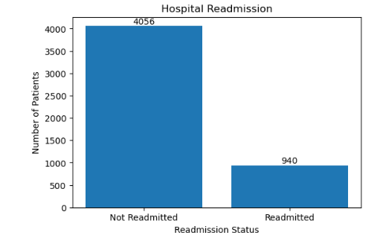
EDA
What is the overall hospital readmission rate?
Out of 4,996 patients, 18.81% were readmitted while 81.19% were not, nearly one in five patients experienced a hospital readmission

Slide 10
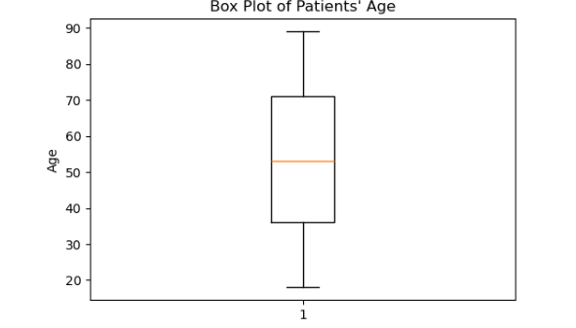
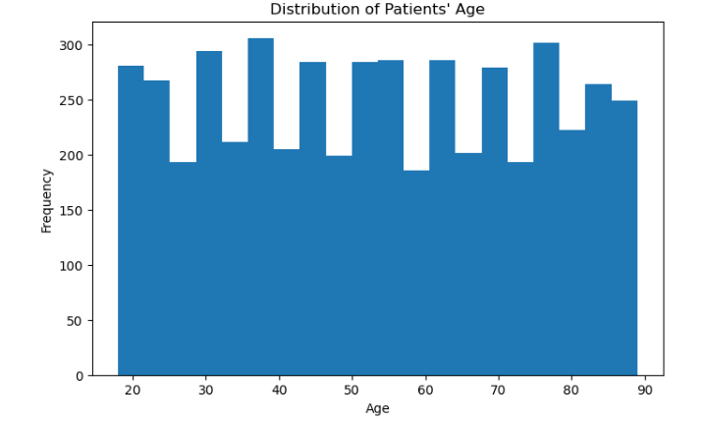
EDA
What is the distribution of patients' ages?
Age is approximately symmetric and close to normal (skewness = 0.0095), spanning 18–89 years with a median in the mid-50s
The box plot confirms the data is completely free of outliers

Slide 11
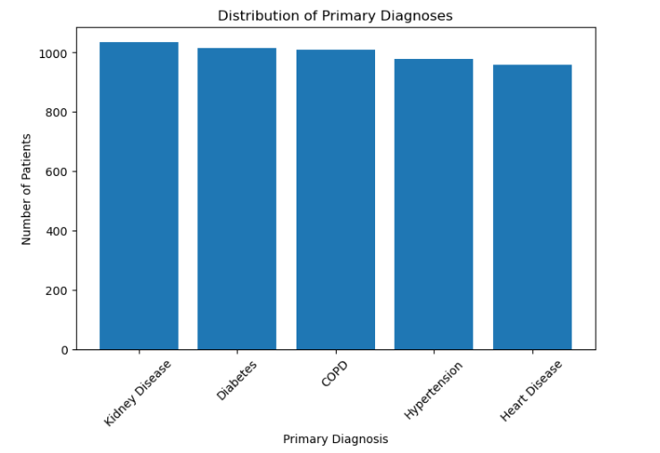
EDA
Which primary diagnoses are most common?
Kidney Disease is the most common primary diagnosis, followed by Diabetes and COPD, Heart Disease is the least frequent

Slide 12
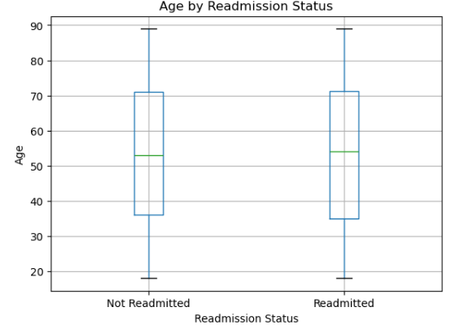
EDA
Does age differ between readmitted and non-readmitted patients?
Independent samples
t-test:
t = -0.114
p = 0.909
not significant.
Age shows no association with hospital readmission

Slide 13
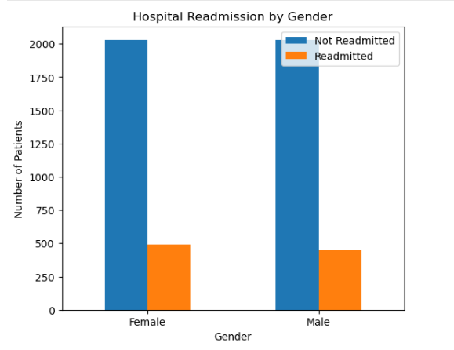
EDA
Is gender associated with hospital readmission?
Chi-Square Test of Independence:
χ² = 1.138
p = 0.286
not significant.
Gender is not a significant factor in readmission

Slide 14
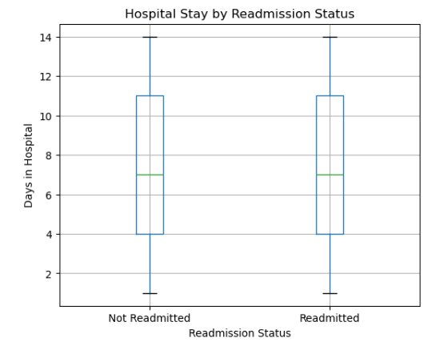
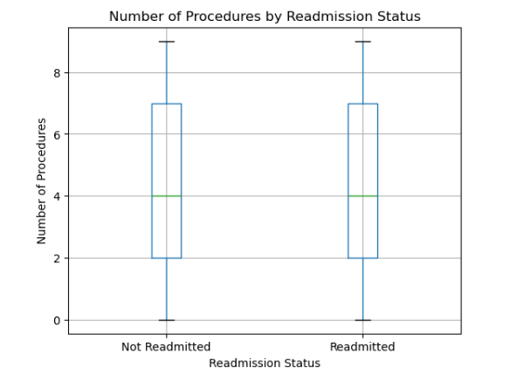
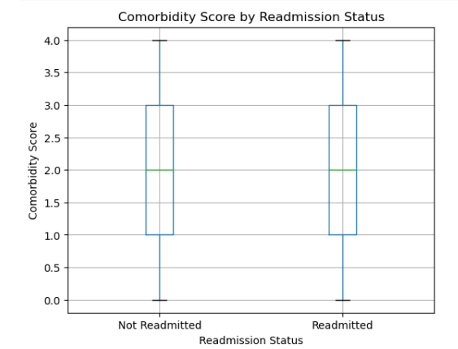
EDA
Do stay length, procedures, and comorbidity differ by readmission?
Days in hospital: t = 0.707, p = 0.480 (NS), Procedures: t = 0.213, p = 0.831 (NS), Comorbidity score: t = 0.095, p = 0.925 (NS)
None of the three care-process variables show a significant difference between readmitted and non-readmitted patients

Slide 15
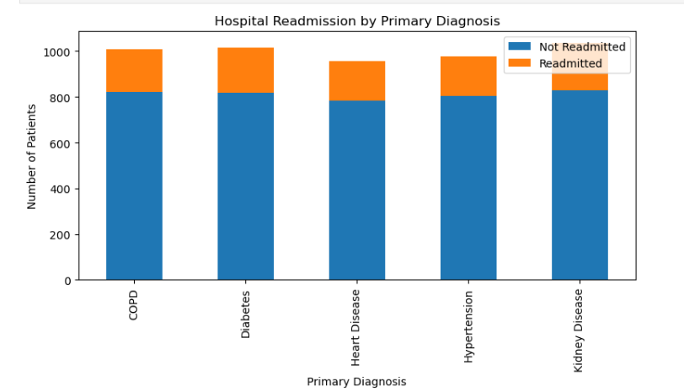
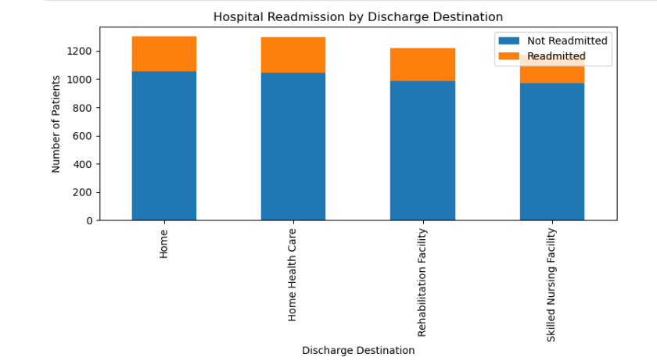
EDA
Are diagnosis or discharge destination linked to readmission?
Diagnosis: χ² = 2.016, df = 4, p = 0.733 (NS)
Discharge destination: χ² = 2.204, df = 3, p = 0.531 (NS)
Readmission is independent of both primary diagnosis and discharge destination in this dataset

Slide 16
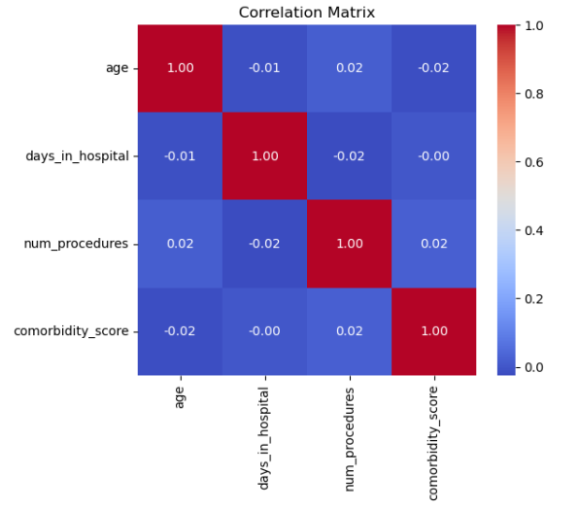
EDA
How are age, stay, procedures & comorbidity related to each other?
All pairwise correlations range from -0.025 to 0.020
negligible linear relationships among all four numeric variables

Slide 17
Variable | β | OR | 95% CI | P-value
Age | 0.0002 | 1.000 | 0.997–1.004 | 0.890
Number of Procedures | -0.003 | 0.997 | 0.972–1.021 | 0.787
Days in Hospital | -0.007 | 0.993 | 0.976–1.011 | 0.447
Comorbidity Score | -0.003 | 0.997 | 0.948–1.048 | 0.906
Gender | -0.081 | 0.922 | 0.800–1.063 | 0.264
Diabetes | 0.063 | 1.065 | 0.853–1.331 | 0.577
Heart Disease | -0.019 | 0.981 | 0.781–1.233 | 0.872
Hypertension | -0.052 | 0.949 | 0.755–1.193 | 0.656
Kidney Disease | 0.089 | 1.093 | 0.877–1.363 | 0.428
Home Health Care | 0.003 | 1.003 | 0.825–1.219 | 0.976
Rehabilitation Facility | -0.014 | 0.987 | 0.809–1.203 | 0.893
Skilled Nursing Facility | -0.136 | 0.873 | 0.711–1.071 | 0.192
EDA
Which factors are the strongest predictors of hospital readmission?
Variable | VIF
Age | 1.00
Number of Procedures | 1.00
Days in Hospital | 1.00
Comorbidity Score | 1.00
Gender | 1.00
Diabetes | 1.60
Heart Disease | 1.58
Hypertension | 1.59
Kidney Disease | 1.61
Home Health Care | 1.48
Rehabilitation Facility | 1.47
Skilled Nursing Facility | 1.46

Slide 18
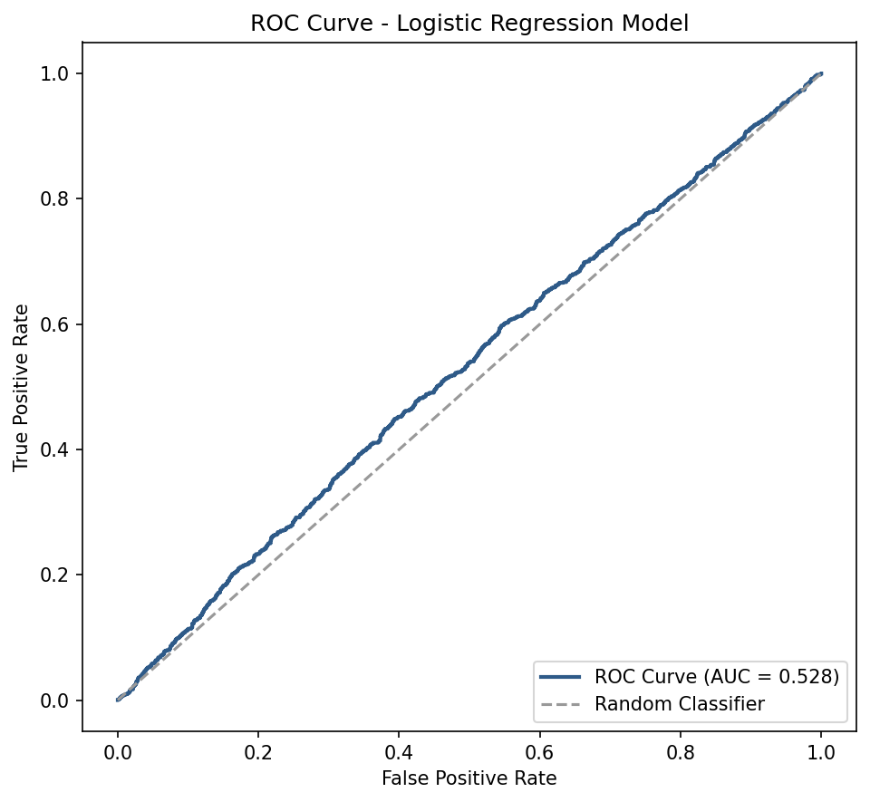

EDA
How well does the logistic regression model predict hospital readmission?
Metric | Value
Accuracy | 81.18%
Precision | 0.00
Recall | 0.00
F1-score | 0.00
ROC-AUC | 0.528
81.18%
Accuracy, but Precision, Recall & F1 = 0
All VIF values < 5 , no multicollinearity among predictors
Full model not significant (LLR p = 0.9046), no individual predictor reached significance
ROC-AUC = 0.528 — the model predicts only the majority class (0 true positives out of 940 readmitted patients)

Slide 19
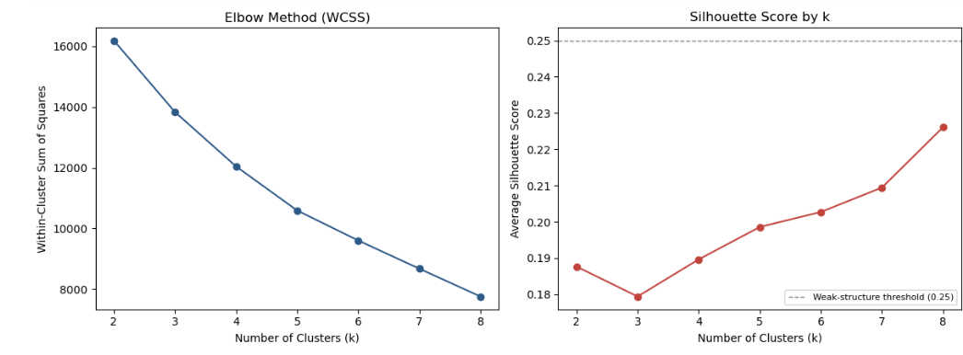
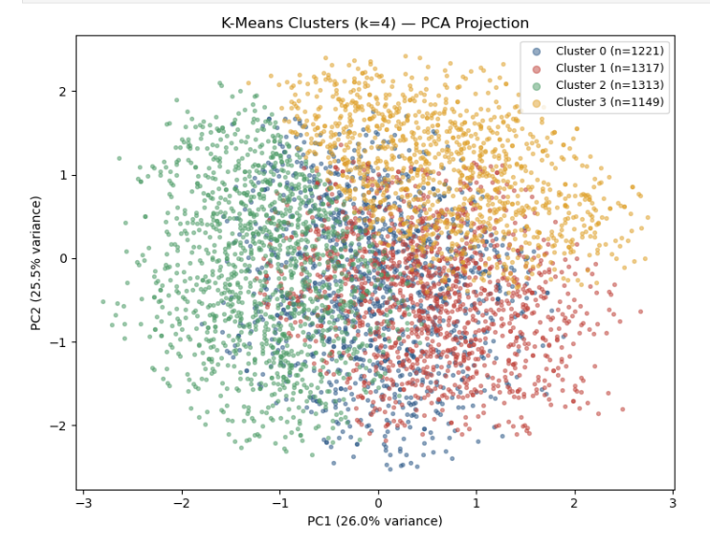
EDA
Do Patients Naturally Cluster Into Distinct Groups?
patients do not form natural, well-separated clusters. Any partition imposed on this data (e.g., k = 4) is a mathematical convenience for description, not evidence of real patient subgroups.

Slide 20
EDA
Composition of Each Cluster (MANOVA / ANOVA)
Test | Statistic | df | p-value
Wilks' Lambda | 0.0949 | —
MANOVA (Bartlett's χ² approx.) | χ² = 11762.2 | 12 | < 0.001
Univariate ANOVA per Variable
Variable | F-statistic | p-value
age | 4.99 | 0.0019
num_procedures | 3555.28 | < 0.001
days_in_hospital | 1420.01 | < 0.001
comorbidity_score | 1346.6 | < 0.001
These findings indicate that the identified clusters represent patient groups with distinct clinical characteristics across all variables included in the clustering analysis.

Slide 21
EDA
Readmission Rate by Cluster
Chi-Square Test of Independence: χ²(3) = 1.591, p = 0.661 (Not Significant)
Cluster | Readmission Rate
Cluster 0 | 19.9%
Cluster 1 | 18.6%
Cluster 2 | 17.97%
Cluster 3 | 18.8%
Despite the clusters differing sharply on the variables used to build them (Section 14), their readmission rates are nearly identical, ranging narrowly from 18.0% to 19.9%, and the chi-square test confirms this difference is not statistically significant.

Slide 22

Power BI
Interactive Dashboard
Switching to the live Power BI dashboard

Slide 23
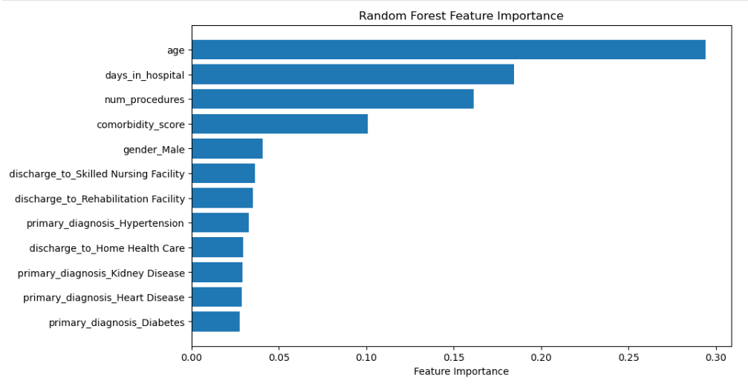
MACHINE LEARNING
Can a Random Forest Detect Patterns the Logistic Regression Missed?
The feature importance plot shows that age is the most influential predictor, followed by days in hospital, number of procedures, and comorbidity score.
The remaining variables have relatively lower importance.

Slide 24
MACHINE LEARNING
Relative Variable Importance:
Random Forest vs. Logistic Regression
Variable | Logistic Regression | Random Forest
Age | β = 0.0002, P = 0.890 (Not Significant) | 0.2941 (Highest Importance)
Days in Hospital | β = -0.007, P = 0.447 (Not Significant) | 0.1844
Number of Procedures | β = -0.003, P = 0.787 (Not Significant) | 0.1614
Comorbidity Score | β = -0.003, P = 0.906 (Not Significant) | 0.1007
Gender | β = -0.081, P = 0.264 (Not Significant) | 0.0405
Diagnosis Variables | All Not Significant | Low Importance
Discharge Variables | All Not Significant | Low Importance
Although Random Forest provides a ranking of variable importance, it does not indicate statistical significance, and both models suggest limited predictive information in the available variables.

Slide 25
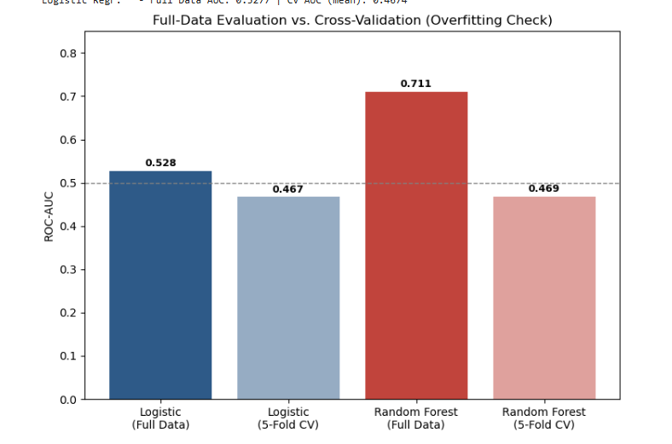
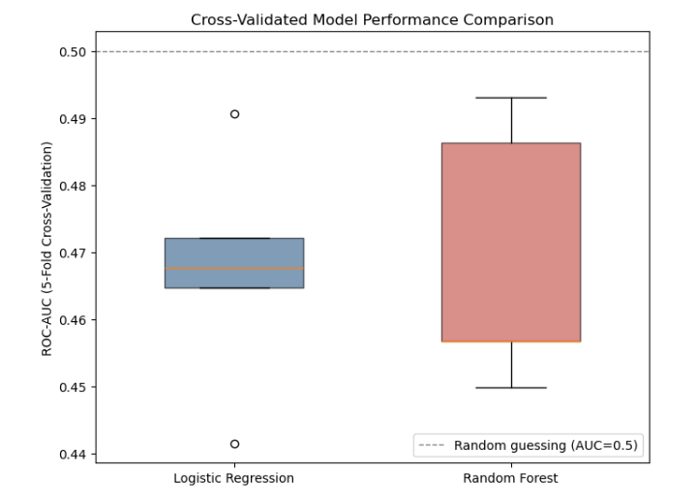
MACHINE LEARNING
Which model actually performs best?
Random Forest's full-data ROC-AUC (0.711) looks strong, but drops to 0.469 under 5-fold cross-validation, below random chance. Logistic regression shows a far smaller gap (0.528 → 0.467) because it has less capacity to overfit

Slide 26
CONCLUSION
1
None of the tested variables (age, gender, diagnosis, discharge destination, length of stay, procedures, or comorbidity score) show a statistically significant association with readmission
2
Multivariate logistic regression, Random Forest, and K-Means clustering all converge on the same conclusion: no combination of these variables meaningfully predicts readmission
Apparent gains from more complex models (Random Forest's 0.711 full-data ROC-AUC) do not survive honest cross-validation, a reminder to always validate before trusting a training-data score
3
4
Practical implication: reducing readmissions in this population likely depends on factors outside this dataset (e.g., post-discharge follow-up, medication adherence, or social factors) this analysis is as valuable for ruling out what isn't driving it

Slide 27
Thank you

