Slide 1

Computer vision final project
Hiding a QR code in an image
Student : Hadi Vahabpour Roudsari 1898985
Professor: Luigi Cinque

Slide 2
Why hiding a QR code?
The plain old QR code has negative effect on the beauty of the design.
Customers normally do not like to use them.
It leads to an idea to encode the QR code to an image.

Slide 3
Review of the paper embedding QR code into color image.
1.Using halftoning method.
2.Pixel Selection.
3.Luminance Modification.
4.Threshold Calculation for Binarization.
5.Color optimization.
6.Encoding Technique.
7.Decoding Algorithm.

Slide 4
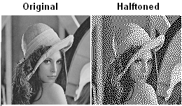
Halftoning method
Halftoning techniques reproduce the same image base on dots but it keeps the high details of the image.
In the paper try to halftone the image and then embed the qr code on the halftoned image .
They believe in this way it is harder
For human eyes to detect The
embedded qr code.

Slide 5
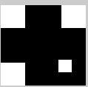
Pixel Selection
In the paper they use the fix mask to detect the part of QR code that is not finder pattern or Alignment pattern.
Demerit: Finder pattern or Alignment pattern could be in different location from QR code to another QR code. Fixing this kind of
mask can not be a good And general strategies.

Slide 6
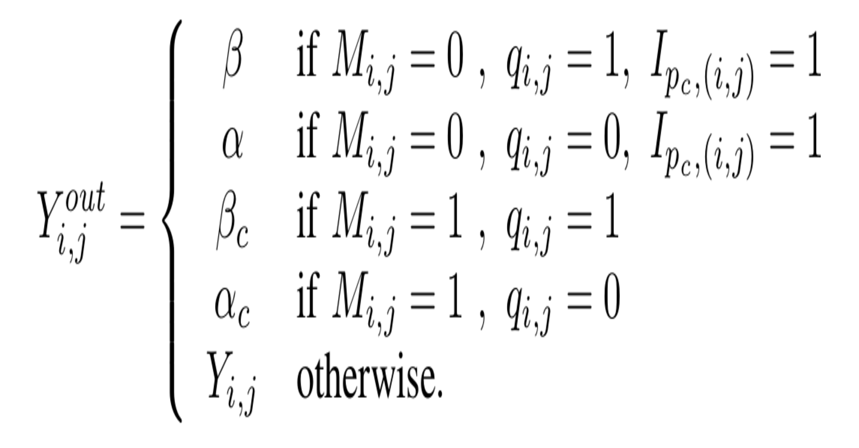
Luminance Modification

Slide 7
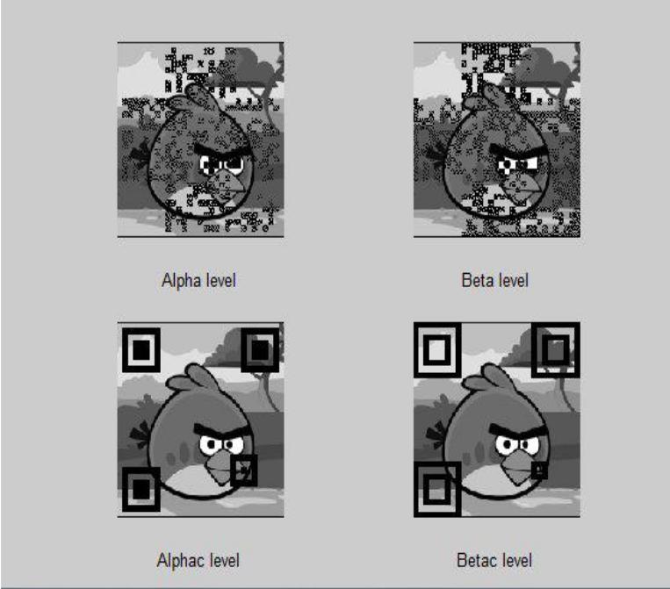

Slide 8
Color optimization
To embed the QR code to color image we need to change the color of modified luminance base on some rules.
HSL color space is selected because it involves simpler computations than other color spaces.
RGB image transforms to HSL, while the H and S keep fixed they change the L values base on this formula on next slides.

Slide 9


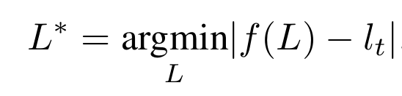

Color optimization
W is the predefined weight luminance vector
L is new light of HSL and l is desire luminance.

Slide 10
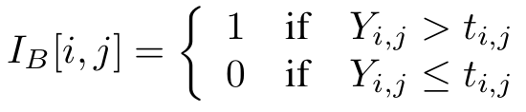
Decode technique
Binarization: The gray scale of image is segmented into black and white pixels
Using the threshold.
we should play with the luminance value of the qr code, so we need to convert again the image from RGB to HSL color space and then optimising parameter of L until reaching to a good QR code image.

Slide 11
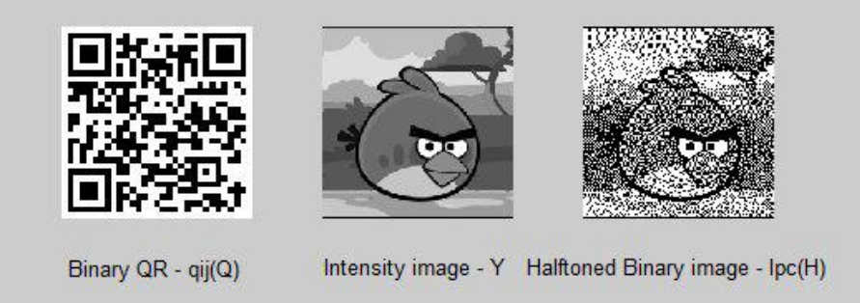
Sample of papers

Slide 12
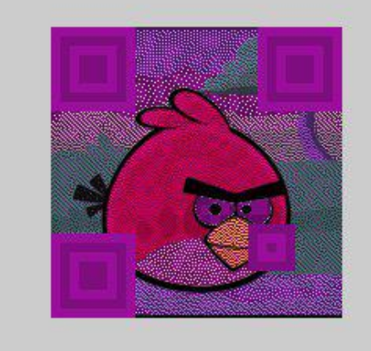
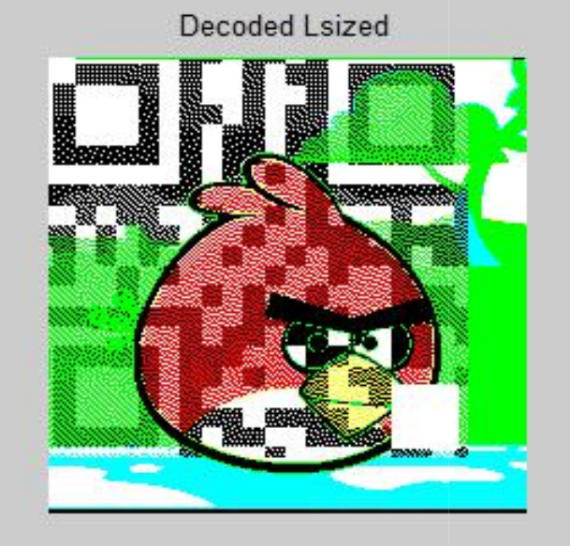
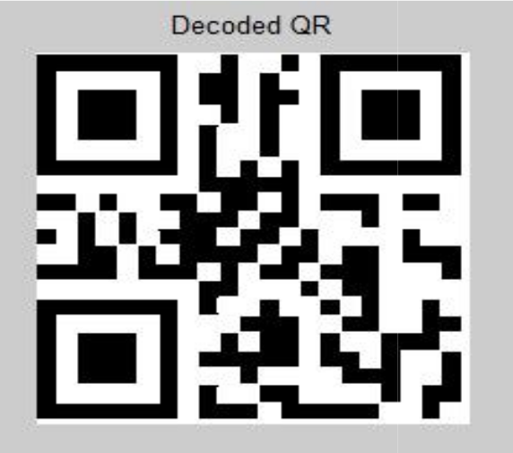
Sample of papers
Embede QR code half decoded optimizing L fully decode using Zinx libaray

Slide 13


Slide 14
Hidining QR code by tuning the saturation
Now I want to choose another method that look more practical. Instead of changing the intensity parameter in HSL color space I want to try saturation parameter.
Why HSL?
Why saturation?

Slide 15
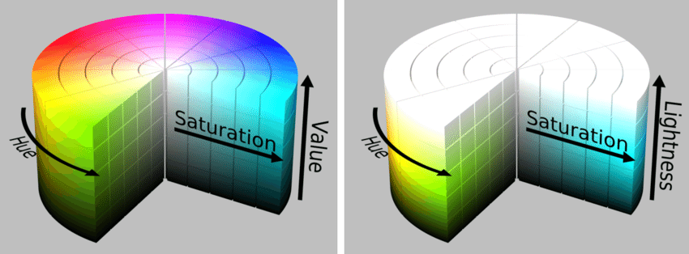
HSL and HSV

Slide 16
The new Idea for hiding QR code
The idea is that removing the saturation layer and putting the tuning gray scale QR code will not change the color image so much. But changing the two other parameters like Hue or intensity can completely destroy the image.

Slide 17
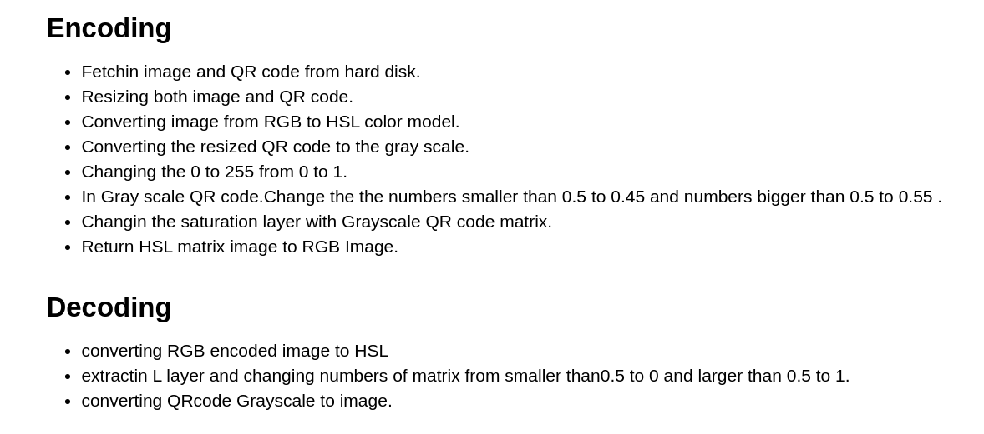

Slide 18
Encoding algorithm
Resizing both QR code image and color image to the size of QR code.
Converting the color image from RGB to HSL matrix image.
Converting QR code to gray Scale matrix.(values from 0 to 1)
change with threshold 0.5 for the gray scale image matrix.so the number bigger than 0.5 will be 0.55 and smaller than 0.5 will be 0.45 .
Changing the S layer of HSL matrix with new Gray scale matrix.
Converting HSL matrix to RGB image.

Slide 19

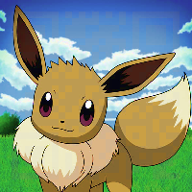
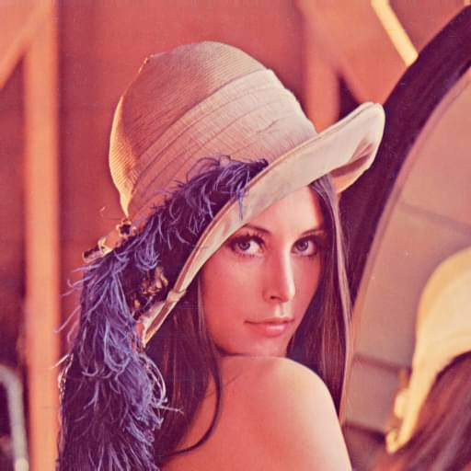
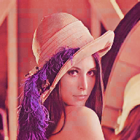
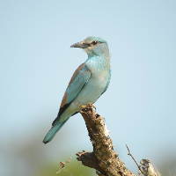
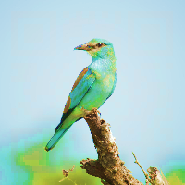
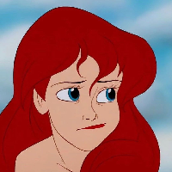
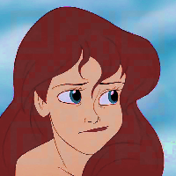
Sample image and encoded image(left normal image, right encoded)

Slide 20
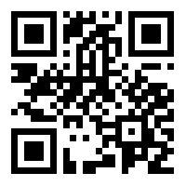
Decoding algorithm
Converting encoded RGB image to HSL Matrix.
Extracting The S layer of HSL matrix.
Changing the S layer matrix with threshold of 0.5 (so numbers that are smaller than the 0.5 will be zero and number bigger than 0.5 will be 255).
Converting the matrix to an image.

Slide 21
