Slide 1
RESEARCH VIDEO · 5-MINUTE CUT
Safe PPO on MountainCar
Reaching the goal without speeding — a PPO-Lagrangian study
TEAM
Hadis Amin u8050066
Muhammad Rafif u7964962
λ
Edwar Budiman uXXXXXX
Mukhit Onalbekov uXXXXXX
Slides prepared with the assistance of AI.
Notes:
OPEN (Presenter A). 5-minute cut. Hook: to get the car over the hill it must build speed — but what if speed is exactly what we must limit? Can the agent reach the goal while keeping speed under control?

Slide 2
THE SETUP
Speed is the solution — and the thing we must limit
MountainCar only succeeds by building momentum. We add a gentle, proportional cost for going too fast, and ask the agent to reach the flag while staying under a budget.
d = 15
the total cost budget per episode
shared env
cost rule = (|speed| − 0.04) × 100, only when speed > 0.04
same shaping for all three agents
So any difference is the safety mechanism — not luck.
DQN
PPO
Safe PPO
Notes:
Presenter A. Constrained RL: reward for the flag plus a proportional speed cost; budget 15; three agents on one shared shaped environment so the comparison is clean.

Slide 3
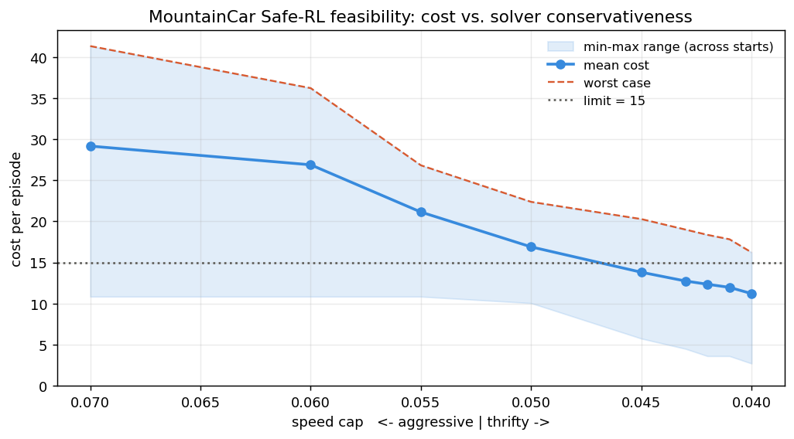
SANITY CHECK
Is a safe solution even possible?
Before training anything, we measured hand-coded drivers that pump but refuse to exceed a chosen speed cap.
≈ 29
reckless driver: nearly 2× the budget
≈ 11
Feasible — but thin. We should hit the budget, with little slack.
cautious floor: lowest cost that still wins
Notes:
Presenter B. Cheap feasibility probe. Reckless ~29 (double budget); most cautious winner bottoms out ~11. Safe-and-successful exists, but the window is narrow.

Slide 4
THE METHOD
PPO + a cost critic + a self-tuning safety knob
Actor (policy)
A second critic predicts cost, alongside the usual reward critic.
state
Reward critic
One number, λ, is a volume knob for safety: it turns up when over budget, down when safe.
Cost critic
Nobody sets λ by hand — it self-tunes every update.
Notes:
Presenter B. Dual critic: reward + cost. Lambda = adaptive safety weight via dual ascent; turns up under violation, relaxes when safe.

Slide 5
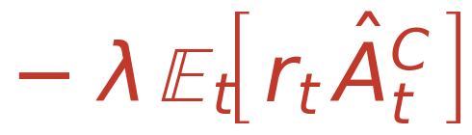
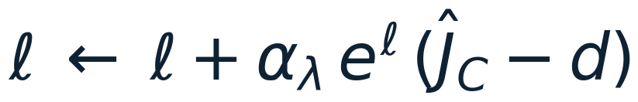
THE METHOD · THE MATH
PPO vs. Safe PPO: one extra term
PPO — maximize the clipped reward surrogate
Safe PPO — same reward surrogate, minus weighted cost, plus entropy
What actually changes
the only term added to PPO — penalize the cost advantage, weighted by λ
λ self-tunes by dual ascent — up when over budget, down when safe
Notes:
Presenter B (the math beat). PPO maximizes the clipped reward surrogate. Safe PPO keeps that exact term and SUBTRACTS lambda times the cost advantage (plus a small entropy bonus). That single red term is the whole difference — and lambda isn't fixed: it climbs by dual ascent when cost is over budget and relaxes when we're safe. Everything else is identical to PPO.

Slide 6
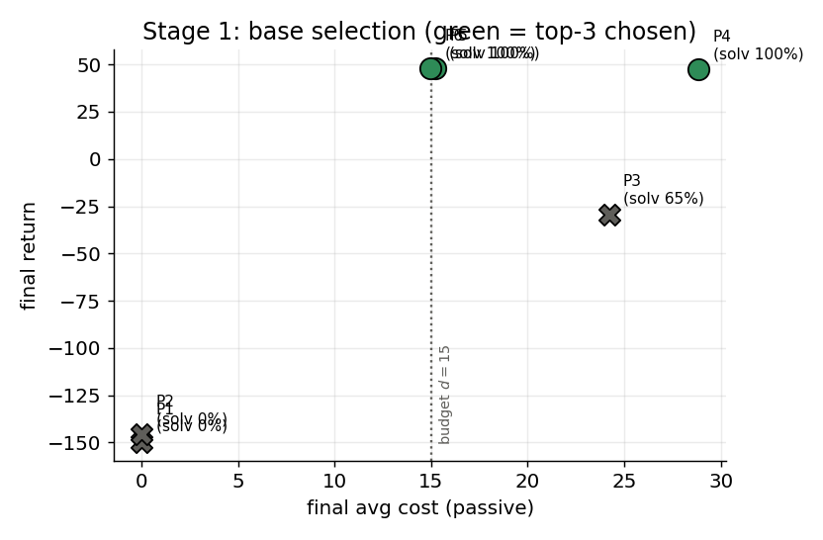
TUNING · STAGE 1
Screen the base policy (safety off)
ID | Return | Cost | Solved
P1 | −149.7 | 0.0 | 0%
P2 | −145.8 | 0.0 | 0%
P3 | −29.2 | 24.2 | 65%
P4 ✓ | 47.5 | 28.9 | 100%
P5 ✓ | 47.8 | 15.2 | 100%
P6 ✓ | 47.8 | 15.0 | 100%
Three configs solve with identical reward — but very different cost.
Notes:
Presenter C. Stage 1 ignores safety: 6 settings x 3 seeds. Two never learn, one unstable, three solve at return ~47.5. We also passively log each one's speed cost — the hidden tiebreaker.

Slide 7
THE HIDDEN SIGNAL
Same reward. Double the cost.
P4 — speed demon
P5 / P6 — cruisers
floors it to the flag
reach the goal gently
return ≈ 47.5
return ≈ 47.5
cost 28.9
cost ≈ 15
Reward can't tell them apart. Cost can — and it's about to decide everything.
Notes:
Presenter C. The three solving bases tie on reward but split ~2x on cost. Ranking by reward alone treats them as equal. Hold onto this gap.

Slide 8
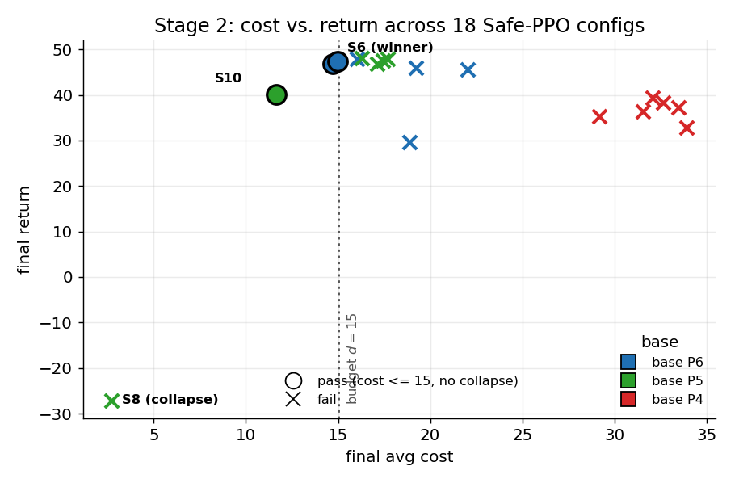
TUNING · STAGE 2 · THE FINDING
The base decides whether safety is achievable
Every P4-based config fails the budget — no matter how we tune λ.
Feasibility is set by the base's COST, not its reward.
Picking by reward alone would have chosen the one base that can never be made safe.
Notes:
Presenter C sets up; Presenter A delivers the punchline. All P4-based configs stranded past the budget; low-cost bases reach the feasible region. The cheap passive-cost number was the difference between success and failure.

Slide 9
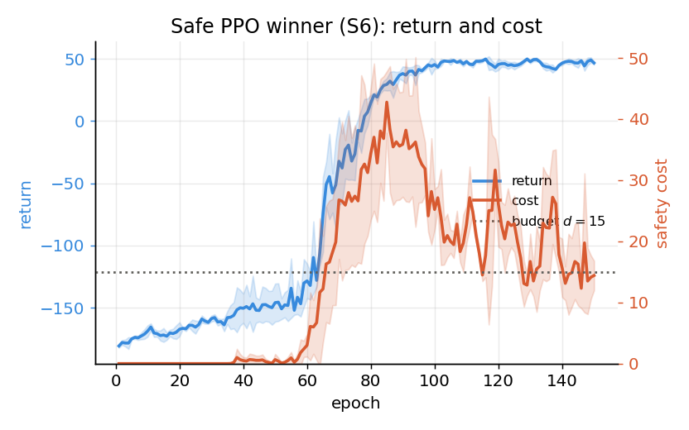
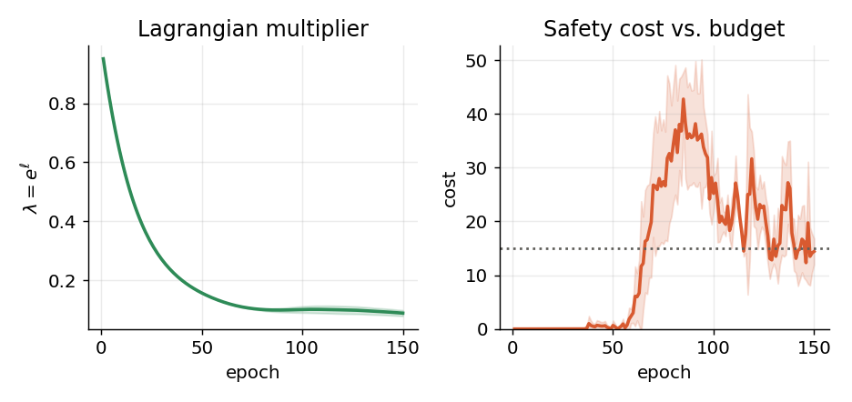
RESULT
The winner (S6): safe, essentially for free
47.3
15.0
0.95 → 0.09
return — matches the baseline (47.8)
cost — exactly on the budget
λ peaks, then relaxes
Notes:
Presenter A. Winner reaches full reward as fast as the unconstrained baseline; cost settles on the budget. Lambda spikes as the car first speeds, then relaxes — the method explaining itself.

Slide 10
FOR THE FINAL REPORT
Where the hyperparameter study goes next
1
Confirm on 5 seeds — re-run finalists; a champion from 3 runs can be luck
2
Widen the safety grid — open up the λ step sizes; check for a better point
3
Sweep the budget → Pareto front — d ∈ {12,15,20,25}: a safety-vs-reward trade-off curve
4
Full base × safety ablation — all 6 bases, not 3 — nails the base-cost claim
5
Reconcile the cost metric — use one definition for λ-update and reporting
Each slots straight into the existing two-stage runner.
Notes:
Presenter B. First pass was deliberately disciplined. Extensions: 5-seed confirm; widen grid; budget sweep -> Pareto (highest value); full ablation; fix cost metric. All run via the same scripts.

Slide 11
TAKEAWAYS
Three things to remember
See it
MountainCar is simple enough to watch a constraint reshape learning.
Read it
λ is an automatic, interpretable safety dial.
Choose by cost
To satisfy a constraint, pick your base policy by its cost — not just its reward.
Code, paper, and training-process videos available in the project repository. · Slides prepared with the assistance of AI.
Notes:
Close (all three). C: MountainCar makes constraint dynamics visible. B: lambda is a readable safety dial. A: choose the base by cost, not just reward. Thanks for watching.

