Slide 1
CSE 3112, Technical Writing and Presentation
LaTeX Math and Equations
Md.Hadiuzzaman
Id:170201065

Slide 2
For mathematical equation
For declare mathematical equation $....$
example ,
$ x^2 $ = x²
For declare mathematical equation with new line $$....$$
$$ 2x^2 $$ = 2x²
$$ 2x^4 $$ = 2x⁴

Slide 3
Math-Superscripts
$$ 2x ^ 34 $$ =2x³4
For multiple data can used {…}
$$ 2x ^ {34} $$ = 2x³⁴
$$ 2x ^ {3x+4} $$ = 2x^{3x+4}
Math-Subscripts
$ 2x_3 $ = 2x₃
For multiple data can used {…}
$$ 2 _{34} $$ = 2x₃₄
$$ {2x_1}_2 $$ = 2x₁₂

Slide 4
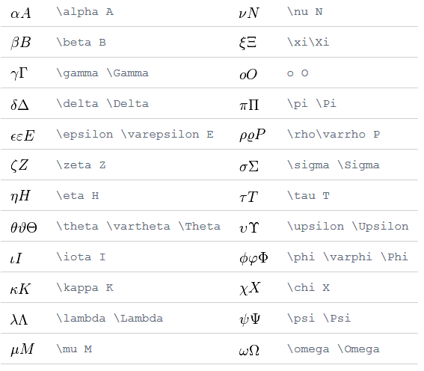
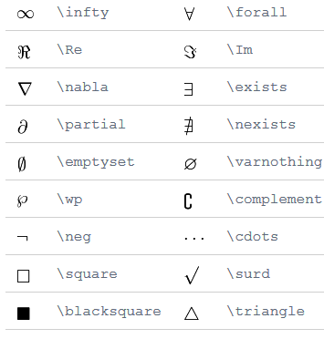
Math-Greek letter
Miscellaneous Symbols

Slide 5

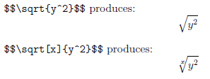
The command \sum inserts a sum symbol
Square Roots

Slide 6
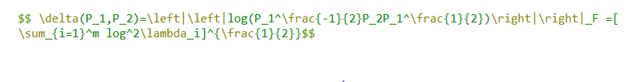





Slide 7




Slide 8
Thank You

