Slide 1
CSE311 Project Presentation
Real Estate Management System
Section: 08 | Group: 08 | Fall 2025
Hadi Uzzaman 2022206642
Md. Rayhan Chowdhury 1921647042
Yousra Amin 2221044042

Slide 2
Project Objectives
Content:
Design a comprehensive real estate management database
Implement proper normalization (up to BCNF)
Create efficient relational schema
Develop practical SQL queries
Ensure data integrity and consistency
Key Features:
Property Management
Client Relationship Management
Employee Assignment Tracking
Contract & Offer Processing
Inspection Scheduling

Slide 3
Core Entities (ER Diagram Overview)
Main Entities: Client, Employee, Property
Transaction Tables: Listing, Offer, Contract, Inspection
Junction Tables: Property_Feature, Property_Employee, Client_Inspection, Client_Property_Interest
Lookup Tables: PropertyType, ListingStatus, ListingType, OfferStatus, ContractStatus, RoleType, Feature

Slide 4
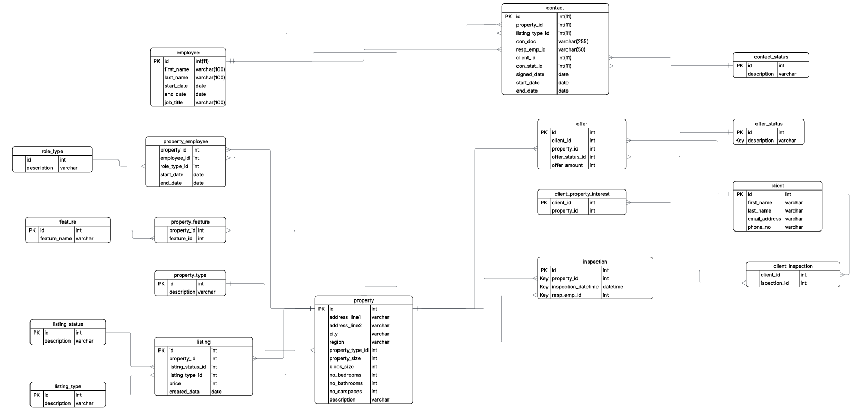
ER Diagrams

Slide 5
Step 1: Identify Functional Dependencies List all FDs for each table (e.g., property_id → address, client_id → name, offer_id → amount) Understand what determines what This becomes the foundation for all further normalization Step 2: Convert to 1NF Ensure all attributes are atomic Remove repeating groups and multi-valued fields Create separate bridge tables for M:N relations (e.g., PROPERTY_FEATURE, PROPERTY_EMPLOYEE)
Normalization

Slide 6
Step 3: Convert to 2NF
Applicable only for tables with composite primary keys
Remove partial dependencies
Keep only attributes fully dependent on the entire key
Mapping tables now contain only key + dependent attributes
Step 4: Convert to 3NF
Remove transitive dependencies
(A → B → C chains)
Move derived/descriptive attributes into lookup tables
e.g., PROPERTY_TYPE, OFFER_STATUS, CONTRACT_STATUS
Every non-key attribute depends directly on the key

Slide 7
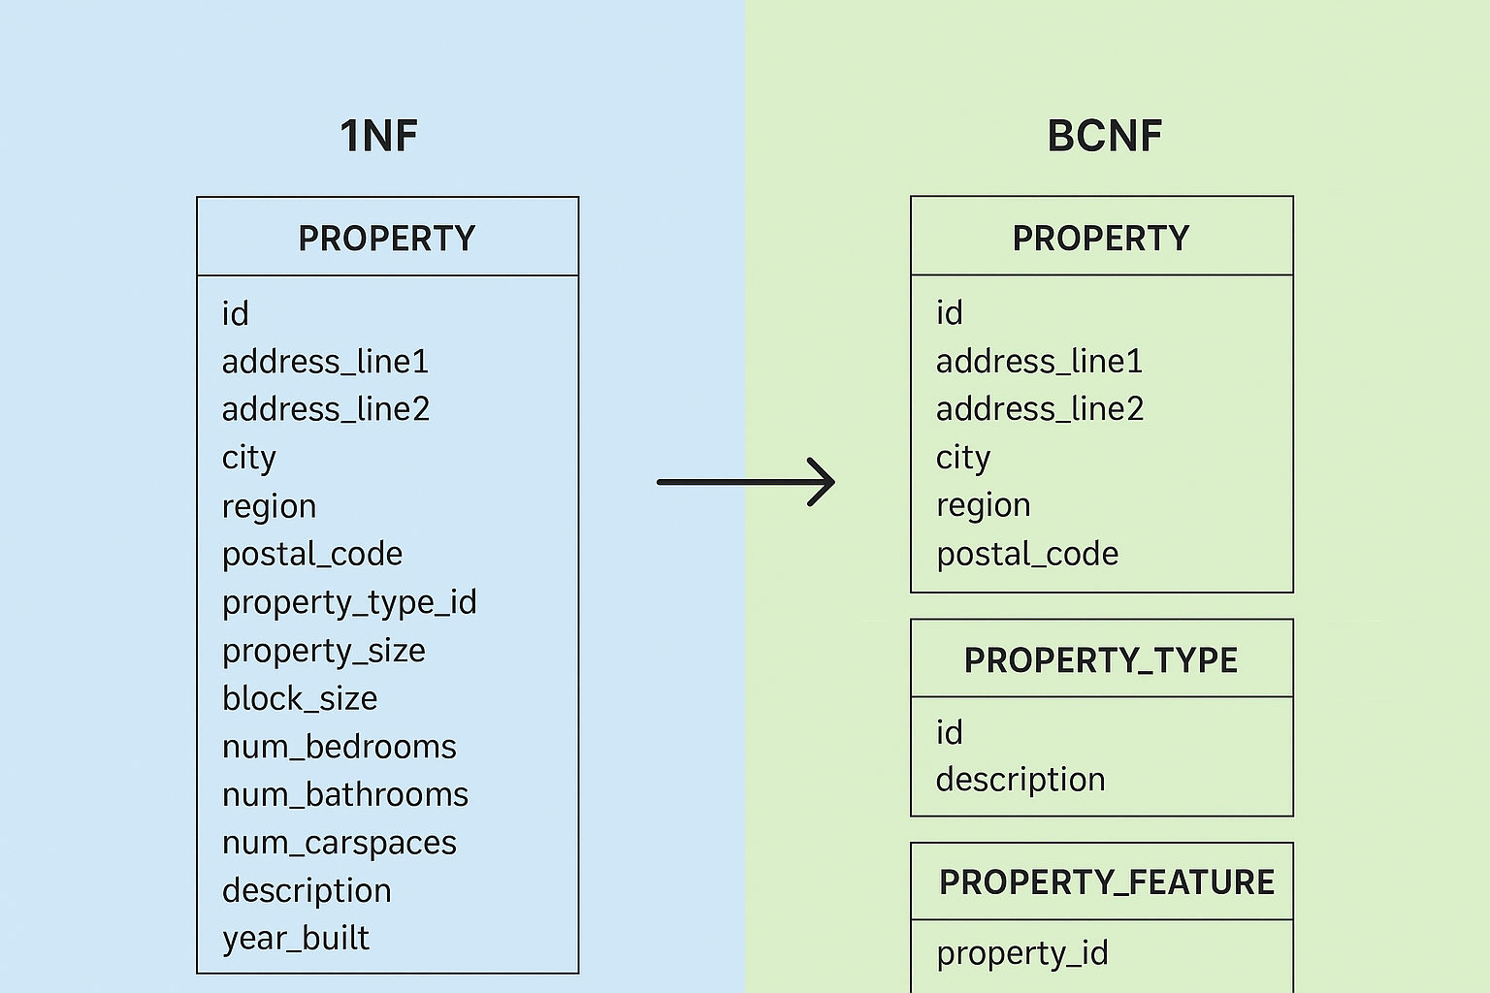

Slide 8
Step 5: Convert to BCNF
For every dependency X → Y, ensure X is a superkey
If not, decompose the table
Final BCNF schema contains:
Clean entity tables (CLIENT, PROPERTY, EMPLOYEE, OFFER, CONTRACT, INSPECTION)
Lookup tables (statuses & types)
Bridge tables (PROPERTY_FEATURE, PROPERTY_EMPLOYEE)
Final Summary
1NF: Remove repeating values
2NF: Remove partial dependencies
3NF: Remove transitive dependencies
BCNF: Ensure every determinant is a superkey
Result: Minimal redundancy, maximal consistency, cleanest schema

Slide 9
Relational Schema
ENTITY TABLES
Client(id PK, first_name, last_name, email_address UNIQUE, phone_number, registration_date, preferred_contact) Employee(id PK, first_name, last_name, start_date, end_date, job_title, email UNIQUE, phone_number, role_type_id FK→RoleType) Property(id PK, address_line1, address_line2, city, region, postal_code, property_type_id FK→PropertyType, property_size, block_size, num_bedrooms, num_bathrooms, num_carspaces, description, year_built)
2. TRANSACTION TABLES
Listing(id PK, property_id FK→Property, listing_status_id FK→ListingStatus, listing_type_id FK→ListingType, price, created_date, available_from, available_until) Offer(id PK, client_id FK→Client, property_id FK→Property, offer_status_id FK→OfferStatus, offer_amount, offer_date, expiry_date, conditions) Contract(id PK, property_id FK→Property, listing_type_id FK→ListingType, contract_document, responsible_employee_id FK→Employee, client_id FK→Client, contract_status_id FK→ContractStatus, signed_date, start_date, end_date, contract_amount) Inspection(id PK, property_id FK→Property, inspection_datetime, responsible_employee_id FK→Employee, inspection_notes)

Slide 10
3. JUNCTION TABLES (Many-to-Many Relationships)
Property_Feature(property_id PK FK→Property, feature_id PK FK→Feature) Property_Employee(property_id PK FK→Property, employee_id PK FK→Employee, role_type_id FK→RoleType, start_date PK, end_date) Client_Inspection(client_id PK FK→Client, inspection_id PK FK→Inspection, feedback, attended) Client_Property_Interest(client_id PK FK→Client, property_id PK FK→Property, interest_date, interest_level, notes)
4. LOOKUP TABLES
PropertyType(id PK, description)
ListingStatus(id PK, description)
ListingType(id PK, description)
OfferStatus(id PK, description)
ContractStatus(id PK, description)
RoleType(id PK, description)
Feature(id PK, feature_name)

Slide 11
KEY RELATIONSHIPS:
- One Property can have many Listings (1:N)
- One Client can make many Offers (1:N)
- One Property can receive many Offers (1:N)
- One Property can have many Contracts (1:N)
- One Employee can manage many Properties (M:N via Property_Employee)
- One Property can have many Features (M:N via Property_Feature)
- One Client can attend many Inspections (M:N via Client_Inspection)

Slide 12
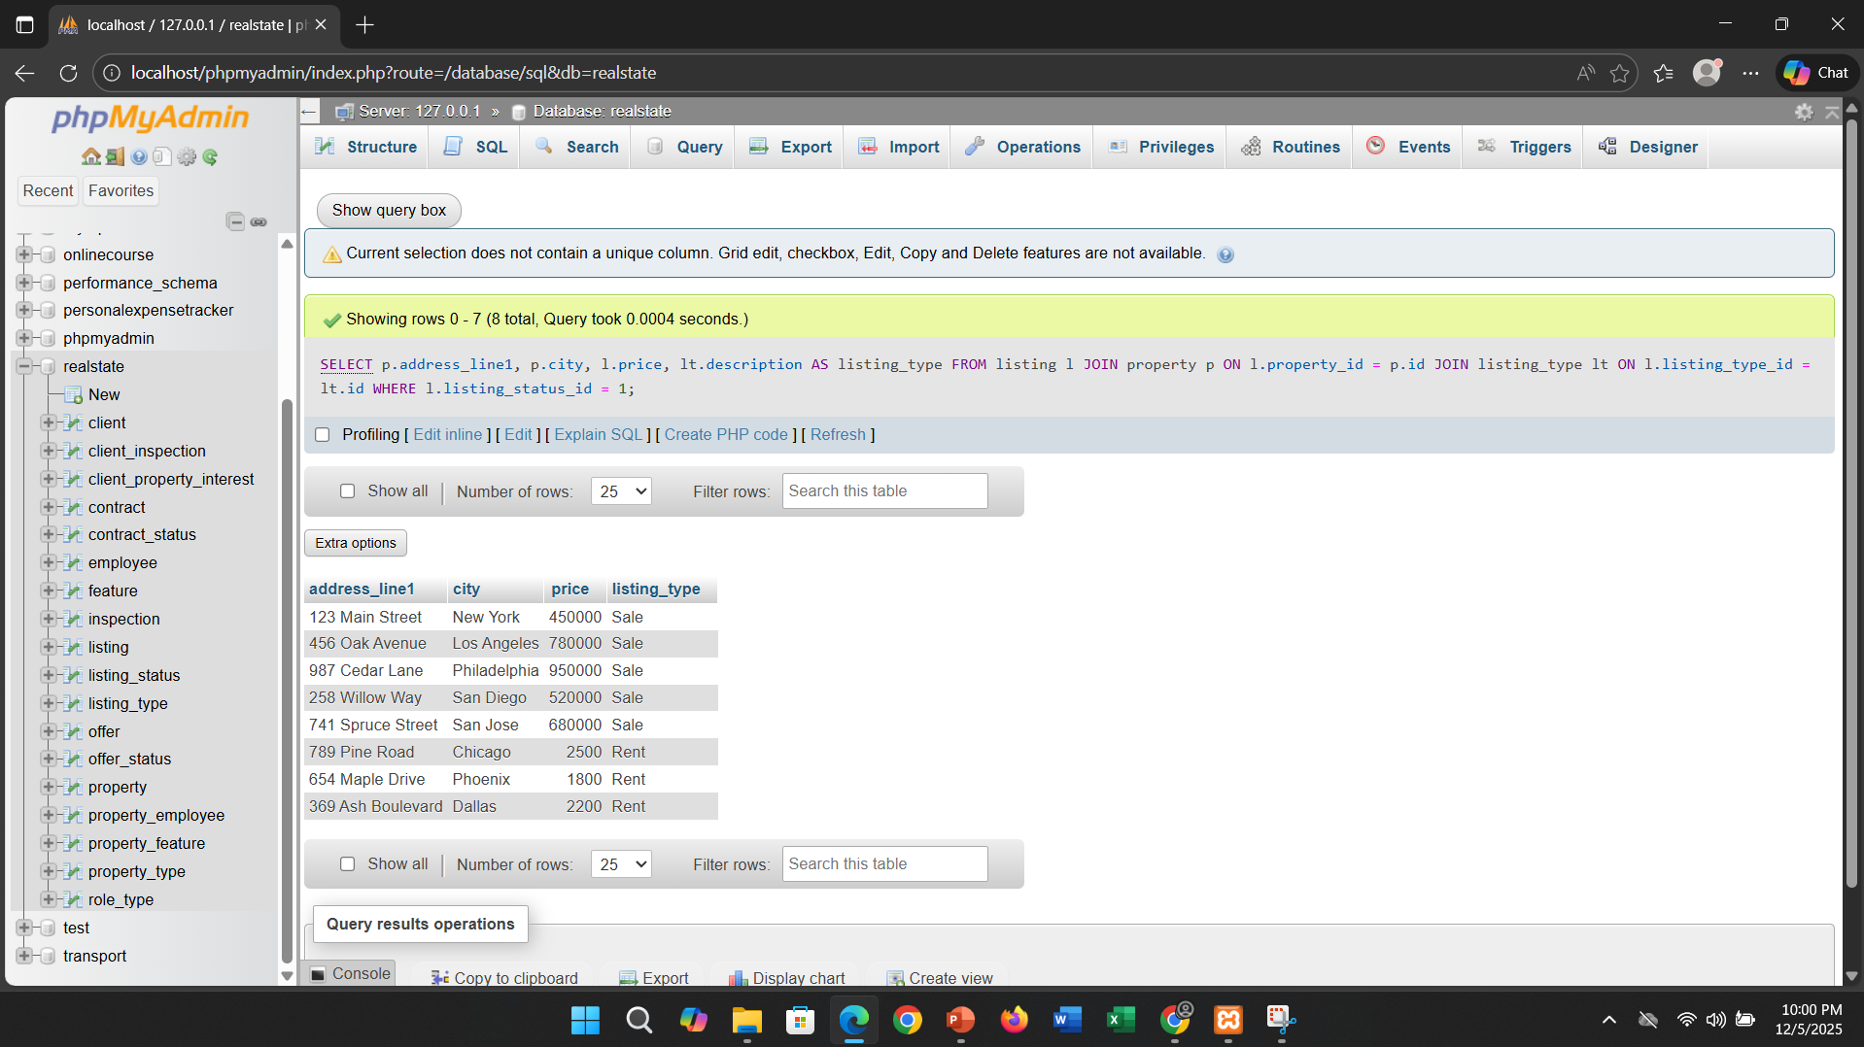
Sample SQL Queries
1. List all available properties with their listing price
SELECT p.address_line1, p.city, l.price, lt.description AS listing_type
FROM listing l
JOIN property p ON l.property_id = p.id
JOIN listing_type lt ON l.listing_type_id = lt.id
WHERE l.listing_status_id = 1;

Slide 13
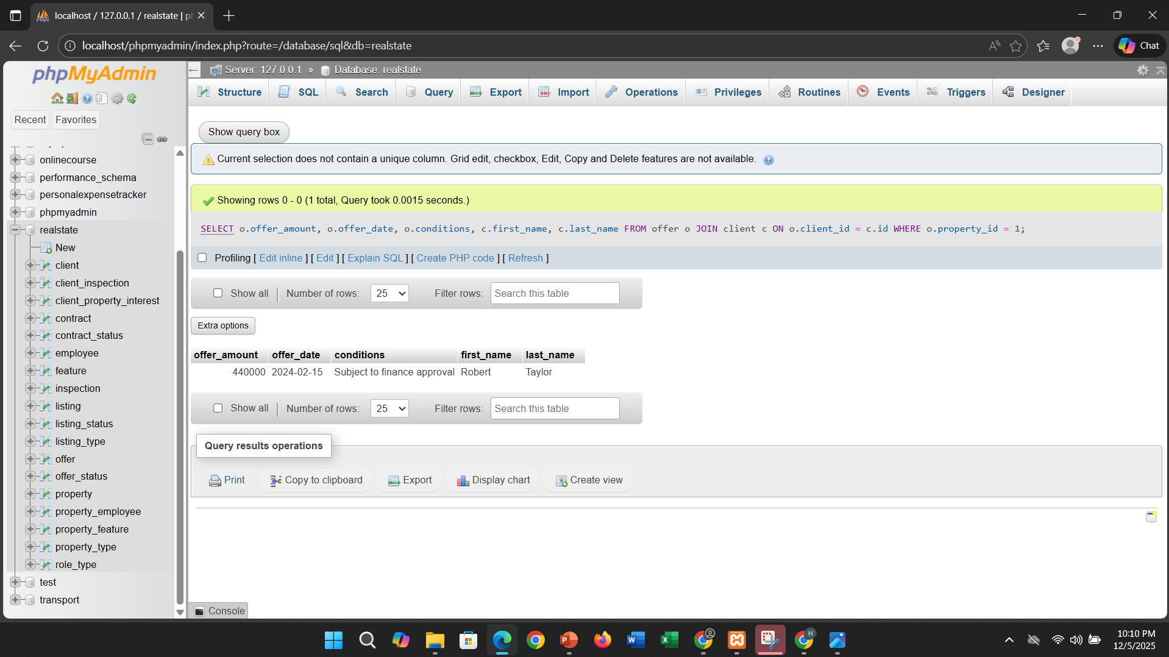
2. Find all offers made on a specific property
SELECT o.offer_amount, o.offer_date, o.conditions,
c.first_name, c.last_name
FROM offer o
JOIN client c ON o.client_id = c.id
WHERE o.property_id = 1;

Slide 14
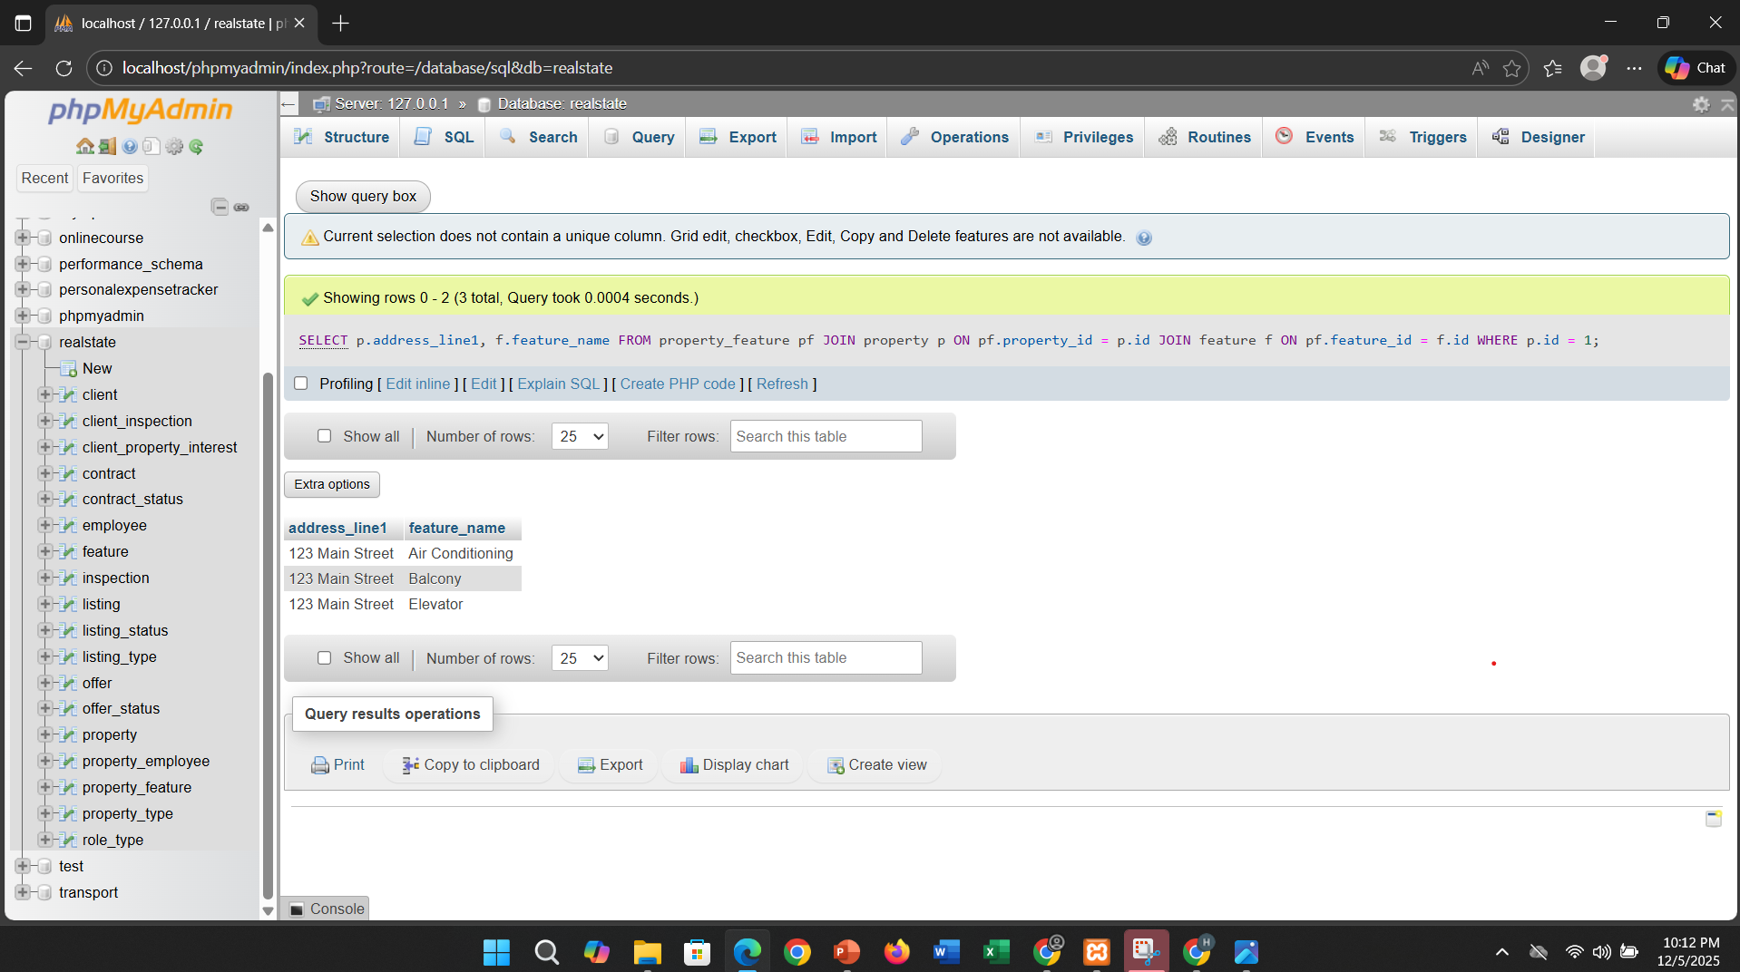
3. Show all features of a property
SELECT p.address_line1, f.feature_name
FROM property_feature pf
JOIN property p ON pf.property_id = p.id
JOIN feature f ON pf.feature_id = f.id
WHERE p.id = 1;

Slide 15
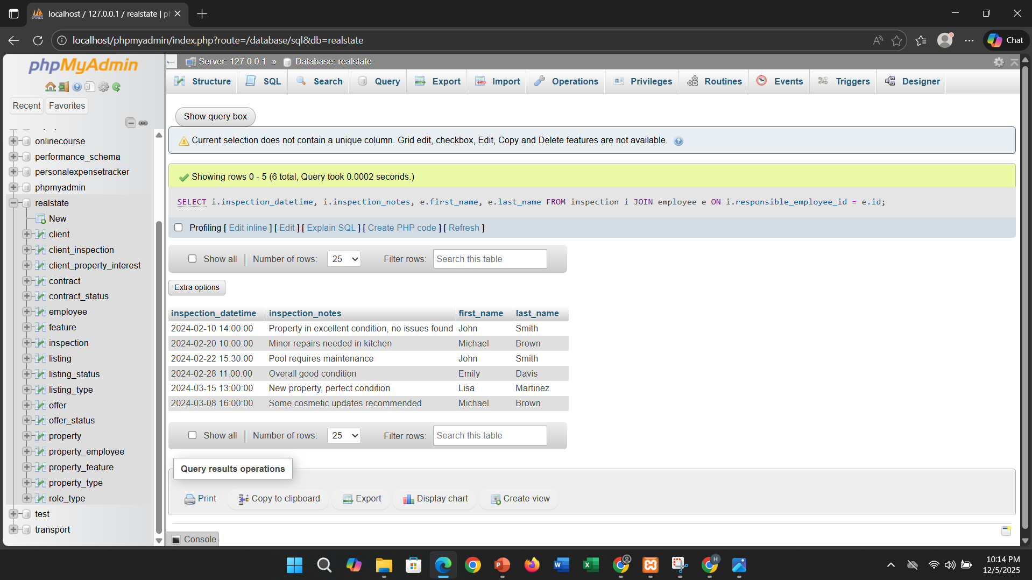
4. List inspections with employee names
SELECT i.inspection_datetime, i.inspection_notes,
e.first_name, e.last_name
FROM inspection i
JOIN employee e ON i.responsible_employee_id = e.id;

Slide 16
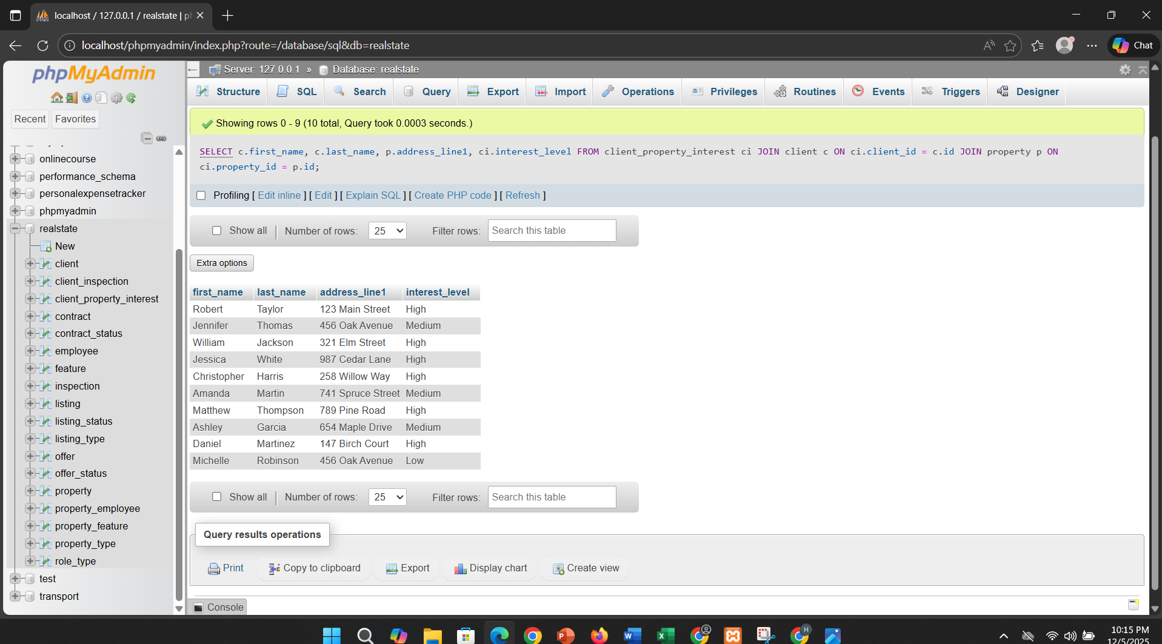
5. Which clients are interested in which properties?
SELECT c.first_name, c.last_name, p.address_line1, ci.interest_level
FROM client_property_interest ci
JOIN client c ON ci.client_id = c.id
JOIN property p ON ci.property_id = p.id;

Slide 17
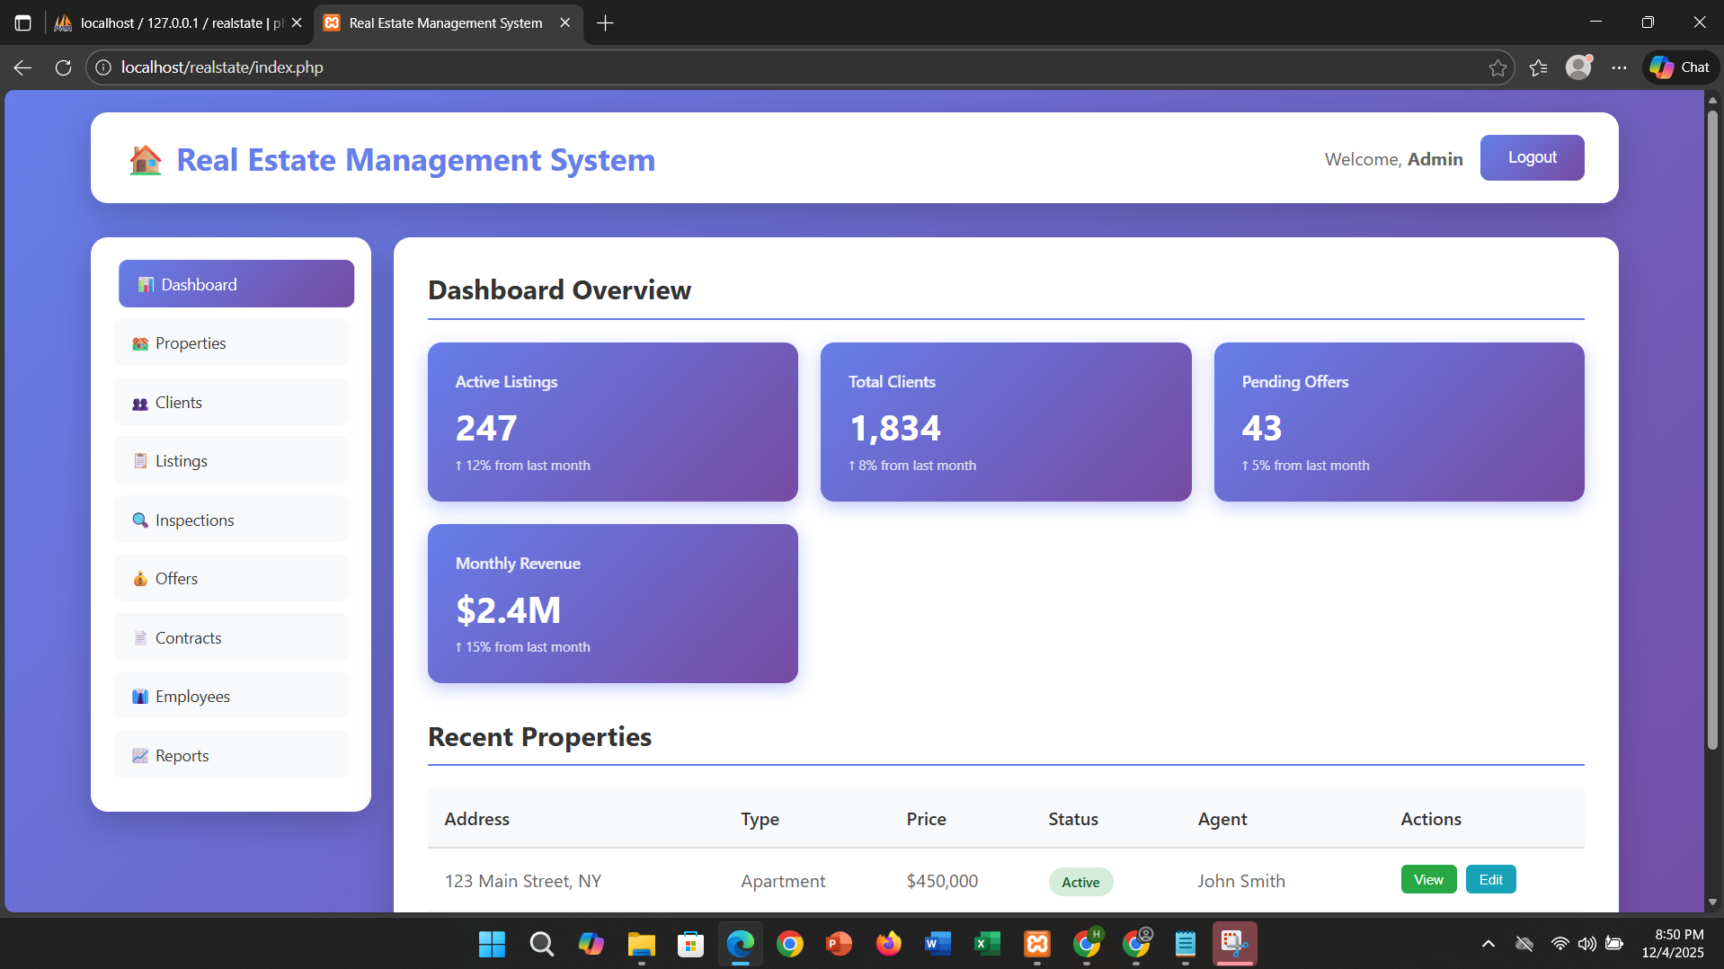

Slide 18
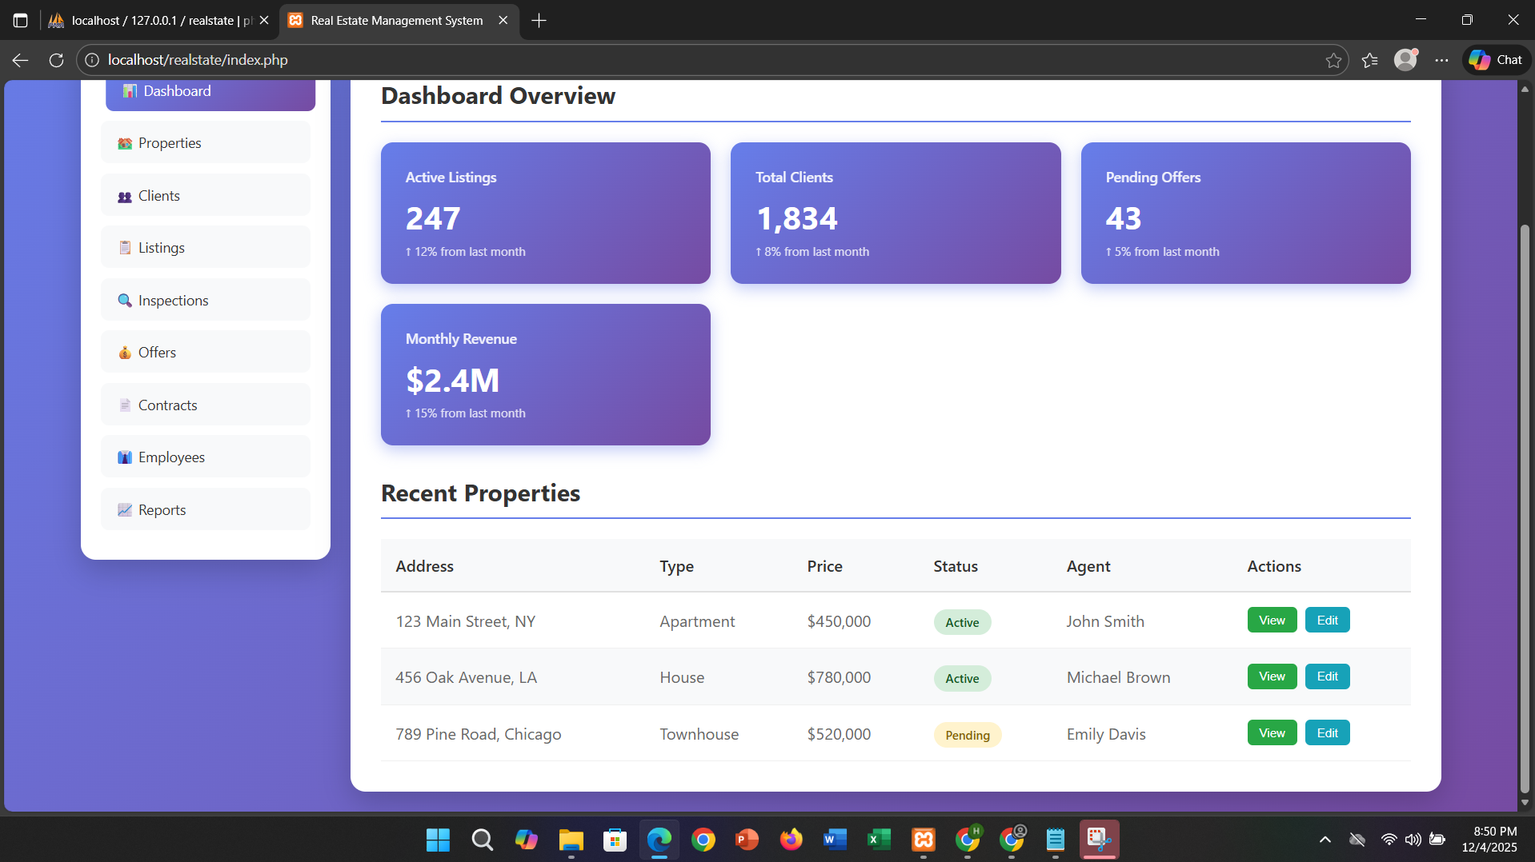

Slide 19
THANK YOU

