Slide 1
Hi, I’m Hadiya!
AI and Data Science Batch 15 – Ms. Tayyaba Akram
Project: Shape Detection using Python and OpenCV
Notes:
Replace the [Your Name] and [Your class / department / roll number] placeholders with your own details. Say who you are and that your project is a simple computer vision program that detects shapes.

Slide 2
What is Computer Vision?
Computer Vision is a field of computer science that teaches computers to see, understand and make decisions from images and videos.
Everyday examples
Face unlock on phones
Self-driving cars reading road signs
Detecting problems in medical scans
Notes:
Computer vision means giving computers the ability to understand pictures the way humans do. Mention one or two everyday examples.

Slide 3
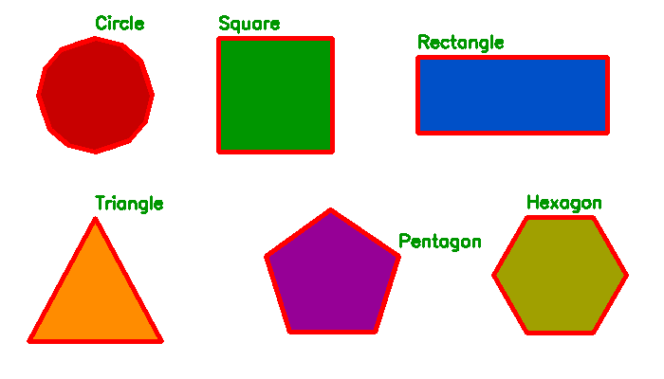
My Model: Shape Detector
Input
An image uploaded on a web page
Output
Each shape outlined in red and named in green
Shapes it knows
Triangle, Square, Rectangle, Pentagon, Hexagon, Circle
No training needed. It names a shape by counting its corners.
Notes:
This is a rule-based model with no training data. The user uploads an image on a Streamlit web page. The program finds the outline of each shape, counts the corners and uses that number to name the shape.

Slide 4
Libraries Used and Why
Python
The programming language. Simple and easy to read.
OpenCV (cv2)
Does the image work: grayscale, threshold, contours, drawing outlines and text.
NumPy
Turns the uploaded file's bytes into an array of numbers that OpenCV can decode.
Streamlit
Builds the web page: the upload button, messages and the result display.
Notes:
Python is the language. OpenCV does all the image processing. NumPy converts the uploaded file into an array so OpenCV can decode it. Streamlit turns the script into a web app with very little code.

Slide 5
Main Code Explained
st.file_uploader()
User uploads an image
cv2.imdecode()
Turns the uploaded bytes into an image
cv2.cvtColor()
Converts the image to grayscale
cv2.threshold()
Separates shapes from the background
cv2.findContours()
Finds the outline of each shape
cv2.approxPolyDP()
Reduces each outline to its corner points
len(approx)
Counts the corners, which names the shape
st.image()
Shows the final result on the page
Notes:
Go down the list: each line is one step. The key idea is approxPolyDP, which reduces a curvy outline to a few corner points. Then 3 corners = triangle, 4 = square or rectangle (check width divided by height), 5 = pentagon, 6 = hexagon, more = circle.

Slide 6
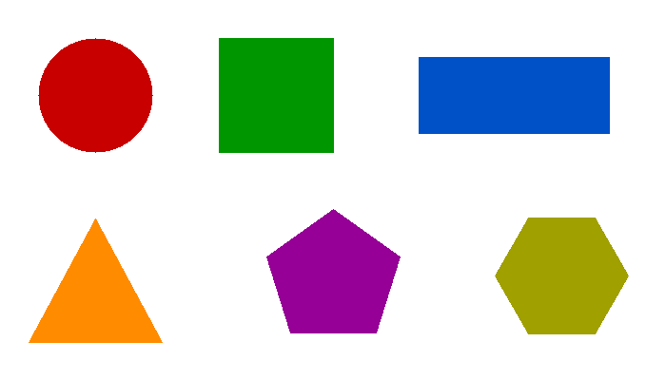
How the Model Works
1
›
2
›
3
›
4
›
5
Upload image
Grayscale + Threshold
Find contours
Count corners
Show result
›
Input
Output
Notes:
Summarise the whole model: the uploaded image goes through the steps and comes out with each shape named. Offer a live demo with: streamlit run app.py (use your own file name).

Slide 7
Thank You
Any questions?
Notes:
Thank the audience and invite questions.

