Slide 1
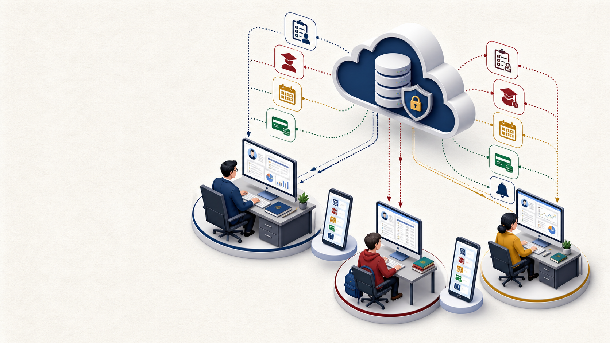
COLLEGE MANAGEMENT SYSTEM
CMS Viva
Preparation
Architecture • Database • Flows • Sync • Key terms
Explain the decisions, not just the screens.
Notes:
Teaching cue: Open by telling students that a viva rewards understanding of decisions and data movement, not memorized class names.
Likely viva question: What is the project in one sentence?
Model answer: It is a role-based college management system with separate Admin, Teacher, and Student clients on mobile and desktop, backed by Supabase and platform-specific local caching.
[Sources]
- D:/CMS/settings.gradle.kts
- AI-generated ecosystem illustration created for this deck

Slide 2
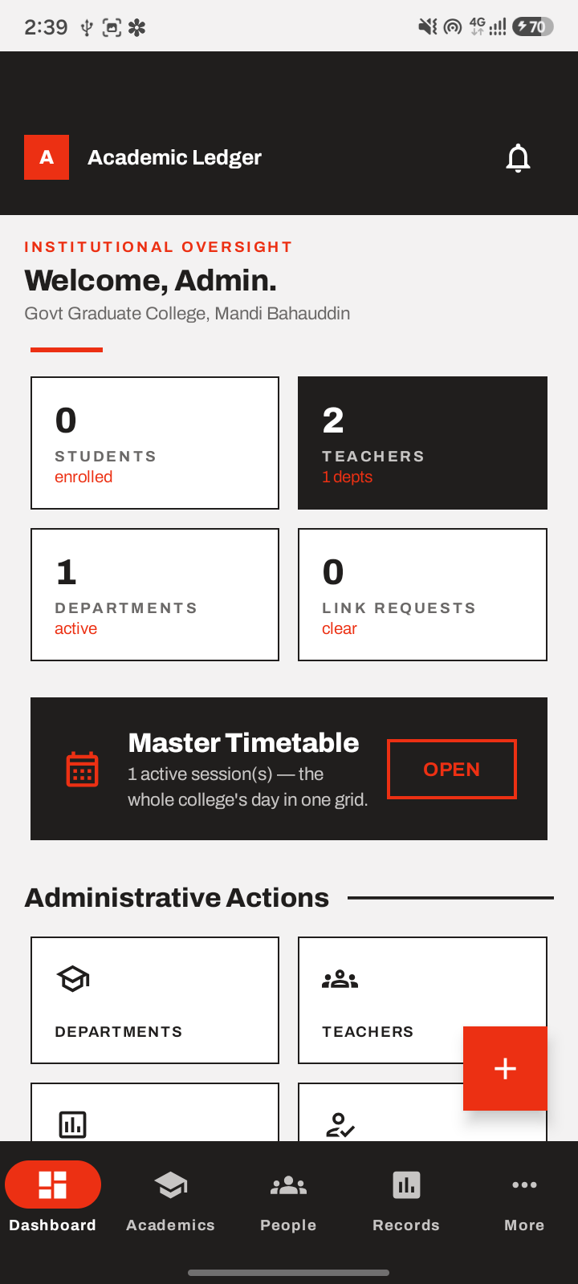
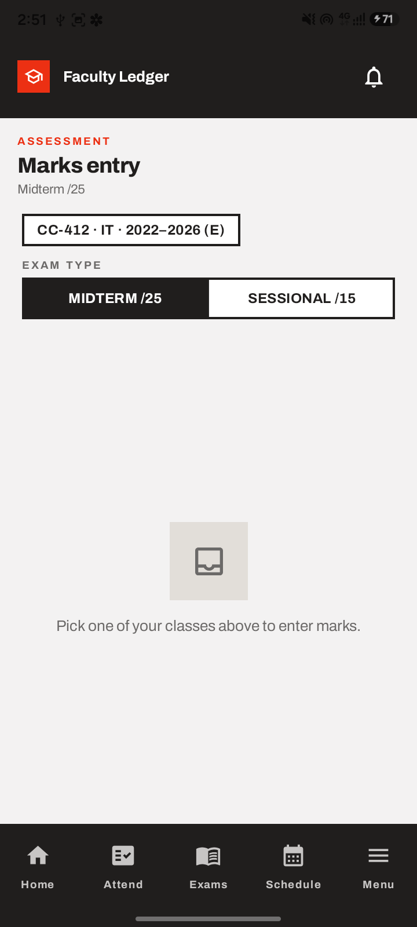
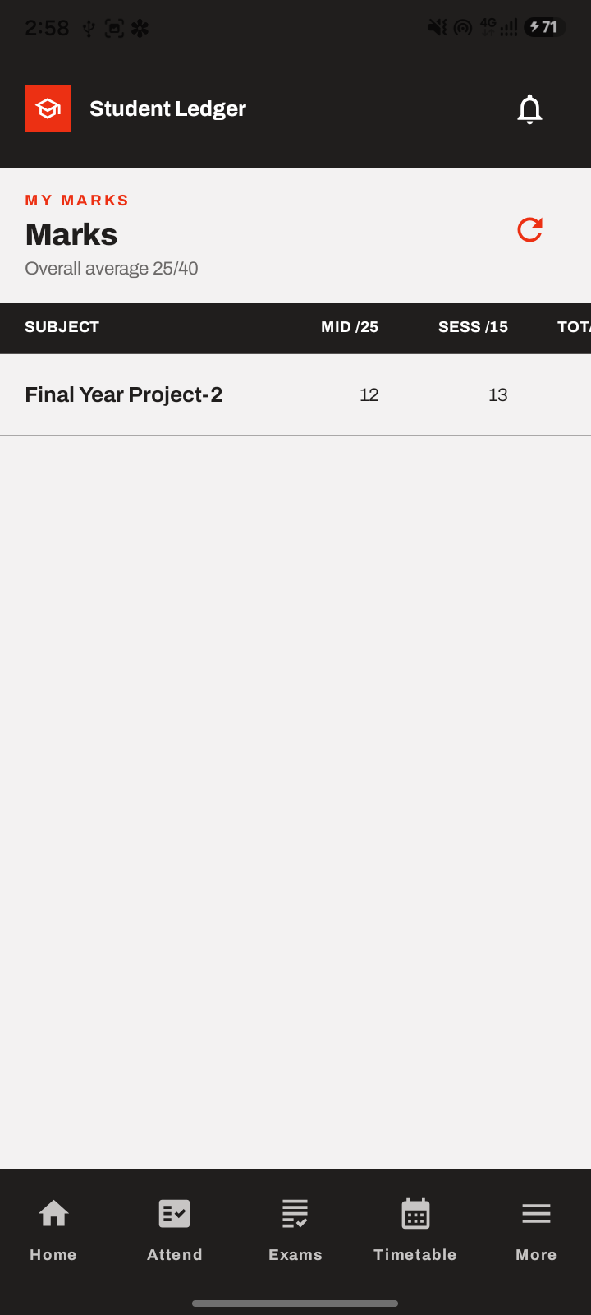
CMS VIVA PREPARATION
One product serves six clients
The same academic data appears through three roles on two platforms.
ADMIN
TEACHER
STUDENT
oversight and setup
teaching records
personal academic view
Mobile
Desktop
Mobile
Desktop
Mobile
Desktop
02
Notes:
Teaching cue: Point to one role at a time, then emphasize that each role has both a mobile and desktop executable.
Likely viva question: Why did you build separate applications instead of one screen with a role switch?
Model answer: Separate clients keep each workflow focused and reduce accidental exposure of actions, while shared modules prevent the domain model from being duplicated.
[Sources]
- D:/CMS/settings.gradle.kts
- D:/CMS/Documentation/build/screenshots/admin_02_home.png
- D:/CMS/Documentation/build/screenshots/teacher_03_marks_entry.png
- D:/CMS/Documentation/build/screenshots/student_04_marks.png

Slide 3
CMS VIVA PREPARATION
Three roles divide responsibility
ADMIN
TEACHER
STUDENT
• Creates academic structure
• Manages people and permissions
• Reviews controlled workflows
• Reads institution-wide reports
• Works with assigned sessions
• Records attendance and marks
• Submits papers and requests
• Views teaching insights
• Links an account to a record
• Views own attendance and marks
• Checks timetable, fees, datesheets
• Receives scoped notifications
Same records. Different authority. The backend still checks every request.
03
Notes:
Teaching cue: Ask students to name one operation each role can perform and one it must not perform.
Likely viva question: What is role-based access control in this system?
Model answer: The authenticated user is resolved to a domain role, UI actions are limited by that role, and database RLS policies independently enforce the permitted rows and operations.
[Sources]
- D:/CMS/core/src/main/kotlin/com/mbd/cmscommon/domain/model/UserRole.kt
- D:/CMS/supabase/migrations/20260714000002_rls.sql
- D:/CMS/design.md

Slide 4
CMS VIVA PREPARATION
Nine modules separate concerns
Three libraries hold shared logic; six executables provide role-specific entry points.
core
portable domain • DTOs • repositories • auth
mobile-shared
Room • Hilt • Android UI
desktop-shared
Dagger • snapshots • Desktop UI
Android apps
Desktop apps
mobile-admin
mobile-teacher
mobile-student
desktop-admin
desktop-teacher
desktop-student
04
Notes:
Teaching cue: Start at core, move down to platform libraries, then to executables. This is the easiest architecture explanation to remember.
Likely viva question: Why is core a plain JVM module?
Model answer: It keeps portable domain models, contracts, DTOs, and shared business logic independent of Android and desktop UI frameworks, so both platform stacks can depend on it.
[Sources]
- D:/CMS/settings.gradle.kts
- D:/CMS/core/build.gradle.kts
- D:/CMS/mobile-shared/build.gradle.kts
- D:/CMS/desktop-shared/build.gradle.kts

Slide 5
CMS VIVA PREPARATION
Every request crosses four layers
Follow one action from a tap to stored data; that path explains most of the system.
1 UI
2 STATE
3 DOMAIN
4 DATA
Compose screen
collects state
emits intent
ViewModel or
controller validates
and coordinates
Repository contract
expresses the use case
Room / snapshot
and Supabase adapters
Example: Save attendance → validate rows → repository save → PostgREST insert → local cache update
05
Notes:
Teaching cue: Trace one familiar action. Students should be able to substitute marks, fees, or notifications into the same layered path.
Likely viva question: Why use repositories?
Model answer: Repositories give the UI a stable domain-facing contract and hide whether data came from Room, a desktop snapshot, or Supabase.
[Sources]
- D:/CMS/core/src/main/kotlin/com/mbd/cmscommon/domain/repository
- D:/CMS/mobile-shared/src/main/java/com/mbd/cmscommon/data/repository
- D:/CMS/desktop-shared/src/main/kotlin/com/mbd/cmsdesktop/data/repository

Slide 6
CMS VIVA PREPARATION
Shared backend, different caches
Architecture is shared at the domain and backend levels, not at every platform detail.
Supabase
Auth • Postgres • Storage
6 client apps
core contracts
platform repos
Mobile: Room v31
DAOs + Flow
Desktop: JSON snapshots
MutableStateFlow
same repository interfaces
Mobile favors durable local tables. Desktop currently favors a lightweight reference-data snapshot.
06
Notes:
Teaching cue: Explain that shared contracts do not force identical persistence. This is a deliberate abstraction boundary.
Likely viva question: Are mobile and desktop implementations identical?
Model answer: No. They share domain contracts and backend services, but mobile uses Room with DAOs and checkpoints, while desktop currently seeds in-memory flows from JSON snapshot files.
[Sources]
- D:/CMS/settings.gradle.kts
- D:/CMS/mobile-shared/src/main/java/com/mbd/cmscommon/data/local/CmsDatabase.kt
- D:/CMS/desktop-shared/src/main/kotlin/com/mbd/cmsdesktop/data/cache/DesktopBootstrapSnapshotStore.kt

Slide 7
CMS VIVA PREPARATION
Login also resolves a domain role
A valid token answers “who are you?”; role resolution answers “what may you do?”
Credentials
Supabase Auth
Session
Manager
Profile + teacher
UserRole
Home
Admin
Teacher + permissions
Linked / unlinked student
JWT is authentication evidence. The domain role still comes from application records and permissions.
07
Notes:
Teaching cue: Contrast authentication with authorization. Students often merge these two concepts in a viva.
Likely viva question: What happens after Supabase accepts the password?
Model answer: SessionManager exposes the signed-in identity, repository data is loaded, RoleResolver maps cached profile and teacher data into a sealed UserRole, and navigation opens the matching home experience.
[Sources]
- D:/CMS/core/src/main/kotlin/com/mbd/cmscommon/auth/SessionManager.kt
- D:/CMS/mobile-shared/src/main/java/com/mbd/cmscommon/auth/RoleResolver.kt
- D:/CMS/core/src/main/kotlin/com/mbd/cmscommon/domain/model/UserRole.kt

Slide 8
CMS VIVA PREPARATION
Security works at two levels
APPLICATION LEVEL
DATABASE LEVEL
Improves the user experience
Protects the data even if UI is bypassed
• Role-specific navigation
• Teacher permission flags
• Read-only screens for restricted roles
• Validation before repository calls
• PostgreSQL Row-Level Security
• Students see their own session and roll number
• Teachers act only on assigned sessions
• Attendance has no admin write policy
Rule to remember: hiding a button is not security; RLS is the final authority.
08
Notes:
Teaching cue: Use the attendance policy as the memorable example: admin can read attendance but cannot forge it.
Likely viva question: Why is UI role checking not enough?
Model answer: A client can be modified or called directly, so the database must independently filter rows and reject unauthorized writes through RLS policies.
[Sources]
- D:/CMS/supabase/migrations/20260714000002_rls.sql
- D:/CMS/core/src/main/kotlin/com/mbd/cmscommon/domain/model/UserRole.kt

Slide 9
CMS VIVA PREPARATION
The schema mirrors college structure
Foreign keys turn real academic ownership into enforceable database relationships.
Department
dept_id
Academic session
session_id
Subjects + students
composite keys
Attendance + marks
session • course • roll
Fees + GPA
student history
Notices + calendar
audience scope
Why composite keys?
Attendance and marks are not owned by one generated number alone. Their identity comes from the session, course, date or exam, and roll number that define the real record.
09
Notes:
Teaching cue: Walk from department to student-owned records. Ask what would break if session_id were removed from attendance.
Likely viva question: What is a foreign key?
Model answer: A foreign key requires a child row to reference a valid parent row, preserving relationships such as a session belonging to a department and attendance belonging to a session student.
[Sources]
- D:/CMS/supabase/migrations/20260714000001_schema.sql

Slide 10
CMS VIVA PREPARATION
The current SQL snapshot has 23 tables
Remember the families first. Individual names become easier once their purpose is clear.
2
5
5
7
4
IDENTITY
STRUCTURE
SCHEDULING
ASSESSMENT + FEES
WORKFLOW
profiles
teachers
departments
sessions
subjects
terms
students
timetable
period links
datesheets
slots
calendar
attendance • marks • GPA
fees • heads
overrides • fines
documents
exam papers
link requests
notifications
Counts describe the checked-in migration snapshot, not a permanent schema promise.
10
Notes:
Teaching cue: Do not ask students to memorize 23 names at once. Make them name the five families and two examples from each.
Likely viva question: How many tables are in the current SQL migration snapshot?
Model answer: There are 23 CREATE TABLE statements in the checked-in migrations. The important explanation is how they group around identity, academic structure, scheduling, assessment and finance, and workflow.
[Sources]
- D:/CMS/supabase/migrations/20260714000001_schema.sql
- D:/CMS/supabase/migrations/20260718000001_semester_terms.sql
- D:/CMS/core/src/main/kotlin/com/mbd/cmscommon/data/remote/SupabaseTables.kt

Slide 11
CMS VIVA PREPARATION
The sync design depends on audit fields
A client can fetch changes only if each mutable row records when it changed and whether it was deleted.
entity_id
created_at / by
updated_at / by
is_deleted
deleted_at / by
stable tie-breaker
origin
change cursor
tombstone flag
deletion audit
Tombstone
The server keeps a deletion marker long enough for every client to learn that the row must disappear locally. Hard deletion would leave offline copies behind.
Repository warning: the client code expects these fields, but the checked-in Supabase migrations are not fully aligned yet.
11
Notes:
Teaching cue: Define a tombstone with the offline-device example. Then explicitly distinguish the intended sync contract from current migration completeness.
Likely viva question: Why not hard-delete a synchronized row immediately?
Model answer: An offline client would never receive the deletion. A tombstone travels through the same updated_at stream, letting the client remove its cached row before the server eventually purges anything.
[Sources]
- D:/CMS/mobile-shared/src/main/java/com/mbd/cmscommon/data/local/CmsDatabaseMigrations.kt
- D:/CMS/mobile-shared/src/main/java/com/mbd/cmscommon/data/repository/AcademicSessionRepositoryImpl.kt
- D:/CMS/supabase/migrations/20260714000001_schema.sql

Slide 12
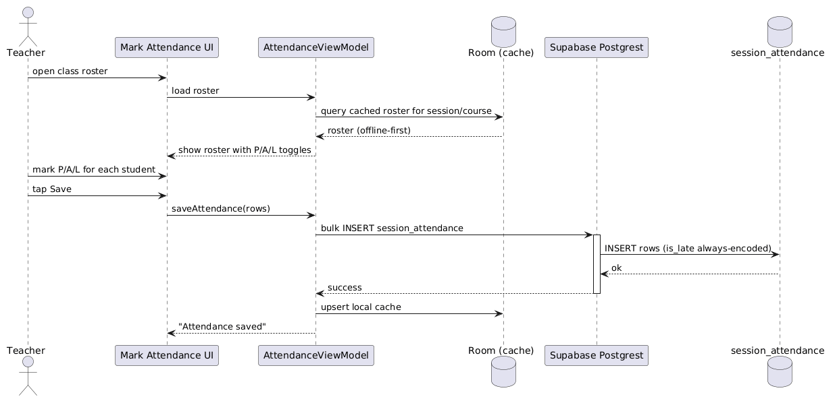
CMS VIVA PREPARATION
Attendance reads local, then saves remote
Offline-first roster display; online-confirmed write; local cache updates only after success.
12
Notes:
Teaching cue: Read the diagram from left to right. Pause at the remote success response; that ordering is the consistency decision.
Likely viva question: Why update Room after the server confirms attendance?
Model answer: It avoids showing a locally successful save that the backend rejected. The roster can still be read from cache, but the authoritative write is confirmed remotely before local state is finalized.
[Sources]
- D:/CMS/Documentation/build/seq_attendance.png
- D:/CMS/mobile-shared/src/main/java/com/mbd/cmscommon/data/repository/SessionAttendanceRepositoryImpl.kt
- D:/CMS/supabase/migrations/20260714000002_rls.sql

Slide 13
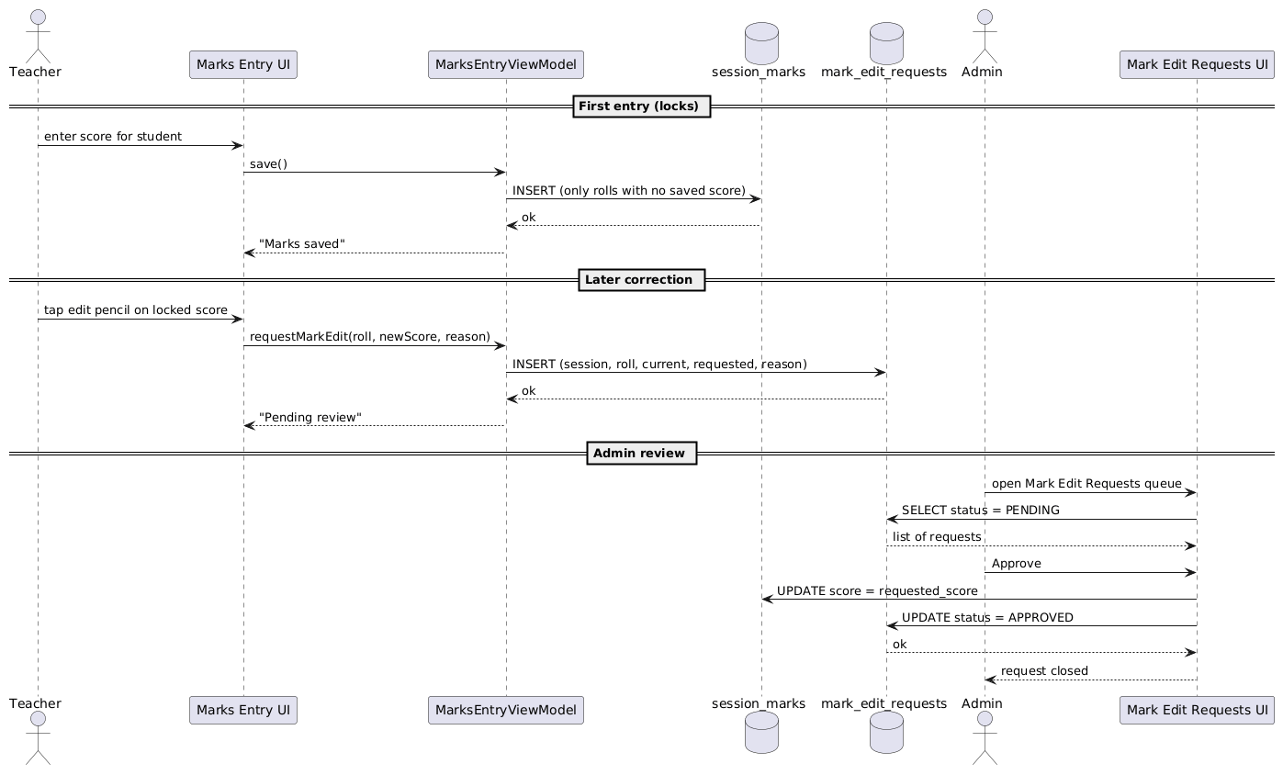
CMS VIVA PREPARATION
Marks edits follow an approval path
First entry is simple. A later correction becomes an auditable request instead of an invisible overwrite.
13
Notes:
Teaching cue: Explain the three phases: first save, correction request, admin review. This is a design decision about accountability.
Likely viva question: Why not let a teacher silently overwrite marks?
Model answer: Marks are high-impact records. A separate edit request preserves the original value, requested value, reason, reviewer, and status, creating an audit trail.
[Sources]
- D:/CMS/Documentation/build/seq_marks.png
- D:/CMS/mobile-shared/src/main/java/com/mbd/cmscommon/data/repository/MarkEditRequestRepositoryLocalImpl.kt
- D:/CMS/core/src/main/kotlin/com/mbd/cmscommon/domain/model/MarkEditRequest.kt

Slide 14
CMS VIVA PREPARATION
Student linking protects identity
An authenticated email is not automatically trusted as a particular roll number.
Register
Supabase account
Unlinked
limited student role
Request
identity claims
Review
admin or permitted teacher
Linked
session + roll access
Security result
Only an approved link lets RLS match auth.uid() to the student’s session and roll number. Until then, the account remains intentionally unlinked.
14
Notes:
Teaching cue: Use a real-world analogy: a login proves control of an email, not ownership of a college roll number.
Likely viva question: Why does UserRole include both LinkedStudent and UnlinkedStudent?
Model answer: It models the identity-verification lifecycle explicitly, allowing registration without granting access to academic records until a link request is approved.
[Sources]
- D:/CMS/core/src/main/kotlin/com/mbd/cmscommon/domain/model/UserRole.kt
- D:/CMS/mobile-shared/src/main/java/com/mbd/cmscommon/data/repository/StudentLinkRequestRepositoryImpl.kt
- D:/CMS/supabase/migrations/20260714000002_rls.sql

Slide 15
CMS VIVA PREPARATION
Caching differs by platform
MOBILE
DESKTOP
Persistence
Room database v31
JSON files under app cache
Reactive state
DAO + Kotlin Flow
MutableStateFlow
Refresh
updated_at checkpoint deltas
full refresh per requested scope
Deletion
tombstone → applyDelta
server filters deleted rows
Offline breadth
many feature tables
reference data snapshots
Same repository interfaces; different durability and synchronization guarantees.
15
Notes:
Teaching cue: Read each row across. Students should be able to compare persistence, reactivity, refresh, deletion, and offline coverage.
Likely viva question: Why can the two platforms share repository interfaces while using different caches?
Model answer: The interface describes domain operations and flows, while each platform supplies an adapter suited to its storage technology and lifecycle.
[Sources]
- D:/CMS/mobile-shared/src/main/java/com/mbd/cmscommon/data/local/CmsDatabase.kt
- D:/CMS/mobile-shared/src/main/java/com/mbd/cmscommon/data/sync/RoomSyncCheckpointStore.kt
- D:/CMS/desktop-shared/src/main/kotlin/com/mbd/cmsdesktop/data/cache/DesktopBootstrapSnapshotStore.kt
- D:/CMS/desktop-shared/src/main/kotlin/com/mbd/cmsdesktop/data/repository/DesktopAcademicSessionRepositoryImpl.kt

Slide 16
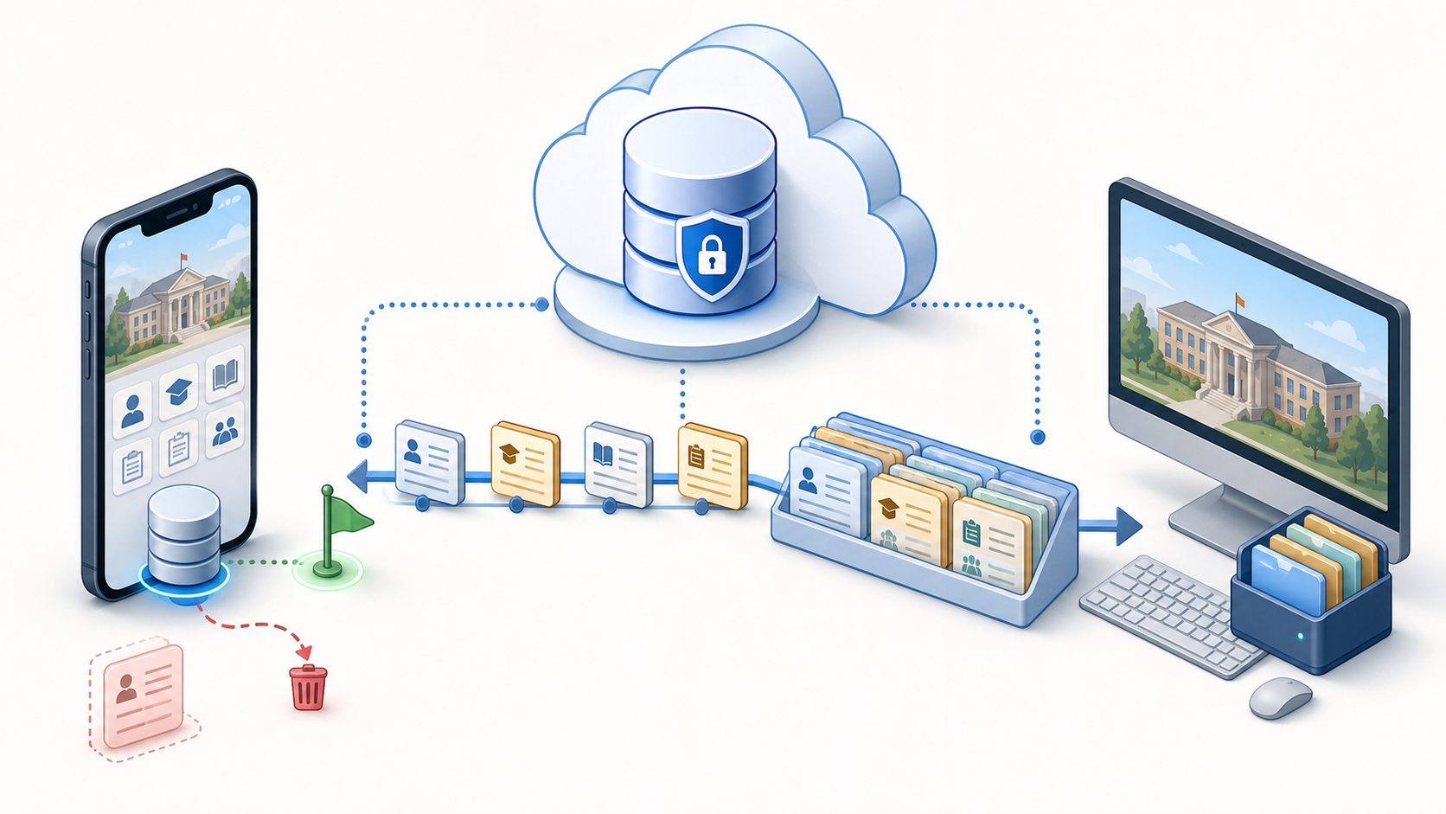
CMS VIVA PREPARATION
Mobile sync fetches only changes
The checkpoint changes a full-table download into a repeatable delta query.
1
Read checkpoint
owner + table + scope
2
Query changed rows
updated_at >= cursor
3
Apply delta
upsert active; remove tombstones
4
Advance checkpoint
only after the page loop succeeds
16
Notes:
Teaching cue: Use the picture, then map each visual cue to the four code steps. State that the desktop bundle in the picture represents its broader snapshot refresh.
Likely viva question: What makes this synchronization incremental?
Model answer: The client stores the greatest remote updated_at it has processed for a particular owner, table, and scope, then asks only for rows at or beyond that value on the next run.
[Sources]
- AI-generated synchronization illustration created for this deck
- D:/CMS/mobile-shared/src/main/java/com/mbd/cmscommon/data/repository/AcademicSessionRepositoryImpl.kt
- D:/CMS/mobile-shared/src/main/java/com/mbd/cmscommon/data/sync/RoomSyncCheckpointStore.kt

Slide 17
CMS VIVA PREPARATION
Checkpoints are owner, table, and scope
A single global timestamp would mix users, datasets, and partial views.
teacher@college.edu | session_students | session=IT-2022-E
OWNER
TABLE
SCOPE
prevents one account
reusing another cursor
each dataset moves
at its own speed
department or session
can sync independently
startup sync_state answers “did bootstrap finish?” • table_sync_state answers “where does this dataset continue?”
17
Notes:
Teaching cue: Use the sample key as a sentence. Then contrast the two local state tables; this is a common viva trap.
Likely viva question: Why keep sync_state and table_sync_state separate?
Model answer: Bootstrap completion is a yes-or-no milestone for startup, while data checkpoints are per-owner, per-table, per-scope cursors. Combining them would confuse lifecycle state with data progress.
[Sources]
- D:/CMS/core/src/main/kotlin/com/mbd/cmscommon/data/sync/SyncCheckpoint.kt
- D:/CMS/mobile-shared/src/main/java/com/mbd/cmscommon/data/sync/StartupBootstrapTracker.kt
- D:/CMS/mobile-shared/src/main/java/com/mbd/cmscommon/data/local/entity/TableSyncStateEntity.kt

Slide 18
CMS VIVA PREPARATION
Inclusive cursors avoid missed rows
The query intentionally overlaps the previous boundary: updated_at >= cursor.
saved cursor
A
B
C
D
E
10:00
10:05
10:05
10:08
10:12
Benefit
Tradeoff
Rows B and C share the boundary timestamp. Re-reading the boundary avoids skipping C.
Some rows repeat. Idempotent upsert/applyDelta makes the overlap safe.
Pages are ordered by updated_at and fetched in batches of 500.
18
Notes:
Teaching cue: Use the two rows at 10:05 to explain the boundary. This is more memorable than defining inclusive cursor abstractly.
Likely viva question: Why use greater-than-or-equal instead of greater-than?
Model answer: Several rows can share the same timestamp. An inclusive query re-reads the boundary so a row committed at that timestamp is not missed; local delta application must therefore be idempotent.
[Sources]
- D:/CMS/mobile-shared/src/main/java/com/mbd/cmscommon/data/repository/AcademicSessionRepositoryImpl.kt
- D:/CMS/mobile-shared/src/main/java/com/mbd/cmscommon/data/repository/DepartmentRepositoryImpl.kt

Slide 19
CMS VIVA PREPARATION
Know what is built—and what is not
A strong viva answer separates implemented client logic from end-to-end completion.
BUILT IN CLIENT CODE
CURRENT DESKTOP
STILL NEEDS ALIGNMENT
• Room v31 checkpoint table
• table + scope cursor store
• inclusive paged queries
• active/deleted delta partition
• JSON reference snapshots
• MutableStateFlow caches
• full scoped refresh
• no SQLDelight checkpoint DB
• Remote entity_id fields
• remote soft-delete columns
• mark_edit_requests migration
• end-to-end tests and builds
Honest wording: “the mobile incremental pipeline exists, but the checked-in backend schema and desktop path are not yet fully aligned.”
19
Notes:
Teaching cue: Make students practice the exact honest sentence. It turns a weakness into evidence that they understand verification boundaries.
Likely viva question: Is incremental synchronization complete across all six applications?
Model answer: Not end to end. Mobile client code contains checkpoints and delta application, but desktop still uses snapshots and the checked-in backend migrations are not fully aligned with the client’s audit and tombstone expectations.
[Sources]
- D:/CMS/mobile-shared/src/main/java/com/mbd/cmscommon/data/sync/RoomSyncCheckpointStore.kt
- D:/CMS/desktop-shared/src/main/kotlin/com/mbd/cmsdesktop/data/cache/DesktopBootstrapSnapshotStore.kt
- D:/CMS/core/src/main/kotlin/com/mbd/cmscommon/data/remote/SupabaseTables.kt
- D:/CMS/supabase/migrations/20260714000001_schema.sql

Slide 20
CMS VIVA PREPARATION
Define these terms in one sentence
Repository
domain-facing data contract
Checkpoint
last processed remote position
DTO
remote payload shape
Scope
subset such as a session or department
Entity
locally stored row model
Tombstone
deletion record that can synchronize
DAO
typed Room database access
Idempotent
safe to apply more than once
RLS
row rules enforced by PostgreSQL
Bootstrap
initial data needed to start the app
If a definition needs a paragraph, the mental model is not clear enough yet.
20
Notes:
Teaching cue: Run this as a rapid-fire exercise. Accept different wording only when the meaning stays precise.
Likely viva question: What is the difference between a DTO and an entity?
Model answer: A DTO matches the remote API payload, while an entity matches the local database schema; a mapper translates between them and the domain model.
[Sources]
- D:/CMS/core/src/main/kotlin/com/mbd/cmscommon/data/remote/dto
- D:/CMS/mobile-shared/src/main/java/com/mbd/cmscommon/data/local/entity
- D:/CMS/mobile-shared/src/main/java/com/mbd/cmscommon/data/local/dao

Slide 21
CMS VIVA PREPARATION
Use a five-part viva answer
1
2
3
4
5
PROBLEM
STRUCTURE
FLOW
DECISION
EVIDENCE
What needed to be solved?
Which modules or layers own it?
How does data move?
Why this approach?
Which code, table, or test proves it?
Example: Why use repositories?
The UI needs stable operations without knowing the storage technology. Repository interfaces live in the domain layer; platform implementations connect them to Room, snapshots, and Supabase. This lets both platforms share use cases while changing persistence independently. The interface and its two platform implementations are the evidence.
21
Notes:
Teaching cue: Have one student answer using all five parts, then let the group identify any missing part.
Likely viva question: How should I structure an architecture answer under pressure?
Model answer: State the problem, locate the responsible modules or layers, trace one data flow, name the decision and tradeoff, then cite concrete evidence from code or schema.
[Sources]
- D:/CMS/settings.gradle.kts
- D:/CMS/core/src/main/kotlin/com/mbd/cmscommon/domain/repository
- D:/CMS/mobile-shared/src/main/java/com/mbd/cmscommon/data/repository
- D:/CMS/desktop-shared/src/main/kotlin/com/mbd/cmsdesktop/data/repository

Slide 22
CMS VIVA PREPARATION
Practice until the explanation is yours
ARCHITECTURE + SECURITY
DATABASE + SYNC
• Why six apps instead of one?
• Why keep core platform-independent?
• How does login become authorization?
• Why is RLS still required?
• Why use composite keys?
• How does incremental sync work?
• Why keep tombstones?
• What is not complete yet?
One-sentence synthesis
CMS separates role-specific clients from shared domain logic, protects one Supabase data model with RLS, and uses platform-specific caches whose sync guarantees must be explained honestly.
22
Notes:
Teaching cue: Close with the synthesis sentence, then assign each student two questions to answer without looking at the slide.
Likely viva question: What should the examiner remember after your answer?
Model answer: The project has a clear separation of roles, modules, layers, security boundaries, data relationships, and synchronization responsibilities, including an honest account of current limitations.
[Sources]
- D:/CMS/settings.gradle.kts
- D:/CMS/supabase/migrations/20260714000002_rls.sql
- D:/CMS/mobile-shared/src/main/java/com/mbd/cmscommon/data/sync
- D:/CMS/desktop-shared/src/main/kotlin/com/mbd/cmsdesktop/data/cache/DesktopBootstrapSnapshotStore.kt

