Slide 1
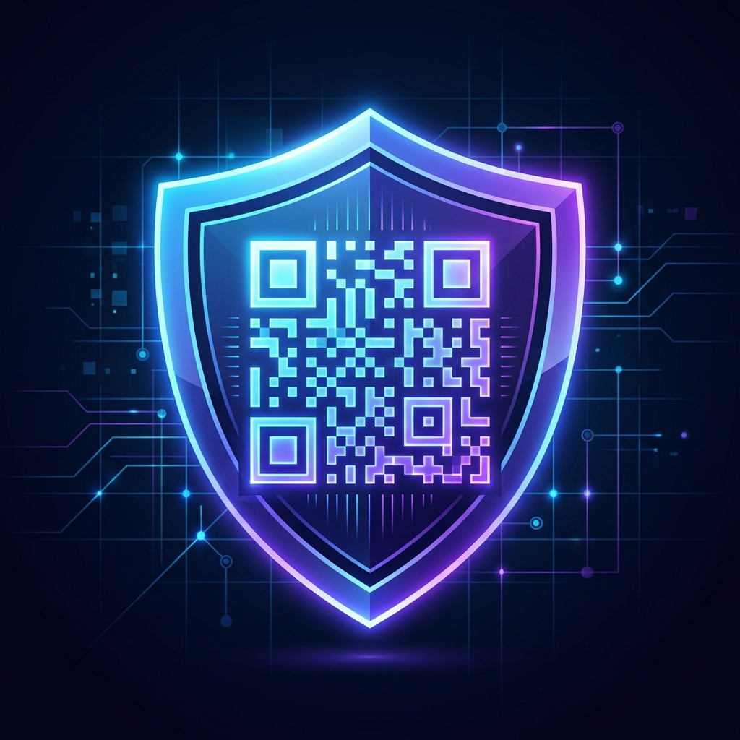
QR Code Safety Scanner & Auditor
Mitigating Quishing & Rogue Wi-Fi Networks with Local Heuristics
College Project Presentation | Presenter: CSE Department

Slide 2
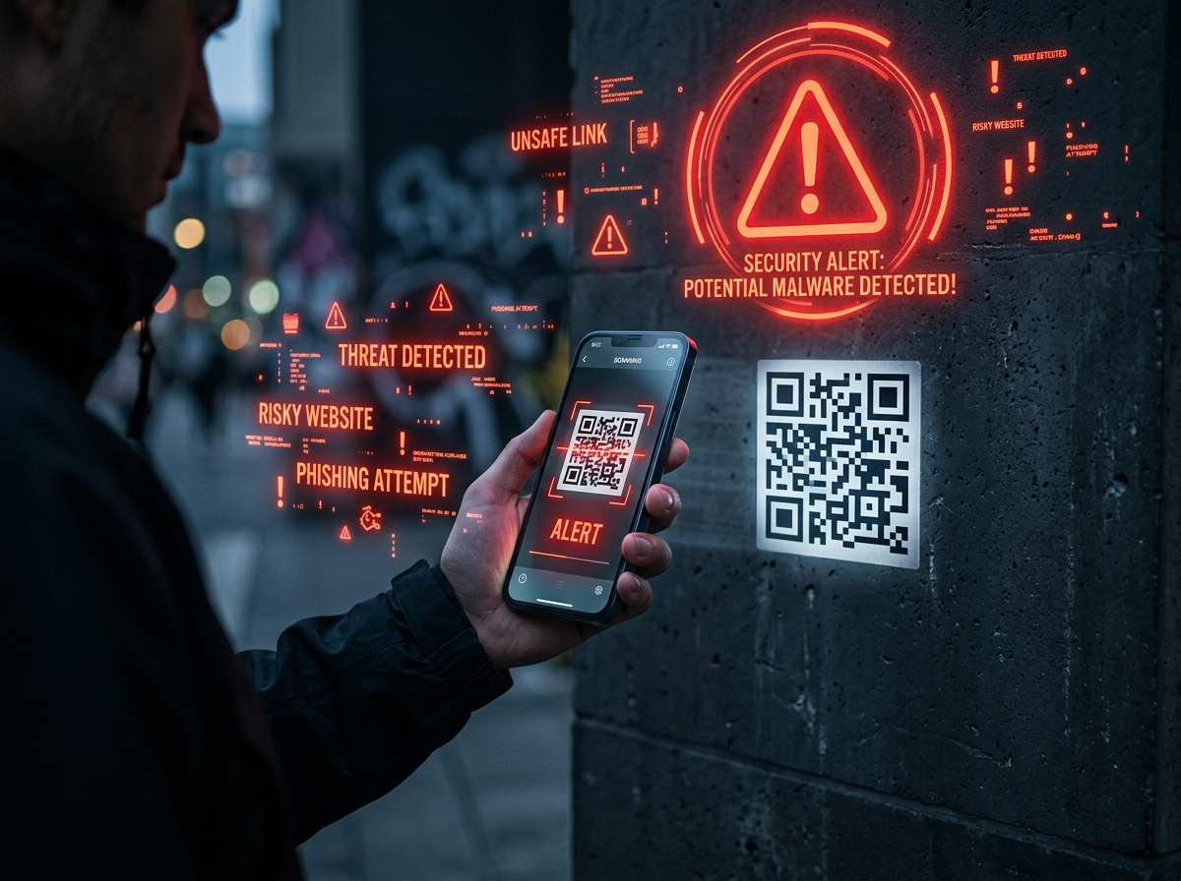
The Security Threat: Malicious QR Codes
• Visual Obscurity & Blind Trust
QR code grids cannot be read visually. Users scan codes without knowing the destination URL path.
• Quishing (QR Phishing Attacks)
Fake QR labels pasted over public merchant codes to steal banking credentials.
• Rogue Wi-Fi Access Points
Access codes designed to auto-connect devices to packet-sniffing network interfaces.
• Link Masking Abuses
Obscured redirects and shorteners (like bit.ly) are used to hide malicious domains.

Slide 3
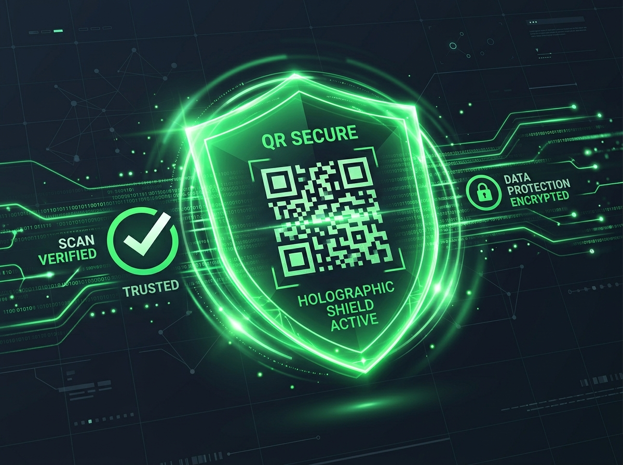
Proposed Solution: Local-First Auditor
• 100% Client-Side Evaluation
All decryption, unshortening, and security audits run locally in the browser sandbox. No user telemetry leaks.
• 8-Rule Heuristic Scanner Core
Automated algorithmic analysis of URL parameters to calculate threat level indexes in real-time.
• AES Payload Cryptography
Integrates client-side AES-256 password decryption to protect QR data before verification.
• Visual Sandbox Previewing
Loads isolated previews of destination pages to inspect visual brand identity securely.

Slide 4
System Architecture & Workflow
• Matrix Parsing Pipeline
Decodes images from local files or live WebRTC camera streams using jsQR and html5-qrcode libraries.
• Routing & Decrypt Verification
Checks for AES prefix tokens to trigger key inputs, then routes string payloads to Wi-Fi, URL, or plain text controllers.
• Heuristic Safety Engine Analysis
Invokes the 8-rule checker suite, populates risk scores, and flags items in a dynamic results panel.
• PDF Report & History Logging
Compiles findings, timestamps, and verdicts into formatted PDF documents using client-side jsPDF libraries.

Slide 5
Heuristics Safety Engine Checkpoints
• HTTPS Encryption & Host Audits
Flags insecure http: protocols (+25 risk) and numeric raw IP address hosts (+35 risk).
• Link Masking & Extension Scan
Identifies URL shorteners (+20 risk) and low-reputation top-level domains like .xyz, .top, or .work (+25 risk).
• Phishing Keywords & Entropy
Audits paths for credential harvesting terms (login, banking) and flags excessive subdomain nesting (+15 risk).
• Unicode Homograph Identity Verification
Inspects hostnames for unicode spoofing prefixes (xn--) used to impersonate famous brand domains (+35 risk).

Slide 6

Wi-Fi Audit & Hidden SSID Guidance
• Encryption Protocol Verification
Warns users if the network setup utilizes weak WEP keys or open encryption standards.
• Hidden SSID Warning guide
SSID broadcast checks alert the user, displaying a connection checklist for manual hidden configuration.
• Interactive Clipboard Copy
Features Copy buttons for SSID names and passwords to prevent input errors on long, complex passphrases.
• Security Recommendations
Checks password strength and flags compliance reports directly in the details grid.

Slide 7
Technical Implementation Stack
• Core Programming Layer
Pure client-side development using HTML5, Vanilla CSS3 variables, and modern modular ES6 Javascript.
• Decoders & Crypto Library
jsQR and html5-qrcode for matrix decodes; CryptoJS for local AES-256 data protection.
• Styled Generation & Export
qr-code-styling for drawing customized designer QR vectors; jsPDF for client-side report compilation.
• Microlink Interface API
Queries isolated, headless visual sandbox screenshots dynamically inside the dashboard.

Slide 8
Key Accomplishments & Future Scope
• Visual Safety Audits
Successfully replaces blind browser loading with proactive heuristic security scorecards.
• Absolute Privacy Control
Preserves complete user privacy by executing code locally in the browser sandbox.
• Offline Threat Database Updates
Future enhancement: Download compressed, local hash lookup lists for offline safe checking.
• Cryptographic Key Signing
Future enhancement: Support digital signatures (Ed25519) to verify QR code issuer authority.

