Slide 1
Coding in Assembly Language

Slide 2
Topics Covered
Comments
Reserve words
Identifiers
Statements
Common Directives

Slide 3
Comments
A comment is a section of regular text that the assembler ignores when turning the assembly code into the machine code. In assembly comments are usually denoted with a semicolon ";”.
Example
mov ax, bx ;move contents of bx into ax a
dd ax, bx ;add the contents of bx into ax
Everything after the semicolon, on the same line, is ignored.
mov ax, bx
;mov cx, ax

Slide 4
Reserved Words
Reserved words have a special meaning to the assembler and cannot be used for anything other than their specified purpose.
They include:
Instruction mnemonics
Directives
Operators in constant expressions
Predefined symbols such as @data which return constant values at assembly time

Slide 5
Reserve words categories
Instruction
Statements that translate into machine language.
MOV, ADD, SUB, MUL, DIV, INC, DEC, LOOP, CMP
Directives
Gives information to the assembler
TITLE, DOSSEG, MODEL, STACK, DATA, CODE
Operators
Use at assembly time to affect the value of the operand
OFFSET, SIZE, LENGTH, PTR, MOD, +,-.*,/
Pre-defined Symbols
This are symbols that return information to your program
@data, @model

Slide 6
Identifiers
User defined name or variable you can use into the program.
NAME
Refers to the address of a data item
A db 0
Message db “Hello World$”
LABEL
Refers to the address of an instruction or procedure

Slide 7
Rules in identifiers
Must use letters (A..Z..a..z) numbers (0..9) or special symbols such as underscore (_), question mark (?) and atsign (@).
Must always start with a letter
Must not use reserve words
Must not exceed 31 characters

Slide 8
Statements
An assembly program consist of set of statements
Types of statement
Instruction
Directives
Guidelines
Statement may begin anywhere
Not case sensitive
Statements can have two operand, single operand or non.
ADD AX, BX ;2 operands
DEC CX ;1 operand
RET ;No operand

Slide 9
Directives
Directives are instructions used by the assembler to help automate the assembly process and to improve program readability.
Examples of common assembler directives are ORG (origin), EQU (equate), and DS.B (define space for a byte).
TITLE CODE
DOSSEG END
MODEL
STACK
DATA

Slide 10
Directives
TITLE
Creates a title up to 60 characters
TITLE <text>
TITLE This program display single text on the screen
DOSSEG
Tells the assembler to ignore all other request and to adopt DOS segment sequence - stack data and code
DOSSEG

Slide 11
Directives
MODEL
Specifies and initialized the memory model before defining the segment
MODEL <memory-model>
MODEL | DATA SEGEMENT | NO OF SEGMENT
TINY | 0 | 0
SMALL | 1 | 1
MEDIUM | 1 | MORE THAN 1
COMPACT | MORE THAN 1 | 1
LARGE | MORE THAN 1 | MORE THAN 1

Slide 12
Directives
STACK
Defines the size of stack
Default size is 1025 bytes
Can be overwritten
STACK <size>
DATA
Defines and marks the beginning of data segment

Slide 13
Directives
CODE
Defines and marks the code segment which consist of the set of instruction
END
Is place at the last line of the source code.

Slide 14
Defining data
DIRECTIVE | LENGTH | DESCRIPTION
DB | 1 | DEFINE BYTE
DW | 2 | DEFINE WORD
DD | 4 | DEFINE DOUBLE WORD
DF | 6 | DEFINE FAR WORD
DQ | 8 | DEFINE QUAD WORD
DT | 10 | DEFINE TEN BYTE

Slide 15
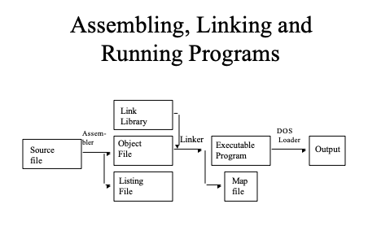

Slide 16
