Slide 1


Code to success review session
DR. HADJI J. TEJUCO

Slide 2
TOPICS
Logic and Design Formulation
Basic Input and Output
Conditional Control Structure
Repetition Control Structure
Function and Recursion
Array Manipulation
Object and Classes
Inheritance
Encapsulation
Polymorphism
Abstraction

Slide 3
Logic and Design Formulation
All programming involves creating something that solves a problem.
Identify the Problem
Design a Solution
Write the Program
Check the Solution

Slide 4

Basic Input and Output
C++ Output
In C++, cout sends formatted output to standard output devices, such as the screen. We use the cout object along with the << operator for displaying output.
C++ Input
In C++, cin takes formatted input from standard input devices such as the keyboard. We use the cin object along with the >> operator for taking input.
Cascading of Insertion ( << ) operator and Cascading of Extraction ( >> ) operator

Slide 5
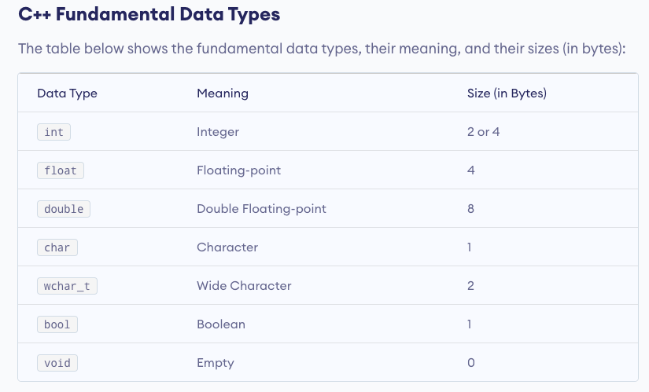

Slide 6
C++ Operators
Arithmetic Operators
Assignment Operators
Relational Operators
Logical Operators

Slide 7

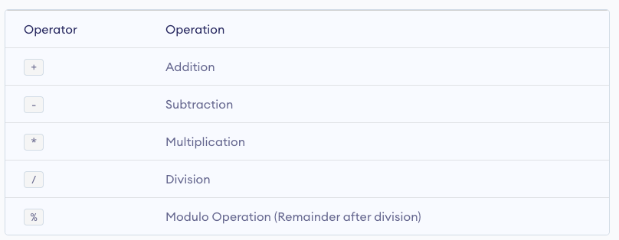


C++ Arithmetic Operators

Slide 8
Increment and Decrement Operators
C++ also provides increment and decrement operators: ++ and --respectively. ++ increases the value of the operand by 1, while -- decreases it by 1.

Slide 9
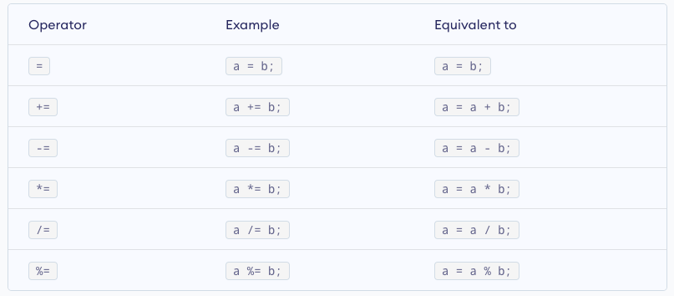
C++ Assignment Operators

Slide 10
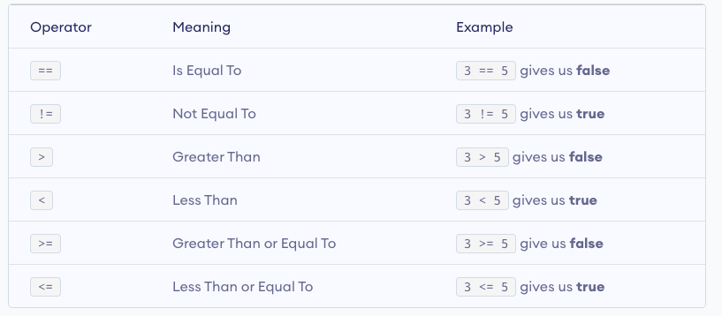
C++ Relational Operators

Slide 11
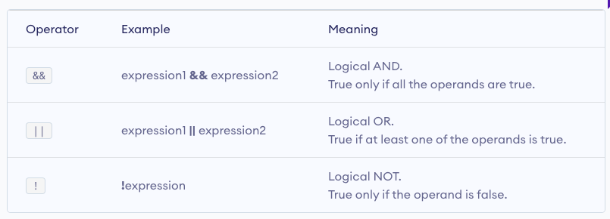
C++ Logical Operators

Slide 12
Conditional Control Structure
IF
IF ELSE
IF ELSE IF ELSE
NESTED IF ELSE
SWITCH STATEMENT

Slide 13
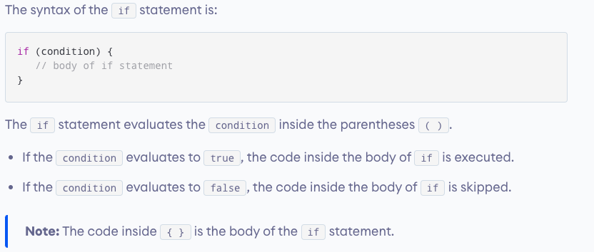
C++ if Statement

Slide 14
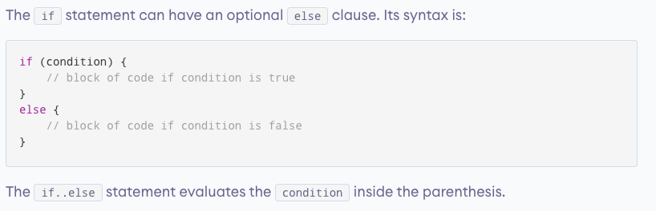
C++ if...else

Slide 15
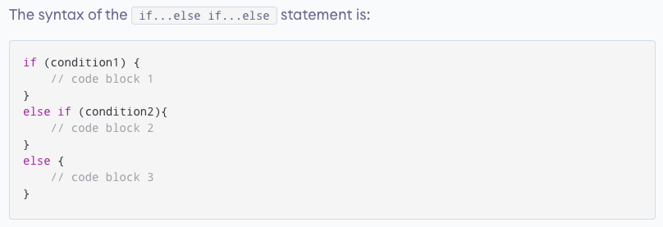
C++ if...else...else if statement

Slide 16
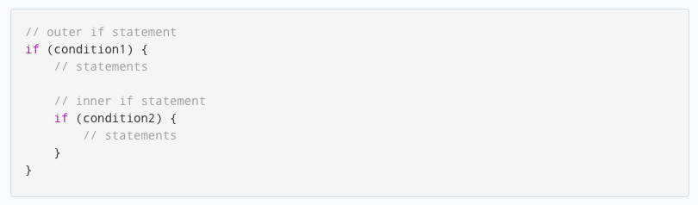
C++ Nested if...else

Slide 17
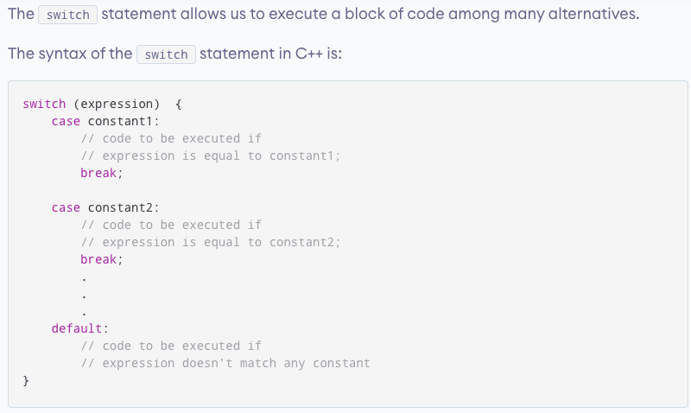
C++ switch..case Statement

Slide 18
Repetition Control Structure
FOR
WHILE
DO WHILE

Slide 19
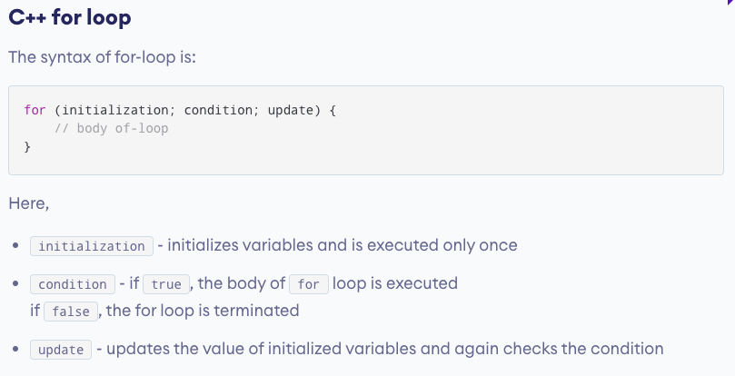

Slide 20
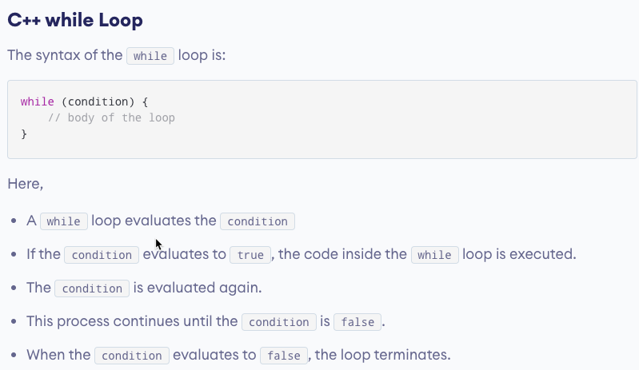

Slide 21
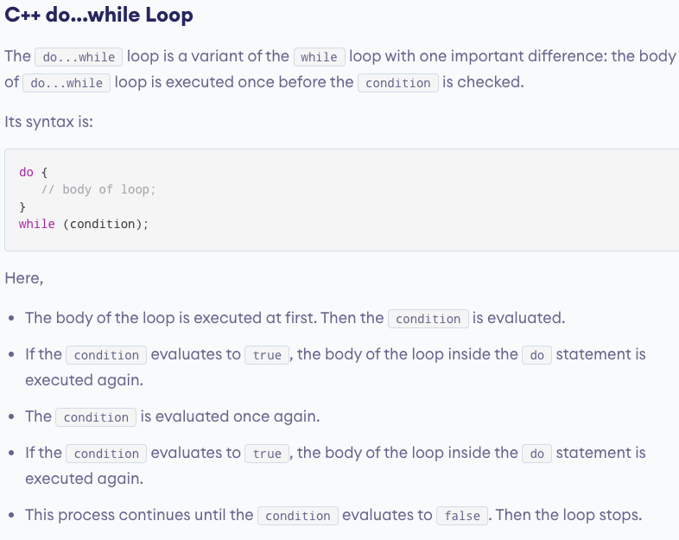

Slide 22
Function and Recursion
There are two types of function:
Standard Library Functions: Predefined in C++
User-defined Function: Created by users
Function with no argument and no return value
Function with no argument but return value
Function with argument but no return value
Function with argument and return value
Program to explain Default Arguments
Program to explain Function Overloading

Slide 23
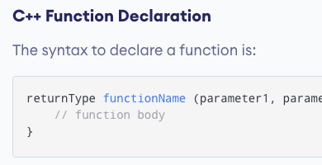

Slide 24
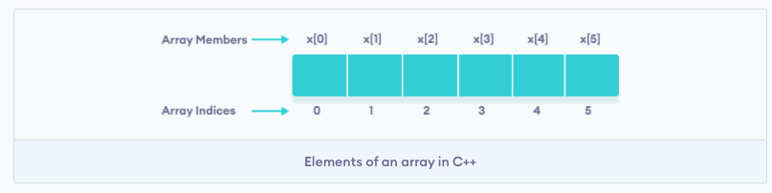
Array Manipulation
In C++, an array is a variable that can store multiple values of the same type.
C++ Array Declaration
dataType arrayName[arraySize];

Slide 25
Object and Classes
C++ Class
A class is a blueprint for the object. We can think of a class as a sketch (prototype) of a house. It contains all the details about the floors, doors, windows, etc. Based on these descriptions we build the house. House is the object.
Create a Class
A class is defined in C++ using keyword class followed by the name of the class.
The body of the class is defined inside the curly brackets and terminated by a semicolon at the end.

