Slide 1
Introduction to PHP
Dr. hadji j. tejuco

Slide 2
Topics
Introduction to PHP
What PHP can do?
Why use PHP?
How to install?
Additional software

Slide 3
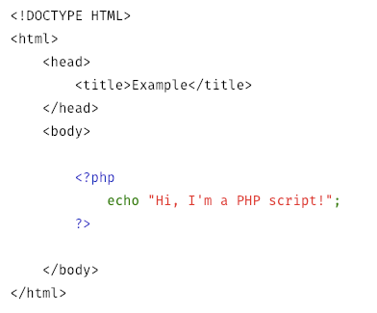
Introduction
PHP is one of the most widely used and recognizable web technology use on the internet. Originally PHP is known as “Personal Home Page”, though more recently it has been changed to stand for "PHP: Hypertext Preprocessor".
PHP (recursive acronym for PHP: Hypertext Preprocessor) is a widely-used open source general-purpose scripting language that is especially suited for web development and can be embedded into HTML.
http://php.net/manual/en/intro-whatis.php

Slide 4
What Can PHP Do?
There are three main areas where PHP scripts are used
Server-side scripting. This is the most traditional and main target field for PHP. You need three things to make this work: the PHP parser (CGI or server module), a web server and a web browser. You need to run the web server, with a connected PHP installation. You can access the PHP program output with a web browser, viewing the PHP page through the server.
Command line scripting. You can make a PHP script to run it without any server or browser. You only need the PHP parser to use it this way. This type of usage is ideal for scripts regularly executed using cron (on *nix or Linux) or Task Scheduler (on Windows).
Writing desktop applications. PHP is probably not the very best language to create a desktop application with a graphical user interface, but if you know PHP very well, and would like to use some advanced PHP features in your client-side applications you can also use PHP-GTK to write such programs.
http://php.net/manual/en/intro-whatcando.php

Slide 5
Why PHP?
PHP runs on various platforms (Windows, Linux, Unix, Mac OS X, etc.)
PHP is compatible with almost all servers used today (Apache, IIS, etc.)
PHP supports a wide range of databases
PHP is free. Download it from the official PHP resource: www.php.net
PHP is easy to learn and runs efficiently on the server side

Slide 6




How to install
Package software
Windows
XAMPP
WAMP
MAC
MAMP
LINUX
LAMP

Slide 7
TEXT EDITORS
Sublime
Notepad++
Atom
Visual Studio Code
Brackets
PHPStorm
Netbeans
Eclipse
Aptana Studio

Slide 8
Sample Code

