Slide 1
Head Transplant
Hadley Delaney

Slide 2
Overview
History
Plan and Implementation
Organ Statistics
Upsides/Pros
Downsides/Cons
Summary
References

Slide 3
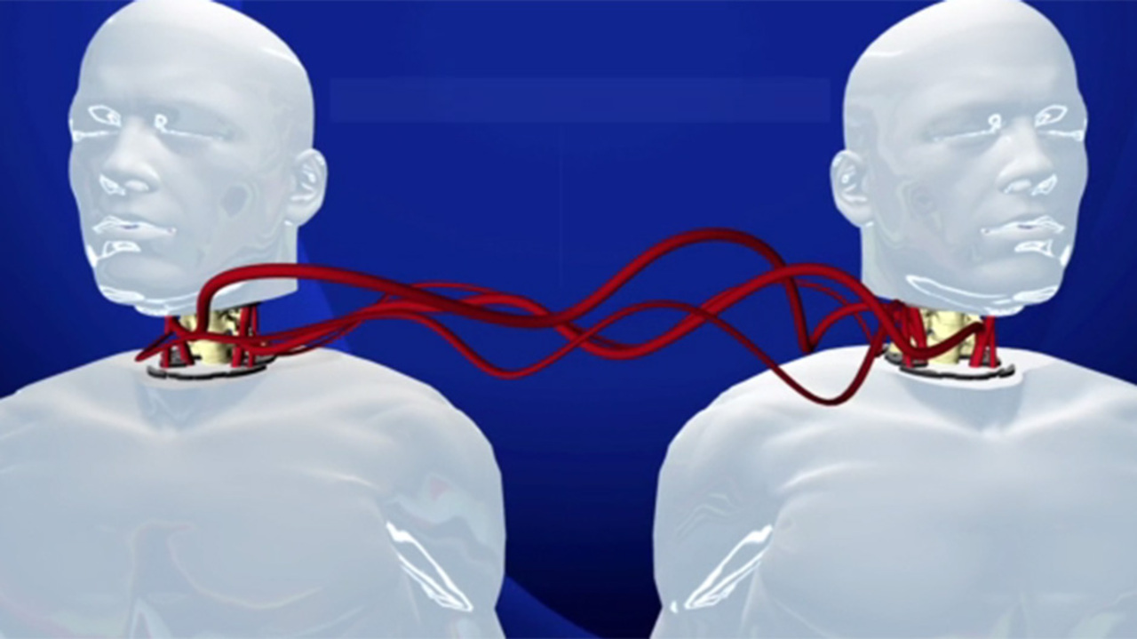
History
What exactly is a head transplant?
It’s an experimental surgical procedure that involves grafting the head of one organism onto the torso of another. Removing the patient's head surgically, then fusing the donated body's blood vessels, muscles, trachea, and esophagus to the patient's organs.
Notes:
Ever since the beginning of the last century, with advances in medicine and specifically transplantation, the prospect of head transplant has captured the imagination of scientists and the general public. Recently, head transplant has regained attention in the popular media, as neurosurgeons have proposed to perform this procedure in the near future.

Slide 4
History
- Alexis Carrel, a French surgeon, developed improved surgical methods to connect blood vessels, in the context of organ transplantation.
- 1908 - Carrel collaborated with Charles Guthrie to attempt to graft the head of one dog on an intact second dog. (there was small reflex movement, but the animal declined quickly and died)
- 1958 - Vladimir Demikhov performed an experiment to improve coronary bypass surgery.
- 1950/60’s - Immunosuppressant drugs and organ transplantation techniques were developed.
Notes:
It was French surgeon, Dr. Alexis Carrel, who changed these results by using a more reliable method of suturing severed vessels back together: he used fine needles and extremely thin threads as suture and enlarged the severed vessel opening using three retaining sutures to form a triangular shape. His method proved effective in protecting against postoperative hemorrhages and embolisms, as well as in preventing strictures at the site of the suture. Carrel was able to successfully implement this technique to vessel reconstruction and whole organ transplantation (mainly in procedures involving the thyroid and kidney.
He grafted head showed some reflexes early on but deteriorated quickly and the animal was killed after a few hours.

Slide 5
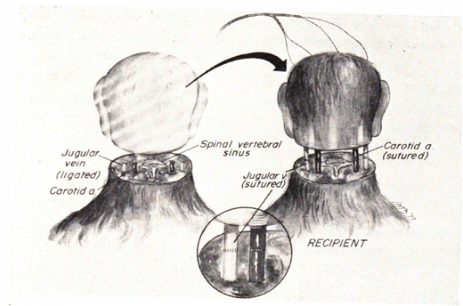
Plan and Implementation
- The head of the patient is taken from their body, then attached to a donor’s body through carotid and jugular silastic cannula.
- Sutures are applied on the vessels of the transplanted head together with those of the new body.
- The donor’s circulation provides blood to the recipient’s head.
Notes:
The vascular anastomosis between the recipient and donor is conducted through carotid and jugular silastic cannulae. The vascular tubes are removed and sutures are applied on the vessels of the transplanted head together with those of the new body. The donor's circulation provides blood to the recipient's head.

Slide 6
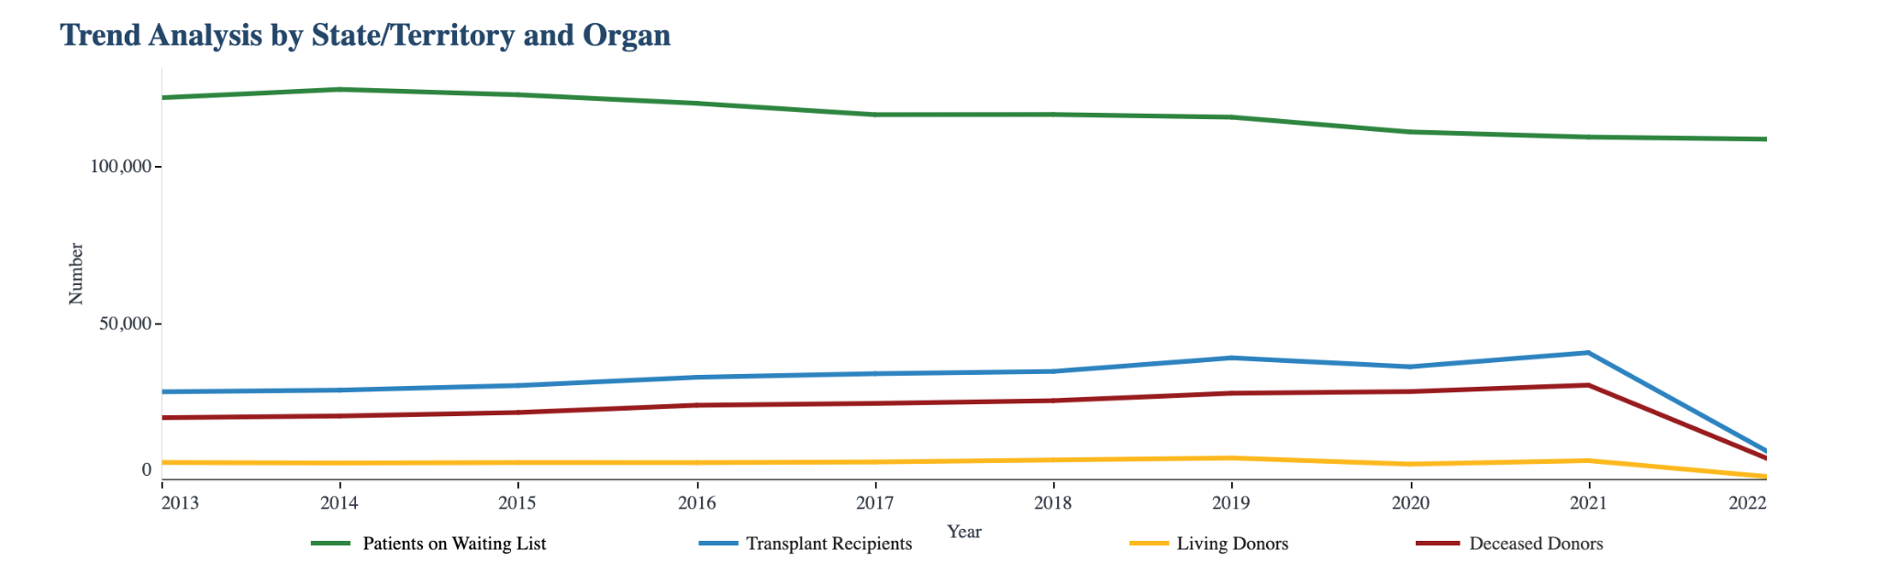
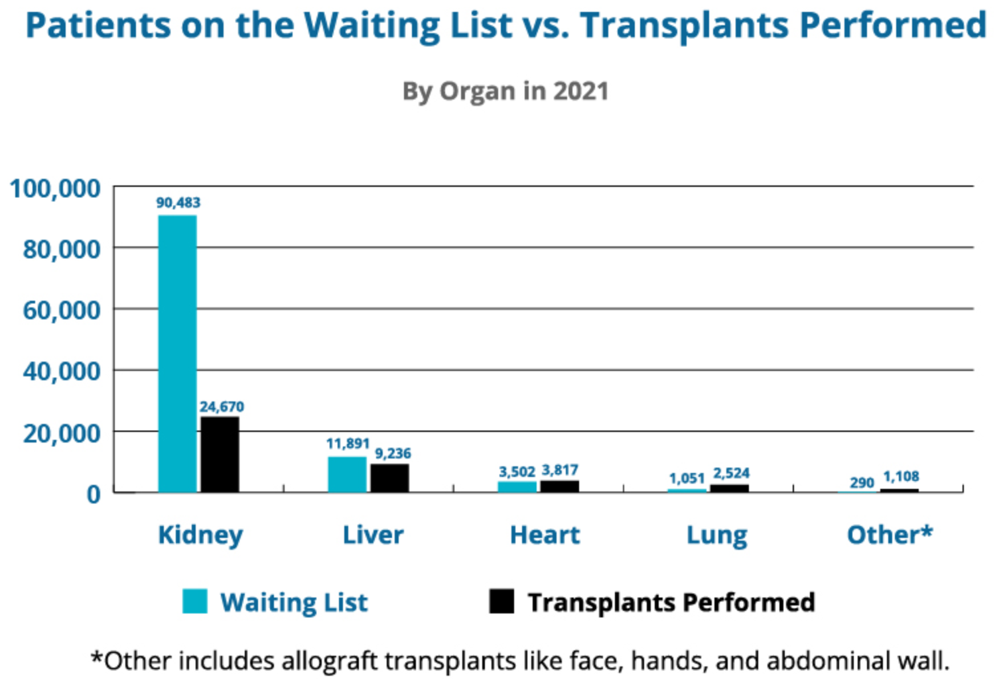
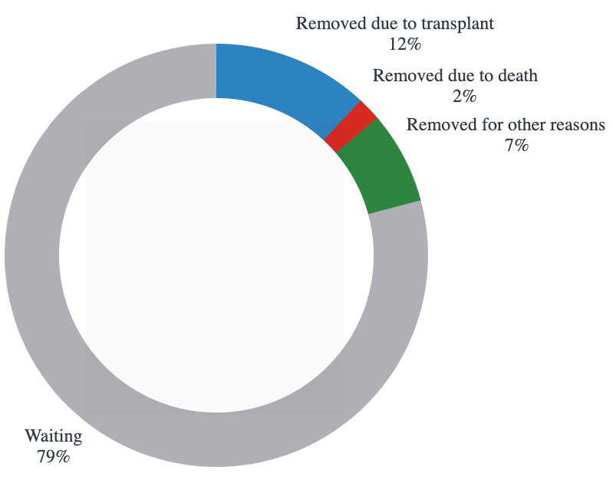
Organ Statistics
Notes:
17 people die each day waiting for an organ transplant
Every donor can save 8 lives and enhance over 75 more.
40,000+transplants were performed in 2021.
Every 10 minutes another person is added to the transplant waiting list.

Slide 7
Upsides/Pros
- Sustain the life of individuals who suffer from terminal disease, but whose head and brain are healthy.
- Provides life-saving treatments for several conditions where none currently exists.
Notes:
The goal of body-to-head transplantation (BHT) is to sustain the life of individuals who suffer from terminal disease, but whose head and brain are healthy. Ideally BHT could provide a life-saving treatment for several conditions where none currently exists.

Slide 8
Downsides/Cons
- The brain is highly dependent on the continuous flow of blood, with damage setting in quickly when blood flow is cut off.
- The autonomic nervous system controls essential functions, such as breathing and heart rate. If the recipient body’s head is removed this can no longer happen.
- Around a quarter of organs are rejected within the first year. We don’t know, if surgery is successful, whether or not the body will accept the head (vice versa).
- Cut and repair an injured vessel and subsequently restore blood flow without interrupting circulation.
- Doctors so far have never succeeded in rewiring a human spinal cord.
Notes:
Your autonomic nervous system is a network of nerves throughout your body that control unconscious processes. These are things that happen without you thinking about them, such as breathing and your heart beating. Your autonomic nervous system is always active, even when you’re asleep, and it’s key to your continued survival.

Slide 9
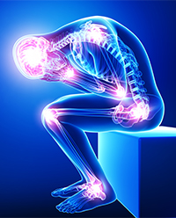
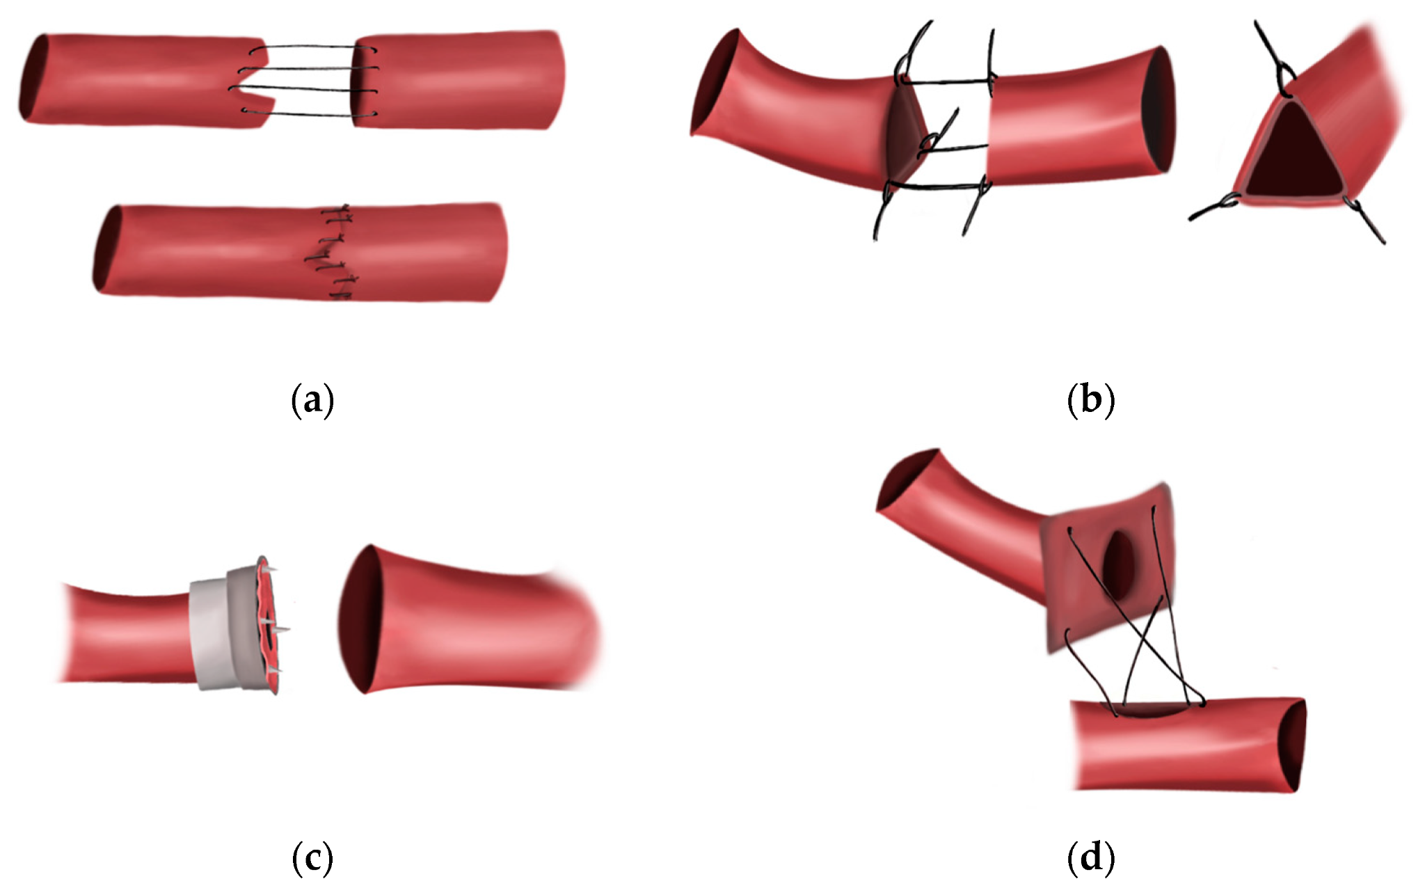
Downsides/Cons
- Chronic neuropathic pain
- Organ toxicity of immunosuppressants
- Reliable vessel anastomosis
- Very expensive ($100 M+)
- Extrusive Procedure (lasting up to 18 hours)
Notes:
The donor will be the healthy body of a brain-dead patient matched for build with a recipient's disease-free head. Canavero estimates the procedure will cost up to $100 million and involve several dozen surgeons and other specialists.

Slide 10
Summary
Personally, I am neither for the advancement of this technology. I believe with enough time, and excruciating education, that there will be improvement in this field of study. This will not only be a large development for human kind, but it will also be life-saving technology that gives people a second chance at existence. However, I do feel hesitant to the information we do know now. I don’t think that I would feel confident nor comfortable undergoing this type of procedure. More successful experiments and breakthroughs need to be accomplished.

Slide 11
References
First Human Head Transplantation
Pros and Cons of a Head Transplant
Autonomic Nervous System

