Slide 1
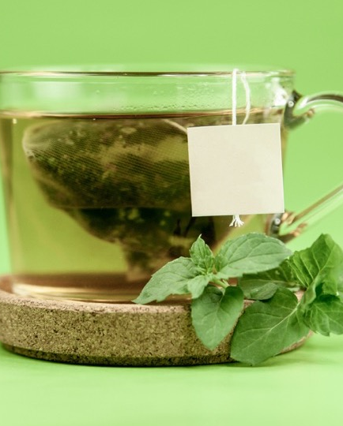
SMOOTHY KING
43 ingredients.
440,640 drinks.
One of them is today’s.
A smoothie built for today: a goal-aware path from everyday constraints to a repeatable drink plan and weekly ingredient list.
Live demo
SMOOTHY KING
01
Notes:
Open with the user, not the technology. The product starts when someone has a goal but does not know what to make.
[Sources]
- Repository README.md and docs/README.md — product summary and current catalog figures.
- User-provided reference: Smoothy King — A smoothie built for today (8_11_2026 4：07：45 PM).html.
- Food image: artifacts/smoothy-king/public/food/ingredients/cold-green-tea.jpg; source policy: public/food/CREDITS.md.

Slide 2
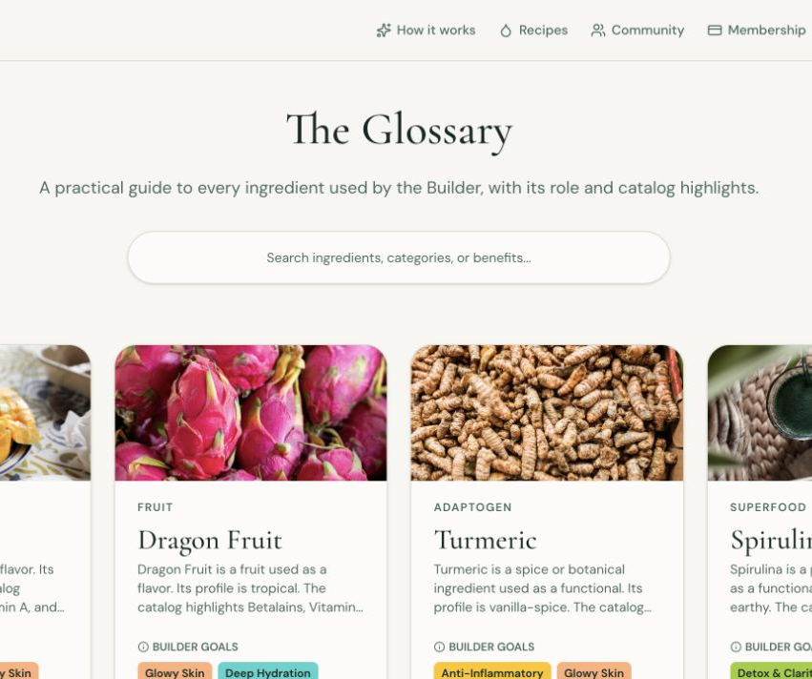
THE GAP
Recipe apps begin
with a recipe.
But the real morning starts with a goal, a constraint, and whatever is actually in the kitchen.
Smoothy King gives that starting point a checked path forward.
SMOOTHY KING
02
Notes:
Point out that the catalog is intentionally controlled rather than infinitely open-ended. The app can inspect every catalog ingredient and use it consistently.
[Sources]
- Product screenshot captured from local production rehearsal: /private/tmp/smoothy-demo/ingredients.png.
- Repository README.md — controlled catalog and deterministic checks.

Slide 3
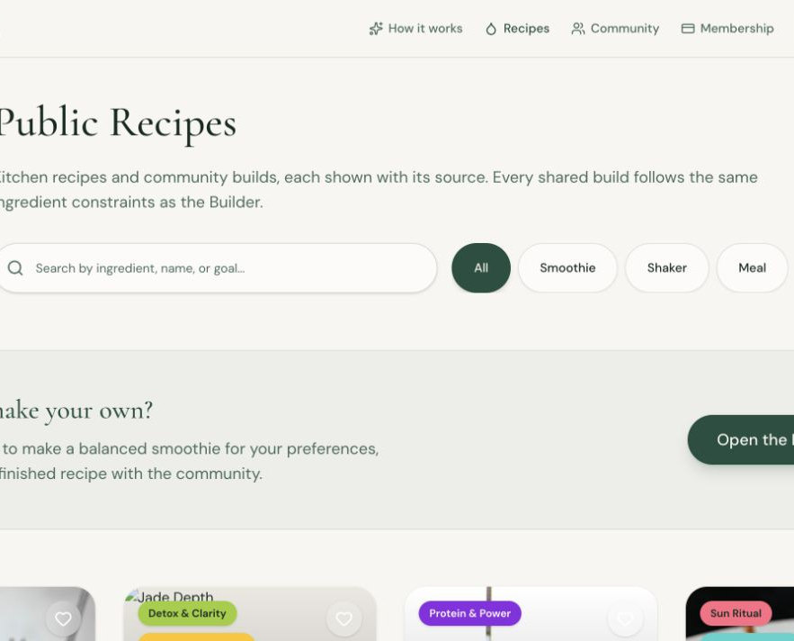
THE ONE CORE THING
A few answers become
a plan you can act on.
1 Tell us the goal and constraints
2 Build a checked drink
3 Log it and plan the week
In the live demo, mark one ingredient unavailable and choose a safe alternative—or skip it.
SMOOTHY KING
03
Notes:
Keep this slide short, then leave the slides and perform the live loop. The best proof is a new user completing the path without explanation.
[Sources]
- Product screenshot captured from local production rehearsal: /private/tmp/smoothy-demo/public-recipes.png.
- docs/demo-day.md — live demo path.

Slide 4
THE TRUST BOUNDARY
AI understands the request.
Code decides the drink.
OPTIONAL AI
DETERMINISTIC CODE
Maps everyday language
to controlled choices
and writes a name/story.
Chooses ingredients,
checks slots and exclusions,
and totals nutrition.
No model decides allergens, quantities, or whether a drink is safe to show.
SMOOTHY KING
04
Notes:
This is the technical trust point. Do not say the model makes a safe smoothie; the controlled code path does that work. If the model is unavailable, the product uses keyword matching.
[Sources]
- README.md — What makes the recommendation trustworthy.
- docs/ai-collaboration.md — in-product AI boundary.

Slide 5
READY FOR A LIVE DEMO
A useful plan is better
than a beautiful guess.
What works today
What comes next
Goal → checked smoothie → weekly plan
Account-level privacy and authentication
A deployable container with a health check
Taste pairing and adaptation
Shaker-only routes for no-blender users
Medication/pregnancy interaction data
github.com/hadocter/SmoothieKing
SMOOTHY KING
05
Notes:
Close with the product’s actual value and volunteer two limitations. Owning the gaps makes the safety boundary credible. Invite questions, then return to the live product if useful.
[Sources]
- README.md — Honest limits and deployment checklist.
- docs/demo-day.md — direct Q&A answers.

