Slide 1
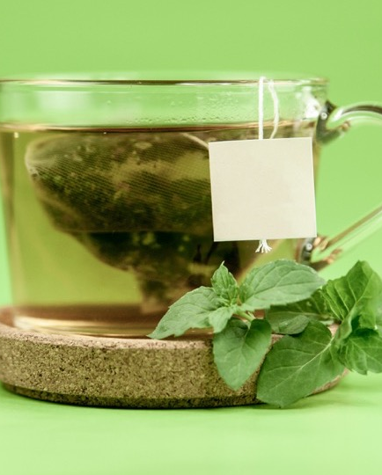
SMOOTHY KING
43 ingredients.
440,640 drinks.
One of them is today’s.
A smoothie built for today: a goal-aware path from everyday constraints to a repeatable drink plan and weekly ingredient list.
Live demo
SMOOTHY KING
01
Notes:
Open with the user, not the technology. The product starts when someone has a goal but does not know what to make.
[Sources]
- Repository README.md and docs/README.md — product summary and current catalog figures.
- User-provided reference: Smoothy King — A smoothie built for today (8_11_2026 4：07：45 PM).html.
- Food image: artifacts/smoothy-king/public/food/ingredients/cold-green-tea.jpg; source policy: public/food/CREDITS.md.

Slide 2
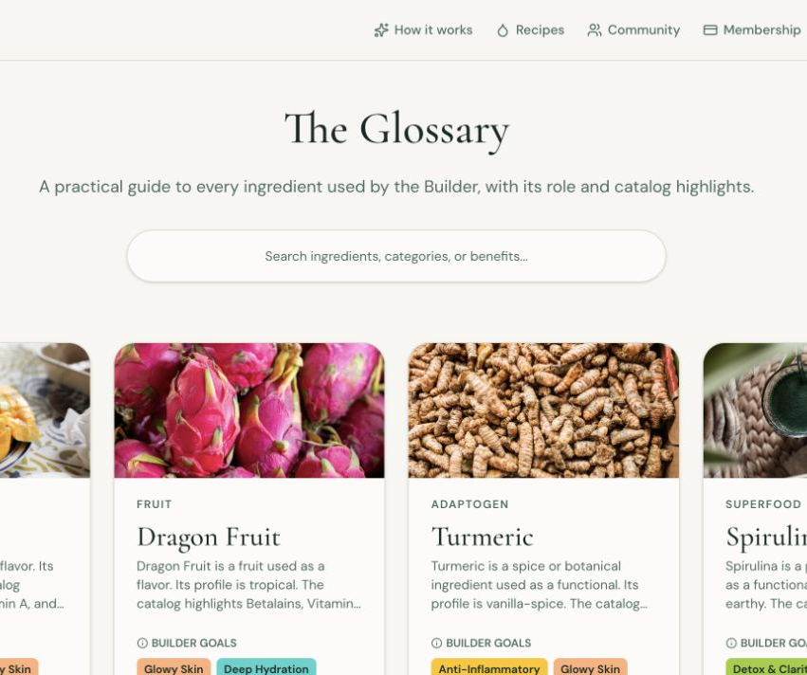
THE GAP
Recipe apps begin
with a recipe.
But the real morning starts with a goal, a constraint, and whatever is actually in the kitchen.
Smoothy King gives that starting point a checked path forward.
SMOOTHY KING
02
Notes:
Point out that the catalog is intentionally controlled rather than infinitely open-ended. The app can inspect every catalog ingredient and use it consistently.
[Sources]
- Product screenshot captured from local production rehearsal: /private/tmp/smoothy-demo/ingredients.png.
- Repository README.md — controlled catalog and deterministic checks.

Slide 3
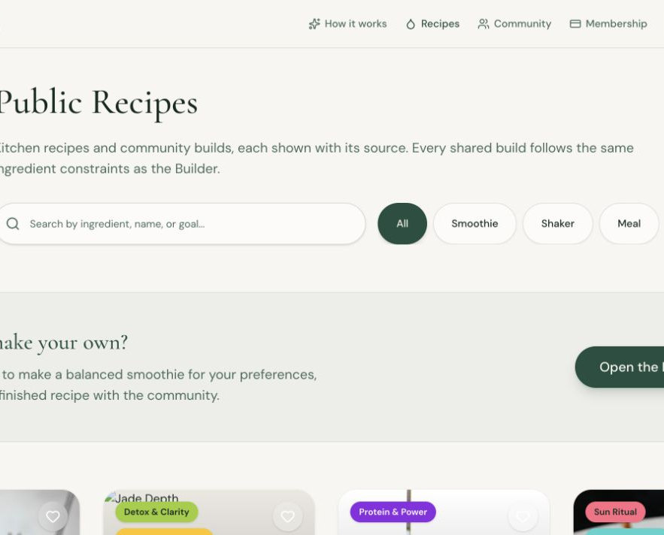
THE ONE CORE THING
A few answers become
a plan you can act on.
1 Tell us the goal and constraints
2 Build a checked drink
3 Log it and plan the week
In the live demo, mark one ingredient unavailable and choose a safe alternative—or skip it.
SMOOTHY KING
03
Notes:
Keep this slide short, then leave the slides and perform the live loop. The best proof is a new user completing the path without explanation.
[Sources]
- Product screenshot captured from local production rehearsal: /private/tmp/smoothy-demo/public-recipes.png.
- docs/demo-day.md — live demo path.

Slide 4
THE TRUST BOUNDARY
AI understands the request.
Code decides the drink.
OPTIONAL AI
DETERMINISTIC CODE
Maps everyday language
to controlled choices
and writes a name/story.
Chooses ingredients,
checks slots and exclusions,
and totals nutrition.
No model decides allergens, quantities, or whether a drink is safe to show.
SMOOTHY KING
04
Notes:
This is the technical trust point. Do not say the model makes a safe smoothie; the controlled code path does that work. If the model is unavailable, the product uses keyword matching.
[Sources]
- README.md — What makes the recommendation trustworthy.
- docs/ai-collaboration.md — in-product AI boundary.

Slide 5
ONE LIMIT, SAID OUT LOUD
It does not predict
whether it will taste great.
Why
What we would do next
We match flavor families,
but do not yet have pairing
or post-drink satisfaction data.
Collect feedback and test
pairing rules before claiming
better taste.
github.com/hadocter/SmoothieKing
SMOOTHY KING
05
Notes:
Name one limit clearly: this version does not predict taste. Explain that flavor-family tags are not the same as pairing or satisfaction data. The next step is feedback plus tested pairing rules, not a marketing promise. Close: start with a goal, leave with a checked plan. Invite questions.
[Sources]
- README.md — Honest limits and deployment checklist.
- docs/demo-day.md — direct Q&A answers.
- /Users/hadocter/.codex/attachments/b5e08e6c-ca7a-48a2-8dea-1427d382aee3/pasted-text.txt — Demo Day guidance.

