Slide 1
Action Plan For Blog and TechNews

Slide 2
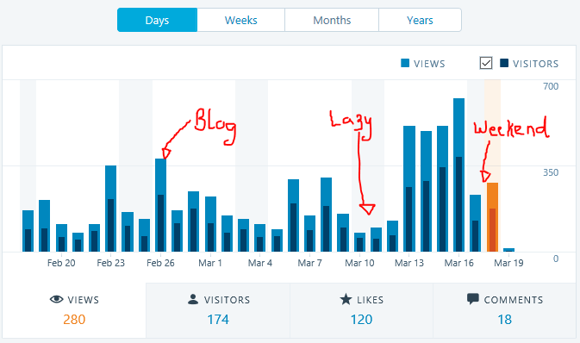
Add visitors option or views option

Slide 3
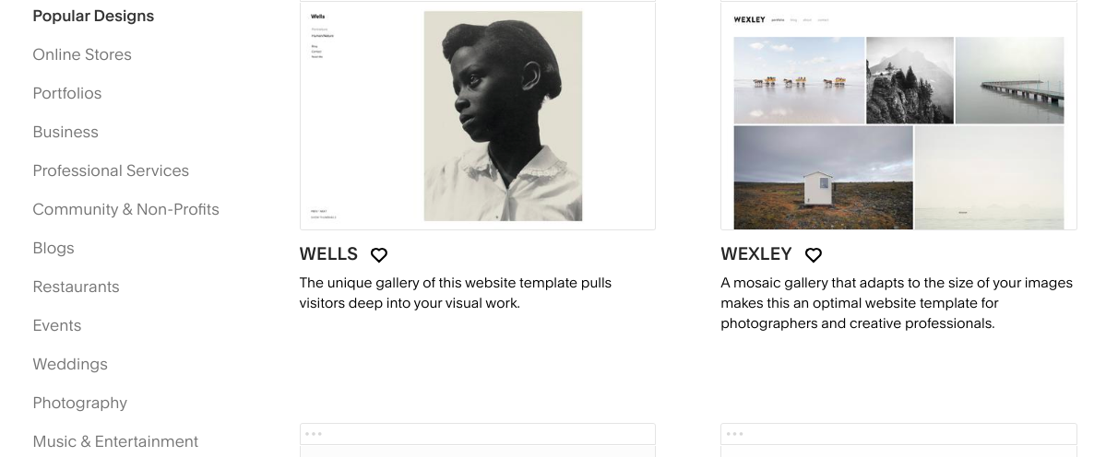
Show only one option button Blog on sidebar.

Slide 4
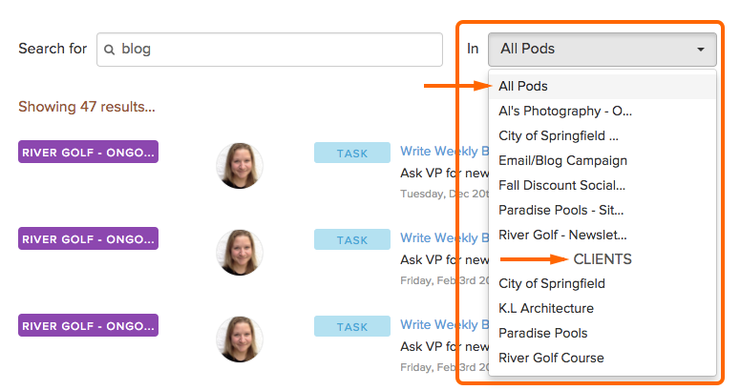
Search blog using title,author,content.

Slide 5
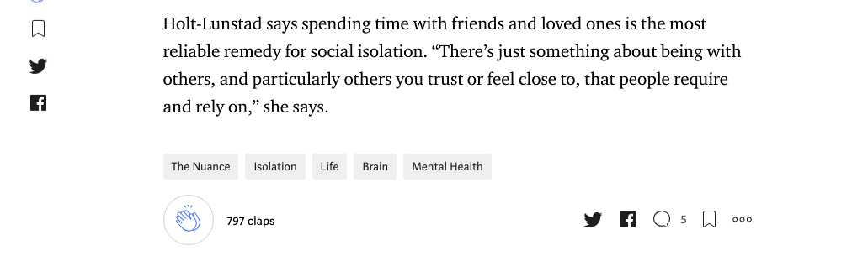
Share blog on social media

Slide 6
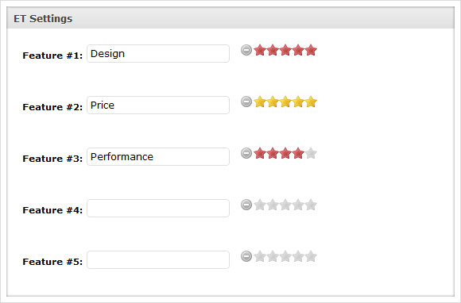
Add ratings option.

Slide 7
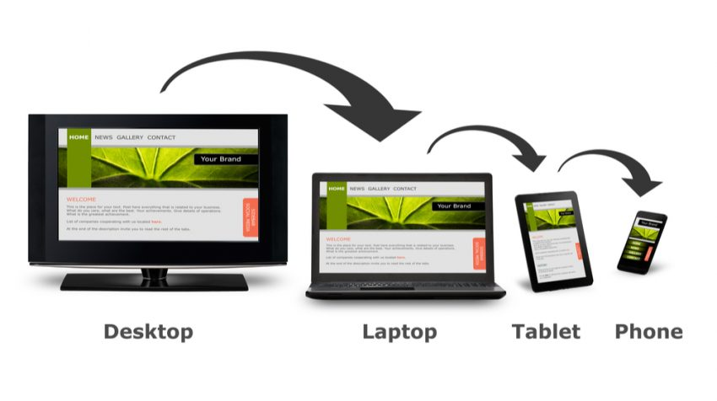
Responsive web design

Slide 8
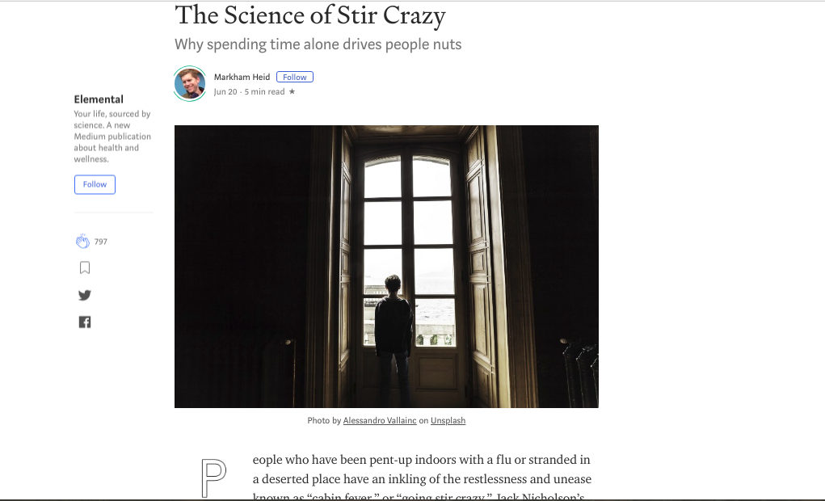
Attractive UI design

Slide 9

Use charts

Slide 10
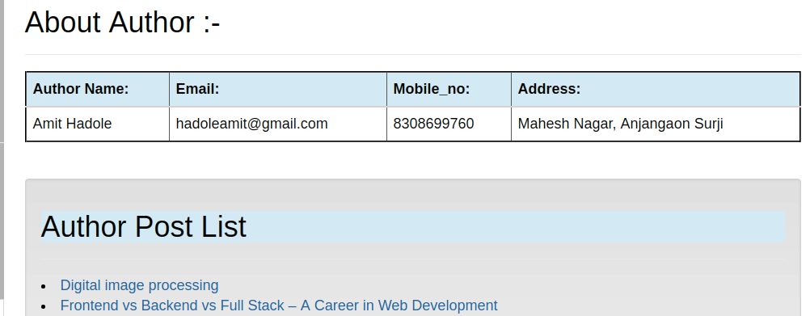
View author details

Slide 11
Thank You

