Slide 1

Java Programming Language SE – 6
Module 15: Threads

Slide 2

Objectives
Define a thread
Create separate threads in a Java technology program, controlling the code and data that are used by that thread
Control the execution of a thread and write platform- independent code with threads
Describe the difficulties that might arise when multiple threads share data
Use wait and notify to communicate between threads
Use synchronized to protect data from corruption

Slide 3
Relevance
How do you get programs to perform multiple tasks concurrently?

Slide 4
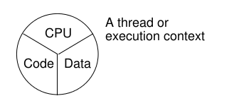
Threads
What are threads?
  Threads are a virtual CPU.
The three parts of at thread are:
  CPU
  Code
  Data

Slide 5
Creating the Thread
public class ThreadTester {
public static void main(String args[]) {
HelloRunner r = new HelloRunner();
Thread t = new Thread(r);
t.start();
}}
class HelloRunner implements Runnable {
int i;
public void run() {
i = 0;
while (true) {
System.out.println("Hello " + i++);
if ( i == 50 ) {
break;
}}}}

Slide 6
Creating the Thread
Multithreaded programming has these characteristics:
Multiple threads are from one Runnable instance.
Threads share the same data and code.
For example:
Thread t1 = new Thread(r);
Thread t2 = new Thread(r);

Slide 7
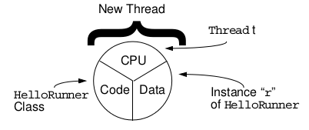
Creating the Thread

Slide 8
Starting the Thread
Use the start method.
Place the thread in a runnable state.

Slide 9
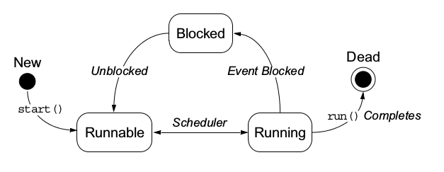
Thread Scheduling

Slide 10
Thread Scheduling Example
public class Runner implements Runnable {
public void run() {
while (true) {
// do lots of interesting stuff
// ...
// Give other threads a chance
try {
Thread.sleep(10);
} catch (InterruptedException e) {
// This thread’s sleep was interrupted
// by another thread
}}}}

Slide 11
Terminating a Thread
public class Runner implements Runnable {
private boolean timeToQuit=false;
public void run() {
while ( ! timeToQuit ) {
// continue doing work
}
// clean up before run() ends
}
public void stopRunning() {
timeToQuit=true;
}}

Slide 12
Terminating a Thread
public class ThreadController {
private Runner r = new Runner();
private Thread t = new Thread(r);
public void startThread() {
t.start();
}
public void stopThread() {
// use specific instance of Runner
r.stopRunning();
}}

Slide 13
Basic Control of Threads
Test threads:
  isAlive()
Access thread priority:
  getPriority()
  setPriority()
Put threads on hold:
  Thread.sleep()// static method
  join()
  Thread.yield()// static method

Slide 14

The join Method
public static void main(String[] args) {
Thread t = new Thread(new Runner());
t.start();
...
// Do stuff in parallel with the other thread for a while
...
// Wait here for the other thread to finish
try {
t.join();
} catch (InterruptedException e) {
// the other thread came back early
}
...
// Now continue in this thread
...}

Slide 15
Other Ways to Create
Threads
public class MyThread extends Thread {
public void run() {
while ( true ) {
// do lots of interesting stuff
try {
Thread.sleep(100);
} catch (InterruptedException e) {
// sleep interrupted
}}}
public static void main(String args[]) {
Thread t = new MyThread();
t.start();
}}

Slide 16
Selecting a Way to Create
Threads
Implement Runnable:
  Better object-oriented design
  Single inheritance
  Consistency
Extend Thread:
  Simpler code

Slide 17
Using the synchronized
Keyword
public class MyStack {
int idx = 0;
char [] data = new char[6];
public void push(char c) {
data[idx] = c;
idx++;
}
public char pop() {
idx--;
return data[idx];
}

Slide 18
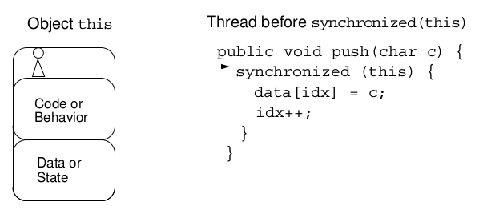
The Object Lock Flag
Every object has a flag that is a type of lock flag.
The synchronized enables interaction with the lock flag.

Slide 19
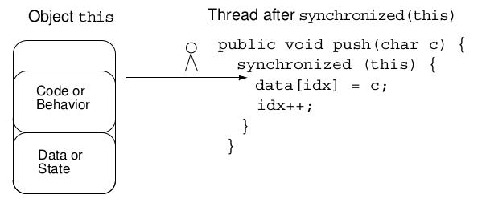

The Object Lock Flag

Slide 20
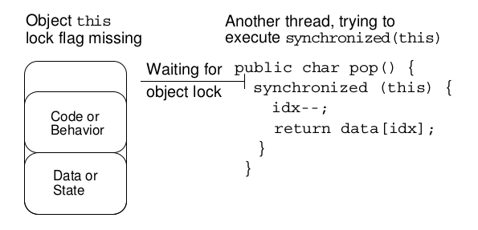
The Object Lock Flag

Slide 21

Releasing the Lock Flag
The lock flag is released in the following events:
Released when the thread passes the end of the synchronized code block
Released automatically when a break, return, or exception is thrown by the synchronized code block

Slide 22
Using synchronized –
Putting It Together
All access to delicate data should be synchronized.
Delicate data protected by synchronized should be private.

Slide 23
Using synchronized –
Putting It Together
The following two code segments are equivalent:
public void push(char c) {
synchronized(this) {
// The push method code
}
}
public synchronized void push(char c) {
// The push method code
}

Slide 24
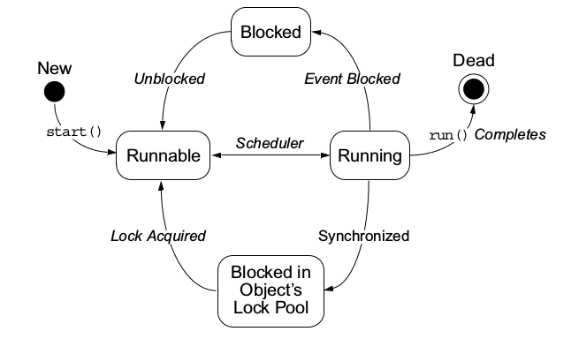
Thread State Diagram
With Synchronization

Slide 25
Deadlock
A deadlock has the following characteristics:
It is two threads, each waiting for a lock from the other.
It is not detected or avoided.
Deadlock can be avoided by:
  Deciding on the order to obtain locks
  Adhering to this order throughout
  Releasing locks in reverse order

Slide 26
Thread Interaction – wait and notify
Scenario:
  Consider yourself and a cab driver as two threads.
The problem:
  How do you determine when you are at your destination?
The solution:
  You notify the cab driver of your destination and relax.
  The driver drives and notifies you upon arrival at your destination.

Slide 27
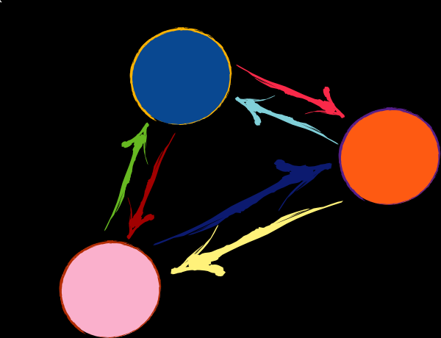
Thread Interaction
Thread interactions include:
The wait and notify methods
The pools:
  Wait pool
  Lock pool

Slide 28
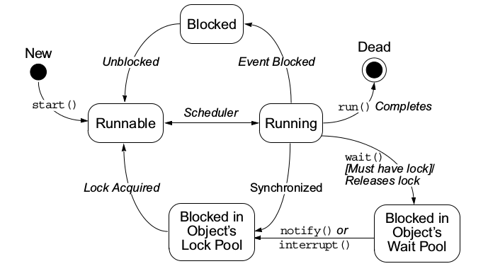
Thread State Diagram With wait and notify

Slide 29
Monitor Model for
Synchronization
Leave shared data in a consistent state.
Ensure programs cannot deadlock.
Do not put threads expecting different notifications in the same wait pool.

Slide 30
The Producer Class
package mod13;
public class Producer implements Runnable {
private SyncStack theStack;
private int num;
private static int counter = 1;
public Producer (SyncStack s) {
theStack = s;
num = counter++;
}

Slide 31
The Producer Class
public void run() {
char c;
for (int i = 0; i < 200; i++) {
c = (char)(Math.random() * 26 +’A’);
theStack.push(c);
System.out.println(“Producer” + num + “: “ + c);
try {
Thread.sleep((int)(Math.random() * 300));
} catch (InterruptedException e) {
// ignore it
}}}}

Slide 32
The Consumer Class
package mod13;
public class Consumer implements Runnable {
private SyncStack theStack;
private int num;
private static int counter = 1;
public Consumer (SyncStack s) {
theStack = s;
num = counter++;
}

Slide 33
The Consumer Class
public void run() {
char c;
for (int i = 0; i < 200; i++) {
c = theStack.pop();
System.out.println(“Consumer” + num + “: “ + c);
try {
Thread.sleep((int)(Math.random() * 300));
} catch (InterruptedException e) {
// ignore it
}
}
} // END run method

Slide 34



Stay connected
About us: Emertxe is India’s one of the top IT finishing schools & self learning kits provider. Our primary focus is on Embedded with diversification focus on Java, Oracle and Android areas
Emertxe Information Technologies,
No-1, 9th Cross, 5th Main,
Jayamahal Extension,
Bangalore, Karnataka 560046
T: +91 80 6562 9666
E: training@emertxe.com
https://www.facebook.com/Emertxe
https://twitter.com/EmertxeTweet
https://www.slideshare.net/EmertxeSlides

Slide 35
Thank You

