Slide 1

MongoDB
Replication & Sharding

Slide 2

Replication
Replication is the process of making replica (a copy) of something i.e the same data is available on more than one MongoDB server.
An Replica set in MongoDB is a group of MongoDB process that maintain the same data set.
Replication provide data redundancy and increases data availability.

Slide 3
Replica Set Member
The member of replica set are :
The Primary Replica is the main server which interacts with the clients and perform all the read/write operations .
The Secondary Replica maintain a copy of the data of the primary.
When a Primary Replica fails , the Replica set automatically switches over to the secondary and becomes the primary server.

Slide 4
Primary
MongoDB applies write operations on the primary’s oplog.
Secondary members replicate this log and apply the operations to their data sets.
All members of replica sets can accept read operations.

Slide 5
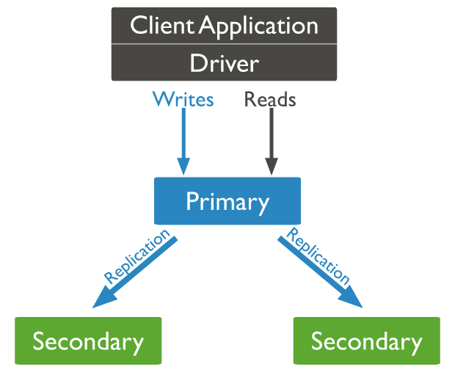
Primary
Image source : https://docs.mongodb.com/manual/core/replica-set-members/

Slide 6
Secondaries
A secondary maintains the copy of the primary’s data set.
A replica set can have one or more secondaries .
Clients can only read data from secondaries , not write data to secondaries.
A Secondary can become a primary if the current primary is not available.
The replica set holds an election to choose which of the secondaries becomes new primary.

Slide 7
HeartBeats
Replica set members send heartbeats (pings) to each other every two seconds.
If a heartbeat does not return within 10 seconds , the other member mark the member as inaccessible.

Slide 8
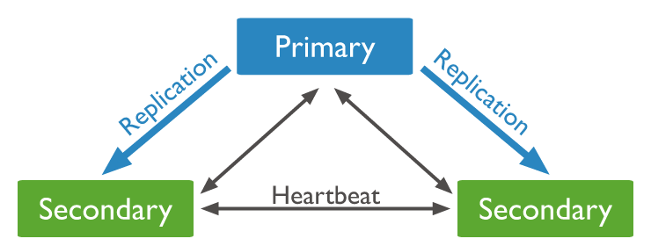
Secondaries
Image source : https://docs.mongodb.com/manual/core/replica-set-members/

Slide 9
Arbiter
The arbiter only votes in elections for primary.
Arbiter have exactly one election vote.
Replica sets use elections to determine which set member will become primary.
If a primary is not available , one of the remaining secondaries holds an election to elect itself as a new primary key.

Slide 10
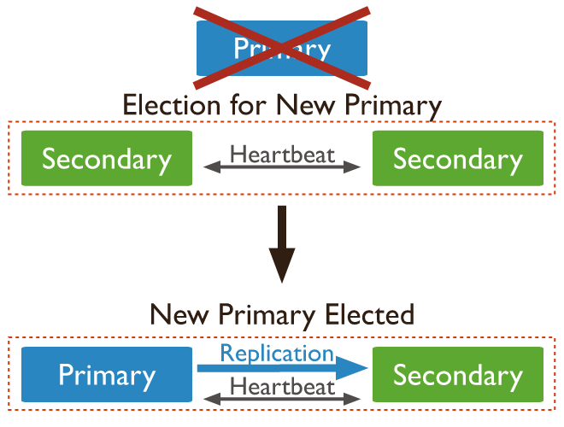
Arbiter
Image source : https://docs.mongodb.com/manual/core/replica-set-members/

Slide 11
Replication Features

Slide 12
Replica Set Oplog
The Oplog (Operation log) keeps a rolling record of all operations that modify data stored in the database.
MongoDB applies database operation on Primary and then records the operations on the Primary’s Oplog.
The Secondary operations then copy these operations.
All replica set member contain a copy of the Oplog in the local.oplog.rs collection to maintain current state of the database.

Slide 13
Replica Set
Data Synchronization
MongoDB uses two form of data synchronization :
Initial Sync
Replication
Initial Sync : Initial Sync copies all the data from one member of the replica set to another.
Replication : Secondary Member replicate data continuously after the initial sync.

Slide 14
Replica Set
High Availability
Replica Set provide high availability using automatic failover.
Failover allows a secondary member to become primary if the current primary not available.
In some situations the failover process may undertake a rollback.

Slide 15
Replication Methods

Slide 16
Replication Methods
Method Name | Description
rs.add() | Adds a number to replica set.
rs.addArb() | Adds an Arbiter to a replica set.
rs.help() | Returns basic help text for replica set function.
rs.conf() | Returns the replica set configuration document
rs.remove() | Remove a Member from a replica set.

Slide 17
Add Member to an existing Replica Set
The rs.add() method adds a member to replica set.
To run this method connect to the primary of replica set.

Slide 18
Add Member to
Replica Set
Parameter | Type | Description
Host | String or document | Specify the host name & optionally port number
arbiterOnly | Boolean | Optional , Applies only if the <host> value is string , if true the added host is an arbiter.

Slide 19
Add Member to
Replica Set (Example)
>rd.add(‘docs.mongodb.com : 8080’);
Default port : 8080
if ‘docs.mongodb.com’ is an arbiter following form is used:
>rd.add(‘docs.mongodb.com : 8080’,true);

Slide 20
Sharding

Slide 21
Sharding
Sharding is a method for distributing data across multiple machines.
MongoDB uses sharding to support deployments with very large data sets and high throughput operations.
MongoDB supports horzontal scaling through sharding.

Slide 22
Why Sharding?
All the data will be written to the Master node in replication.
Space in local disk may not be huge enough to handle the data growth.
Vertical scaling is too expensive.
Simple replica set has limitation of 12 nodes.

Slide 23
Sharding Component
Shards are used to store actual data.
Config server stores the mapping of the cluster’s data set to the shards.
Query Router provides an interface between client application and sharded cluster. The Mongos act as a query router.

Slide 24
Sharding Architecture
Replica Set
Shard 1
Replica Set
Shard 2
Shard 3
Shard 4
Config Server
Mongos
C1 Mongod
C2 Mongod
C3 Mongod
Application Server

Slide 25

Shard Keys
The Shard key determines the distribution of the collection’s documents among the cluster’s shard.
The Shard keys is either an indexed field or indexed compound fields that exist in every document in the collection.
MongoDB partitions the collection to distribute the documents in a collection using shard key.
A sharded collection can have only one shard key.

Slide 26
Shard Key Specification
To Specify Shard key
sh.shardCollection(namespace, key)
Namespace consists of a string <database>.<collection>
The key parameter consist of document containing a field and the index for that field.

Slide 27
Shard key Indexes
All Sharded collections must have an index that supports the shard key.
If the collection is empty , sh.shardCollection() creates the index on the shard key.
If the collection is not empty , create the index before using sh.shardCollection()

Slide 28
Shard Key Limitations
A shard key cannot exceed 512 bytes.
A shard key index can an ascending index on the shard key.
A shard key index cannot be an index that specifies a multikey index , a text index or a geospatial index on the shard key fields.
Shard key is Immutable.

Slide 29
Chunks
MongoDB partitions sharded data into chunks .
Each chunk has an inclusive lower and exclusive upper range based on the shard key.
The default chunk size in MongoDB is 64 megabytes.
We can increase or reduce the chunk size.

Slide 30
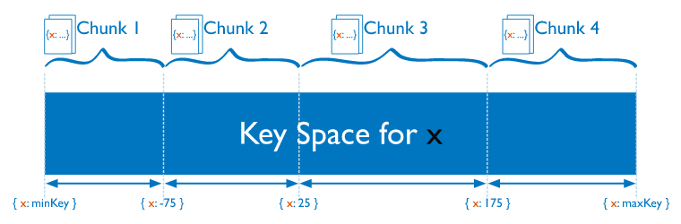
Data Partitioning with chunks
Image Source : https://docs.mongodb.com/manual/core/sharding-data-partitioning/

Slide 31
Data Partitioning with chunks
The mongos routes writes to the appropriate chunk based on the shard key value.
The smallest range chunk can represent a single unique shard key value.
MongoDB splits chunks when they grow beyond the configured chunk size.
The smallest range a chunk can represent a single unique shard key value cannot be split.

Slide 32
Advantages of
Sharding
Read/Writes
MongoDB distributes the read and write workload across the shards in the sharded cluster. Both read and write workloads can be scaled horizontally.
Storage Capacity
Sharding distributes data across the shards in the cluster allowing each shard to contain a subset of the total cluster data.

Slide 33
Advantages of
Sharding
High Availability
A sharded cluster can continue to perform partial read/write operations even if one or more shards are unavailable.

Slide 34
Hashed Sharding
Hashed Sharding uses a hashed index of a single field as the shard key to partition data across the sharded cluster.
Hashed Sharding provides more even data distribution across the sharded cluster

Slide 35
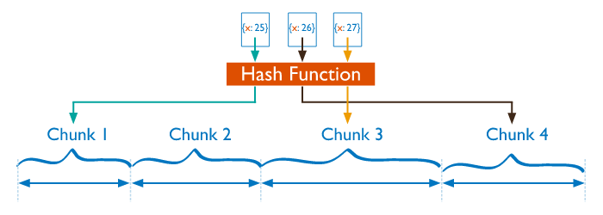
Hashed Sharding
Image Source : https://docs.mongodb.com/manual/core/hashed-sharding/

Slide 36
Ranged Sharding
Range based Sharding involves dividing data into contiguous ranges determined by the shard key values.
This allows for efficient queries where read target documents within a contiguous range.
Range based Sharding is the default Sharding methodology.

Slide 37
Ranged Sharding
Image Source : https://docs.mongodb.com/manual/core/ranged-sharding/

Slide 38
References
https://www.wikimedia.org/
https://docs.mongodb.com/manual/

Slide 39



Stay connected
About us: Emertxe is India’s one of the top IT finishing schools & self learning kits provider. Our primary focus is on Embedded with diversification focus on Java, Oracle and Android areas
Emertxe Information Technologies,
No-1, 9th Cross, 5th Main,
Jayamahal Extension,
Bangalore, Karnataka 560046
T: +91 80 6562 9666
E: training@emertxe.com
https://www.facebook.com/Emertxe
https://twitter.com/EmertxeTweet
https://www.slideshare.net/EmertxeSlides

Slide 40
Thank You

