Slide 1
RDBMS Concepts

Slide 2
What is RDBMS?

Slide 3


Slide 4
Definition
RDBMS stands for Relational Database Management System. RDBMS is the basis for SQL, and for all modern database systems like MS SQL Server, IBM DB2, Oracle, MySQL, and Microsoft Access.
A Relational database management system (RDBMS) is a database management system (DBMS) that is based on the relational model as introduced by E. F. Codd.
The data in RDBMS is stored in database objects called tables.

Slide 5
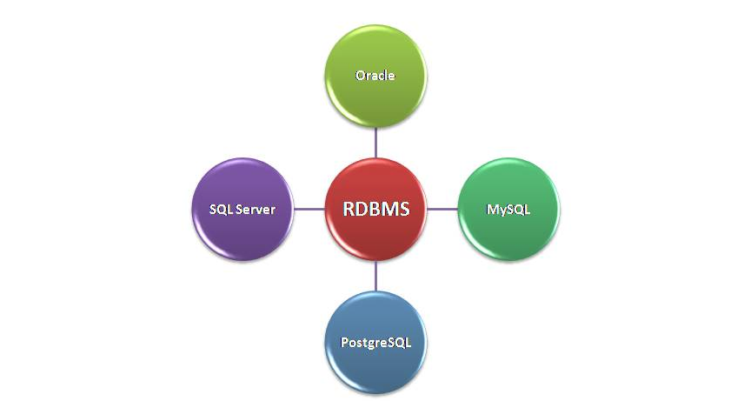
Different RDBMS Technology

Slide 6
DBMS & RDBMS
DBMS applications store data as file.
DBMS does not support client/server architecture.
DBMS does not allow normalization.
DBMS does not impose integrity constraints.
RDBMS applications store data in a tabular form.
RDBMS supports client/server architecture.
RDBMS allows normalization.
RDBMS imposes integrity constraints.

Slide 7
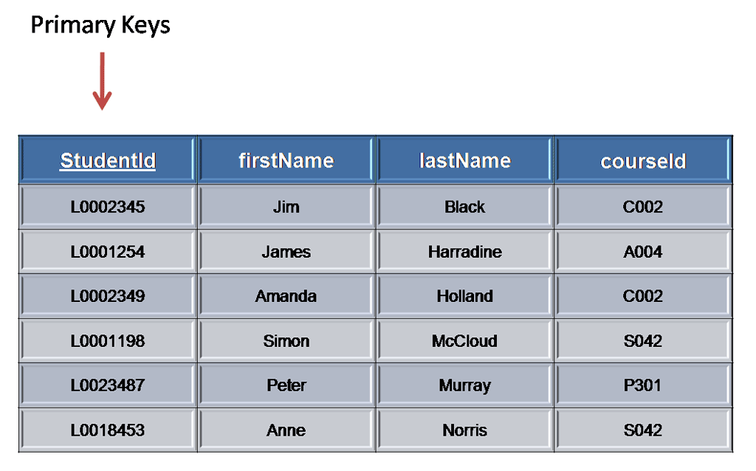
Creating Table

Slide 8
Creating Table
The data in RDBMS is stored in database objects called tables. The table is a collection of related data entries and it consists of columns and rows.
Remember, a table is the most common and simplest form of data storage in a relational database.

Slide 9
Field, Record or
Row
Every table is broken up into smaller entities called fields. The fields in the CUSTOMERS table consist of ID, NAME, AGE, ADDRESS and SALARY.
A record, also called a row of data, is each individual entry that exists in a table. For example there are 7 records in the above CUSTOMERS table.

Slide 10
Column
A column is a vertical entity in a table that contains all information associated with a specific field in a table.

Slide 11
Null Value
A NULL value in a table is a value in a field that appears to be blank, which means a field with a NULL value is a field with no value.

Slide 12
SQL

Slide 13
SQL
SQL is a standard language for accessing databases.
SQL stands for Structured Query Language
SQL lets you access and manipulate databases
SQL is an ANSI (American National Standards Institute) standard

Slide 14
Benefit of SQL
SQL can execute queries against a database
SQL can retrieve data from a database
SQL can insert records in a database
SQL can update records in a database
SQL can delete records from a database

Slide 15
Using SQL in your
Project
To build an application that shows data from a database, you will need:
An RDBMS database program (i.e. MS Access, SQL Server, MySQL)
To use a server-side scripting language, like Java, PHP or ASP
To use SQL to get the data you want
To use HTML / CSS

Slide 16
SQL Data Types
Number Data types :-
- INTEGER :- The Integer data type is used to specify an integer value.
- SMALLINT :- The SMALLINT data type is used to specify small integer value.
- NUMERIC(P,S) :-It specifies a numeric value. Here 'p' is precision value and 's' is a scale value.

Slide 17
SQL Data Types
Float Types :
  - FLOAT(P) - It specifies floating-point value. Here 'p' is precision value.
  - DOUBLE PRECISION - It specifies double precision floating point number.
  - REAL - The real integer is used to specify a single precision floating point number.
  - DECIMAL(P,S) - It specifies a decimal value. Here 'p' is precision value and 's' is scale value.

Slide 18
SQL Data Types
String Types :-
  - CHAR(X) - Here 'x' is the character's number to store. Here char should be used for storing fix length strings.
  - VARCHAR2(X) - Here 'x' is the character's number to store. varchar is used to store variable length strings. The String value's length will be stored on disk with the value itself.

Slide 19
SQL Data Types
Date & Time Type
  - DATE :- It stores year , month and days values.
  - TIME : -It stores hour,minute and second values.
  - TIMESTAMP :- The timestamp data type is used to year , month ,day ,hour ,minute and second values.

Slide 20
MYSQL
Data Types
In MySQL there are three main types : text, number, and Date/Time types.

Slide 21
MySQL Datatypes
Text Types:
  CHAR(size):(can contain letters, numbers, and special characters).Can store up to 255 characters
  VARCHAR(size):can contain letters, numbers, and special characters).Can store up to 255 characters.
  TEXT: Holds a string with a maximum length of 65,535 characters
  BLOB: For BLOBs (Binary Large OBjects). Holds up to 65,535 bytes of data

Slide 22
MySQL Data Types
Number types:
  INT(size)
  FLOAT(size,d)
  DOUBLE(size,d)

Slide 23

MySQL Data Types
Date types:
  DATE(): A date. Format: YYYY-MM-DD
  DATETIME(): A date and time combination. Format: YYYY-MM-DD HH:MM:SS
  TIME(): A time. Format: HH:MM:SS
  YEAR(): A year in two-digit or four-digit format.

Slide 24
Important SQL
Commands
SELECT - extracts data from a database
UPDATE - updates data in a database
DELETE - deletes data from a database
INSERT INTO - inserts new data into a
database
CREATE DATABASE - creates a new database

Slide 25
Important SQL
Commands
ALTER DATABASE - modifies a database
CREATE TABLE - creates a new table
ALTER TABLE - modifies a table
DROP TABLE - deletes a table

Slide 26
SQL Syntax
CREATE DATABASE
  CREATE DATABASE dbname;
CREATE TABLE
  CREATE TABLE Persons(PersonID int,LastName varchar(255),FirstName varchar(255),Address varchar(255),City varchar(255)
  );

Slide 27
SQL Syntax
SQL SELECT Statement
  SELECT * FROM table_name;
SELECT Column Example
  SELECT CustomerName,City FROM Customers;
SELECT DISTINCT Statement
  SELECT DISTINCT column_name,column_name
  FROM table_name;

Slide 28
SQL Syntax
SQL WHERE Clause
  SELECT * FROM Customers
  WHERE Country='Mexico';;

Slide 29
SQL Syntax
Operators in the where clause:
=, >,<,>=,<=, BETWEEN, LIKE, IN
SQL AND Operators
  SELECT * FROM Customers
  WHERE Country='Germany'
  AND City='Berlin';
OR Operator Example
  SELECT * FROM Customers
  WHERE City='Berlin'
  OR City='Munchen';

Slide 30
SQL Syntax
Combining AND & OR
  SELECT * FROM Customers
  WHERE Country='Germany'
  AND (City='Berlin' OR City='München');

Slide 31
ORDER BY Keyword
The ORDER BY keyword is used to sort the result-set by one or more columns.
The ORDER BY keyword sorts the records in ascending order by default. To sort the records in a descending order, you can use the DESC keyword.

Slide 32
ORDER BY Keyword
  SELECT column_name,column_name
  FROM table_name
  ORDER BY column_name,column_name ASC|DESC;
  SELECT * FROM Customers ORDER BY Country;
  SELECT * FROM Customers ORDER BY Country DESC;
  SELECT * FROM Customers ORDER BY Country,CustomerName;

Slide 33
INSERT INTO
Statement
INSERT INTO table_name
VALUES (value1,value2,value3,...);
INSERT INTO table_name (column1,column2,column3,...)
VALUES (value1,value2,value3,...);
INSERT INTO Customers (CustomerName, ContactName, Address, City, PostalCode, Country)
VALUES ('Cardinal','Tom B. Erichsen','Skagen 21','Stavanger','4006','Norway');

Slide 34
Update Statement
The UPDATE statement is used to update existing records in a table.
UPDATE table_name
SET column1=value1,column2=value2,...
WHERE some_column=some_value;
UPDATE Customers SET ContactName='Alfred Schmidt', City='Hamburg' WHERE CustomerName='Alfreds Futterkiste';

Slide 35
DELETE Statement
The DELETE statement is used to delete records in a table.
DELETE FROM table_name WHERE some_column=some_value;
DELETE FROM Customers WHERE CustomerName='Alfreds Futterkiste' AND ContactName='Maria Anders';

Slide 36

DELETE Statement
Delete All Data
DELETE FROM table_name;
or
DELETE * FROM table_name;

Slide 37
SQL Injection
An SQL Injection can destroy the database. SQL injection is a technique where malicious users can inject SQL commands into an SQL statement ,via web page input.
Injected SQL commands can alter SQL statements and compromise the security of a web application.

Slide 38
SQL Web Page
When SQL is used to display data on a web page,it is common to let web user input their own search value.
Since SQL statements are text only,it is easy,with a little piece of computer code, to dynamically change SQL statements to provide the user with selected data.

Slide 39
SQL WEB Page
txtUserId =getRequestString(“UserId”);
txtSQL =”SELECT * FROM Users Where UserId=”+txtUserId
The example creates a select statement by adding a variable (txtUserId) to a select string. The variable is fetched from the user input (Request) to the page.

Slide 40
SQL Injection
SELECT * FROM Users Where UserId =105 or 1=1
SQL above is valid. It will return all rows from the table Users ,since Where 1=1 is always true.

Slide 41
SELECT TOP
SELECT TOP clause is used to specify the number of records to return.
SELECT TOP clause can be very useful on large tables with thousands of records. Returning a large number of records can impact on performance.

Slide 42
SELECT TOP
MySQL Syntax :
SELECT column_name(s) from table_name LIMIT number;
Example
SELECT * FROM Students LIMIT 5;

Slide 43
SELECT TOP
Oracle Syntax :
SELECT column_name(s) FROM table_name WHERE ROWNUM <= number;
Example
SELECT * FROM Students WHERE ROWNUM <=5;

Slide 44
SELECT TOP
Oracle Syntax :
SELECT column_name(s) FROM table_name WHERE ROWNUM <= number;
Example
SELECT * FROM Students WHERE ROWNUM <=5;

Slide 45

Between Operators

Slide 46
BETWEEN
Operator
SELECT column_name(s) FROM table_name WHERE column_name BETWEEN value1 AND value2;
SELECT * FROM Products WHERE Price BETWEEN 10 AND 20;
NOT BETWEEN
SELECT * FROM Products WHERE Price NOT BETWEEN 10 AND 20;
BETWEEN Operator with IN
SELECT * FROM Products WHERE (Price BETWEEN 10 AND 20) AND NOT CategoryID IN (1,2,3);

Slide 47
BETWEEN
Operator
BETWEEN Operator with Text Value
  SELECT * FROM Products WHERE ProductName BETWEEN 'C' AND 'M';
NOT BETWEEN Operator with Text Value
  SELECT * FROM Products WHERE ProductName NOT BETWEEN 'C' AND 'M';
BETWEEN Operator with Date Value
  SELECT * FROM Orders WHERE OrderDate BETWEEN #07/04/1996# AND #07/09/1996#;

Slide 48
LIKE
Operator
The Like operator is used to search for a specified pattern in a column .
SQL LIKE Syntax :
SELECT column_name(s) FROM table_name WHERE column_name LIKE pattern;

Slide 49
LIKE
Operator
Select all Customers starting with a City starting with the letter “m”
SELECT * FROM Customers WHERE City LIKE 'm%';
Select all Customers with a City ending with the letter “m”
SELECT * FROM Customers WHERE City LIKE '%m';
Select all customers with a City not containing the pattern
“nadu”
SELECT * FROM Customers WHERE City NOT LIKE '%nadu%';

Slide 50
Wildcards
A wildcard character can be used to substitute for any other character(s) in a string.
Two types of Wildcard characters :
Percent sign(%) : Matches one or more Characters
Underscore (_) : Matches one Character

Slide 51
Wildcards
Find any value start with 50
SELECT * FROM Product where price LIKE '50%';
Find any value that have 50 in any position.
SELECT * FROM Product where price LIKE '%50%';
Find any value that have 00 in the second and third positions
SELECT *FROM Product where price LIKE '_00%';
Finds any values in a five-digit number that start with 2 and end with 3
SELECT * FROM Product where price LIKE '2___3';

Slide 52
IN Operator
In operator allows to specify multiple values in a Where clause.
IN Operator Syntax :
SELECT column_name(s) FROM table_name WHERE column_name IN (value1,value2,....);

Slide 53
IN Operator
Select all Customer with a City of “Manchester” and “London”
SELECT * FROM Customers WHERE City IN ('Manchester','London');
Select all Customers Except City of “Manchester” and “London”
SELECT * FROM Customers WHERE City NOT IN ('Manchester','London');

Slide 54
SQL Functions
SQL has many built-in functions for performing calculations on data.

Slide 55
Aggregate Functions
SQL aggregate functions return a single value , calculated from values in a column.

Slide 56
Aggregate Functions
SUM() - Returns the sum
AVG() - Returns the average value
COUNT() - Returns the number of rows
MAX() - Returns the Largest value
MIN() - Returns the Smallest value
FIRST() - Returns the first value
LAST() - Returns the last value

Slide 57
SUM()
Syntax :
SELECT SUM(expression) FROM tables WHERE conditions;
Example :
SELECT SUM(salary) AS “Total Salary” FROM Employee WHERE salary >20000;

Slide 58
Group By
The GROUP BY clause is a SQL command that is used to group rows that have the same values.
It is used in conjunction with aggregate functions to produce summary reports from the database.
GROUP BY clause are called grouped queries and only return a single row for every grouped item.

Slide 59
Group By
Syntax :
SELECT column_name , aggregate_function(column_name ) FROM table_name WHERE column_name operator value
GROUP BY column_name;
Example :
SELECT Department ,SUM(Salary) AS “Total Salary “ FROM Employee
GROUP BY Department ;

Slide 60
SQL Scalar Functions
SQL Scalar function return a single value, based on the input value.

Slide 61
SQL Scalar Functions
UCASE() - Converts a field to upper case.
LCASE() - Converts a field to lower case.
LEN() - Returns the length of a text field.
MID() - Extract characters from a text field.
ROUND() - Rounds a numeric field to the number of decimal specified.
NOW() - Returns the current date and time.
FORMAT() - Formats how a field is to be displayed.

Slide 62
UCASE()
The UCASE() function converts the value of a field to uppercase.
Syntax
SELECT UCASE(column_name) FROM table_name;
Syntax for SQL Server
SELECT UPPER(column_name) FROM table_name;

Slide 63
LEN()
The LEN() function returns the length of the value in a text field.
Syntax
SELECT LEN(column_name) FROM table_name;
Syntax for Oracle
SELECT LENGTH(column_name) FROM table_name;

Slide 64
MID()
The MID() function is used to extract characters from a text field.
Syntax
SELECT MID(column_name,start,length) AS some_name FROM table_name;
column_name - The field to extract characters
Start - Specifies the starting position
Length - The number of characters to return.

Slide 65
ROUND()
The ROUND() function is used to round a numeric field to the number of decimal specified.
Syntax :
SELECT ROUND(column_name ,decimals) FROM table_name;
column_name - The field to round.
Decimals - Specifies the number of decimals to be returned.

Slide 66
NOW()
The Now() function returns the current date and time.
Syntax :
SELECT NOW() FROM table_name;
Example :
SELECT Product_Name ,Price ,NOW() AS “ Per Date” from Products;

Slide 67
FORMAT()
The FORMAT() function is used to format how a field is to be displayed.
Syntax :
SELECT FORMAT(column_name,format) FROM table_name;
Example :
SELECT Product_Name ,Price, FORMAT(NOW(),'YYYY-MM-DD') AS 'Per Date' FROM Products;

Slide 68
SQL Aliases
SQL Aliases are used to temporarily rename a table or column heading.
Syntax
SELECT column_name AS alias_name FROM table_name;

Slide 69
Table Alias
Syntax :
SELECT column_name AS alias_name FROM table_name;
Example
SELECT C.ID ,C.NAME ,C.AGE ,O.AMOUNT FROM Customer As C , Order As O WHERE C.ID = O.Customer _ID;

Slide 70
Column Alias
Syntax :
SELECT column_name(s) FROM table_name AS alias_name;
Example
SELECT ID AS CUSTOMER_ID , NAME AS CUSTOMER_NAME FROM CUSTOMERS WHERE SALARY IS NOT NULL;

Slide 71
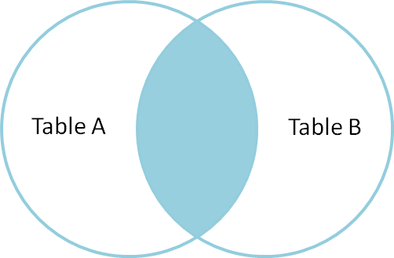
SQL Joins

Slide 72
SQL Joins
An SQL JOIN clause is used to combine rows from two or more tables, based on a common field between them.

Slide 73
SQL Joins
The different SQL JOINs you can use:
  INNER JOIN: Returns all rows when there is at least one match in BOTH tables
  LEFT JOIN: Return all rows from the left table, and the matched rows from the right table. The result is null in the right side if there is no match.
  RIGHT JOIN: Return all rows from the right table, and the matched rows from the left table. The result is null in the right side if there is no match.
  FULL JOIN: Return all rows from the left table and right table. It combines the result of both LEFT and RIGHT join.

Slide 74

SQL Joins
The most common type of join is: SQL INNER JOIN (simple join). An SQL INNER JOIN return all rows from multiple tables where the join condition is met.

Slide 75
SQL Joins
Let's look at a selection from the "Orders" table:
OrderID CustomerID OrderDate
10308 2 1996-09-18
10309 37 1996-09-19
10310 77 1996-09-20

Slide 76
SQL Joins
Have a look at a selection from the "Customers" table:
CustomerID CustomerName ContactName Country
1 Alfreds Futterkiste Maria Anders Germany
2 Ana Trujillo Trujillo Mexico
3 Antonio Moreno Moreno Mexico
Notice that the "CustomerID" column in the "Orders" table refers to the customer in the "Customers" table. The relationship between the two tables above is the "CustomerID" column.

Slide 77
SQL Joins
Example:
SELECT Orders.OrderID, Customers.CustomerName, Orders.OrderDate
FROM Orders
INNER JOIN Customers
ON Orders.CustomerID=Customers.CustomerID;
It will produce the following:
OrderID CustomerName OrderDate
10308 Ana Trujillo 9/18/1996

Slide 78
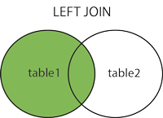
LEFT JOIN
SYNTAX :
SELECT column_name(s) FROM table1 LEFT JOIN table2
ON table1.column_name = table2.column_name ;

Slide 79
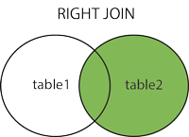
RIGHT JOIN
SYNTAX :
SELECT column_name(s) FROM table1 RIGHT JOIN table2
ON table1.column_name = table2.column_name ;

Slide 80
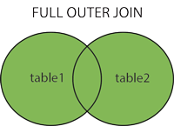
FULL JOIN
SYNTAX :
SELECT column_name(s) FROM table1 FULL JOIN table2
ON table1.column_name = table2.column_name ;

Slide 81
Union Operator
The SQL Union operator combines the result of two or more select statement. Union Operator Select only distinct values by default . To allow duplicate values use ALL keyword with UNION .
Syntax :
SELECT Column_name(s) FROM table1
UNION
SELECT Column_name(s) FROM table2;

Slide 82
Select Into
The SELECT INTO statement copies data from one table and insert it into a new Table.
Syntax :
SELECT * INTO new table [ IN External db ] FROM table1
OR
SELECT column_name (s) INTO new table [IN external db]
FROM table1;

Slide 83
Insert into Select
The INSERT INTO SELECT statement copies data from one table and insert it into existing table.
Syntax
Copy data from one table to another existing table.
INSERT INTO table2
SELECT * FROM table1;
Copy only columns into another existing table
INSERT INTO table2
( column_name (s))
SELECT column_name(s) FROM table1;

Slide 84

SQL Constraints
SQL constraints are used to specify rules for the data in a table.
Constraints can be specified when the table is created (inside the CREATE TABLE statement) or after the table is created (inside the ALTER TABLE statement).

Slide 85
SQL Constraints
NOT NULL
UNIQUE
PRIMARY KEY
FOREIGN KEY
CHECK
DEFAULT

Slide 86
NOT NULL Constraint
NOT NULL Constraint enforces a column to not accept a null values.
Example
CREATE TABLE Student
(Stud_ID int (10) NOT NULL,
Name varchar (20) NOT NULL,
Address varchar(20)
Course varchar (20));

Slide 87
Unique Constraint
The UNIQUE Constraint uniquely identifies each record in a database table.
Example
CREATE TABLE Student
(Stud_id int NOT NULL UNIQUE,
Name varchar (255) NOT NULL,
Address varchar (255),
City varchar (255) );

Slide 88
PRIMARY KEY Constraint
PRIMARY KEY Constraint uniquely identifies each record in a database table.
PRIMARY KEY must contain UNIQUE values.
PRIMARY KEY column cannot contain NULL values.
Each table can have only one PRIMARY KEY.

Slide 89
Primary Key Constraint
CREATE TABLE Student
(Stud_Id int PRIMARY KEY,
Name varchar (20) NOT NULL,
Address varchar (20) ,
City varchar(35));

Slide 90
Primary Key Constraint
Adding Primary key Already created Table
ALTER TABLE STUDENT
ADD PRIMARY_KEY (STUD_ID) ;
Defining Primary Key Constraints on Multiple Columns
ALTER TABLE STUDENT
ADD CONSTRAINT S_ID PRIMARY_KEY( STUD_ID, FIRSTNAME) ;

Slide 91
Primary Key Constraint
To DROP a Primary KEY
ALTER TABLE STUDENT
DROP PRIMARY KEY

Slide 92
Foreign Key Constraint
A Foreign Key in one table points to a PRIMARY KEY in another table.
A Foreign key is a field or a column that is used to establish a link between two tables.
The Foreign Key constraint also prevents invalid data from being inserted into foreign key column ,because it has to be one of the values contained in the table it points to.

Slide 93
Foreign Key Constraint
CREATE TABLE Student_Detail
(Stud_Id int PRIMARY KEY,
Name varchar (20) NOT NULL,
Address varchar (20) ,
City varchar(35));
CREATE TABLE Marks_Detail
(Stud_Id int PRIMARY KEY,
Name varchar (20) NOT NULL,
Address varchar (20) ,
City varchar(35)
FOREIGN KEY (Stud_Id) REFERENCES STUDENT_DETAILS(Stud_Id)
);

Slide 94
Check Constraint
The CHECK constraint is used to limit the value range that can be placed in a column.
CREATE TABLE Student
( Stud_Id int PRIMARY KEY,
Name varchar(20) NOT NULL,
Address varchar(20) NOT NULL,
City varchar(20) NOT NULL CHECK (City ='Banglore'));

Slide 95
Default Constraint
Default constraint is used to insert a default value into a column. Default value will be added to all new records ,if no other value is specified.
CREATE TABLE Student
( Stud_Id int PRIMARY KEY,
Name varchar(20) NOT NULL,
Address varchar(20) NOT NULL,
City varchar(20) DEFAULT 'Banglore');

Slide 96
Indexes
Indexes allows the database application to find data fast , without reading the whole table.
An Index can be created in a table to find data more quickly and efficiently
The users cannot see the indexes, they are just used to speed up searches/queries.

Slide 97
Indexes
Create Index Syntax
CREATE INDEX index_name
ON table_name (column_name)
Create Unique Index
CREATE UNIQUE INDEX index_name
ON table_name (column_name)

Slide 98
Index Example
Creating Index on a single column
CREATE INDEX ID1 ON Student(Name);
Creating Index on a multiple Column
CREATE INDEX ID2
ON Student (FirstName , LastName);

Slide 99
SQL Drop
DROP TABLE
  The DROP TABLE statement is used to delete a table.
  DROP TABLE table_name
DROP DATABASE
  The DROP DATABASE statement is used to delete a database.
  DROP DATABASE database_name
ALTER TABLE
  The ALTER TABLE statement is used to add, delete, or modify columns in an existing table.
  ALTER TABLE table_name ADD column_name datatype

Slide 100

SQL Drop
TRUNCATE TABLE
  What if we only want to delete the data inside the table, and not the table itself?
  TRUNCATE TABLE table_name

Slide 101
SQL AUTO
INCREMENT
Very often we would like the value of the primary key field to be created automatically every time a new record is inserted.
We would like to create an auto-increment field in a table.
CREATE TABLE Persons(ID int NOT NULL AUTO_INCREMENT,LastName varchar(255) NOT NULL,FirstName varchar(255),Address varchar(255),
City varchar(255),PRIMARY KEY (ID))

Slide 102
SQL AUTO
INCREMENT
By default, the starting value for AUTO_INCREMENT is 1,and it will increment by 1 for each new record.
To let the AUTO_INCREMENT sequence start with another value, use the following SQL statement:
  ALTER TABLE Persons AUTO_INCREMENT=100
To insert a new record into the "Persons" table, we will NOT have to specify a value for the "ID" column (a unique value will be added automatically):
  INSERT INTO Persons (FirstName,LastName) VALUES ('Lars','Monsen')

Slide 103
Views
View is a virtual table based on the result-set of an SQL statement.
A view contains rows and columns , just like a real table.
The fields in a view are fields from one or more real tables in the database.

Slide 104
Views
Updating View
CREATE OR REPLACE VIEW view_name AS SELECT column_name(s) FROM table_name WHERE condition;
Dropping a View
DROP VIEW view_name;

Slide 105
View
View Syntax :
CREATE VIEW view_name AS SELECT column_name(s) FROM table_name WHERE condition
Example :
CREATE VIEW StudentList AS SELECT Stud_Id ,Name FROM Students WHERE City ='Banglore' ;
We can query the view as follows :
SELECT * FROM StudentList ;

Slide 106
Views
Updating View
CREATE OR REPLACE VIEW view_name AS SELECT column_name(s) FROM table_name WHERE condition;
Dropping a View
DROP VIEW view_name;

Slide 107
SQL DATES
Assume we have following “Orders” table
OrderID CustomerID OrderDate
10308 2 2011-09-18
10309 37 2009-09-19
10310 77 2012-09-20
10311 78 2012-09-21
SELECT *FROM Orders WHERE OrderDate='2011-09-18'

Slide 108
SQL DATE Function
GETDATE() returns the current date & Time from SQL Server.
Example
SELECT GETDATE() AS CurrentDateTime
DATEDIFF() function returns the time between two functions.
DATEDIFF(datepart, startdate, enddate)
Example
SELECT DATEDIFF(day,'2016-08-05' ,'2016-08-06') AS DiffDate

Slide 109
SQL NULL Values
NULL values represent missing unknown data.
By default ,a table can hold NULL values.
NULL values are treated differently from other values.
Example
SELECT OrderId ,CustomerId from Orders where OrderId IS NULL

Slide 110
NULL Functions
ISNULL() :- function is used to specify how we want to treat NULL values.
NVL(), IFNULL(), and COALESCE() functions can also be used to achieve the same result.

Slide 111
Subquery
Subquery or Inner query or Nested query is a query in query is usually added in the WHERE clause of the SQL Statement.
Subqueries are an alternate way of returning data from multiple tables.
Subqueries can be used with the SELECT ,INSERT ,UPDATE and DELETE statements along with the operators like = ,<,>,>=,<=,IN ,BETWEEN etc.

Slide 112
Subquery
Syntax :
SELECT select_list FROM table WHERE expr operator (SELECT select_list FROM table);
The subquery (inner query) executes once before the main query (outer query) executes.
The main query(outer query) use the subquery result.

Slide 113
Subquery Example
We have the following two tables
student and marks.
Student Table
StudentID Name City
A001 John Paris
A002 Smith London
A003 Mac Berlin
A004 Ivan London

Slide 114
Subquery Example
Marks Table
StudentID Total_Marks
A001 95
A002 80
A003 75
A004 81

Slide 115
Subquery Example
We want to write a query to identify all students who get better marks than that of the students who's StudentID is A002,but we don't know the marks of A002.
Here two query one query return the the marks stored in Total_marks field another query identifies the students who get better marks than the result of the first query.

Slide 116
Subquery Example
SELECT a.StudentID , a.name , b.Total_marks FROM Student a , Marks b WHERE a.StudentID =b.StudentID AND b.Total_marks > (SELECT Total_Marks FROM Marks WHERE StudentId='A002');
Output :
StudentID Name Total_Marks
A001 John 95
A004 Ivan 81

Slide 117
Types of Subqueries
Single Row Subquery
Multiple Row Subquery
Correlated Subquery

Slide 118
Single Row Subquery
Subquery which returns single row output. They mark the usage of single row comparison operators when used in where condition.
Agent Table
AGENT_CODE | AGENT_NAME | WORKING_AREA | COMMISSION | PHONE_NO | COUNTRY |
+------------+----------------------+--------------------+------------+-----------------+---------+
| A007 | Ramasundar | Bangalore | 0.15 | 077-25814763 | |
| A003 | Alex | London | 0.13 | 075-12458969 | |
| A008 | Alford | New York | 0.12 | 044-25874365 | |
| A011 | Ravi Kumar | Bangalore | 0.15 | 077-45625874 | |
| A010 | Santakumar | Chennai | 0.14 | 007-22388644 | |
| A012 | Lucida | San Jose | 0.12 | 044-52981425 | |
| A005 | Anderson | Brisban | 0.13 | 045-21447739 | |
| A001 | Subbarao | Bangalore | 0.14 | 077-12346674 | |
| A002 | Mukesh | Mumbai | 0.11 | 029-12358964 | |
| A006 | McDen | London | 0.15 | 078-22255588 | |
| A004 | Ivan | Torento | 0.15 | 008-22544166 | |
| A009 | Benjamin | Hampshair | 0.11 | 008-22536178 | |
+------------+----------------------+--------------------+------------+-----------------+---------+

Slide 119
Single Row Subquery Example
SQL Statement :
SELECT agent_name ,agent_code,phone_no FROM agents WHERE agent_code=(SELECT agent_code FROM agents WHERE agent_name ='Alex';
Output
AGENT_NAME AGENT_CODE PHONE_NO
Alex A003 075-12458969

Slide 120
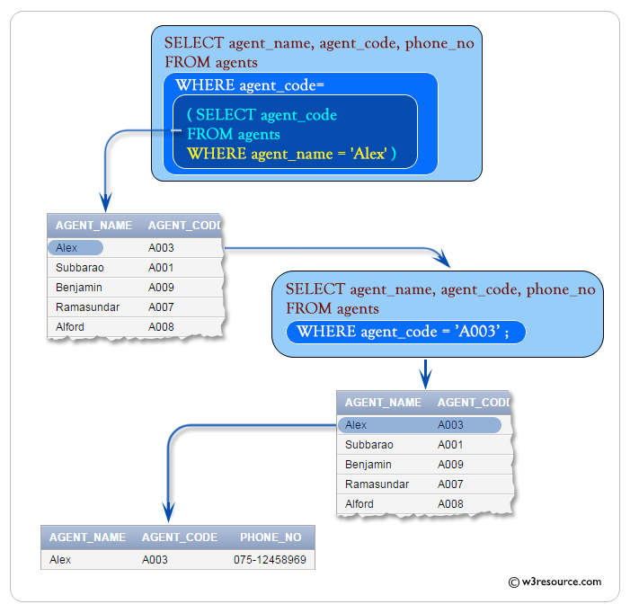
Single Row Subquery Example

Slide 121
Multiple Row Subquery
Multiple row subquery returns one or more rows to the outer SQL statement. We can use IN, ANY, or ALL operator in outer query to handle a subquery that returns multiple rows.

Slide 122
Multiple Row Subquery[Using IN]
Order Table
ORD_NUM ORD_AMOUNT ADVANCE_AMOUNT ORD_DATE CUST_CODE AGENT_CODE ORD_DESCRIPTION
---------- ---------- -------------- --------- --------------- --------------- -----------------
200114 3500 2000 15-AUG-08 C00002 A008
200122 2500 400 16-SEP-08 C00003 A004
200118 500 100 20-JUL-08 C00023 A006
200119 4000 700 16-SEP-08 C00007 A010
200121 1500 600 23-SEP-08 C00008 A004
200130 2500 400 30-JUL-08 C00025 A011
200134 4200 1800 25-SEP-08 C00004 A005
200108 4000 600 15-FEB-08 C00008 A004
200103 1500 700 15-MAY-08 C00021 A005
200105 2500 500 18-JUL-08 C00025 A011
200109 3500 800 30-JUL-08 C00011 A010
200101 3000 1000 15-JUL-08 C00001 A008
200111 1000 300 10-JUL-08 C00020 A008
200104 1500 500 13-MAR-08 C00006 A004
200106 2500 700 20-APR-08 C00005 A002
200125 2000 600 10-OCT-08 C00018 A005
200117 800 200 20-OCT-08 C00014 A001
200123 500 100 16-SEP-08 C00022 A002
200120 500 100 20-JUL-08 C00009 A002
200116 500 100 13-JUL-08 C00010 A009
200124 500 100 20-JUN-08 C00017 A007
200126 500 100 24-JUN-08 C00022 A002
200129 2500 500 20-JUL-08 C00024 A006
200127 2500 400 20-JUL-08 C00015 A003
200128 3500 1500 20-JUL-08 C00009 A002
200135 2000 800 16-SEP-08 C00007 A010
200131 900 150 26-AUG-08 C00012 A012
200133 1200 400 29-JUN-08 C00009 A002
200100 1000 600 08-JAN-08 C00015 A003

Slide 123
Multiple Row Subquery
SQL Statement :
SELECT ord_num,ord_amount ,ord_date ,cust_code ,agent_code FROM orders WHERE agent_code IN (SELECT agent_code FROM agents WHERE working_area ='Banglore');
Output :
ORD_NUM ORD_AMOUNT ORD_DATE CUST_CODE AGENT_CODE
200130 25000 30-JUL-08 C00025 A011
200105 2500 18-JUL-08 C00025 A011

Slide 124
Correlated Subquery
SQL Correlated Subqueries are used to select data from a table referenced in the outer query. The subquery is known as a correlated because the subquery is related to the outer query.

Slide 125
Correlated Subquery
SQL Statement :-
SELECT a.ord_num ,a.ord_amount ,a.cust_code ,a.agent_code FROM orders a WHERE a.agent_code =(SELECT b.agent_code FROM agents b WHERE b.agent_name='Alex');
Output :-
ORD_NUM ORD_AMOUNT CUST_CODE AGENT_CODE
200127 2500 C00015 A003
200100 1000 C00015 A003

Slide 126
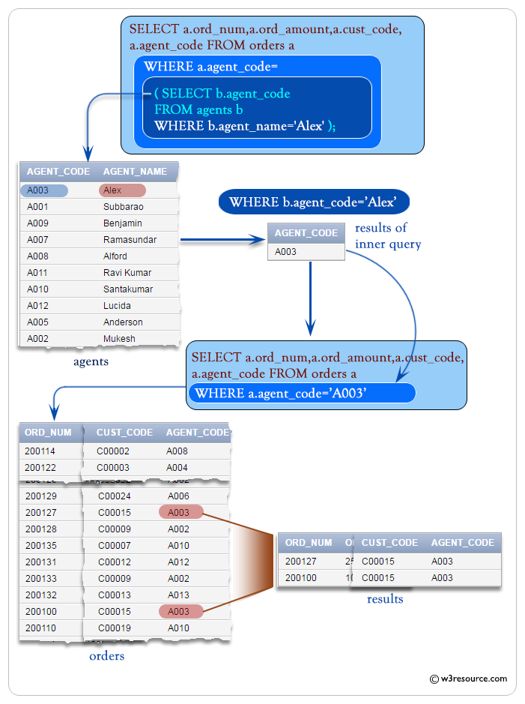
Correlated Subquery

Slide 127
Thank You

