Slide 1

Web Component Development Using Servlet & JSP Technology (EE6)
Module-2: Introduction to Java Server Pages(JSP)

Slide 2
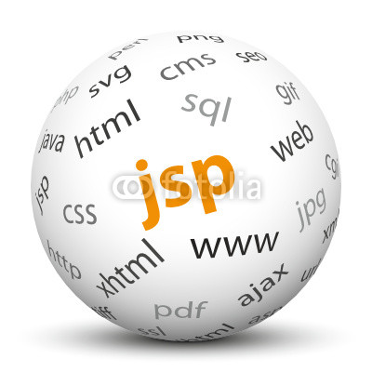
Introduction to Java Server Pages(JSP)

Slide 3
Objectives
Upon completion of this module, you should be able to:
Describe a significant weakness in servlets when used alone.
Write a simple Java Server Page (JSP)
Describe the translation of a JSP into a servlet
Understand the basic goals of MVC

Slide 4
Relevance
Discussion – The following questions are relevant to understanding how to develop a view component:
How easy would it be to edit HTML that is created by a Java program?
What would make a good separation of concerns for a web application?

Slide 5
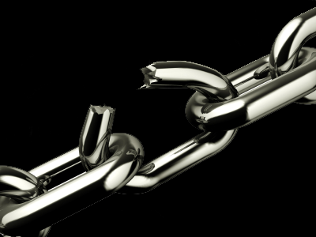
A Weakness in Servlets
Most modern web applications have elegant and complex user interface designs. The designs are often created by dedicated web designers, and even if that is not the case, the HTML pages that implement the designs are frequently created using “What You See Is What You Get” (WYSIWYG) Graphical User Interface (GUI) based design tools. Such design tools work on HTML, not on HTML embedded in Java program code.
Because of this, the pure servlet approach becomes unmanageable—often catastrophically—when maintenance is required on the web pages. Having to re-type all the HTML code back into out.print(...) statements would be a very time consuming and error prone process.

Slide 6
Addressing the Problem With JSPs
Soon after the original introduction of servlets, Java Server Pages, usually called simply JSPs, were introduced to address this problem.
While a servlet is a Java source file containing embedded HTML, a JSP might be considered to be an HTML file with Java embedded in it.

Slide 7
Example of a very simple JSP.
<%--
Simple Hello World JSP example
--%>
<%@page contentType="text/html" pageEncoding="UTF-8"%>
<!DOCTYPE HTML PUBLIC "-//W3C//DTD HTML 4.01 Transitional//EN" "http://www.w3.org/TR/html4/loose.dtd">
<html>
<body>
<% out.print("welcome to jsp"); %>
</body>
</html>

Slide 8
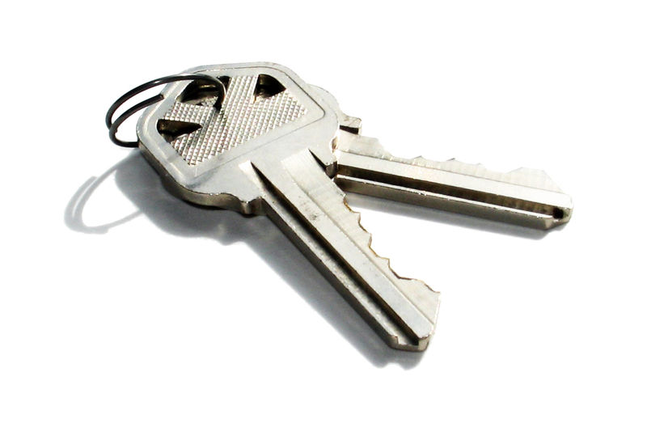
Key Elements of JSPs
Within <% ... %> pairs, three distinct variations are exemplified.
These are:
Comments
A “page directive”
An “expression”

Slide 9
How a JSP Is Processed
Before a JSP is executed for the first time, it is converted to an equivalent Servlet.

Slide 10
Reading Input Parameters From the Browser
<html>
<head>
<meta http-equiv="Content-Type" content="text/html; charset=UTF-8">
<title>JSP Page</title>
</head>
<body>
<h1>Hello
<%= request.getParameter("customerName") %>
</h1>
</body>
</html>

Slide 11
Sending Parameters in an HTTP GET Request
http://localhost:8080/SL314m2ex2/index.jsp?customerName=Corporal+Jones
Note that the space is encoded as a plus sign (+). Other encodings are required for many other symbols, but such conversions are beyond the scope of this module.

Slide 12
Remaining Problems With the JSP Approach
The JSP approach results in Java code embedded in an HTML source file. Because of this,programmers and web-designers must share the same file, and changes made by one group might cause bugs in the work of the other group.
In fact, the root of the problem is that one of the basic tenets of good software design has been broken. That tenet states that unrelated concerns should be separated in the source code.

Slide 13



Stay connected
About us: Emertxe is India’s one of the top IT finishing schools & self learning kits provider. Our primary focus is on Embedded with diversification focus on Java, Oracle and Android areas
Emertxe Information Technologies,
No-1, 9th Cross, 5th Main,
Jayamahal Extension,
Bangalore, Karnataka 560046
T: +91 80 6562 9666
E: training@emertxe.com
https://www.facebook.com/Emertxe
https://twitter.com/EmertxeTweet
https://www.slideshare.net/EmertxeSlides

Slide 14
Thank You

