Slide 1

Web Component Development with Servlet & JSP Technologies (EE 6)
Module-7: Developing JSP Pages
Team Emertxe

Slide 2
Objectives
Upon completion of this module, you should be able to:
Describe JSP page technology
Write JSP code using scripting elements
Write JSP code using the page directive
Write JSP code using standard tags
Write JSP code using the EL
Configure the JSP page environment in the web.xml file

Slide 3
Relevance
Discussion – The following questions are relevant to understanding JSP technology:
What problems exist in generating an HTML response in a servlet?
How do template page technologies (and JSP technology in
particular) solve these problems?

Slide 4
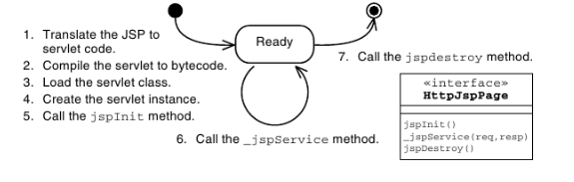
How a JSP Page Is Processed
A JSP page is essentially source code, and must be converted into a servlet before it can service requests. Figure shows the steps of JSP page processing.

Slide 5
Writing JSP Scripting Elements
JSP scripting elements are embedded with the <% %> tags and are
processed by the JSP engine during translation of the JSP page. Any other
text in the JSP page is considered part of the response and is copied
verbatim to the HTTP response stream that is sent to the web browser.
<html>
<%-- scripting element --%>
</html>

Slide 6
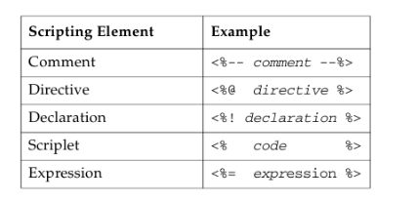
Writing JSP Scripting Elements

Slide 7
Comments
HTML Comment:
<!-- This is an HTML comment. It will show up in the response. -->
JSP Comment:
<%-- This is a JSP comment. It will only be seen in the JSP m code.
It will not show up in either the servlet code or the response.--%>
Java Comment:
<%
/* This is java comment and it will only be seen in servlet.It will not show in response. */
%>

Slide 8
Directive Tag
A directive tag provides information that affects the overall translation of
the JSP page. The syntax for a directive tag is as follows:
<%@ DirectiveName [attr=”value”]* %>
Three types of directives are used in JSP pages: page, include, and
taglib. The following are some examples:
<%@ page session=”false” %>
<%@ include file=”incl/copyright.html” %>
The page and include directives are described later in this module. The taglib directive is described in Module 8, “Developing JSP Pages Using Custom Tags.”

Slide 9
Declaration Tag
A declaration tag lets you include members in the JSP servlet class, either attributes or methods. The syntax for a declaration tag is as follows:
<%! JavaClassDeclaration %>

Slide 10
Scriptlet Tag
A scriptlet tag lets the JSP page developer include arbitrary Java technology code in the _jspService method. The syntax for a scriptlet tag is as follows:
<% JavaCode %>

Slide 11

Expression Tag
An expression tag holds a Java language expression that is evaluated during an HTTP request. The result of the expression is included in the HTTP response stream. The syntax for an expression tag is as follows:
<%= JavaExpression %>

Slide 12
Implicit Variables
The JSP engine gives you access to the following implicit variables, also called implicit objects, in scriptlet and expression tags. These variables represent commonly used objects for servlets that JSP page developers might need to use. For example, you can retrieve HTML form parameter data by using the request variable, which represents the HttpServletRequest object.

Slide 13
Implicit Variables
Request
Response
Out
Session
Application
Config
PageContext
Page
Exception

Slide 14
Using the page Directive
You use the page directive to modify the overall translation of the JSP page. For example, you can declare that the servlet code generated from a JSP page requires the use of the Date class:
<%@ page import=”java.util.Date” %>

Slide 15
Including JSP Page Segments
There are two standard approaches to including presentation segments in your JSP pages:
The include directive
The jsp:include standard action

Slide 16
Using the include Directive
The include directive lets you include a segment in the text of the main JSP page at translation time. The syntax of this JSP technology directive is as follows:
<%@ include file=”segmentURL” %>

Slide 17
Using Standard Tags
The JSP specification provides standard tags for use within your JSP pages. Because these tags are required in the specification, every JSP container must support them. This ensures that any applications using the standard tags will work in any compliant JSP container.
Standard tags begin with the jsp: prefix. You use these tags to reduce or eliminate scriptlet code within your JSP page. However, the standard tags only provide limited functionality. Using the JSTL and EL reduces the need for the standard tags.

Slide 18
JavaBeans Components
A JavaBeans component is a Java technology class with at minimum the following features:
Properties defined with accessors and mutators (get and set methods).
A no-argument constructor.
No public instance variables.
The class implements the java.io.Serializable interface.

Slide 19
The useBean Tag
If you want to interact with a JavaBeans component using the standard
tags in a JSP page, you must first declare the bean. You do this by using
the useBean standard tag.
The syntax of the useBean tag is as follows:
<jsp:useBean id=”beanName”
scope=”page | request | session | application”
class=”className” />
The id attribute specifies the attribute name of the bean. Where the bean is stored is specified by the scope attribute. Scope defaults to page if not specified. The class attribute specifies the fully qualified class name.

Slide 20
The setProperty Tag
You use the setProperty tag to store data in the JavaBeans instance. The syntax of the setProperty tag is as follows:
<jsp:setProperty name="beanName" property_expression/>
The property attribute specifies the property within the bean that will be set. For example, to set the email property in the customer bean, you can use the following:
<jsp:setProperty name=”cust” property=”email” />

Slide 21
The getProperty Tag
The getProperty tag is used to retrieve a property from a JavaBeans instance and display it in the output stream.
The syntax of the getProperty tag is as follows:
<jsp:getProperty name=”beanName”
property=”propertyName” />
The name attribute specifies the name of the JavaBeans instance and the property attribute specifies the property used for the get method.
Given a getProperty usage of the following:
<jsp:getProperty name=”cust” property=”email” />

Slide 22
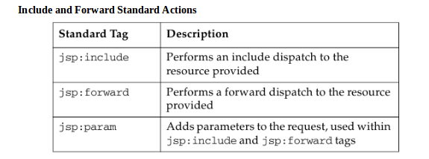
Other Standard Tags

Slide 23
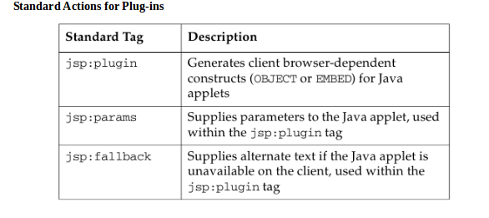
Other Standard Tags

Slide 24
Using the jsp:include Standard Action
The jsp:include standard action lets you include a segment in the text of the main JSP page at runtime. The syntax of this JSP technology action tag is as follows:
<jsp:include page=”segmentURL” />
You might have noticed that the include directive uses an
attribute called file and the jsp:include standard action uses an attribute called page. These attributes represent the same concept: The URL to the segment file to be included.
The jsp:include action is equivalent to using the include
method on a RequestDispatcher object. For example:
RequestDispatcher segment = request.getRequestDispatcher(page);
segment.include(request, response);

Slide 25
Using the jsp:include Standard Action
The jsp:include standard action lets you include a segment in the text of the main JSP page at runtime. The syntax of this JSP technology action tag is as follows:
<jsp:include page=”segmentURL” />
You might have noticed that the include directive uses an
attribute called file and the jsp:include standard action uses an attribute called page. These attributes represent the same concept: The URL to the segment file to be included.
The jsp:include action is equivalent to using the include
method on a RequestDispatcher object. For example:
RequestDispatcher segment = request.getRequestDispatcher(page);
segment.include(request, response);

Slide 26
Using the jsp:param Standard Action
Sometimes, you might want to alter a presentation segment at runtime.
The jsp:include action lets you pass additional parameters to the presentation segment at runtime using the jsp:param standard action. The syntax of this JSP technology action tag and the relationship to the jsp:include action is:
<jsp:include page=”segmentURL”>
<jsp:param name=”paramName” value=”paramValue”/>
</jsp:include>

Slide 27
Using the jsp:param Standard Action
<!-- START of banner -->
<jsp:include page=”/WEB-INF/view/common/banner.jsp”>
<jsp:param name=”subTitle” value=”Registration” />
</jsp:include>
<!-- END of banner -->

Slide 28



Stay connected
About us: Emertxe is India’s one of the top IT finishing schools & self learning kits provider. Our primary focus is on Embedded with diversification focus on Java, Oracle and Android areas
Emertxe Information Technologies,
No-1, 9th Cross, 5th Main,
Jayamahal Extension,
Bangalore, Karnataka 560046
T: +91 80 6562 9666
E: training@emertxe.com
https://www.facebook.com/Emertxe
https://twitter.com/EmertxeTweet
https://www.slideshare.net/EmertxeSlides

Slide 29
Thank You

