Slide 1

Web Component Development with Servlet & JSP Technologies (EE 6)
Module-8: Developing JSP Pages using
Custom Tags
Team Emertxe

Slide 2
Objectives
Upon completion of this module, you should be able to:
Describe the Java EE job roles involved in web application development
Design a web application using custom tags
Use JSTL tags in a JSP page

Slide 3
Relevance
Discussion – The following questions are relevant to understanding the use of custom tag libraries:
Who in your organization will be creating JSP pages?
Suppose you start with a small number of JSP pages in a web application and have a significant amount of scripting code in these pages. What problems can you foresee as the web application grows?

Slide 4
The JSTL
Custom tags were originally created to permit development of JSP pages without using Java technology code (scripting elements).
Since then, other mechanisms, notably the MVC approach supported by EL, have been developed that might be considered to provide a cleaner separation of concerns.
However, many existing web applications exist that make
extensive use of tags. Because of this, tags remain the preferred tool of some organizations for creating JSP pages without embedding Java programming language scriptlets into those pages.

Slide 5
The Java EE Job Roles Involved in Web Application Development
Web Designers – Responsible for creating the views of the application, which are primarily composed of HTML pages
Web Component Developers – Responsible for creating the control elements of the application, which are almost exclusively Java technology code
Business Component Developers – Responsible for creating the model elements of the application, which might reside on the web server or on a remote server (such as an EJB technology server)

Slide 6
Designing JSP Pages With Custom Tag Libraries
A custom tag is an XML tag used in a JSP page to represent some dynamic
action or the generation of content within the page during runtime. Custom tags are used to eliminate scripting elements in a JSP page.
Compared with coding these conditions and loops in Java scriptlets, JSTL tags offer these advantages:
Java technology code is removed from the JSP page.
Custom tags are reusable components.
Standard job roles are supported.

Slide 7
Custom Tag Library Overview
A custom tag library is a collection of custom tag handlers and the tag library descriptor file.
A custom tag library is a web component that is part of the web application. Figure 8-(next slide) shows a tag library as a web Component

Slide 8
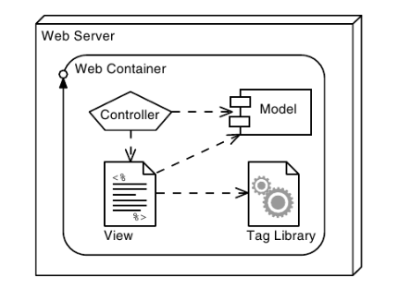
Custom Tag Library Overview

Slide 9
Custom Tag Syntax Rules
JSP technology custom tags use XML syntax. There are four fundamental XML rules that all custom tags must follow:
Standard tag syntax must conform to the following structure:
<prefix:name { attribute={”value”|’value’ }}*>
body
</prefix:name>
Example:
<c:forEach var=”message” items=”${errorMsgs}”>
<li>${message}</li>
</c:forEach>

Slide 10
Custom Tag Syntax Rules
Empty tag syntax must conform to the following structure:
<prefix:name { attribute={”value”|’value’|'value'}}*/>
Example:
<c:url value=”addLeague.do”/>
Tags must follow nesting rules:
<tag1>
<tag2>
</tag2>
</tag1>

Slide 11
Custom Tag Syntax Rules
Here is an example of correct nesting:
<c:if test=”${not empty errorMsgs}”>
<c:forEach var=”message” items=”${errorMsgs}”>
<%-- JSP code showing a single error message --%>
</c:forEach>
</c:if>
Here is an example of incorrect nesting:
<c:if test=”${not empty errorMsgs}”>
<c:forEach var=”message” items=”${errorMsgs}”>
<%-- JSP code showing a single error message --%>
</c:if>
</c:forEach>

Slide 12
JSTL Sample Tags
The JSTL core library contains several tags that reduce the scripting necessary in a JSP page. The if and forEach tags have been introduced already, and this section will examine more of the tags in the core library:
set,, url, and out.

Slide 13
JSTL set Tag
You use the set tag to store a variable in a named scope, or update the property of a JavaBeans instance or Map.
There are two ways of using the set tag to store a variable:
<c:set var=”varName” value=”value”
[scope=”{page|request|session|application}”]/>

Slide 14
JSTL set Tag
<%-- Set page title --%>
<c:set var=”pageTitle”>Duke’s Soccer League: Registration</c:set>
<%-- Generate the HTML response --%>
<html>
<head>
<title>${pageTitle}</title>
</head>

Slide 15
JSTL url Tag
You use the url tag to provide a URL with appropriate rewriting for
session management. The syntax of the tag is as follows:
<c:url value=”value”
[var=”varName”]
[scope=”{page|request|session|application}”] />
The value attribute specifies the URL to which rewriting rules will be applied. The var attribute provides a variable name in which the
rewritten URL will be stored. The scope attribute specifies the storage location of the variable. If var is not supplied, the URL is written to the current JspWriter.
<form action=’<c:url value=”enter_player.do” />’ method=’POST’>

Slide 16
JSTL out Tag
If you want to display the value of the request parameter email or the string no email provided if the parameter does not exist,you could use the out tag.
<c:out value=”${param.email}”
default=”no email provided” />

Slide 17
Using a Custom Tag Library in JSP Pages
A custom tag library is made up of two parts: the JAR file of tag handler classes and the tag library descriptor (TLD). The TLD is an XML file that names and declares the structure of each custom tag in the library.
A JSP page can use a tag library by directing the JSP technology translator to access the TLD. This is specified using the JSP technology taglib directive. This directive includes the TLD URI and a custom tag prefix.
<%@ taglib prefix=”c” uri=”http://java.sun.com/jsp/jstl/core” %>
<%@ taglib prefix=”forms” uri=”http://www.soccer.org/forms.tld” %>

Slide 18
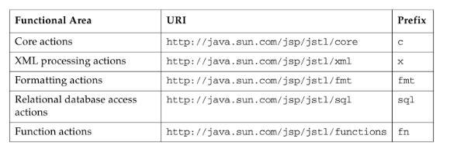
JSTL Tags

Slide 19



Stay connected
About us: Emertxe is India’s one of the top IT finishing schools & self learning kits provider. Our primary focus is on Embedded with diversification focus on Java, Oracle and Android areas
Emertxe Information Technologies,
No-1, 9th Cross, 5th Main,
Jayamahal Extension,
Bangalore, Karnataka 560046
T: +91 80 6562 9666
E: training@emertxe.com
https://www.facebook.com/Emertxe
https://twitter.com/EmertxeTweet
https://www.slideshare.net/EmertxeSlides

Slide 20
Thank You

