Slide 1

Web Component Development with Servlet & JSP Technologies (EE 6)
Module-9: More Controller Facilities
Team Emertxe

Slide 2
Objectives
Upon completion of this module, you should be able to:
Understand the lifecycle of a servlet
Understand the threading model of a servlet
Write filters and apply them to groups of servlets or JSPs handle multipart form data

Slide 3
Relevance
Discussion – The following questions are relevant to understanding what technologies are available for developing web applications and the limitations of those technologies:
How are servlets loaded, when, and how many instances are created?
What happens when mulitple clients request service from the same servlet concurrently?
What happens when a piece of behavior should be applied to multiple pages? Does the code have to be duplicated in multiple servlets?

Slide 4
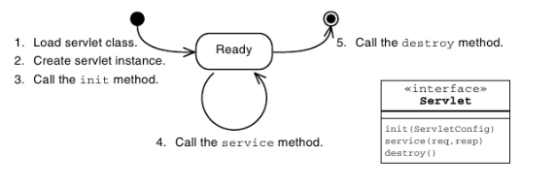
Servlet Life Cycle Overview

Slide 5
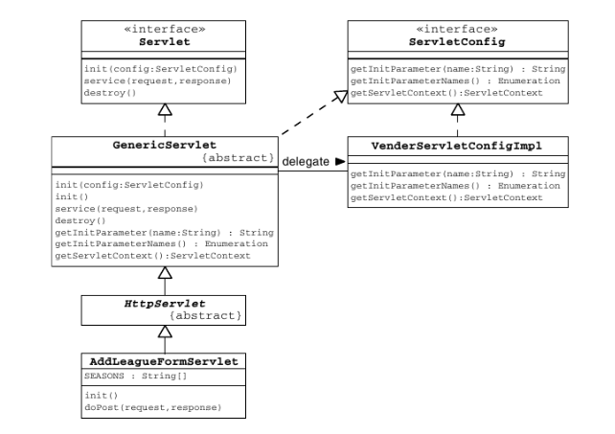
The ServletConfig API

Slide 6
Servlet Lifecycle and Annotations
Java EE 5 introduced some key annotations for container managed objects. In the web container, these objects are Servlets, Filters, and many listeners.
A variety of annotations provide dependency injection for different resource types. Some of these are listed below:
@EJB
@Resource
@PersistenceContext
@PersistenceUnit
@WebServiceRef

Slide 7
Lifecycle Method Annotations
The Java EE specification requires that objects that qualifies dependency injection must also be supported with two lifecycle annotations. These are @PostConstruct and @PreDestroy. These methods are very similar in function to the init() and destroy() methods of a servlet.
If an @PostConstruct method throws any exceptions the container must abandon the object. No methods may be called on the object and the object must not be put into service.

Slide 8
Servlets and Threading
If multiple clients invoke behavior that calls the same method, in the same servlet instance, at the same time, then that one servlet method (in a single servlet instance), might be concurrently executing many times under the control of many different threads—one thread for each client.

Slide 9
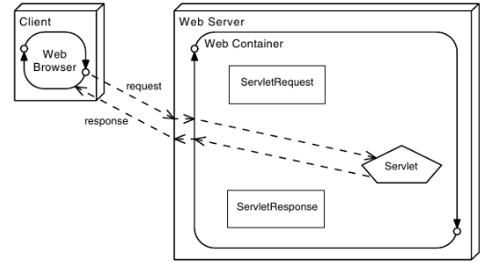
Web Container Request Cycle

Slide 10
Applying Filters to an Incoming Request
Filters are components that you can write and configure to perform some additional pre-processing and post-processing tasks. When a request is received by the web container, several operations occur:
1. The web container performs its pre-processing of the request. What happens during this step is the responsibility of the container provider.
2. The web container checks if any filter has a URL pattern that matches the URL requested.
3. The web container locates the first filter with a matching URL pattern. The filter’s code is executed.

Slide 11
Applying Filters to an Incoming Request
4. If another filter has a matching URL pattern, its code is then executed. This continues until there are no more filters with matching URL patterns.
5. If no errors occur, the request passes to the target servlet. 6. The servlet passes the response back to its caller. The last filter that was applied to the request is the first filter applied to the response.
7. The first filter originally applied to the request passes the response to the web container. The web container might perform post-processing tasks on the response.

Slide 12
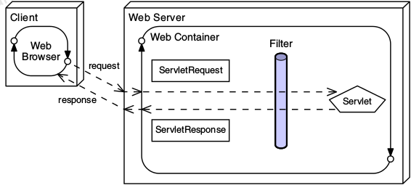
Applying Filters to an Incoming Request

Slide 13
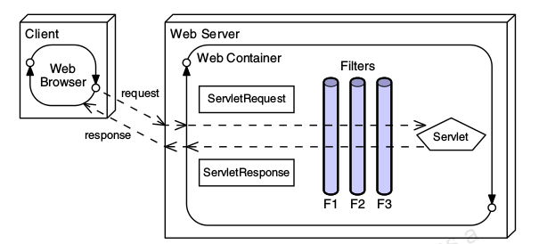
Applying Filters to an Incoming Request

Slide 14
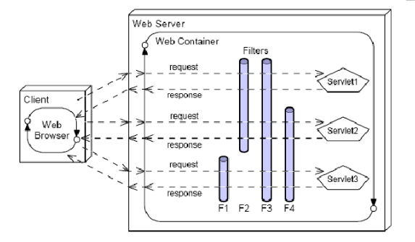
Modular Use of Filters

Slide 15

Applying Filters
Filters can be used for operations such as:
Blocking access to a resource based on user identity or role membership
Auditing incoming requests
Compressing the response data stream
Transforming the response
Measuring and logging servlet performance

Slide 16
Filter API
The Filter API is part of the base servlet API. The interfaces can be found in the javax.servlet package.

Slide 17
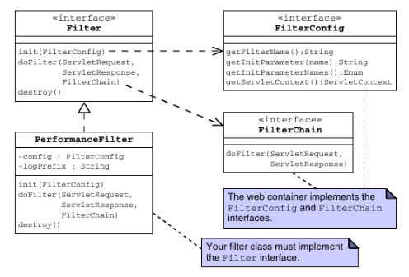
Filter API

Slide 18
The init() method of Filter API
public void init(FilterConfig config)
init() method is invoked only once. It is used to initialize the filter.

Slide 19
The doFilter() Method
public void doFilter(HttpServletRequest request,HttpServletResponse response, FilterChain chain)
doFilter() method is invoked every time when user request to any resource, to which the filter is mapped.It is used to perform filtering tasks.

Slide 20
The destroy() method of Filter API
public void destroy()
This is invoked only once when filter is taken out of the service.

Slide 21
Configuring the Filter
Configuring a Filter Using Annotations:
The annotation is @WebFilter, and this allows specification of the
filter name, the url patterns to which it responds, and the types of
invocation for which it should be invoked. The annotation also allows the specification of init parameters.

Slide 22
Configuring the Filter
Configuring a filter using web.xml:
<web-app>
<filter>
<filter-name>...</filter-name>
<filter-class>...</filter-class>
</filter>
<filter-mapping>
<filter-name>...</filter-name>
<url-pattern>...</url-pattern>
</filter-mapping>
</web-app>

Slide 23
Simple example of filter
public class MyFilter implements Filter{
public void init(FilterConfig arg0) throws ServletException {}
public void doFilter(ServletRequest req, ServletResponse resp,
FilterChain chain) throws IOException, ServletException {
PrintWriter out=resp.getWriter();
out.print("filter is invoked before");
chain.doFilter(req, resp);//sends request to next resource
out.print("filter is invoked after");
}
public void destroy() {}
}

Slide 24
Handling Multipart Forms
Java EE 6 introduced a mechanism to simplify handling of multipart form data. Three key elements make this up, which are: additional methods in the javax.servlet.http.HttpServletRequest object, an annotation javax.servlet.annotation.MultipartConfig, and an interface
javax.servlet.http.Part

Slide 25



Stay connected
About us: Emertxe is India’s one of the top IT finishing schools & self learning kits provider. Our primary focus is on Embedded with diversification focus on Java, Oracle and Android areas
Emertxe Information Technologies,
No-1, 9th Cross, 5th Main,
Jayamahal Extension,
Bangalore, Karnataka 560046
T: +91 80 6562 9666
E: training@emertxe.com
https://www.facebook.com/Emertxe
https://twitter.com/EmertxeTweet
https://www.slideshare.net/EmertxeSlides

Slide 26
Thank You

