Slide 1

Web Component Development with Servlet & JSP Technologies (EE 6)
Module-12: Implementing Security
Team Emertxe

Slide 2
Objectives
Upon completion of this module, you should be able to:
Describe a common failure mode in security
Require that a user log in before accessing specific pages in your web application
Describe the Java EE security model
Require SSL encrypted communication for certain URLs or servlets

Slide 3
Relevance
Discussion – The following question is relevant to understanding what technologies are available for developing web applications and the limitations of those technologies:
If your application uses data that are private to your company or your users, how can you be sure that malicious users cannot inappropriately access or modify those data?

Slide 4

Security Considerations
Every application that is accessible over the web must consider security. Your site must be protected from attack, the private data of your site’s users must be kept confidential, and your site must also protect the browsers and computers used to access your site.
This module introduces the following kwy points:
Confusion of code and data
Encryption of data in transit over the network
Authentication and authorization of users

Slide 5
Confusion of Code and Data: SQL Injection Example
Your application might take the text of the item code, provided by the user, and paste it into an SQL statement like this:
SELECT count from ITEMTABLE where itemcode=”XXXXXX”;
In this case, the XXXXXX would be replaced using the data provided by the user in the field of the form.
This looks fine so far, but consider what happens if the user provides the following as the itemCode field in the form:
unk”; DROP TABLE ITEMTABLE;

Slide 6
Confusion of Code and Data: SQL Injection Example
Now the result of pasting this “data” into the query is this:
SELECT count from ITEMTABLE where itemcode=”unk”; DROP
TABLE ITEMTABLE;”;

Slide 7
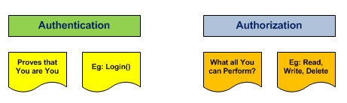
Authentication and Authorization
The application usually needs to be able to identify the user, decide what operations the user is allowed to perform, and maintain the confidentiality and the integrity of the data that is in transit.

Slide 8
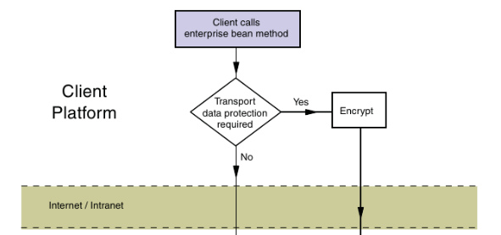
Authentication and Authorization

Slide 9
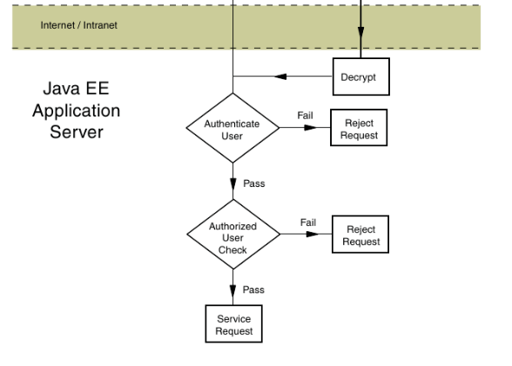
Authentication and Authorization

Slide 10
Authenticating the Caller
Caller authentication is the process of verifying what the user’s identity is, and consists of the following two steps.
Determine the identity claimed by the user
Verify that the user is who they claim to be (Authenticate the user)

Slide 11
Establishing User Identities
The process of caller authentication requires that users of an application be known in advance to the security system. The Java EE specification recognizes the following two types of user identities:
Principals: A principal is an authenticated user in the application security domain. That is, a principal is identifyable to, and can be authenticated by, a JAAS authentication mechanism deployed in the web container.
Roles: When writing an application, the users, and the principals to which they will map, are usually not known. Nevertheless, you must design a security model that will specify that certain categories of user will have certain rights and be denied other rights.

Slide 12
Examining the Java EE Authorization Strategies
The primary purpose of the Java EE security model is to control access to business services and resources in the application.
The Java EE security model provides two complementary strategies for access control:
Programmatic access control and declarative access control.
Both strategies assume that the user has been authenticated by the application server, and the roles of which the user is a member can therefore be determined by the web container.

Slide 13
Using Declarative Authorization
Declarative authorization for web applications involves the following
Tasks:
Collection of user credentials into a credentials database
Declaration of roles
Mapping users to roles
Specification of role requirements for access to URLs

Slide 14
Creating a Credential Database
Creating the collection of user credential is entirely dependent on the web containerin use. The lab for tis module will show you the most basic way to achieve this in Netbeans/ Glassfish you are using.

Slide 15
Declaring Security Roles
Security roles are declared in the web.xml deployment descriptor, using the <security-role> element.
This element lives at the first level of the web.xml file, as a direct child of the <web-app> element.
<security-role>
<description>...</description>
<role-name>...</role-name>
</security-role>

Slide 16
Mapping Users to Roles
<security-role-mapping>
<role-name>Customer</role-name>
<principal-name>Alice</principal-name>
<principal-name>Maverick</principal-name>
</security-role-mapping>

Slide 17
Using Programmatic Authorization
Programmatic authorization is the responsibility of the bean developer.
The following methods in the HttpServletRequest support programmatic authorization:
boolean isUserInRole(String role)
Principal getUserPrincipal()
Programmatic authorization is more expressive than the declarative approach, but is more cumbersome to maintain, and because of the additional complexity, more error prone.

Slide 18

Enforcing Encrypted Transport
Provided the server has been configured with a public key certificate, you can require that communication between client and server be encrypted.
In this case, an additional element, <user-data-constraint> will be added in the web.xml file

Slide 19



Stay connected
About us: Emertxe is India’s one of the top IT finishing schools & self learning kits provider. Our primary focus is on Embedded with diversification focus on Java, Oracle and Android areas
Emertxe Information Technologies,
No-1, 9th Cross, 5th Main,
Jayamahal Extension,
Bangalore, Karnataka 560046
T: +91 80 6562 9666
E: training@emertxe.com
https://www.facebook.com/Emertxe
https://twitter.com/EmertxeTweet
https://www.slideshare.net/EmertxeSlides

Slide 20
Thank You

