Slide 1

Java Programming Language SE – 6
Module 1: Getting Started

Slide 2
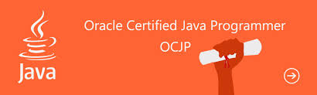
Objectives
Upon completion of this module, you should be able to:
Describe the key features of Java technology
Write, compile and run simple java application
Describe the function of the Java virtual machine
Define garbage collection
List the three task perform by Java that handle code security

Slide 3
Relevance
Is the Java programming language a complete language or is it useful only for writing programs for the Web?
Why do you need another programming language?
How does the Java technology platform improve on other language platforms?
This material also serves as a guide for Oracle Certified Java Professional (OCJP), by making the flow in alignment with prescribed syllabus

Slide 4
What is Java Technology?
Java technology is:
  A programming language
  A development environment
  An application environment
  A deployment environment
It is similar in syntax to C++.
It is used for developing both applets and applications.
Thanks to its scalable nature, Java has emerged as the most preferred language in Web and Mobile application development

Slide 5
Primary Goals of the
Java Technology
Provides an easy-to-use language by:
  Avoiding many pitfalls of other languages
  Being object-oriented
  Enabling users to create streamlined and clear code
Provides an interpreted environment for:
  Improved speed of development
  Code portability

Slide 6
Primary Goals of the
Java Technology
Enables users to run more than one thread of activity
Loads classes dynamically; that is, at the time they are actually needed
Supports changing programs dynamically during runtime by loading classes from disparate sources
Furnishes better security

Slide 7
Primary Goals of the
Java Technology
The following features fulfill these goals:
The Java Virtual Machine (JVMTM) 1
Garbage collection
The Java Runtime Environment (JRE)
JVM tool interface

Slide 8
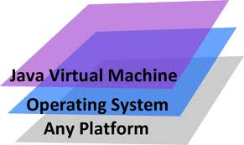
The Java Virtual Machine
Provides hardware platform specifications
Reads compiled byte codes that are platform-independent
Is implemented as software or hardware
Is implemented in a Java technology development tool or a Web browser
The Java Virtual Machine(JVM) make the code run in any platform, thereby making it platform independent

Slide 9
The Java Virtual Machine
JVM provides definitions for the:
Instruction set (central processing unit [CPU])
Register set
Class file format
Stack
Garbage-collected heap
Memory area
Fatal error reporting
High-precision timing support

Slide 10
The Java Virtual Machine
The majority of type checking is done when the code is compiled.
Implementation of the JVM approved by Sun Microsystems must be able to run any compliant class file.
The JVM executes on multiple operating environments.

Slide 11
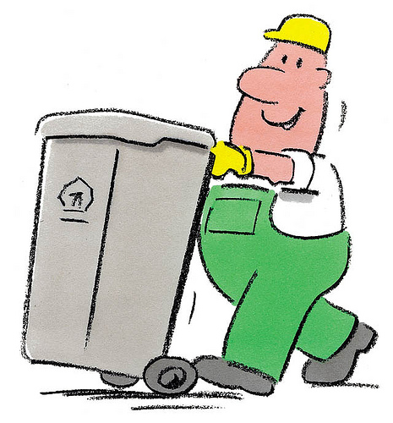
Garbage Collection
Allocated memory that is no longer needed should be deallocated.
In other languages, deallocation is the programmer’s responsibility.
The Java programming language provides a system-level thread to track memory allocation.

Slide 12
Garbage Collection
Garbage collection has the following characteristics:
Checks for and frees memory no longer needed
Is done automatically
Can vary dramatically across JVM implementations

Slide 13
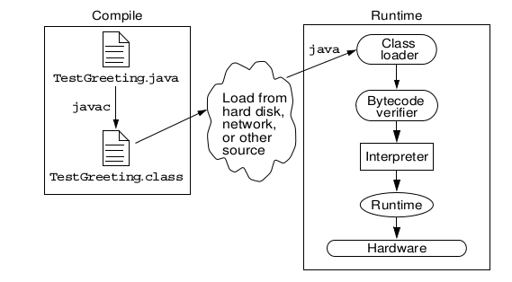
The Java Runtime
Environment

Slide 14
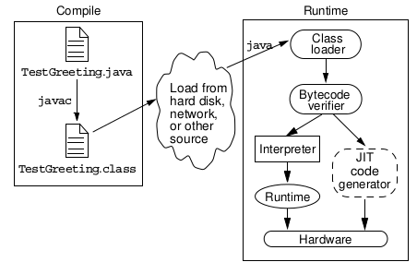
JRE With a Just-In-Time
(JIT) Compiler

Slide 15
JVM Tasks
The JVM performs three main tasks:
Loads code
Verifies code
Executes code

Slide 16
The Class Loader
Loads all classes necessary for the execution of a program
Maintains classes of the local file system in separate namespaces
Prevents spoofing

Slide 17
The Bytecode Verifier
The code adheres to the JVM specification.
The code does not violate system integrity.
The code causes no operand stack overflows or underflows.
The parameter types for all operational code are
correct.
No illegal data conversions (the conversion of integers to pointers) have occurred.

Slide 18
A Simple Java Application
The TestGreeting.java Application
//
// Sample "Hello World" application
//
public class TestGreeting{
public static void main (String[] args) {
Greeting hello = new Greeting();
hello.greet();
}
}

Slide 19
A Simple Java Application
The Greeting.java Class
public class Greeting {
public void greet() {
System.out.println(“hi”);
}
}

Slide 20
Compiling and Running the TestGreeting Program
Compile TestGreeting.java:
javac TestGreeting.java
The Greeting.java is compiled automatically.
Run the application by using the following command:
java TestGreeting
Locate common compile and runtime errors.

Slide 21
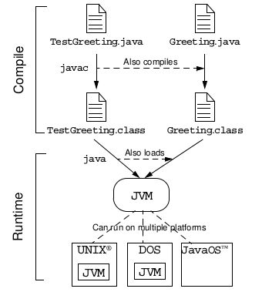
Java Technology Runtime
Environment

Slide 22



Stay connected
About us: Emertxe is India’s one of the top IT finishing schools & self learning kits provider. Our primary focus is on Embedded with diversification focus on Java, Oracle and Android areas
Emertxe Information Technologies,
No-1, 9th Cross, 5th Main,
Jayamahal Extension,
Bangalore, Karnataka 560046
T: +91 80 6562 9666
E: training@emertxe.com
https://www.facebook.com/Emertxe
https://twitter.com/EmertxeTweet
https://www.slideshare.net/EmertxeSlides

Slide 23
Thank You

