Slide 1

Java Programming Language SE – 6
Module 2 : Object-Oriented Programming

Slide 2

Objectives
Define object modeling concepts: abstraction,encapsulation and packages
Discuss why you can reuse Java technology application code
Define class, member, attribute, method, constructor, and package
Use the access modifiers private and public as appropriate for the guidelines of encapsulation
Invoke a method on a particular object
Use the Java technology application programming interface (API) online documentation

Slide 3
Relevance
What is your understanding of software analysis and design?
What is your understanding of design and code reuse?
What features does the Java programming language possess that make it an object-oriented language?
Define the term object-oriented.

Slide 4
Software Engineering

Slide 5
The Analysis and
Design Phase
Analysis describes what the system needs to do:
  Modeling the real-world, including actors and activities, objects, and behaviors
Design describes how the system does it:
  Modeling the relationships and interactions between objects and actors in the system
  Finding useful abstractions to help simplify the problem or solution

Slide 6
Abstraction
Functions – Write an algorithm once to be used in many situations
Objects – Group a related set of attributes and behaviors into a class
Frameworks and APIs – Large groups of objects that support a complex activity; Frameworks can be used as is or be modified to extend the basic behavior

Slide 7
Classes as Blueprints for
Objects
In manufacturing, a blueprint describes a device from which many physical devices are constructed.
In software, a class is a description of an object:
  A class describes the data that each object includes.
  A class describes the behaviors that each object
  exhibits.

Slide 8
Classes as Blueprints for
Objects
In Java technology, classes support three key features of object-oriented programming (OOP):
  Encapsulation
  Inheritance
  Polymorphism

Slide 9
Declaring Java Technology
Classes
Basic syntax of a Java class:
<modifier>* class <class_name> {
<attribute_declaration>*
<constructor_declaration>*
<method_declaration>*
}

Slide 10
Declaring Java Technology
Classes
public class Vehicle {
private double maxLoad;
public void setMaxLoad(double value) {
maxLoad = value;
}
}

Slide 11
Declaring Attributes
Basic syntax of an attribute:
<modifier>* <type> <name> [ = <initial_value>];
Examples:
public class Foo {
private int x;
private float y = 10000.0F;
private String name = "Bates Motel";
}

Slide 12
Declaring Methods
Basic syntax of a method:
<modifier>* <return_type> <name> ( <argument>* ) {
<statement>*
}

Slide 13
Declaring Methods
public class Dog {
private int weight;
public int getWeight() {
return weight;
}
public void setWeight(int newWeight) {
if ( newWeight > 0 ) {
weight = newWeight;
}
}

Slide 14
Accessing Object Members
The dot notation is: <object>.<member>
This is used to access object members, including attributes and methods.
Examples of dot notation are:
d.setWeight(42);
d.weight = 42; // only permissible if weight is public

Slide 15
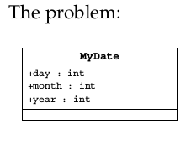
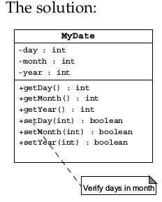
Information Hiding

Slide 16
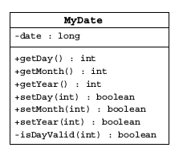
Encapsulation
Hides the implementation details of a class
Forces the user to use an interface to access data
Makes the code more maintainable

Slide 17
Declaring Constructors
Basic syntax of a constructor:
[<modifier>] <class_name> ( <argument>* ) {
<statement>*
}
Example:
public class Dog {
private int weight;
public Dog() {
weight = 42;
}
}

Slide 18
The Default Constructor
There is always at least one constructor in every class.
If the writer does not supply any constructors, the default constructor is present automatically:
  The default constructor takes no arguments
  The default constructor body is empty
The default enables you to create object instances with new Xxx()without having to write a constructor.

Slide 19
Source File Layout
Basic syntax of a Java source file is:
[<package_declaration>]
<import_declaration>*
<class_declaration>+

Slide 20
Source File Layout
package shipping.reports;
import shipping.domain.*;
import java.util.List;
import java.io.*;
public class VehicleCapacityReport {
private List vehicles;
public void generateReport(Writer output) {...}
}

Slide 21
Software Packages
Packages help manage large software systems.
Packages can contain classes and sub-packages.

Slide 22
The package Statement
Basic syntax of the package statement is: package
  <top_pkg_name>[.<sub_pkg_name>]*;
Examples of the statement are:
  package shipping.gui.reportscreens;
Specify the package declaration at the beginning of the source file.
Only one package declaration per source file.
If no package is declared, then the class is placed into the default package.
Package names must be hierarchical and separated by dots.

Slide 23
The import Statement
Basic syntax of the import statement is:
Import<pkg_name>[.<sub_pkg_name>]*.<class_name>;
OR
import<pkg_name>[.<sub_pkg_name>]*.*;
Examples of the statement are:
import java.util.List;
import java.io.*;
import shipping.gui.reportscreens.*;

Slide 24
The import Statement
The import statement does the following:
Precedes all class declarations
Tells the compiler where to find classes

Slide 25
Compiling Using the -d
Option
cd JavaProjects/ShippingPrj/src
javac -d ../classes shipping/domain/*.java

Slide 26
Recap
Class – The source-code blueprint for a run-time object
Object – An instance of a class;
also known as instance
Attribute – A data element of an object;
also known as data member, instance variable, and data field
Method – A behavioral element of an object;
also known as algorithm, function, and procedure

Slide 27
Recap
Constructor – A method-like construct used to initialize a new object
Package – A grouping of classes and sub-packages

Slide 28
Java Technology API
Documentation
A set of Hypertext Markup Language (HTML) files provides information about the API.
A frame describes a package and contains hyperlinks to information describing each class in that package.
A class document includes the class hierarchy, a description of the class, a list of member variables, a list of constructors, and so on.

Slide 29
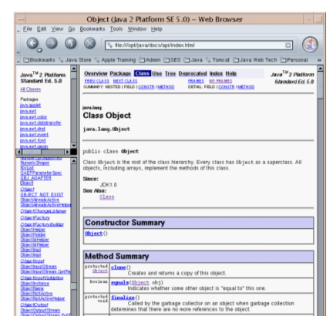
Java Technology API
Documentation

Slide 30



Stay connected
About us: Emertxe is India’s one of the top IT finishing schools & self learning kits provider. Our primary focus is on Embedded with diversification focus on Java, Oracle and Android areas
Emertxe Information Technologies,
No-1, 9th Cross, 5th Main,
Jayamahal Extension,
Bangalore, Karnataka 560046
T: +91 80 6562 9666
E: training@emertxe.com
https://www.facebook.com/Emertxe
https://twitter.com/EmertxeTweet
https://www.slideshare.net/EmertxeSlides

Slide 31
Thank You

