Slide 1

Java Programming Language SE – 6
Module 4 : Expressions and Flow Control

Slide 2
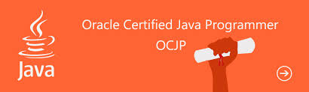
Objectives
Distinguish between instance and local variables
Describe how to initialize instance variables
Identify and correct a Possible reference before
assignment compiler error
Recognize, describe, and use Java software operators
Distinguish between legal and illegal assignments of
primitive types

Slide 3
Objectives
Identify boolean expressions and their requirements in control constructs
Recognize assignment compatibility and required casts in fundamental types
Use if, switch, for, while, and do constructions and the labelled forms of break and continue as flow control structures in a program

Slide 4
Relevance
What types of variables are useful to programmers?
Can multiple classes have variables with the same name and, if so, what is their scope?
What types of control structures are used in other languages? What methods do these languages use to control flow?

Slide 5
Variables and Scope
Local variables are:
Variables that are defined inside a method and are called local, automatic, temporary, or stack variables
Variables that are created when the method is executed are destroyed when the method is exited
Variable initialization comprises the following:
Local variables require explicit initialization.
Instance variables are initialized automatically.

Slide 6
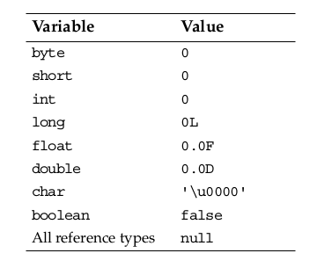
Variable Initialization

Slide 7
Initialization Before
Use Principle
The compiler will verify that local variables have been initialized before used.
int x=8;
int y;
int z;
z=x+y;

Slide 8
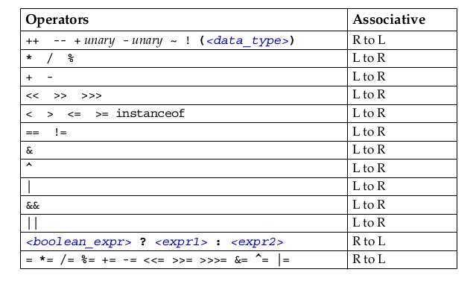
Operator Precedence

Slide 9
Logical Operators
The boolean operators are:
  ! – NOT
  | – OR
  & – AND
  ^ – XOR
The short-circuit boolean operators are:
  && – AND
  || – OR

Slide 10
Logical Operators
You can use these operators as follows:
MyDate d = reservation.getDepartureDate();
if ( (d != null) && (d.day > 31) {
// do something with d
}

Slide 11
Bitwise Logical Operators
The integer bitwise operators are:
  ~ – Complement
  ^ – XOR
  & – AND
  | – OR

Slide 12
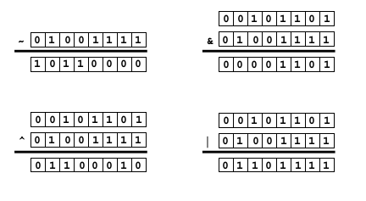
Bitwise Logical Operators:
Example

Slide 13
Right-Shift Operators >> and >>>
Arithmetic or signed right shift ( >> ) operator:
Examples are:
  128 >> 1 returns 128/2 1 = 64
  256 >> 4 returns 256/2 4 = 16
  -256 >> 4 returns -256/2 4 = -16
The sign bit is copied during the shift.
Logical or unsigned right-shift ( >>> ) operator:
  This operator is used for bit patterns.
  The sign bit is not copied during the shift.

Slide 14
Left-Shift Operator <<
Left-shift ( << ) operator works as follows:
  128 << 1 returns 128 * 2 1 = 256
  16 << 2 returns 16 * 2 2 = 64

Slide 15
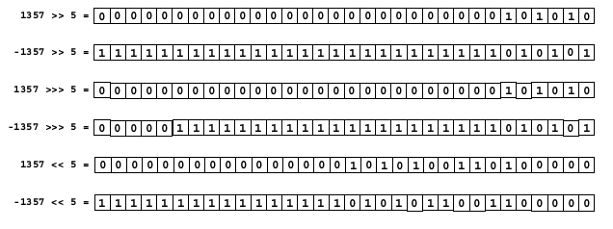
Shift Operator Examples

Slide 16
String Concatenation With +
The + operator works as follows:
  Performs String concatenation
  Produces a new String:
  String salutation = "Dr.";
  String name = "Pete" + " " + "Seymour";
  String title = salutation + " " + name;

Slide 17
Casting
If information might be lost in an assignment, the programmer must confirm the assignment with a cast.
The assignment between long and int requires an explicit cast.
long bigValue = 99L;
int squashed = bigValue;// Wrong, needs a cast
int squashed = (int) bigValue; // OK
int squashed = 99L;// Wrong, needs a cast
int squashed = (int) 99L;// OK, but...
int squashed = 99; // default integer literal

Slide 18
Promotion and Casting of Expressions
Variables are promoted automatically to a longer form (such as int to long).
Expression is assignment-compatible if the variable type is at least as large
long bigval = 6;// 6 is an int type, OK
int smallval = 99L; // 99L is a long, illegal
double z = 12.414F;// 12.414F is float, OK
float z1 = 12.414; // 12.414 is double, illegal

Slide 19
Simple if, else Statements
The if statement syntax:
if ( <boolean_expression> )
<statement_or_block>
Example:
if ( x < 10 )
System.out.println("Are you finished yet?");
or (recommended):
if ( x < 10 ) {
System.out.println("Are you finished yet?");
}

Slide 20
Complex if, else Statements
The if-else statement syntax:
if ( <boolean_expression> )
<statement_or_block>
else
<statement_or_block>
Example:
if ( x < 10 ) {
System.out.println("Are you finished yet?");
} else {
System.out.println("Keep working...");
}

Slide 21
Complex if, else Statements
The if-else-if statement syntax:
if ( <boolean_expression> )
<statement_or_block>
else if ( <boolean_expression> )
<statement_or_block>

Slide 22
if-else-if statement: Example
Example:
int count = getCount(); // a method defined in the class
if (count < 0) {
System.out.println("Error: count value is negative.");
} else if (count > getMaxCount()) {
System.out.println("Error: count value is too big.");
} else {
System.out.println("There will be " + count +
" people for lunch today.");
}

Slide 23
Switch Statements
The switch statement syntax:
switch ( <expression> ) {
case <constant1>:
<statement_or_block>*
[break;]
case <constant2>:
<statement_or_block>*
[break;]
default:
<statement_or_block>*
[break;]
}

Slide 24
Switch Statement Example
String carModel = ”STANDARD”;
switch ( carModel ) {
case DELUXE:
System.out.println(“DELUXE”);
break;
case STANDARD:
System.out.println(“Standard”);
break;
default:
System.out.println(“Default”);
}

Slide 25
Switch Statements
Without the break statements, the execution falls through each subsequent case clause.

Slide 26
For Loop
The for loop syntax:
for ( <init_expr>; <test_expr>; <alter_expr> )
<statement_or_block>

Slide 27
For Loop Example
for ( int i = 0; i < 10; i++ )
System.out.println(i + " squared is " + (i*i));
or (recommended):
for ( int i = 0; i < 10; i++ ) {
System.out.println(i + " squared is " + (i*i));
}

Slide 28
While Loop
The while loop syntax:
while ( <test_expr> )
<statement_or_block>

Slide 29
While Loop Example
Example:
int i = 0;
while ( i < 10 ) {
System.out.println(i + " squared is " + (i*i));
i++;
}

Slide 30
The do/while Loop
The do/while loop syntax:
do
<statement_or_block>
while ( <test_expr> );

Slide 31
The do/while Loop:
Example
Example:
int i = 0;
do {
System.out.println(i + " squared is " + (i*i));
i++;
} while ( i < 10 );

Slide 32
Special Loop Flow
Control
The break [<label>]; command
The continue [<label>]; command
The <label> : <statement> command, where <statement> should be a loop

Slide 33
The break Statement
do {
statement;
if ( condition ) {
break;
}
statement;
} while ( test_expr );

Slide 34
The continue Statement
do {
statement;
if ( condition ) {
continue;
}
statement;
} while ( test_expr );

Slide 35

Using break Statements with Labels
outer:
do {
statement1;
do {
statement2;
if ( condition ) {
break outer;
}
statement3;
} while ( test_expr );
statement4;
} while ( test_expr );

Slide 36
Using continue Statements with Labels
test:
do {
statement1;
do {
statement2;
if ( condition ) {
continue test;
}
statement3;
} while ( test_expr );
statement4;
} while ( test_expr );

Slide 37



Stay connected
About us: Emertxe is India’s one of the top IT finishing schools & self learning kits provider. Our primary focus is on Embedded with diversification focus on Java, Oracle and Android areas
Emertxe Information Technologies,
No-1, 9th Cross, 5th Main,
Jayamahal Extension,
Bangalore, Karnataka 560046
T: +91 80 6562 9666
E: training@emertxe.com
https://www.facebook.com/Emertxe
https://twitter.com/EmertxeTweet
https://www.slideshare.net/EmertxeSlides

Slide 38
Thank You

