Slide 1

Java Programming Language SE – 6
Module 5 : Arrays

Slide 2

Objectives
Declare and create arrays of primitive, class, or array types
Explain why elements of an array are initialized
Explain how to initialize the elements of an array
Determine the number of elements in an array
Create a multidimensional array
Write code to copy array values from one array to another

Slide 3
Relevance
What is the purpose of an array?

Slide 4
Declaring Arrays
Group data objects of the same type.
Declare arrays of primitive or class types:
char s[];
Point p[];
char[] s;
Point[] p;
Create space for a reference.
An array is an object; it is created with new.

Slide 5
Creating Arrays
Use the new keyword to create an array object.
For example, a primitive (char) array:
public char[] createArray() {
char[] s;
s = new char[26];
for ( int i=0; i<26; i++ ) {
s[i] = (char) (’A’ + i);
}
return s;
}

Slide 6
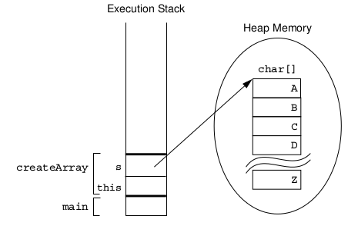
Creating an Array of
Character Primitives

Slide 7
Creating Reference Arrays
Another example, an object array:
public Point[] createArray() {
Point[] p;
p = new Point[10];
for ( int i=0; i<10; i++ ) {
p[i] = new Point(i, i+1);
}
return p;
}

Slide 8
Initializing Arrays
Initialize an array element.
Create an array with initial values.
String[] names;
names = new String[3];
names[0] = "Georgianna";
names[1] = "Jen";
names[2] = "Simon";

Slide 9
Multidimensional Arrays
Arrays of arrays:
int[][] twoDim = new int[4][];
twoDim[0] = new int[5];
twoDim[1] = new int[5];
int[][] twoDim = new int[][4]; // illegal
Array of four arrays of five integers each:
int[][] twoDim = new int[4][5];

Slide 10
Array Bounds
All array subscripts begin at 0:
public void printElements(int[] list) {
for (int i = 0; i < list.length; i++) {
System.out.println(list[i]);
}
}

Slide 11
Using the Enhanced for Loop
Java 2 Platform, Standard Edition (J2SETM) version 5.0 introduced an enhanced for loop for iterating over arrays:
public void printElements(int[] list) {
for ( int element : list ) {
System.out.println(element);
}
}

Slide 12
Array Resizing
You cannot resize an array.
You can use the same reference variable to refer to an entirely new array, such as:
int[] myArray = new int[6];
myArray = new int[10];

Slide 13
Copying Arrays
The System.arraycopy() method to copy arrays is:
//original array
int[] myArray = { 1, 2, 3, 4, 5, 6 };
// new larger array
int[] hold = { 10, 9, 8, 7, 6, 5, 4, 3, 2, 1 };
// copy all of the myArray array to the hold
// array, starting with the 0th index
System.arraycopy(myArray, 0, hold, 0, myArray.length);

Slide 14



Stay connected
About us: Emertxe is India’s one of the top IT finishing schools & self learning kits provider. Our primary focus is on Embedded with diversification focus on Java, Oracle and Android areas
Emertxe Information Technologies,
No-1, 9th Cross, 5th Main,
Jayamahal Extension,
Bangalore, Karnataka 560046
T: +91 80 6562 9666
E: training@emertxe.com
https://www.facebook.com/Emertxe
https://twitter.com/EmertxeTweet
https://www.slideshare.net/EmertxeSlides

Slide 15
Thank You

