Slide 1

Java Programming Language SE – 6
Module 6 : Class Design

Slide 2

Objectives
Define inheritance, polymorphism, overloading, overriding, and virtual method invocation
Use the access modifiers protected and the default
(package-friendly)
Describe the concepts of constructor and method overloading
Describe the complete object construction and initialization operation

Slide 3
Relevance
How does the Java programming language support object
inheritance?

Slide 4
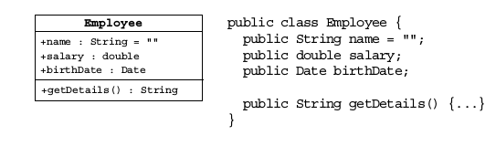
Subclassing
The Employee class is shown here.

Slide 5
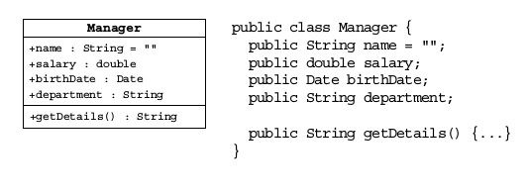
Subclassing
The Manager class is shown here.

Slide 6
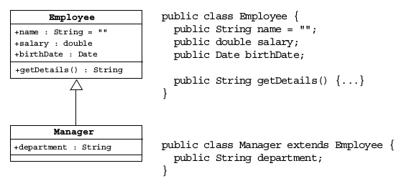
Employee and Manager
Using Inheritance

Slide 7
Single Inheritance
When a class inherits from only one class, it is called
single inheritance.
Interfaces provide the benefits of multiple inheritance
without drawbacks.
Syntax of a Java class is as follows:
<modifier> class <name> [extends <superclass>] {
<declaration>*
}

Slide 8
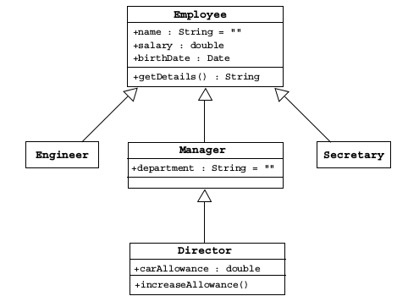
Single Inheritance

Slide 9
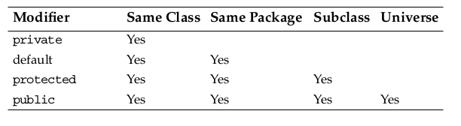

Access Control
Access modifiers on class member declarations are listed here.

Slide 10
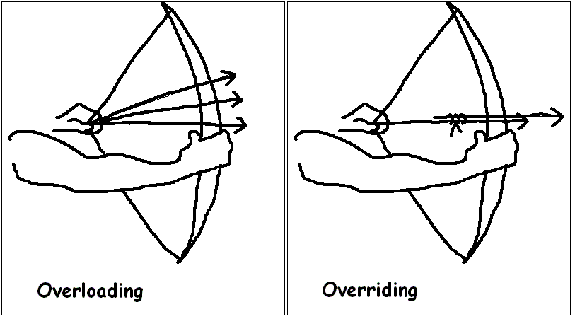
Overriding Methods
A subclass can modify behavior inherited from a parent class.
A subclass can create a method with different functionality than the parent’s method but with the same:
  Name
  Return type
  Argument list

Slide 11
Overriding Methods
public class Employee {
protected String name;
protected double salary;
protected Date birthDate;
Public String getDetails(){
Return “Name:”+name+”\n”+”Salary:”+salary;
}
}

Slide 12
Overriding Methods
public class Manager extends Employee {
protected String department;
public String getDetails() {
return “Name: “ + name + “\n” +
“Salary: “ + salary +”\n” +”Manager of:”+ department;
}
}

Slide 13
Rules of Method Overriding
Overridden methods can't be less accessible.
public class Parent {
public void doSomething() {}
}
public class Child extends Parent {
private void doSomething() {} // illegal
}

Slide 14
Invoking Overridden
Methods
A subclass method may invoke a superclass method using the super keyword:
The keyword super is used in a class to refer to its superclass.
The keyword super is used to refer to the members of superclass, both data attributes and methods.
Behavior invoked does not have to be in the superclass; it can be further up in the hierarchy.

Slide 15
Invoking Overridden
Methods
public class Employee {
protected String name;
protected double salary;
protected Date birthDate;
public String getDetails(){
return “Name:”+name+”\n”+”Salary:”+salary;
}
}

Slide 16
Invoking Overridden
Methods
public class Manager extends Employee {
protected String department;
public String getDetails() {
//call parent method
return super.getDetails()+”\nDepartment:”+ department;
}
}

Slide 17
Polymorphism
Polymorphism is the ability to have many different forms; for example, the Manager class has access to methods from Employee class.
An object has only one form.
A reference variable can refer to objects of different forms.

Slide 18
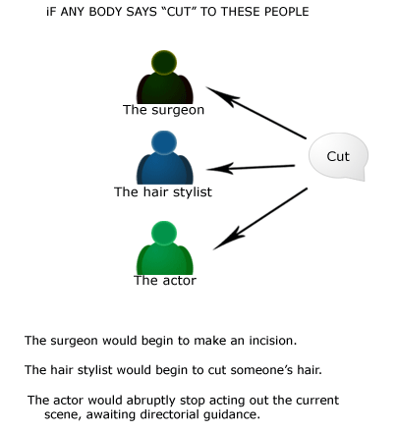
Polymorphism

Slide 19
Polymorphism
Employee e = new Manager(); // legal
// illegal attempt to assign Manager attribute
e.department = "Sales";
// the variable is declared as an Employee type,
// even though the Manager object has that attribute

Slide 20
Virtual Method Invocation
Virtual method invocation is performed as follows:
Employee e = new Manager();
e.getDetails();
Compile-time type and runtime type invocations have the following characteristics:
The method name must be a member of the declared variable type; in this case Employee has a method called getDetails.
The method implementation used is based on the runtime object’s type; in this case the Manager class has an implementation of the getDetails method.

Slide 21

Homogeneous Collections
Collections of objects with the same class type are called homogeneous collections. For example:
MyDate[] dates = new MyDate[2];
dates[0] = new MyDate(22, 12, 1964);
dates[1] = new MyDate(22, 7, 1964);

Slide 22
Heterogeneous Collections
Collections of objects with different class types are called heterogeneous collections. For example:
Employee [] staff = new Employee[1024];
staff[0]= new Manager();
staff[1]= new Employee();
staff[2]= new Engineer();

Slide 23
Polymorphic Arguments
Because a Manager is an Employee, the following is valid:
public class TaxService {
public TaxRate findTaxRate(Employee e) {
// calculate the employee’s tax rate
}}
// Meanwhile, elsewhere in the application class
TaxService taxSvc = new TaxService();
Manager m = new Manager();
TaxRate t = taxSvc.findTaxRate(m);

Slide 24
The instanceof Operator
public class Employee extends Object
public class Manager extends Employee
public class Engineer extends Employee
----------------------------------------
public void doSomething(Employee e) {
if ( e instanceof Manager ) {
// Process a Manager
} else if ( e instanceof Engineer ) {
// Process an Engineer
} else {
// Process any other type of Employee
}}

Slide 25
Casting Objects
public void doSomething(Employee e) {
if ( e instanceof Manager ) {
Manager m = (Manager) e;
System.out.println(“This is the manager of ”
+ m.getDepartment());
}
// rest of operation
}

Slide 26
Casting Objects
Use instanceof to test the type of an object.
Restore full functionality of an object by casting.
Check for proper casting using the following guidelines:
Casts upward in the hierarchy are done implicitly.
Downward casts must be to a subclass and checked by the compiler.
The object type is checked at runtime when runtime errors can occur.

Slide 27
Overloading Methods
Use overloading as follows:
  public void println(int i)
  public void println(float f)
  public void println(String s)
Argument lists must differ.
Return types can be different.

Slide 28
Methods Using Variable
Arguments
public float average(int... nums) {
int sum = 0;
for ( int x : nums ) {
sum += x;
}
return ((float) sum) / nums.length;
}
The vararg parameter is treated as an array. For
Example: float gradePointAverage = stats.average(4, 3, 4);

Slide 29
Overloading Constructors
As with methods, constructors can be overloaded.
An example is:
public Employee(String name, double salary, Date DoB)
public Employee(String name, double salary)
public Employee(String name, Date DoB)
Argument lists must differ.
You can use the this reference at the first line of a constructor to call another constructor.

Slide 30
Constructors Are Not
Inherited
A subclass inherits all methods and variables from the superclass (parent class).
A subclass does not inherit the constructor from the superclass.
• Two ways to include a constructor are:
• Use the default constructor.
• Write one or more explicit constructors.

Slide 31
Invoking Parent Class
Constructors
To invoke a parent constructor, you must place a call to super in the first line of the constructor.
You can call a specific parent constructor by the arguments that you use in the call to super.
If no this or super call is used in a constructor, then the compiler adds an implicit call to super() that calls the parent no argument constructor (which could be the default constructor).
If the parent class defines constructors, but does not provide a no-argument constructor, then a compiler error message is issued.

Slide 32
The Object Class
The Object class is the root of all classes in Java.
A class declaration with no extends clause implies
extends Object. For example:
public class Employee {
...
}
is equivalent to:
public class Employee extends Object {
...
}

Slide 33
The Object Class
Two important methods are:
  equals
  toString

Slide 34
The equals Method
The == operator determines if two references are identical to each other (that is, refer to the same object).
The equals method determines if objects are equal but not necessarily identical.
The Object implementation of the equals method uses the == operator.
User classes can override the equals method to implement a domain-specific test for equality.
Note: You should override the hashCode method if you override the equals method.

Slide 35
An equals Example-1
public class MyDate {
private int day;
private int month;
private int year;
public MyDate(int day, int month, int year) {
this.day= day;
this.month = month;
this.year = year;
}

Slide 36
An equals Example-1
public boolean equals(Object o) {
boolean result = false;
if ( (o != null) && (o instanceof MyDate) ) {
MyDate d = (MyDate) o;
if ( (day == d.day) && (month == d.month)
&& (year == d.year) ) {
result = true;
}}
return result;
}
public int hashCode() {
return (day ^ month ^ year);
}}

Slide 37
An equals Example-2
class TestEquals {
public static void main(String[] args) {
MyDate date1 = new MyDate(14, 3, 1976);
MyDate date2 = new MyDate(14, 3, 1976);
if ( date1 == date2 ) {
System.out.println("date1 is identical to date2");
} else {
System.out.println("date1 is not identical to date2");
}
if ( date1.equals(date2) ) {
System.out.println("date1 is equal to date2");
} else {
System.out.println("date1 is not equal to date2");
}

Slide 38
An equals Example-2
System.out.println("set date2 = date1;");
date2 = date1;
if ( date1 == date2 ) {
System.out.println("date1 is identical to date2");
} else {
System.out.println("date1 is not identical to date2");
}}}

Slide 39
The toString Method
The toString method has the following characteristics:
This method converts an object to a String.
Use this method during string concatenation.
Override this method to provide information about a user-defined object in readable format.
Use the wrapper class’s toString static method to convert primitive types to a String.

Slide 40
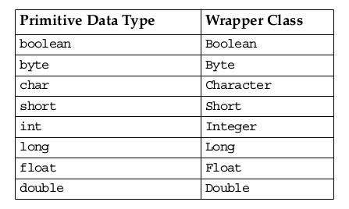
Wrapper Classes
Look at primitive data elements as objects.

Slide 41

Wrapper Classes
An example of a wrapper class is:
int pInt = 420;
Integer wInt = new Integer(pInt); // this is called boxing
int p2 = wInt.intValue(); // this is called unboxing
Other methods are:
int x = Integer.valueOf(str).intValue();
int x = Integer.parseInt(str);

Slide 42
Autoboxing of Primitive
Types
Autoboxing has the following description:
• Conversion of primitive types to the object equivalent
• Wrapper classes not always needed
• Example:
  int pInt = 420;
  Integer wInt = pInt; // this is called autoboxing
  int p2 = wInt; // this is called autounboxing
• Language feature used most often when dealing with collections
• Wrapped primitives also usable in arithmetic expressions
• Performance loss when using autoboxing

Slide 43



Stay connected
About us: Emertxe is India’s one of the top IT finishing schools & self learning kits provider. Our primary focus is on Embedded with diversification focus on Java, Oracle and Android areas
Emertxe Information Technologies,
No-1, 9th Cross, 5th Main,
Jayamahal Extension,
Bangalore, Karnataka 560046
T: +91 80 6562 9666
E: training@emertxe.com
https://www.facebook.com/Emertxe
https://twitter.com/EmertxeTweet
https://www.slideshare.net/EmertxeSlides

Slide 44
Thank You

