Slide 1

Java Programming Language SE – 6
Module 8 : Exceptions and Assertions

Slide 2
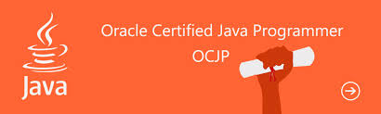
Objectives
Define exceptions
Use try, catch, and finally statements
Describe exception categories
Identify common exceptions
Develop programs to handle your own exceptions
Use assertions
Distinguish appropriate and inappropriate uses of assertions
Enable assertions at run time

Slide 3
Relevance
In most programming languages, how do you resolve runtime errors?
If you make assumptions about the way your code works, and those assumptions are wrong, what might happen?
Is it always necessary or desirable to expend CPU power testing assertions in production programs?

Slide 4

Exceptions and Assertions
Exceptions handle unexpected situations – Illegal argument, network failure, or file not found
Assertions document and test programming assumptions – This can never be negative here
Assertion tests can be removed entirely from code at runtime, so the code is not slowed down at all.

Slide 5
Exceptions
Conditions that can readily occur in a correct program are checked exceptions. These are represented by the Exception class.
Severe problems that normally are treated as fatal or situations that probably reflect program bugs are unchecked exceptions.
Fatal situations are represented by the Error class. Probable bugs are represented by the RuntimeException class.
The API documentation shows checked exceptions that
can be thrown from a method.

Slide 6
Exception Example
public class AddArguments {
public static void main(String args[]) {
int sum = 0;
for ( String arg : args ) {
sum += Integer.parseInt(arg);
}
System.out.println("Sum = " + sum);
}
}

Slide 7
Exception Example
java AddArguments 1 2 3 4
Sum = 10
java AddArguments 1 two 3.0 4
Exception in thread "main" java.lang.NumberFormatException: For input string: "two"
at java.lang.NumberFormatException.forInputString(Numb erFormatException.java:48)
at java.lang.Integer.parseInt(Integer.java:447)
at java.lang.Integer.parseInt(Integer.java:497)
at AddArguments.main(AddArguments.java:5)

Slide 8
The try-catch Statement
public class AddArguments2 {
public static void main(String args[]) {
try {
int sum = 0;
for ( String arg : args ) {
sum += Integer.parseInt(arg);
}
System.out.println("Sum = " + sum);
} catch (NumberFormatException nfe) {
System.err.println("One of the command-line "
+ "arguments is not an integer.");
}}}

Slide 9
The try-catch Statement
java AddArguments2 1 two 3.0 4
One of the command-line arguments is not an integer.

Slide 10
The try-catch Statement
public class AddArguments3 {
public static void main(String args[]) {
int sum = 0;
for ( String arg : args ) {
try {
sum += Integer.parseInt(arg);
} catch (NumberFormatException nfe) {
System.err.println("[" + arg + "] is not an integer"
+ " and will not be included in the sum.");
}
}
System.out.println("Sum = " + sum);
}}

Slide 11
The try-catch Statement
java AddArguments3 1 two 3.0 4
[two] is not an integer and will not be included in the sum.
[3.0] is not an integer and will not be included in the sum.
Sum = 5

Slide 12
The try-catch Statement
A try-catch statement can use multiple catch clauses:
try {
// code that might throw one or more exceptions
} catch (MyException e1) {
// code to execute if a MyException exception is thrown
} catch (MyOtherException e2) {
// code to execute if a MyOtherException exception is thrown
} catch (Exception e3) {
// code to execute if any other exception is thrown
}

Slide 13
Call Stack Mechanism
If an exception is not handled in the current try-catch block, it is thrown to the caller of that method.
If the exception gets back to the main method and is not handled there, the program is terminated abnormally.

Slide 14

The finally Clause
The finally clause defines a block of code that always
executes.
try {
startFaucet();
waterLawn();
} catch (BrokenPipeException e) {
logProblem(e);
} finally {
stopFaucet();
}

Slide 15
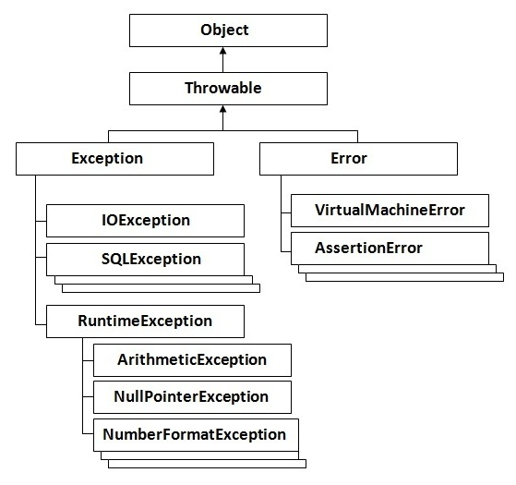
Exception Categories

Slide 16
Common Exceptions
NullPointerException
FileNotFoundException
NumberFormatException
ArithmeticException
SecurityException

Slide 17
The Handle or Declare Rule
Use the handle or declare rule as follows:
Handle the exception by using the try-catch-finally block.
Declare that the code causes an exception by using the throws clause.
  void trouble() throws IOException { ... }
  void trouble() throws IOException, MyException { ... }

Slide 18
The Handle or Declare Rule
Other Principles
You do not need to declare runtime exceptions or errors.
You can choose to handle runtime exceptions.

Slide 19
Method Overriding and Exceptions
The overriding method can throw:
No exceptions
One or more of the exceptions thrown by the overridden method
One or more subclasses of the exceptions thrown by the overridden method

Slide 20
Method Overriding and Exceptions
The overriding method cannot throw:
Additional exceptions not thrown by the overridden method
Superclasses of the exceptions thrown by the overridden method

Slide 21
Method Overriding and
Exceptions
public class TestA {
public void methodA() throws IOException {
// do some file manipulation
}}
public class TestB1 extends TestA {
public void methodA() throws EOFException {
// do some file manipulation
}}
public class TestB2 extends TestA {
public void methodA() throws Exception { // WRONG
// do some file manipulation
}}

Slide 22
Creating Your Own
Exceptions
1. Extends Exception class
2. Override toString() method
3. Define constructor.

Slide 23
Example of Override
Exception
class NegativeAgeException extends Exception{
int age;
NegativeAgeException(int age){
This.age=age;
}
Public String toString(){
Return “negative age exception:”+ age;
}
Public static void main(String[] args){
Int age =-25;
if(age<=0){throw new NegativeAgeException(age)}
else{System.ou.println(“your age is”+age)}
}}

Slide 24
Assertions
Syntax of an assertion is:
  assert <boolean_expression> ;
  assert <boolean_expression> : <detail_expression> ;
If <boolean_expression> evaluates false, then an AssertionError is thrown.
The second argument is converted to a string and used as descriptive text in the AssertionError message.

Slide 25
Recommended Uses of
Assertions
Use assertions to document and verify the assumptions and internal logic of a single method:
Internal invariants
Control flow invariants
Postconditions and class invariants

Slide 26
Recommended Uses of
Assertions
Inappropriate Uses of Assertions:
Do not use assertions to check the parameters of a public method.
Do not use methods in the assertion check that can cause side-effects.

Slide 27
Internal Invariants
The problem is:
if (x > 0) {
// do this
} else {
// do that
}

Slide 28
Internal Invariants
The solution is:
if (x > 0) {
// do this
} else {
assert ( x == 0 );
// do that, unless x is negative
}

Slide 29
Control Flow Invariants
For example:
switch (suit) {
case Suit.CLUBS: // ...
break;
case Suit.DIAMONDS: // ...
break;
case Suit.HEARTS: // ...
break;
case Suit.SPADES: // ...
break;
default: assert false : "Unknown playing card suit";
break;
}

Slide 30
Postconditions and
Class Invariants
public Object pop() {
int size = this.getElementCount();
if (size == 0) {
throw new RuntimeException("Attempt to pop from empty stack");
}
Object result = /* code to retrieve the popped element */ ;
// test the postcondition
assert (this.getElementCount() == size - 1);
return result;
}

Slide 31
Controlling Runtime
Evaluation of Assertions
If assertion checking is disabled, the code runs as fast as if the check was never there.
Assertion checks are disabled by default. Enable assertions with the following commands:
java -enableassertions MyProgram
or:
java -ea MyProgram
Assertion checking can be controlled on class, package, and package hierarchy bases, see: docs/guide/language/assert.html

Slide 32



Stay connected
About us: Emertxe is India’s one of the top IT finishing schools & self learning kits provider. Our primary focus is on Embedded with diversification focus on Java, Oracle and Android areas
Emertxe Information Technologies,
No-1, 9th Cross, 5th Main,
Jayamahal Extension,
Bangalore, Karnataka 560046
T: +91 80 6562 9666
E: training@emertxe.com
https://www.facebook.com/Emertxe
https://twitter.com/EmertxeTweet
https://www.slideshare.net/EmertxeSlides

Slide 33
Thank You

