Slide 1

Java Programming Language SE – 6
Module 9:Collections and Generics Framework

Slide 2

Objectives
Describe the Collections
Describe the general purpose implementations of the core interfaces in the Collections framework
Examine the Map interface
Examine the legacy collection classes
Create natural and custom ordering by implementing the Comparable and Comparator interfaces
Use generic collections
Use type parameters in generic classes
Refactor existing non-generic code
Write a program to iterate over a collection
Examine the enhanced for loop

Slide 3
The Collections API
A collection is a single object managing a group of objects known as its elements.
The Collections API contains interfaces that group objects as one of the following:
Collection – A group of objects called elements; implementations determine whether there is specific ordering and whether duplicates are permitted.
Set – An unordered collection; no duplicates are permitted.
List – An ordered collection; duplicates are permitted.

Slide 4
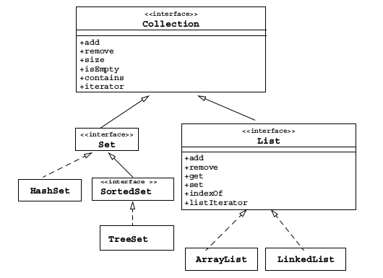
The Collections API

Slide 5
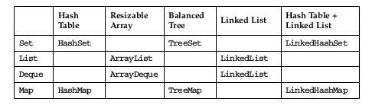
Collection Implementations
There are several general purpose implementations of the core interfaces (Set, List, Deque and Map)

Slide 6
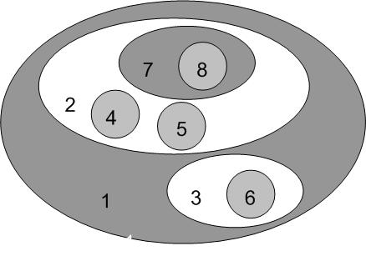
A Set Example
import java.util.*;
public class SetExample {
public static void main(String[] args) {
Set set = new HashSet();
set.add("one");
set.add("second");
set.add("3rd");
set.add(new Integer(4));
set.add(new Float(5.0F));
// duplicate, not added
set.add("second");// duplicate, not added
set.add(new Integer(4)); // duplicate, not added
System.out.println(set);
}

Slide 7
A Set Example
The output generated from this program is:
[one, second, 5.0, 3rd, 4]

Slide 8

A List Example
import java.util.*
public class ListExample {
public static void main(String[] args) {
List list = new ArrayList();
list.add("one");
list.add("second");
list.add("3rd");
list.add(new Integer(4));
list.add(new Float(5.0F));
// duplicate, is added
list.add("second");//duplicate, is added
list.add(new Integer(4)); // duplicate, is added
System.out.println(list);
}}

Slide 9
A List Example
The output generated from this program is:
[one, second, 3rd, 4, 5.0, second, 4]

Slide 10
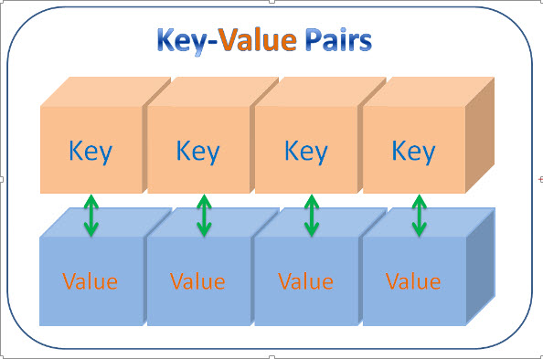
The Map Interface
Maps are sometimes called associative arrays
A Map object describes mappings from keys to values:
Duplicate keys are not allowed
One-to-many mappings from keys to values is not permitted

Slide 11
The Map Interface
The contents of the Map interface can be viewed and manipulated as collections
entrySet – Returns a Set of all the key-value pairs.
keySet – Returns a Set of all the keys in the map.
values – Returns a Collection of all values in the map

Slide 12
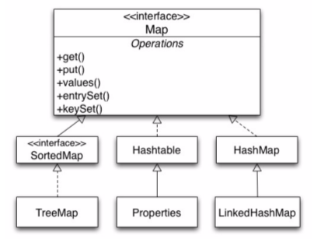
The Map Interface API

Slide 13
A Map Example
public static void main(String args[]) {
Map map = new HashMap();
map.put("one","1st");
map.put("second", new Integer(2));
map.put("third","3rd");
map.put("third","III");
Set set1 = map.keySet();
Collection collection = map.values();
Set set2 = map.entrySet();
System.out.println(set1 + "\n" + collection + "\n" + set2);
}

Slide 14
A Map Example
Output generated from the MapExample program:
[second, one, third]
[2, 1st, III]
[second=2, one=1st, third=III]

Slide 15
Legacy Collection Classes
Collections in the JDK include:
The Vector class, which implements the List interface.
The Stack class, which is a subclass of the Vector class and supports the push, pop, and peek methods.
The Hashtable class, which implements the Map interface.
The Properties class is an extension of Hashtable that only uses Strings for keys and values.
Each of these collections has an elements method that returns an Enumeration object. The Enumeration interface is incompatible with, the Iterator interface.

Slide 16
Ordering Collections
The Comparable and Comparator interfaces are useful for ordering collections:
The Comparable interface imparts natural ordering to classes that implement it.
The Comparator interface specifies order relation. It can also be used to override natural ordering.
Both interfaces are useful for sorting collections.

Slide 17
The Comparable Interface
Imparts natural ordering to classes that implement it:
Used for sorting
The compareTo method should be implemented to make any class comparable:
int compareTo(Object o) method
The String, Date, and Integer classes implement the Comparable interface
You can sort the List elements containing objects that implement the Comparable interface

Slide 18
The Comparable Interface
While sorting, the List elements follow the natural ordering of the element types
  String elements – Alphabetical order
  Date elements – Chronological order
  Integer elements – Numerical order

Slide 19
Example of the
Comparable Interface
class Student implements Comparable {
String firstName, lastName;
int studentID=0;
double GPA=0.0;
public Student(String firstName, String lastName, int studentID,
double GPA) {
if (firstName == null || lastName == null || studentID == 0
|| GPA == 0.0) {throw new IllegalArgumentException();}
this.firstName = firstName;
this.lastName = lastName;
this.studentID = studentID;
this.GPA = GPA;
}

Slide 20
Example of the
Comparable Interface
public String firstName() { return firstName; }
public String lastName() { return lastName; }
public int studentID() { return studentID; }
public double GPA() { return GPA; }
public int compareTo(Object o) {
double f = GPA-((Student)o).GPA;
if (f == 0.0)
return 0;
else if (f<0.0)
return -1;
else
return 1;
}}

Slide 21
Example of the
Comparable Interface
public static void main(String[] args) {
TreeSet studentSet = new TreeSet();
studentSet.add(new Student("Mike", "Hauffmann",101,4.0));
studentSet.add(new Student("John", "Lynn",102,2.8 ));
studentSet.add(new Student("Jim", "Max",103, 3.6));
studentSet.add(new Student("Kelly", "Grant",104,2.3));
Object[] studentArray = studentSet.toArray();
Student s;
for(Object obj : studentArray){
s = (Student) obj;
System.out.printf("Name = %s %s ID = %d GPA = %.1f\n",
s.firstName(), s.lastName(), s.studentID(), s.GPA());
}}

Slide 22
Example of the
Comparable Interface
Generated Output:
Name = Kelly Grant ID = 104 GPA = 2.3
Name = John Lynn ID = 102 GPA = 2.8
Name = Jim Max ID = 103 GPA = 3.6
Name = Mike Hauffmann ID = 101 GPA = 4.0

Slide 23
The Comparator Interface
Represents an order relation
Used for sorting
Enables sorting in an order different from the natural order
Used for objects that do not implement the Comparable interface
Can be passed to a sort method
You need the compare method to implement the Comparator interface:
  int compare(Object o1, Object o2) method

Slide 24
Example of the
Comparator Interface
class Student {
String firstName, lastName;
int studentID=0; double GPA=0.0;
public Student(String firstName, String lastName,
int studentID, double GPA) {
if (firstName == null || lastName == null || studentID == 0 ||
GPA == 0.0) throw new NullPointerException();
this.firstName = firstName;this.lastName = lastName;this.studentID = studentID;
this.GPA = GPA;
}
public String firstName() { return firstName; }public String lastName() { return lastName; }
public int studentID() { return studentID; } public double GPA() { return GPA; }
}

Slide 25
Example of the
Comparator Interface
public class NameComp implements Comparator {
public int compare(Object o1, Object o2) {
return
(((Student)o1).firstName.compareTo(((Student)o2).firstName));
}}
public class GradeComp implements Comparator {
public int compare(Object o1, Object o2) {
if (((Student)o1).GPA == ((Student)o2).GPA)
return 0;
else if (((Student)o1).GPA < ((Student)o2).GPA)
return -1;
else
return 1;
}}

Slide 26
Example of the
Comparator Interface
public class ComparatorTest {
public static void main(String[] args) {
Comparator c = new NameComp();
TreeSet studentSet = new TreeSet(c);
studentSet.add(new Student("Mike", "Hauffmann",101,4.0));
studentSet.add(new Student("John", "Lynn",102,2.8 ));
studentSet.add(new Student("Jim", "Max",103, 3.6));
studentSet.add(new Student("Kelly", "Grant",104,2.3));
Object[] studentArray = studentSet.toArray();
Student s;
for(Object obj : studentArray) {
s = (Student) obj;
System.out.println("Name = %s %s ID = %d GPA = %.1f\n",
s.firstName(), s.lastName(), s.studentID(), s.GPA());
}}

Slide 27
Example of the
Comparator Interface
The output:
Name =Jim Max ID = 0 GPA = 3.6
Name = John Lynn ID = 0 GPA = 2.8
Name = Kelly Grant ID = 0 GPA = 2.3
Name = Mike Hauffmann ID = 0 GPA = 4.0

Slide 28

Generics
Generics are described as follows:
Provide compile-time type safety
Eliminate the need for casts
Provide the ability to create compiler-checked homogeneous collections

Slide 29
Generics
Using non-generic collections:
ArrayList list = new ArrayList();
list.add(0, new Integer(42));
int total = ((Integer)list.get(0)).intValue();
Using generic collections:
ArrayList<Integer> list = new ArrayList<Integer>();
list.add(0, new Integer(42));
int total = list.get(0).intValue();

Slide 30
Generic Set Example
import java.util.*;
public class GenSetExample {
public static void main(String[] args) {
Set<String> set = new HashSet<String>();
set.add("one");
set.add("second");
set.add("3rd");
set.add(new Integer(4));
set.add("second");
System.out.println(set);
}}

Slide 31
Generic Map Example
public class MapPlayerRepository {
HashMap<String, String> players;
public MapPlayerRepository() {
players = new HashMap<String, String> ();
}
public String get(String position) {
String player = players.get(position);
return player;
}
public void put(String position, String name) {
players.put(position, name);
}

Slide 32
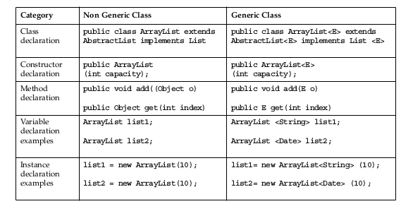
Generics: Examining
Type Parameters

Slide 33
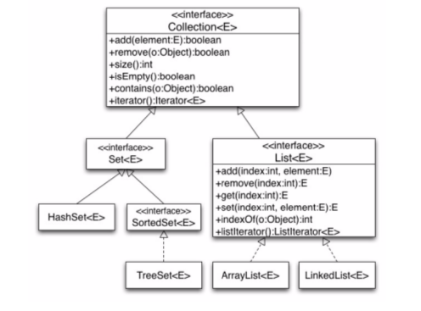
Generic Collections API

Slide 34
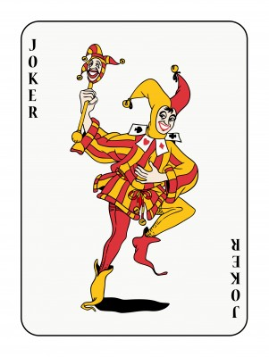
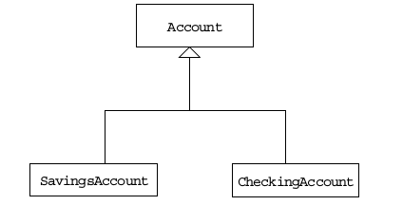
Wild Card Type Parameters

Slide 35
The Type-Safety Guarantee
public class TestTypeSafety {
public static void main(String[] args) {
List<CheckingAccount> lc = new ArrayList<CheckingAccount>();
lc.add(new CheckingAccount("Fred")); // OK
lc.add(new SavingsAccount("Fred")); // Compile error!
CheckingAccount ca = lc.get(0);
}
}

Slide 36
The Invariance Challenge
List<Account> la;
List<CheckingAccount> lc = new ArrayList<CheckingAccount>();
List<SavingsAccount> ls = new ArrayList<SavingsAccount>();
la = lc;
la.add(new CheckingAccount("Fred"));
la = ls;
la.add(new CheckingAccount("Fred"));
SavingsAccount sa = ls.get(0); //aarrgghh!!

Slide 37
The Invariance Challenge
In fact, la=lc; is illegal, so even though a CheckingAccount
is an Account, an ArrayList<CheckingAccount> is not an
ArrayList<Account>.

Slide 38
The Covariance Response
public static void printNames(List <? extends Account> lea) {
for (int i=0; i < lea.size(); i++) {
System.out.println(lea.get(i).getName());
}
}
public static void main(String[] args) {
List<CheckingAccount> lc = new ArrayList<CheckingAccount>();
List<SavingsAccount> ls = new ArrayList<SavingsAccount>();
printNames(lc);
printNames(ls);
List<? extends Object> leo = lc; //OK
leo.add(new CheckingAccount("Fred"));//Compile error!
}}

Slide 39
Generics: Refactoring
Existing Non-Generic Code
import java.util.*;
public class GenericsWarning {
public static void main(String[] args) {
List list = new ArrayList();
list.add(0, new Integer(42));
int total = ((Integer)list.get(0).intValue();
}}

Slide 40
Generics: Refactoring
Existing Non-Generic Code
javac GenericsWarning.java
Note: GenericsWarning.java uses unchecked or unsafe operations.
Note: Recompile with -Xlint:unchecked for details.
javac -Xlint:unchecked GenericsWarning.java
GenericsWarning.java:7: warning: [unchecked] unchecked call to add(int,E) as a member of the raw type java.util.ArrayList
  list.add(0, new Integer(42));
1 warning

Slide 41
Iterators
Iteration is the process of retrieving every element in a collection.
The basic Iterator interface allows you to scan forward through any collection.
A List object supports the ListIterator, which allows you to scan the list backwards and insert or modify elements.

Slide 42
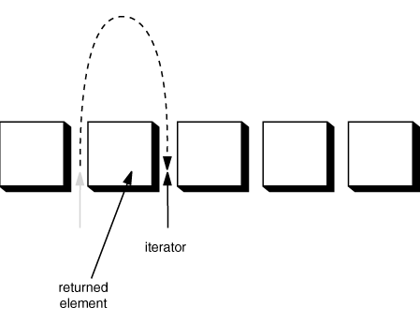
Iterators
List<Student> list = new ArrayList<Student>();
// add some elements
Iterator<Student> elements = list.iterator();
while (elements.hasNext()) {
System.out.println(elements.next());
}

Slide 43
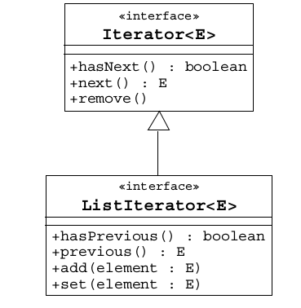
Generic Iterator Interfaces

Slide 44
The Enhanced for Loop
The enhanced for loop has the following characteristics:
  Simplified iteration over collections
  Much shorter, clearer, and safer
  Effective for arrays
  Simpler when using nested loops
  Iterator disadvantages removed
Iterators are error prone:
  Iterator variables occur three times per loop.
  This provides the opportunity for code to go wrong.

Slide 45
The Enhanced for Loop
An enhanced for loop can look like the following:
Using the iterator with a traditional for loop:
public void deleteAll(Collection<NameList> c){
for ( Iterator<NameList> i = c.iterator() ; i.hasNext() ; ){
NameList nl = i.next();
nl.deleteItem();
}}

Slide 46
The Enhanced for Loop
Iterating using an enhanced for loop in collections:
public void deleteAll(Collection<NameList> c){
for ( NameList nl : c ){
nl.deleteItem();
}}

Slide 47
The Enhanced for Loop
Nested enhanced for loops:
List<Subject> subjects=...;
List<Teacher> teachers=...;
List<Course> courseList = ArrayList<Course)();
for (Subject subj: subjects) {
for (Teacher tchr: teachers) {
courseList.add(new Course(subj, tchr));
}}

Slide 48



Stay connected
About us: Emertxe is India’s one of the top IT finishing schools & self learning kits provider. Our primary focus is on Embedded with diversification focus on Java, Oracle and Android areas
Emertxe Information Technologies,
No-1, 9th Cross, 5th Main,
Jayamahal Extension,
Bangalore, Karnataka 560046
T: +91 80 6562 9666
E: training@emertxe.com
https://www.facebook.com/Emertxe
https://twitter.com/EmertxeTweet
https://www.slideshare.net/EmertxeSlides

Slide 49
Thank You

