Slide 1

Java Programming Language SE – 6
Module 10: I/O Fundamentals

Slide 2

Objectives
Write a program that uses command-line arguments and system properties
Examine the Properties class
Construct node and processing streams, and use them appropriately
Serialize and deserialize objects
Distinguish readers and writers from streams, and select appropriately between them

Slide 3
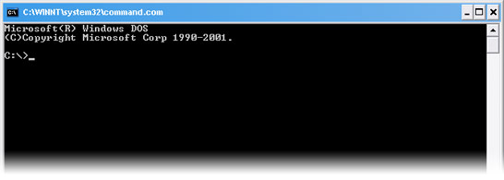
Command-Line Arguments
Any Java technology application can use command-line arguments.
These string arguments are placed on the command line to launch the Java interpreter after the class name:
java TestArgs arg1 arg2 "another arg"
Each command-line argument is placed in the args array that is passed to the static main method:
public static void main(String[] args)

Slide 4
Command-Line Arguments
public class TestArgs {
public static void main(String[] args) {
for ( int i = 0; i < args.length; i++ ) {
System.out.println("args[" + i + "] is ’" + args[i] + "’");
}}}
Example execution:
java TestArgs arg0 arg1 "another arg"
args[0] is ’arg0’
args[1] is ’arg1’
args[2] is ’another arg’

Slide 5

System Properties
System properties are a feature that replaces the concept of environment variables (which are platform-specific).
The System.getProperties method returns a Properties object.
The getProperty method returns a String representing the value of the named property.
Use the -D option on the command line to include a new property.

Slide 6
The Properties Class
The Properties class implements a mapping of names to values (a String-to-String map).
The propertyNames method returns an Enumeration of all property names.
The getProperty method returns a String representing the value of the named property.
You can also read and write a properties collection into a file using load and store.

Slide 7
The Properties Class
import java.util.Properties;
import java.util.Enumeration;
public class TestProperties {
public static void main(String[] args) {
Properties props = System.getProperties();
props.list(System.out);
}
}

Slide 8
The Properties Class
The following is an example test run of this program:
java -DmyProp=theValue TestProperties
The following is the (partial) output:
java.runtime.name=Java(TM) SE Runtime Environment
sun.boot.library.path=C:\jse\jdk1.6.0\jre\bin
java.vm.version=1.6.0-b105
java.vm.vendor=Sun Microsystems Inc.
java.vm.name=Java HotSpot(TM) Client VM
file.encoding.pkg=sun.io
user.country=US
myProp=theValue

Slide 9
I/O Stream Fundamentals
A stream is a flow of data from a source or to a sink.
A source stream initiates the flow of data, also called an input stream.
A sink stream terminates the flow of data, also called an output stream.
Sources and sinks are both node streams.
Types of node streams are files, memory, and pipes between threads or processes.

Slide 10
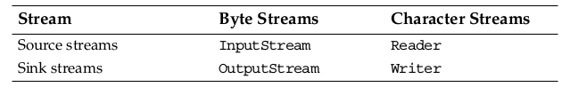
Fundamental Stream
Classes

Slide 11
Data Within Streams
Java technology supports two types of streams: character and byte.
Input and output of character data is handled by readers and writers.
Input and output of byte data is handled by input streams and output streams:
Normally, the term stream refers to a byte stream.
The terms reader and writer refer to character streams.

Slide 12
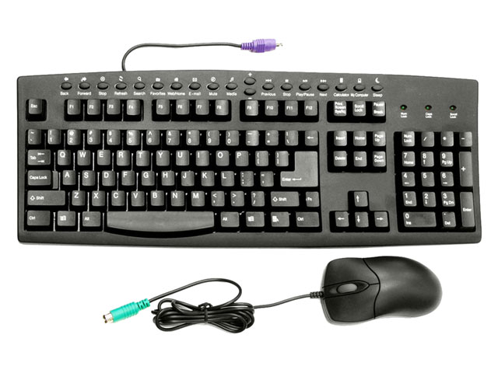
The InputStream Methods
The three basic read methods are:
  int read()
  int read(byte[] buffer)
  int read(byte[] buffer, int offset, int length)
Other methods include:
  void close()
  int available()
  long skip(long n)
  boolean markSupported()
  void mark(int readlimit)
  void reset()

Slide 13

The OutputStream Methods
The three basic write methods are:
  void write(int c)
  void write(byte[] buffer)
  void write(byte[] buffer, int offset, int length)
Other methods include:
  void close()
  void flush()

Slide 14
The Reader Methods
The three basic read methods are:
  int read()
  int read(char[] cbuf)
  int read(char[] cbuf, int offset, int length)
Other methods include:
  void close()
  boolean ready()
  long skip(long n)
  boolean markSupported()
  void mark(int readAheadLimit)
  void reset()

Slide 15
The Writer Methods
The basic write methods are:
  voidwrite(int c)
  Void write(char[] cbuf)
  Void write(char[]cbuf, int offset, int length)
  Void write(String string)
  Void write(String string, int offset, int length)
Other methods include:
  void close()
  void flush()

Slide 16
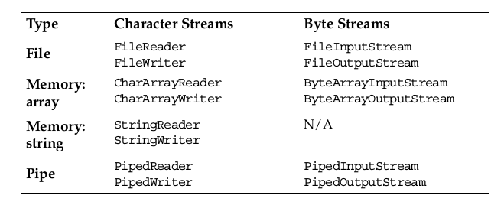
Node Streams

Slide 17
A Simple Example
This program performs a copy file operation using a manual
buffer: java TestNodeStreams file1 file2
public static void main(String[] args) {
try {
FileReader input = new FileReader(args[0]);
try {
FileWriter output = new FileWriter(args[1]);
try {
char[] buffer = new char[128];
int charsRead;
charsRead = input.read(buffer);
while ( charsRead != -1 ) {
// next slide

Slide 18
A Simple Examples
output.write(buffer, 0, charsRead);
charsRead = input.read(buffer);
}
} finally {
output.close();}
} finally {
input.close();}
} catch (IOException e) {
e.printStackTrace();
}}

Slide 19
Buffered Streams
This program performs a copy file operation using a built-in buffer: java TestBufferedStreams file1 file2
public static void main(String[] args) {
try {
FileReader input = new FileReader(args[0]);
BufferedReader bufInput = new BufferedReader(input);
try {
FileWriter output = new FileWriter(args[1]);
BufferedWriter bufOutput= new BufferedWriter(output);
try {
String line;
line = bufInput.readLine();
while ( line != null ) {

Slide 20
Buffered Streams
bufOutput.write(line, 0, line.length());
bufOutput.newLine();
line = bufInput.readLine();
}
} finally {
bufOutput.close();
}
} finally {
bufInput.close();
}
} catch (IOException e) {
e.printStackTrace();
}}

Slide 21
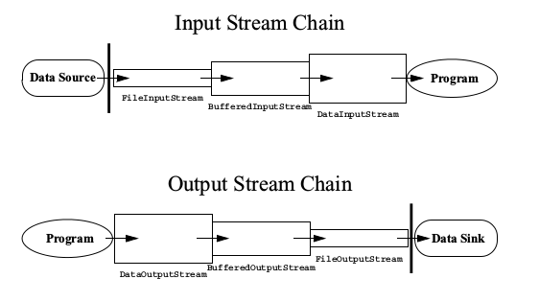
I/O Stream Chaining

Slide 22
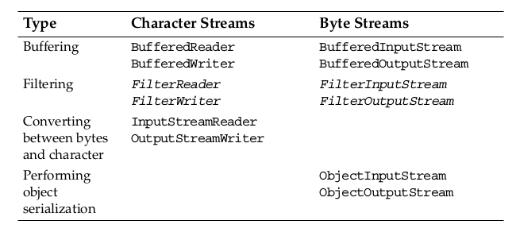
Processing Streams

Slide 23
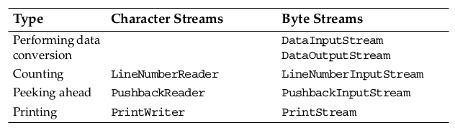
Processing Streams

Slide 24
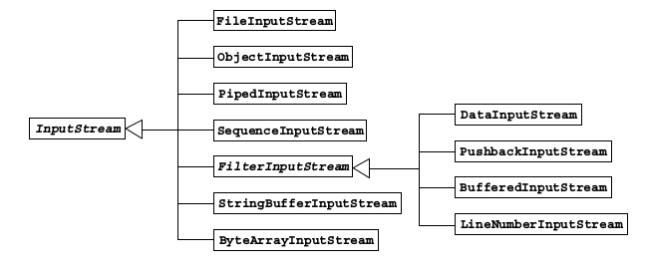
The InputStream
Class Hierarchy

Slide 25
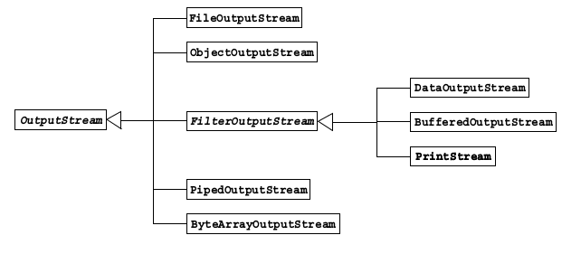
The OutputStream
Class Hierarchy

Slide 26
The ObjectInputStream and
The ObjectOutputStream
Classes
The Java API provides a standard mechanism (called object serialization) that completely automates the process of writing and reading objects from streams.
When writing an object, the object input stream writes the class name, followed by a description of the data members of the class, in the order they appear in the stream, followed by the values for all the fields on that object.

Slide 27
The ObjectInputStream and
The ObjectOutputStream
Classes
When reading an object, the object output stream reads the name of the class and the description of the class to match against the class in memory, and it reads the values from the stream to populate a newly allocation instance of that class.
Persistent storage of objects can be accomplished if files (or other persistent storage) are used as streams.

Slide 28
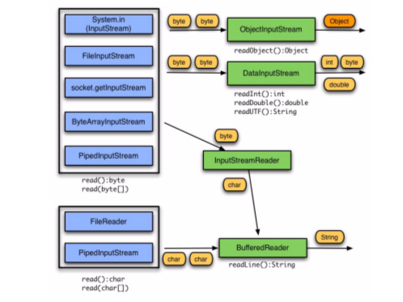
Input Chaining
Combinations: A Review

Slide 29
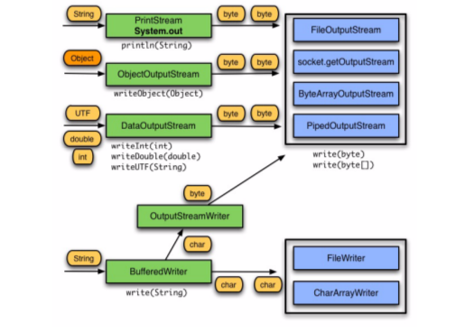
Output Chaining
Combinations: A Review

Slide 30
Serialization
Serialization is a mechanism for saving the objects as a sequence of bytes and rebuilding them later when needed.
When an object is serialized, only the fields of the object are preserved
When a field references an object, the fields of the referenced object are also serialized
Some object classes are not serializable because their fields represent transient operating system-specific information.

Slide 31
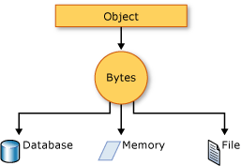
The SerializeDate Class
public class SerializeDate implements Serializable{
SerializeDate() {
Date d = new Date ();
try {
FileOutputStream f =
new FileOutputStream ("date.ser");
ObjectOutputStream s =
new ObjectOutputStream (f);
s.writeObject (d);
s.close ();
} catch (IOException e) {
e.printStackTrace ();
}

Slide 32
The SerializeDate Class
public static void main (String args[]) {
new SerializeDate();
}}

Slide 33
The DeSerializeDate Class
public class DeSerializeDate {
DeSerializeDate () {
Date d = null;
try {
FileInputStream f =
new FileInputStream ("date.ser");
ObjectInputStream s =
new ObjectInputStream (f);
d = (Date) s.readObject ();
s.close ();
} catch (Exception e) {
e.printStackTrace ();
}

Slide 34
The SerializeDate Class
public class SerializeDate implements Serializable{
SerializeDate() {
Date d = new Date ();
try {
FileOutputStream f =
new FileOutputStream ("date.ser");
ObjectOutputStream s =
new ObjectOutputStream (f);
s.writeObject (d);
s.close ();
} catch (IOException e) {
e.printStackTrace ();
}

Slide 35
The DeSerializeDate Class
System.out.println(
"Deserialized Date object from date.ser");
System.out.println("Date: "+d);
}
public static void main (String args[]) {
new DeSerializeDate();
}}

Slide 36
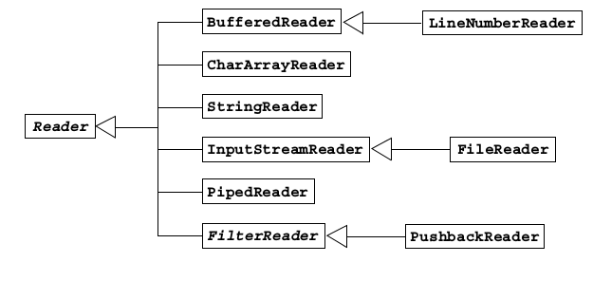
The Reader Class Hierarchy

Slide 37
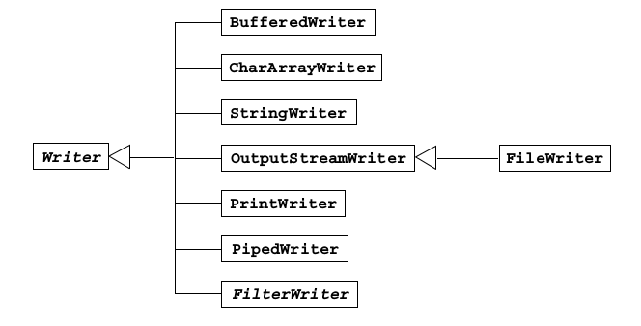
The Writer Class Hierarchy

Slide 38



Stay connected
About us: Emertxe is India’s one of the top IT finishing schools & self learning kits provider. Our primary focus is on Embedded with diversification focus on Java, Oracle and Android areas
Emertxe Information Technologies,
No-1, 9th Cross, 5th Main,
Jayamahal Extension,
Bangalore, Karnataka 560046
T: +91 80 6562 9666
E: training@emertxe.com
https://www.facebook.com/Emertxe
https://twitter.com/EmertxeTweet
https://www.slideshare.net/EmertxeSlides

Slide 39
Thank You

