Slide 1

Java Programming Language SE – 6
Module 12: Building Java GUIs Using the Swing API

Slide 2

Objectives
Describe the JFC Swing technology
Define Swing
Identify the Swing packages
Describe the GUI building blocks: containers,
components, and layout managers
Examine top-level, general-purpose, and special-
purpose properties of container
Examine components
Examine layout managers
Describe the Swing single-threaded model
Build a GUI using Swing components

Slide 3
What Are the Java
Foundation Classes (JFC)?
Java Foundation Classes are a set of Graphical User Interface (GUI) support packages, including:
  Abstract Window Toolkit (AWT)
  The Swing component set
  2D graphics
  Pluggable look-and-feel
  Accessibility
  Drag-and-drop
  Internationalization

Slide 4
What Is Swing?
An enhanced GUI component set
Provides replacement components for those in the original AWT
Has special features, such as a pluggable look-and feel

Slide 5
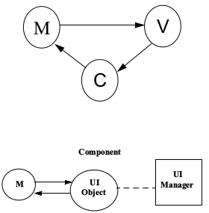
Swing Architecture
Has its roots in the
Model-View-Controller
(MVC) architecture
The Swing components
follow Separable Model
Architecture

Slide 6
Swing Packages
Package Name
  javax.swing
  javax.swing.border
  javax.swing.event
  javax.swing.undo
  javax.swing.plaf
  javax.swing.plaf.basic
  javax.swing.plaf.metal
  javax.swing.plaf.multi
  javax.swing.plaf.synth

Slide 7
Swing Packages
Package Name
  javax.swing.colorchooser
  javax.swing.filechooser
  javax.swing.table
  javax.swing.tree
  javax.swing.text
  javax.swing.text.html
  javax.swing.text.html.parser
  javax.swing.text.rtf
  javax.swing.undo

Slide 8
Examining the Composition of a Java Technology GUI
A Swing API-based GUI is composed of the following elements:
  Containers – Are on top of the GUI containment hierarchy.
  Components – Contain all the GUI components that are derived from the JComponent class.
  Layout Managers – Are responsible for laying out components in a container.

Slide 9
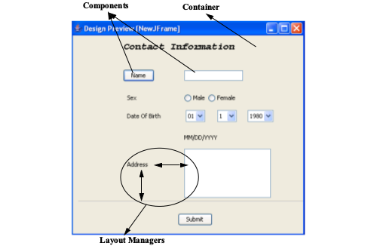
Examining the Composition of a Java Technology GUI

Slide 10
Swing Containers
Swing containers can be classified into three main categories:
Top-level containers:
  JFrame, JWindow, and JDialog
General-purpose containers:
  JPanel, JScrollPane,JToolBar,JSplitPane, and JTabbedPane
Special-purpose containers:
  JInternalFrame and JLayeredPane

Slide 11
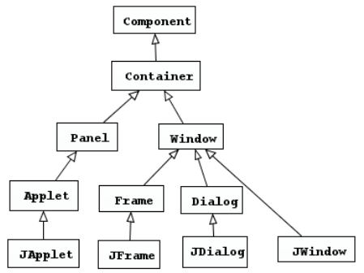
Top-Level Containers

Slide 12
Swing Components
Swing components can be broadly classified as:
Buttons
Text components
Uneditable information display components
Menus
Formatted display components
Other basic controls

Slide 13
Text Components
Swing text components can be broadly divided into three categories.
Text controls – JTextField, JPasswordField (for user input)
Plain text areas – JTextArea (displays text in plain text, also for multi-line user input
Styled text areas – JEditorPane, JTextPane (displays formatted text)

Slide 14
Swing Component
Properties
Common component properties:
  All the Swing components share some common properties because they all extend Jcomponent.
Component-specific properties:
  Each component defines more specific properties.

Slide 15
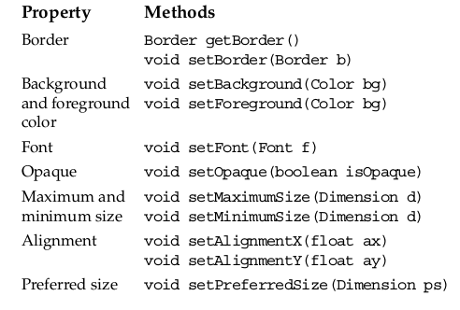
Common Component
Properties

Slide 16
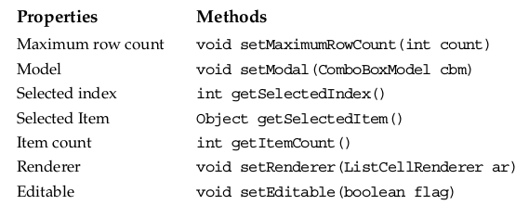
Component-Specific
Properties

Slide 17
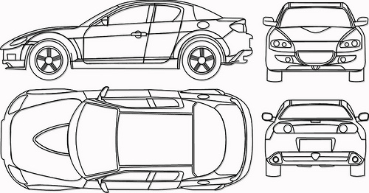
Layout Managers
Handle problems caused by:
  GUI resizing by user
  Operating system differences in fonts
  Locale-specific text layout requirements

Slide 18
Layout Managers
Layout manager classes:
  BorderLayout
  FlowLayout
  BoxLayout
  CardLayout
  GridLayout
  GridBagLayout

Slide 19
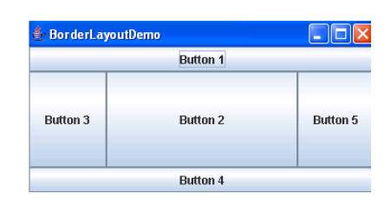
The BorderLayout Manager
The BorderLayout manager places components in top,bottom, left, right and center locations.

Slide 20
BorderLayout Example
import java.awt.*;
import javax.swing.*;
public class BorderExample {
private JFrame f;
private JButton bn, bs, bw, be, bc;
public BorderExample() {
f = new JFrame("Border Layout");
bn = new JButton("Button 1");
bc = new JButton("Button 2");
bw = new JButton("Button 3");
bs = new JButton("Button 4");
be = new JButton("Button 5");}

Slide 21
BorderLayout Example
public void launchFrame() {
f.add(bn, BorderLayout.NORTH);
f.add(bs, BorderLayout.SOUTH);
f.add(bw, BorderLayout.WEST);
f.add(be, BorderLayout.EAST);
f.add(bc, BorderLayout.CENTER);
f.setSize(400,200);
f.setVisible(true);
}
public static void main(String args[]) {
BorderExample guiWindow2 = new BorderExample();
guiWindow2.launchFrame();
}}

Slide 22
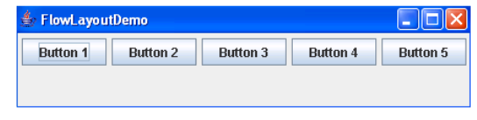
The FlowLayout Manager
The FlowLayout manager places components in a row, and if the row fills, components are placed in the next row.

Slide 23
FlowLayout Example
public class LayoutExample {
private JFrame f;
private JButton b1;
private JButton b2;
private JButton b3;
private JButton b4;
private JButton b5;
public LayoutExample() {
f = new JFrame("GUI example");
b1 = new JButton("Button 1");
b2 = new JButton("Button 2");
b3 = new JButton("Button 3");
b4 = new JButton("Button 4");
b5 = new JButton("Button 5");
}

Slide 24
FlowLayout Example
public void launchFrame() {
f.setLayout(new FlowLayout());
f.add(b1);
f.add(b2);
f.add(b3);
f.add(b4);
f.add(b5);
f.pack();
f.setVisible(true);
}
public static void main(String args[]) {
LayoutExample guiWindow = new LayoutExample();
guiWindow.launchFrame();
}}

Slide 25
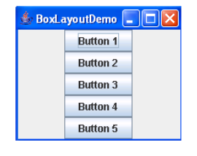
The BoxLayout Manager
The BoxLayout manager add components from left to right, and from top to bottom in a single row of column.

Slide 26
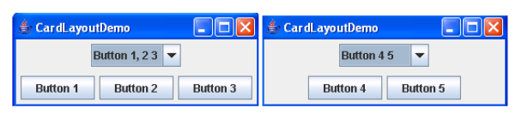
The CardLayout Manager
The CardLayout manager places the components in different cards. Cards are usually controlled by a combo box.

Slide 27
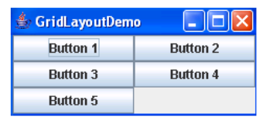
The GridLayout Manager
The GridLayout manager places components in rows and columns in the form of a grid.

Slide 28
GridLayout Example
import java.awt.*;
import javax.swing.*;
public class GridExample {
private JFrame f;
private JButton b1, b2, b3, b4, b5;
public GridExample() {
f = new JFrame("Grid Example");
b1 = new JButton("Button 1");
b2 = new JButton("Button 2");
b3 = new JButton("Button 3");
b4 = new JButton("Button 4");
b5 = new JButton("Button 5");}

Slide 29
GridLayout Example
public void launchFrame() {
f.setLayout (new GridLayout(3,2));
f.add(b1);
f.add(b2);
f.add(b3);
f.add(b4);
f.add(b5);
f.pack();
f.setVisible(true);}
public static void main(String args[]) {
GridExample grid = new GridExample();
grid.launchFrame();
}}

Slide 30
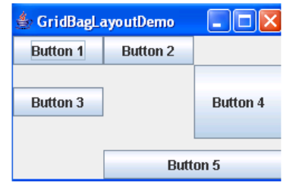
The GridBagLayout
Manager
The GridBagLayout manager arranges components in rows and columns, similar to a grid layout, but provides a wide variety of options for resizing and positioning the components.

Slide 31

GUI Construction
Programmatic
GUI builder tool

Slide 32
Programmatic Construction
import javax.swing.*;
public class HelloWorldSwing {
private static void createAndShowGUI() {
JFrame frame = new JFrame("HelloWorldSwing");
//Set up the window.
frame.setDefaultCloseOperation(JFrame.EXIT_ON_CLOSE);
JLabel label = new JLabel("Hello World");
// Add Label
frame.add(label);
frame.setSize(300,200);
// Display Window
frame.setVisible(true);}

Slide 33
Programmatic Construction
public static void main(String[] args) {
javax.swing.SwingUtilities.invokeLater(new Runnable() {
//Schedule for the event-dispatching thread:
//creating,showing this app's GUI.
public void run() {createAndShowGUI();}
});
}
}

Slide 34
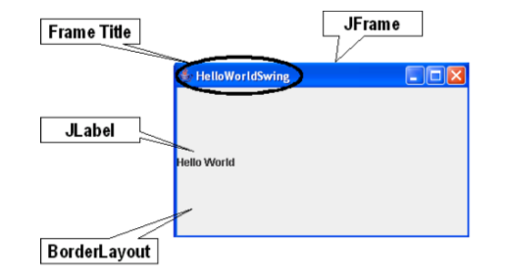
Programmatic Construction

Slide 35

Key Methods
Methods for setting up the JFrame and adding JLabel:
setDefaultCloseOperationJFrame.EXIT_ON_CLOSE)
–Creates the program to exit when the close button is clicked.
setVisible(true)– Makes the JFrame visible.
add(label)– JLabel is added to the content pane not to the JFrame directly.

Slide 36
Key Methods
Tasks:
  Executing GUI application code, such as rendering
  Handling GUI events
  Handling time consuming (background) processes
The SwingUtilities class:
  SwingUtilites.invokeLater(new Runnable())

Slide 37



Stay connected
About us: Emertxe is India’s one of the top IT finishing schools & self learning kits provider. Our primary focus is on Embedded with diversification focus on Java, Oracle and Android areas
Emertxe Information Technologies,
No-1, 9th Cross, 5th Main,
Jayamahal Extension,
Bangalore, Karnataka 560046
T: +91 80 6562 9666
E: training@emertxe.com
https://www.facebook.com/Emertxe
https://twitter.com/EmertxeTweet
https://www.slideshare.net/EmertxeSlides

Slide 38
Thank You

